Slide 1
Resilience in Challenging Times
Using our strengths and resources in coping with the challenge of working from home how to mind our mental health whilst staying motivated
Bláthnaid McCabe
M.Soc.Sc. M.Sc.
Reachout Psychotherapy

Slide 2
Aims of presentation
Resilience and humans go hand in hand
Understanding Motivation & Procrastination
Some thoughts on stress & anxiety
Working from home – issues to consider
5 a day for Mental Health
Useful resources

Slide 3
Being resilient during
Covid-19
Resilience is the human capacity to endure, to overcome, to adapt and to be transformed by life’s adversities
Humans are very adept at finding ways to turn to our own sense of feeling strong, and being in control during uncertainty
Notes:
During times like this, it’s natural to feel afraid, anxious, or threatened. The brain has evolved to react quickly to threats, and it’s easy for there to be a sense of helplessness associated with problems that appear far beyond our control.
But being consumed by fear causes wear and tear on the body, which actually undermines your safety. That’s why it’s so important to look for ways to be effective and express our agency, even if it’s only through how we choose to think about things.

Slide 4
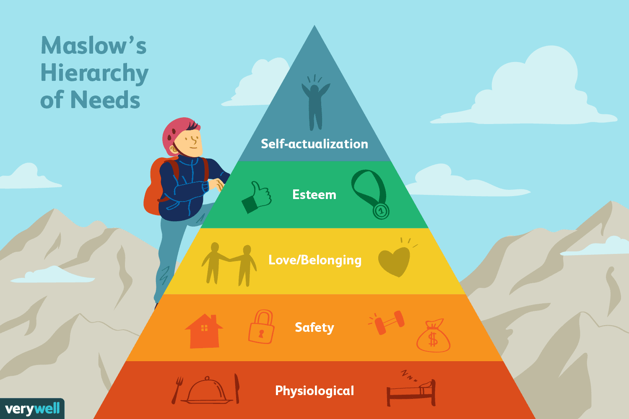
Maslow’s hierarchy of needs
(Abraham Maslow, Psychologist, 1943)
Humans are inherently motivated to better themselves and move toward expressing their full potential
People reach the pinnacle of growth and find the highest meaning in life by attending to things beyond the self
Notes:
Maslow’s Hierarchy of needs is a really useful template to help us understand the layers of human evolvement and human endeavour and no more that in hard times

Slide 5
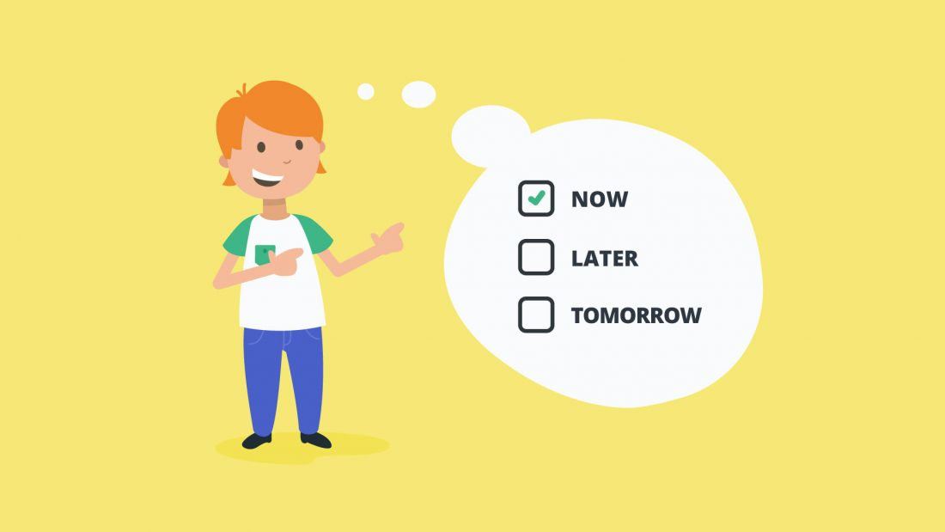
Procrastination..
Everyone has had experience with putting off stuff (forms, bills, phone calls, work tasks!)
WHY?

Slide 6
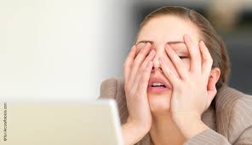
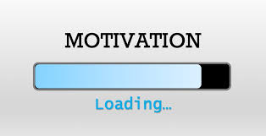
Staying motivated can be hard!
I don't feel like it" takes precedence over goals
Sometimes the goal seems too big
Sometimes the goal is unclear
You may be lacking confidence, rather than motivation, and may be afraid to proceed.
Or you may be tired/burned out and may need a rest to re-group
Perfectionism and procrastination can be linked to fear of failure.
Notes:
If you inherently doubt your ability to accomplish the task at hand, you may feel anxiously motivated but incapable of taking action. It is in the gap between motivation and execution that many forms of self-sabotage and self-doubt lie, and it is important to identify what thought processes intercept the pipeline to goal achievement.

Slide 7

Top 10 tips to Motivate…
Scheduling is key
Think positively that you can do it, because you can - you only need to convince yourself
Avoid triggers that initiate old behaviours
Take one step at a time to build to your goal
Have patience with yourself
Notes:
Activities the things you enjoy (pleasant), accomplishments (it feels good to get it done) the projects of the day overcoming avoidance- the steps to get it done. The 3 As based on Behavioural Activation also useful for families during lockdown who are struggling to cope with no routine (ACES achievements, closeness and enjoyment)

Slide 8
How to Overcome Procrastination
Take Action | Sometimes just doing something creates the momentum to continue, so just do something to get you started which will naturally lead to more…
Visualise it | Visualise or rehearse in your imagination finishing the task and feeling pleased with yourself.
Salami Technique | Slice a task or goal down by function and time, getting down to smallest unit. Breaking it down into smaller tasks, makes it much more manageable.
Five minutes Worst First | Spending just 5 minutes at the task, once started, may as well keep going! Start with the most difficult task first
Notes:
Take action, that way the rest is much easier because the hard part is already done! Do this when you are at your best, ie: Morning?

Slide 9
How to overcome Procrastination
Keep motivated | Keep yourself motivated by writing down your personal goals and posting them around the place where you can see them on a regular basis.
Get support | Get help from other people, team, colleague - start meetings with a check in
Pep talk | Give yourself a pep talk. Remind yourself of the benefits of getting the task done. Think positively that you can do it, because you can - you only need to convince yourself
Organise yourself | Surround yourself physically with items associated with the task. Keep your work space organised (limited distractions, things you need to hand).
Mistakes | Don’t worry about making mistakes -you learn and grow (growth mindset)
Avoid negative thinking | Thinking you’re not good enough or that everyone else is doing a better job or that you’ll never get it all done is not helpful, try to encourage and support yourself instead.

Slide 10
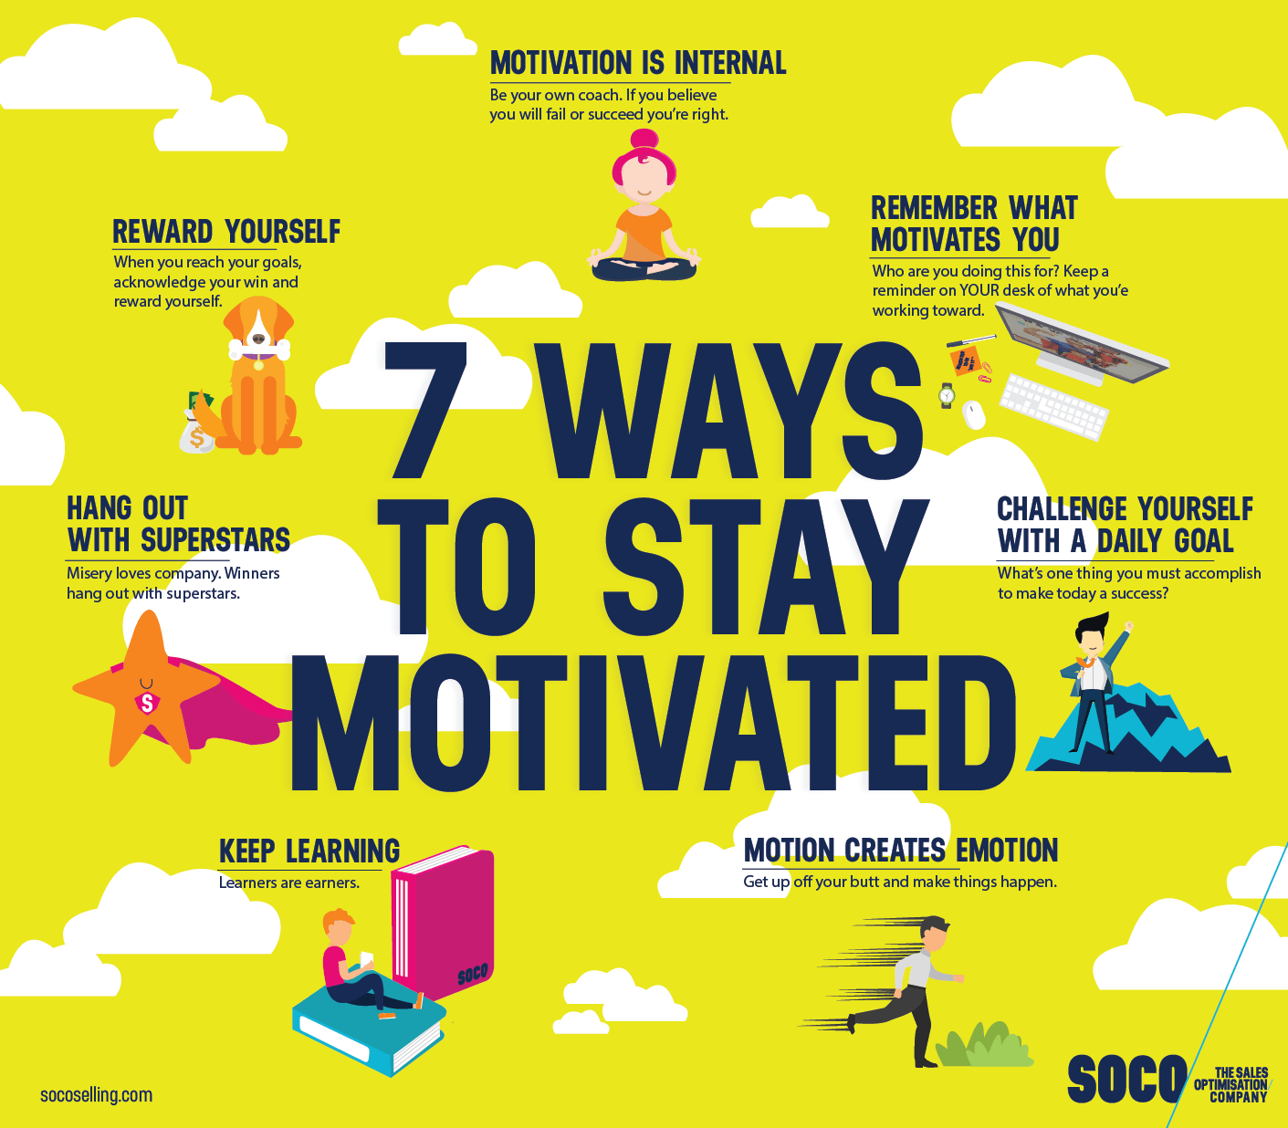

Slide 11
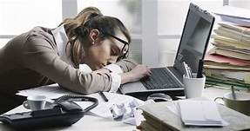
Hard day at the office

Slide 12
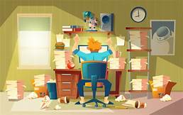
Day from hell!
When feeling overwhelmed working from home:
  We loose energy and feel tired
  We loose short term memory and forget simple things
  Return to primitive thinking and survival mode
  Stress eats your energy
Notes:
We lose ability to problem solve and we lose creativity
Just want to get through this meeting, p/c task

Slide 13
Stress Management & Self Care
Two pronged approach quick recovery when having a bad day at the office (stress management)
Self-regulation strategies for calming anxiety (long-term) - breathing, self care & turning of our over active (anxious) brain
All really relevant during Covid-19
Notes:
Press the pause button

Slide 14
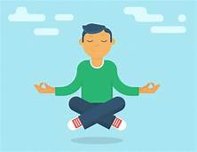
Recovery

Slide 15
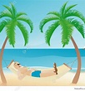
60 second recovery
Recovery breaks for 1-5 mins every hour
Examples: tidy, filing, reading, chatting, stretching, walking, posture, petting dog, movement breaks, standing….. list is endless
Most importantly of all: BREATHING
Intervals & bridges between home and work
The key to resilience is effort, reflecting on what’s not going well, stopping, recovering ‘properly’ and returning to work again
Tune into your own self of feeling strong
Notes:
You need to recover to have energy for the rest of your day otherwise you will be worn out by the end of the day, how many people feel more tired after a day at home compared to the hectic day of the office. Stopping work and going straight back to homelife is not recovery, crashing to bed feeling exhausted is not recovery, doing something that absorbs you, energises you is recovery. This requires a bit of discipline

Slide 16
Why are we all feeling so tired right now?
Huge amount of change
Emotional exhaustion
Slower pace and reduced movement
Sleep disturbance
Motivation up and down
Exposure to news
EXHAUSTING!!
More later on sleep….
Notes:
Many different emotions in our bodies, holding emotions of others, as a family member, we’re constantly thinking right now, problem solving, focused concentration on our pcs eye fatigue, its intense we are communicating differently, we are primed to socially connect

Slide 17
Stress
Stress is part of normal life everyone experiences it
However, sometimes it can seriously impact our Q.o.L
Stressors include:
Relationships
Work-related issues/demands
Juggling your own needs and needs of others
Change
The future
Loneliness/Isolation also cause stress

Slide 18
Scaling
Pick a number between 0-10 that best describes how much stress you have been experiencing in the past week including today.
Adapted from the NCCN distress thermometer.

Slide 19
Symptoms of stress
Irritability or moodiness
Interrupted sleep
Worrying or feeling of anxiety
Back and neck pain
Frequent headaches
Upset stomach
Increased blood pressure
Changes in appetite
Rashes or skin breakouts
Chest pains
Existing physical problems worse
More susceptible to cold/flu and slower recovery

Slide 20
Notes:
Anyone remember feeling like this?

Slide 21


Slide 22

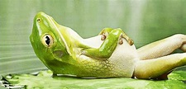
Balance
Not all stress is negative... It can have benefits
Much of the stress we experience can be helpful and stimulating
It can motivate us – nothing like a deadline to motivate!
NB - stress is only harmful when it is excessive!!

Slide 23
Stress Management Tips
1) Identify your stressors –can you find solutions or manage things better?
2) Build regular exercise into your life –healthy body, healthy mind, gives you more energy and it helps us relax and unwind.
3)Diet –pay attention to your diet, we literally are what we eat, try to make healthier choices.
4)Sleep–Create healthy patterns of sleep
5) Take time out - take deliberate steps to have time out
-take your coffee break, lunch break
-set aside regular time to connect with people
-take time to enjoy an interest/hobby
6) Problem-solving techniques can be a useful
-clarify the problem
-brainstorming possible solutions
-list pros and cons of each option
-choose one and put it into action
7) Learn calming techniques such as controlled breathing and progressive muscle relaxation, to train your mind and body to become more relaxed.
8) Tackle negative thinking which may be contributing to your stress. Negative thinking can spiral…

Slide 24

Anxiety

Slide 25
Definition
When we’re very anxious, we have intense feelings of worry or distress that are not easy to control. Anxiety can interfere with how we go about our everyday lives, and make it hard to cope with ‘normal’ challenges.
Anxiety is the most common mental health conditions. Up to one-third of women and one-fifth of men will experience anxiety at some point in their lives.
Sometimes severe anxiety can develop over time and we may not notice how it’s affecting us. Someone else may notice first.
(Black Dog Institute)
Notes:
You might be feeling:
very worried or afraid most of the time
tense and on edge
nervous or scared
panicky
irritable, agitated
worried you’re going crazy
detached from your body
feeling like you may vomit.
You may be thinking:
‘everything’s going to go wrong’
‘I might die’
‘I can’t handle the way I feel’
‘I can’t focus on anything but my worries’
‘I don’t want to go out today’
‘I can’t calm myself down’.
You may also be experiencing:
sleep problems (can’t get to sleep, wake often)
pounding heart
sweating
‘pins and needles’
tummy aches, churning stomach
lightheadedness, dizziness
twitches, trembling
problems concentrating
excessive thirst.

Slide 26
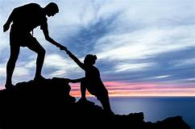
The Good News

Slide 27
Managing anxiety
So many resources available to us right now
Internal (our own strengths, and how we have overcome challenges in the past, personality factors, family friends, work colleagues)
‘5 a day’ for mental health
Breathing
Mindfulness
APPS/BLOGS/Public resources
Formal services
See resources at end

Slide 28
Awareness/Breathing/Self soothing - CRUCIAL
Be aware of the ongoing background trickle of anxiety in your mind
Try to relax some, remind yourself that you are actually alright right now
Most of the signals coming into the brain originate inside the body, not from out there in the world
Regulate by soothing your mind and body
Take a deep breath and feel each part of it
Noticing that you are basically OK, and letting go of tension and anxiety as you exhale
Notes:
Shift your posture – even right now as you read this – to a more comfortable position. As you do activities such as eating, walking, using the bathroom, or going to bed, keep bringing awareness to the fact that you are safe, that necessary things are getting done just fine, that you are alive and well.

Slide 29

BREATHING
Catch yourself in the moment (whether it's entering the office, home schooling, talking to a colleague) and just pause for a few seconds.
Bring your concentration to your breath, inhaling through your nose, exhaling through your mouth (repeat x 3).
The increase in o2 into the bloodstream relaxes the body and calms the mind
(Use the 3 breath prompt as a way to ground yourself throughout the day
Notes:
Breathing changes when we are stressed. Becomes rapid and shallow, and we inhale more oxygen as if we are out of breath, we’re prepared for action. Okay if we are running away from danger or if we are preparing for a race, okay in the short term. In the LT rapid breathing forces too much oxygen into the blood stream which will trigger unpleasant sensations This exercise is particularly useful when dealing with difficult situations because it activates the prefrontal cortex which is the part of the brain that allows a calmer response and better decision making.
We have already learned that the brain is hard wired to over-think (anxiety is a natural instinctive response), and that our brains are wired in this interconnected web where one bad/negative event can trigger a tidal wave of negative thoughts associations. For example, if our thoughts are intrinsically woven together it means when stressors are triggered it can unlock a cascade of racing negative thoughts that have nothing to do with the original trigger e.g. when we are feeling negative or what something 'bad' happens we are more likely to think negative things and see connections between all bad events that have happened in our lives.
So how do we break this pattern? BY BREATHING!
The increase in O2 into the bloodstream relaxes the body and calms the adrenal system's response to obsessive thoughts / negative automatic responses.

Slide 30
Coping statements/self affirmations when anxious/overwhelmed
I can do this, it will be okay
I am stronger than I think
I can cope with most things
I can feel anxious and still do it
Its just anxiety, its not dangerous, its uncomfortable but temporary
It’s okay

Slide 31
5 A DAY New Economic Foundation on behalf of the Foresight commission in the UK
Give
Keep learning
Take notice
connect
Be active

Slide 32

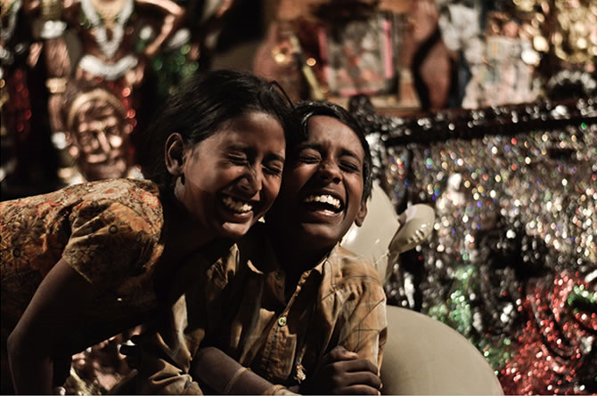
Connect
Social Participation
Happy people have stronger social networks than those who are unhappy (Deiner, E et al, 2008)
Social relationships increase feelings of happiness, self worth and feeling understood
Organisations can also reap the benefits if there is a culture of social connectedness
Notes:
The most significant difference found between those with mental ill health and those with wellbeing is ‘social participation’ (Jenkins et al, 2008)
In orgs where employees feel more connected to others and describe 1 or more colleagues as friends, engagement and commitment to the org is higher + greater productivity and creativity
Cannot stress the importance of connection, we are wired to connect before e are even born. We have organised ourselves socially from the beginning of time.

Slide 33

GIVE
More that just the sharing of material things with others – cultivates a spirit of generosity and supporting others,
Examples, compliments and acknowledgements, helping out sharing resources, promotes social connectedness
Promotes effective communication and problem solving and reduces hostility and conflict
Produces positive feelings and self worth
Social co-operation intrinsically rewarding
Notes:
The act of giving, receiving and being aware of acts of kindness have all been shown to generate positive feelings and self worth, reciprocity and giving back to others promotes mental wellbeing, those who give are more likely to report themselves as happy, committing an act of kindness once per week over a 6 wk period is associated with significant increase in welbeing. Stimulates the reward areas in the brain

Slide 34
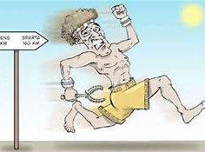
BE ACTIVE
Increases mental well being and reduces depression and anxiety
Doesn’t have to involve great athletism
Standing desks, walking meetings, use of stairs, lunch time walks….

Slide 35
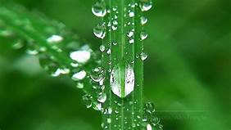
Take Notice
Using attention to increase awareness, concentration - improves mental wellbeing- noticing sights, smells, sounds tastes as well as the thoughts and feelings- re-connecting with the world around you
Evidence supporting mindfulness for decreasing symptoms of anxiety, depression and stress
Mindfulness – give present moment our full attention without distraction
Notes:
Find ways to integrate mindfulness in to work, 2 minutes at the start of meetings spaces for reflection, place art and objects that can be viewed

Slide 36
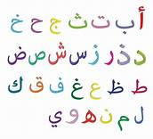
NEW LEARNING
Learning, being curious and setting goals has been shown to increase self-esteem and self belief and preventing depression in later years
Goal setting and working towards those goals is strongly associated with higher levels of wellbeing
Notes:
Goals that are particularly good for promoting wellbeing and positive MH are those that align with personal values, Creativity and right brain activation

Slide 37
What helps resilience and coping during challenging times
*Laughter
*Sleep time
Focus time
Time in
*Down time
Play time
(Healthy Mind Platter)
Notes:
Research shows that a break from close, focused effortful attention improves performance with insight prob solving, even short bouts of ‘reverie’ (Segal, 2004)
Regular breaks on a daily basis/weekend/monthly basis to allow for good decision making and creative thinking!
NB that our brain dis-connects and un-focuses

Slide 38
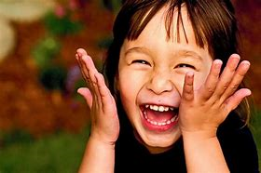
laughter

Slide 39
Laughter really is the best medicine
The best doctors in the work are Dr Diet, Dr Quiet & Dr Merryman- (Jonathan Swift)
Comedy is good for the heart
Notes:
There is some scientific evidence to show that comedy is good for your heart. In 1 study Researchers asked 20 healthy people to watch 15 mins of Kingpin. After 48 hour break, the same volunteers were asked to view the opening battle scene from Saving Private Ryan. After watching each film segment researchers carried out an ultrasound test to measure the changes in the reactivity of blood vessels, they found that bloodflow increased by 22% after watching Kingpin and decreased by 35% after Saving Private Ryan which is similiar to the average increase in blood flow after exercise = positive effect on cardiovascular function and maybe as beneficial as going for a run, the laughter has to be intense, a deep belly laugh, it is estimated our muscles stay relaxed for up to 45 mins

Slide 40
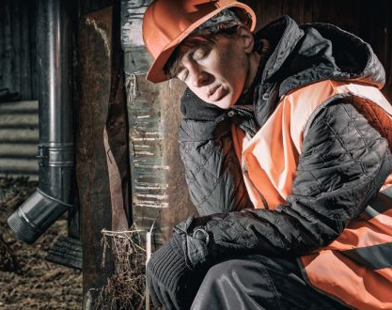
Sleep time

Slide 41
Sleep time
Some important facts!
Most powerful performance enhancer
US study reported average sleep time of 6 hours 40 mins Link between depression and sleep deprivation (Nakata, 2011)
Sleep deprivation can increase weight gain/decrease quality of exercise
(Why we sleep, Mathew Walker)
Stress during day effects quality of sleep
Peak of circadium rhythm is 11am, we are at our peak.. slowly reduce caffeine from now
Notes:
I could spend a whole morning talking about the importance of proper sleep. Memory consolidation, semantic integration (perceptual learning of language), learning and the processing of emotions
REM Sleep associated with insight and creativity
Napping siesta cultures show us that night time sleep can be done in 5-7 hours and day time napping of 1-2 hours

Slide 42
Good sleep hygiene
PRIORTISE SLEEP – ‘Go to bed alarm’! Try 20 mins earlier..
Ability to detach (from work/technology) fundamental to sleep
Physical activity improves quality & quantity of deep sleep
Exposure to daylight v nb, 10 am - outside x 10 mins = syncronises body clock & alertness
Switch of artificial (blue) light in evenings (aids release of melatonin- sleep hormone)
Reduce stimulants in afternoon and evening
Baths really helpful – reduces body temp necessary for sleep
Room should be 18 degrees, bedroom is for sleep & sex only, reading a BOOK
8 hours sleep is not a luxury
Alcohol is sedation –sedation is not (natural) sleep, alcohol induced sleep very fragmented –poor quality and blocks REM sleep
Larks & owls really do exist
Notes:
Short nap can be highly restorative
10 minute naps can benefit us in terms of alertness and performance immediately after and up to three hours, napping can be learned with enough, regular napping is more beneficial than one off necessary napping
10 minute naps can benefit us in terms of alertness and performance immediately after and up to three hours, napping can be learned with enough, regular napping is more beneficial than one off necessary napping
REM sleep crucial for emotional processing on sleep, alcohol worst thing we can do as we have many awakenings we are not aware of, impacts us in so many ways the next day self inflicted under-performance

Slide 43

Positive emotions
Sustained emotions such as appreciation, care, kindness, compassion
Feeling energised; hopeful; grateful; cheerful; feeling inspired, awed; trusting and connected
Gratitude (diary) 3 things you’re grateful for x 21 days
Helps re-wire anxious brain
Notes:
Most people prefer experiencing positive emotions because they feel good. Extensive research suggests that positive emotions also contribute to building psychological resilience, stronger social bonds increased cog ability and better CV health (Friedrickson, 2009) –improved performance and better collegial relationships. Positive emotions are like nutrients for the brain. The effects are accumulative but require continual reinforcement and effort

Slide 44
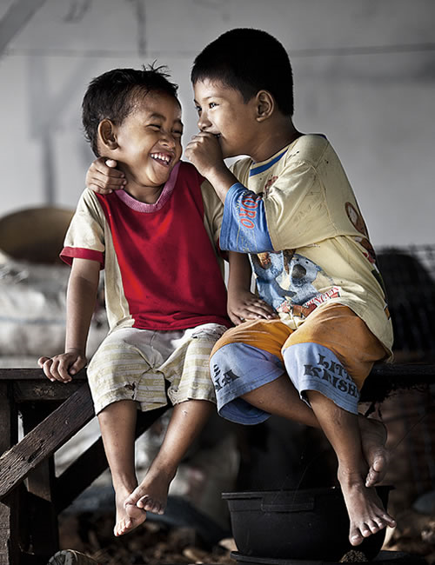
Positive Emotions

Slide 45
Useful Resources
https://www.who.int/publications-detail/9789240003927
https://www.mentalhealthireland
https://www.alustforlife.com/
Re-wiring the anxious brain 1&2:-
https://www.youtube.com/watch?v=zTuX_ShUrw0
https://www.youtube.com/watch?v=zTuX_ShUrw0
Mind UK - Corona Virus and your Well Being
Black Dog Institute - Managing your Anxiety during Covid-19
https://www.nicabm.com/the-neuroscience-of-worry-during-quarantine
Headspace
https://www.headspace.com/
Calm:
https://www.calm.com/
Stop, Breathe, Think
https://www.stopbreathethink.com/
HSE Stress Control Classes - https://www.hse.ie/eng/about/who/healthwellbeing/about-us/free-online-stress-control-classes.html

Slide 46

Useful resources
TedTalks: Ted Radio Hour ‘Maslow’s Human Needs’ https://podcasts.apple.com/ie/podcast/ted-radio-hour/id523121474?i=1000452235140
‘
the opportunity of boredom https://podcasts.apple.com/ie/podcast/ted-radio-hour/id523121474?i=1000468812737
Mindset is The Key to Success with Tom Bilyeu
https://podcasts.apple.com/ie/podcast/feel-better-live-more-with-dr-rangan-chatterjee/id1333552422?i=1000472958570
Resiliency Series by Aware – where Athletes, TV presenters, GAA players, Musicians, and even Senators talk about their own stories and experiences and what has helped them:
https://www.aware.ie/resilience/

Slide 47
Mental Health Resources
Young People
Jigsaw - https://jigsawonline.ie/young-people/
Turn2me - https://turn2me.ie/
Adults
CIPC – Counselling in Primary Care - https://www.hse.ie/eng/services/list/4/mental-health-services/counsellingpc/cipcinfoclients.pdf
HSE Stress Control Classes - https://www.hse.ie/eng/about/who/healthwellbeing/about-us/free-online-stress-control-classes.html
My Mind - https://mymind.org/
Clanwilliam Institute - https://www.clanwilliam.ie/
Aware Life Skills program - https://www.aware.ie/education/life-skills-group-programme/
Samaritans Self Help App - https://www.samaritans.org/ireland/how-we-can-help/contact-samaritan/self-help/

Slide 48

www.reachoutpsychotherapy.com
Tel 085 100 2177 info@reachoutpsychotherapy.com

