Slide 1

Year 7 Brackets
Dr J Frost (jfrost@tiffin.kingston.sch.uk)
www.drfrostmaths.com
Objectives: Be able to expand and simplify expressions involving single brackets.
Last modified: 22nd July 2018

Slide 2




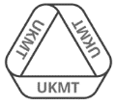
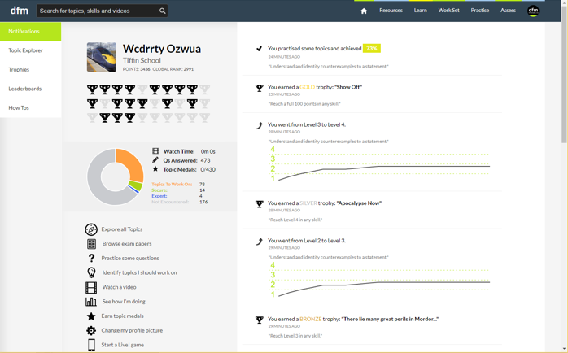
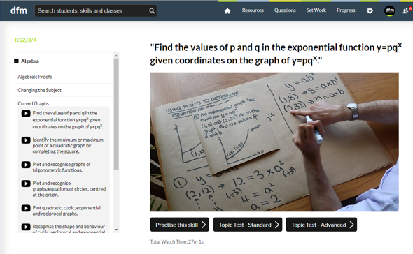
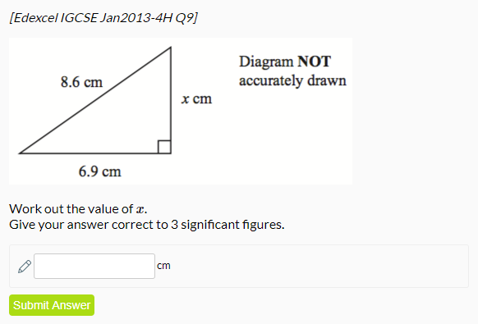
www.drfrostmaths.com
Everything is completely free.
Why not register?
Register now to interactively practise questions on this topic, including past paper questions and extension questions (including UKMT).
Teachers: you can create student accounts (or students can register themselves), to set work, monitor progress and even create worksheets.
With questions by:
Dashboard with points, trophies, notifications and student progress.
Questions organised by topic, difficulty and past paper.
Teaching videos with topic tests to check understanding.

Slide 3

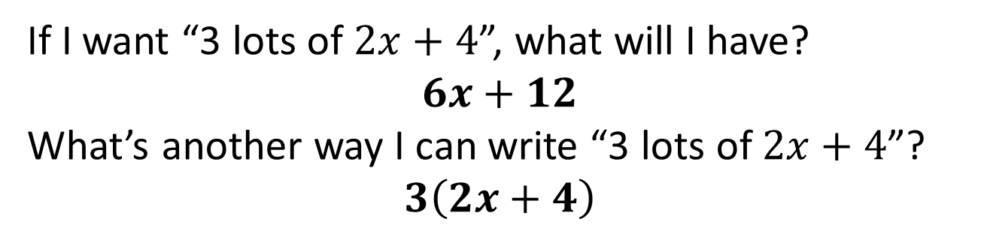
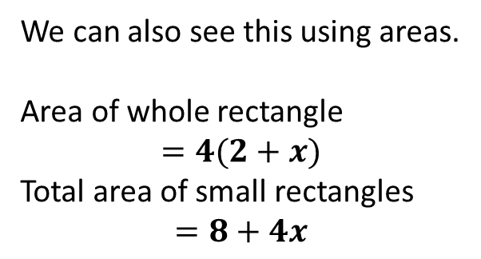


Brackets
If I want “3 lots of $2x+4$”, what will I have?
$$6x+12$$
What’s another way I can write “3 lots of $2x+4$”?
$$3\left(2x+4\right)$$
?
?
So we can multiply each thing inside the bracket by the thing outside it.
$$2$$
$$x$$
We can also see this using areas.
Area of whole rectangle
$$=4(2+x)$$
Total area of small rectangles
$$=8+4x$$
$$4$$
?
?

Slide 4
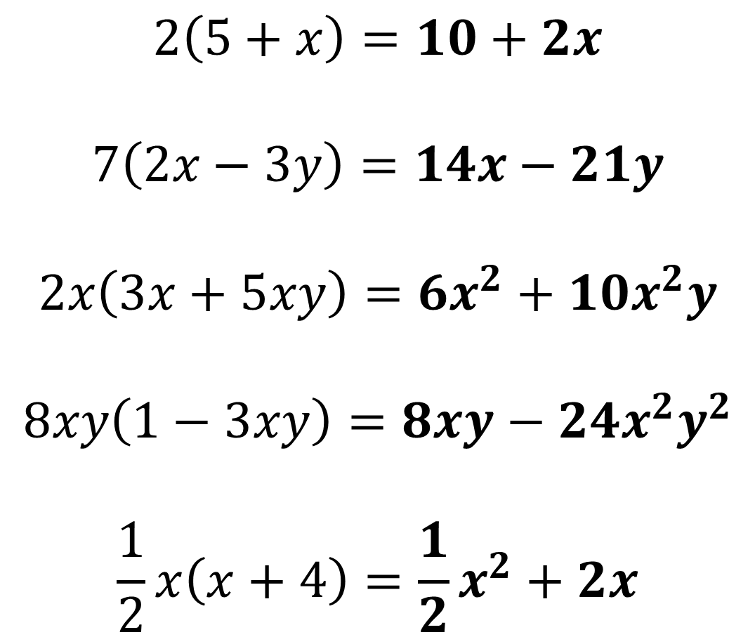
Examples
?
$$2\left(5+x\right)=10+2x$$
$$7\left(2x−3y\right)=14x−21y$$
$$2x\left(3x+5xy\right)=6x^{2}+10x^{2}y$$
$$8xy\left(1−3xy\right)=8xy−24x^{2}y^{2}$$
$$\frac{1}{2}x\left(x+4\right)=\frac{1}{2}x^{2}+2x$$
?
?
?
?

Slide 5
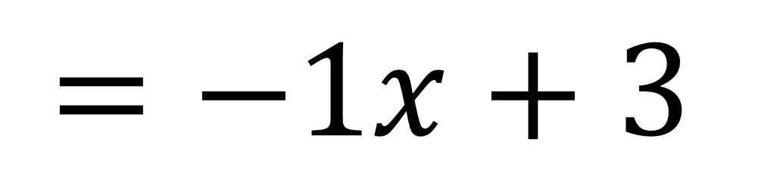
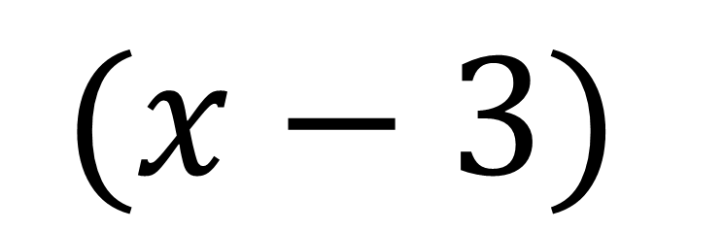
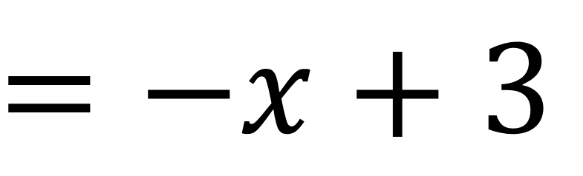


Dealing with negative sign
Click to give hint >
$$−$$
$$(x−3)$$
$$1$$
$$=−1x+3$$
?
$$=−x+3$$
?

Slide 6
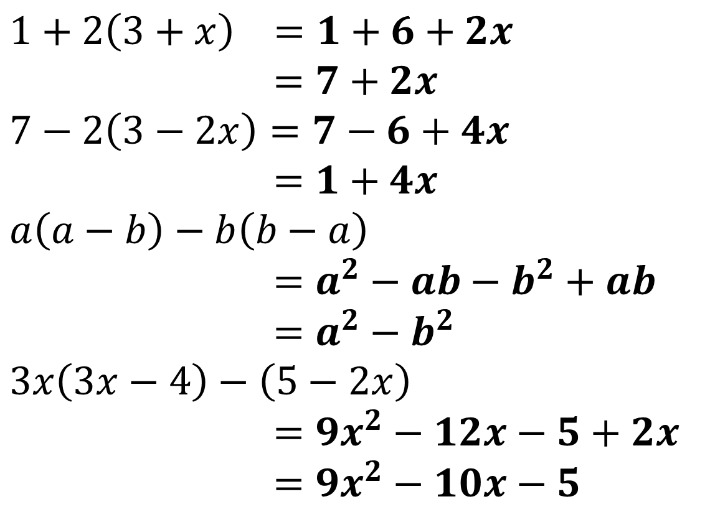
Expanding and Simplifying
If we have multiple brackets we can usually collect like terms after.
$$1+2\left(3+x\right) =1+6+2x \\ =7+2x$$
$$7−2\left(3−2x\right)=7−6+4x \\ =1+4x \\ a\left(a−b\right)−b\left(b−a\right) \\ =a^{2}−ab−b^{2}+ab \\ =a^{2}−b^{2} \\ 3x\left(3x−4\right)−\left(5−2x\right) \\ =9x^{2}−12x−5+2x \\ =9x^{2}−10x−5$$
?
?
?
?

Slide 7
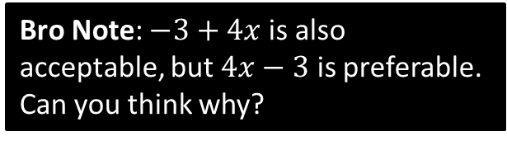
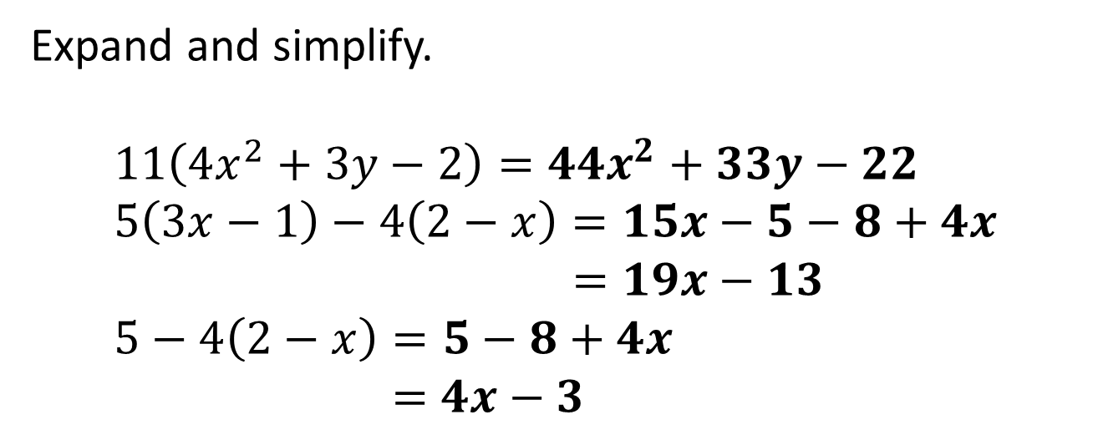
Test Your Understanding
Expand and simplify.
$$11\left(4x^{2}+3y−2\right)=44x^{2}+33y−22 \\ 5\left(3x−1\right)−4\left(2−x\right)=15x−5−8+4x \\ =19x−13 \\ 5−4\left(2−x\right)=5−8+4x \\ =4x−3$$
?
?
?
Bro Note: $−3+4x$ is also acceptable, but $4x−3$ is preferable. Can you think why?

Slide 8



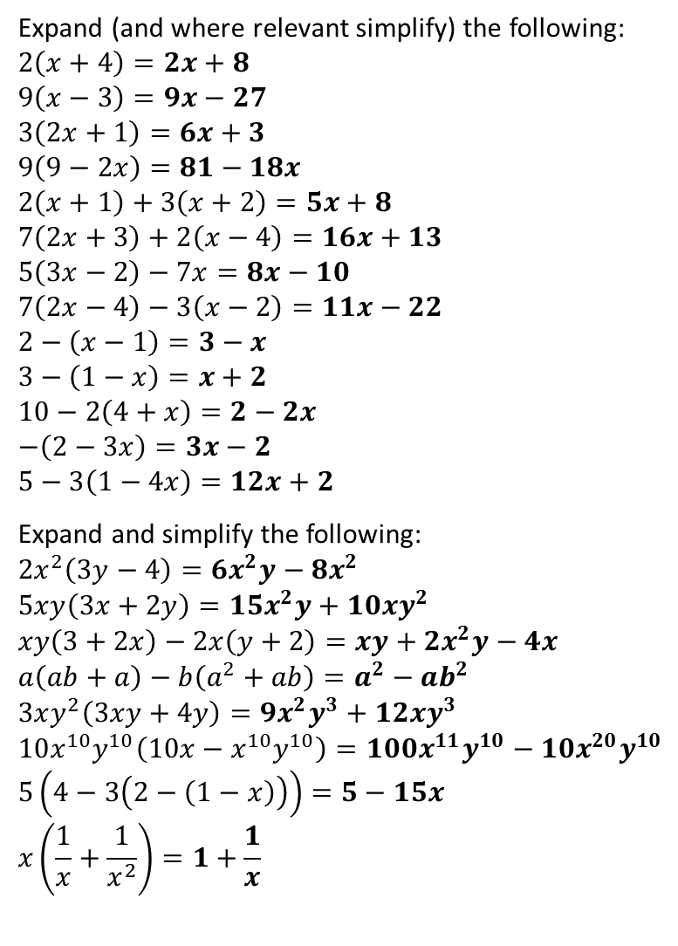

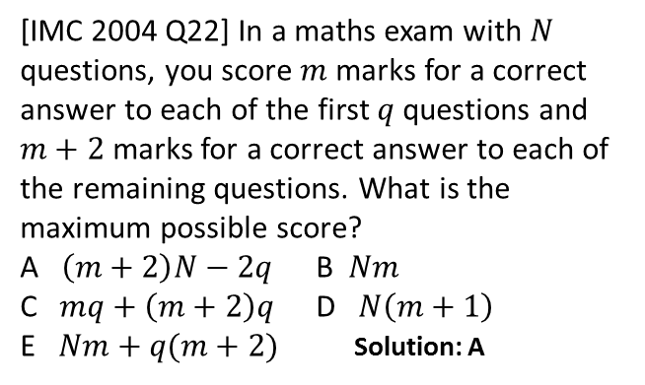




Exercises
1
Expand (and where relevant simplify) the following:
$$2\left(x+4\right)=2x+8 \\ 9\left(x−3\right)=9x−27 \\ 3\left(2x+1\right)=6x+3 \\ 9\left(9−2x\right)=81−18x \\ 2\left(x+1\right)+3\left(x+2\right)=5x+8 \\ 7\left(2x+3\right)+2\left(x−4\right)=16x+13 \\ 5\left(3x−2\right)−7x=8x−10 \\ 7\left(2x−4\right)−3\left(x−2\right)=11x−22 \\ 2−\left(x−1\right)=3−x \\ 3−\left(1−x\right)=x+2 \\ 10−2\left(4+x\right)=2−2x \\ −\left(2−3x\right)=3x−2 \\ 5−3\left(1−4x\right)=12x+2$$
Expand and simplify the following:
$$2x^{2}\left(3y−4\right)=6x^{2}y−8x^{2}$$
$$5xy\left(3x+2y\right)=15x^{2}y+10xy^{2} \\ xy\left(3+2x\right)−2x\left(y+2\right)=xy+2x^{2}y−4x$$
$$a\left(ab+a\right)−b\left(a^{2}+ab\right)=a^{2}−ab^{2} \\ 3xy^{2}\left(3xy+4y\right)=9x^{2}y^{3}+12xy^{3} \\ 10x^{10}y^{10}\left(10x−x^{10}y^{10}\right)=100x^{11}y^{10}−10x^{20}y^{10} \\ 5\left(4−3\left(2−\left(1−x\right)\right)\right)=5−15x \\ x\left(\frac{1}{x}+\frac{1}{x^{2}}\right)=1+\frac{1}{x}$$
Find the area and perimeter of the following (expand and simplify your answer)
3
a
?
b
?
$$2a$$
?
$$x+3$$
c
d
?
$$1$$
e
?
?
$$5$$
$$5$$
f
g
?
h
?
i
?
?
$$A=5x+15 \\ P=2x+16$$
j
?
?
$$2$$
k
?
$$A=10a−4\left(2a−2\right) \\ =2a+8 \\ P=2a+10$$
?
l
?
m
?
?
2
a
?
4
[IMC 2004 Q22] In a maths exam with $N$ questions, you score $m$ marks for a correct answer to each of the first $q$ questions and $m+2$ marks for a correct answer to each of the remaining questions. What is the maximum possible score?
A $\left(m+2\right)N−2q$ B $Nm$
C $mq+\left(m+2\right)q$ D $N\left(m+1\right)$
E $Nm+q(m+2)$ Solution: A
b
?
c
?
d
?
e
?
f
?
g
?
h
?
?

