Slide 1
Using roi tools to drive strategic planning
By Beverly James, UF/IFAS Communications Director of Public Relations

Slide 2
Strategic Planning with Tools
Define Needs for ROI
Choose Platform
Understand Metrics
Create Narratives
Lessons Learned

Slide 3
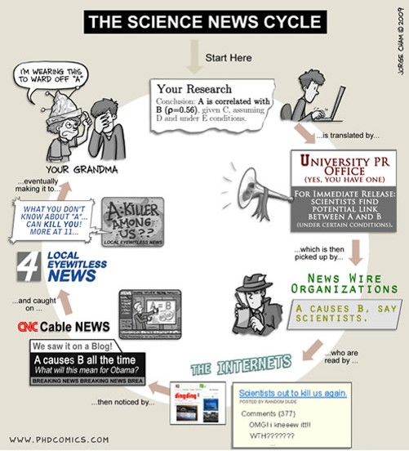
Mad, Mad, Mad World
Notes:
We live in a 24-hour news cycle, which means messages get contorted and devalued. What do we need?

Slide 4
Define Your Needs
Analytics
Number of media hits
Share of voice
Trending key messages
Search Engine Optimization
Top publishers
Top content

Slide 5





Who Gets the Rose?

Slide 6

Citrus Greening Report: 2013-18
http://app.trendkite.com/report?id=57f1a533-aeb2-4301-9147-89f7dfa0bf21

Slide 7
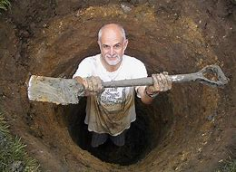
Digging Deep for ROI

Slide 8
2013-2018
Over 5 Years:
Share of voice: 81%
Total mentions: 27,074
SEO: 58

Slide 9
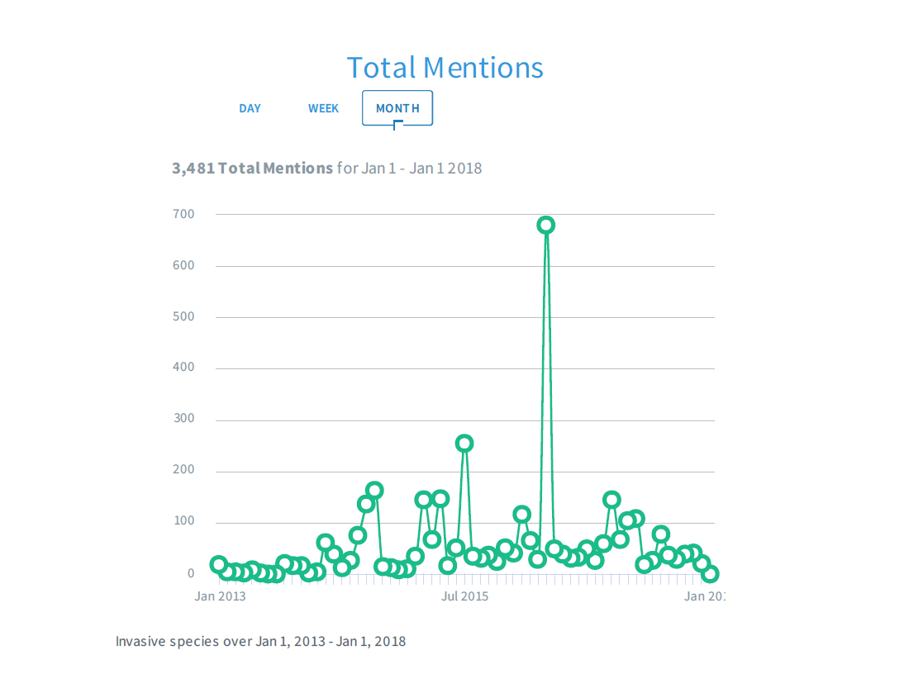
Mentions
Summarizes the number of hits in media outlets.

Slide 10
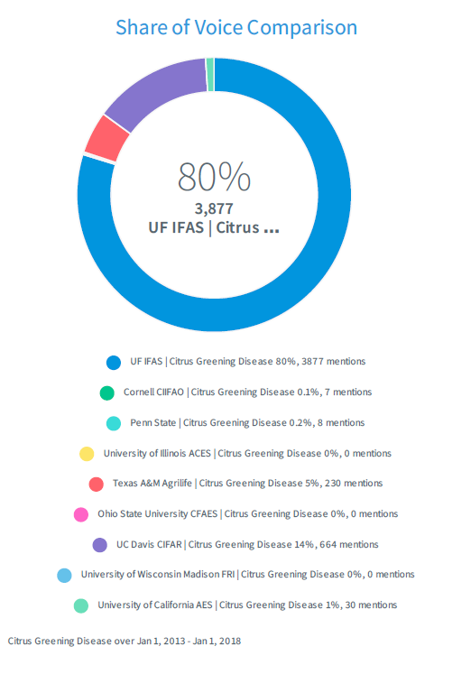
Share of Voice
The Share of Voice Comparison compares our brand coverage against competitors’ coverage.

Slide 11
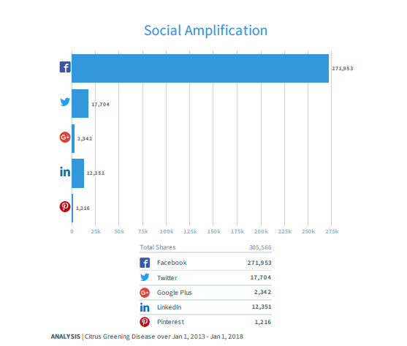
Social Amplification
This chart shows how effective our social media efforts are, and which platform works best.

Slide 12
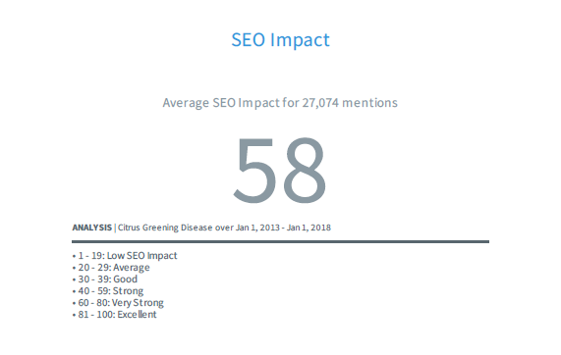
SEO
Search Engine Optimization provides a score of how likely visitors are to see our webpage.

Slide 13
Year-by-Year Comparison
2013-14: 969 mentions; SOV 55%; SEO 64; SM 7,188
2014-15: 6,609 mentions; SOV 85%; SEO 65; SM 14,377
2015-16: 5,174 mentions; SOV 81%; SEO 60; SM 100,318
2016-17: 6,244 mentions; SOV 86%; SEO 57: SM 67,830
2017-18: 8,092 mentions; SOV 80%; SEO 55; SM 116,148

Slide 14
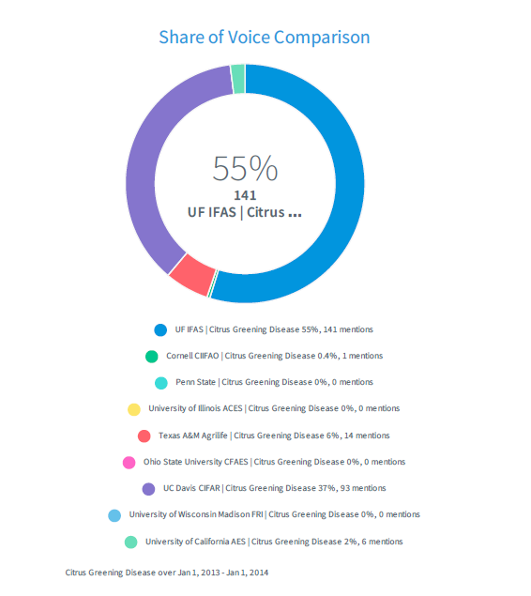
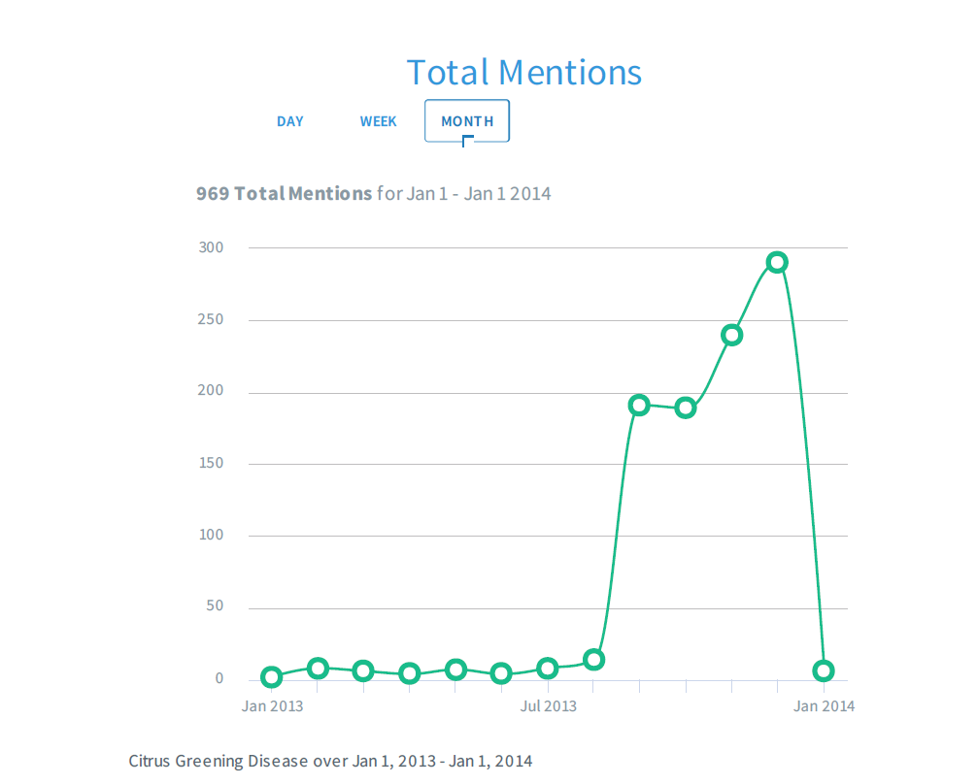
Analysis
More mentions, more share of voice.

Slide 15
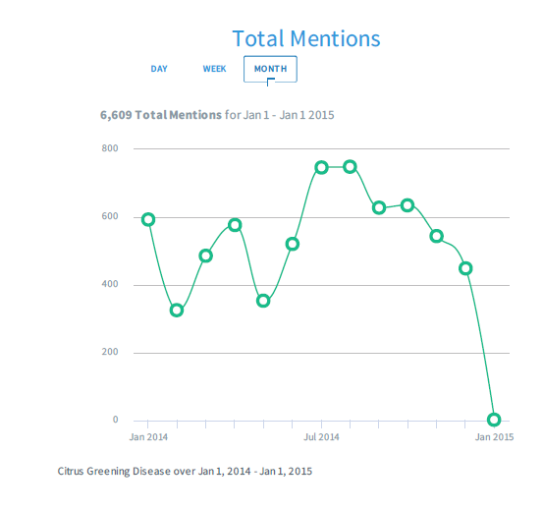
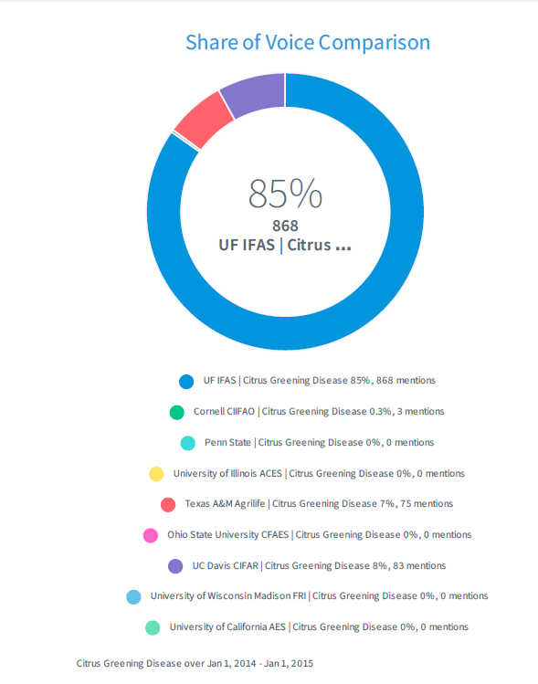
Notes:
By 2014-15, our mentions increased to 6,609 and our share of voice to 85%.

Slide 16
Competitors at Our Heals
2013-14:
UC-Davis was our closest competitor, with a 37% share of voice.
Texas A&M University had 6% share of voice.
UF/IFAS had a 55% share of voice.
2017-18:
UC-Davis 20% share of voice.
Texas A&M 2%
UF/IFAS 77%

Slide 17
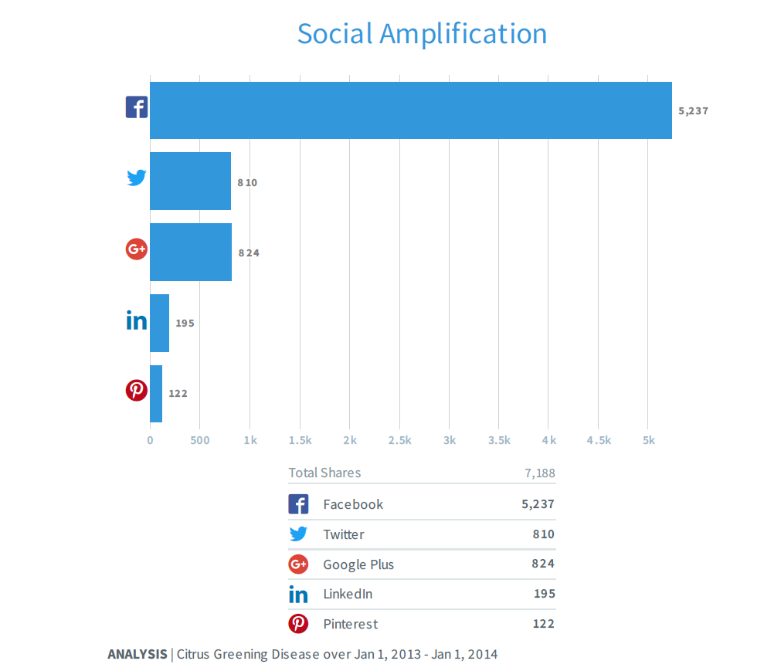
Facebook vs. Twitter

Slide 18
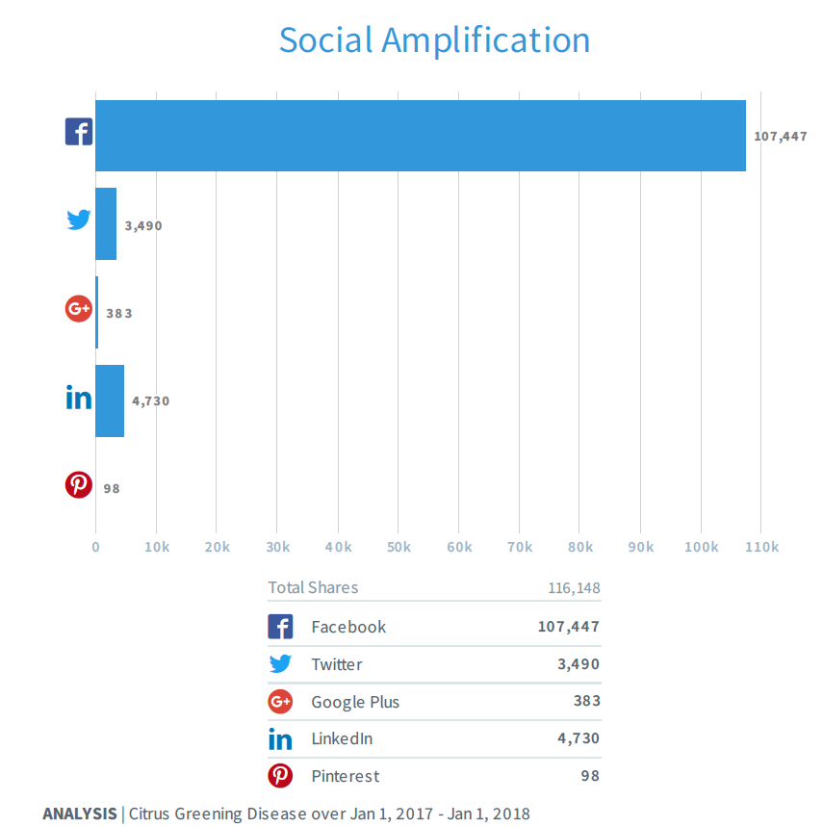
Notes:
While out Twitter mentions grow, Facebook mentions exploded from 5,237 to 107,447.

Slide 19
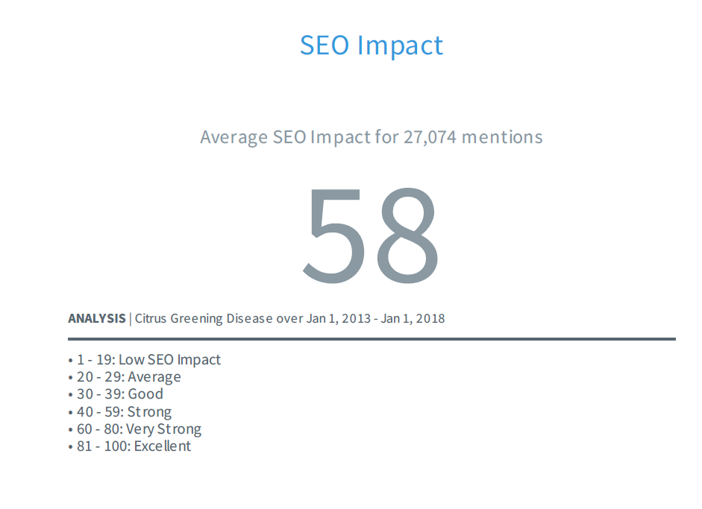
SEO Impact
Notes:
Facebook has changed it’s analytics several times, which means our search engine optimization numbers can change dramatically.

Slide 20
Lessons Learned
There is a lot of competition out there.
Emphasize what makes us special.
Know your audience and tailor communications efforts accordingly.
Use tools to find journalists and outlets that will best convey your message.
Digital/social media is key.
Pitch! Pitch! Pitch!

Slide 21
Questions?
Beverly James
beverlymjames@ufl.edu
352-273-3566

