Slide 1


Investing in THE KEY OF ESG
KHLOÉ U. KAROVA
CERTIFIED FINANCIAL PLANNER™
khloe@moderncapitalconcepts.com
Securities offered through LPL Financial, member FINRA/SIPC. Financial planning offered through Modern Capital Concepts, a Registered Investment Advisor and separate entity.
Tracking 1-582968

Slide 2
Email questions and schedule a time:
khloe@moderncapitalconcepts.com

Slide 3
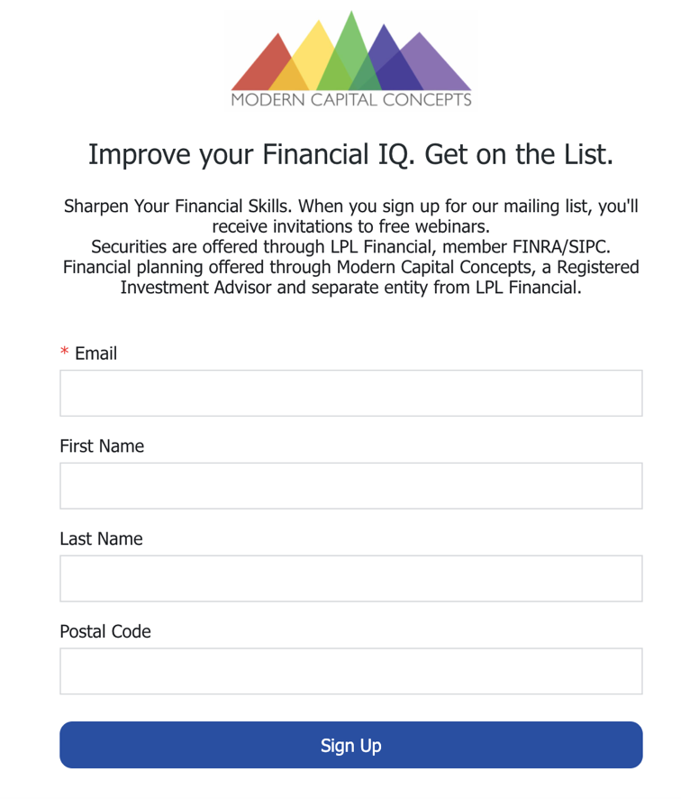
https://lp.constantcontactpages.com/su/Ozod1zm/seminars
Sign up for the seminars email list to receive a pdf or recording of this presentation.

Slide 4
MONEY SKILLS AT EACH STAGE
Financial wisdom is a cumulative process. Build financial literacy throughout your life.
60s, 70s, 80s
50s
23. Plan for financial independence: re-evaluate spending, gifting and travel goals.
24. Build connections across generations: part-time work, volunteering, mentoring.
25. Consider moving to a low-tax state or low-cost country.
26. Plan for long-term care and talk to parents about their plan.
27. Delay taking Social Security until age 75.
40s
30s
18. Take advantage of retirement account catch-up contributions: $7,500 in 401(k)s, $1,000 in IRAs. And executive compensation plans at work.
19. Start downsizing to prepare for retirement or paying for college.
20. Plan to reinvent or refresh your skills.
21. Teach your teenage kids how to be financially independent.
22. Business owners: know the value of your business and factors that increase business value.
20s
14. Re-evaluate how much you need to save for retirement and healthcare expenses. The US average annual expense in retirement is $60,000.
15. Max out your 401(k) and IRAs. The most you can save in a 401(k) is $23,000 for 2023 and $7,000 for an IRA annually before catch-up. You may need to save more in a taxable account depending on lifestyle choices.
16. Step up college savings for children and pay off student loan debt.
17. Consider saving in a Roth 401(k) and/or converting part of IRA to a Roth IRA to diversify taxes in retirement.
8. Always be negotiating your salary.
9. Do not overinvest in housing. Know how much house you can afford.
10. Save in a 529 or taxable account if you are saving for college for children.
11. Nudge up your retirement savings.
12. Rebalance your portfolio at least once a year. Do not time the market.
13. Develop a basic understanding of micro and macroeconomics, fiscal and monetary policy.
1. Focus on growing your income and make saving a habit.
2. Invest in your human capital. Don’t delay plans for grad school. Control your personal brand and social media image.
3. Save for retirement – any amount. Time is an asset.
4. Build an emergency fund.
5. Monitor and increase your credit score.
6. Have a realistic plan for paying off student loans (no more than 10 years).
7. Get investment information from high quality sources: Wall Street Journal, Financial Times.
Notes:
Financial wisdom is a cumulative process. Build financial literacy throughout your life. Women who defer decisions to their partners throughout their lives are more likely to struggle if they become divorced or widowed.

Slide 5
HAVING A GOAL IS THE MOST POWERFUL MOTIVATOR IN FINANCIAL PLANNING

Slide 6
EXERCISE: WHAT ARE YOUR GOALS?
WHY ARE YOU INVESTING?
Expect goals involving six figure sums to require many years of saving.
More than 7 Years
Three to Seven Years
College
Retirement
Second home
Long-term care
Family support
Buy a business
Angel investing
Charity
______________
______________
______________
Within Three Years
Wedding
New baby/s
College
Buy investment property
Home addition
Sabbatical
________________
________________
________________
Emergencies
Vacation
Relocation
New car
House down payment
Medical expense
Start your own business
________________
________________
Notes:
This seminar is designed to enable participants to become smarter investors and more discriminating consumers of financial information.
We will cover the importance of setting financial goals, risk and asset allocation and types of investments, specifically, stocks and bonds. There will also be plenty of time for Q&A.
First, let’s talk about financial goals. Why do we invest?
College
Buying a house
Saving for retirement
Generate income in retirement
Most people invest to pursue specific financial goals. Some of these goals are widely shared. For example, many people want to own their own home and send their children or grandchildren to college. And there's an almost universal desire to retire someday and be financially independent.

Slide 7
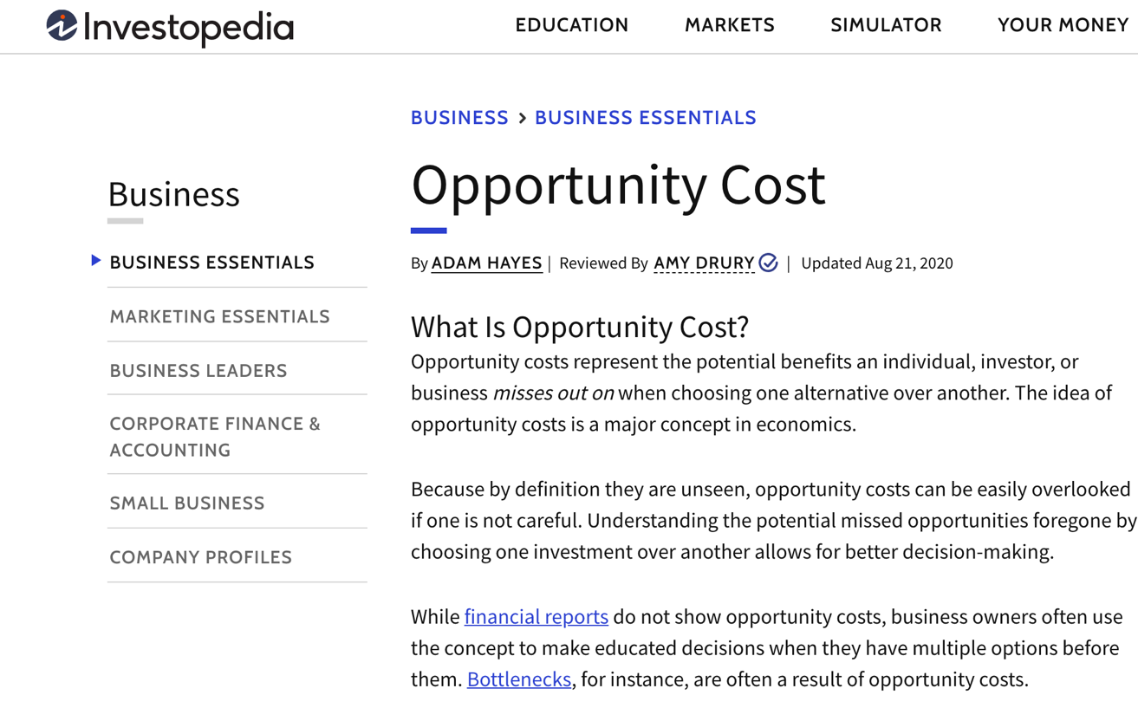

Slide 8
EXERCISE: SHORT-TERM GOALS
What makes you happy? What do you want to experience? What investment do you need to make in your human capital? Determining the order of goals can be daunting for some. A CERTIFIED FINANCIAL PLANNER™ can help you weigh the OPPORTUNITY COSTS.
More than 7 Years
3 to 7 Years
______________
______________
______________
Within 3 Years
______________
______________
______________
______________
______________
______________
Investing in human capital is the best long-term investment – Jerome Powell, Federal Reserve Chairman
Notes:
Investing in human capital is the best long-term investment – Jerome Powell, Federal Reserve Chairman

Slide 9
Goal + Account Organization - Example
Emergencies
& Short-Term
Retirement
College
Emergency Fund
At least 3 months of essential expenses. 12 months if close or at retirement
Example: $5,000 monthly expenses x 3 = $15,000
Increase cash to >22% of down payment if buying a house.
Compare rates at Bankrate.com for savings accounts and CDs
401(k)
529
$23,000 annual contribution + $7,500 if > age 50
Employer match: _____%
Invest for growth, reduce risk (% stocks) closer to retirement
Save at least 16% of gross income
$18,000 per child/beneficiary to avoid gift tax. IRS permits “front-loading” 5-years. $18,000 x 5 = $90,000 upfront. Assumes no other gifts.
Invest for growth, reduce risk (% stocks) closer to enrollment
One account per child or change beneficiaries
SEP IRA
25% of Self-employed net income
Can convert traditional to SEP and vice versa
Assets not counted in financial aid FAFSA. Might be counted on CSS form. Income counted when distribute. Use last year of college.
Roth or Traditional IRAs
Taxable Account
Example: $15,000
5 year time frame, Low risk
Roth IRA
$7,000 CDs
$7,000 annual contribution + $1,000 if >50
Tax-free distributions: invest more aggressively
Consider Roth Conversions when stocks are down.
$3,000 Corporate bond funds, high yield (junk) bonds
Taxable
Pay taxes every year on dividends and interest income (lower tax rate than ordinary income).
$5,000 Dividend paying blue-chip stocks
Taxable
Pay taxes every year on dividends and interest income (lower tax rate than ordinary income).
Borrow from cash value. Use after saved max in 529 and IRAs. More suitable for families with very high level of assets due to liquidity risk.
Health Savings Account
Whole Life Insurance
Available with High Deductible Health Plan. NOT “use it or loose it.” Maximums: +$1,000 catchup > age 55 or older
Individuals $4,150
Family $8,300
Better for age 50+
Use for risk management
Beware of fees
Annuities
Notes:
Before undertaking any investment, it is critical that you assess your current situation and goals. You need to take an accurate measurement of your finances to determine how much you can invest reasonably. You should build up an emergency fund of at least 3 to 6 months expenses. Then you'll need to ask yourself a few key questions:
What are your goals? In order words, what is your vision for the future?
What will they cost? When do you want to pursue each goal?

Slide 10
WHAT IS SOMETHING WORTH?
How would you determine how much a car is worth?
  Compare features and price to other vehicles
  Cost of alternatives: public transit
  Value of costs avoided: time saved
How would you determine how much a house is worth?
  Location: factors driving desirability of location (schools, amenities, safety)
  Compare price to other similar homes for sale
How would you determine how much a degree is worth?
  Increase in lifetime earnings

Slide 11
WHAT DETERMINES A STOCK’S PRICE?
Brand prestige might deteriorate if leadership suspected of sexism, racism or other discriminatory practices.
High labor costs may reduce profit margins if cannot pass costs to customers.
ESG plays a role in the background in which business operates mainly because climate change is real.
Earnings
Revenue Growth
Product Cycle
Sector Outlook
Strength of Competitors
Supply and Demand
Management Quality
High inflation could temporarily lower stock prices if future earnings are expected to be worth less in real terms.
Climate change might increase public pressure on governments to pass regulations limiting emissions.
High energy costs could shut down factories and lower supply of goods that could lead to a recession.
Brand loyalty may not matter in new categories like electric vehicles.
First-movers may not have an advantage in some sectors such as renewable energy with high cost of capital.
Notes:
Stock Basics
What does a stock price represent?
Fundamental analysis: price/earnings ratio
Defensive versus cyclical companies
Growth versus value
Sector analysis
Technical analysis: short-term strategy, moving averages.
When you invest in stock, you buy ownership shares in a company—also known as equity shares. Your return on investment, or what you get back in relation to what you put in, depends on the success or failure of that company. If the company does well and makes money from the products or services it sells, you expect to benefit from that success. Investing in stocks involves risks, including the risk you might lose all your principal.
There are two main ways to make money with stocks:
Dividends. When publicly owned companies are profitable, they can choose to distribute some of those earnings to shareholders by paying a dividend. You can either take the dividends in cash or reinvest them to purchase more shares in the company. Many retired investors focus on stocks that generate regular dividend income to replace income they no longer receive from their jobs. Stocks that pay a higher than average dividend are sometimes referred to as "income stocks." Dividends are not guaranteed and the dividend yield may fluctuate. Companies may reduce or eliminate the payment of dividends at any given time
Capital gains. Stocks are bought and sold constantly throughout each trading day, and their prices change all the time. When a stock price goes higher than what you paid to buy it, you can sell your shares at a profit. These profits are known as capital gains. In contrast, if you sell your stock for a lower price than you paid to buy it, you've incurred a capital loss.
Both dividends and capital gains depend on the fortunes of the company—dividends as a result of the company's earnings and capital gains based on investor demand for the stock. Demand normally reflects the prospects for the company's future performance. Strong demand—the result of many investors wanting to buy a particular stock—tends to result in an increase in the stock's share price. On the other hand, if the company isn't profitable or if investors are selling rather than buying its stock, your shares may be worth less than you paid for them.
Evaluating a Stock
When you buy a stock, you're buying part ownership of a company, so the questions to ask as you select among the stocks you're considering are the same questions you'd ask if you were buying the whole company:
What are the company's products?
Are they in demand and of high quality?
Is the industry as a whole doing well?
How has the company performed in the past?
Are talented, experienced managers in charge?
Are operating costs low or too high?
Is the company in heavy debt?
What are the obstacles and challenges the company faces?
Is the stock worth the current price?

Slide 12
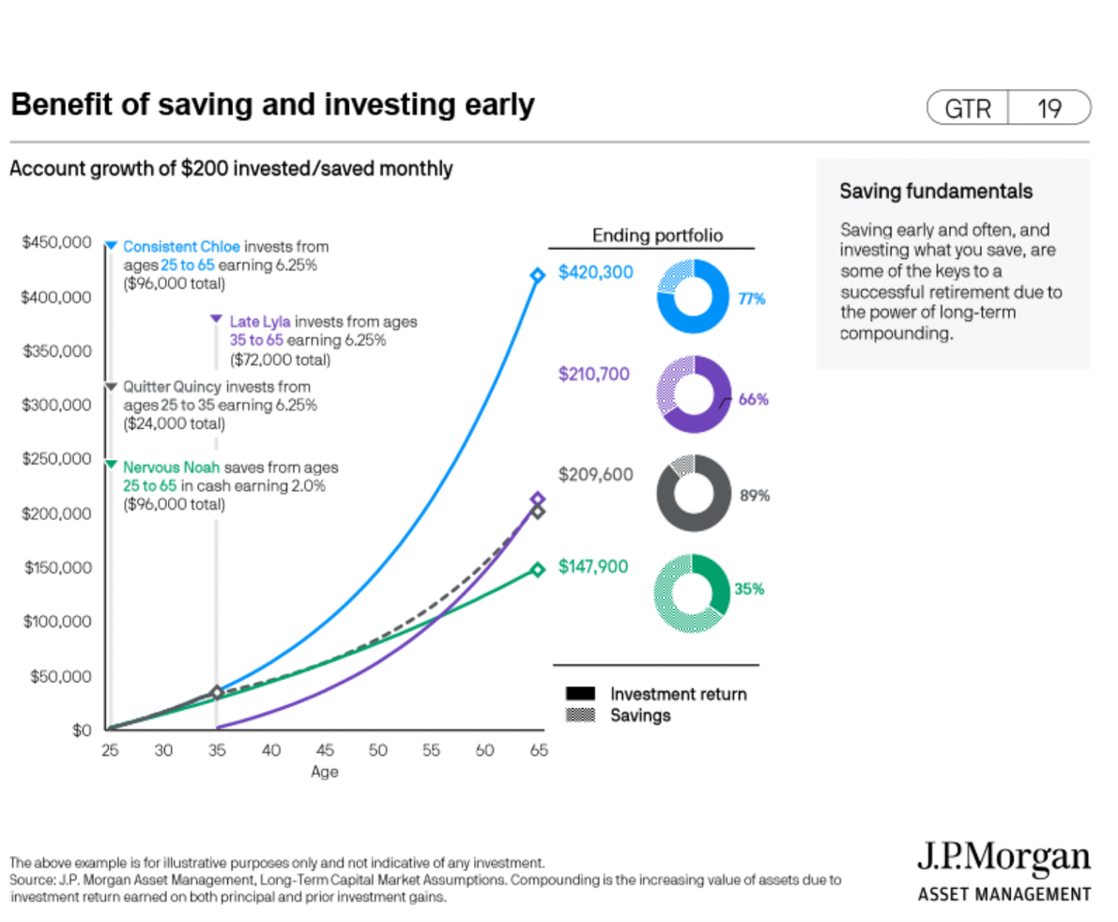
Time is an important component of investing.
When you are young you might have more time than money.
Time is on your side.
https://am.jpmorgan.com/us/en/asset-management/adv/insights/retirement-insights/guide-to-retirement/
Notes:
When you are in your twenties, you might not have achieved your full earning potential, but time is on your side. Time is as asset. Through compound returns, consistent small investments could grow to large sums later in life if invested prudently.

Slide 13
WHAT IS RISK?
Risk preferences are influenced by
Age and time-frame
Experience with investing
Personal experiences: job loss or inheritance
Sensitivity to loss
Gender may be a factor
There is no return without risk.
Investing in stocks involves risks, including the risk you might lose all your principal.
Savvy investors make decisions after weighing all the known risks that could impact future cash flows.
Young investors copying their parents or older coworkers might not be taking on enough risk.
Investing for the long-term has more to do with managing risk than picking a “hot” stock.
There is no “get rich quick” investment that does not involve risk. Bitcoin investors will not get a bail-out.
Notes:
Risk Tolerance
What words come to mind when you hear the word “risk”? How many of you associate risk with taking chances or with things that are beyond our control? Let’s take a few minutes to go through the risk tolerance questionnaire to determine your level of risk taking.
Both your age and your time frame for pursuing specific financial goals play a role in determining your risk tolerance. If you're young and have a long time to work towards your goals, you may have a higher risk tolerance than someone who is nearing retirement and is counting on investment income to live on for two or three decades.
But other factors may also affect your tolerance for investment risk. Your personality, personal experiences, and current financial circumstances also come into play. For instance, if you're a single parent, are responsible for the care of a sick or elderly relative or have lived through a period of economic upheaval such as a major recession, you may be a more risk-averse, or conservative, investor. On the other hand, if you have a promising career, a generous salary, and little in the way of financial responsibilities, then you may be more comfortable in assuming greater investment risk.
Above all, you need to feel comfortable with the risk you're taking. If changes in the value of your portfolio keep you tossing and turning at night, or your instinct is to sell your investments every time the market drops, then you may want to consider shifting to a more moderate investment mix, with a greater emphasis on income-producing investments such as bonds.
Or, if you're a risk taker by nature and have at least 15 years to pursue your goals, then you may be comfortable allocating most of your assets to a diversified portfolio of stocks and certain fixed-income investments that have the potential to provide the highest returns over the long run.
Keep in mind that investment risk doesn't mean staking your life savings on highly speculative investments like a new company that a friend is starting. (The only money you'd want to put in investments like that is money you can afford to lose.) But it does mean getting used to the fact that virtually all investments that have the potential to provide substantial returns may drop in value at one time or another—sometimes significantly.

Slide 14
EXERCISE: RISK TOLERANCE
1. When you think of the word "risk" which of the following comes to mind?
 | a. | Loss
 | b. | Uncertainty
 | c. | Opportunity
 | d. | Thrill
2. You are ten years away from retirement. Suppose you have saved $500,000 for retirement in a diversified stock portfolio. By what percentage could the total value of your retirement assets drop in one year before you would begin to think about selling you investments and going to cash?
 | a. | 10% drop | Drop of $50,000
 | b. | 20% drop | Drop of $100,000
 | c. | 30% drop | Drop of $150,000
 | d. | 40% drop | Drop of $200,000
3. If you had to invest $500,000 for retirement, which of the following investment choices would you find most appealing?
 | a. | 70% in low-risk investments, 30% in medium-risk investments, 0% in high-risk investments.
 | b. | 50% in low-risk investments, 20% in medium-risk investments, 30% in high-risk investments.
 | c. | 30% in low-risk investments, 20% in medium-risk investments, 50% in high-risk investments.
 | d. | 0% in low-risk investments, 30% in medium-risk investments, 70% in high-risk investments.

Slide 15
RISK AND ASSET PRICES
Risk can be defined as variance in future outcomes.
Wide range of outcomes = higher risk
Profitable outcomes
Low range of outcomes = lower risk
Time
Losing outcomes

Slide 16
EXERCISE: RISKS FROM AN ESG PERSPECTIVE
Environmental
Climate change may raise the cost of insurance to companies with factories and real estate in areas with rising sea levels or prone to wildfires. Can you think of examples?
Social
Executives who allow discrimination against women and minorities become a potential human resource liability. Do you think allowing a sexist culture has any impact on a company’s performance?
Governance
  Without competent board oversight a company might be sold to an owner who does not know how to lead a company to profitability. What company is an example of a CEO who did not know how to lead a company acquired?

Slide 17

INFLATION AND ASSET PRICES
When inflation goes up, revenues that will be earned in the future are worth less today.
Notes:
Inflation is an outcome of a healthy economy. Rising prices is a sign a growth. However, when the cost of living rises too quickly for consumers to adjust their lifestyle, this can cause severe financial stress among working households. High inflation or hyperinflation can be caused by too much demand chasing too few goods and services, a shortage of available workers leading companies to have to raise wages, or a sudden drop in supply making goods more scarce and expensive. Inflation can be general, that is, affecting a wide range of goods and services or specific to a sector like housing. Housing costs are the main component of the Consumer Price Index (CPI). Since many entitlement programs such as Social Security are pegged to the CPI, a rise in inflation is not necessarily a bad thing.

Slide 18
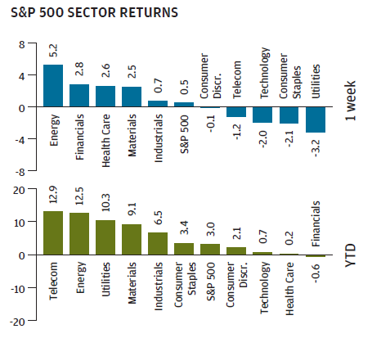
RESIST SHORT-TERM THINKING
SOCIAL MEDIA OVEREMPHASIZES THE SHORT-TERM OVER LONG-TERM.
Short-term trends say nothing about longer-term potential of a company or industry.
Day to day price movements could be driven by tax changes, news, or investor preferences for risk-taking.
Notes:
It can be fun watching the stock market and stock prices for your favorite companies everyday, but keep in mind short-term trends say nothing about longer-term potential of a company or industry. Day to day price movements could be driven by tax changes, news, or investor preferences for risk-taking. The charts on the right show there is no relationship between the best performing sectors of the week and those over a longer-time frame.

Slide 19
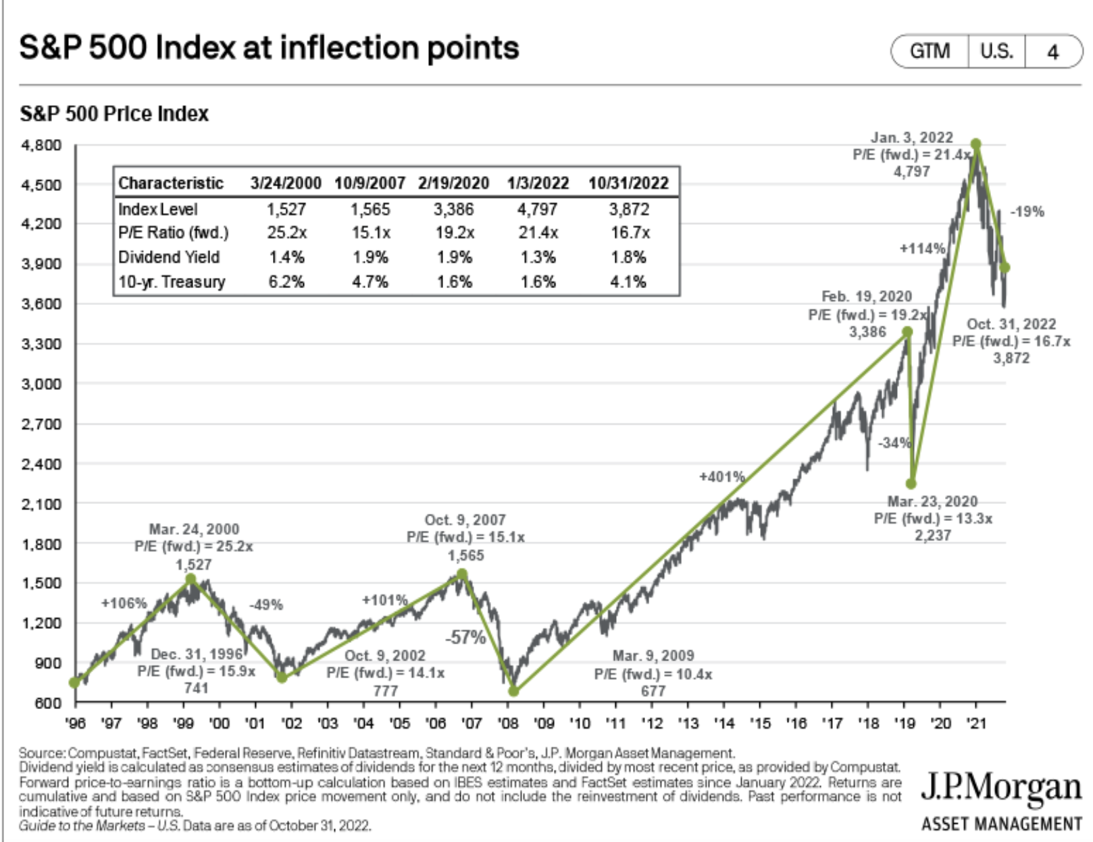
STOCK MARKETS ALWAYS RECOVER
https://am.jpmorgan.com/us/en/asset-management/adv/insights/market-insights/guide-to-the-markets/
https://am.jpmorgan.com/us/en/asset-management/adv/insights/market-insights/guide-to-the-markets/
Notes:
Protracted periods of low volatility coupled with an extended stock rally may increase the attractiveness of stocks to small investors because there is lower risk of ownership. Protracted low volatility with a flat stock market increases the likelihood investors will search for alternatives such as real estate for returns. This is what we saw last decade.
The benefit for long-term investors is that if you are making monthly contributions to your 401(k) or IRA, you are able to participate in dollar cost averaging. Dollar cost averaging involves continuous investment in securities regardless of fluctuation in price levels of such securities. Therefore, you have the potential to buy shares cheaper when the stock market dips. An investor should consider their ability to continue purchasing through fluctuating price level. Such a plan does not assure a profit and does not protect against loss in declining markets. Asset allocation still matters. Volatility could and has recently resulted in decoupling of asset classes and markets. I have no idea which strategy is going to generate the highest return over the course of the next year, so consider diversifying to help less overall risk. There is no guarantee that a diversified portfolio will enhance overall returns or outperform a non-diversified portfolio. Diversification does not protect against market risk,
Recent levels of high volatility can be disturbing because the market is reflecting investor anxiety over deeper structural problems, such as lack of confidence in Congress, geopolitical conflicts, or mistrust of the market itself. Investors need to make sure they have the downside risk management in their portfolio. Downside risk management could be in the form of cash, bonds, defensive stocks, or sectors less immune to the anticipated market shock. The extended bull market has made some forget about asset allocation. But keep in mind, asset allocation does not guarantee against losses.

Slide 20
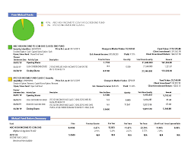
HOW TO READ A STATEMENT
Instead of focusing on the year-to-date or past three months of performance, look at the five-year or ten-year average.
It is not unusual for a year with high returns to be followed by a year with low returns.
If a high-quality asset is trading at a discount, a long-term investor should like it more.

Slide 21
RESPONDING TO GLOBAL MARKET MELTDOWNS
Stock markets have recovered from every drop.
When all asset classes (stocks, bonds, and real estate) fall sharply, it is most likely an over-reaction.
Focus on what you can control.
Stick to your long-term plan. It’s better to do nothing than selling irrationally.
In the long-run, inflation may pose a greater risk to financial independence in retirement that stock market volatility. Learn the long-run average return required to get to your goals.
Notes:
How can a long-term investor respond to global market meltdowns?
Stock markets have recovered from every drop. History tells us that selling during a market correction (drop of 10% from prior highs) is the worse than doing nothing.
When all asset classes (stocks, bonds, and real estate) fall sharply, it is most likely an over-reaction.
Focus on what you can control. Beef up your emergency fund and review your budget.
Stick to your long-term plan. It’s better to do nothing than selling irrationally.

Slide 22

WHAT IS AN ASSET CLASS?
FROM INVESTOPEDIA:
An asset class is a group of securities that exhibits similar characteristics, behaves similarly in the marketplace and is subject to the same laws and regulations.
The three main asset classes are
equities (stocks)
fixed income (bonds)
cash equivalents (money market instruments)
Some investment professionals add real estate and commodities, and possibly other types of investments, to the asset class mix.
Asset classes are often combined together.
Each asset class is expected to reflect different risk and return investment characteristics and perform differently in any given market condition.
Investors interested in maximizing return often do so by reducing portfolio risk through asset class diversification.
Read more: Asset Class https://www.investopedia.com/terms/a/assetclasses.asp#ixzz56x2zgXZF
Notes:
An asset class is a group of securities that exhibits similar characteristics, behaves similarly in the marketplace and is subject to the same laws and regulations. The three main asset classes are equities, or stocks; fixed income, or bonds; and cash equivalents, or money market instruments. Some investment professionals add real estate and commodities, and possibly other types of investments, to the asset class mix.
Asset classes are often combined together. Each asset class is expected to reflect different risk and return investment characteristics and perform differently in any given market environment. Investors interested in maximizing return often do so by reducing portfolio risk through asset class diversification.

Slide 23
DO YOU WANT TO SETTLE FOR AVERAGE?

Slide 24
DIVERSIFICATION ACROSS ACCOUNT TYPES
NONE
BASIC
FULL
Account types: Could be any – taxable brokerage, trusts, 529 college savings. Can be managed or unmanaged. Index funds may not offer broad diversification. 100% stock portfolios tend to be for experienced investors and those with an aggressive growth profile.
Account types: Could be any – Usually found in 401(k) plans in mutual fund products under the names “Target Date” or “Allocation.” Might be suitable for small accounts (under $50,000) with a low to moderate risk objective.
Account types: Retail investors not likely to be able to execute without a professional due to research costs (this is why you would pay an asset management fee).

Slide 25
If you have a taxable investment account that has a retirement goal, strive for an after-tax rate of return similar to that of your 401(k) or IRA. This means you would have to get more growth (by having a different asset allocation with more stocks).
Offset capital gains with capital losses when possible. Do not wait until retirement to sell shares. Sell some shares each year to manage gains.
Notes:
When I tell people I am a financial advisor, the response I get goes something like this: “So you’re a financial advisor. What’s a good stock to buy?” When most people think of investing, they think of stocks. You could become wealthy just with stocks, but investing 100% in stocks comes with risks. You’re probably familiar with the saying, “Don’t put all your eggs in one basket.” Investing over the long term is more about managing risk and one of the best ways to do this is through asset-allocation.

Slide 26
STOCK PORTFOLIO STRATEGY (EXAMPLE)
What is your goal and time-frame?
  Goal is retirement before age 50 1/2 and tax diversification on distributions.
  Timeframe is 20 years.
What is your risk tolerance?
  High risk tolerance: willing to tolerate 30% market fluctuation before going to cash.
  Diversifying risk across accounts: 401(k) and 529 college savings moderate risk.
What is your investment thesis?
  US stocks will outperform bonds over the next 20 years.
  US stock market will outperform European markets due to lower prevalence of tech in Europe.
  Factors: Small companies will outperform large companies, ESG
How will you manage your downside?
  No more than 3% of account in pure risk positions.
  Stop-loss orders.
Will you use leverage?
  No leverage to be used.
  Use leverage if margin loan less than 6%
What is your analysis process? Top-down or bottom-up?
  Top-down: defensive companies when economy slows down. Otherwise, growth companies.
  Bottom-up: Based on ESG criteria - no oil and gas, Gross margins more than 40%, growing dividends, credit rating
How will you determine entry and exit points?
  Technical analysis: buy when price falls below 200-day low. Sell when price above 200-day high.
  Fundamental analysis: corporate actions: change in dividend policy, change in credit rating, change in strategy, regulatory environment, etc.

Slide 27
ALTERNATIVE TO INDEX INVESTING: STOCK PICKING
Ticker | Company Name | Sell Side Analyst Rating | Bloomberg ESG Rating
ADBE | Adobe | 27 Buy 12 Hold 2 Sell | 6.04
GOOGL | Alphabet | 53 Buy 9 Hold 0 sell | 4.30
AMT | American Tower | 20 Buy 4 Hold 0 Sell | 4.34
AAPL | Apple | 35 Buy 14 Hold 4 Sell | 5.75
CARR | Carrier | 10 Buy 11 Hold 3 Sell | 5.49
CEG | Constellation Energy | 8 Buy 5 Hold 0 Sell | 2.50
CSX | CSX Corp | 21 Buy 9 Hold 0 Sell | 6.30
DHR | Danaher | 20 Buy 7 Hold 0 Sell | 4.52
EQIX | Equinix | 20 Buy 7 Hold 2 Sell | 4.85
ETSY | Etsy | 16 Buy 14 Hold 3 Sell | 4.24
Ticker | Company Name | Sell Side Analyst Rating | Bloomberg ESG Rating
LVMUY | LVMH | 29 Buy 7 Hold 0 Sell | 4.12
MA | Mastercard | 40 Buy 5 Hold 0 Sell | 4.83
MSFT | Microsoft | 59 Buy 6 Hold 6 Sell | 5.67
NVDA | Nvidia | 60 Buy 3 Hold 0 Sell | 6.59
PDD | Pinduoduo Holdings | 50 Buy 4 Hold 0 Sell | 1.96
PG | Proctor & Gamble | 17 Buy 11 Hold 2 Sell | 5.29
SBGSY | Schneider Electric | 16 Buys 7 Holds 3 Sells | 8.11
NOW | ServiceNow | 38 Buys 4 Hold 0 Sell | 4.42
SHOP | Shopify | 25 Buy 27 Hold 1 Sell | 3.59
UNH | United Healthcare | 23 Buy 3 Hold 1 Sell | 6.26
WM | Waste Management | 12 Buy 11 Hold 1 Sell | 5.68

Slide 28
RSUs STRATEGIES
EXAMPLE: Employee is granted Restricted Stock Units (RSUs) every year. Immediate vesting. Today is 2/28/2024. Current price is $100 per share. 52-week high is $102.
GRANT DATE | VEST DATE | QUANTITY | TAX-TREATMENT | COST-BASIS (price at grant) | GAIN/LOSS if sell today
5/1/2022 | 5/1/2022 | 100 | Long-term | $150.00 | $100 x 100 = $10,000 - $150 x 100 = $15,000 -$5,000 loss
1/1/2023 | 1/1/2023 | 50 | Long-term | $20.00 | $100 x 50 = $5,000 - $20 x 50 = $1,000 $4,000 gain
2/1/24 | 2/1/2024 | 25 | Short-term | $75.00 | $100 x 25 = $2,500 - $75 x 25 = $1,875 $625 gain
2/26/24 | 2/26/2024 | 25 | Short-term | $98.00 | $100 x 25 = $2,500 - $98 x 25 = $2,450 $50 gain
To reduce risk – tax neutral
When stock is near 52-Week high, sell short-term capital gains shares that are at the money (cost basis within 5% of current share price) so there is a small taxable profit or loss. Example: sell 25 of 2/26/2024 $98 costs basis shares at $100.
Or, sell _25___ of short-term cost basis shares at $75 (gain of $625) AND sell _13_ of 5/1/2022 $150 cost basis shares (loss of $650). Short-term gains offset by losses.
The conditions to sell to profit-maximize
Select shares that are vested to qualify for long-term capital gain treatment
Sell lowest cost basis shares
Stock must be near 52-Week high

Slide 29
Stock Options
If a company is not publicly traded, only fundamental analysis can be done. Put emphasis on growth, as profitability may not actually be the focus of management. Look for indications of interest from buyers, such as private equity firms.
Each startup is going to have milestones or key performance indicators (KPIs), including metrics like number of new contracts and platform users. If granted stock options, evaluate your commitment to the company and if it’s creating something you believe in long term. If you think you might leave in one year, why would you hold the stock for 5 to 7 years which is how long it might take for the company to become profitable.
Exercising these options can be risky. No more than 3% of one's net worth should be allocated towards a risky investment, and individual risk tolerance must be considered.
Discipline, careful evaluation, and tax implications should be thoroughly assessed when making decisions regarding stock options.

Slide 30
STORIES: ESG COMPANIES
[pull from Facebook] Response in times of crisis
  Etsy during start of COVID, mask algorithm
  WM reduced garbage collection for restaurants to lower their bills.
Response to climate change
  Boeing and sustainable jet fuel
  Microsoft reversing carbon emissions
Response to social issues
  Target and BLM?
  Starbucks and unionization
  Automakers and labor unions

Slide 31
ESG STORIES: EUROFINS SCIENTIFIC
A French-listed company that offers analytical testing services. It looks at soil and waste, monitors dioxin levels in the air, and detects “forever chemicals” in water. The company’s impact has been on the following:
Detecting microplastics in the marine ecosystem by using microfiltration and microscopy photography techniques
Developing wastewater testing solutions to detect infections like COVID-19 in long-term care facilities, hospitals and prisons
Notes:
Sources:
https://impaxam.com/assets/pdfs/sustainability/impax-impact-report-2022-usa.pdf?pwm=107
https://cdnmedia.eurofins.com/corporate-eurofins/media/12158026/eurofins_esg_report_2021_final.pdf

Slide 32
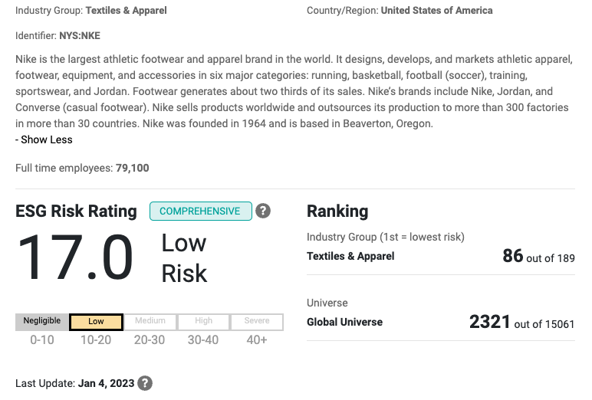
NIKE: LEADER IN BLM AND GENDER EQUALITY
Nike does not drop athlete BLM: Stood behind Colin Kaepernick. es when they take a stand against injustices.
Women: Ends sponsorship with athlete not cooperating with sexual assault investigation. *
https://www.sustainalytics.com/esg-rating/nike-inc/1008170227
* “Nike says it cut ties with Neymar over his refusal to cooperate in sexual assault investigation.” By Rob McLean, Jill Disis, Marcia Reverdosa and Rodrigo Pedroso, CNN Business, May 28, 2021. https://www.cnn.com/2021/05/28/business/nike-neymar-sexual-assault-investigation-spt/index.html

Slide 33
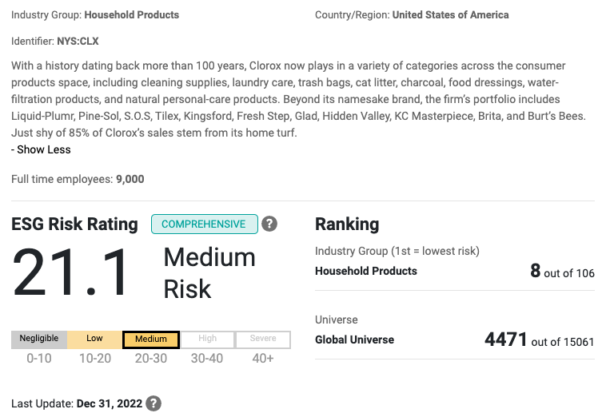
CLOROX:
Product safety (ESG) is key to maintain trust of consumers.
50-70% of Clorox’s legal team does pro bono work.*
https://www.sustainalytics.com/esg-rating/nike-inc/1008170227
*https://www.thecloroxcompany.com/blog/why-clorox-lawyers-harness-the-power-of-pro-bono/

Slide 34
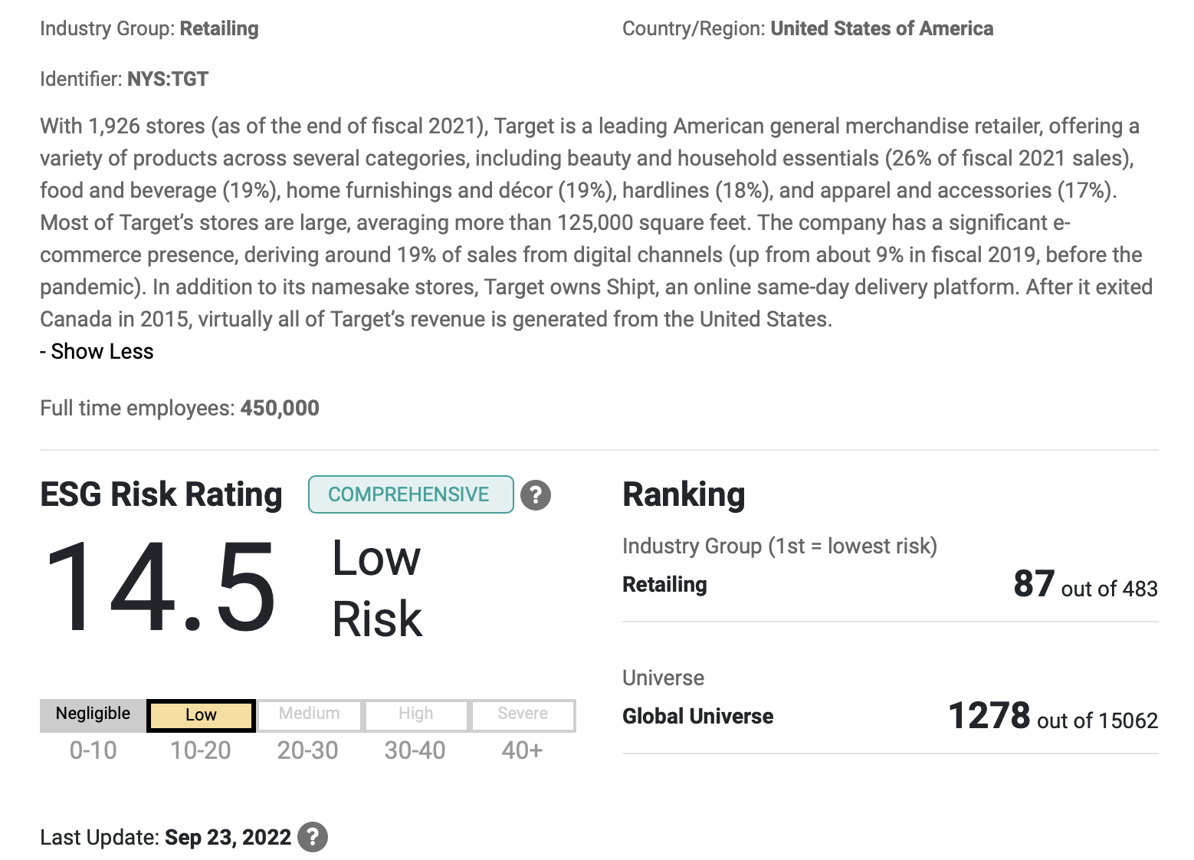
TARGET:
Investing $100 million through 2025 to help Black communities.
Committing to spend $2 billion with Black-owned businesses by 2025*.
https://www.sustainalytics.com/esg-rating/target-corp/1008052684
*https://corporate.target.com/article/2021/10/reach-pensole

Slide 35
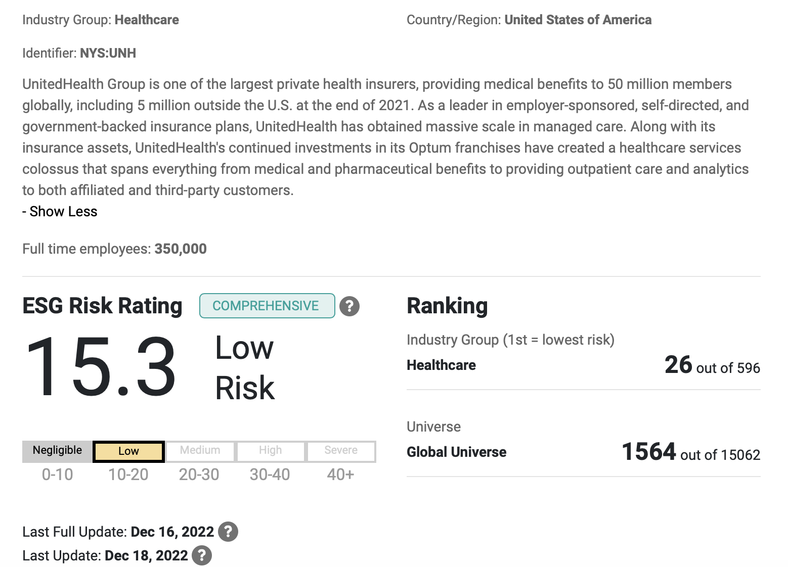
UNITEDHEALTH:
Investing nearly $800 million in affordable housing resulting in the creation of nearly19,000 homes*.
Provided more than $1 million to support on-site health-related services for resident in affordable housing communities.
https://www.sustainalytics.com/esg-rating/unitedhealth-group-inc/1007982919
*https://www.unitedhealthgroup.com/newsroom/2022/additional-housing-investment-bolsters-uhg-efforts.html

Slide 36
ESG STORIES: PROCTER & GAMBLE (P&G)
P&G has set a target to have 100% of consumer packaging designed to be recyclable or reusable by 2030.
P&G reusable packaging initiative includes partnering with Loop, a global reuse platform that collaborates with brands and manufacturers to allow refillable versions of their single-use products.
Notes:
Sources:
ESG Is Key to Attracting Gen Z for Beauty, Home-Care Companies
https://www.pginvestor.com/esg/environmental/plastic-packaging/default.aspx#plastic_packaging_goals
https://exploreloop.com

Slide 37
ESG STORIES: ETSY
Many Etsy sellers offer made to order items that reduce product waste and overconsumption. Many also have an eco-conscious approach in their product lines and packaging.
Illustrator Julienne Reyes sells stickers and accessories on her Etsy shop, Belugabee. She uses sustainable packaging called EcoEnclose and donates a portion of her proceeds to charities that help the environment and children in need.
Etsy has a planet-friendly packaging partnership with EcoEnclose to bring sellers made from 100% recycled materials or certified responsibly sourced paper.
Notes:
Sources:
ESG Is Key to Attracting Gen Z for Beauty, Home-Care Companies
https://www.pginvestor.com/esg/environmental/plastic-packaging/default.aspx#plastic_packaging_goals
https://exploreloop.com

Slide 38
ESG STORIES: L'ORÉAL
A leader in reconstructing human skin models in laboratories to replace traditional animal testing.
L'Oréal is the most active company working alongside the Chinese government and scientists to have alternative testing methods recognized. Since 2014, products manufactured and sold in China like shampoo, body wash, and certain make-up products are no longer tested on animals.
Notes:
Sources:
ESG Is Key to Attracting Gen Z for Beauty, Home-Care Companies
https://inside-our-products.loreal.com/our-approach/our-alternative-methods-animal-testing

Slide 39
ESG STORIES: VALMONT
A US engineering company that supports agriculture productivity and infrastructure development. The company’s impact has been on the following:
Saving 3.9 trillion gallons of water each year, compared to traditional irrigation methods, by using its agricultural sprinkler systems to irrigate approximately 30 million acres of farmland worldwide
Optimizing AT&T’s telecommunication structures to provide a reliable nationwide communication network to the public safety sector
Notes:
The events of 9/11 revealed flaws in our country’s communication system especially in the systems used by first responders. To prevent these issues from happening
again, Congress established the First Responder Network Authority, or FirstNet. The idea was to give lifesaving 21st century communication tools to the public safety sector and it awarded the contract to AT&T.
AT&T turned to Valmont.
Sources:
https://impaxam.com/assets/pdfs/sustainability/impax-impact-report-2022-usa.pdf?pwm=107
https://webassets.valmont.com/valmontstaging/docs/librariesprovider80/sustainability-2022/vo22_corp_sustainabilityreport_final_060222.pdf

Slide 40
ESG STORIES: IMPAX
Invested in the first social mortgage-backed securities (MBS) issued by Fannie Mae. The social MBS is collateralized by loans that support multi-family properties qualifying as either restricted affordable housing or manufactured housing communities.
In 2021the social bond has financed 85,300 mortgages for multi-family affordable housing and 48,200 manufactured housing communities
Notes:
Source: https://impaxam.com/assets/pdfs/sustainability/impax-impact-report-2022-usa.pdf?pwm=107

Slide 41
ESG STORIES: SCHNEIDER ELECTRIC
It has a long history of partnering with the US government to advance the clean energy transition. The company’s impact has been on the following:
Building a microgrid to allow operations at the Port of Long Beach, the second busiest seaport in the nation, to be more resilient and cleaner
Modernizing 90 buildings of the US Navy and optimizing its data center operations at two bases
Providing infrastructure upgrades to the US Department of Veterans Affairs Medical Center in Puerto Rico to enhance patient care
Notes:
Sources:
1. https://www.se.com/us/en/about-us/newsroom/news/press-releases/schneider-electric-north-america-ceo-attends-white-house-inflation-reduction-act-celebration-63207e9b93b68b362004223f

Slide 42
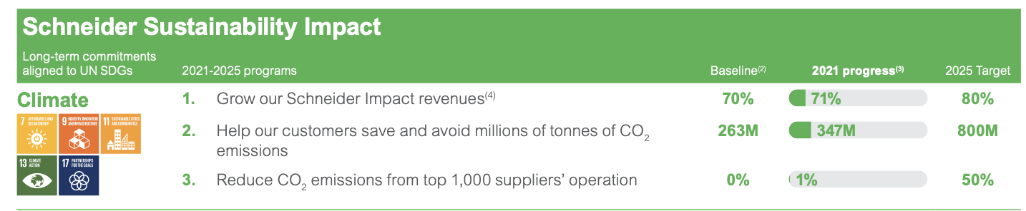
NET-ZERO PLAN: SCHNEIDER ELECTRIC
Goal is to have carbon neutral operations in 2025, be carbon neutral across the company’s value chain by 2040 and reach net-zero by 2050.
Market Size
In 2021, 71% of the company’s €28.9 billion revenue came from offers that bring energy, climate, or resources efficiency to its customers while not having a harmful impact on the environment.
https://www.se.com/ww/en/assets/564/document/322964/sustainability-report-2021.pdf
Notes:
Sources:
https://www.se.com/ww/en/assets/564/document/322964/sustainability-report-2021.pdf
https://www.statista.com/statistics/596171/revenue-of-schneider-electric/

Slide 43
ESG STORIES: SIEMENS ENERGY
It is a global market leader in renewable energies. The company’s impact has been on the following:
Partnering with other energy companies to provide gas turbine to stabilize the power supply when renewables such as solar or wind fluctuate. Burning natural gas produces 42% fewer CO2 emissions than burning coal.
Designing renewable energy project that combines wind power, water and CO2 to produce carbon-neutral fuel at an industrial scale.
Notes:
Sources:
1. https://assets.siemens-energy.com/siemens/assets/api/uuid:aa057b32-4046-418f-a429-84ba3664dbc5/global-energy-transition-readiness-index-2023.pdf?ste_sid=3dcd11fa2bff409dca7daea535cdd4f5

Slide 44
NET-ZERO PLAN: SIEMENS ENERGY
All company production facilities and buildings will be carbon neutral by 2030. The company’s strategy includes:
Developing new products and technologies that have zero emissions or significantly lower emissions
Developing products and services to transport for the transportation and storage of electricity
Market Size
As of 2022, the company has invested €65 million in energy efficiency projects. Over the past three years, the company has spent €1 billion on R&D.
Notes:
Sources:
https://assets.siemens-energy.com/siemens/assets/api/uuid:49bc59fb-7af0-47fc-a764-a3550d4153dc/siemens-energy-sustainability-report-2022.pdf
https://new.siemens.com/global/en/company/sustainability/carbonneutral.html

Slide 45
ESG STORIES: AES
A global energy company that creates greener and innovative energy solutions. The company is making progress on the following:
Utilizing an automated solar deployment robot, Atlas, to increase the speed at which solar panels are installed and to scale the deployment of renewable energy among challenges like labor shortages.
Enticing US solar panel manufacturers to increase production of domestic solar panels by pledging to buy as much as 7 gigawatts worth of of US-made solar panels per year.
Notes:
Sources:
https://www.pv-tech.org/accelerating-solar-deployment-through-robotics/
https://www.wsj.com/articles/solar-power-developers-pledge-to-buy-u-s-panelsif-someone-makes-them-11655805600

Slide 46
NET-ZERO PLAN: AES
Goal is to achieve net zero carbon emissions associated with electricity sales by 2040, reduce coal-fired generation to less than 10% by 2025, and be net zero by 2050 for all business scopes. Key components include:
Scaling synthetic fuels with green inputs such as captured carbon or nitrogen to power long-haul transit and industrial processes
Investing in battery storage and power generation infrastructure using carbon neutral fuels
Conducting a feasibility study in Chile with collaboration of an international hydrogen producer for the first green hydrogen-based ammonia project
Market Size
In 2022, AES committed to invest $2 billion to build the largest US green hydrogen facility.
Notes:
Sources:
https://www.aes.com/sites/default/files/2021-03/2021_AES_Climate_Scenario_vFinal_web_2.pdf
https://www.reuters.com/business/sustainable-business/air-products-aes-invest-4-bln-building-largest-us-green-hydrogen-plant-2022-12-08/

Slide 47
ESG STORIES: NEXTERA ENERGY
The biggest US generator of renewable energy. The company is making progress on the following:
Planning to convert more than two-thirds of its natural gas power plants to run on hydrogen fuel.
Building more than 86,000 megawatts of solar-generating capacity to serve its Florida utility customers.
Increasing the utility’s power storage capacity to discharge power at times when solar production declines.
Installing 50% of 30 million solar panels ahead of schedule. Completion is now expected by 2025.
Notes:
Sources:
https://www.wsj.com/articles/power-company-nextera-plans-to-cut-carbon-emissions-to-close-to-nothing-by-2045-11655207881?page=1

Slide 48
NET-ZERO PLAN: NEXTERA ENERGY
Goal is to reach Net-Zero by no later than 2045 without using carbon offsets at no incremental cost to their customers. The company plans include:
Partnering with peer companies to decarbonize the US power sector and continue working with investor-owned utilities, municipalities and cooperatives.
Leading the decarbonization of the US economy by partnering with Fortune 1000 customers to provide renewable energy infrastructure solutions.
Market Size
From 2012 – 2021, Florida Power & Light Company (FPL) has deployed approximately $51 billion in smart capital investments in Florida. In doing so, FPL saves its customers nearly $2.6 billion a year. As of year-end 2021, FPL residential customer bill was about 28% lower than the national average.
NextEra Energy plans to invest between $50 and $55 billion through 2022.
Notes:
Sources:
https://www.nexteraenergy.com/content/dam/nee/us/en/pdf/2022_NEE_ESG_Report_Final.pdf
https://www.nexteraenergy.com/company/work.html

Slide 49
ESG STORIES: CATERPILLAR
A leading manufacturer of construction and mining equipment, natural gas engines, and industrial gas turbines. The company has made progress in the following:
Providing reliable and sustainable backup power to Microsoft data centers using renewable hydrogen fuel.
Using its methane Cat® generators to collect, clean and run on harmful gases produced by landfills.
Notes:
Sources:
1. https://s7d2.scene7.com/is/content/Caterpillar/CM20220511-3628c-87ee2

Slide 50
NET-ZERO PLAN: CATERPILLAR
The company has established seven sustainability goals to achieve by 2030, five of which are climate and environmental goals. The goals include:
Designing all its new products through 2030 to be more sustainable than the previous generation
Reducing landfill intensity by 50% from 2018 to 2030
Implementing water management strategies at all facilities located in water high-risk areas
Market Size
Notes:
Sources:
1. https://www.caterpillar.com/en/company/sustainability/2030-sustainability-goals.html

Slide 51
WHAT COULD AN ESG DOW LOOK LIKE?
Future is likely: e-commerce, acceleration of global travel, remote work, US renewable energy
Investment ideas: Shopify, CSX, Boeing, Equinix, American Tower, Siemens/First Solar???
High = monopoly power
Global travel: Boeing. Need regulations requiring sustainable jet fuel before carriers buy new planes.
Remote work: American Tower. 5G penetration may be limited by local laws (NIMBY). People not wanting cell phone towers on buildings. On the other hand, governments looking to attract new residents might want to invest in 5G infrastructure.
Market share opportunity
E-Commerce: Shopify. Regulatory risk low due to inability of Congress to comprehend internet technologies. Congress attacks on incumbent monopolies might create opportunities for 2nd and 3rd place companies in terms of market share. Demand for services driven by consumer trends (higher cyclical risks = where we are at in the business cycle).
Low
Regulatory risk
High

Slide 52
CSX
The need for moving goods from point A to point B is constant in good times and bad. Reducing carbon emissions is crucial to move towards a sustainable economy.
What CSX is doing: In 2021, compared to shipping by truck, CSX rail “avoided 11 million metric tons of carbon dioxide emissions, the equivalent of taking 2.3 million cars off the road.”
https://www.csx.com/share/wwwcsx15/assets/File/About_Us/Responsibility/2021-CSX-ESG-Report-final.pdf

Slide 53
An example is a 2040 Target Date strategy which is found in many 401(k) plans. It is designed to provide basic diversification.
For example, if US stocks fall 10% in one year and foreign companies rose in value and bonds were flat, your portfolio would not have suffered as much as if it were only invested in US companies.
Notes:
Here is an example of basic diversification. If US stocks fall 10% in one year and foreign companies rose in value and bonds were flat, your portfolio would not have suffered as much as if it were only invested in US companies.

Slide 54
FOR SOME PEOPLE, GOOD ENOUGH IS ACCEPTABLE. IF YOU WANT TO DO BETTER, YOU NEED TO EDUCATE YOURSELF.

Slide 55
WHAT ARE NARRATIVES THAT COULD PREVENT YOU FROM DOING BETTER THAN AVERAGE?

Slide 56
The 60/40 strategy is based on the premise that when stocks go down bonds retain value and has been promoted as a strategy that could weather all storms for everyday investors, but it may not provide stable returns in extreme economic conditions.
Notes:
Should investors in a 60% stocks/40% bonds portfolio change their allocation? It depends on their goals and need for income. Some point to consider:
The 60/40 portfolio allocation has been promoted as a strategy that could weather all storms for everyday investors, but against today’s high inflation backdrop, that may no longer be the case. The Federal Reserve Bank's response to soaring inflation has impacted all asset classes including stocks and bonds.
The 60/40 strategy is based on the premise that when stocks go down bonds retain value. However, year-to-date bondholders in general have suffered losses.
In recent months bonds have showed signs of resuming a defensive role, but only two asset classes have consistently beaten inflation historically: stocks and real estate. US stocks have recovered from every market drop and rental real estate could be an inflation hedge depending on a number of factors. Other options include cash, laddered CDs, I-Bonds, and dividend paying stocks depending on the time horizon and account size.

Slide 57
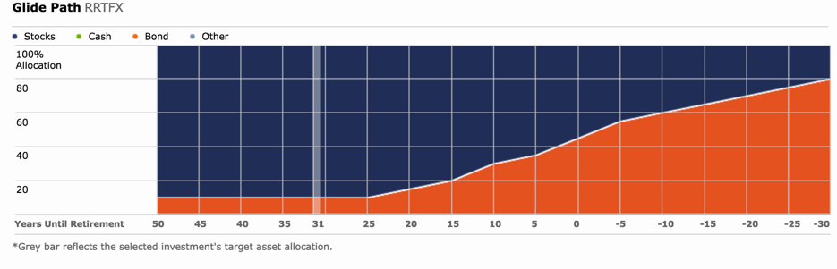
EXAMPLE: TARGET DATE | ALLOCATION STRATEGIES
Asset allocation determined by years to retirement.
Example: Target Date 2050 strategy
~30 years to retirement: Bond allocation about 10% and increases closer to target retirement year. Assumes bonds less volatile than stocks, but this might not always be the case.
Notes:
Target Date Funds provide basic asset allocation and designed to be the only holding in your account. They rebalance over time to reduce risk. The assumption is that the closer the investor is to retirement, the lower the amount of stocks in the portfolio. This chart shows the glidepath which shows allocation changes based on investment timeframe. You will notice in this example it is not until 20 years to retirement that a meaningful reduction in stocks occurs.

Slide 58
TARGET DATE | ALLOCATION STRATEGIES
For investors 20+ years from retirement, target date strategies have more stocks and less bonds.
However, strategies could have higher weight to foreign and emerging markets than suitable for one’s risk tolerance.
Target Date and Allocation strategies are designed to be the only holding in an account, but they are composed of several different funds.
Passive (index-based) strategies may have lower costs. Active management assumes human beings are screening companies for management quality. Many indices rebalance (change composition) quarterly or annually.
The “target date” is the approximate date when investors plan to start withdrawing their money.
The principal value of a target fund is not guaranteed at any time, including at the target date.
Notes:
Here are the key points for target date funds
When an investor is 20+ years from retirement, target date funds have more stocks and less bonds.
However, funds could have higher weight to foreign and emerging markets than suitable for one’s risk tolerance.
Target Date funds are designed to be the only holding in an account.
Passive (index-based) funds may have lower costs. Active management assumes human beings are screening companies for management quality. Many indices rebalance (change composition) quarterly or annually.

Slide 59
BASIC INVESTING ON YOUR OWN, BUT BETTER

Slide 60
Notes:
Here is an example of basic diversification. If US stocks fall 10% in one year and foreign companies rose in value and bonds were flat, your portfolio would not have suffered as much as if it were only invested in US companies.

Slide 61
WORKING WITH A PROFESSIONAL INVESTOR

Slide 62
There is no guarantee that a diversified portfolio will enhance overall returns or outperform a non-diversified portfolio. Diversification does not protect against market risk.
Notes:
Here is an example of a fully diversified portfolio. Asset allocation is not designed to give the highest return. The intention is to produce the most stable return given an investor’s risk tolerance and investment time horizon. Talk to your financial advisor on how your investments are diversified. To set up an appointment with me, go to www.moderncapitalconcepts.com

Slide 63
HOMEWORK: ACTION PLAN
Write down at least three things you can do right now.
1.
2.
3.
4.
5.

Slide 64
The opinions voiced in this material are for general information only and are not intended to provide specific advice or recommendations for any individual. The economic forecasts may not develop as predicted. All performance referenced is historical and is no guarantee of future results. Stock investing involves risk including loss of principal.
The prices of small and mid-cap stocks are generally more volatile than large cap stocks.
International investing involves special risks such as currency fluctuation and political instability and may not be suitable for all investors. These risks are often heightened for investments in emerging markets.
Bonds are subject to market and interest rate risk if sold prior to maturity. Bond values will decline as interest rates rise and bonds are subject to availability and change in price.
High yield/junk bonds (grade BB or below) are not investment grade securities, and are subject to higher interest rate, credit, and liquidity risks than those graded BBB and above. They generally should be part of a diversified portfolio for sophisticated investors.

Slide 65


www.moderncapitalconcepts.com
khloe@moderncapitalconcepts.com

