Slide 1
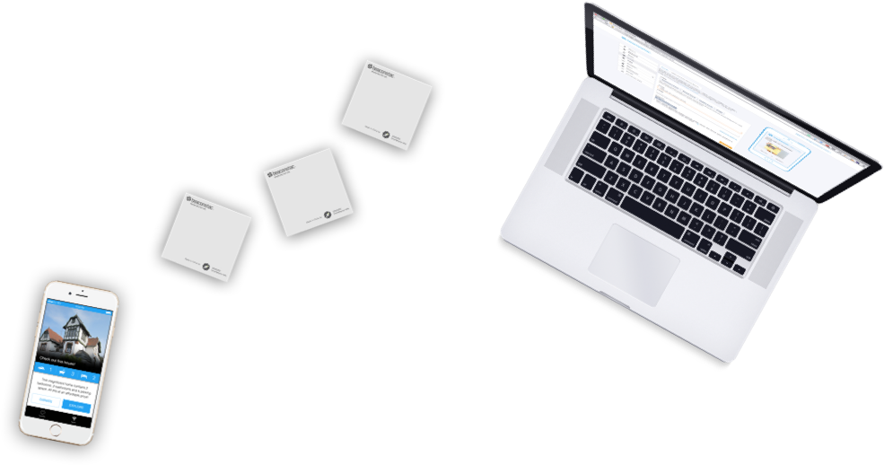
Proximity Marketing
&
Data Analysis
By
Think Inc.

Slide 2
Main Goals for a retail business
Maximize Sales
Retain Customer Loyalty
What is the most important information for any Retail Business ?
Customer Buying Behavior

Slide 3
How Do you attain these goals?
Increase Sales
  Active Marketing of the brand, products and offers
    Emails
    SMS
    Billboards
    Media Advertisements
Customer Loyalty
  Organize sales
  Provide loyalty offers
  Distribute discount coupons
  Award loyalty points

Slide 4
Conventional vs. out of the box
Conventional : Mass Marketing
Out of the box : One to One Marketing / Assistant Buyer
Conventional : No Details about the items bought by a Customer
Out of the box: Learn about the Customer Buying Pattern
Conventional : Unaware about the Hot & Cold Zones in a store
Out of the box : Analyze the Heat Map of the store and strategize

Slide 5
BLUETOOTH Beacon Technology
UPSELLS PRODUCTS
ASSISTANT BUYER
HEAT MAP OF THE STORE
CUSTOMER FLOW IN THE STORE
AVERAGE DWELL TIME OF A ZONE
CUSTOMER PROFILING
SELECTIVE ADVERTISING BASED ON GENDER, AGE, NATIONALITY ETC.

Slide 6


Slide 7
Beacon Implementation Process
Prerequisites
  Working App – Loyalty App
  Bluetooth Connectivity – Increasing everyday (GEOFENCING)
  Active Data Package / Wifi – 3.7 Million Users / Free Wifi in Malls
3 Step Implementation
  Integration in to the Loyalty App
  Definition of Zones in a Store
  Placement of Beacons according to the Zones

Slide 8
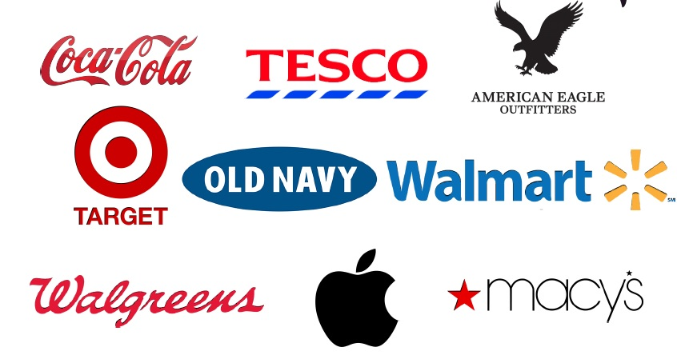
Who is using beacons?

Slide 9
Case Studies – How to use beacons ?
Macy’s
  Deployed 4000 beacons across stores in the US
  Future Plan : Tracking and Targeting customers who visited but did not purchase
Lord & Taylor
  Deployed Beacons in 7 departments of each store
  Individual campaign
  Saw 60% higher Engagement Rate with its Beacon Marketing Program
American eagle Outfitter
  Placed Beacons at the Entrance and Fitting Rooms
  Rewards customers for trying out clothes
  More than 10,000 customers took part in the Campaign

Slide 10
Case Studies – How to use beacons ?
Regent Street
  Leader in iBeacon
  130 Stores
  Built a detailed profile of the customer based on offers redeemed
House of Fraser
  Smart Mannequins
  Send offers to Customers as they walk past the store
  Display prices of the Clothes on the Mannequin

Slide 11
Key facts and numbers
33% of top 100 Retailers in the USA – Business Insider Report
73 % Chances of selling a product that is Marketed to the Customer directly – Suggestive Selling / Impulse Buying
1 Billion + - Devices that can communicate with a Beacon
2016 – Year of the Beacon according to Retailers in the USA
85% of Stores in the USA – End of this Year

Slide 12
Beacon vs. other technologies (GSM, WiFi, Camera & GPS)
Markets on a One to One basis
Cheap and Durable Hardware
Most Accurate in terms of Positioning (15 cms to 100 meters)
Not dependent on any Infrastructure
Location can be changed easily
Can be combined with POS reports – Buying Behaviour and Pattern
Software becomes smarter with more data
No data belonging to the business is extracted during the process
WiFi & GSM are considered illegal in some countries - Privacy

Slide 13
Ankit Lodha
Founder
Think Inc.
+971 50 780 1501
ankit.lodha@thinkinc.ae

