Slide 1



SIBO Capital Investments Pty Ltd
SIBO Capital Investments is a business advisory dedicated to empowering start-ups and SMEs. We help entrepreneurs scale operations, and access the right talent. We combine industry expertise with a hands‑on, partner‑led approach, ensuring our clients are equipped to make informed decisions and achieve sustainable growth.
2026v2
COMPANY PROFILE

Slide 2




WELCOME TO SIBO CAPITAL
SIBO Capital Investments Pty Ltd is dedicated to start-ups and SMEs. We provide practical, hands-on guidance that helps entrepreneurs build strong foundations, scale operations, and develop high-performing teams.
Welcome To SIBO Capital Investments

Slide 3



ABOUT US
We work alongside our clients to implement strategies, streamline operations, and build the internal capabilities that drive long‑term success..
By leveraging data-driven insights and a deep understanding of industry dynamics, the company empowers organizations to enhance their operational frameworks and achieve their strategic objectives.
SIBO Business Solutions

Slide 4

THE VISION..
01.
02.
To provide an unparalleled range of customized solutions and services addressing our clients’ current and future needs.
To be the most trusted business partner for start-ups and SMEs, known for delivering practical, high‑impact solutions that fuel sustainable growth.

Slide 5




THE MISSION..
To equip entrepreneurs and growing businesses with the strategic clarity, operational support, and human capital they need to thrive
01.
02.
We believe that success is a collaborative effort, and we work tirelessly to connect our clients with the tools and systems they need to improve profit and efficiency

Slide 6






We concentrate on three areas where we deliver the most value, allowing us to maintain deep expertise and consistent qlity
OUR CORE FOCUS
ADVISORY
We concentrate on three areas where we deliver the most value, allowing us to maintain deep expertise and consistent quality
HUMAN CAPITAL
BPO
Strategic Planning – Business models, and planning
Market Analysis & Feasibility – Due dilligence and validating research.
Operational Efficiency – Streamlining processes, reducing costs, and improving productivity.
Risk Management – Identifying and mitigating operational, market, and regulatory risk
Talent Acquisition – Key recruitment support for key roles.
Training & Development – Workshops and programmes in B2B, communication, digital, and direct sales.
Team Capability Assessment – Identifying skill gaps and creating development plans.
Customer Support – Tailored helpdesk and client communication services.
Data Management – Data entry, reporting, and administrative support.
HR Administration – Payroll support, employee records, and basic HR compliance.
Need Hosting ?
Designed with reliability and security in mind, ensuring that our clients' websites are not only accessible but also protected against potential cyber threats.
Your Business needs strategic planning and effective operational processes & business development solutions that include ERP/CRM systems.
Optimize sales strategies, and improve operational efficiencies.
Sales Optimisation

Slide 7



OUR APPROACH
We work as an extension of your team. Our advice is practical, our communication is direct, and our success is measured by yours
Office Automation
PARTNER NOT PROVIDER
TAILORED NOT UNIFORM
We work as an extension of your team. Our advice is practical, our communication is direct, and our success is measured by yours.
Every business is unique. We take the time to understand your context, constraints, and ambitions before proposing any solution.
Seed Capital Funding
Our office automation solutions are designed to streamline processes, reduce operational costs, and increase productivity, allowing organizations to focus on their core competencies.
SIBO Capital actively engages in investment opportunities that align with our vision of fostering innovation and economic partnerships
We seek out promising startups and established companies that demonstrate potential for significant returns and impact.
Project Funding
We offer flexible computer rental options, allowing businesses to access state-of-the-art technology without the burden of significant upfront investment..

Slide 8



WHY CHOOSE US
Deep SME & Start-up Experience
Focus on Implementation
Cost‑Effective Solutions
We don’t just deliver reports; we help you execute, with clear milestones and measurable outcomes
We design our services to deliver high value without the overhead of large consulting firms
Our team has hands‑on experience in building and scaling businesses across various industries.

Slide 9






WHATS IN IT FOR YOU
At SIBO Capital Pty Ltd, we are driven by a passion for innovation and a commitment to excellence.
Our comprehensive suite of services is designed to equip business, entrepreneurs and startups with the tools, resources, and guidance necessary to navigate the complexities of today’s business environment.

Slide 10








WE ADD VALUE
We work closely with SME businesses to identify areas for improvement and growth.
SIBO Capital's team of experts conducts thorough assessments of organizational structures and processes.

Slide 11
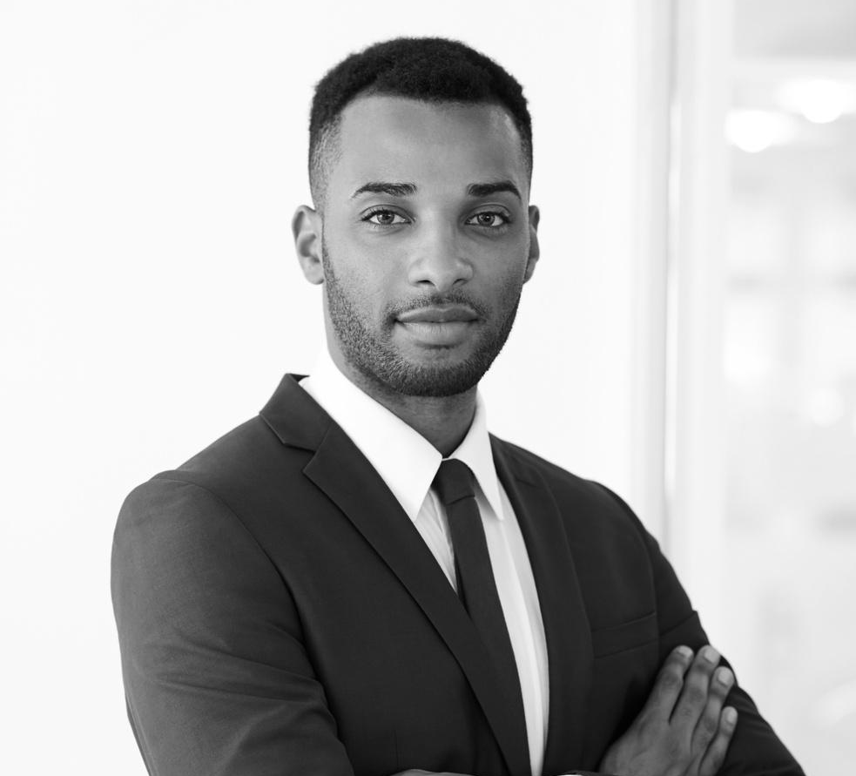



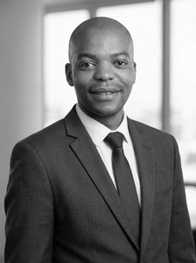
YOU HAVE OUR WORD
SIBO Capital is led by professionals with extensive backgrounds in business strategy, operations, and talent development. We believe in leading by example—our team is accessible, responsive, and deeply invested in the success of the entrepreneurs we serve.
Pearl Vilakazi, Managing Director
At SIBO Capital, the focus is on developing tailored management strategies that align with the unique needs and goals of each client. We embrace a holistic approach to management consulting, emphasizing the importance of integrating best practices across all levels of your organization.
Bongani Buthelezi, Head of Business Development
Our leadership is supported by a network of industry specialists who contribute expertise in finance, technology, and regulatory compliance as needed.
Name Here
Name Here
Name Here
Name Here
Accounting
Marketing
Consultant
Designer

Slide 12




CONTACT US
We are driven by a passion for innovation and a commitment to excellence
www.sibocapital.co.za
business.sibo@sibocapital.co.za
129 Jan Smuts Ave
Freeway Office Park
Randburg, 2193

