Slide 1

Securing International Remote Jobs over the Internet
Prepared for the Internet Society of Lebanon

Slide 2
Table of Contents
1. What is Remote Working?
2. Advantages and Disadvantages of Remote Work
3. Is Remote Work Right for You?
4. How to Find Remote Jobs Internationally?
5. What are Remote Employers Looking for?
6. Writing a Resume for a Remote Job
7. What to Expect in a Remote Work Interview?
8. If Hired, What Can You Expect from Your Employer?
9. Summary and Conclusion

Slide 3
What is Remote Working? - Terminology
Telework? Telecommute? Remote Work? Nomad Work?
Telework
Work at locations different from the main office using the phone and fax to connect with your team (same area/geography). Term coined in 1960’s
Telecommute
Work at locations different from main office for a few days. Has to report occasionally
Remote work
Work from home or any other space outside the office. No concern over location
Nomad work
Works from different geographical locations, possibly outside their home country, relying entirely on technology.

Slide 4

Office v/s Remote Work -
Home

Slide 5


A Remote Worker – Co-Working
A Nomad Worker - from the Bahamas

Slide 6
Countries with Digital Nomad Visas
Spain
Portugal
Germany
Croatia
Iceland
Czech Republic
Cyprus
Costa Rica
Bahamas
Barbados
Cayman Islands
Bermuda
Mexico
Taiwan

Slide 7
Some Remote Work Statistics
56% of Global Employers currently offer remote work
Half of all Jobs are considered compatible for remote work
In the past 5 years remote work grew 44% per year
61% of US workers would accept a pay cut to be able to work from home
2/3 of workers believe that continuing to work remotely will make them happier
It’s anticipated that by 2027, more people will work remotely than not
A new Job Title has surfaced. It is the Chief Remote Officer.

Slide 8
Suitable Remote Work Jobs – A Sample
Requiring a degree
Financial expert
Writer/Editor
Not requiring a degree
Customer service representative
Data entry
Software developer
Teacher
Marketing manager
Sales Representative
Transcriptionist
Virtual assistant

Slide 9

Most Popular Remote jobs
Product designer
Writer
Product manager
Executive assistant
Recruiter
Social-Media manager
Marketing Manager
Graphic designer
Accountant
WordPress developer
Senior software engineer

Slide 10
Sample of Remote Work Pay Rates
Vary between one location and another and between one job category and another.

Slide 11
Sample of Remote Work Pay Rates – Schedule 1
 | Annual Income in US$ 000 |  | Hourly Rates in US$
Job Title | From | To | From | To
Developer | 75,000 | 160,000 | 36 | 77
Web Designer | 40,000 | 125,000 | 19 | 60
Cyber Security | 51,000 | 117,000 | 25 | 56
Technical Support Manager | 50,000 | 119,000 | 24 | 57
SEO Specialist | 60,000 | 85,000 | 29 | 41
Content Writer | 50,000 | 100,000 | 24 | 48
Project Manager | 45,000 | 150,000 | 22 | 72
Product Manager | 54,000 | 121,000 | 26 | 58
Business Development Manager | 44,000 | 122,000 | 21 | 59
Finance Director | 61,000 | 161,000 | 29 | 77
Marketing Director | 130,000 | 270,000 | 63 | 130
PR Director | 49,000 | 140,000 | 24 | 67
Virtual Assistant /Office Manager | 50,000 | 100,000 | 24 | 48
Customer Support | 23,000 | 60,000 | 11 | 29
Source: WeWorkRemotely and FlexJobs

Slide 12
2. Advantages & Disadvantages of
Remote Work
To the Remote Worker
To the Employer

Slide 13
Advantages & Disadvantages to the Remote Worker
Advantages
Disadvantages
  Flexible time – When to start and end workday including breaks
  No commuting expenses
  More personal time available due to less commuting time
  Beneficial to older people and those with disabilities
  Potentially higher earnings
  Fewer networking opportunities
  Feelings of isolation
  Distractions at home
  Time management – When does work
  start and end – impact on family
  Payment of own taxes and social security

Slide 14
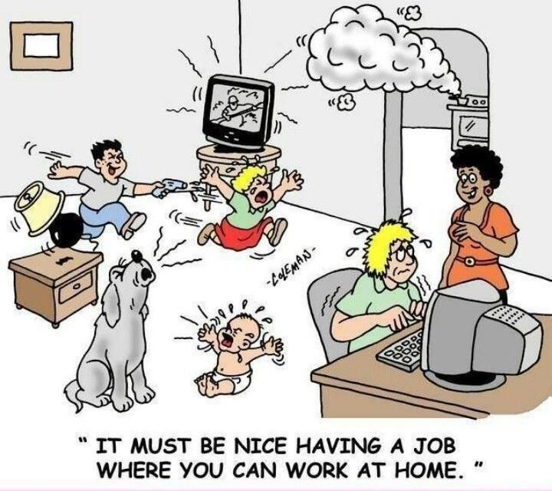
Distractions at Home

Slide 15
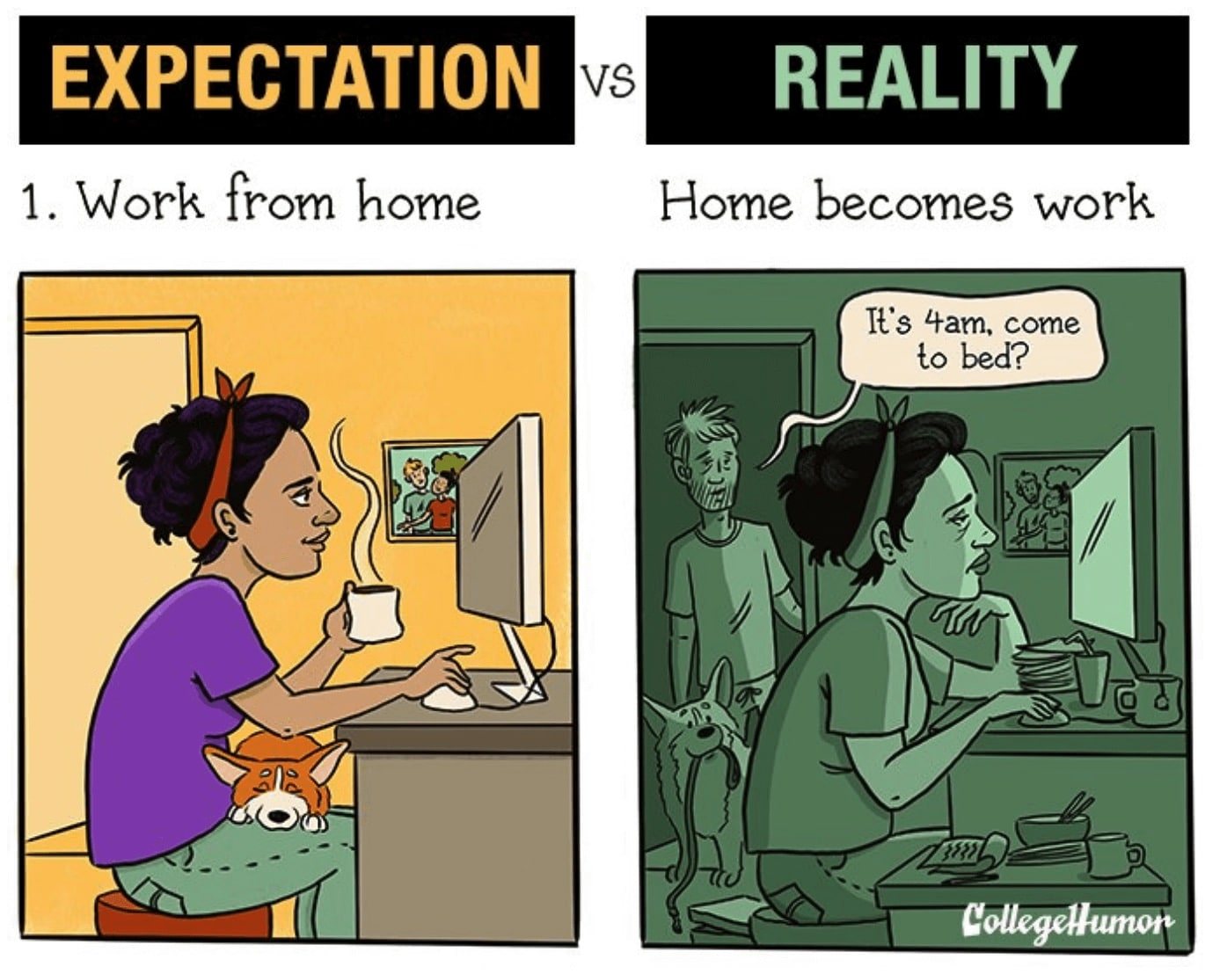
Time Management – Impact on Family

Slide 16
Advantages & Disadvantages to the Employer
Advantages
Disadvantages
  Greater pool of talent – no geographical limitation
  Productivity increase – less office interruptions
  Office space savings
  No social security or benefits paid
  Reduced staff turnover
  Some workers less suitable for remote working
  Harder to build team spirit and manage people
  Cybersecurity concerns - security loopholes increase at home or co-working space
  Difficulty of controlling remote work

Slide 17




3- Is Remote Work Right for You?
’
Remote work is not a ‘fit for all’ proposition
Are you self-disciplined and self-motivated?
Can you work alone?
Assess your communication skills
Can you balance your work and life?

Slide 18
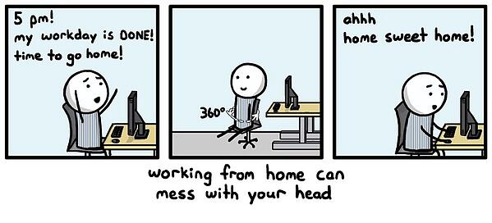
Balancing Work and Life

Slide 19
4- How to Find Remote Jobs Internationally?
  Through remote job recruiting agencies
  Directly from remote employers’ job sites

Slide 20
Remote Work Recruiting Agencies - Variations
  95% of remote jobs still have geographic requirements, whether it is a specific region, city, state or country.
  This leaves the 5% of remote jobs that are ‘work-from-anywhere’ jobs where employees work 100% remotely and are independent of location and time zone.

Slide 21
A- Top Recruiting Agencies for International
Remote work- A comparison
There are hundreds, if not thousands, of recruiting agencies around the globe.
But not all of them are specialized in ‘remote work’ and fewer in ‘work-from-anywhere’ jobs.
Not all of them have similar approaches to doing business making it fairly complex to find a good fit for either the contractor or the employer.

Slide 22
Top Recruiting Agencies for International
Remote Work- A Comparison
Please open Schedule 2 - Top Recruiting Agencies for International
Remote work- A comparison
Selected and sorted by focus on ‘work from anywhere’ jobs

Slide 23
Well Established Recruiting Agencies
Familiar names in the recruitment business may not be the best for Remote Job availability, however they are more and more focused on remote work:
Indeed
Manpower
Adecco
Randstad
Kelly Services
Robert Half
Etc…
The key again is focusing on ’Work from Anywhere Jobs’ recruiting agencies

Slide 24
B-Top Remote Jobs Companies in 2023
Ten companies according to ‘FlexJobs’ hire ‘work from anywhere’ jobs:
Protocol Labs Open source tools
Wikimedia Foundation Educational Content
StudySmarter UG Educational technology
Toptotal Talent marketplace
Achieve Test Prep College education consultant
ModSquad Moderation and Customer Service
Polygon Technology Development of user-friendly apps
Superside Subscription design service
ConsenSys Blockchain technology solutions
Airbnb Marketplace for part time home rentals

Slide 25
5- What are Remote Employers Looking for?
Remote Employers will consider the following traits as essential:
Communication Skills: Engaging in communication thru both phone and online platforms and messaging systems are vital
Technical Skills: Manage and troubleshoot equipment independently is critical
Initiative and Independence: Ability to work alone and initiative to complete tasks without supervision
Reliability and Time management: Delivering work efficiently and effectively

Slide 26
6- Writing a Resume for a remote Job
To stand out your resume has to highlight Remote Work skills and experience
1- Your desire for remote work and how it fits with your personality - Best listed under the Summary section
2- Any prior remote work experience - Best listed under the Summary and Work History sections
3- Expertise with useful remote tools – Best listed under Technical skills section
4- Independence, Communication, Collaboration + - Best listed under Summary & Personal skills section

Slide 27
Other Ways to Attract Remote Employers
Create a profile in LinkedIn where most employers and recruiting agencies search to find talent.
  Keep your profile up to date helps you build your network and connect with others via the integrated messaging system.
Create your own website or blog
  Start publishing articles in them
Write articles and send them to specialized sites.

Slide 28
7- What to Expect in a
Remote Work Interview?
Remote work interviews are mostly done through a video, possibly a phone call.
You should be prepared to answer questions mostly related to your ability to work remotely.
As outlined before under “What the remote employer is interested in”.
  Questions regarding your personal and technical skills, your ability to work independently and manage your time efficiently will certainly surface.
  Be well prepared to face them head on.

Slide 29
8-If hired, what can you expect from the employer?
A- Non-Disclosure Agreement (NDA) – In most cases, employees will be asked to sign an NDA
B-Employer monitoring your work - Employers may use tracking software to monitor work
C-HR Employee Handbook – Details issues of communication, security, ethics, payroll and benefits
D- Conflict Resolution – Why does it happen, Impact and how it is addressed.
E- Payment Methods – Specific Payroll Cycles - Internal Processing, Payroll Outsourcer, ‘Employer of Record’

Slide 30
A- Non Disclosure Agreement (NDA)
Most employers will require their employees and contractors to sign a Non-Disclosure Agreement (NDA).
  This agreement limits the ability of the signer to disclose any information received while doing work with the company.
  It protects the company against secret information being shared with competitors or the service provider using confidential information to start a competing business.
  Such information can include but is not limited to trade secrets, proprietary processes, client lists and strategic and marketing plans.
  You will find a couple of NDA templates provided in Appendix 2 under ‘Relevant links’.

Slide 31
B- Employers Monitoring your Work
In order to track employees’ productivity, most employers today use tracking software to monitor work at home.
  Software companies such as InterGuard, ActivTrack and Teramind have blossomed in the last few years with the remote work trend.
  Companies will normally track your emails, your focus and activities, your browser, and workplace collaboration tools.
  Gartner, the research firm, found that 60 percent of large employers today use tracking software to monitor their employees
Companies will normally alert you to the fact that they are monitoring them if you ask for it and it may be written in your work contract.
It is not fun to feel watched. It seems to be the price paid for working flexibly and remotely.

Slide 32
C- HR Employee Book
If you are hired as an employee, you should expect to get an Employee Handbook
  Detailing issues of communication, security
  Company ethics rules, dispute resolution
  Benefits including pension, healthcare, vacation and holidays
  Payroll, taxes and social security

Slide 33
D- Conflict Resolution
Remote workers experience a good bit of conflicts due to
  work isolation,
  working in different time zones,
  aggressive communication thru text messages or emails,
  clash of values and
  lack of work-life balance.
Employers’ strategies to address conflict resolution at work include
  addressing a conflict ahead of time or as soon as possible,
  Setting clear expectations,
  Setting positive examples,
  Apply the same rules to All,
  Have regular open meetings, and
  Seek common ground.

Slide 34
E- Payment Methods
It is the employer’s responsibility to pay employee income tax in the country where its employees are tax residents - not in the country where it is headquartered.
Each Employer has their specific payroll cycles (monthly, bi-monthly or weekly).
An employer can either do the payroll
  internally within their financial department or
  outsource it to a local Payroll Provider that will issue payroll checks, pay local taxes and social security
  A third alternative is using an ‘Employer of Record’ whose function is to handle a variety of compliance aspects in multiple legal jurisdictions.
In many cases companies hire contractors instead of international full-time remote employees

Slide 35
9- Summary and Conclusion - Steps
1- Understand what working remotely entails
2- Ask yourself if you have the right personality and skills to be happy
3- Select no more than a handful of ‘remote only’ recruiting agencies
4- Prepare your profile and remote work resume.
5- Prepare for your remote work interview (s)
6- Follow up with a letter highlighting your interest and comfort with remote working

Slide 36
Schedule 2 - Top Recruiting Agencies for International Remote work- A comparison
See Attachment

Slide 37
Resources
Appendix 1 - Glossary
See Attachment

Slide 38
Resources
Appendix 2 – Relevant Links
See Attachment

