Slide 1
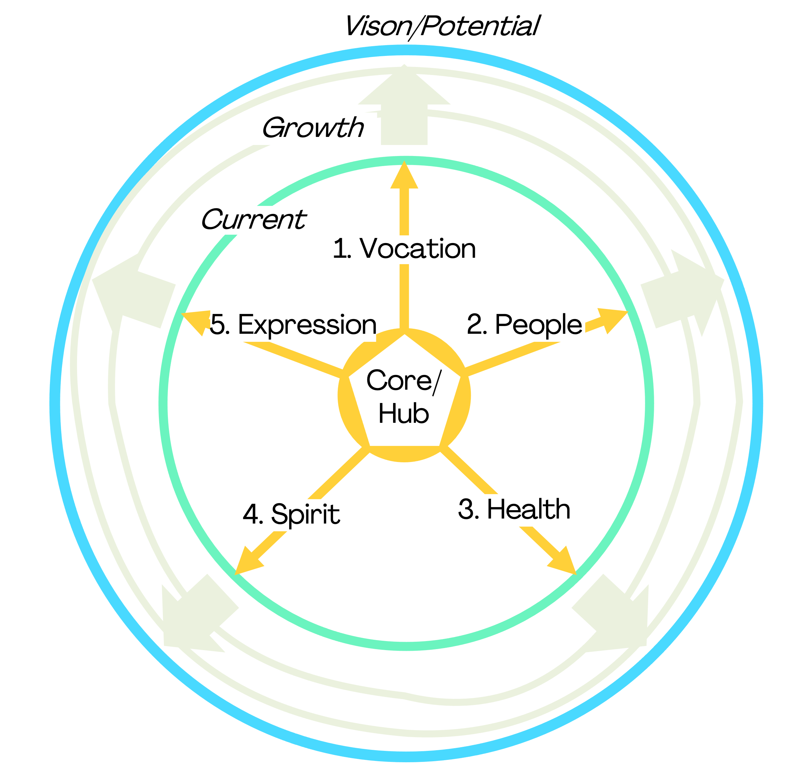
The Good Life Book – The Wheel Status
Name: | Date: | Date: | Date: | TP: |  | LP: |  | Score: (__/5)
Overall Commentary (inc. core alignment):
1. Vocation (__/5) | 2. People (__/5) |  | 3. Health (__/5) | 4. Spirit (__/5) |  |  |  | 5. Expression (__/5)
This period: | This period: |  | This period: | This period: |  |  |  | This period:
Next period actions: | Next period actions: |  | Next period actions: | Next period actions: |  |  |  | Next period actions:
Risks/Opportunities | Risks/Opportunities |  | Risks/Opportunities | Risks/Opportunities |  |  |  | Risks/Opportunities
Notes (inc. Dreams, WIRW/WIGDTGI, Big Ideas, Quick Wins, Watchouts, Key Achievements, Resources Needed, Contribution Opportunities)):

