Slide 1
The 22nd Washington International Education Conference: Immigration Updates for International Students and Scholars
April 8, 2025

Slide 2
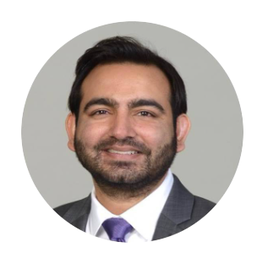
Basim Kamal Senior Associate
Fragomen
Washington, DC
basimkamal@fragomen.com

Slide 3
Post-Inauguration State of Play
Many early executive actions on immigration have had direct and indirect effects on universities, scholars, and students.
This administration has taken numerous actions that impact immigration, including executive orders and presidential memos, as well as with agency policy directives, notices, and regulation proposals
Many of these actions have had both an immediate impact and have set in motion additional impacts and changes over time
Within the first few months, these changes can be seen through agency trends and enforcement actions
3

Slide 4
KEY EXECUTIVE AND AGENCY ACTIONS ON IMMIGRATION UNDER THIS ADMINISTRATION

Slide 5
Key Executive Orders That Impact International Students and Scholars
EO 14148: Initial Rescissions of Harmful Executive Orders and Actions
Rescinds many previous Executive Orders, including those that reduced barriers to legal immigration and those that developed mechanisms to attract international students in STEM
Specifically rescinds EO that directed immigration agencies to develop ways to help the US attract and retain foreign AI and STEM talent; it was credited with facilitating NIV and IV pathways for critical talent

Slide 6
Key Executive Orders That Impact International Students and Scholars (Continued)
EO 14159: Protecting the American People Against Invasion
Calls for DHS to authorize state and local law enforcement to be Immigration Officers and to maximize use of expedited removal authorities
Directs DHS to enable program for the registration of noncitizens

Slide 7
Key Executive Orders That Impact International Students and Scholars (Continued)
EO 14161: Protecting the US from Foreign Terrorists and Other National Security/Public Safety Threats
Calls for maximum vetting of all noncitizens seeking admission to the U.S. and those already in the U.S
“…the United States must ensure that admitted aliens and aliens otherwise already present in the United States do not bear hostile attitudes toward its citizens, culture, government, institutions, or founding principles, and do not advocate for, aid, or support designated foreign terrorists and other threats to our national security.”

Slide 8
Key Executive Orders That Impact International Students and Scholars (Continued)
EO 14188: Additional Measures to Combat Anti-Semitism
Directs agencies to report on recommendations for higher education institutions to monitor and report noncitizen students and staff for possible removal
“…recommendations for familiarizing institutions of higher education with the grounds for inadmissibility under 8 U.S.C. 1182(a)(3) so that such institutions may monitor for and report activities by alien students and staff relevant to those grounds and for ensuring that such reports about aliens lead, as appropriate and consistent with applicable law, to investigations and, if warranted, actions to remove such aliens.”

Slide 9
Key Executive Orders That Impact International Students and Scholars (Continued)
EO 14222: Implementing the President’s “Department of Government Efficiency” Cost Efficiency Initiative
EO targets discretionary spending through federal contracts, grants, loans, and related instruments
+
Hiring Freeze Memo
Memo stipulates a federal civilian hiring freeze, as well as to curtail hiring once lifted

Slide 10
Immigration Executive Orders: Near-term Timeline
Expected actions stemming from recent orders
As soon as practicable
By May 20, 2025
By Feb. 19, 2025
By March 21, 2025
By April 11, 2025
By April 20, 2025
Enhanced vetting EO: review of criminal and security-related admissibility; evaluate visa programs to identify potential harms to U.S. interests
Birthright citizenship EO: Implementation guidance (currently enjoined)
Gender EO: Guidance on sex-based definitions set forth in the EO; third gender option banned
Enhanced vetting EO: Agencies submit a report to the President identifying countries for which a partial or full travel ban may be warranted. Country list is expected to be more expansive than Trump 1.0 ban on 11 majority Muslim countries (report appears to be delayed)
EO on Protecting US from Invasion: Foreign national registration requirement takes effect
Hiring Freeze EO: Dept of Gov’t Efficiency must submit a plan to reduce the size of the federal government’s workforce. Hiring freeze will end upon submission of this report, except for IRS.
Enforcement EO: DHS/DOT submit a report to the President re: agencies’ progress in assessing and collecting fines and penalties from those unlawfully present in U.S. and who facilitate such individuals’ presence in U.S.
Refugee EO: DHS/DOS issue a report to the White House re: whether resumption of USRAP would be in interest of U.S.
Gender EO: Each agency head submits update on implementation of Gender EO, including removing third gender option from agency documents, regulations, guidance, and forms. (Some implementation already undertaken by agencies)
America First foreign policy Executive Order (EO)
Refugee EO: Suspension of United States Refugee Assistance Program (USRAP) for at least three months effective January 27, 2025, at 12:01am EST

Slide 11
How Government Agencies Have Responded to Executive Orders
USCIS proposed regulation to be able to collect social media identifiers on immigration forms for enhanced identity verification, vetting, and national security screening
USCIS interim final regulation for foreign national registration process
USCIS notices terminating certain designations of TPS and other forms of humanitarian parole

Slide 12
How Government Agencies Have Responded to Executive Orders (Continued)
Department of State guidance on narrowing eligibility for visa waiver interviews
Department of State closure of consulates and reducing staffing levels
Department of State cable* instructing consular officers to scrutinize social media posts for those who are suspected of having terrorist ties or sympathies and to deny visas if their behavior or actions show a “hostile attitude towards US citizens or US culture” (*reported, with leak text of cable)
Particularly focused on F, J, or M visas issued between October 7th, 2023 and August 31st, 2024

Slide 13
How Government Agencies Have Responded to Executive Orders (Continued)
DHS directive rescinding protected areas for ICE enforcement, including colleges and universities
USCIS closing of Ombudsman Office
DOJ memo directing prosecutors to pursue the most serious, immigration-related criminal offenses, as well as much less serious infractions

Slide 14
How Government Agencies Have Responded to Executive Orders (Continued)
Closure of USAID, and consequently its research funding/grants to institutions of higher education
Department of Education, Department of Health and Human Services, and NIH research funding cuts*
Funding freezes by the State Department Bureau of Educational and Cultural Affairs programs

Slide 15
IMPACTS OF KEY EXECUTIVE AND AGENCY ACTIONS ON INTERNATIONAL STUDENTS AND SCHOLARS

Slide 16
Impacts to International Students and Scholars
Enhanced Vetting
Travel Restrictions
Border and Enforcement
Increased scrutiny of students and scholars
Visa revocations for students and scholars

Slide 17
Changes in Government Administration Practices
Creation of the Department of Government Efficiency (DOGE): Seeking to cut costs and personnel in U.S. government. Reduced resources for immigration agencies would mean increased processing times
Freeze on Hiring Federal Civilian Employees: Expected to strain resources, resulting in longer processing times
For USCIS, increased processing times will likely be compounded by expected policy changes such as increased green card interviews, increased biometrics, and increased RFEs
For DOS, decreased appointment availability and increase in processing times
One of the few exceptions to the hiring freeze – “positions related to immigration enforcement” – meaning ICE and border officials, among-other enforcement-related roles

Slide 18
Changes in Government Actors + Authorities SOPs
Government officials involved in immigration-decision making have immense authority.
Customs and Border Protection (CBP) officers can generally turn anyone on a temporary visa around at the border or ports of entry and/or put them into detention
The Department of State can cause delays through administrative processing at consulates and/or deny cases.
USCIS can implement extreme vetting when adjudicating immigration applications
ICE officers’ practices when detaining students and scholars
These government actors may scrutinize for compliance and consistency across all statements, applications, and more.
Consulate
Border
Documents
Attestations
Notes:
Consular nonreviewability; State taking the lead on student visa revocations

Slide 19
Enhanced Vetting By Government Actors
Foreign nationals face heightened scrutiny at all stages of their immigration process.
Enhanced vetting
All foreign nationals are now subject to more stringent security checks at the border, at consulates, and when applying for immigration benefits in the US, based on:
- Country of birth - Country of citizenship - Work history - Travel history - Involvement in advanced technology fields - Military service - Affiliations - Social media use
Applicants for visas and other immigration benefits should expect more intensive screening at each stage of their immigration process
Stricter vetting for USCIS benefits is expected to lead to additional requests for evidence (RFEs) and higher denial rates
Stricter vetting for consular applications could mean increased volume and processing times for security clearance delays and visa denials
Stricter vetting at the border could mean more in-depth questioning and denied entries
Detention by ICE officers when being placed into removal proceedings

Slide 20
Curbing of Humanitarian Immigration Programs
DACA: Though the DACA program remains in place for existing recipients, the U.S. Supreme Court is expected to invalidate the program.
Asylum-seekers and refugees: President Trump’s Day 1 executive orders suspended the U.S. refugee assistance program (USRAP) and halted asylum applications at the U.S.-Mexico border
Temporary Protected Status (TPS) program: Though President Biden extended TPS for several countries, President Trump ordered the government to examine the Biden administration’s use of TPS and other programs, and possibly rescind them. On Jan. 29, DHS reversed Biden’s recent TPS designation extension for Venezuela; on March 31, a federal district court postponed the termination. On Feb. 20, DHS truncated the TPS extension of Haiti
Humanitarian parole programs for Cubans, Haitians, Nicaraguans, Ukrainians, Venezuelans (CHNV) have been terminated. CHNV parolee benefits will terminate on April 24, 2025, even if their parole document and associated EAD have a later expiration date.
How many humanitarian beneficiaries are likely to be affected?
DACA: 535,000 recipients
TPS: 863,000 recipients
Humanitarian parolees: 1.7 million recipients

Slide 21
Deportations Under Section 237(a)(4)(C)(i) of the INA
Regulation permits to deport any alien “whose presence or activities in the United States the Secretary of State has reasonable grounds to believe would have potentially serious adverse foreign policy consequences for the United States.”
This administration has taken the position that students involved in protests against Israel undermines US foreign policy objectives of combating antisemitism around the world
As of now, at least 300 international students have had their visas revoked under this provision
Could potentially be applied broadly to students/scholars critical of trade agreements, foreign government policies, and other current issues across the globe

Slide 22
Automatic Termination of SEVIS Records
Automatic termination of SEVIS records after visas have been revoked for “Otherwise failing to maintain status”
Little to no information from the government as to reasons for the termination
University DSOs are only finding out by proactively checking their SEVIS terminations
Upon termination, students do not have a ‘grace period’

Slide 23
Other Agency Actions Taken That Have Impacted International Students and Scholars
Students receiving emails to “self-deport”
Detainment and deportation of students and scholars with prior criminal offenses
CBP placing students and scholars in expedited removal
Expansion of USCIS role in initiating removal proceedings when denying immigration benefits

Slide 24
Other Agency Actions Taken That Have Impacted International Students and Scholars (Continued)
Post graduation applications receiving increased scrutiny by USCIS (OPT, H-1Bs, NIWs, etc.)
Gender identity restrictions
Temporary revocations of all visas/travel from individuals of certain countries (e.g. previously as it related to Colombia and most recently with South Sudan)
New online registration requirement (into effect starting April 11th)

Slide 25
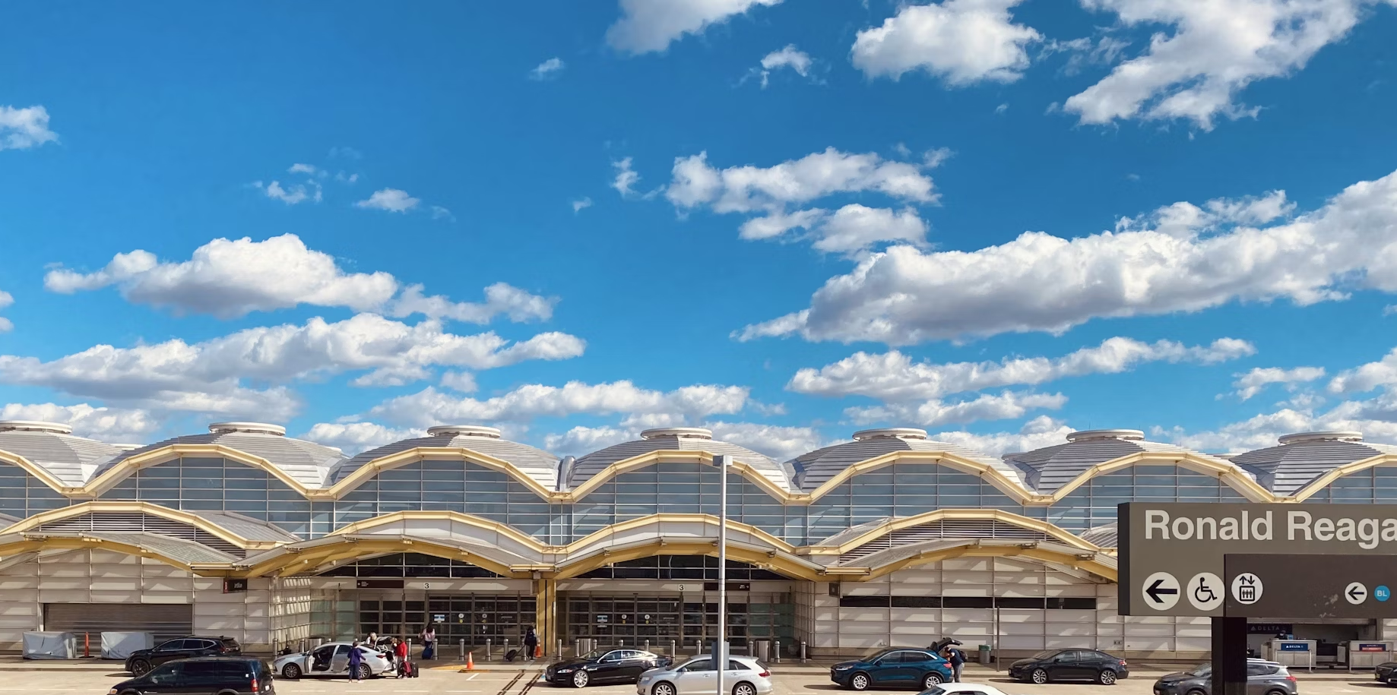
Travel Specific Impacts
25

Slide 26
Student/Scholar Risk Factor #1: Travel Bans
We do not yet know when or if they will be issued, but they could happen any day.
Press reports suggest a color-coded scale and lists 40+ countries that could be subject to some ban, but is temporarily postponed.
Unclear what specific categories may be affected and whether carveouts.
Supreme Court affirmed the president’s authority to impose such bans in Trump v. Hawaii, which may make bans more durable and less open to challenge.
Red: full entry restrictions
Orange: Partial restrictions or enhanced vetting reqs.
Yellow: 60-day probationary period to improve security/vetting or face elevation
Anyone from the 40+ countries should reconsider international travel.

Slide 27
Sources: David Bier “A New, Discriminatory, and Arbitrary Legal Immigration System Is Coming,” New York Times, Reuters, NAFSA archive, and MPI.
*Indicates NYT and Reuters disagree on level.
Reported Proposed List of Travel Ban Countries
Red | Afghanistan, Bhutan*, Cuba, Iran, Libya, North Korea, Somalia, Sudan, Syria, Venezuela, Yemen
Orange | Belarus*, Eritrea, Haiti, Laos, Myanmar, Pakistan*, Russia*, Sierra Leone*, South Sudan, Turkmenistan*
Yellow | Angola, Antigua and Barbuda, Benin, Burkina Faso, Cabo Verde, Cambodia, Cameroon, Chad, DROC, Dominica, Equatorial Guinea, Gambia, Liberia, Malawi, Mauritania, Republic of the Congo, St. Kitts and Nevis, St. Lucia, São Tomé and Príncipe, East Timor*, Vanuatu, Zimbabwe
Subject to Prior Trump Travel Bans But Not on Reported List | China (limited categories), Iraq, Kyrgyzstan, Nigeria, Tanzania
*This is the previously reported list – it will likely change if/when it is announced.

Slide 28
Student/Scholar Risk Factor #2: Criminal History
ANY past criminal history at all makes students/scholars vulnerable to enforcement action and significantly raises the risk of travel.
Criminal history should be broadly construed.
Have they ever had an interaction with law enforcement?
Have they been arrested even if the charges were dropped?
This includes any arrests tied to recent campus protests, drug use, DUI, DWI, etc.
These types of incidents are likely visible to immigration officials.

Slide 29
Student/Scholar Risk Factor #3: Social Media + Electronics
Rights to express oneself may run counter to broad immigration authorities in real time when entering the United States.
The U.S. government can and may examine phone and electronic devices at the border. Rights may vary based on your immigration status.
Social media vetting has increased with the help of AI tools. For posts on social media, including LinkedIn, assume officials know or can find it.
It is not clear what viewpoints the government may find objectionable enough to deny entry, but vetting is likely to focus on perceived antisemitism, communism, Marxism, and other views that officials may consider “contrary to American values.”

Slide 30
Student/Scholar Risk Factor #4: Immigration Status
Least durable statuses include DACA and Temporary Protected Status (TPS)
Visa holders are not guaranteed entry at the border if an individual is found inadmissible
Green card holders can also face friction, though they have more procedural due process rights
Those with less durable statuses should consult a lawyer before travel.

Slide 31
INSTITUTIONAL CONSIDERATIONS
AND WHAT TO EXPECT GOING FORWARD

Slide 32
Institutional Considerations In Response To Increased Enforcement, Vetting, and Investigations
Assistance with law enforcement and immigration agencies
Plans and considerations (including legal, communications, and student support) when enforcement action occurs either on or off campus
Responding to data collection and other government investigation requests
As an employer, consideration of student, scholar, faculty, and staff workforce records and compliance

Slide 33
What to Expect Moving Forward
Both short-term and longer-term travel bans
Limited visa appointment availability and processing delays
Additional vetting by CBP at ports of entry
Continued visa revocations
Stricter adjudication standards and processing delays by USCIS on reinstatement, change of status, OPT, self-sponsored green card applications, and other post-graduation employment-based petitions
Revival of ICE proposed rule of removing ‘D/S’ as the default admission validity for F-1/J-1 students/scholars

Slide 34
The information contained herein is current as of April 2025. It is offered for informational purposes only and does not constitute legal advice or give rise to an attorney-client relationship between you and our firm. The information: (i) must be regarded as a practical guide for general information and not a process guide for determining the specific immigration requirements of the countries covered, (ii) should not be a substitute for a more in-depth analysis of applicable facts and circumstances (including, without limitation, criminal or health-related circumstances) conducted by competent professionals, and (iii) does not represent an opinion from Fragomen or any of its agents with regard to the laws of any of the jurisdictions concerned. The information herein does not guarantee the outcome or approval of any immigration application. These materials are subject to copyright by our firm with all rights reserved and shall not be disclosed in whole or in part in any form to any third party absent Fragomen's advance written consent.

Slide 35
THANK YOU

