Slide 1

Transforming Agriculture Through Diversification and Entrepreneurship
GENERAL PROGRAMME OVERVIEW
By
Oscar Ulili
KMCO

Slide 2

O U T L I N E
1
2
3
4
5
Theory of Change
TRADE Design Framework
Modus Operandi
Uniqueness
Coverages

Slide 3

THEORY OF CHANGE
CONSTRAINTS TO SMALLHOLDER COMMERCIALISATION
TARGETING
INTERVENTIONS
OUTPUTS
OUTCOMES
IMPACT
Inadequate access to markets
Weak linkages with private sector and other VC actors
Unfavorable conditions in agriculture and agribusiness among women and youth
Limited access to financial services
Their agriculture production vulnerable to climate shocks
Inadequate skills for NRM and CSAs
Poor Physical infrastructure
Lack Knowledge on nutrition aspects related to production and consumption
Facilitate market linkages and commercial partnership with market actors, including 4p
Win – win partnerships between small holder producers and public and private (4P) entities supported
Smallholder producers increase access to market
Train and support smallholder producers on GAPS/ CSA
Increased value chain commercialisation and resilience of rural poor and smallholders producers
Business skills of smallholders producers to engage in commercial agriculture strengthened
COMPONENT 1
Build management capacity of FBOs and producers especially women and youth to engage in farming as business and agribusiness
Production skills of smallholders producers to engage in commercial agriculture strengthened
Smallholder producers productivity and product quality increased
Targeting Smallholder Farmers with the ability to generate Market surplus
Establish partnerships with financial service providers link VC actors to financial markets (through FARMSE)
FBO’s skills for collective services and market linkages provided
Smallholder producers adoption and product quality increased
Support commodity platforms on policy dialogue and advocacy
Knowledge and access to CSA technologies/ practices increased
COMPONENT 2
Provide legal and regulatory support for business partnerships for MOUs and contracts
Smallholder producers and FBOs access to financial services increased
Enabling environment improved for commercialisation of smallholder agriculture
Improved sustainable livelihoods of rural people in Malawi
Construct/ rehabilitate climate resilient and environmental friendly VC infrastructure
Capacity to influence policy and formal business arrangements increased
Institutional performance and knowledge mgt. improved
Institutional capacity for VC development at district level for public and non state actors
Infrastructure to support VC development built/ rehabilitated
COMPONENT 3
Support knowledge mgt, to strengthen programme implementation and sharing of good practices
Institutional capacity and knowledge mgt. for VC development

Slide 4

TRADE DESIGN FRAMEWORK
Goal
Improved Sustainable Livelihoods of Rural People
Development Objective
Increasing value chain commercialisation and improving resilience of rural poor and smallholder producers
Components
Outcomes
2. Enabling environment for smallholder commercialization and component
1. Sustainable producer-private partnerships
3. Institutional Support and Programme Management
Main activities/
outputs
1.1. Sustainable intensification and value chain commercialisation.
Increasing smallholder productivity
The Agricultural Commercialisation Innovation Fund (ACIF)
1.2. Capacity development of farmers and farmer based organisations
Strengthening of Farmer Based Organisations (FBOs)
Develop Farmer Skills in Agri-Business FBS
2.1. Enabling Environment for Commercial Agriculture
Support to community platforms and legal and regulatory support for commercial partnerships.
Improve market information and market intelligence
2.2. Enabling Infrastructure
Roads rehabilitation maintenance
Value Chain/commodity facilities
Water points
3.1. Capacity building and value chain governance
Capacity building for public sector and non state actors
District capacity development
3.2. Programme Management and knowledge Management
Programme management
Knowledge management
Inputs
60.1 mil
53.3 mil
11.8 mil
Funding (125.4 Million USD)

Slide 5
STRATEGIC ALIGNMENT
  SO 2 of the Malawi COSOP “Smallholder households access remunerative markets and services”.
  SO 1 of the COSOP “Smallholder households become resilient to natural shocks
MGDSIII (then)
MALAWI 2063 (Now)
  Agriculture Production and commercialization
  Malawi Implementation Plan
  NAP & NAIP
  Food security
  Ending Hunger
  Ending Malnutrition
SDGs
COSOP

Slide 6
MODUS OPERANDI
Develop and sustain their agribusiness enterprise opportunities
Improved access to rural financial services, market and business development services and partnerships with the private sector.
Targeted support to smallholder farmers and non-farm actors to benefit from commodity markets

Slide 7
UNIQUENESS
Improve horizontal linkages
Improve Production & Productivity
Functionally upgrade smallholder farmers and the rural poor
Improve vertical linkages between stakeholders

Slide 8



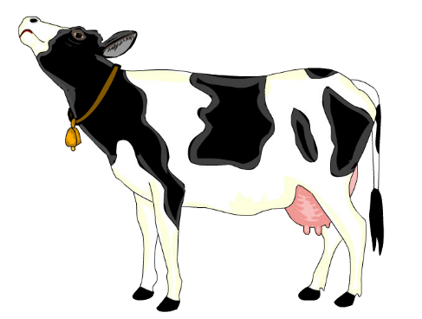



COMMODITY COVERAGE
GROUNDNUT
BEEF
IRISH POTATO
DAIRY
SOY BEAN
HONEY
SUNFLOWER

Slide 9
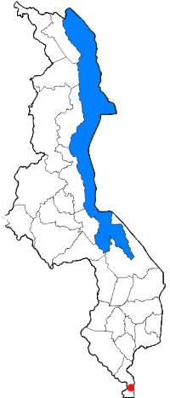
GEOGRAPHICAL COVERAGE
Chitipa
Karonga
Rumphi
Nkhata Bay
Kasungu
Ntchisi
Mchinji
Lilongwe
Dedza
Thyolo
Blantyre

Slide 10
BENEFICIARY COVERAGE

Slide 11





THANK YOU !!
Area9 Plot No: 328; Multichoice street
P.O Box 2135, Lilongwe.
npc@tradeprogramme.org
www.tradeprogramme.org

