Slide 1
Stats Yr2 Chapter 2 :: Conditional Probability
jamie@drfrostmaths.com
www.drfrostmaths.com
@DrFrostMaths
Last modified: 15th November 2019

Slide 2
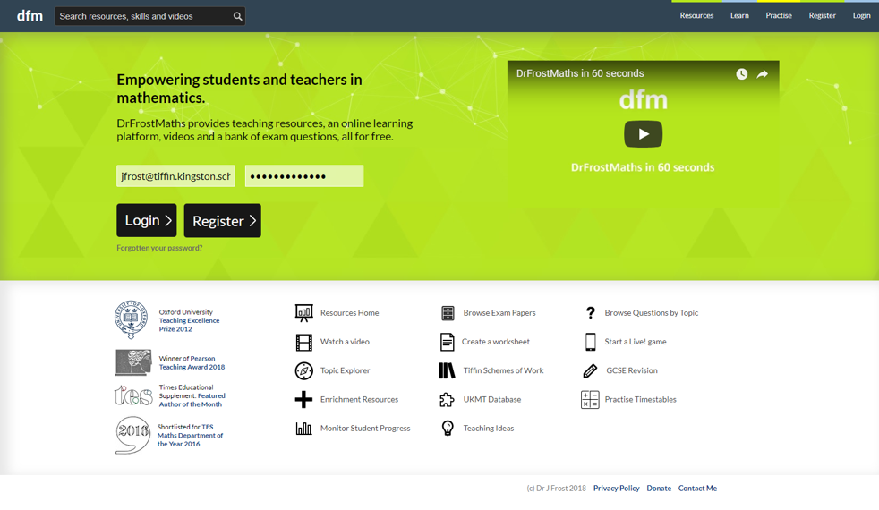







www.drfrostmaths.com
Everything is completely free.
Why not register?
Register now to interactively practise questions on this topic, including past paper questions and extension questions (including MAT + UKMT).
Teachers: you can create student accounts (or students can register themselves), to set work, monitor progress and even create worksheets.
With questions by:
Dashboard with points, trophies, notifications and student progress.
Questions organised by topic, difficulty and past paper.
Teaching videos with topic tests to check understanding.

Slide 3

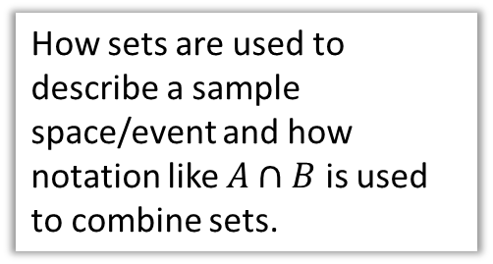
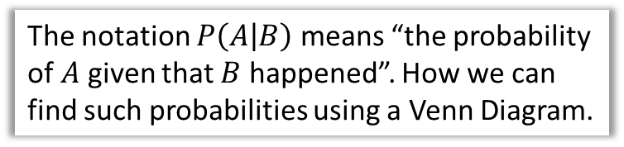
Chapter Overview
1:: Set Notation
2:: Conditional Probability in Venn Diagrams
How sets are used to describe a sample space/event and how notation like $A∩B$ is used to combine sets.
The notation $P\left(A | B\right)$ means “the probability of $A$ given that $B$ happened”. How we can find such probabilities using a Venn Diagram.
4:: Tree Diagrams
3:: Formula for Conditional Probability
“I have 3 red and 4 green balls in a bag. I take one ball out the bag, keep it, then take another. Given that the second ball was green, determine the probability the first was red.”
$$P\left(A | B\right)=\frac{P\left(A∩B\right)}{P\left(B\right)}$$
Teacher Notes: All of this is from the old S1. The chapter was effectively split into two: all the non-conditional probability content in Year 1 and the rest in Year 2. Set notation was not used in Year 1.

Slide 4


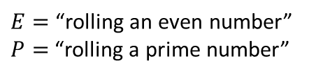
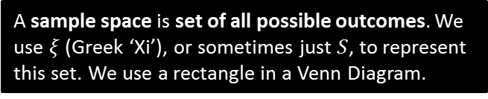

RECAP :: Using sets for sample spaces and events
In general, sets are used to represent collections of items.
In probability, an event is a set of one or more outcomes. These are the circles in the Venn Diagram.
We use capital letters for the variables representing sets.
A sample space is set of all possible outcomes. We use $ξ$ (Greek ‘Xi’), or sometimes just $S$, to represent this set. We use a rectangle in a Venn Diagram.
Each number represents an outcome.
$$ξ$$
$E=$“rolling an even number”
$P=$“rolling a prime number”
$$P$$
$$E$$
3
6
2
5
4
1

Slide 5



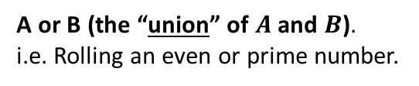




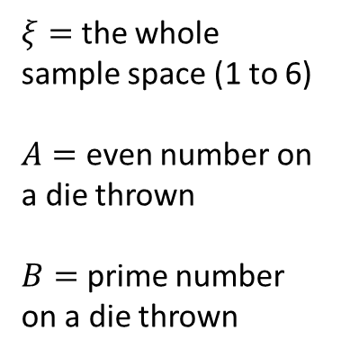
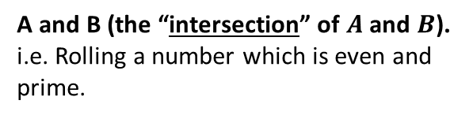
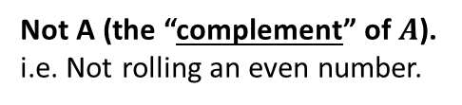


Combining events/sets
$$ξ$$
$$A$$
$$B$$
$ξ=$ the whole sample space (1 to 6)
$A=$ even number on a die thrown
$B=$ prime number on a die thrown
3
4
1
2
6
5
What does it mean in this context?
What is the resulting set of outcomes?
$$A′$$
?
?
Not A (the “complement” of $A$).
i.e. Not rolling an even number.
$$\{1, 3, 5\}$$
$$A∪B$$
A or B (the “union” of $A$ and $B$).
i.e. Rolling an even or prime number.
?
?
$$\{2,3,4,5,6\}$$
$$A∩B$$
A and B (the “intersection” of $A$ and $B$).
i.e. Rolling a number which is even and prime.
?
?
$$\{2\}$$

Slide 6



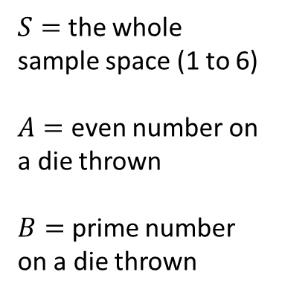



Some fundamentals
$$ξ$$
$$A$$
$$B$$
$S=$ the whole sample space (1 to 6)
$A=$ even number on a die thrown
$B=$ prime number on a die thrown
3
4
1
2
6
5
What does it mean in this context?
What is the resulting set of outcomes?
$$A∩B′$$
?
?
“A and not B”. Rolling a number which is even and not prime.
$$\{4,6\}$$
$$(A∪B)′$$
?
?
Rolling a number which is not [even or prime].
$$\{1\}$$
$${\left(A∩B\right)}^{′}$$
Rolling a number which is not [even and prime].
?
?
$$\{1,3,4,5,6\}$$

Slide 7




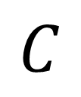
What area is indicated?
$$A$$
$$B$$
$$C$$
$$ξ$$
$$A∩B$$
?

Slide 8

What area is indicated?
$$A$$
$$B$$
$$C$$
$$ξ$$
$$A∪B$$
?

Slide 9

What area is indicated?
$$A$$
$$B$$
$$C$$
$$ξ$$
$$A∩B∩C$$
?

Slide 10

What area is indicated?
$$A$$
$$B$$
$$C$$
$$ξ$$
$$A∩C^{′}$$
?

Slide 11

What area is indicated?
$$A$$
$$B$$
$$C$$
$$ξ$$
$$A∩B∩C^{′}$$
?

Slide 12



What area is indicated?
$$ξ$$
$$A$$
$$B$$
$$C$$
?
?
$$A^{′}∩B^{′}∩C^{′}$$
or
alternatively…
$${\left(A∪B∪C\right)}^{′}$$

Slide 13


What area is indicated?
$$ξ$$
$$A$$
$$B$$
$$C$$
$$A^{′}$$
?

Slide 14


What area is indicated?
$$ξ$$
$$A$$
$$B$$
$$C$$
$$A∩{\left(B∩C\right)}^{′}$$
?

Slide 15


What area is indicated?
$$ξ$$
$$A$$
$$B$$
$$C$$
$$A∩B^{′}∩C′$$
?

Slide 16

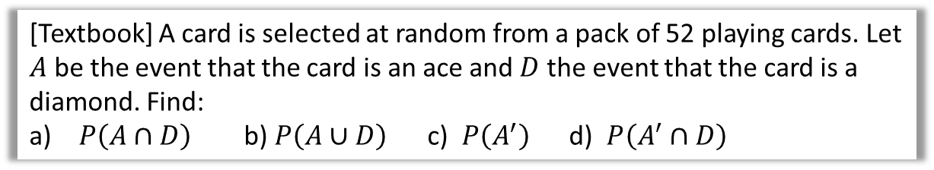


Examples
Venn Diagram can either contain:
The specific outcomes in each set
The number of items in the set (i.e. frequencies)
The probability of being in that set.
This will usually be stated or made obvious from the context.
[Textbook] A card is selected at random from a pack of 52 playing cards. Let $A$ be the event that the card is an ace and $D$ the event that the card is a diamond. Find:
$P\left(A∩D\right)$ b) $P\left(A∪D\right)$ c) $P\left(A^{′}\right)$ d) $P\left(A^{′}∩D\right)$
? Venn Diagram
? a
Think “A and D”.
$$P\left(A∩D\right)=\frac{1}{52} \\ P\left(A∪D\right)=\frac{16}{52} \\ P\left(A^{′}\right)=\frac{48}{52} \\ P\left(A^{′}∩D\right)=\frac{12}{52}$$
$$A$$
$$D$$
For union, I visualise this ‘figure-of-8’ shape:
1
? b
3
12
36
? c
? d

Slide 17

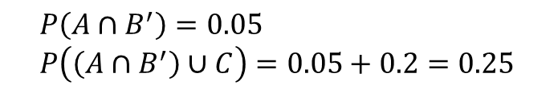
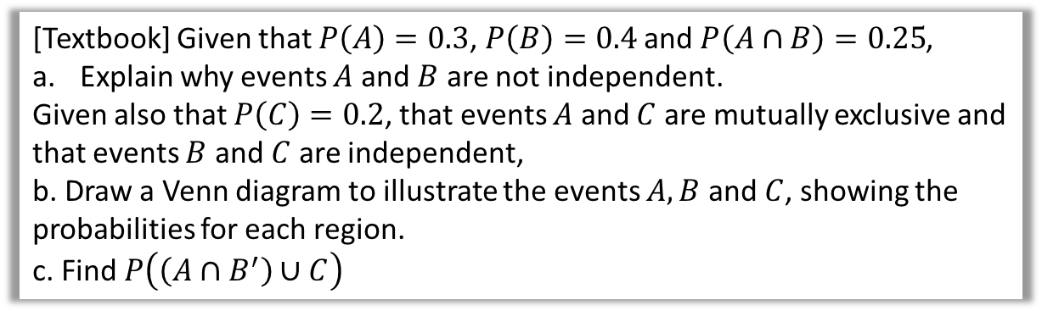



Examples
[Textbook] Given that $P\left(A\right)=0.3$, $P\left(B\right)=0.4$ and $P\left(A∩B\right)=0.25$,
Explain why events $A$ and $B$ are not independent.
Given also that $P\left(C\right)=0.2$, that events $A$ and $C$ are mutually exclusive and that events $B$ and $C$ are independent,
b. Draw a Venn diagram to illustrate the events $A, B$ and $C$, showing the probabilities for each region.
c. Find $P\left(\left(A∩B^{′}\right)∪C\right)$
a
$$P\left(A\right)×P\left(B\right)=0.3×0.4=0.12$$
$$P\left(A∩B^{′}\right)=0.05 \\ P\left(\left(A∩B^{′}\right)∪C\right)=0.05+0.2=0.25$$
?
c
?
b
?
$$A$$
$$B$$
$$C$$
0.07
0.05
0.25
0.08
0.12
0.43

Slide 18

Test Your Understanding
May 2013 (R) Q6
Using the above:
$0.1=\left(p+0.1\right)×0.4$
$p+0.1=0.25$
$p=0.15$
?
The Venn diagram in Figure 1 shows three events A, B and C and the probabilities associated with each region of B. The constants p, q and r each represent probabilities associated with the three separate regions outside B.
The events A and B are independent.
Find the value of p. (3)

Slide 19
Exercise 2A
Pearson Stats/Mechanics Year 2
Pages 19-21

Slide 20



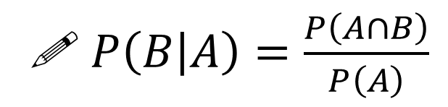



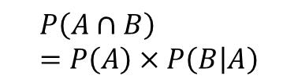


Conditional Probability
Think about how we formed a probability tree at GCSE:
?
$$P\left(A∩B\right) \\ =P\left(A\right)×P\left(B | A\right)$$
P$\left(B|A\right)$
$$B$$
?
$$P\left(A\right)$$
$$A$$
Read the ‘|’ symbol as “given that”. i.e. “B occurred given that A occurred”.
$$B′$$
$$B$$
$$A′$$
$$B′$$
Alternatively (and more commonly):
Memory Tip: You’re dividing by the event you’re conditioning on.
?
! $P\left(B | A\right)=\frac{P\left(A∩B\right)}{P\left(A\right)}$

Slide 21
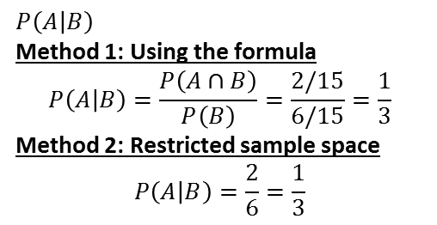
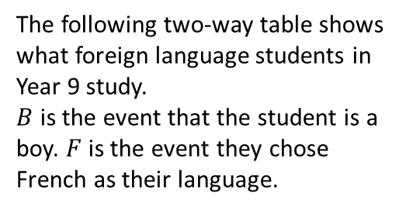






Examples
a
Determine the probability of:
$P\left(F | B^{′}\right)$
Method 1: Using the formula:
$$P\left(F | B^{′}\right)=\frac{P\left(F∩B^{′}\right)}{P\left(B^{′}\right)}=\frac{\frac{38}{100}}{\frac{60}{100}}=\frac{38}{60}$$
Method 2: Restricted sample space.
We’re finding the “probability they study French given they’re not a boy”, i.e. we’re choosing only from the non-boys:
$$P\left(F | B^{′}\right)=\frac{38}{60}$$
$P\left(B | F^{′}\right)=\frac{26}{48}$
1
The following two-way table shows what foreign language students in Year 9 study.
$B$ is the event that the student is a boy. $F$ is the event they chose French as their language.
?
?
 | $$B$$ | $$B′$$ | Total
$$F$$ | 14 | 38 | 52
$$F′$$ | 26 | 22 | 48
Total | 40 | 60 | 100
?
b
2
Using the Venn Diagram, determine:
a
$P\left(A | B\right)$
Method 1: Using the formula
$$P\left(A | B\right)=\frac{P\left(A∩B\right)}{P\left(B\right)}=\frac{2/15}{6/15}=\frac{1}{3}$$
Method 2: Restricted sample space
$$P\left(A | B\right)=\frac{2}{6}=\frac{1}{3}$$
$$ξ$$
$$A$$
$$B$$
?
?
2
3
Out of 6 things in $B$, 2 are in $A∩B$.
6
4
?
?
$P\left(A′ | B′\right)=\frac{3}{9}=\frac{1}{3} P\left(B | A∪B\right)=\frac{6}{12}=\frac{1}{2}$
b
c

Slide 22





Further Examples
Given that $P\left(A\right)=0.5$ and $P\left(A∩B\right)=0.3$, what is $P\left(B | A\right)$?
$$P\left(B | A\right)=\frac{P\left(A∩B\right)}{P\left(A\right)}=\frac{0.3}{0.5}=0.6$$
Given that $P\left(Y\right)=0.6$ and $P\left(X∩Y\right)=0.4$, what is $P\left(X^{′} | Y\right)$?
(Hint: Drawing a Venn Diagram will help!)
$P\left(X^{′} | Y\right)=\frac{P\left(X^{′}∩Y\right)}{P\left(Y\right)}$ $∴P\left(X^{′} | Y\right)=\frac{0.2}{0.6}=\frac{1}{3}$
Given that $P\left(A\right)=0.5$, $P\left(B\right)=0.5$ and $P\left(A∩B\right)=0.4$, what is $P\left(B | A^{′}\right)$?
$$P\left(B | A^{′}\right)=\frac{P\left(A^{′}∩B\right)}{P\left(A^{′}\right)} \\ =\frac{0.1}{0.5}$$
$$=0.2$$
a
Fro Tip: The ‘restricted sample space’ method also works for Venn Diagrams with probabilities.
?
b
?
$$X$$
$$Y$$
0.4
0.2
c
?
$$A$$
$$B$$
0.1
0.4
0.1
0.4

Slide 23

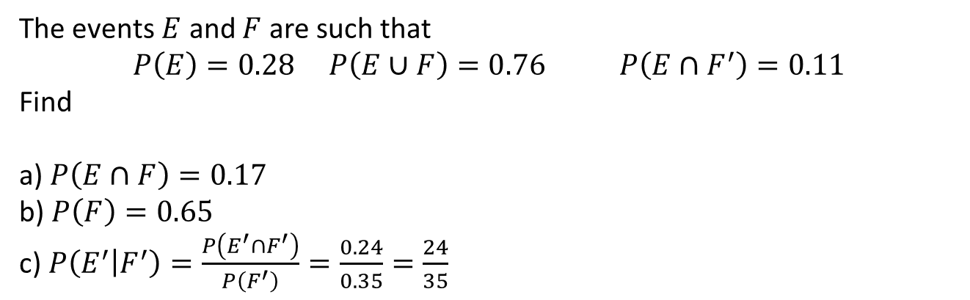


Check your understanding
The events $E$ and $F$ are such that
$$P\left(E\right)=0.28 P\left(E∪F\right)=0.76 P\left(E∩F^{′}\right)=0.11$$
Find
a) $P\left(E∩F\right)=0.17$
b) $P\left(F\right)=0.65$
c) $P\left(E^{′} | F^{′}\right)=\frac{P\left(E^{′}∩F^{′}\right)}{P\left(F^{′}\right)}=\frac{0.24}{0.35}=\frac{24}{35}$
?
?
?
Click to reveal Venn Diagram
$$ξ$$
$$E$$
$$F$$
0.11
0.17
0.48
0.24

Slide 24
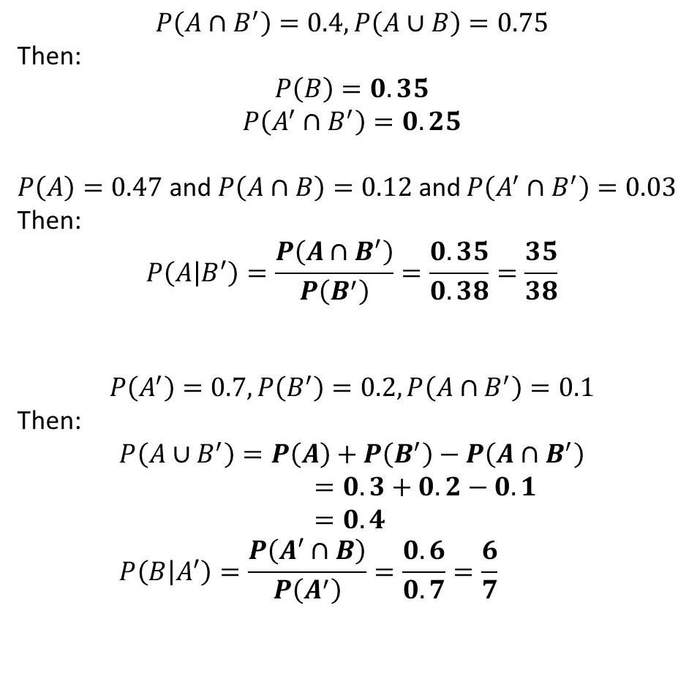
Further Practice (outside of class)
1
$$P\left(A∩B^{′}\right)=0.4, P\left(A∪B\right)=0.75$$
Then:
$$P\left(B\right)=0.35$$
$$P\left(A^{′}∩B^{′}\right)=0.25$$
$P\left(A\right)=0.47$ and $P\left(A∩B\right)=0.12$ and $P\left(A^{′}∩B^{′}\right)=0.03$
Then:
$$P\left(A | B^{′}\right)=\frac{P\left(A∩B^{′}\right)}{P\left(B^{′}\right)}=\frac{0.35}{0.38}=\frac{35}{38}$$
$$P\left(A^{′}\right)=0.7, P\left(B^{′}\right)=0.2, P\left(A∩B^{′}\right)=0.1$$
Then:
$$P\left(A∪B^{′}\right)=P\left(A\right)+P\left(B^{′}\right)−P\left(A∩B^{′}\right) \\ =0.3+0.2−0.1 \\ =0.4 \\ P\left(B | A^{′}\right)=\frac{P\left(A^{′}∩B\right)}{P\left(A^{′}\right)}=\frac{0.6}{0.7}=\frac{6}{7}$$
?
?
2
?
3
?
?

Slide 25
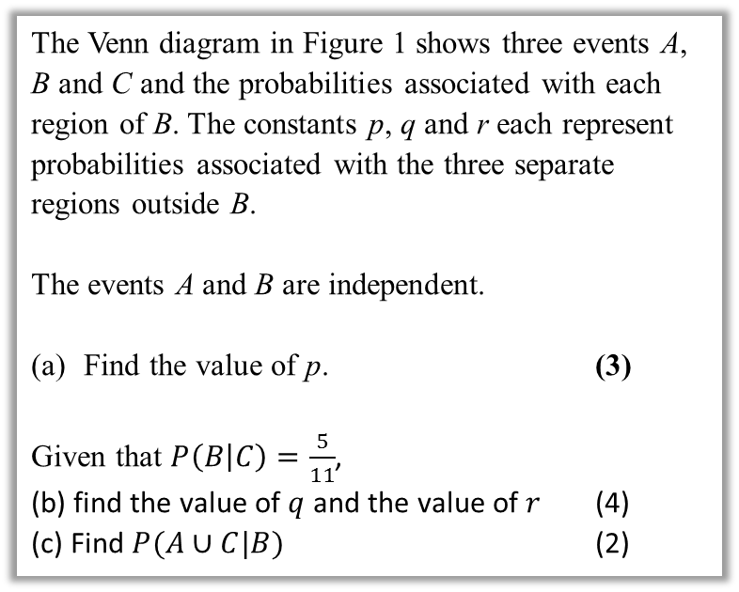

Further Test Your Understanding
May 2013 (R) Q6
(From earlier)
$0.1=\left(p+0.1\right)×0.4$
$p+0.1=0.25$
$p=0.15$
$P\left(B | C\right)=\frac{P\left(B∩C\right)}{P\left(C\right)}$
$\frac{5}{11}=\frac{0.2}{0.2+q}$
$q=0.24$
$r=1−0.15−0.1−0.1−0.2−0.24$
$=0.21$
$P\left(A∪C | B\right)=\frac{P\left(\left(A∪C\right)∩B\right)}{P\left(B\right)}$
$=\frac{0.1+0.2}{0.4}=0.75$
?
The Venn diagram in Figure 1 shows three events A, B and C and the probabilities associated with each region of B. The constants p, q and r each represent probabilities associated with the three separate regions outside B.
The events A and B are independent.
Find the value of p. (3)
Given that $P\left(B | C\right)=\frac{5}{11}$,
(b) find the value of $q$ and the value of $r$ (4)
(c) Find $P(A∪C|B)$ (2)
?

Slide 26

Exercise 2C
Pearson Stats/Mechanics Year 2
Pages 25-27
Note: I have skipped Exercise 2B.
Extension:
[Classic puzzle] I have 2 children. One of them is a boy. What’s the probability the other is a boy?
If (at least) one is a boy, restricted sample space is BB, BG, GB. Of these, only in one case is the other a boy. $∴\frac{1}{3}$
1
?

Slide 27
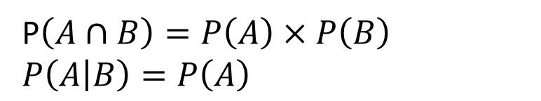
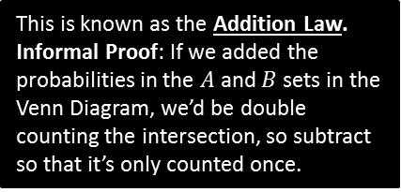
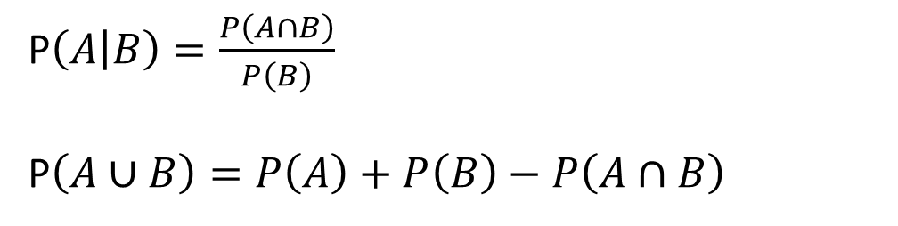
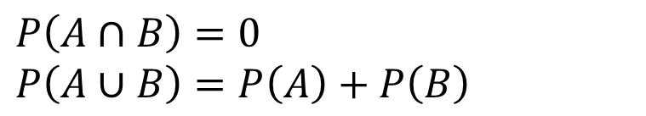
Full Laws of Probability
!
If events $A$ and $B$ are independent.
?
P$\left(A∩B\right)=P\left(A\right)×P\left(B\right)$
$P\left(A | B\right)=P\left(A\right)$
?
If events $A$ and $B$ are mutually exclusive:
?
$P\left(A∩B\right)=0$
$P\left(A∪B\right)=P\left(A\right)+P\left(B\right)$
?
In general:
We first encountered this in the previous section.
?
P$\left(A | B\right)=\frac{P\left(A∩B\right)}{P\left(B\right)}$
P$\left(A∪B\right)=P\left(A\right)+P\left(B\right)−P\left(A∩B\right)$
This is known as the Addition Law.
Informal Proof: If we added the probabilities in the $A$ and $B$ sets in the Venn Diagram, we’d be double counting the intersection, so subtract so that it’s only counted once.
?

Slide 28
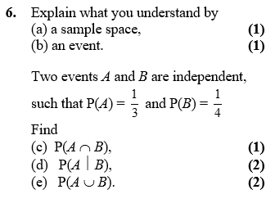
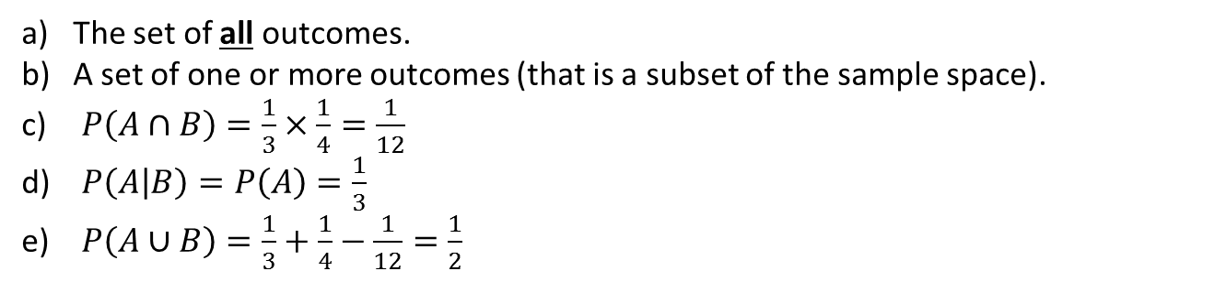
Example
Edexcel S1
?
The set of all outcomes.
A set of one or more outcomes (that is a subset of the sample space).
$P\left(A∩B\right)=\frac{1}{3}×\frac{1}{4}=\frac{1}{12}$
$P\left(A | B\right)=P\left(A\right)=\frac{1}{3}$
$P\left(A∪B\right)=\frac{1}{3}+\frac{1}{4}−\frac{1}{12}=\frac{1}{2}$
?
?
?
?

Slide 29
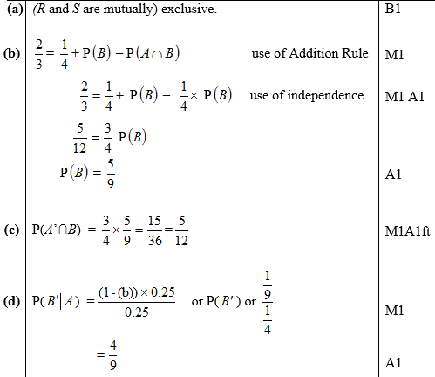
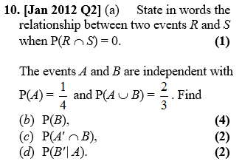

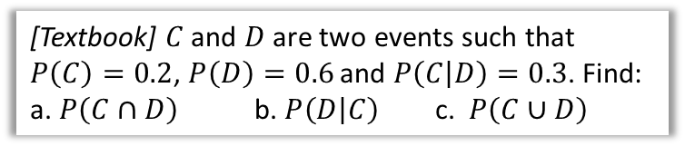
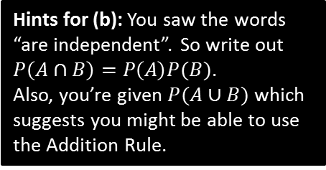
Further Examples
Hints for (b): You saw the words “are independent”. So write out $P\left(A∩B\right)=P\left(A\right)P(B)$.
Also, you’re given $P(A∪B)$ which suggests you might be able to use the Addition Rule.
[Textbook] $C$ and $D$ are two events such that $P\left(C\right)=0.2$, $P\left(D\right)=0.6$ and $P\left(C | D\right)=0.3$. Find:
a. $P\left(C∩D\right)$ b. $P\left(D | C\right)$ c. $P\left(C∪D\right)$
? a
$$P\left(C | D\right)=\frac{P\left(C∩D\right)}{P\left(D\right)} → 0.3=\frac{P\left(C∩D\right)}{0.6} \\ P\left(C∩D\right)=0.18$$
$$P\left(D | C\right)=\frac{P\left(C∩D\right)}{P\left(C\right)}=\frac{0.18}{0.2}=0.9$$
$$P\left(C∪D\right)=P\left(C\right)+P\left(D\right)−P\left(C∩D\right) \\ =0.2+0.6−0.18=0.62$$
?
? b
?
? c
?
?

Slide 30
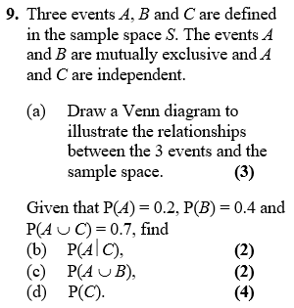





Test Your Understanding
Edexcel S1
a)
?
$$ξ$$
$$C$$
$$A$$
$$B$$
b) $P\left(A | C\right)=P\left(A\right)=0.2$
c) $P\left(A∪B\right)=P\left(A\right)+P\left(B\right)=0.6$
d) $P\left(A∪C\right)=P\left(A\right)+P\left(C\right)−P\left(A∩C\right)$
$$0.7=0.2+P\left(C\right)−0.2P\left(C\right) \\ 0.5=0.8P\left(C\right) \\ P\left(C\right)=\frac{5}{8}$$
?
?
?

Slide 31

SUPER IMPORTANT TIPS
If I were to identify two tips that will possible help you the most in probability questions:
If you see the words ‘given that’, Immediately write out the law for conditional probability.
Example: “Given Bob walks to school, find the probability that he’s not late…”
?
First thing you should write: $P\left(L^{′} | W\right)=\frac{P\left(L^{′}∩W\right)}{P\left(W\right)}=…$
If you see the words ‘are independent’, Immediately write out the laws for independence.
(Even before you’ve finished reading the question!)
Example: “$A$ is independent from $B$…”
?
First thing you should write: $P\left(A∩B\right)=P\left(A\right)P\left(B\right)$
$$P\left(A | B\right)=P(A)$$
If you’re stuck on a question where you have to find a probability given others, it’s probably because you’ve failed to take into account that two events are independent or mutually exclusive, or you need to use the conditional probability or additional law.

Slide 32
Exercise 2D
Pearson Stats/Mechanics Year 2
Pages 29-30

Slide 33
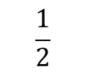
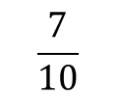


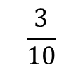


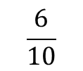

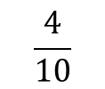

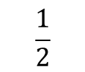

Probability Trees
We saw probability trees in Year 1. The only difference here is determining a conditional probability using your tree.
Example: You have two bags, the first with 5 red balls and 5 blue balls, and the second with 3 red balls and 6 blue balls. You first pick a ball from the first bag, and place it in the second. You then pick a ball from the second bag. Complete the tree diagram.
Hence find the probability that:
You pick a red ball on your second pick.
$P\left(R_{2}\right)=P\left(R_{1}∩R_{2}\right)+P\left(B_{1}{∩R}_{2}\right)=\frac{1}{5}+\frac{3}{20}=\frac{7}{20}$
Given that your second pick was red, the first pick was also red.
$P\left(R_{1} | R_{2}\right)=\frac{P\left(R_{1}∩R_{2}\right)}{P\left(R_{2}\right)}$
$=\frac{\frac{1}{5}}{\frac{7}{20}}=\frac{4}{7}$
$$\frac{4}{10}$$
?
$$R_{2}$$
?
?
$$\frac{1}{2}$$
$$R_{1}$$
$$\frac{6}{10}$$
?
$$B_{2}$$
?
$$\frac{3}{10}$$
$$R_{2}$$
$$\frac{1}{2}$$
?
$$B_{1}$$
?
$$\frac{7}{10}$$
?
$$B_{2}$$
It’s vitally important that you use good notation, making use of the | symbol.
Fro Tip: Use variable subscripting to indicate what pick you’re referring to.

Slide 34
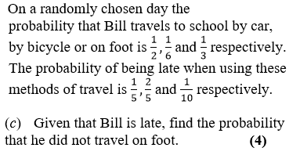
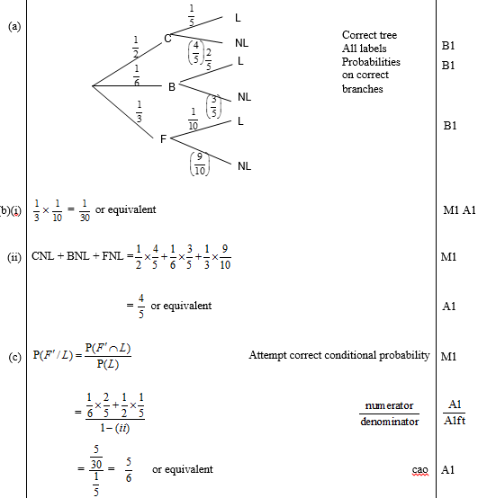

Further Example
Edexcel S1 May 2009 Q2
(Part (a) asks for a tree diagram, which may help with this question)
?
$$P\left(F^{′} | L\right)=\frac{P\left(F^{′}∩L\right)}{P\left(L\right)} \\ =\frac{\left(\frac{1}{6}×\frac{2}{5}\right)+\left(\frac{1}{2}×\frac{1}{5}\right)}{\left(\frac{1}{2}×\frac{1}{5}\right)+\left(\frac{1}{6}×\frac{2}{5}\right)+\left(\frac{1}{3}×\frac{1}{10}\right)} \\ =\frac{5}{6}$$

Slide 35


Testing Your Understanding
Edexcel S1
?
?
?

Slide 36
Exercise 2E
Pearson Stats/Mechanics Year 2
Pages 31-34

