Slide 1

Stats Yr2 Chapter 1 :: Regression, Correlation & Hypothesis Tests
jfrost@tiffin.kingston.sch.uk
www.drfrostmaths.com
@DrFrostMaths
Last modified: 5th July 2019

Slide 2








www.drfrostmaths.com
Everything is completely free.
Why not register?
Register now to interactively practise questions on this topic, including past paper questions and extension questions (including MAT + UKMT).
Teachers: you can create student accounts (or students can register themselves), to set work, monitor progress and even create worksheets.
With questions by:
Dashboard with points, trophies, notifications and student progress.
Questions organised by topic, difficulty and past paper.
Teaching videos with topic tests to check understanding.

Slide 3
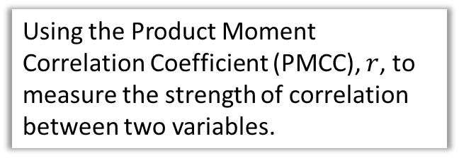
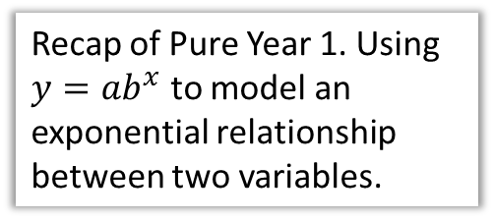
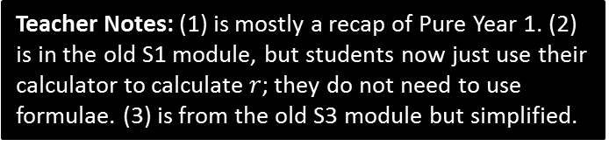
Chapter Overview
1:: Exponential Models
Recap of Pure Year 1. Using $y=ab^{x}$ to model an exponential relationship between two variables.
2:: Measuring Correlation
Using the Product Moment Correlation Coefficient (PMCC), $r$, to measure the strength of correlation between two variables.
3:: Hypothesis Testing for no correlation
Find the first 4 terms in the We want to test whether two variables have some kind of correlation, or whether any correlation observed just happened by chance.
Teacher Notes: (1) is mostly a recap of Pure Year 1. (2) is in the old S1 module, but students now just use their calculator to calculate $r$; they do not need to use formulae. (3) is from the old S3 module but simplified.

Slide 4


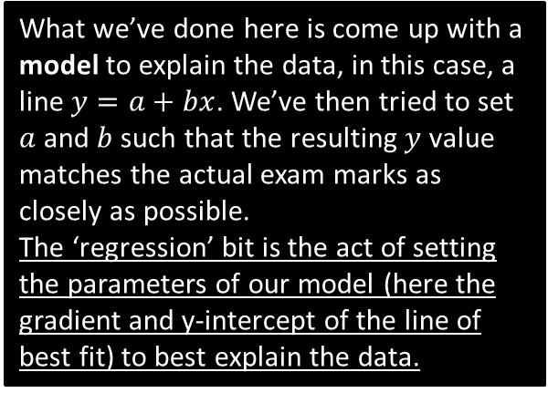

RECAP :: What is regression?
What we’ve done here is come up with a model to explain the data, in this case, a line $y=a+bx$. We’ve then tried to set $a$ and $b$ such that the resulting $y$ value matches the actual exam marks as closely as possible.
The ‘regression’ bit is the act of setting the parameters of our model (here the gradient and y-intercept of the line of best fit) to best explain the data.
Exam mark $(y)$
$$y=20+3x$$
Time spent revising $(x)$
I record people’s exam marks as well as the time they spent revising. I want to predict how well someone will do based on the time they spent revising. How would I do this?

Slide 5
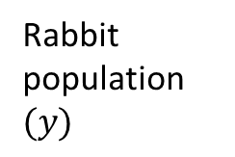
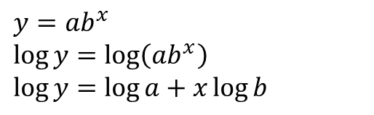


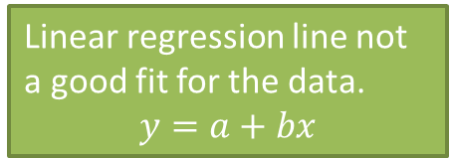

Exponential Regression
Linear regression line not a good fit for the data.
$$y=a+bx$$
Rabbit population $(y)$
Exponential line much better fit.
$$y=ab^{x}$$
Time$(x)$
For some variables, e.g. population with time, it may be more appropriate to use an exponential equation, i.e. $y=ab^{x}$, where $a$ and $b$ are constants we need to fix to best match the data.
$$y=ab^{x} \\ \log{y}=\log\left(ab^{x}\right) \\ \log{y}=\log{a}+x\log{b}$$
In Year 1, what did we do to both sides to end up with a straight line equation?
?
! If $y=kb^{x}$ for constants $k$ and $b$ then $\log{y}=\log{k}+x\log{b}$

Slide 6

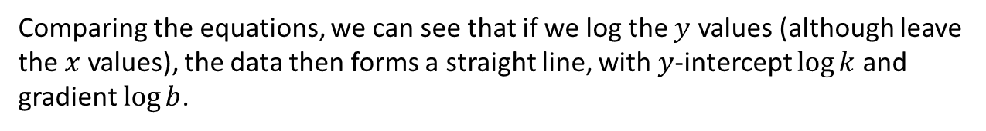
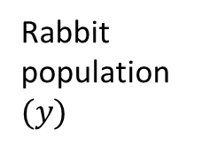


Exponential Regression
If $y=kb^{x}$ for constants $k$ and $b$ then $\log{y}=\log{k}+x\log{b}$
$$\log{y}$$
Rabbit population $(y)$
Time ($x$)
Time ($x$)
Comparing the equations, we can see that if we log the $y$ values (although leave the $x$ values), the data then forms a straight line, with $y$-intercept $\log{k}$ and gradient $\log{b}$.

Slide 7
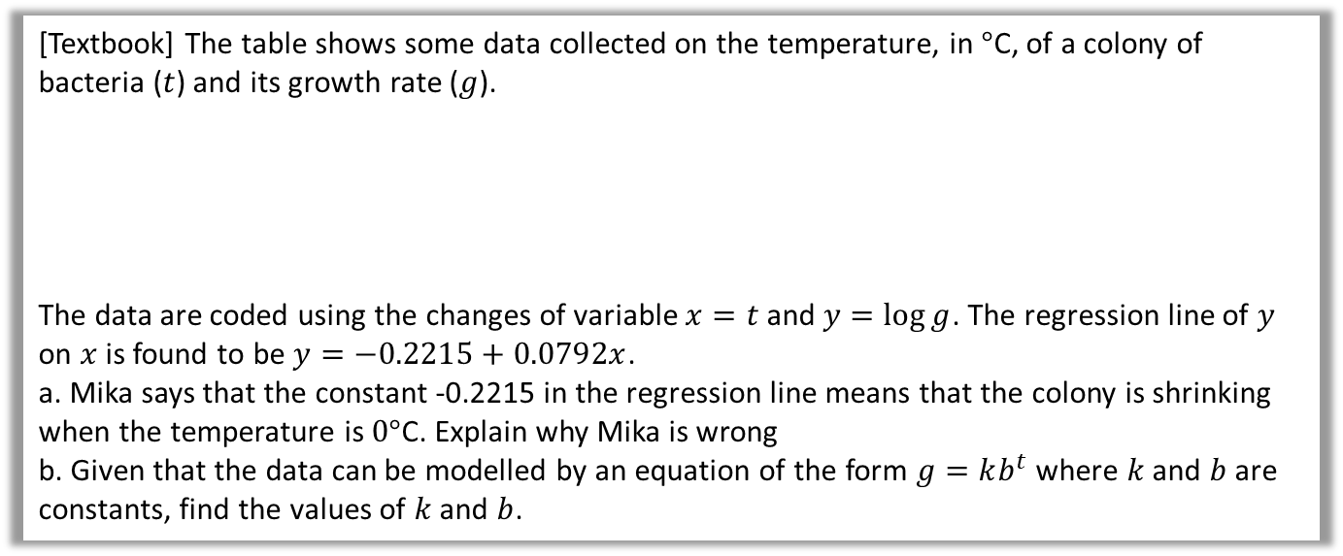
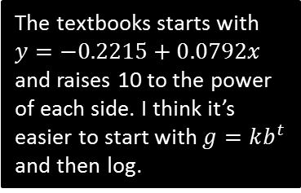

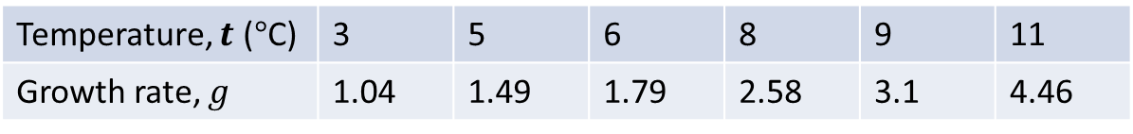
Example
[Textbook] The table shows some data collected on the temperature, in $°$C, of a colony of bacteria ($t$) and its growth rate ($g$).
The data are coded using the changes of variable $x=t$ and $y=\log{g}$. The regression line of $y$ on $x$ is found to be $y=−0.2215+0.0792x$.
a. Mika says that the constant -0.2215 in the regression line means that the colony is shrinking when the temperature is $0°$C. Explain why Mika is wrong
b. Given that the data can be modelled by an equation of the form $g=kb^{t}$ where $k$ and $b$ are constants, find the values of $k$ and $b$.
Temperature, $t$ ($°$C) | 3 | 5 | 6 | 8 | 9 | 11
Growth rate, $g$ | 1.04 | 1.49 | 1.79 | 2.58 | 3.1 | 4.46
a
When $t=0,y=−0.2215+\left(0.0792×0\right)=−0.2215$
$$y=\log{g} ∴g={10}^{y}={10}^{−0.2215}=0.600 (3sf)$$
The growth rate is positive.
$$g=kb^{t} \\ \log{g}=\log{k}+t\log{b}$$
Compare to $y=−0.2215+0.0792x → \log{g}=−0.2215+0.0792g$
$$\log{k}=−0.2215 → k={10}^{−0.2215}=0.600 \\ \log{b}=0.0792 → b={10}^{0.0792}=1.20$$
?
?
b
The textbooks starts with $y=−0.2215+0.0792x$ and raises 10 to the power of each side. I think it’s easier to start with $g=kb^{t}$ and then log.

Slide 8
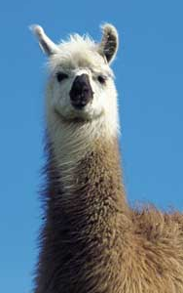

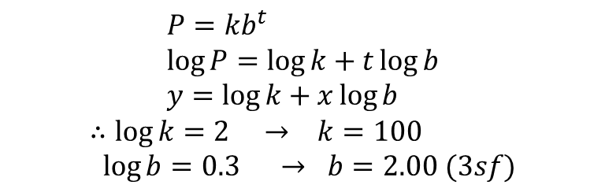
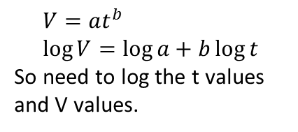
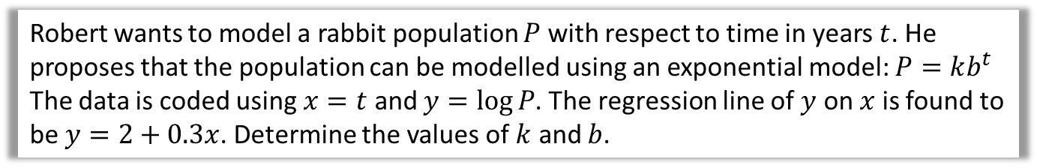
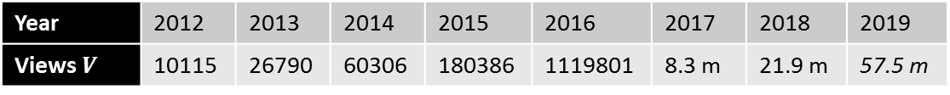
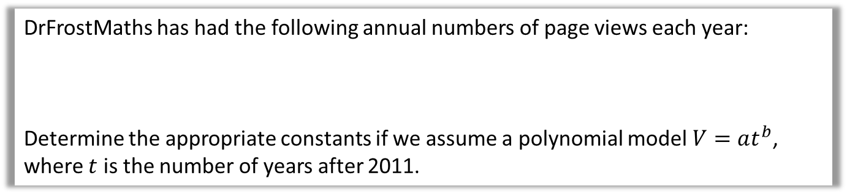
Test Your Understanding
Robert wants to model a rabbit population $P$ with respect to time in years $t$. He proposes that the population can be modelled using an exponential model: $P=kb^{t}$
The data is coded using $x=t$ and $y=\log{P}$. The regression line of $y$ on $x$ is found to be $y=2+0.3x$. Determine the values of $k$ and $b$.
?
$$P=kb^{t} \\ \log{P}=\log{k}+t\log{b} \\ y=\log{k}+x\log{b}$$
$$∴\log{k}=2 → k=100 \\ \log{b}=0.3 → b=2.00 (3sf)$$
Rabbit
DrFrostMaths has had the following annual numbers of page views each year:
Determine the appropriate constants if we assume a polynomial model $V=at^{b}$, where $t$ is the number of years after 2011.
Year | 2012 | 2013 | 2014 | 2015 | 2016 | 2017 | 2018 | 2019
Views $V$ | 10115 | 26790 | 60306 | 180386 | 1119801 | 8.3 m | 21.9 m | 57.5 m
projected
$$V=at^{b} \\ \log{V}=\log{a}+b\log{t}$$
So need to log the t values and V values.
?
$$log t$$ | 0 | 0.3010 | 0.4771 | 0.6020 | 0.6989 | 0.7781 | 0.8450 | 0.9030
$$log V$$ | 4.0050 | 4.4280 | 4.7804 | 5.2562 | 6.0491 | 6.9191 | 7.3404 | 7.7597
Using calculator stats mode, y-intercept: $\log{a}=3.3406$, gradient: $b=4.3025$
Therefore $V=2191×t^{4.3025}$

Slide 9


DrFrostMaths has had the following annual numbers of page views each year:
Determine the appropriate constants if we assume a polynomial model $V=at^{b}$, where $t$ is the number of years after 2011.
Year | 2012 | 2013 | 2014 | 2015 | 2016 | 2017 | 2018 | 2019
Views $V$ | 10115 | 26790 | 60306 | 180386 | 1119801 | 8.3 m | 21.9 m | 57.5 m
As you can see below, this polynomial model we found produces a strong fit to the data!
An exponential model would have also produced a good fit.

Slide 10
Exercise 1A
Pearson Stats/Mechanics Year 2
Pages 3-5

Slide 11

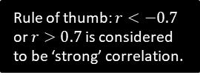


Measuring Correlation
You’re used to use qualitative terms such as “positive correlation” and “negative correlation” and “no correlation” to describe the type of correlation, and terms such as “perfect”, “strong” and “weak” to describe the strength.
The Product Moment Correlation Coefficient is one way to quantify this:
! The product moment correlation coefficient (PMCC), denoted by $r$, describes the linear correlation between two variables. It can take values between -1 and 1.
$$r=−1$$
$$0$$
$$1$$
Perfect negative
Strong negative
No correlation
Weak positive
Perfect positive
Rule of thumb: $r<−0.7$ or $r>0.7$ is considered to be ‘strong’ correlation.
Note that PMCC is only applicable for a linear correlation, i.e. closeness of fit to a linear regression line (i.e. a straight ‘line of best fit’). It may be the data exhibits strong correlation with respect to a different model (e.g. exponential) even when the PMCC is low.

Slide 12


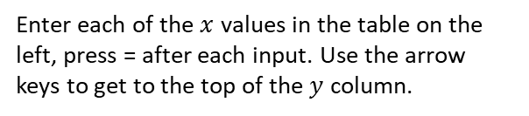
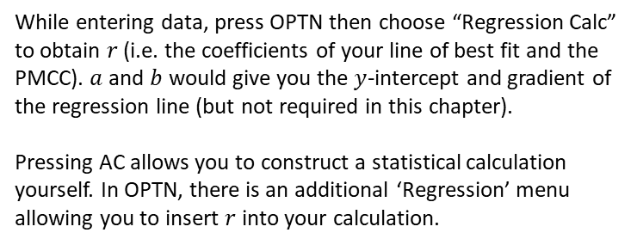

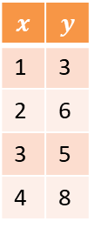

Calculating $r$ on your calculator
You must have a calculator that is capable of calculating $r$ directly: in the A Level 2017+ syllabus you are no longer required to use formulae to calculate $r$.
$$x$$ | $$y$$
1 | 3
2 | 6
3 | 5
4 | 8
6: Statistics
The following instructions are for the Casio ClassWiz.
Press MODE then select ‘Statistics’.
$$y=a+bx$$
We want to measure linear correlation, so select $y=a+bx$
Data Entry
Enter each of the $x$ values in the table on the left, press = after each input. Use the arrow keys to get to the top of the $y$ column.
PMCC
While entering data, press OPTN then choose “Regression Calc” to obtain $r$ (i.e. the coefficients of your line of best fit and the PMCC). $a$ and $b$ would give you the $y$-intercept and gradient of the regression line (but not required in this chapter).
Pressing AC allows you to construct a statistical calculation yourself. In OPTN, there is an additional ‘Regression’ menu allowing you to insert $r$ into your calculation.
You should obtain $r=0.868$

Slide 13
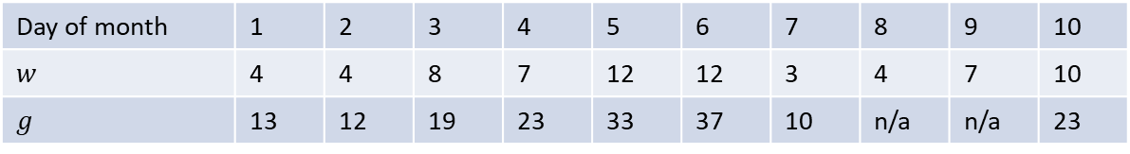
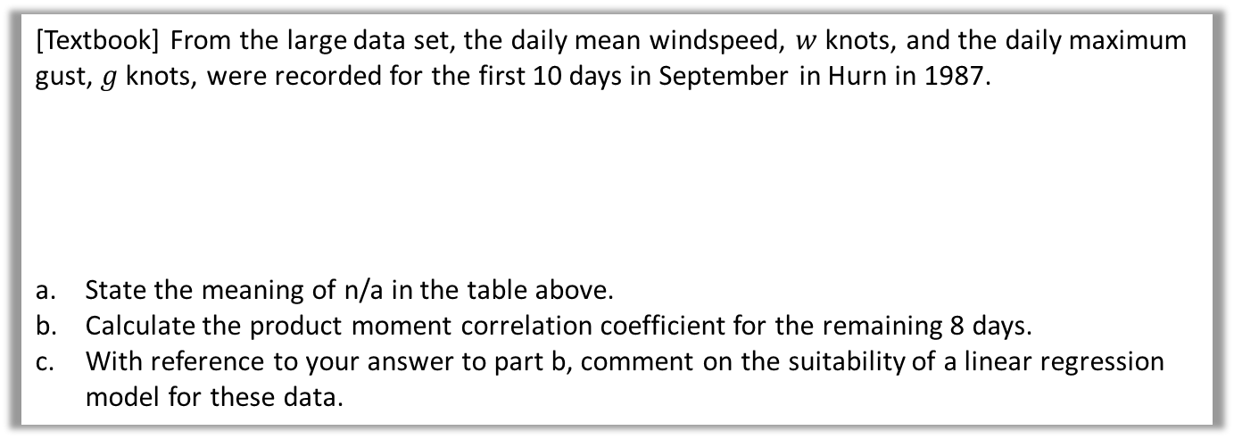
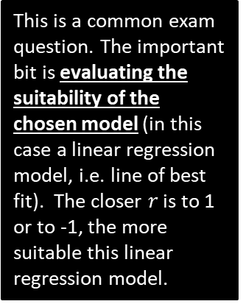

Example
[Textbook] From the large data set, the daily mean windspeed, $w$ knots, and the daily maximum gust, $g$ knots, were recorded for the first 10 days in September in Hurn in 1987.
State the meaning of n/a in the table above.
Calculate the product moment correlation coefficient for the remaining 8 days.
With reference to your answer to part b, comment on the suitability of a linear regression model for these data.
Day of month | 1 | 2 | 3 | 4 | 5 | 6 | 7 | 8 | 9 | 10
$$w$$ | 4 | 4 | 8 | 7 | 12 | 12 | 3 | 4 | 7 | 10
$$g$$ | 13 | 12 | 19 | 23 | 33 | 37 | 10 | n/a | n/a | 23
a
Data on daily maximum gust is not available for these days.
$$r=0.9533$$
$r$ is close to 1 so there is a strong positive correlation between daily mean windspeed and daily maximum gust. This means that the data points lie close to a straight line, so a linear regression model is suitable.
?
This is a common exam question. The important bit is evaluating the suitability of the chosen model (in this case a linear regression model, i.e. line of best fit). The closer $r$ is to 1 or to -1, the more suitable this linear regression model.
b
?
c
?

Slide 14
Exercise 1B
Pearson Stats/Mechanics Year 2
Pages 6-8

Slide 15
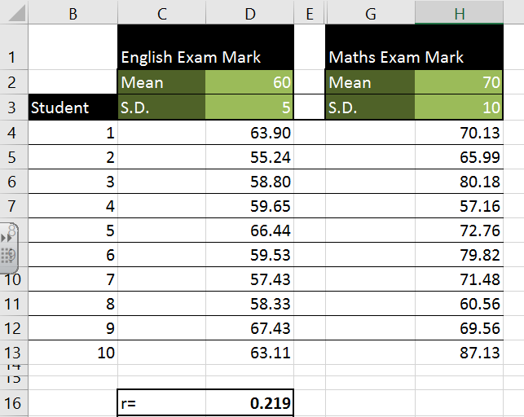
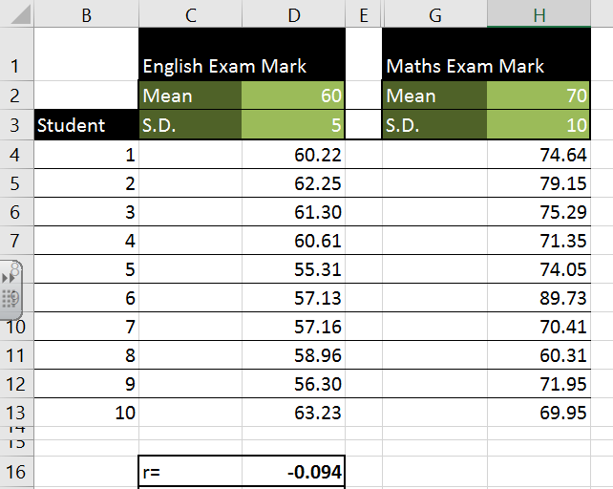
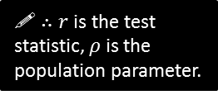


Hypothesis Testing for correlation
Suppose we use a spreadsheet to randomly generate maths marks for students, and separately generate random English marks.
(This Excel demo accompanies this file – you can press F9 in Excel to generate a new set of random data)
What is the observed PMCC between Maths and English marks in this first set of data?
0.219
But what is the true underlying PMCC between Maths and English?
0. It was stated above that the maths and English marks were generated independently of each other. Independent variables, by definition, have no correlation. The observed PMCC may vary from the true PMCC because the data is randomly sampled, just as if we threw a fair die, we wouldn’t necessarily see equal counts of each outcome.
! $r$ denotes the PMCC of a sample.
! $ρ$ (Greek letter rho) is the PMCC for the whole population.
?
?
! $∴r$ is the test statistic, $ρ$ is the population parameter.

Slide 16

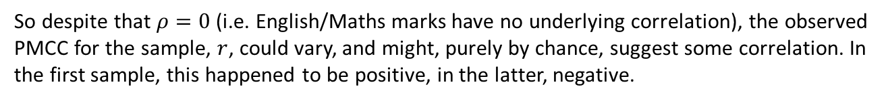
Hypothesis Testing for correlation
So despite that $ρ=0$ (i.e. English/Maths marks have no underlying correlation), the observed PMCC for the sample, $r$, could vary, and might, purely by chance, suggest some correlation. In the first sample, this happened to be positive, in the latter, negative.
If we increased the sample size (in this case 10), we’d expect the observed PMCC to more closely match the true PMCC (0).
A natural question we might therefore ask is, if we had no knowledge about the underlying population: “is the PMCC of $r=0.219$ statistically significant, or are Maths/English marks not correlated, and this observed correlation emerged just by chance?”
This sounds like a Hypothesis Test!

Slide 17
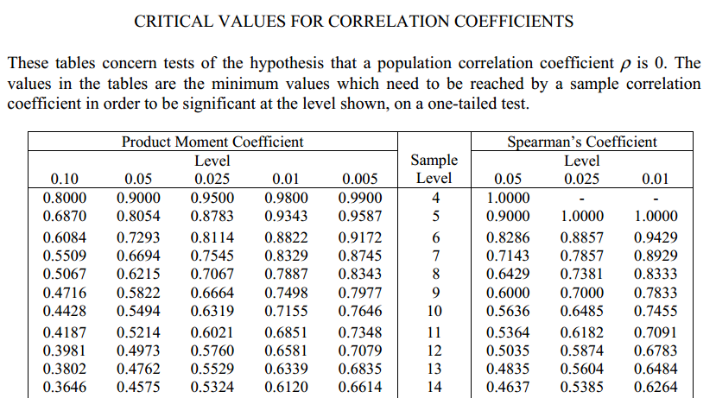
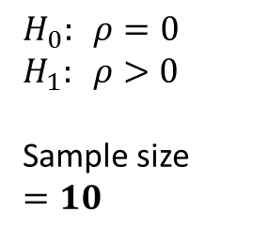
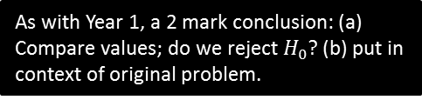
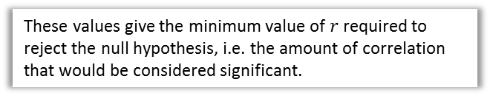
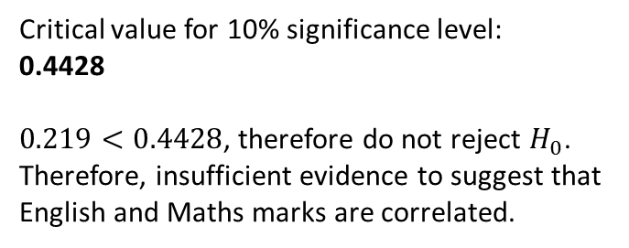
How to carry out the hypothesis test
Let’s carry out a hypothesis test on whether there is positive correlation between English and Maths marks, at 10% significance level:
?
There is no underlying correlation between English and maths marks.
$$H_{0}: ρ=0 \\ H_{1}: ρ>0$$
Sample size
$$=10$$
?
There is an underlying positive correlation between English and maths marks.
?
Critical value for 10% significance level:
0.4428
$0.219<0.4428$, therefore do not reject $H_{0}$.
Therefore, insufficient evidence to suggest that English and Maths marks are correlated.
?
Look up value in table.
?
As with Year 1, a 2 mark conclusion: (a) Compare values; do we reject $H_{0}$? (b) put in context of original problem.
These values give the minimum value of $r$ required to reject the null hypothesis, i.e. the amount of correlation that would be considered significant.

Slide 18
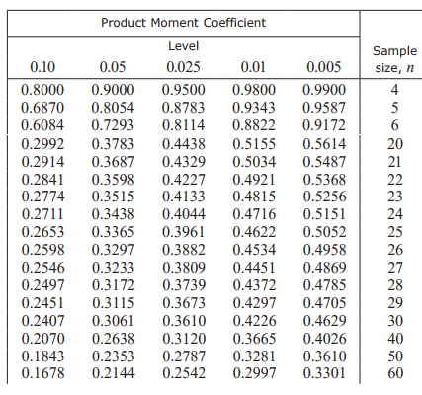
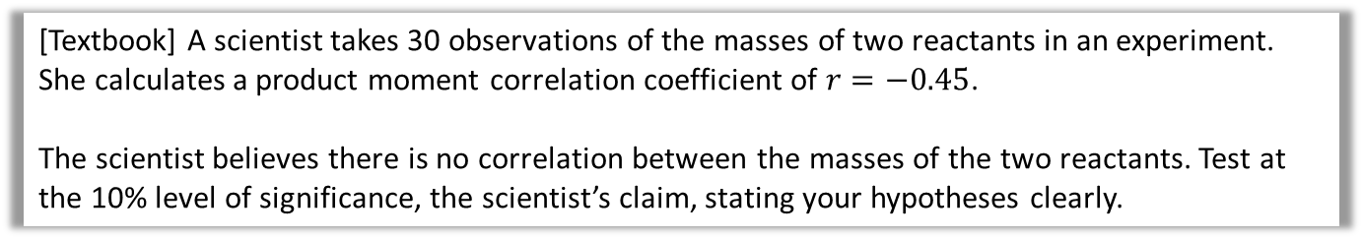

Two-tailed test
In the previous example we hypothesised that English/Maths marks were positively correlated. But we could also test whether there was any correlation, i.e. positive or negative.
[Textbook] A scientist takes 30 observations of the masses of two reactants in an experiment. She calculates a product moment correlation coefficient of $r=−0.45$.
The scientist believes there is no correlation between the masses of the two reactants. Test at the 10% level of significance, the scientist’s claim, stating your hypotheses clearly.
?
$$H_{0}:ρ=0 \\ H_{1}:ρ≠0$$
Sample size $=30$
Critical value at 5% significance:
0.3061
$−0.45<−0.3061$, therefore reject $H_{0}$.
There is evidence, at the 10% level of significance, that there is a correlation between the masses of the two reactants.
?
?
Two-tailed, so 5% at each tail.
?
?
?

Slide 19
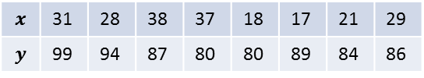
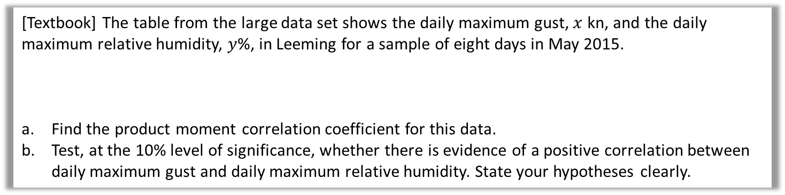

Test Your Understanding
[Textbook] The table from the large data set shows the daily maximum gust, $x$ kn, and the daily maximum relative humidity, $y$%, in Leeming for a sample of eight days in May 2015.
Find the product moment correlation coefficient for this data.
Test, at the 10% level of significance, whether there is evidence of a positive correlation between daily maximum gust and daily maximum relative humidity. State your hypotheses clearly.
$$x$$ | 31 | 28 | 38 | 37 | 18 | 17 | 21 | 29
$$y$$ | 99 | 94 | 87 | 80 | 80 | 89 | 84 | 86
a
$$r=0.1149$$
$$H_{0}:ρ=0, H_{1}:ρ>0$$
Sample size = 8
Critical value at 10% significant level $=0.5067$
$0.1149<0.5067$ therefore insufficient evidence to reject $H_{0}$.
Not sufficient evidence, at 10% significance level, of a positive correlation between the daily maximum gust and the daily maximum relative humidity.
?
b
?

Slide 20
Exercise 1C
Pearson Stats/Mechanics Year 2
Pages 10-12

