Slide 1

Stats1 Chapter 7 :: Hypothesis Testing
jamie@drfrostmaths.com
www.drfrostmaths.com
@DrFrostMaths
Last modified: 27th April 2020

Slide 2








www.drfrostmaths.com
Everything is completely free.
Why not register?
Register now to interactively practise questions on this topic, including past paper questions and extension questions (including MAT + UKMT).
Teachers: you can create student accounts (or students can register themselves), to set work, monitor progress and even create worksheets.
With questions by:
Dashboard with points, trophies, notifications and student progress.
Questions organised by topic, difficulty and past paper.
Teaching videos with topic tests to check understanding.

Slide 3

Experimental
i.e. Dealing with collected data.
Chp2: Measures of Location/Spread
Chp3: Representation of Data
Chp1: Data Collection
Statistics used to summarise data, including mean, standard deviation, quartiles, percentiles. Use of linear interpolation for estimating medians/quartiles.
Producing and interpreting visual representations of data, including box plots and histograms.
Methods of sampling, types of data, and populations vs samples.
Chp4: Correlation
Measuring how related two variables are, and using linear regression to predict values.
Theoretical
Deal with probabilities and modelling to make inferences about what we ‘expect’ to see or make predictions, often using this to reason about/contrast with experimentally collected data.
Chp5: Probability
Chp6: Statistical Distributions
Chp7: Hypothesis Testing
Venn Diagrams, mutually exclusive + independent events, tree diagrams.
Common distributions used to easily find probabilities under certain modelling conditions, e.g. binomial distribution.
Determining how likely observed data would have happened ‘by chance’, and making subsequent deductions.

Slide 4
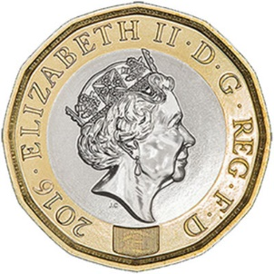


What is Hypothesis Testing?
I throw a coin 10 times. For what numbers of heads might you conclude that the coin is biased towards heads? Why?
Our intuition is that the further away we are from the ‘expected’ number of heads (i.e. 5 heads out of 10), the more unlikely it is.
$$p(x)$$
8 Heads still moderately likely to happen ‘by chance’.
Unlikely to happen ‘by chance’.
0 1 2 3 4 5 6 7 8 9 10
Number of heads ($x$)

Slide 5
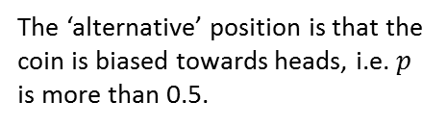

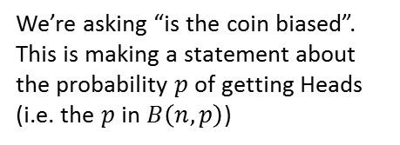
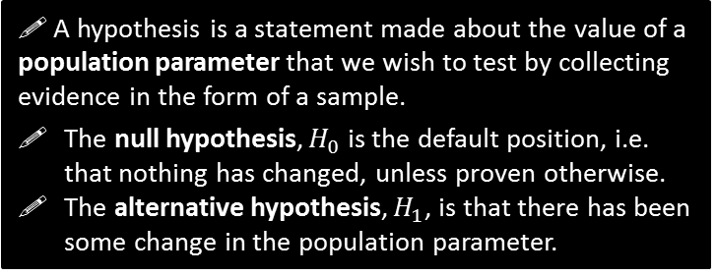
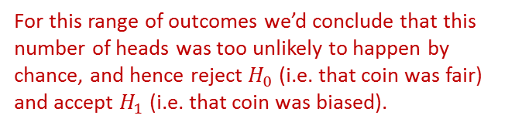

What is Hypothesis Testing?
I throw a coin 10 times. For what numbers of heads might you conclude that the coin is biased towards heads? Why?
! A hypothesis is a statement made about the value of a population parameter that we wish to test by collecting evidence in the form of a sample.
The null hypothesis, $H_{0}$ is the default position, i.e. that nothing has changed, unless proven otherwise.
The alternative hypothesis, $H_{1}$, is that there has been some change in the population parameter.
In this context…
We’re asking “is the coin biased”. This is making a statement about the probability $p$ of getting Heads (i.e. the $p$ in $B\left(n,p\right)$)
?
The ‘default position’ is that the coin is fair, i.e. $p=0.5$.
?
$$p(x)$$
For this range of outcomes we wouldn’t conclude the coin is biased, i.e. we’d “accept $H_{0}$”
The ‘alternative’ position is that the coin is biased towards heads, i.e. $p$ is more than 0.5.
?
For this range of outcomes we’d conclude that this number of heads was too unlikely to happen by chance, and hence reject $H_{0}$ (i.e. that coin was fair) and accept $H_{1}$ (i.e. that coin was biased).
0 1 2 3 4 5 6 7 8 9 10
Number of heads ($x$)

Slide 6

What is Hypothesis Testing?
I throw a coin 10 times. For what numbers of heads might you conclude that the coin is biased towards heads? Why?
In this context…
! In a hypothesis test, the evidence from the sample is a test statistic.
?
The test statistic $X$ is what we observed, in this case, $X$ is the number of heads seen in 10 throws.
Note that the test statistic is a distribution (i.e. across the possible things we might observe).
$$X\sim B(10,p)$$
noting that $p$ is not known until we start making assumptions.
$$p(x)$$
0 1 2 3 4 5 6 7 8 9 10
Number of heads ($x$)

Slide 7
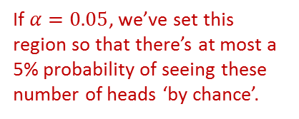
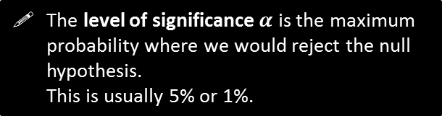

What is Hypothesis Testing?
I throw a coin 10 times. For what numbers of heads might you conclude that the coin is biased towards heads? Why?
In this context…
The level of significance $α$ is the maximum probability where we would reject the null hypothesis.
This is usually 5% or 1%.
?
We said that if we saw a number of heads within ranges of outcomes that were sufficiently unlikely, then we’d rule out that the coin is fair and conclude it was in fact biased.
But how unlikely is ‘sufficiently unlikely’? If $α=5\%$, then we’d find a region of outcomes where there’s (at most) a 5% chance of one of these extreme values happening ‘by chance’ (i.e. if the coin was fair).
$$p(x)$$
If $α=0.05$, we’ve set this region so that there’s at most a 5% probability of seeing these number of heads ‘by chance’.
0 1 2 3 4 5 6 7 8 9 10
Number of heads ($x$)

Slide 8
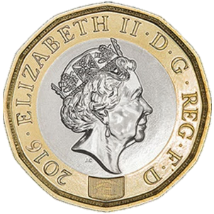
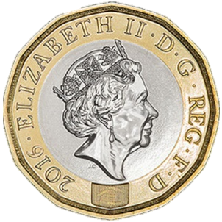
What is Hypothesis Testing?
!
Hypothesis testing in a nutshell then is:
We have some hypothesis we wish to see if true (e.g. coin is biased towards heads), so…
We collect some sample data by throwing the coin (giving us our ‘test statistic’) and…
If that number of heads (or more) is sufficiently unlikely to have emerged ‘just by chance’, then we conclude that our (alternative) hypothesis is correct, i.e. the coin is biased.

Slide 9
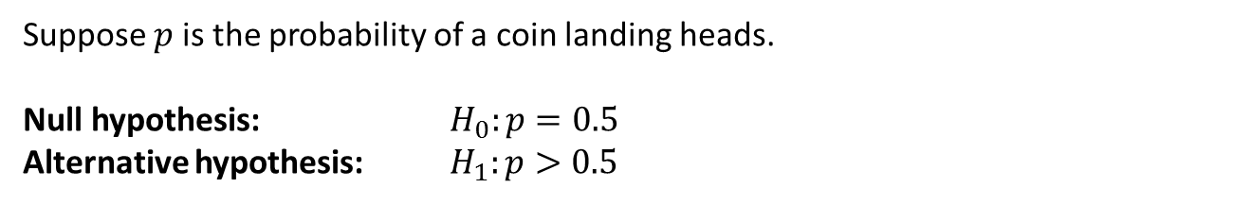
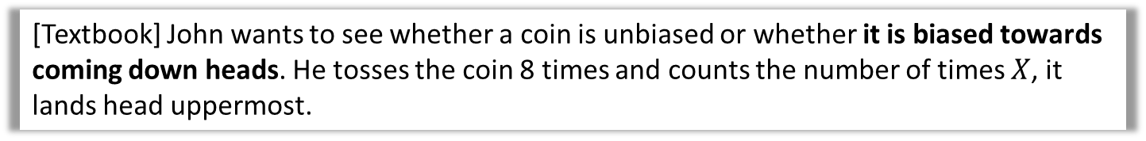
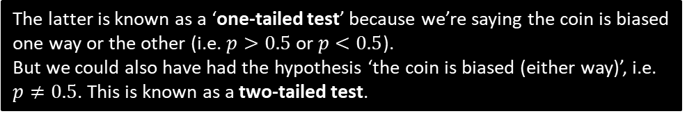
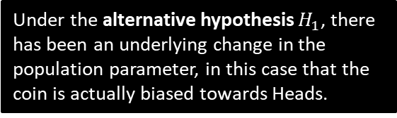
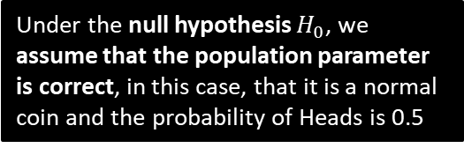
Null Hypothesis and Alternative Hypothesis
[Textbook] John wants to see whether a coin is unbiased or whether it is biased towards coming down heads. He tosses the coin 8 times and counts the number of times $X$, it lands head uppermost.
We said that our two hypotheses are about the population parameter.
Suppose $p$ is the probability of a coin landing heads.
Null hypothesis: $H_{0}:p=0.5$
Alternative hypothesis: $H_{1}:p>0.5$
?
Under the null hypothesis $H_{0}$, we assume that the population parameter is correct, in this case, that it is a normal coin and the probability of Heads is 0.5
?
Under the alternative hypothesis $H_{1}$, there has been an underlying change in the population parameter, in this case that the coin is actually biased towards Heads.
The latter is known as a ‘one-tailed test’ because we’re saying the coin is biased one way or the other (i.e. $p>0.5$ or $p<0.5$).
But we could also have had the hypothesis ‘the coin is biased (either way)’, i.e. $p≠0.5$. This is known as a two-tailed test.

Slide 10
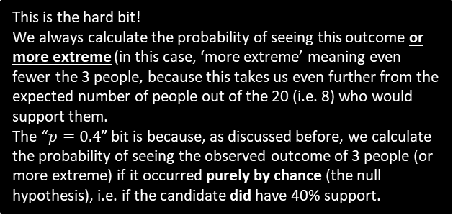

Further Example
[Textbook] An election candidate believes she has the support of 40% of the residents in a particular town. A researcher wants to test, at the 5% significance level, whether the candidate is over-estimating her support. The researcher asks 20 people whether they support the candidate or not. 3 people say they do.
Write down a suitable test statistic.
Write down two suitable hypotheses.
Explain the condition under which the null hypothesis would be rejected.
The number of people who say they support the candidate.
$$H_{0}:p=0.4 \\ H_{1}:p<0.4$$
Null hypothesis would be rejected if the probability of 3 or fewer people supporting the candidate is less than 5%, given that $p=0.4$
For a hypothesis test involving the binomial distribution, the test statistic is always the count of successes.
a
?
The alternative hypothesis is that the candidate is overestimating her support, so we’re interested where less than 40% support them (more than 40% would not undermine the candidate’s claim).
b
?
c
?
This is the hard bit!
We always calculate the probability of seeing this outcome or more extreme (in this case, ‘more extreme’ meaning even fewer the 3 people, because this takes us even further from the expected number of people out of the 20 (i.e. 8) who would support them.
The “$p=0.4$” bit is because, as discussed before, we calculate the probability of seeing the observed outcome of 3 people (or more extreme) if it occurred purely by chance (the null hypothesis), i.e. if the candidate did have 40% support.

Slide 11
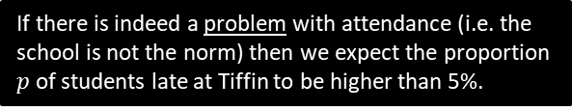

Test Your Understanding
In the UK, 5% of students turn up late to school each day. Mr Hameed wishes to determine, to a 10% significance level if his school, Piffin School, has a problem with attendance. He stands at the front gate one day and finds that 6 of the 40 students who pass him are late.
Write down a suitable test statistic.
Write down two suitable hypotheses.
Explain the condition under which the null hypothesis would be rejected.
a
The number of students who are late to school that day.
$$H_{0}:p=0.05 \\ H_{1}:p>0.05$$
Null hypothesis would be rejected if the probability of 6 or more students being late to school is less than 10%, given that $p=0.05$
?
If there is indeed a problem with attendance (i.e. the school is not the norm) then we expect the proportion $p$ of students late at Tiffin to be higher than 5%.
b
?
c
?
Just to reiterate again what’s going on here:
We assume that the school is the norm (i.e. 5% of students are late), and calculate the probability that 6 or more students would be late under this assumption.
If the probability of this happening by chance is sufficiently unlikely (less than the 10% significance level), we conclude that it probably isn’t just by chance, and the school’s lateness rate is worse than 5%.

Slide 12
Exercise 7A
Pearson Applied Year 1/AS
Pages 100-101

Slide 13

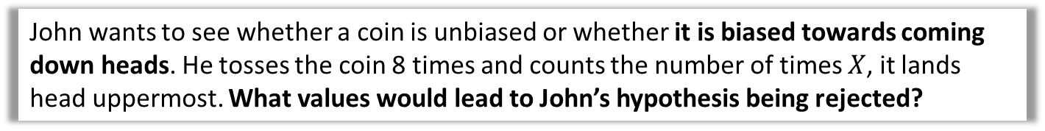
Critical Regions and Values
John wants to see whether a coin is unbiased or whether it is biased towards coming down heads. He tosses the coin 8 times and counts the number of times $X$, it lands head uppermost. What values would lead to John’s hypothesis being rejected?
As before, we’re interested how likely a given outcome is likely to happen ‘just by chance’ under the null hypothesis (i.e. when the coin is not biased).
However, there are values which collectively form a range of ‘extreme values’ where it would be unlikely that the coin would be unbiased. Their combined probability is limited by the level of significance set (e.g. 5%)
The probability of getting exactly 5 heads is only 22%, which is more likely to not happen than to happen. If we saw this number of heads, why would it not be sensible to think the coin is biased?
The probability is only low because there’s lots of possible outcomes. But 5 heads forms part of a range of possible number of heads that collectively would be consistent with a coin not biased towards heads.
?
Prob under $H_{0}$
0 1 2 3 4 5 6 7 8
Num heads

Slide 14
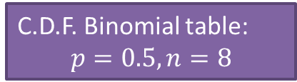
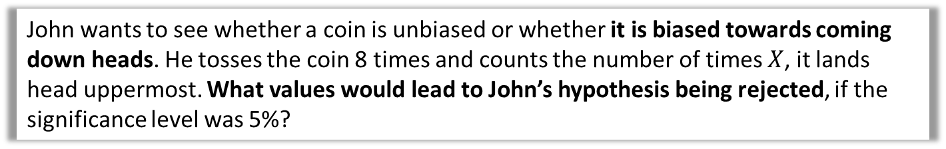
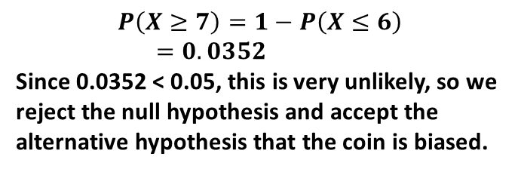
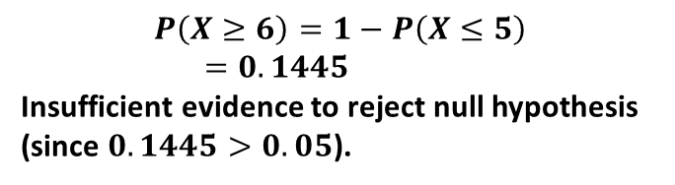
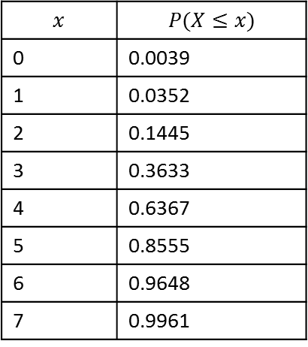
Critical Regions and Values
John wants to see whether a coin is unbiased or whether it is biased towards coming down heads. He tosses the coin 8 times and counts the number of times $X$, it lands head uppermost. What values would lead to John’s hypothesis being rejected, if the significance level was 5%?
What’s the probability that we would see 6 heads, or an even more extreme value? Is this sufficiently unlikely to support John’s claim that the coin is biased?
C.D.F. Binomial table:
$$p=0.5, n=8$$
$$x$$ | $$P(X≤x)$$
0 | 0.0039
1 | 0.0352
2 | 0.1445
3 | 0.3633
4 | 0.6367
5 | 0.8555
6 | 0.9648
7 | 0.9961
$$P\left(X≥6\right)=1−P\left(X≤5\right) \\ =0.1445$$
Insufficient evidence to reject null hypothesis (since $0.1445>0.05$).
?
What’s the probability that we would see 7 heads, or an even more extreme value?
?
$$P\left(X≥7\right)=1−P\left(X≤6\right) \\ =0.0352$$
Since 0.0352 < 0.05, this is very unlikely, so we reject the null hypothesis and accept the alternative hypothesis that the coin is biased.

Slide 15
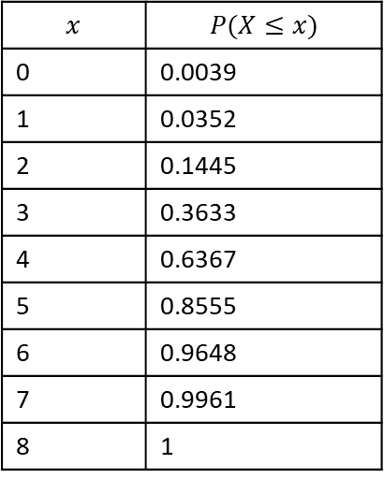
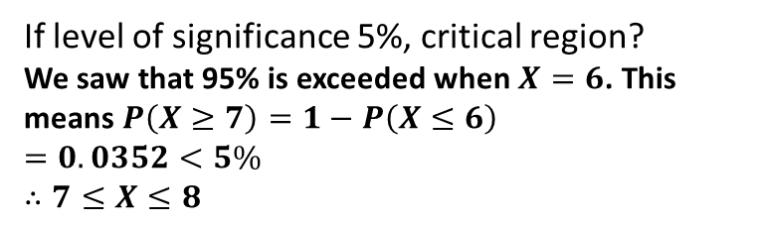
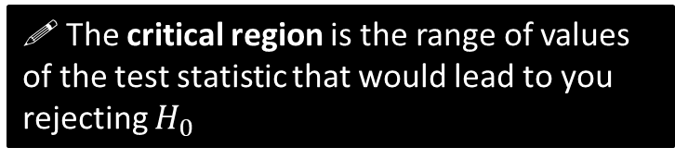

Critical Regions and Values
John wants to see whether a coin is unbiased or whether it is biased towards coming down heads. He tosses the coin 8 times and counts the number of times $X$, it lands head uppermost. What values would lead to John’s hypothesis being rejected, if the significance level was 5%?
! The critical region is the range of values of the test statistic that would lead to you rejecting $H_{0}$
C.D.F. Binomial table:
$$p=0.5, n=8$$
?
$$x$$ | $$P(X≤x)$$
0 | 0.0039
1 | 0.0352
2 | 0.1445
3 | 0.3633
4 | 0.6367
5 | 0.8555
6 | 0.9648
7 | 0.9961
8 | 1
If level of significance 5%, critical region?
We saw that 95% is exceeded when $X=6$. This means $P\left(X≥7\right)=1−P\left(X≤6\right)$
$=0.0352<5\%$
$$∴7≤X≤8$$
Fro Tip: Use the first value AFTER the one in the table that exceeds 95%.
! The value(s) on the boundary of the critical region are called critical value(s).
Critical value:
$$7$$
?

Slide 16

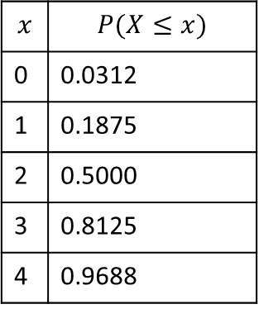

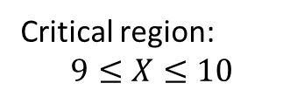

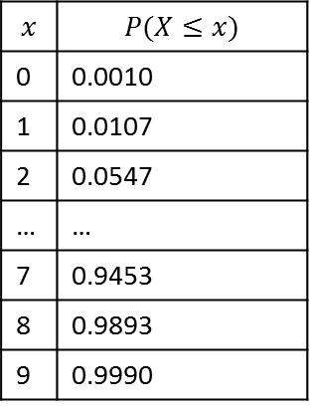
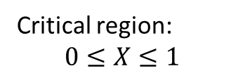
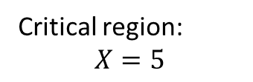
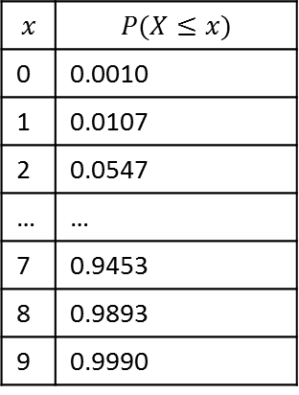
Quickfire Critical Regions
Determine the critical region when we throw a coin where we’re trying to establish if there’s the specified bias, given the specified number of throws, when the level of significance is 5%.
Coin thrown 5 times. Trying to establish if biased towards heads.
Coin thrown 10 times. Trying to establish if biased towards heads.
Coin thrown 10 times. Trying to establish if biased towards tails.
Fro Reminder: At the positive tail, use the value AFTER the first that exceeds 95% (100 - 5).
$$p=0.5, n=5$$
$$p=0.5, n=10$$
$$p=0.5, n=10$$
$$x$$ | $$P(X≤x)$$
0 | 0.0312
1 | 0.1875
2 | 0.5000
3 | 0.8125
4 | 0.9688
$$x$$ | $$P(X≤x)$$
0 | 0.0010
1 | 0.0107
2 | 0.0547
… | …
7 | 0.9453
8 | 0.9893
9 | 0.9990
$$x$$ | $$P(X≤x)$$
0 | 0.0010
1 | 0.0107
2 | 0.0547
… | …
7 | 0.9453
8 | 0.9893
9 | 0.9990
At the negative tail, we just use the first value that goes under the significance level.
Critical region:
$$X=5$$
Critical region:
$$9≤X≤10$$
Critical region:
$$0≤X≤1$$
?
?
?

Slide 17

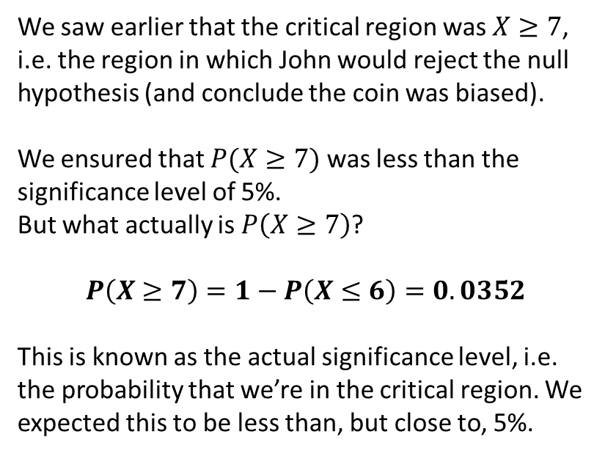
Actual Significance Level
John wants to see whether a coin is unbiased or whether it is biased towards coming down heads. He tosses the coin 8 times and counts the number of times $X$, it lands head uppermost. What values would lead to John’s hypothesis being rejected, if the significance level was 5%?
We saw earlier that the critical region was $X≥7$, i.e. the region in which John would reject the null hypothesis (and conclude the coin was biased).
We ensured that $P(X≥7)$ was less than the significance level of 5%.
But what actually is $P\left(X≥7\right)$?
$$P\left(X≥7\right)=1−P\left(X≤6\right)=0.0352$$
This is known as the actual significance level, i.e. the probability that we’re in the critical region. We expected this to be less than, but close to, 5%.
C.D.F. Binomial table:
$$p=0.5, n=8$$
$$x$$ | $$P(X≤x)$$
0 | 0.0039
1 | 0.0352
2 | 0.1445
3 | 0.3633
4 | 0.6367
5 | 0.8555
6 | 0.9648
7 | 0.9961
8 | 1
?
! The actual significance level is the actual probability of being in the critical region.

Slide 18



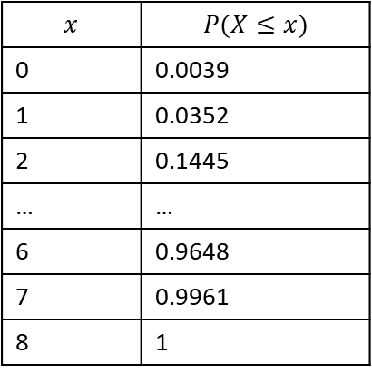
Two-tailed test
Critical region
Acceptance region
Critical region
Suppose I threw a coin 8 times and was now interested in how may heads would suggest it was a biased coin (i.e. either way!). How do we work out the critical values now, with 5% significance?
We split the 5% so there’s 2.5% at either tail, then proceed as normal:
Prob under $H_{0}$
?
0 1 2 3 4 5 6 7 8
Num heads
C.D.F. Binomial table:
$$p=0.5, n=8$$
Critical region at positive tail:
Look at closest value above 0.975 (then go one above):
$$X=8$$
Critical region at negative tail:
Look at closest value below 0.025.
$$X=0$$
?
$$x$$ | $$P(X≤x)$$
0 | 0.0039
1 | 0.0352
2 | 0.1445
… | …
6 | 0.9648
7 | 0.9961
8 | 1
?

Slide 19
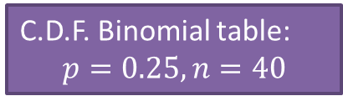

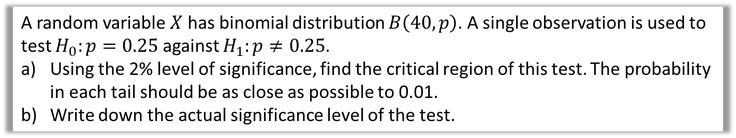
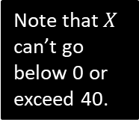

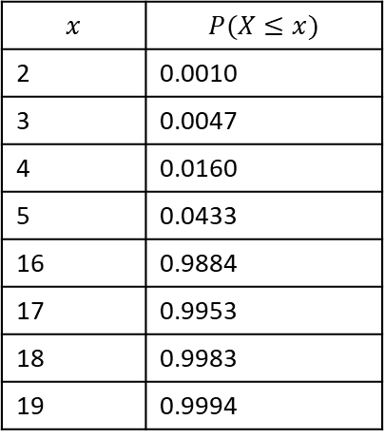
Test Your Understanding
A random variable $X$ has binomial distribution $B\left(40,p\right)$. A single observation is used to test $H_{0}:p=0.25$ against $H_{1}:p≠0.25$.
Using the 2% level of significance, find the critical region of this test. The probability in each tail should be as close as possible to 0.01.
Write down the actual significance level of the test.
The $≠$ indicates bias either way, i.e. two-tailed.
This means you find the closest to 0.01 (even if slightly above) rather than the closest under 0.01
a
?
To ensure all method marks always show the probability of being in the critical region (even if you don’t subsequently need the value!)
(Half of 0.02 is 0.01)
$$P\left(X≤3\right)=0.0047$$
$$0≤X≤3$$
$$P\left(X≥17\right)=1−P\left(X≤16\right)=0.0116$$
$$17≤X≤40$$
Critical region is $0≤X≤3$ or $17≤X≤40$
$$0.0047+0.0116=0.0163=1.63\%$$
C.D.F. Binomial table:
$$p=0.25, n=40$$
$$x$$ | $$P(X≤x)$$
2 | 0.0010
3 | 0.0047
4 | 0.0160
5 | 0.0433
16 | 0.9884
17 | 0.9953
18 | 0.9983
19 | 0.9994
Note that $X$ can’t go below 0 or exceed 40.
b
?
Warning: Textbook has several typos in this example.

Slide 20
Exercise 7B
Pearson Applied Year 1/AS
Pages 103-105

Slide 21
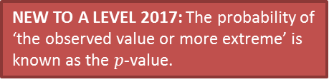
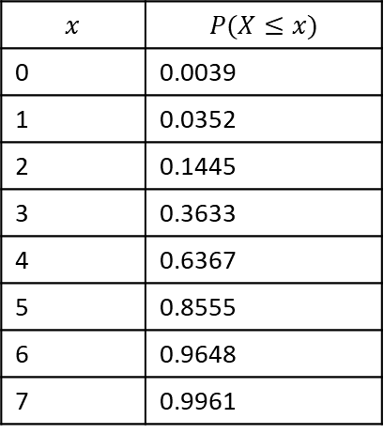
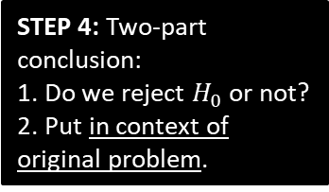
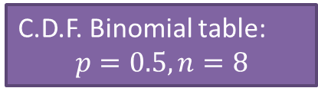
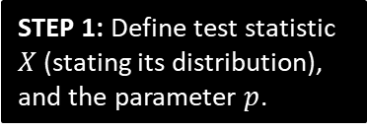


Doing a full one-tailed hypothesis test
We’ve done various bits of a hypothesis test, and haven’t actually properly conducted one yet. Let’s do an example!
John tosses a coin 8 times and it comes up heads 6 times. He claims the coin is biased towards heads. With a significance level of 5%, test his claim.
?
$X$ is number of heads.
$p$ is probability of heads.
$$X\sim B\left(8,p\right)$$
$$H_{0}:p=0.5 \\ H_{1}:p>0.5$$
STEP 1: Define test statistic $X$ (stating its distribution), and the parameter $p$.
C.D.F. Binomial table:
$$p=0.5, n=8$$
STEP 2: Write null and alternative hypotheses.
$$x$$ | $$P(X≤x)$$
0 | 0.0039
1 | 0.0352
2 | 0.1445
3 | 0.3633
4 | 0.6367
5 | 0.8555
6 | 0.9648
7 | 0.9961
?
Assume $H_{0}$ is true, $X\sim B\left(8,0.5\right)$
$$P\left(X≥6\right)=1−P\left(X≤5\right) \\ =1−0.8555 \\ =0.1445$$
14.45% > 5%, so insufficient evidence to reject $H_{0}$.
Coin is not biased.
STEP 3: Determine probability of observed test statistic (or ‘more extreme’), assuming null hypothesis.
i.e. Determine probability we’d see this outcome just by chance.
?
?
STEP 4: Two-part conclusion:
1. Do we reject $H_{0}$ or not?
2. Put in context of original problem.
NEW TO A LEVEL 2017: The probability of ‘the observed value or more extreme’ is known as the $p$-value.

Slide 22

Alternative method using critical regions
We can also find the critical region and see if the test statistic lies within it.
John tosses a coin 8 times and it comes up heads 6 times. He claims the coin is biased towards heads. With a significance level of 5%, test his claim.
$X$ is number of heads.
$p$ is probability of heads.
$$X\sim B\left(8,p\right)$$
$$H_{0}:p=0.5 \\ H_{1}:p>0.5$$
STEP 1: Define test statistic $X$ (stating its distribution), and the parameter $p$.
C.D.F. Binomial table:
$$p=0.5, n=8$$
STEP 2: Write null and alternative hypotheses.
$$x$$ | $$P(X≤x)$$
0 | 0.0039
1 | 0.0352
2 | 0.1445
3 | 0.3633
4 | 0.6367
5 | 0.8555
6 | 0.9648
7 | 0.9961
$$P\left(X≥7\right)=1−0.9648=0.0352$$
Critical region is $X≥7$
6 is not in critical region, so do not reject $H_{0}$.
Coin is not biased.
?
STEP 3 (Alternative): Determine critical region.
?
STEP 4: Two-part conclusion:
1. Do we reject $H_{0}$ or not?
2. Put in context of original problem.

Slide 23



More on $p$-values
(Note that this is not covered in the Pearson textbook, but is in the specification)
Sheila wants to know if a coin is biased towards heads and throws it a large number of times, counting the number of heads. The $p$-value is less than 0.03.
Conduct a hypothesis test at the 5% significance level.
?
Froflections: Ordinarily we’d calculate the probability of seeing the observed number of heads ‘or more extreme’. But this has already been done for us (i.e. the $p$-value), so we just need to compare this against the threshold.
Let $p$ be the probability of heads.
$H_{0}: p=0.5$
$H_{1}: p>0.5$
$0.03<0.05$ so reject $H_{0}$.
Sufficient evidence to suggest the coin is biased.

Slide 24





Further Example
[Textbook] The standard treatment for a particular disease has a $\frac{2}{5}$ probability of success. A certain doctor has undertake research in this area and has produced a new drug which has been successful with 11 out of 20 patients. The doctor claims the new drug represents an improvement on the standard treatment.
Test, at the 5% significance level, the claim made by the doctor.
?
$X$ is number of patients for whom trial was successful.
$p$ is probability of success in each patient.
$$X\sim B\left(20,p\right)$$
$$H_{0}:p=0.4 \\ H_{1}:p>0.4$$
Assume $H_{0}$ is true, so $X\sim B(20,0.4)$
$$P\left(X≥11\right)=1−P\left(X≤10\right)=0.1275$$
12.75% > 5% so not enough evidence to reject $H_{0}$.
$∴$ New drug is no better than old one.
STEP 1: Define test statistic $X$ (stating its distribution), and the parameter $p$.
?
STEP 2: Write null and alternative hypotheses.
?
STEP 3: Determine probability of observed test statistic (or ‘more extreme’), assuming null hypothesis.
?
STEP 4: Two-part conclusion:
1. Do we reject $H_{0}$ or not?
2. Put in context of original problem.

Slide 25


Test Your Understanding
Edexcel S2 Jan 2011 Q2
A student takes a multiple choice test. The test is made up of 10 questions each with 5 possible answers. The student gets 4 questions correct. Her teacher claims she was guessing the answers. Using a one tailed test, at the 5% level of significance, test whether or not there is evidence to reject the teacher’s claim.
State your hypotheses clearly. (6)
?
Note the mark for stating distribution of $X$ under null hypothesis.
Note two-mark conclusion.

Slide 26
Exercise 7C
Pearson Applied Year 1/AS
Pages 106-107

Slide 27

Two-Tailed Tests
We have already seen that if we’re interest in bias ‘either way’, we have two tails, and therefore have to split the critical region by halving the significance level at each end.
Over a long period of time it has been found that in Enrico’s restaurant the ratio of non-veg to veg meals is 2 to 1. In Manuel’s restaurant in a random sample of 10 people ordering meals, 1 ordered a vegetarian meal. Using a 5% level of significance, test whether or not the proportion of people eating veg meals in Manuel’s restaurant is different to that in Enrico’s restaurant.
?
Proportion eating veg meals at Enrico’s is $\frac{1}{3}$
Let $p$ be the proportion of people at Manuel’s that order veg.
Let $X$ be number of people eating veg meals.
$$H_{0}:p=\frac{1}{3} H_{1}:p≠\frac{1}{3}$$
If $H_{0}$ true then $X\sim B\left(10,\frac{1}{3}\right)$
$$P\left(X≤1\right)=P\left(X=0\right)+P\left(X=1\right) \\ =0.104 (3sf)$$
$0.104>0.025$ therefore insufficient evidence to reject $H_{0}$.
There is no evidence that proportion of veg meals at Manuel’s restaurant is different to Enrico’s.
Half significance as 2 tailed.
Conclusion and what it means in context.

Slide 28


Test Your Understanding
Edexcel S2 Jan 2006 Q7a
?
?

Slide 29
Exercise 7D
Pearson Applied Year 1/AS
Pages 108-109

