Slide 1

Stats1 Chapter 4 :: Correlation
jfrost@tiffin.kingston.sch.uk
www.drfrostmaths.com
@DrFrostMaths
Last modified: 3rd March 2018

Slide 2
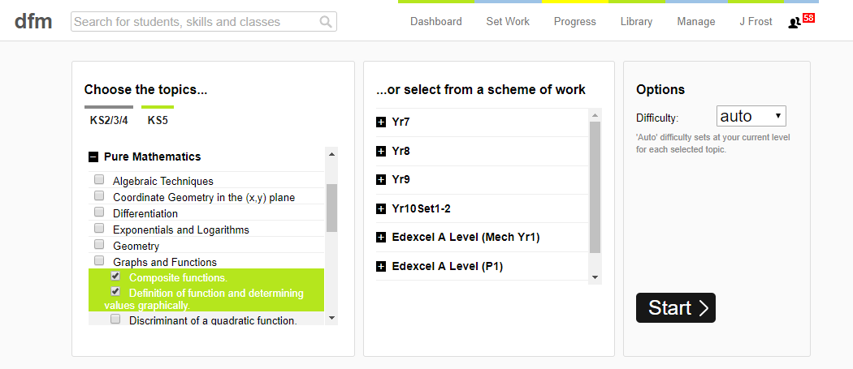
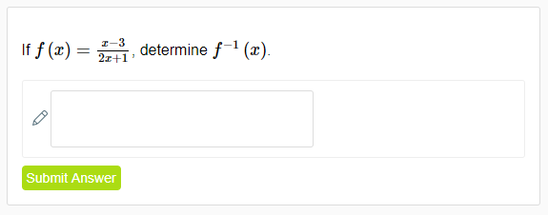
Use of DrFrostMaths for practice
Register for free at:
www.drfrostmaths.com/homework
Practise questions by chapter, including past paper Edexcel questions and extension questions (e.g. MAT).
Teachers: you can create student accounts (or students can register themselves).

Slide 3

Experimental
i.e. Dealing with collected data.
Chp2: Measures of Location/Spread
Chp3: Representation of Data
Chp1: Data Collection
Statistics used to summarise data, including mean, standard deviation, quartiles, percentiles. Use of linear interpolation for estimating medians/quartiles.
Producing and interpreting visual representations of data, including box plots and histograms.
Methods of sampling, types of data, and populations vs samples.
Chp4: Correlation
Measuring how related two variables are, and using linear regression to predict values.
Theoretical
Deal with probabilities and modelling to make inferences about what we ‘expect’ to see or make predictions, often using this to reason about/contrast with experimentally collected data.
Chp5: Probability
Chp6: Statistical Distributions
Chp7: Hypothesis Testing
Venn Diagrams, mutually exclusive + independent events, tree diagrams.
Common distributions used to easily find probabilities under certain modelling conditions, e.g. binomial distribution.
Determining how likely observed data would have happened ‘by chance’, and making subsequent deductions.

Slide 4
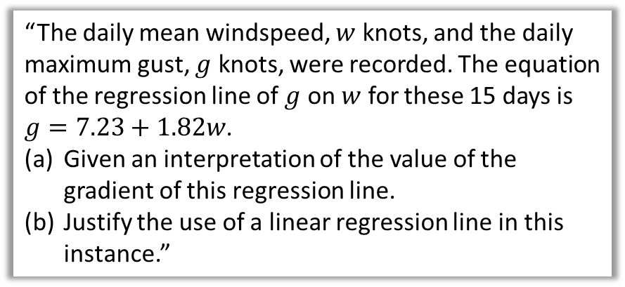
This Chapter Overview
Previously we have only considered one variable at a time. When we introduce a second variable (e.g. height with age), we might want to consider the relationship between them.
This is a short chapter!
Hourly pay at 25
“Describe the type of correlation.”
20
15
5
0
Hourly Pay (£)
“The daily mean windspeed, $w$ knots, and the daily maximum gust, $g$ knots, were recorded. The equation of the regression line of $g$ on $w$ for these 15 days is $g=7.23+1.82w$.
Given an interpretation of the value of the gradient of this regression line.
Justify the use of a linear regression line in this instance.”
15 20 25
Age (years)
Changes since the old ‘S1’ syllabus:
This chapter has been scaled back significantly since the S1 ‘Correlation’ and ‘Regression’ chapters. You no longer need to determine the equation of the line of best fit (the regression line), or calculate measures of correlation, but merely have to interpret an equation already given or the limitations of estimates made or comment on the suitability of a linear regression model.

Slide 5
Recap of correlation
Correlation gives the strength of the relationship (and the type of relationship) between two variables. Data with two variables is known as bivariate data.
Weak negative correlation
?
?
Type of correlation:
Weak positive correlation
?
?
strength
type
No correlation
?
?
Strong positive correlation
?
The vertical-axis variable usually depends on the horizontal-axis value. For this reason distance would be the independent/explanatory variable and cost the dependent/response variable.

Slide 6
Important correlation concepts
Important Point 1
To interpret the correlation between two variables is to give a worded description in the context of the problem.
State the correlation shown.
Describe/interpret the relationship between age and weekly time on the internet.
?
Negative correlation.
As age increases, the weekly time on the internet tends to decrease.
?
Important Point 2
[Textbook] Two variables have a causal relationship if a change in one variable directly causes a change in the other. Just because two variables show correlation it does not necessarily mean that they have a causal relationship.
Hourly pay at 25
20
15
5
0
Hideko was interested to see if there was a relationship between what people earn and the age which they left education or training. She says her data supports the conclusion that more education causes people to earn a lower hourly rate of pay. Give one reason why Hideko’s conclusion might not be valid.
Hourly Pay (£)
15 20 25
“Respondents who left education later would have significantly less work experience than those who left education earlier. This could be the cause of the reduced income shown in her results.”
?
Age (years)

Slide 7
Exercise 4A
Pearson Statistics/Mechanics Year 1/AS
Pages 61-62

Slide 8

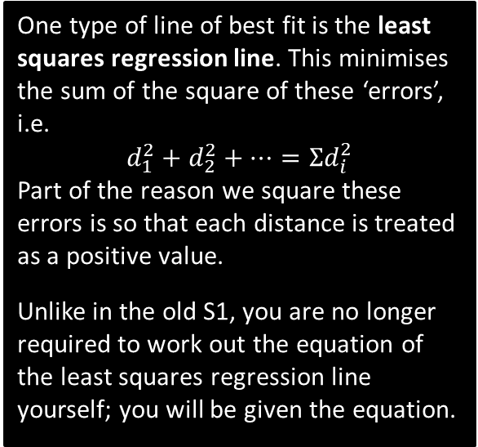






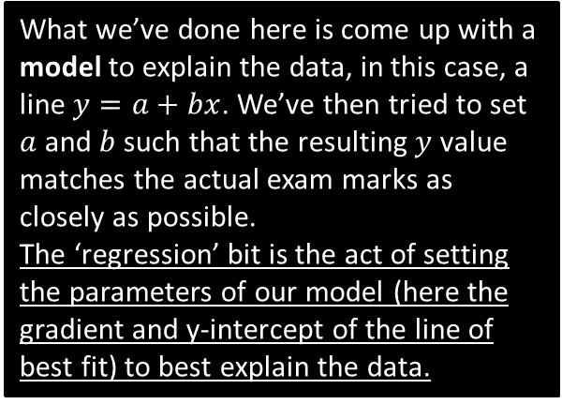



What is regression?
What we’ve done here is come up with a model to explain the data, in this case, a line $y=a+bx$. We’ve then tried to set $a$ and $b$ such that the resulting $y$ value matches the actual exam marks as closely as possible.
The ‘regression’ bit is the act of setting the parameters of our model (here the gradient and y-intercept of the line of best fit) to best explain the data.
$$d_{7}$$
$$d_{5}$$
$$d_{6}$$
Exam mark $(y)$
$$y=20+3x$$
$$d_{3}$$
$$d_{4}$$
$$d_{2}$$
$$d_{1}$$
One type of line of best fit is the least squares regression line. This minimises the sum of the square of these ‘errors’, i.e.
$$d_{1}^{2}+d_{2}^{2}+…=Σd_{i}^{2}$$
Part of the reason we square these errors is so that each distance is treated as a positive value.
Unlike in the old S1, you are no longer required to work out the equation of the least squares regression line yourself; you will be given the equation.
Time spent revising $(x)$
I record people’s exam marks as well as the time they spent revising. I want to predict how well someone will do based on the time they spent revising. How would I do this?

Slide 9
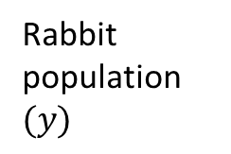


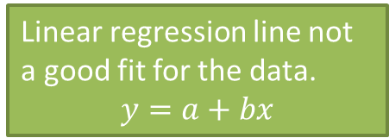
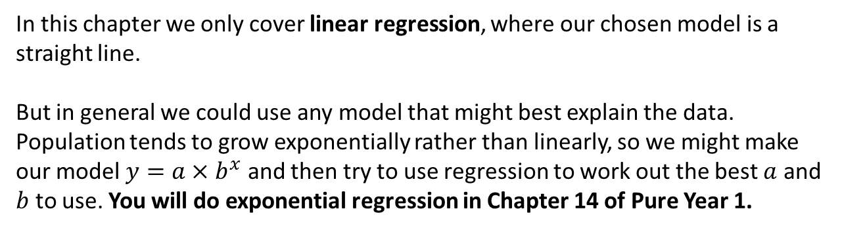
What is regression?
Linear regression line not a good fit for the data.
$$y=a+bx$$
Rabbit population $(y)$
Exponential line much better fit.
$$y=ab^{x}$$
Time$(x)$
In this chapter we only cover linear regression, where our chosen model is a straight line.
But in general we could use any model that might best explain the data. Population tends to grow exponentially rather than linearly, so we might make our model $y=a×b^{x}$ and then try to use regression to work out the best $a$ and $b$ to use. You will do exponential regression in Chapter 14 of Pure Year 1.

Slide 10
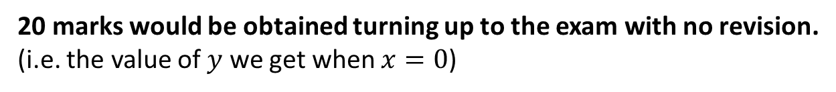
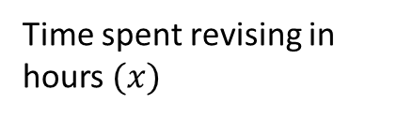
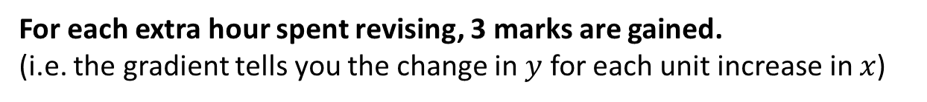

Interpreting $a$ and $b$.
$$y=20+3x$$
Exam mark $(y)$
Time spent revising in hours $(x)$
How do we interpret the gradient of 3?
?
For each extra hour spent revising, 3 marks are gained.
(i.e. the gradient tells you the change in $y$ for each unit increase in $x$)
How do we interpret the $y$-intercept of 20?
?
20 marks would be obtained turning up to the exam with no revision.
(i.e. the value of $y$ we get when $x=0$)

Slide 11
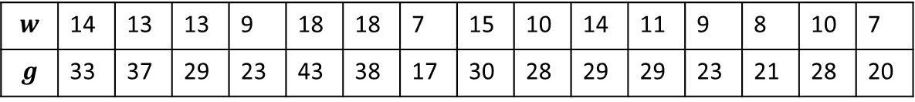

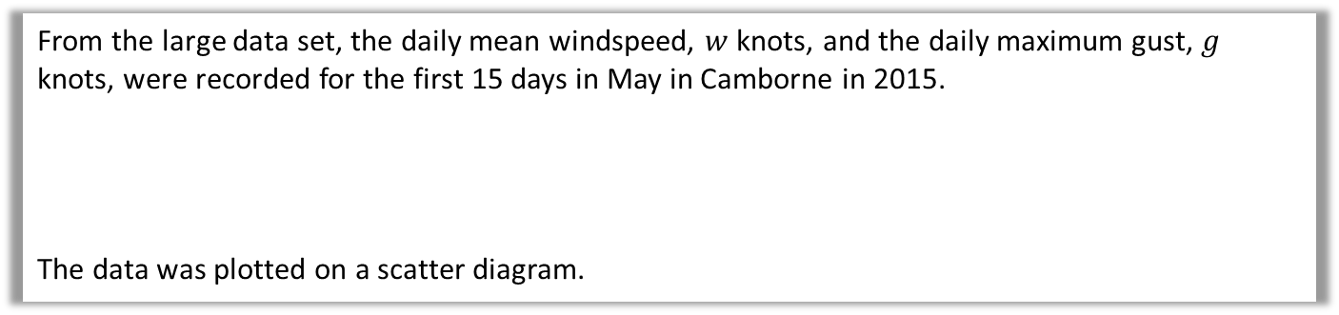
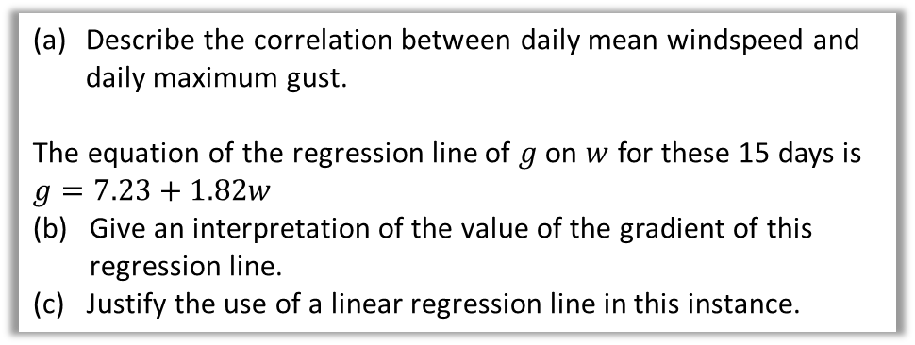


Example
From the large data set, the daily mean windspeed, $w$ knots, and the daily maximum gust, $g$ knots, were recorded for the first 15 days in May in Camborne in 2015.
The data was plotted on a scatter diagram.
$$w$$ | 14 | 13 | 13 | 9 | 18 | 18 | 7 | 15 | 10 | 14 | 11 | 9 | 8 | 10 | 7
$$g$$ | 33 | 37 | 29 | 23 | 43 | 38 | 17 | 30 | 28 | 29 | 29 | 23 | 21 | 28 | 20
© Met Office
Describe the correlation between daily mean windspeed and daily maximum gust.
The equation of the regression line of $g$ on $w$ for these 15 days is $g=7.23+1.82w$
(b) Give an interpretation of the value of the gradient of this
regression line.
(c) Justify the use of a linear regression line in this instance.
50
40
30
20
10
0
Daily maximum gust, $g$ (knots)
0 5 10 15 20
Daily mean windspeed, $w$ (knots)
There is a strong positive correlation between daily mean windspeed and daily maximum gust.
If the daily mean windspeed increases by 10 knots the daily maximum gust increases by approximately 18 knots.
The correlation suggests that there is a linear relationship between $g$ and $w$ so a linear regression line is a suitable model.
a
?
b
?
The stronger the (linear) correlation, the more suitable a linear regression line is.
c
?

Slide 12
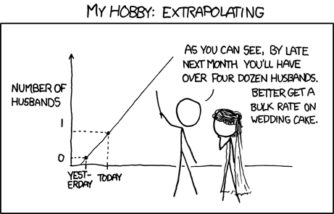
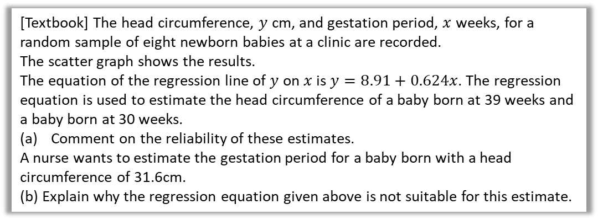
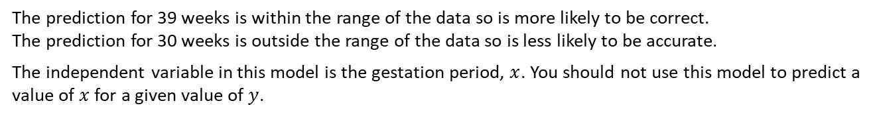
Interpolating and Extrapolating
You should only use the regression line to make predictions for values of the dependent variable that are within the range of the given data.
Estimating a value inside the data range is known as interpolating.
Estimating a value outside the data range is known as extrapolating
(as per the cartoon on the left!)
xkcd.com
[Textbook] The head circumference, $y$ cm, and gestation period, $x$ weeks, for a random sample of eight newborn babies at a clinic are recorded.
The scatter graph shows the results.
The equation of the regression line of $y$ on $x$ is $y=8.91+0.624x$. The regression equation is used to estimate the head circumference of a baby born at 39 weeks and a baby born at 30 weeks.
Comment on the reliability of these estimates.
A nurse wants to estimate the gestation period for a baby born with a head circumference of 31.6cm.
(b) Explain why the regression equation given above is not suitable for this estimate.
36
34
32
30
28
Head circumference (cm)
30 32 34 36 38 40 42x
Gestation period (weeks)
The prediction for 39 weeks is within the range of the data so is more likely to be correct.
The prediction for 30 weeks is outside the range of the data so is less likely to be accurate.
The independent variable in this model is the gestation period, $x$. You should not use this model to predict a value of $x$ for a given value of $y$.
a
?
b
?

Slide 13
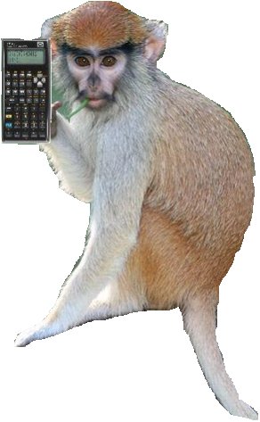
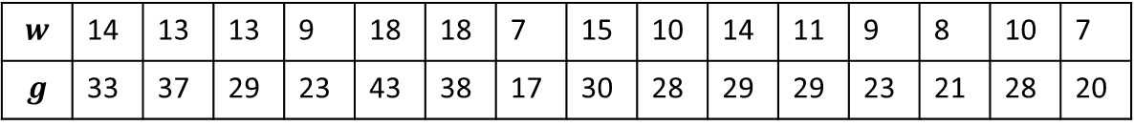
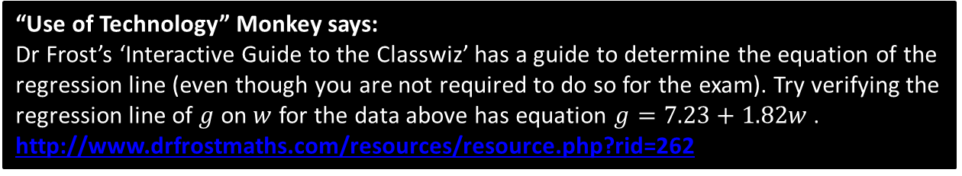
Exercise 4B
Pearson Statistics/Mechanics Year 1/AS
Pages 65-66
$$w$$ | 14 | 13 | 13 | 9 | 18 | 18 | 7 | 15 | 10 | 14 | 11 | 9 | 8 | 10 | 7
$$g$$ | 33 | 37 | 29 | 23 | 43 | 38 | 17 | 30 | 28 | 29 | 29 | 23 | 21 | 28 | 20
“Use of Technology” Monkey says:
Dr Frost’s ‘Interactive Guide to the Classwiz’ has a guide to determine the equation of the regression line (even though you are not required to do so for the exam). Try verifying the regression line of $g$ on $w$ for the data above has equation $g=7.23+1.82w$ .
http://www.drfrostmaths.com/resources/resource.php?rid=262

