Slide 1

P2 Chapter 6 :: Trigonometry
jfrost@tiffin.kingston.sch.uk
www.drfrostmaths.com
@DrFrostMaths
Last modified: 6th September 2018

Slide 2
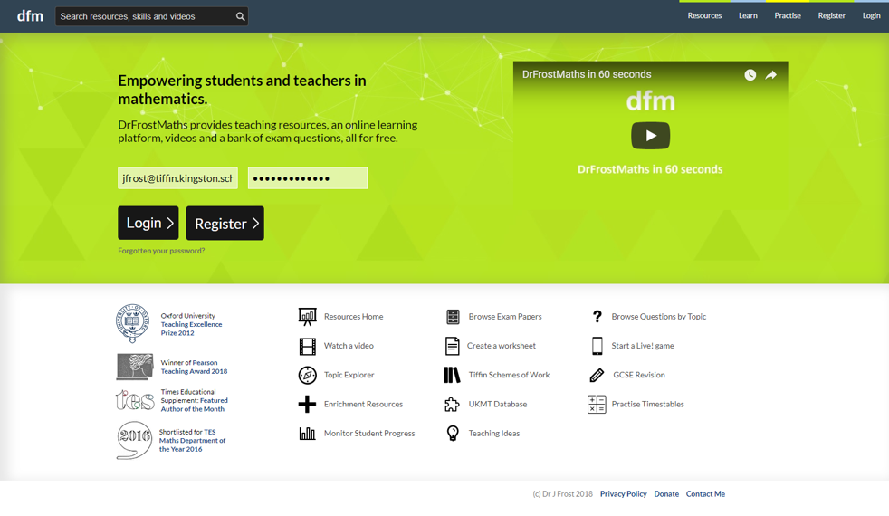







www.drfrostmaths.com
Everything is completely free.
Why not register?
Register now to interactively practise questions on this topic, including past paper questions and extension questions (including MAT + UKMT).
Teachers: you can create student accounts (or students can register themselves), to set work, monitor progress and even create worksheets.
With questions by:
Dashboard with points, trophies, notifications and student progress.
Questions organised by topic, difficulty and past paper.
Teaching videos with topic tests to check understanding.

Slide 3
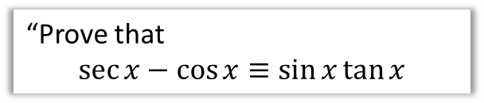
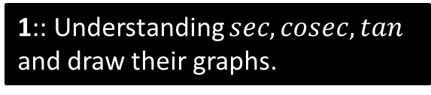
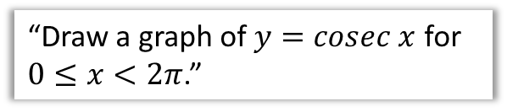
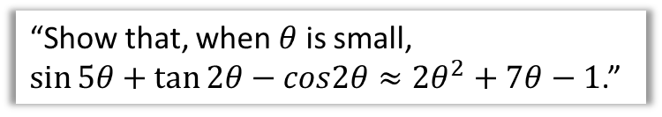
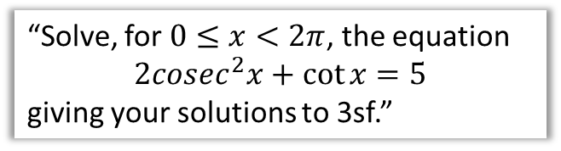
Chapter Overview
This chapter is very similar to the trigonometry chapters in Year 1. The only difference is that new trig functions: $sec, cosec$ and $cot$, are introduced.
1:: Understanding $sec, cosec, tan$ and draw their graphs.
2:: ‘Solvey’ questions.
“Solve, for $0≤x<2π$, the equation
$$2cosec^{2}x+\cot{x}=5$$
giving your solutions to 3sf.”
“Draw a graph of $y=cosec x$ for $0≤x<2π$.”
4:: Inverse trig functions and their domains/ranges.
3:: ‘Provey’ questions.
“Prove that
$$\sec{x}−\cos{x}≡\sin{x}\tan{x}$$
“Show that, when $θ$ is small,
$\sin{5θ}+\tan{2θ}−cos2θ≈2θ^{2}+7θ−1$.”
Teacher Note: There is no change in this chapter relative to the old pre-2017 syllabus.

Slide 4
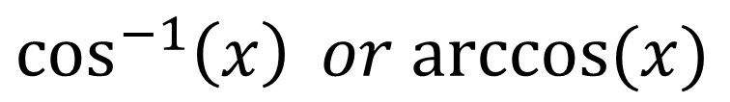
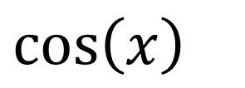
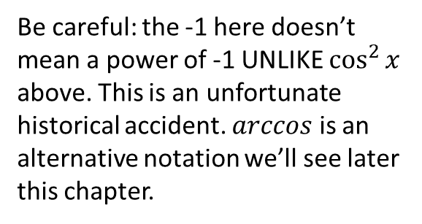
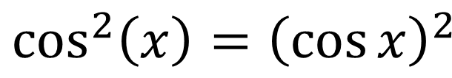
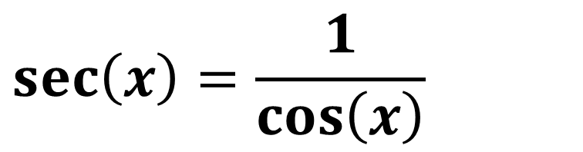
A new member of the trig family…
$$\cos\left(x\right)$$
Original and best. Like the ‘Classic Cola’ of trig functions*.
$$\cos^{2}\left(x\right)={\left(\cos{x}\right)}^{2}$$
The latter form is particularly useful for differentiation (see Chp9)
Be careful: the -1 here doesn’t mean a power of -1 UNLIKE $\cos^{2}{x}$ above. This is an unfortunate historical accident. $arccos$ is an alternative notation we’ll see later this chapter.
$$\cos^{−1}\left(x\right) or arccos⁡(x)$$
$$\sec\left(x\right)=\frac{1}{\cos\left(x\right)}$$
We have a convenient way of representing the reciprocal of the trig functions.
* Actually, I’ll contradict this in the ‘Just For Your Interest’ slides coming up soon.

Slide 5
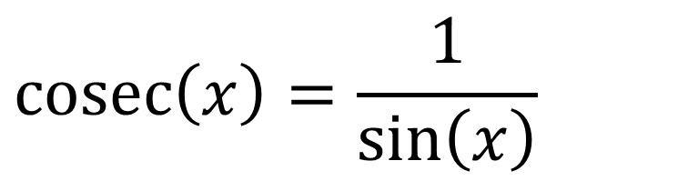
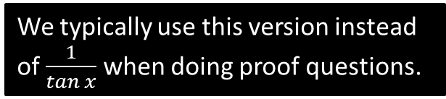
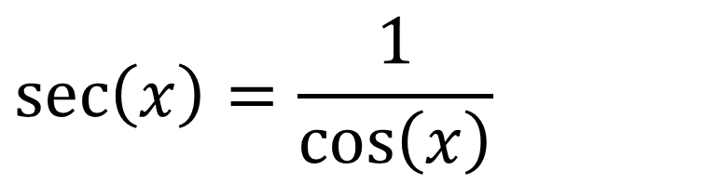
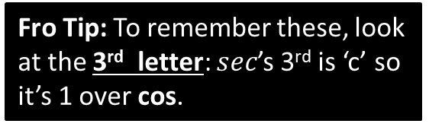
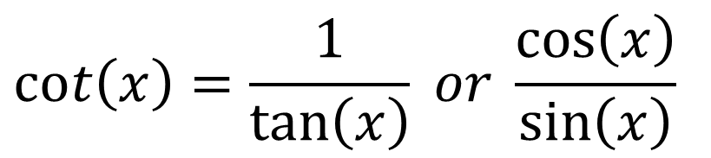
Reciprocal Trigonometric Functions
!
$$\sec\left(x\right)=\frac{1}{\cos\left(x\right)}$$
Short for “secant”
Pronounced “sehk” in shortened form or “sea-Kant” in full.
$$\operatorname{cosec}\left(x\right)=\frac{1}{\sin\left(x\right)}$$
Short for “cosecant”
$$\cot\left(x\right)=\frac{1}{\tan\left(x\right)} or \frac{\cos\left(x\right)}{\sin\left(x\right)}$$
Short for “cotangent”
In shortened form, rhymes with “pot”.
Fro Tip: To remember these, look at the 3rd letter: $sec$’s 3rd is ‘c’ so it’s 1 over cos.
We typically use this version instead of $\frac{1}{tan x}$ when doing proof questions.

Slide 6




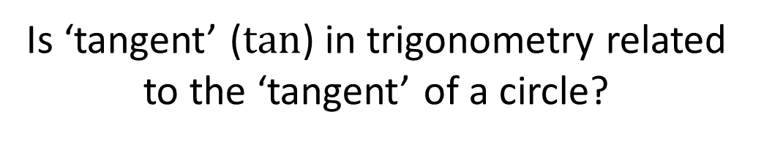






Just for your interest…
Is ‘tangent’ ($tan$) in trigonometry related to the ‘tangent’ of a circle?
A tangent is a trigonometric function (which inputs an angle and gives you the ratio between the opposite and adjacent sides of a right-angled triangle), but also a line which touches a circle. Are they related?
A common myth is that $sin$, $cos$ and $tan$ are the ‘core’ trigonometric functions.
Actually, they’re $sin, tan$ and $sec$!
?
?
?
tangent
A tangent is a line which touches the circle. We’re interested in the length just between the touching point and where it meets the secant.
$$\tan{θ}=\frac{opp}{adj}$$
?
Just as ‘radius’ can refer either to the line itself or its length, we have names for other special lines, which can also refer to their lengths:
$$secant$$
$$tangent$$
$$sine$$
A secant (shortened to ‘sec’) is a line which cuts the circle. In a trig setting, we’re interested in the length from the circle centre to where it meets the tangent.
$$θ$$
Sine (sort of) comes from the word for ‘bowstring’. It refers to half the line if we doubled up the arc and connected the two ends.
$$radius$$

Slide 7


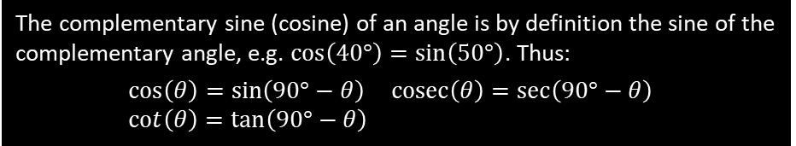



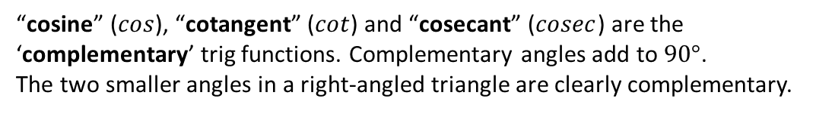
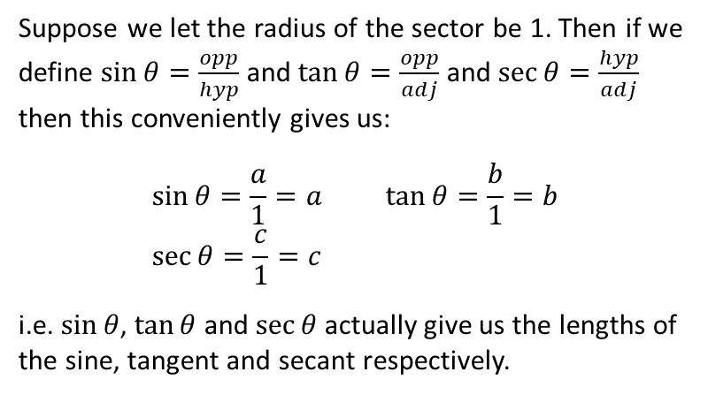






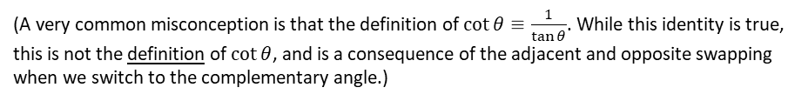
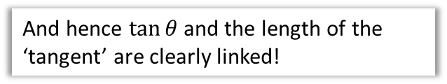


Suppose we let the radius of the sector be 1. Then if we define $\sin{θ}=\frac{opp}{hyp}$ and $\tan{θ}=\frac{opp}{adj}$ and $\sec{θ}=\frac{hyp}{adj}$ then this conveniently gives us:
$$\sin{θ}=\frac{a}{1}=a \tan{θ}=\frac{b}{1}=b \\ \sec{θ}=\frac{c}{1}=c$$
i.e. $\sin{θ}$, $\tan{θ}$ and $\sec{θ}$ actually give us the lengths of the sine, tangent and secant respectively.
$$c$$
$$1$$
$$secant$$
$$tangent$$
$$b$$
$$sine$$
$$a$$
$$θ$$
$$radius$$
$$1$$
And hence $\tan{θ}$ and the length of the ‘tangent’ are clearly linked!
“So if $sin$, $tan$ and $sec$ are the ‘core’ trigonometric functions, where does $cos$ come into the fray?”
“cosine” ($cos$), “cotangent” ($cot$) and “cosecant” ($cosec$) are the ‘complementary’ trig functions. Complementary angles add to $90°$.
The two smaller angles in a right-angled triangle are clearly complementary.
The complementary sine (cosine) of an angle is by definition the sine of the complementary angle, e.g. $\cos\left(40°\right)=\sin\left(50°\right)$. Thus:
$$\cos\left(θ\right)=\sin\left(90°−θ\right) \operatorname{cosec}\left(θ\right)=\sec\left(90°−θ\right) \\ \cot\left(θ\right)=\tan\left(90°−θ\right)$$
$$40°$$
$$50°$$
(A very common misconception is that the definition of $\cot{θ}≡\frac{1}{\tan{θ}}$. While this identity is true, this is not the definition of $\cot{θ}$, and is a consequence of the adjacent and opposite swapping when we switch to the complementary angle.)

Slide 8
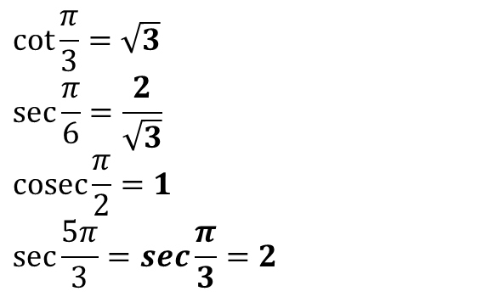

Calculations
You have a calculator in A Level exams, but won’t however in STEP, etc. It’s good however to know how to calculate certain values yourself if needed.
?
$$\cot{\frac{π}{4}}=\frac{1}{\tan{\frac{π}{4}}}=\frac{1}{1}=1 \\ \sec{\frac{π}{4}=\frac{1}{\cos{\frac{π}{4}}}=\frac{1}{\frac{1}{\sqrt{2}}}=\sqrt{2}}$$
$$\operatorname{cosec}{\frac{π}{3}}=\frac{1}{\sin{\frac{π}{3}}}=\frac{2}{\sqrt{3}}$$
$$\cot{\frac{π}{6}}=\sqrt{3}$$
$$\operatorname{cosec}{\frac{5π}{6}}=\operatorname{cosec}{\frac{π}{6}}=2$$
$$\cot{\frac{π}{3}}=\sqrt{3}$$
$$\sec{\frac{π}{6}}=\frac{2}{\sqrt{3}}$$
$$\operatorname{cosec}{\frac{π}{2}}=1$$
$$\sec{\frac{5π}{3}}=sec\frac{π}{3}=2$$
?
?
?
?
?
?
?
?

Slide 9
Exercises 6A
Pearson Pure Mathematics Year 2/AS
Page 144

Slide 10

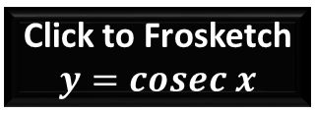


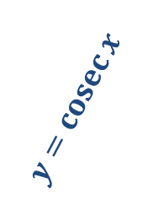



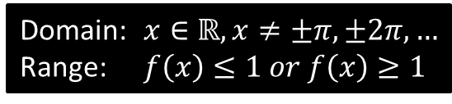

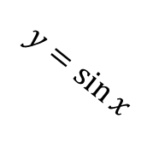


Sketches
To draw a graph of $y=cosec x$, start with a graph of $y=\sin{x}$, then consider what happens when we reciprocate each $y$ value.
It touches here because the reciprocal of 1 is 1.
$$y$$
$$y=\operatorname{cosec}{x}$$
$cosec$ isn’t defined for multiples of $π$ because we can’t divide by 0. We get an asymptote.
Click to Frosketch $y=cosec x$
$$1$$
$$y=\sin{x}$$
$$x$$
$$\frac{1}{2}π$$
$$π$$
$$\frac{3}{2}π$$
$$2π$$
$$−1$$
Domain: $x∈ℝ, x≠±π,±2π,…$
Range: $f\left(x\right)≤1 or f\left(x\right)≥1$
?
?
Reciprocating preserves sign. When we divide by a small positive number, we get a very large positive number.

Slide 11
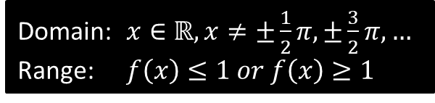
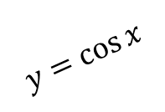
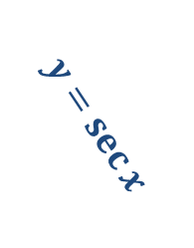

Sketches
$$y$$
$$y=\sec{x}$$
Click to Frosketch $y=sec x$
$$1$$
$$y=\cos{x}$$
$$x$$
$$\frac{1}{2}π$$
$$π$$
$$\frac{3}{2}π$$
$$2π$$
$$−1$$
Domain: $x∈ℝ, x≠±\frac{1}{2}π,±\frac{3}{2}π,…$
Range: $f\left(x\right)≤1 or f\left(x\right)≥1$
?
?

Slide 12

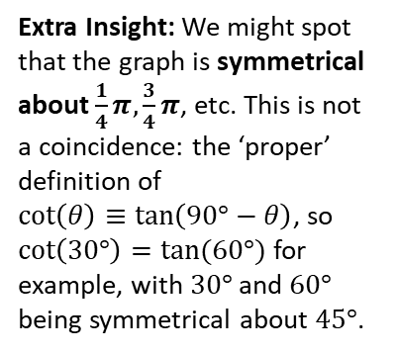
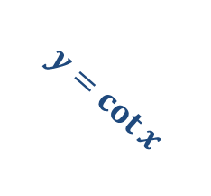
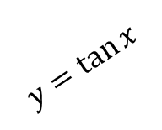
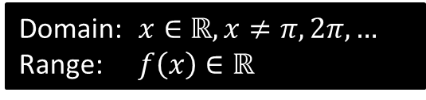
Sketches
Click to Brosketch $y=cot x$
$$y$$
?
Domain: $x∈ℝ, x≠π,2π,…$
Range: $f\left(x\right)∈ℝ$
?
$$y=\tan{x}$$
$$y=\cot{x}$$
$$x$$
$$\frac{1}{2}π$$
$$π$$
$$\frac{3}{2}π$$
$$2π$$
Extra Insight: We might spot that the graph is symmetrical about $\frac{1}{4}π,\frac{3}{4}π$, etc. This is not a coincidence: the ‘proper’ definition of
$\cot\left(θ\right)≡\tan\left(90°−θ\right)$, so $\cot\left(30°\right)=tan⁡(60°)$ for example, with $30°$ and $60°$ being symmetrical about $45°$.

Slide 13




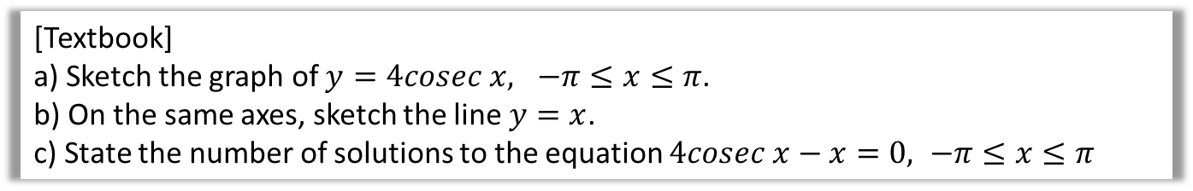





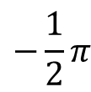
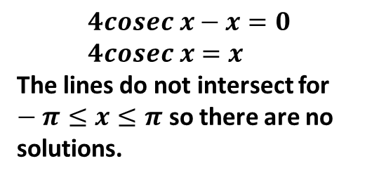
Example
[Textbook]
a) Sketch the graph of $y=4cosec x, −π≤x≤π$.
b) On the same axes, sketch the line $y=x$.
c) State the number of solutions to the equation $4cosec x−x=0, −π≤x≤π$
?
$$y$$
$$y=\operatorname{cosec}{x}$$
$$y=x$$
$$4$$
$$x$$
$$−π$$
$$−\frac{1}{2}π$$
$$\frac{1}{2}π$$
$$π$$
$$4cosec x−x=0 \\ 4cosec x=x$$
The lines do not intersect for $−π≤x≤π$ so there are no solutions.
$$−4$$

Slide 14






















Test Your Understanding
Sketch $y=−1+\sec{2x}$ in the interval $0≤x<360°$.
?
$$y$$
$$y$$
$$y=\sec{x}$$
$$y=\sec{2x}$$
$$1$$
$$1$$
$$x$$
$$x$$
$$90°$$
$$180°$$
$$270°$$
$$360°$$
$$90°$$
$$180°$$
$$270°$$
$$360°$$
$$−1$$
$$−1$$
$$y$$
$$y=−1+\sec{2x}$$
$$x$$
Draw the transformations stage by stage, unless you feel comfortable doing multiple transformations at once.
$$90°$$
$$180°$$
$$270°$$
$$360°$$
$$−2$$

Slide 15
Exercises 6B
Pearson Pure Mathematics Year 2/AS
Page 148-149

Slide 16

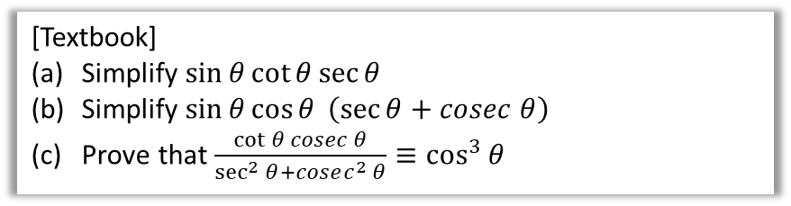

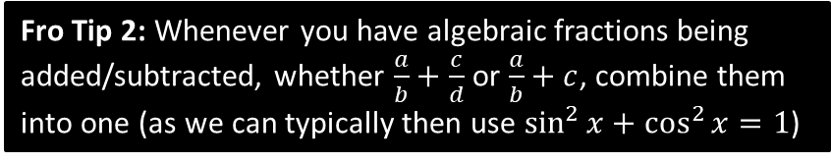
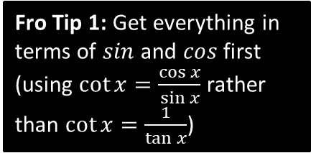

Using $sec,cosec,cot$
Questions in the exam usually come in two flavours: (a) ‘provey’ questions requiring to prove some identity and (b) ‘solvey’ questions.
[Textbook]
Simplify $\sin{θ}\cot{θ}\sec{θ}$
Simplify $\sin{θ}\cos{θ} \left(\sec{θ}+cosec θ\right)$
Prove that $\frac{\cot{θ} cosec θ}{\sec^{2}{θ}+cosec^{2} θ}≡\cos^{3}{θ}$
Fro Tip 1: Get everything in terms of $sin$ and $cos$ first (using $\cot{x}=\frac{\cos{x}}{\sin{x}}$ rather than $\cot{x}=\frac{1}{\tan{x}}$)
Fro Tip 2: Whenever you have algebraic fractions being added/subtracted, whether $\frac{a}{b}+\frac{c}{d}$ or $\frac{a}{b}+c$, combine them into one (as we can typically then use $\sin^{2}{x}+\cos^{2}{x}=1$)
$$\frac{\cot{θ} cosec θ}{\sec^{2}{θ}+cosec^{2} θ}≡\frac{\frac{\cos{θ}}{\sin{θ}}×\frac{1}{\sin{θ}}}{\frac{1}{\cos^{2}{θ}}+\frac{1}{\sin^{2}{θ}}} \\ ≡\frac{\left(\frac{\cos{θ}}{\sin^{2}{θ}}\right)}{\left(\frac{\sin^{2}{θ}+\cos^{2}{θ}}{\sin^{2}{θ}\cos^{2}{θ}}\right)}≡\frac{\left(\frac{\cos{θ}}{\sin^{2}{θ}}\right)}{\left(\frac{1}{\sin^{2}{θ}\cos^{2}{θ}}\right)} \\ ≡\frac{\cos^{3}{θ}}{1} \\ ≡\cos^{3}{θ}$$
$$\sin{θ}\cot{θ}\sec{θ}≡\sin{θ}×\frac{\cos{θ}}{\sin{θ}}×\frac{1}{\cos{θ}}≡1$$
$$\sin{θ}\cos{θ} \left(\sec{θ}+cosec θ\right) \\ =\sin{θ}\cos{θ}\left(\frac{1}{\cos{θ}}+\frac{1}{\sin{θ}}\right) \\ =\sin{θ}\cos{θ}\left(\frac{\sin{θ}+\cos{θ}}{\sin{θ}\cos{θ}}\right) \\ =\sin{θ}+\cos{θ}$$
c
?
a
?
b
?
Multiply top and bottom by $\sin^{2}{θ}\cos^{2}{θ}$

Slide 17
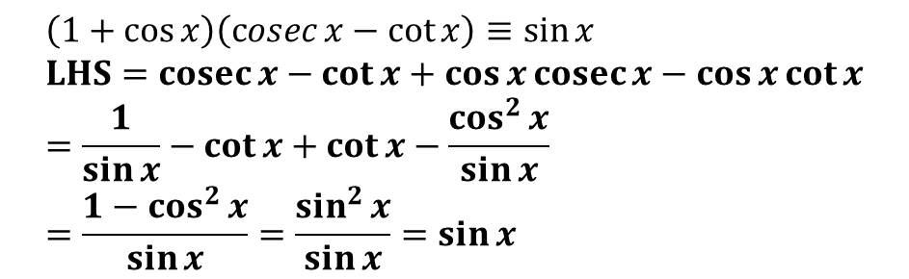

Test Your Understanding
$$\sec{x}−\cos{x}≡\sin{x}\tan{x} \\ LHS=\frac{1}{\cos{x}}−\cos{x} \\ =\frac{1−\cos^{2}{x}}{\cos{x}} \\ =\frac{\sin^{2}{x}}{\cos{x}} \\ =\sin{x}\tan{x}$$
1
?
2
$$\left(1+\cos{x}\right)\left(\operatorname{cosec}{x}−\cot{x}\right)≡\sin{x} \\ LHS=cosec{x}−\cot{x}+\cos{x}\operatorname{cosec}{x}−\cos{x}\cot{x} \\ =\frac{1}{\sin{x}}−\cot{x}+\cot{x}−\frac{\cos^{2}{x}}{\sin{x}} \\ =\frac{1−\cos^{2}{x}}{\sin{x}}=\frac{\sin^{2}{x}}{\sin{x}}=\sin{x}$$
?

Slide 18





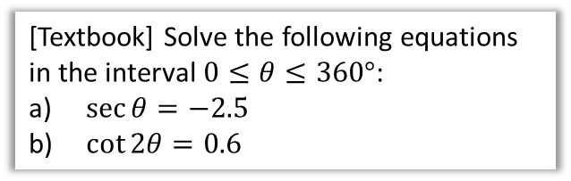

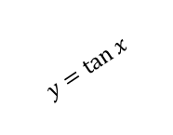





Solvey Questions
[Textbook] Solve the following equations in the interval $0≤θ≤360°$:
$\sec{θ}=−2.5$
$\cot{2θ}=0.6$
Solve $\cot{θ}=0$ in the interval $0≤θ≤2π$.
?
$$\cot{θ}=0 \\ ∴\tan{θ}→∞ \\ θ=\frac{π}{2},\frac{3π}{2}$$
You can’t reciprocate 0. However, the value tends towards $±∞$, which coincides with the asymptotes of $tan$.
a
$$\sec{θ}=−2.5 \\ \cos{θ}=−0.4 \\ θ=113.6°, 246.5°$$
$$\cot{2θ}=0.6 0≤2θ≤720° \\ \tan{2θ}=\frac{5}{3} \\ 2θ=59.0°, 239.0°, 419.0°, 599.0° \\ θ=29.5°, 120°, 210°, 300° (3sf)$$
?
Reciprocate both sides.
$$y$$
b
?
$$y=\tan{x}$$
$$y=\cot{x}$$
$$x$$
$$\frac{1}{2}π$$
$$π$$
$$\frac{3}{2}π$$
$$2π$$

Slide 19


Test Your Understanding
Solve in the interval $0≤θ<360°$:
$$cosec 3θ=2$$
?
$$0≤3θ<1080° \\ \sin{3θ}=\frac{1}{2} \\ 3θ=30°, 150°, 390°, 510°,750°, 870° \\ θ=10°, 50°,130°, 170°,250°,290°$$

Slide 20
Exercises 6C
Pearson Pure Mathematics Year 2/AS
Page 152

Slide 21











New Identities
From C2 you knew:
$$\sin^{2}{x}+\cos^{2}{x}=1$$
There are just two new identities you need to know:
Fro Tip: I used to misremember this as “$1+\sec^{2}{x}=\tan^{2}{x}$”.
Then I imagined the Queen coming back from holiday, saying “One is tanned”, i.e. the 1 goes with the $\tan^{2}{x}.$
Dividing by $\cos^{2}{x}$:
$$1+\tan^{2}{x}=\sec^{2}{x}$$
?
$$1+\cot^{2}{x}={cosec}^{2}{x}$$
Dividing by $\sin^{2}{x}$:
?
“Prove that $1+\tan^{2}{x}≡\sec^{2}{x}$.”
Fro Tip: I remember this one by starting with the above, and slapping ‘co’ on front of each trig function.
$$\sin^{2}{x}+\cos^{2}{x}≡1$$
$$\frac{\sin^{2}{x}}{\cos^{2}{x}}+\frac{\cos^{2}{x}}{\cos^{2}{x}}≡\frac{1}{\cos^{2}{x}}$$
$$\tan^{2}{x}+1≡\sec^{2}{x}$$
Fro Tip: This has been asked in an exam before! You must explicitly show each term being divided by $\cos^{2}{x}$.

Slide 22




Examples
[Textbook] Prove that ${cosec}^{4}{θ}−\cot^{4}{θ}=\frac{1+\cos^{2}{θ}}{1−\cos^{2}{x}}$
?
$$LHS= \left({cosec}^{2}{θ}{+\cot^{2}{θ}}\right)\left({cosec}^{2}{θ}−\cot^{2}{θ}\right) \\ ={cosec}^{2}{θ}{+\cot^{2}{θ}} \\ =\frac{1}{\sin^{2}{θ}}+\frac{\cos^{2}{θ}}{\sin^{2}{θ}} \\ =\frac{1+\cos^{2}{θ}}{1−\cos^{2}{x}}=RHS$$
Solve the equation $4 cosec^{2}θ−9=\cot{θ}$ in the interval $0≤θ≤360°$
?
$$4\left(1+\cot^{2}{θ}\right)−9=\cot{θ} \\ 4\cot^{2}{θ}−\cot{θ}−5=0 \\ \left(4\cot{θ}−5\right)\left(\cot{θ}+1\right)=0 \\ ∴\cot{θ}=\frac{5}{4} or\cot{θ}=−1 \\ \tan{θ}=\frac{4}{5} or\tan{θ}=−1 \\ θ=135°, 315°$$
This is just like in C2; if you had say a mixture of $\sin{θ},\sin^{2}{θ},\cos^{2}{θ}$: you’d change the $\cos^{2}{θ}$ to $1−\sin^{2}{θ}$ in order to get a quadratic in terms of $sin$.

Slide 23



Test Your Understanding
Edexcel C3 June 2013 (R)
$$3\sec^{2}{θ}+3\sec{θ}=2\left(\sec^{2}{θ}−1\right) \\ \sec^{2}{θ}+3\sec{θ}+2=0 →\left(\sec{θ}+2\right)\left(\sec{θ}+1\right)=0 \\ \frac{1}{\cos{θ}}=−2 → \cos{θ}=−\frac{1}{2} → θ=\frac{2π}{3},\frac{4π}{3} \\ \frac{1}{\cos{θ}}=−1 → \cos{θ}=−1 → θ=π$$
?
Q
Solve, for $0≤x<2π$, the equation
$$2cosec^{2}x+\cot{x}=5$$
giving your solutions to 3sf.
$$2\left(1+\cot^{2}{x}\right)+\cot{x}−5=0 \\ 2+2\cot^{2}{x}+\cot{x}−5=0 \\ 2\cot^{2}{x}+\cot{x}−3=0 \\ \left(2\cot{x}+3\right)\left(\cot{x}−1\right)=0 \\ \cot{x}=−\frac{3}{2} or \cot{x}=1 \\ \tan{x}=−\frac{2}{3} or \tan{x}=1 \\ x=2.55, 5.70, 0.785, 3.93$$
?

Slide 24
Exercises 6D
Pearson Pure Mathematics Year 2/AS
Pages 156-157

Slide 25













Inverse Trig Functions
You need to know how to sketch $y=\arcsin{x}, y=\arccos{x}$, $y=\arctan{x}$.
(Yes, you could be asked in an exam!)
$$y$$
We have to restrict the domain of $\sin{x}$ to $−\frac{π}{2}≤x<\frac{π}{2}$ before we can find the inverse. Why?
Because only one-to-one functions have an inverse. By restricting the domain it is now one-to-one.
$$\frac{π}{2}$$
?
$$1$$
$$y=arcsin x$$
$$x$$
$$−\frac{π}{2}$$
$$−1$$
$$1$$
$$\frac{π}{2}$$
$$y=\sin{x}$$
$$−1$$
$$−\frac{π}{2}$$

Slide 26




Inverse Trig Functions
$$y=\arccos{x}$$
$$y=\arctan{x}$$
?
?
Note that this graph has asymptotes.

Slide 27



Evaluating inverse trig functions
[Textbook] Work out, in radians, the values of:
$\arcsin\left(−\frac{\sqrt{2}}{2}\right)$
$\arccos\left(−1\right)$
$\arctan\left(\sqrt{3}\right)$
You can simply use the $\sin^{−1}{x}$, $\cos^{−1}{x}$ and $\tan^{−1}{x}$ buttons on your calculator.
If you don’t have a calculator, just use the $sin,cos,tan$ graphs backwards.
?
$$\arcsin\left(−\frac{\sqrt{2}}{2}\right)=−\frac{π}{4} \\ \arccos\left(−1\right)=π \\ \arctan\left(\sqrt{3}\right)=\frac{π}{3}$$
?
?

Slide 28


One Final Problem…
Edexcel C3 Jan 2007
?
Fewer than 10% of candidates got this part right.
$$y=\arccos{x} \\ x=\cos{y}=sin\left(\frac{π}{2}−y\right) \\ \arcsin{x=\frac{π}{2}−y}$$
$$\arccos{x+\arcsin{x}} \\ =y+\frac{π}{2}−y=\frac{π}{2}$$

Slide 29
Exercises 6E
Pearson Pure Mathematics Year 2/AS
Pages 160-161

