Slide 1

P2 Chapter 5 :: Radians
jfrost@tiffin.kingston.sch.uk
www.drfrostmaths.com
@DrFrostMaths
Last modified: 6th September 2018

Slide 2








www.drfrostmaths.com
Everything is completely free.
Why not register?
Register now to interactively practise questions on this topic, including past paper questions and extension questions (including MAT + UKMT).
Teachers: you can create student accounts (or students can register themselves), to set work, monitor progress and even create worksheets.
With questions by:
Dashboard with points, trophies, notifications and student progress.
Questions organised by topic, difficulty and past paper.
Teaching videos with topic tests to check understanding.

Slide 3

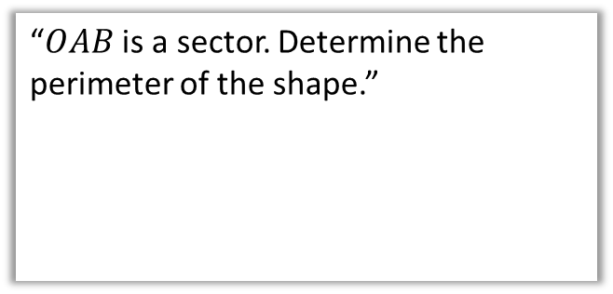

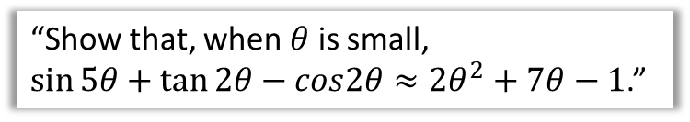





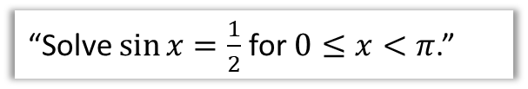

Chapter Overview
The concept of radians will likely be completely new to you.
2:: Find arc length and sector area (when using radians)
1:: Converting between degrees and radians.
“$OAB$ is a sector. Determine the perimeter of the shape.”
“What is $45°$ in radians?”
$$A$$
$$3$$
$$1.3$$
$$C$$
$$4$$
$$O$$
$$B$$
3:: Solve trig equations in radians.
4:: Small angle approximations
“Solve $\sin{x}=\frac{1}{2}$ for $0≤x<π$.”
“Show that, when $θ$ is small,
$\sin{5θ}+\tan{2θ}−cos2θ≈2θ^{2}+7θ−1$.”
*NEW* to A Level 2017!

Slide 4
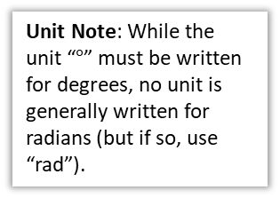
Radians
So far you’ve used degrees as the unit to measure angles.
But outside geometry, mathematicians pretty much always use radians.
r
Unit Note: While the unit “$°$” must be written for degrees, no unit is generally written for radians (but if so, use “rad”).
1°
r
1 rad
A degree is a 360th of a rotation around a full circle. This is a somewhat arbitrary definition!
One radian however is the movement of one radius’ worth around the circumference of the circle.
Click to Start Degree Fro-manimation
Click to Start Radian Fro-manimation
?
Thinking about how many radii around the circumference we can go: $360°=2π$ rad

Slide 5
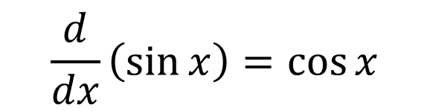
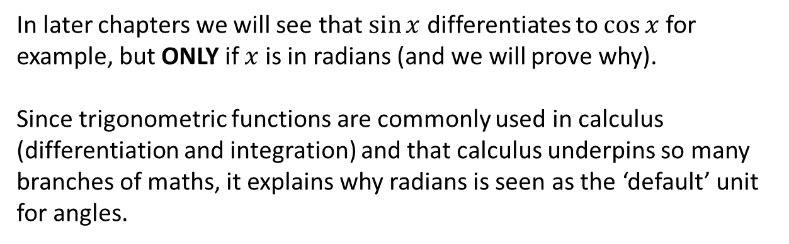
…but WHY use radians as our unit?
In later chapters we will see that $\sin{x}$ differentiates to $\cos{x}$ for example, but ONLY if $x$ is in radians (and we will prove why).
Since trigonometric functions are commonly used in calculus (differentiation and integration) and that calculus underpins so many branches of maths, it explains why radians is seen as the ‘default’ unit for angles.
$$\frac{d}{dx}\left(\sin{x}\right)=\cos{x}$$

Slide 6
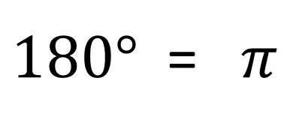




Converting between radians and degrees
?
$÷180$ and $×π$
$180°$ = $π$
$÷π$ and $×180$
?
$$135°=\frac{3}{4}π \\ \frac{3}{2}π=270° \\ 72°=\frac{2}{5}π \\ \frac{5π}{6}=150°$$
?
?
$$90°=\frac{π}{2} \\ \frac{π}{3}=60° \\ 45°=\frac{π}{4} \\ \frac{π}{6}=30°$$
?
?
?
?
?
?

Slide 7
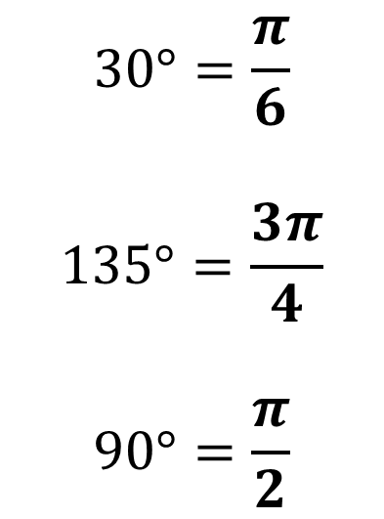
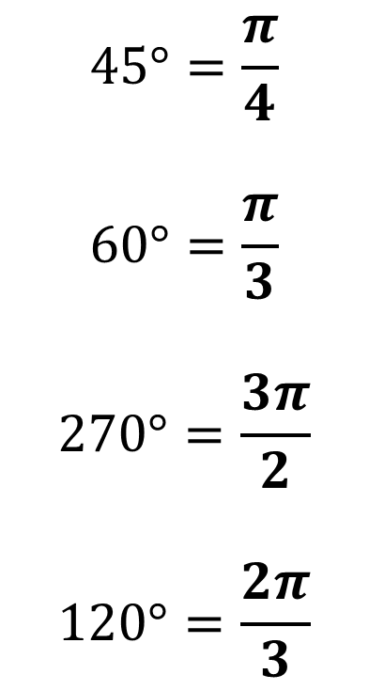
Be able to convert common angles in your head…
?
?
$$45°=\frac{π}{4}$$
$$60°=\frac{π}{3}$$
$$270°=\frac{3π}{2}$$
$$120°=\frac{2π}{3}$$
$$30°=\frac{π}{6}$$
$$135°=\frac{3π}{4}$$
$$90°=\frac{π}{2}$$
?
?
?
?
?

Slide 8







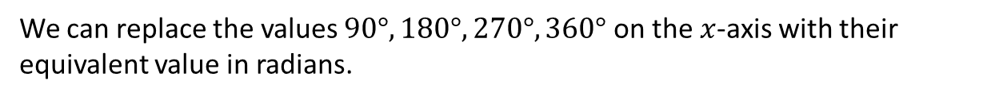











Graph Sketching with Radians
We can replace the values $90°, 180°, 270°, 360°$ on the $x$-axis with their equivalent value in radians.
$$y$$
$$y$$
$$y=cos\left(x\right)$$
$$1$$
$$1$$
$$y=sin\left(x\right)$$
$$x$$
$$x$$
$$\frac{π}{2}$$
$$π$$
$$\frac{3}{2}π$$
$$2π$$
$$\frac{π}{2}$$
$$π$$
$$\frac{3}{2}π$$
$$2π$$
$$−1$$
$$−1$$

Slide 9










Test Your Understanding
Sketch the graph of $y=\cos\left(x+\frac{π}{2}\right)$ for $0≤x<2π$.
?
$$y$$
$$y=cos\left(x+\frac{π}{2}\right)$$
$$1$$
$$y=cos\left(x\right)$$
$$x$$
$$\frac{π}{2}$$
$$π$$
$$\frac{3}{2}π$$
$$2π$$
$$−1$$

Slide 10
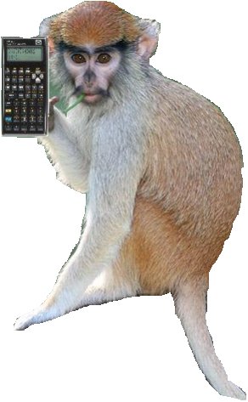

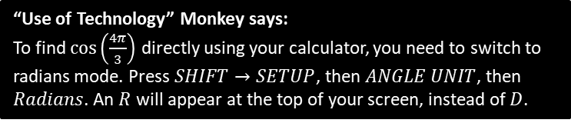
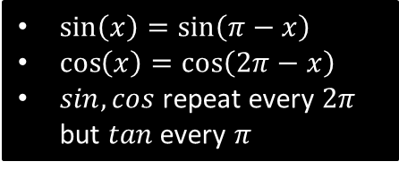

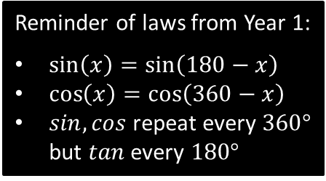






sin, cos, tan of angles in radians
Reminder of laws from Year 1:
$\sin\left(x\right)=\sin\left(180−x\right)$
$\cos\left(x\right)=\cos\left(360−x\right)$
$sin,cos$ repeat every $360°$ but $tan$ every $180°$
$\sin\left(x\right)=\sin\left(π−x\right)$
$\cos\left(x\right)=\cos\left(2π−x\right)$
$sin,cos$ repeat every $2π$ but $tan$ every $π$
To find sin/cos/tan of a ‘common’ angle in radians without using a calculator, it is easiest to just convert to degrees first.
?
$$\cos\left(\frac{4π}{3}\right)=\cos\left(240°\right)=\cos\left(120°\right)=−\cos\left(60°\right)=−\frac{1}{2}$$
$$\frac{1}{2}$$
$$60$$
$$120$$
$$x$$
$$90$$
$$180$$
?
$$\sin\left(−\frac{7π}{6}\right)=\sin\left(−210°\right)=\sin\left(150°\right)=\sin\left(30°\right)=\frac{1}{2}$$
“Use of Technology” Monkey says:
To find $\cos\left(\frac{4π}{3}\right)$ directly using your calculator, you need to switch to radians mode. Press $SHIFT→SETUP$, then $ANGLE UNIT$, then $Radians$. An $R$ will appear at the top of your screen, instead of $D$.

Slide 11
Exercises 5A/5B
Pearson Pure Mathematics Year 2/AS
Pages 116, 118

Slide 12





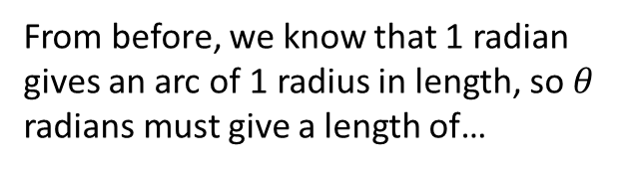
Arc length
$$l$$
$$r$$
$$θ$$
Arc length in degrees:
Arc length in radians
From before, we know that 1 radian gives an arc of 1 radius in length, so $θ$ radians must give a length of…
?
$$l=\frac{θ}{360}×2πr$$
?
$$l=rθ$$

Slide 13




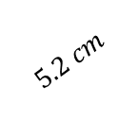
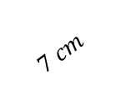

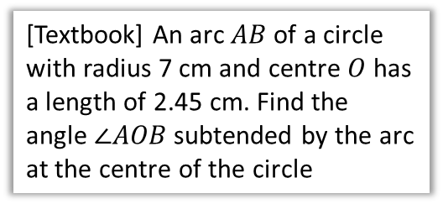



Examples
[Textbook] Find the length of the arc of a circle of radius 5.2 cm, given that the arc subtends an angle of 0.8 radians at the centre of the circle.
[Textbook] An arc $AB$ of a circle with radius 7 cm and centre $O$ has a length of 2.45 cm. Find the angle $∠AOB$ subtended by the arc at the centre of the circle
?
?
$$A$$
$$5.2 cm$$
$$7 cm$$
$$2.45 cm$$
$$0.8$$
$$O$$
$$θ$$
$$0.8×5.2=4.16 cm$$
$$B$$
$$θ×7=2.45 \\ θ=\frac{2.45}{7}=0.35 rad$$
Fro Note: Whether your calculator is in degrees mode or radians mode is only relevant when using sin/cos/tan – it won’t affect simple multiplication!
Terminology: ‘Subtend’ means opposite or extending beneath.

Slide 14


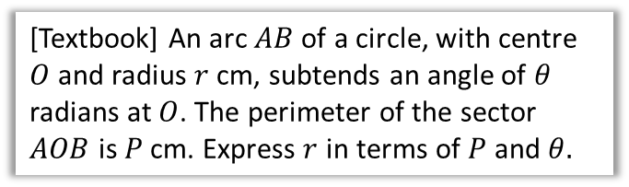










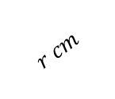

Further Examples
[Textbook] An arc $AB$ of a circle, with centre $O$ and radius $r$ cm, subtends an angle of $θ$ radians at $O$. The perimeter of the sector $AOB$ is $P$ cm. Express $r$ in terms of $P$ and $θ.$
[Textbook] The border of a garden pond consists of a straight edge $AB$ of length 2.4m, and a curved part $C$, as shown in the diagram. The curve part is an arc of a circle, centre $O$ and radius 2m.
Find the length of $C$.
?
$$A$$
$$r cm$$
$$C$$
$$O$$
$$θ$$
$$r cm$$
$$B$$
$$θ$$
$$2 cm$$
$$2 cm$$
$$P=2r+θr \\ P=r\left(2+θ\right) \\ r=\frac{P}{2+θ}$$
$$A$$
$$2.4 cm$$
$$B$$
?
$$2 cm$$
Fro Tip: Trigonometry on right-angled triangles is always simpler than using sine/cosine rule.
$$x$$
$$1.2 cm$$
$$x=\sin^{−1}\left(\frac{1.2}{2}\right)=0.6435…rad \\ θ=2π−2x=4.9961…rad$$
$$∴C=2×4.9961=9.99 m (3sf)$$
Angles round a point add to $2π$.

Slide 15
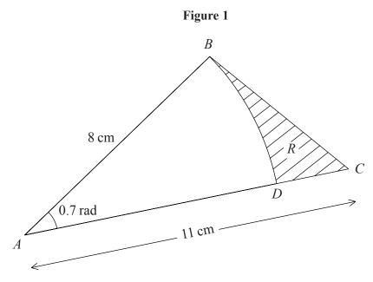
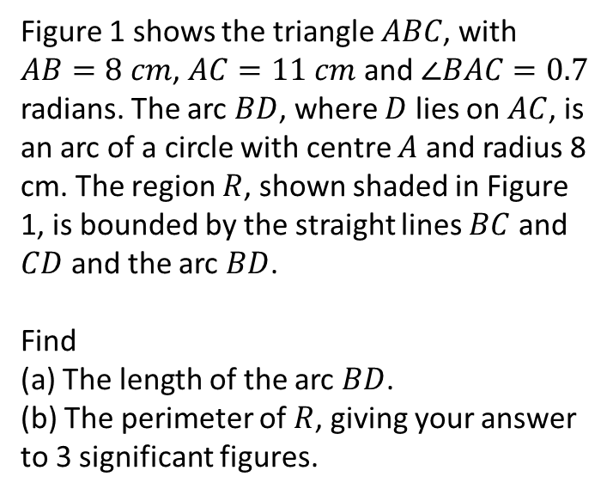
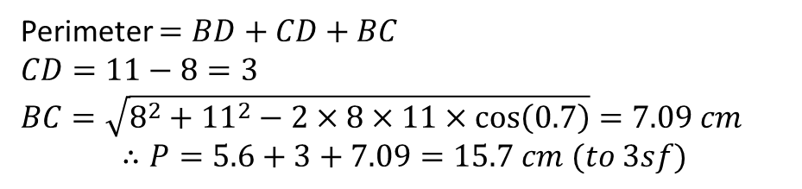

Test Your Understanding
Edexcel C2 Jan 2005 Q7
Figure 1 shows the triangle $ABC$, with $AB=8 cm$, $AC=11 cm$ and $∠BAC=0.7$ radians. The arc $BD$, where $D$ lies on $AC$, is an arc of a circle with centre $A$ and radius 8 cm. The region $R$, shown shaded in Figure 1, is bounded by the straight lines $BC$ and $CD$ and the arc $BD$.
Find
(a) The length of the arc $BD$.
(b) The perimeter of $R$, giving your answer to 3 significant figures.
a
Length of arc $BD=0.7×8=5.6 cm$
?
?
b
Perimeter $=BD+CD+BC$
$CD=11−8=3$
$BC=\sqrt{8^{2}+{11}^{2}−2×8×11×\cos\left(0.7\right)}=7.09 cm$
$$∴P=5.6+3+7.09=15.7 cm (to 3sf)$$

Slide 16
Exercises 5C
Pearson Pure Mathematics Year 2/AS
Pages 120-122
Note: Q10 is based on a past paper question so is worth doing.

Slide 17


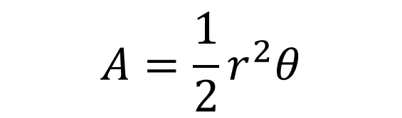
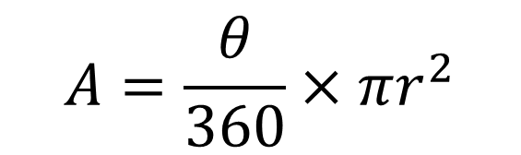
Sector Area
$$r$$
$$θ$$
Area using Degrees
Area using Radians
?
?
$$A=\frac{θ}{360}×πr^{2}$$
$$A=\frac{1}{2}r^{2}θ$$

Slide 18
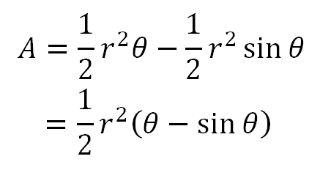

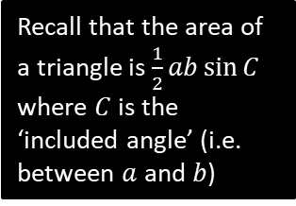


Segment Area
A segment is the region bound between a chord and the circumference.
This is just a sector with a triangle cut out.
$$r$$
$$θ$$
$$r$$
Area using radians:
Recall that the area of a triangle is $\frac{1}{2}ab\sin{C}$ where $C$ is the ‘included angle’ (i.e. between $a$ and $b$)
?

Slide 19












Examples
[Textbook] In the diagram, the area of the minor sector $AOB$ is 28.9 cm². Given that $∠AOB=0.8$ radians, calculate the value of $r$.
[Textbook] A plot of land is in the shape of a sector of a circle of radius 55 m. The length of fencing that is erected along the edge of the plot to enclose the land is 176 m. Calculate the area of the plot of land.
$$A$$
$$A$$
$$55 m$$
$r$cm
$$0.8$$
$$O$$
$$θ$$
$r$cm
$$55 m$$
$$B$$
$$B$$
?
?
Arc $AB=176−55−55=66 m$
$$66=5θ \\ ∴θ=1.2 rad$$
Area $=\frac{1}{2}×{55}^{2}×1.2=1815$m²
$$28.9=\frac{1}{2}r^{2}×0.8 \\ 28.9=0.4r^{2} \\ r^{2}=\frac{28.9}{0.4}=72.25 \\ r=\sqrt{72.25}=8.5$$

Slide 20


















Segment Examples
[Textbook] In the diagram above, $OAB$ is a sector of a circle, radius 4m. The chord $AB$ is 5m long. Find the area of the shaded segment.
[Textbook] In the diagram, $AB$ is the diameter of a circle of radius $r$cm, and $∠BOC=θ$ radians. Given that the area of $ΔAOC$ is three times that of the shaded segment, show that
$3θ−4\sin{θ}=0$.
$$A$$
$$4 m$$
$$C$$
$$O$$
$$θ$$
$$5m$$
$$4 m$$
$$θ$$
$$B$$
$$B$$
$$A$$
$$r$$
$$O$$
$$r$$
?
?
Using cosine rule:
$$5^{2}=4^{2}+4^{2}−\left(2×4×4×\cos{θ}\right) \\ 25=32−32\cos{θ} \\ 32\cos{θ}=32−25=7 \\ θ=\cos^{−1}\left(\frac{7}{32}\right)=1.3502…$$
Area of shaded segment:
$$\frac{1}{2}×4^{2}\left(1.3502…−\sin{1.3502…}\right)$$
$=3.00$ m².
Area of segment $=\frac{1}{2}r^{2}\left(θ−\sin{θ}\right)$
Area of $ΔAOC=\frac{1}{2}r^{2}\sin\left(π−θ\right)$
$$=\frac{1}{2}r^{2}sinθ$$
$$∴\frac{1}{2}r^{2}\sin{θ}=3×\frac{1}{2}r^{2}\left(θ−\sin{θ}\right) \\ \sin{θ}=3\left(θ−\sin{θ}\right)$$
$$∴3θ−4\sin{θ}=0$$
Recall that
$$\sin\left(θ\right)=\sin\left(π−θ\right)$$

Slide 21
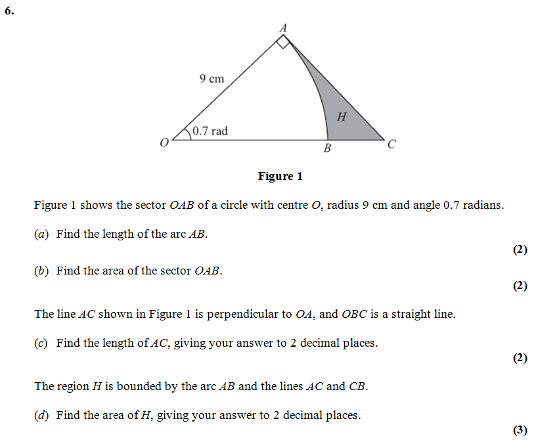


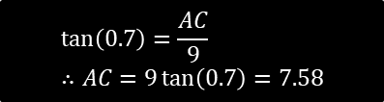
Test Your Understanding
Edexcel C2
?
$$\frac{1}{2}×9^{2}×0.7=28.35$$
?
$$\tan\left(0.7\right)=\frac{AC}{9} \\ ∴AC=9\tan\left(0.7\right)=7.58$$
?
$$Area OAC=\frac{1}{2}×9×7.58=34.11 \\ H=34.11−28.35=5.76$$

Slide 22
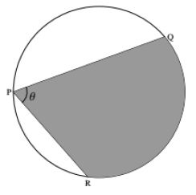


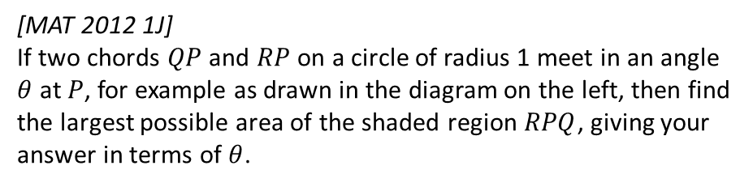







Exercises 5D
Pearson Pure Mathematics Year 2/AS
Pages 125-128
Extension
[MAT 2012 1J]
If two chords $QP$ and $RP$ on a circle of radius 1 meet in an angle $θ$ at $P$, for example as drawn in the diagram on the left, then find the largest possible area of the shaded region $RPQ$, giving your answer in terms of $θ$.
?
For a fixed $θ$ the largest area is obtained when the angle bisector of $PQ$ and $PR$ is the diameter of the circle. This can be broken up into two isosceles triangles and a sector as shown.
$∠BOC=2θ$ as angle at centre is twice angle at circumference.
$$∠AOB=π−\frac{θ}{2}−\frac{θ}{2}=π−θ$$
Area of $AOB=\frac{1}{2}×1^{2}×\sin\left(π−θ\right)=\frac{1}{2}\sin\left(θ\right)$
Area of sector $BOC=\frac{1}{2}×1^{2}×2θ=θ$.
Total shaded area $=2×\frac{1}{2}\sin{θ}+θ=θ+\sin{θ}$.
$$B$$
$$\frac{θ}{2}$$
$$π−θ$$
$$1$$
$$A$$
$$1$$
$$2θ$$
$$\frac{θ}{2}$$
$$O$$
$$1$$
$$C$$

Slide 23







Solving Trigonometric Equations
$\sin\left(x\right)=\sin\left(π−x\right)$
$\cos\left(x\right)=\cos\left(2π−x\right)$
$sin,cos$ repeat every $2π$ but $tan$ every $π$
Solving trigonometric equations is virtually the same as you did in Year 1, except:
Your calculator needs to be in radians mode.
We use $π−$ instead of $180°−$, and so on.
?
[Textbook] Solve the equation
$\sin{3θ}=\frac{\sqrt{3}}{2}$ in the interval $0≤θ≤2π$.
$$0≤3θ≤6π$$
$$3θ=\frac{π}{3},\frac{2π}{3},\frac{7π}{3},\frac{8π}{3},\frac{13π}{3},\frac{14π}{3} \\ ∴θ=\frac{π}{9},\frac{2π}{9},\frac{7π}{9},\frac{8π}{9},\frac{13π}{9},\frac{14π}{9}$$
Adjust interval.
Use $π−$ to get second value in each ‘pair’. Then go to next cycle by adding $2π$ to each value in pair.
Only $÷3$ once all values obtained in range.
?
[Jan 07 Q6] Find all the solutions, in the interval 0 ≤ x < 2π, of the equation
2 cos² x + 1 = 5 sin x,
giving each solution in terms of π. (6)
$$2\left(1−\sin^{2}{x}\right)+1=5\sin{x} \\ 2−2\sin^{2}{x}+1=5\sin{x} \\ 2\sin^{2}{x}+5\sin{x}−3=0 \\ \left(2\sin{x}−1\right)\left(\sin{x}+3\right)=0 \\ \sin{x}=\frac{1}{2} or\sin{x}=−3$$
$$x=\frac{π}{6} \\ or x=π−\frac{π}{6}=\frac{5π}{6}$$

Slide 24


Exercises 5E
Pearson Pure Mathematics Year 2/AS
Pages 131-132
Extension
[MAT 2010 1C] In the range $0≤x≤2π$, the equation $\sin^{2}{x}+3\sin{x}\cos{x}+2\cos^{2}{x}=0$ has how many solutions?
?
$$\left(\sin{x}+2\cos{x}\right)\left(\sin{x}+\cos{x}\right)=0$$
$\sin{x=−2\cos{x}}$ or $\sin{x}=−\cos{x}$
$\tan{x}=−2$ or $\tan{x}=−1$
The tan graph always has 1 solution per each cycle of $π$ radians, so 4 solutions.

Slide 25









Small Angle Approximations
$$y=x$$
$$y=x$$
$$y=\sin{x}$$
$$y=\sin{x}$$
If $x$ is in radians, we can see from the graph that as $x$ approaches 0, the two graphs are approximately the same, i.e. $\sin{x}≈x$
If $x$ was in degrees however, then we can see this is not the case.
! When $θ$ is small and measured in radians:
$\sin{θ}≈θ$
$\tan{θ}≈θ$
$\cos{θ}≈1−\frac{θ^{2}}{2}$

Slide 26
















Small Angle Approximations
$$A$$
Geometric Proof that $sin θ≈θ$:
The area of sector $OAB$ is:
$$\frac{1}{2}×1^{2}×θ=\frac{1}{2}θ$$
The area of triangle $OAB$ is:
$$\frac{1}{2}×1^{2}×sinθ=\frac{1}{2}\sin{θ}$$
$$1$$
$$O$$
$$θ$$
$$1$$
$$B$$
As $θ$ becomes small, the area of the triangle is approximately equal to that of the sector, so:
$$\frac{1}{2}\sin{θ}≈\frac{1}{2}θ \\ \sin{θ}≈θ$$
$$A$$
$$1$$
$$O$$
$$θ$$
$$1$$
$$B$$
Note that this only works for radians, because we used the sector area formula for radians.
The fact that $\sin{θ}≈θ$ is enormously important when we come to differentiation, because we can use it to prove that $\frac{d}{dx}\left(\sin{x}\right)=\cos{x}$.

Slide 27





Examples
When $θ$ is small and measured in radians:
$\sin{θ}≈θ$
$\tan{θ}≈θ$
$\cos{θ}≈1−\frac{θ^{2}}{2}$
[Textbook] When $θ$ is small, find the approximate value of:
$\frac{\sin{2θ}+\tan{θ}}{2θ}$
$\frac{\cos{4θ}−1}{θ\sin{2θ}}$
[Textbook] a) Show that, when $θ$ is small,
$$\sin{5θ}+\tan{2θ}−\cos{2θ}≈2θ^{2}+7θ−1$$
b) Hence state the approximate value of
$\sin{5θ}+\tan{2θ}−\cos{2θ}$ for small values of $θ$.
$$\sin{5θ}+\tan{2θ}−\cos{2θ} \\ ≈5θ+2θ−\left(1−\frac{(2{θ)}^{2}}{2}\right) \\ =7θ−1+2θ^{2}$$
b) The $7θ$ and $2θ^{2}$ terms tend towards 0, thus the approximate value is -1.
?
?
$\frac{\sin{2θ}+\tan{θ}}{2θ}≈\frac{2θ+θ}{2θ}=\frac{3}{2}$
$\frac{\cos{4θ}−1}{θ\sin{2θ}}≈\frac{1−\frac{{\left(4θ\right)}^{2}}{2}−1}{θ×2θ}$
$=\frac{1−\frac{16θ^{2}}{2}−1}{2θ^{2}}$
$=\frac{−8θ^{2}}{2θ^{2}}=−4$
?
?

Slide 28
Exercises 5F
Pearson Pure Mathematics Year 2/AS
Page 134

