Slide 1

P2 Chapter 11 :: Integration
jfrost@tiffin.kingston.sch.uk
www.drfrostmaths.com
@DrFrostMaths
Last modified: 30th June 2020

Slide 2








www.drfrostmaths.com
Everything is completely free.
Why not register?
Register now to interactively practise questions on this topic, including past paper questions and extension questions (including MAT + UKMT).
Teachers: you can create student accounts (or students can register themselves), to set work, monitor progress and even create worksheets.
With questions by:
Dashboard with points, trophies, notifications and student progress.
Questions organised by topic, difficulty and past paper.
Teaching videos with topic tests to check understanding.

Slide 3
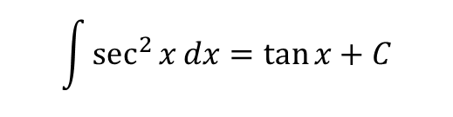
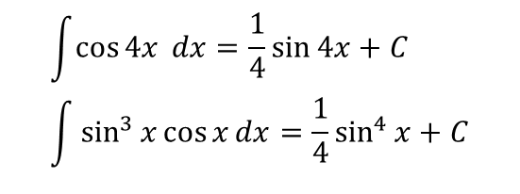
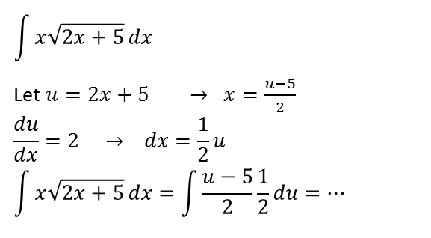
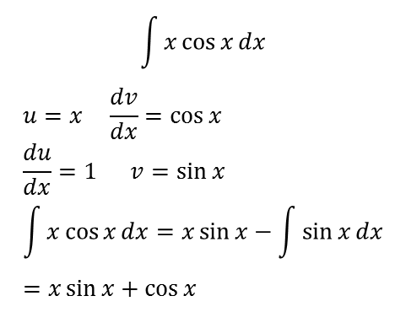
Overview
In this chapter, you’ll be able to integrate a significantly greater variety of expressions, and be able to solve differential equations.
Integration by ‘reverse chain rule’
(We imagine what would have differentiated to get the expression.)
Integration by standard result
(There’s certain expressions you’re expected to know straight off.)
$$\int{\sec^{2}{x}}dx=\tan{x}+C$$
$$\int{\cos{4x} dx}=\frac{1}{4}\sin{4x}+C \\ \int{\sin^{3}{x}\cos{x}}dx=\frac{1}{4}\sin^{4}{x}+C$$
Integration by parts
(Allows us to integrate a product, just as the product rule allowed us to differentiate one)
Integration by substitution
(We make a substitution to hopefully make the expression easier to integrate)
$$\int{x\cos{x}}dx$$
$$u=x \frac{dv}{dx}=\cos{x} \\ \frac{du}{dx}=1 v=\sin{x} \\ \int{x\cos{x}}dx=x\sin{x}−\int{\sin{x}}dx \\ =x\sin{x}+\cos{x}$$
$$\int{x\sqrt{2x+5}}dx$$
Let $u=2x+5 → x=\frac{u−5}{2}$
$$\frac{du}{dx}=2 → dx=\frac{1}{2}u$$
$$\int{x\sqrt{2x+5}}dx=\int{\frac{u−5}{2}}\frac{1}{2}du=…$$

Slide 4
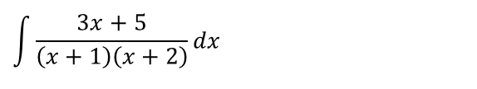
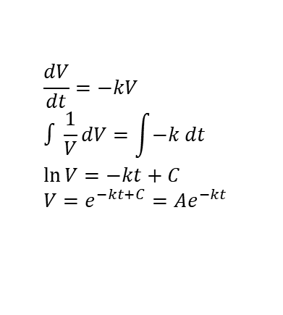
Overview
Integrating partial fractions
(We split into partial fractions first so each fraction easier to integrate)
Approximating areas using the trapezium rule
(Instead of integrating, we split the area under the graph into trapeziums and use these to approximate the area)
$$\int{\frac{3x+5}{\left(x+1\right)\left(x+2\right)}}dx$$
Solving Differential Equations
(Solving here means to find one variable in terms of another without derivatives present)
Notes for teachers: The chapter is the same as the old C4 integration except:
Volumes of Revolution has been removed and is now (slightly oddly) a chapter in itself in Further Maths.
Integration using parametric equations IS still in the syllabus (but was removed from earlier versions of the new Pearson textbooks)
$$\frac{dV}{dt}=−kV \\ ∫\frac{1}{V}dV=\int{−k dt} \\ \ln{V}=−kt+C \\ V=e^{−kt+C}=Ae^{−kt}$$

Slide 5
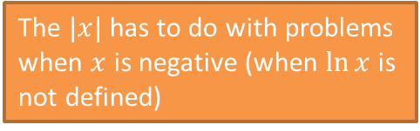
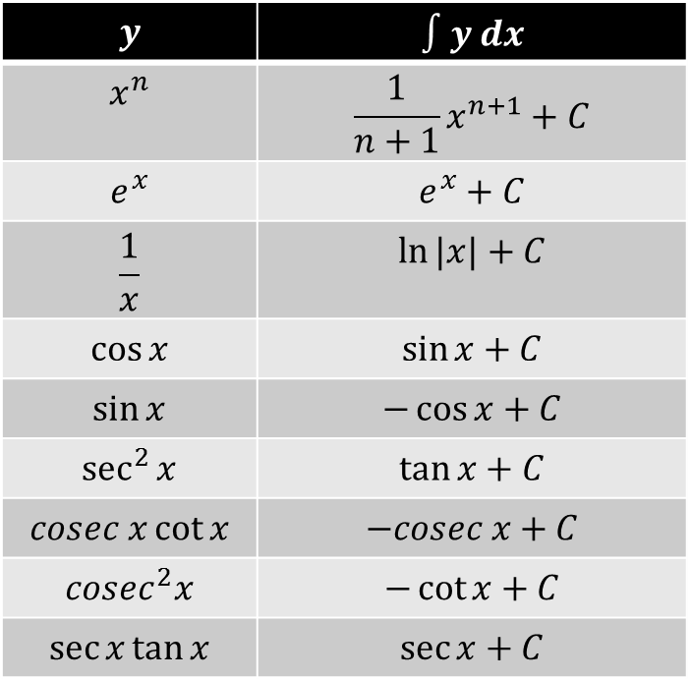
SKILL #1: Integrating Standard Functions
There’s certain results you should be able to integrate straight off, by just thinking about the opposite of differentiation.
$$y$$ | $$∫y dx$$
$$x^{n}$$ | $$\frac{1}{n+1}x^{n+1}+C$$
$$e^{x}$$ | $$e^{x}+C$$
$$\frac{1}{x}$$ | $$\ln{|x|}+C$$
$$\cos{x}$$ | $$\sin{x}+C$$
$$\sin{x}$$ | $$−\cos{x}+C$$
$$\sec^{2}{x}$$ | $$\tan{x}+C$$
$$cosec x\cot{x}$$ | $$−cosec x+C$$
$$cosec^{2}x$$ | $$−\cot{x}+C$$
$$\sec{x}\tan{x}$$ | $$\sec{x}+C$$
?
?
The $|x|$ has to do with problems when $x$ is negative (when $\ln{x}$ is not defined)
?
?
Remember my memorisation trick of picturing sin above cos from C3, so that ‘going down’ is differentiating and ‘going up’ is integrating, and we change the sign if the wrong way round.
?
?
?
?
It’s vital you remember this one.
?
Have a good stare at this slide before turning your paper over – let’s see how many you remember…

Slide 6
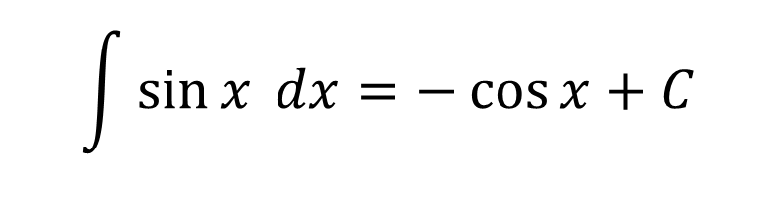
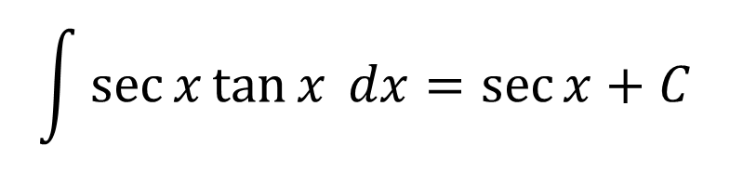
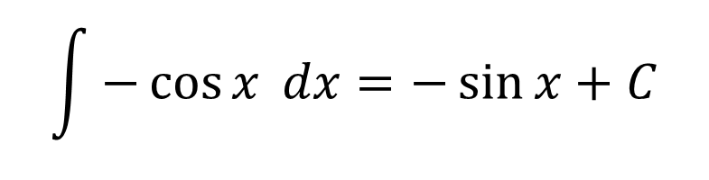
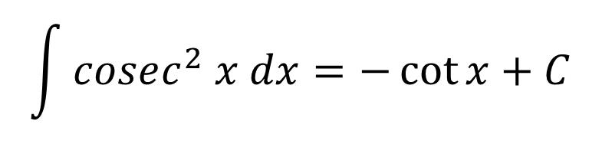
Quickfire Questions (without cheating!)
$$\int{\sec{x}\tan{x} dx}=\sec{x}+C$$
?
$$\int{\sin{x} dx}=−\cos{x}+C$$
?
$$\int{cosec^{2} x dx}=−\cot{x}+C$$
?
$$\int{−\cos{x} dx}=−\sin{x}+C$$
?

Slide 7
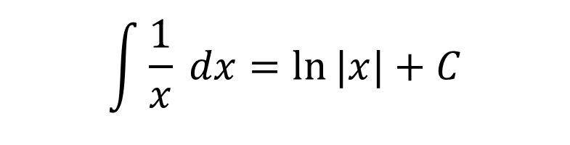
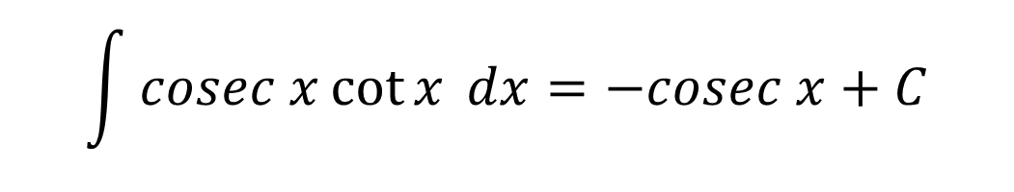
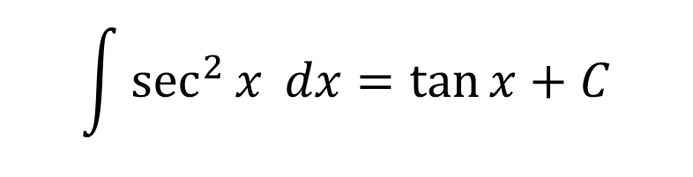
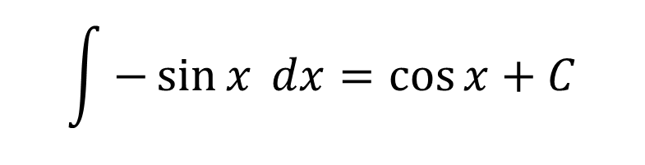
Quickfire Questions (without cheating!)
$$\int{\sec^{2}{x} dx}=\tan{x}+C$$
?
$$\int{cosec x\cot{x} dx}=−cosec x+C$$
?
$$\int{\frac{1}{x} dx}=\ln{|x|}+C$$
?
$$\int{−\sin{x} dx}=\cos{x}+C$$
?

Slide 8
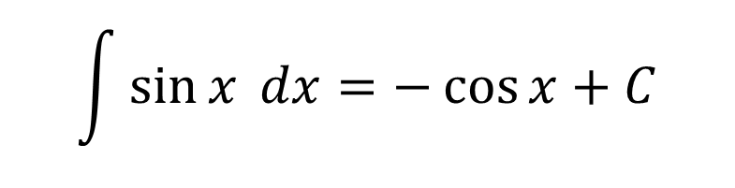
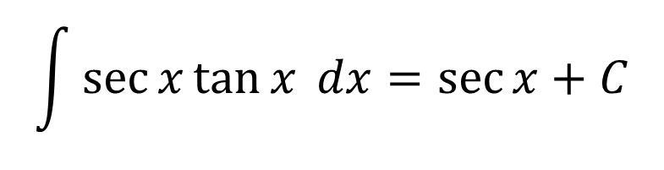
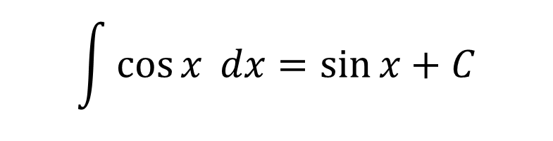
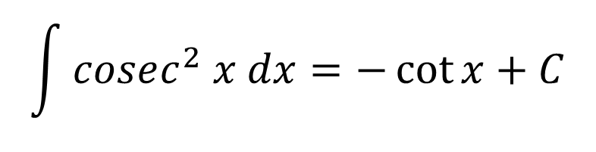
Quickfire Questions (without cheating!)
$$\int{cosec^{2} x dx}=−\cot{x}+C$$
?
$$\int{\sin{x} dx}=−\cos{x}+C$$
?
$$\int{\sec{x}\tan{x} dx}=\sec{x}+C$$
?
$$\int{\cos{x} dx}=\sin{x}+C$$
?

Slide 9
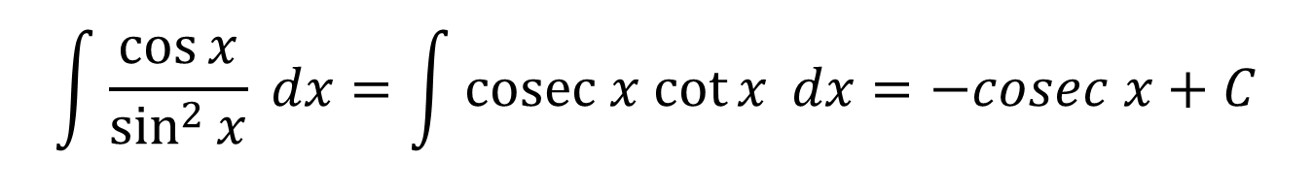
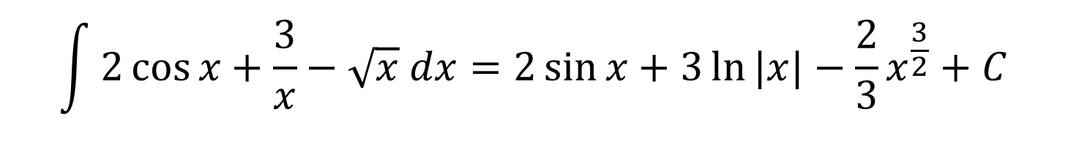
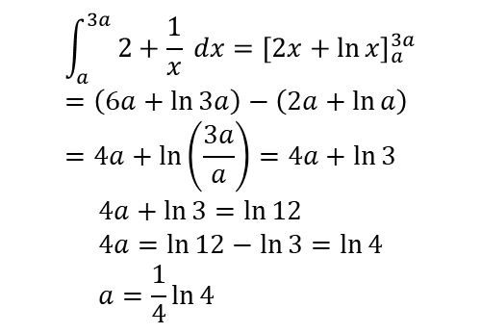
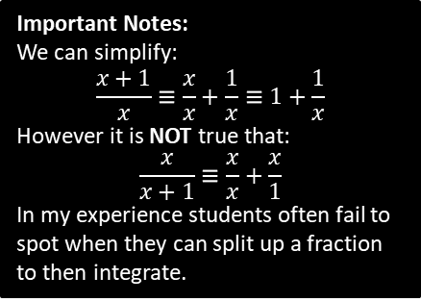
Test Your Understanding
$$\int{2\cos{x}+\frac{3}{x}−\sqrt{x} dx}=2\sin{x}+3\ln{|x|}−\frac{2}{3}x^{\frac{3}{2}}+C$$
?
$$\int{\frac{\cos{x}}{\sin^{2}{x}} dx}=\int{cosec x cot{x} dx}=−cosec x+C$$
?
Hint: What ‘reciprocal’ trig functions does this simplify to?
[Textbook] Given that $\int_{a}^{3a}{ \frac{2x+1}{x} dx}=\ln{12}$, find the exact value of $a$.
$$\int_{a}^{3a}{2+\frac{1}{x} dx}={\left[2x+\ln{x}\right]}_{a}^{3a} \\ =\left(6a+\ln{3a}\right)−\left(2a+\ln{a}\right) \\ =4a+\ln\left(\frac{3a}{a}\right)=4a+\ln{3}$$
$$4a+\ln{3}=\ln{12} \\ 4a=\ln{12}−\ln{3}=\ln{4} \\ a=\frac{1}{4}\ln{4}$$
?
Important Notes:
We can simplify:
$$\frac{x+1}{x}≡\frac{x}{x}+\frac{1}{x}≡1+\frac{1}{x}$$
However it is NOT true that:
$$\frac{x}{x+1}≡\frac{x}{x}+\frac{x}{1}$$
In my experience students often fail to spot when they can split up a fraction to then integrate.

Slide 10
Exercise 11A
Pearson Pure Mathematics Year 2/AS
Pages 295-296

Slide 11

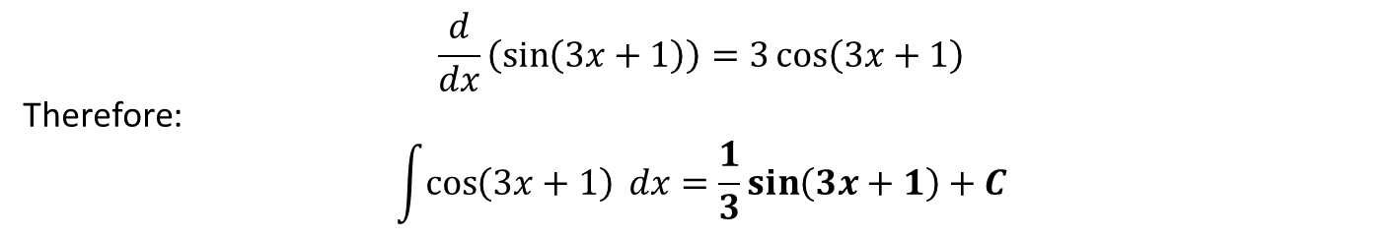

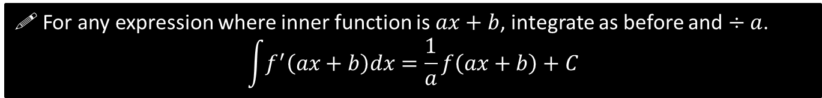

SKILL #2: Integrating $f\left(ax+b\right)$
?
$$\frac{d}{dx}\left(\sin\left(3x+1\right)\right)=3\cos\left(3x+1\right)$$
Therefore:
$$\int{\cos\left(3x+1\right) dx}=\frac{1}{3}\sin\left(3x+1\right)+C$$
?
! For any expression where inner function is $ax+b$, integrate as before and $÷a$.
$$\int{f^{′}\left(ax+b\right)dx}=\frac{1}{a}f\left(ax+b\right)+C$$
Quickfire:
$$\int{e^{3x} dx}=\frac{1}{3}e^{3x}+C$$
$$\int{\frac{1}{5x+2}dx}=\frac{1}{5}\ln\left|5x+2\right|+C$$
$$\int{{2sec}^{2}\left(3x−2\right) dx=\frac{2}{3}\tan\left(3x−2\right)}+C$$
?
?
$$\int{{\left(3x+4\right)}^{3} dx}=\frac{1}{12}{\left(3x+4\right)}^{4}+C$$
$$\int{\sin\left(1−5x\right)dx}=\frac{1}{5}\cos\left(1−5x\right)+C$$
$$\int{\frac{1}{3{\left(4x−2\right)}^{2}}dx=−\frac{1}{12}{\left(4x−2\right)}^{−1}}+C$$
$$\int{{\left(10x+11\right)}^{12}=\frac{1}{130}{\left(10x+11\right)}^{13}+C}$$
?
?
?
?
Fro Tip: For $∫{\left(ax+b\right)}^{n} dx$, ensure you divide by the $\left(n+1\right)$ and the $a$
?

Slide 12

Check Your Understanding
$$\int{e^{3x+1}dx}=\frac{1}{3}e^{3x+1}+C$$
$$\int{\frac{1}{1−2x}dx}=−\frac{1}{2}\ln\left|1−2x\right|+C$$
$$\int{{\left(4−3x\right)}^{5}dx}=−\frac{1}{18}{\left(4−3x\right)}^{6}+C$$
$$\int{\sec\left(3x\right)tan⁡(3x) dx}=\frac{1}{3}\sec\left(3x\right)+C$$
?
?
?
?

Slide 13

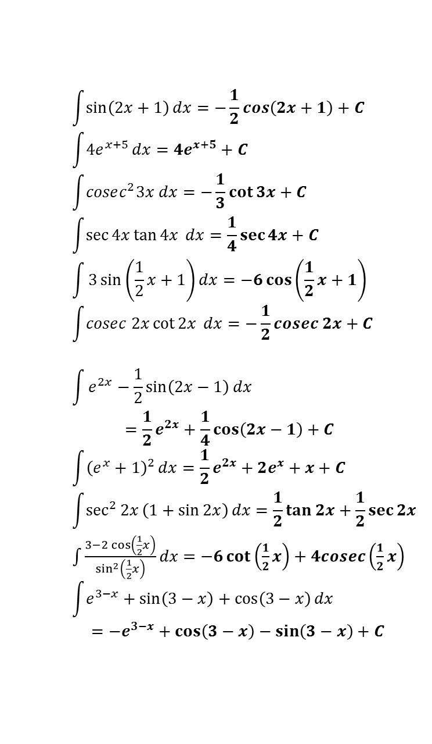
Exercise 11B
Pages 297-298
?
$$\int{\frac{1}{2x+1}}dx=\frac{1}{2}\ln\left|2x+1\right|+C \\ \int{\frac{1}{{\left(2x+1\right)}^{2}}}dx=−\frac{1}{2\left(2x+1\right)}+C \\ \int{{\left(2x+1\right)}^{2}}dx=\frac{1}{6}{\left(2x+1\right)}^{3}+C \\ \int{\frac{3}{4x−1}dx}=\frac{3}{4}\ln\left|4x−1\right|+C$$
$$\int{\frac{3}{{\left(1−4x\right)}^{2}}}dx=\frac{3}{4\left(1−4x\right)}+C \\ \int{\frac{3}{{\left(1−2x\right)}^{3}}dx}=\frac{3}{4{\left(1−2x\right)}^{2}}+C \\ \int{\frac{5}{3−2x}dx}=−\frac{5}{2}\ln\left|3−2x\right|+C$$
$$\int{3\sin\left(2x+1\right)+\frac{4}{2x+1} dx} \\ =−\frac{3}{2}\cos\left(2x+1\right)+2\ln\left|2x+1\right|+C$$
$$\int{\frac{1}{\sin^{2}{2x}}+\frac{1}{1+2x}+\frac{1}{{\left(1+2x\right)}^{2}}dx} \\ =−\frac{1}{2}\cot{2x}+\frac{1}{2}\ln\left|1+2x\right|−\frac{1}{2\left(1+2x\right)}$$
1
a
$$\int{\sin\left(2x+1\right)}dx=−\frac{1}{2}\cos\left(2x+1\right)+C \\ \int{4e^{x+5}}dx=4e^{x+5}+C \\ \int{cosec^{2}3x dx}=−\frac{1}{3}\cot{3x}+C \\ \int{\sec{4x}\tan{4x} dx}=\frac{1}{4}\sec{4x}+C \\ \int{3\sin\left(\frac{1}{2}x+1\right)dx}=−6\cos\left(\frac{1}{2}x+1\right) \\ \int{cosec 2x\cot{2x}} dx=−\frac{1}{2}cosec 2x+C$$
$$\int{e^{2x}−\frac{1}{2}\sin\left(2x−1\right)}dx \\ =\frac{1}{2}e^{2x}+\frac{1}{4}\cos\left(2x−1\right)+C \\ \int{{\left(e^{x}+1\right)}^{2}}dx=\frac{1}{2}e^{2x}+2e^{x}+x+C$$
$$\int{\sec^{2}{2x}\left(1+\sin{2x}\right)}dx=\frac{1}{2}\tan{2x}+\frac{1}{2}\sec{2x}$$
$\int{\frac{3−2\cos\left(\frac{1}{2}x\right)}{\sin^{2}\left(\frac{1}{2}x\right)}}dx=−6\cot\left(\frac{1}{2}x\right)+4cosec\left(\frac{1}{2}x\right)$
$$\int{e^{3−x}+\sin\left(3−x\right)+\cos\left(3−x\right)dx} \\ =−e^{3−x}+\cos\left(3−x\right)−\sin\left(3−x\right)+C$$
3
a
?
c
?
?
b
e
?
c
?
f
?
?
d
?
g
h
?
?
f
h
?
2
a
?
?
j
b
?
c
?
4
a
?
d
?
c
e
?
?

Slide 14
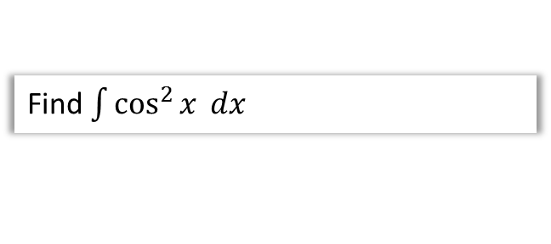

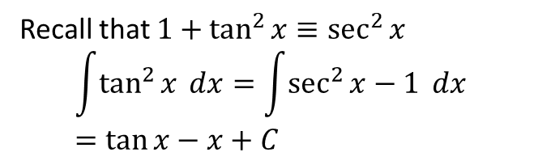



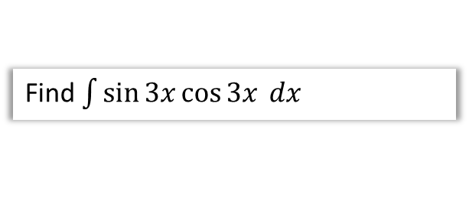

SKILL #3: Integrating using Trig Identities
Some expressions, such as $\sin^{2}{x}$ and $\sin{x}\cos{x}$ can’t be integrated directly, but we can use one of our trig identities to replace it with an expression we can easily integrate.
Q
Find $\int{\sin^{2}{x} dx}$
Q
Find $\int{\sin{3x}\cos{3x} dx}$
?
?
Do you know a trig identity involving $\sin^{2}{x}$?
$$\cos{2x}=1−2\sin^{2}{x} \\ \sin^{2}{x}=\frac{1}{2}−\frac{1}{2}\cos{2x} \\ \int{\sin^{2}{x} dx}=\frac{1}{2}x−\frac{1}{4}\sin{2x}$$
$$\sin{6x≡2\sin{3x}\cos{3x}} \\ \sin{3x}\cos{3x}=\frac{1}{2}\sin{6x}$$
$$\int{\sin{3x}\cos{3x} dx}=−\frac{1}{12}\cos{6x}+C$$
Q
Find $\int{\cos^{2}{x} dx}$
Q
Find $\int{\tan^{2}{x} dx}$
Recall that $1+\tan^{2}{x}≡\sec^{2}{x}$
$$\int{\tan^{2}{x} dx}=\int{\sec^{2}{x}−1} dx \\ =\tan{x}−x+C$$
?
?
$$\cos{2x}=2\cos^{2}{x}−1 \\ \cos^{2}{x}=\frac{1}{2}+\frac{1}{2}\cos{2x} \\ \int{\cos^{2}{x} dx}=\frac{1}{2}x+\frac{1}{4}\sin{2x}$$

Slide 15



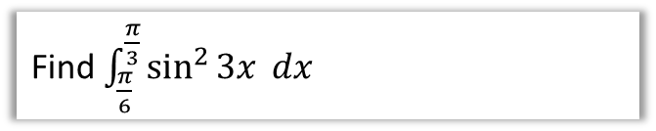
Check Your Understanding
Q
Find $\int{{\left(\sec{x}+\tan{x}\right)}^{2} dx}$
?
$$\int{{\left(\sec{x}+\tan{x}\right)}^{2} dx} \\ =\int{\sec^{2}{x}+2\sec{x}\tan{x}+\tan^{2}{x} dx} \\ =\tan{x}+2\sec{x}+\tan{x}−x+C \\ =2\tan{x}−2\sec{x}−x+C$$
Q
Find $\int_{\frac{π}{6}}^{\frac{π}{3}}{\sin^{2}{3x}} dx$
?
$$\cos{6x}=1−2\sin^{2}{3x} \\ ∴\sin^{2}{3x}=\frac{1}{2}−\frac{1}{2}\cos{6x}$$
$$\int_{\frac{π}{6}}^{\frac{π}{3}}{\sin^{2}{3x}} dx=\int_{\frac{π}{6}}^{\frac{π}{3}}{\frac{1}{2}−\frac{1}{2}cos6x} dx \\ ={\left[\frac{1}{2}x−\frac{1}{12}sin6x\right]}_{\frac{π}{6}}^{\frac{π}{3}} \\ =\left(\frac{π}{6}−\frac{1}{12}\sin{2π}\right)−\left(\frac{π}{12}−\sin{π}\right) \\ =\frac{π}{12}$$

Slide 16
Exercise 11C
Pearson Pure Mathematics Year 2/AS
Page 300

Slide 17
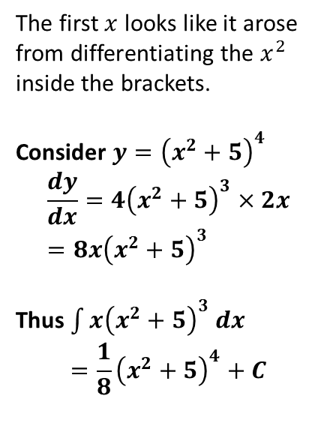
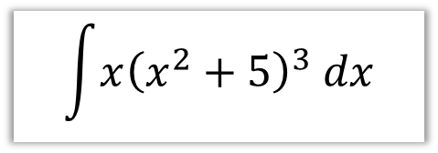
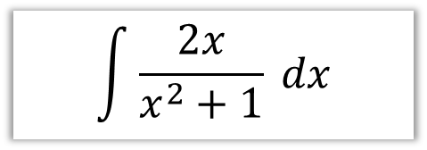

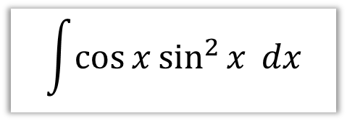
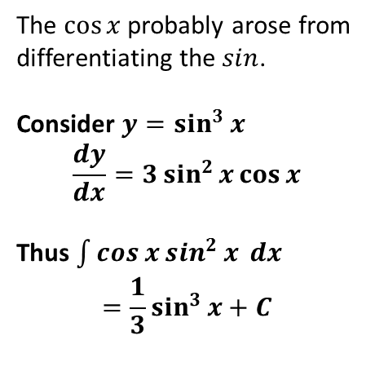
SKILL #4: Reverse Chain Rule
There’s certain more complicated expressions which look like the result of having applied the chain rule. I call this process ‘consider then scale’:
Consider some expression that will differentiate to something similar to it.
Differentiate, and adjust for any scale difference.
$$\int{x{\left(x^{2}+5\right)}^{3} dx}$$
$$\int{\cos{x}\sin^{2}{x} dx}$$
$$\int{\frac{2x}{x^{2}+1} dx}$$
The first $x$ looks like it arose from differentiating the $x^{2}$ inside the brackets.
Consider $y={\left(x^{2}+5\right)}^{4}$
$$\frac{dy}{dx}=4{\left(x^{2}+5\right)}^{3}×2x \\ =8x{\left(x^{2}+5\right)}^{3}$$
Thus $\int{x{\left(x^{2}+5\right)}^{3} dx}$
$$=\frac{1}{8}{\left(x^{2}+5\right)}^{4}+C$$
The $\cos{x}$ probably arose from differentiating the $sin$.
Consider $y=\sin^{3}{x}$
$$\frac{dy}{dx}=3\sin^{2}{x}\cos{x}$$
Thus $\int{\cos{x}\sin^{2}{x} dx}$
$$=\frac{1}{3}\sin^{3}{x+C}$$
The $2x$ probably arose from differentiating the $x^{2}$.
Consider $y=ln|x^{2}+1|$
$$\frac{dy}{dx}=\frac{2x}{x^{2}+1}$$
Thus $\int{\frac{2x}{x^{2}+1} dx}$
$$=ln\left|x^{2}+1\right|+C$$
?
?
?

Slide 18

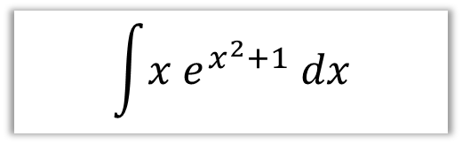
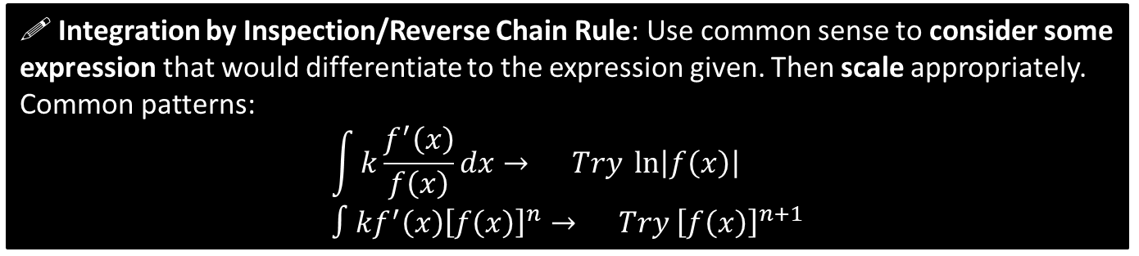


SKILL #4: Reverse Chain Rule
! Integration by Inspection/Reverse Chain Rule: Use common sense to consider some expression that would differentiate to the expression given. Then scale appropriately.
Common patterns:
$$\int{k\frac{f^{′}\left(x\right)}{f\left(x\right)}dx}→ Try \ln\left|f\left(x\right)\right| \\ ∫kf^{′}\left(x\right){\left[f\left(x\right)\right]}^{n}→ Try {\left[f\left(x\right)\right]}^{n+1}$$
In words: “If the bottom of a fraction differentiates to give the top (forgetting scaling), try ln of the bottom”.
$$\int{\frac{x^{2}}{x^{3}+1} dx}$$
$$\int{x e^{x^{2}+1} dx}$$
?
?
Consider $y=ln⁡|x^{3}+1|$
$$\frac{dy}{dx}=\frac{3x^{2}}{x^{3}+1}$$
Therefore:
$$\int{\frac{x^{2}}{x^{3}+1} dx} \\ =\frac{1}{3}ln\left|x^{3}+1\right|+C$$
Consider $y=e^{x^{2}+1}$
$$\frac{dy}{dx}=2x e^{x^{2}+1}$$
Therefore:
$$\int{x e^{x^{2}+1}dx}=\frac{1}{2}e^{x^{2}+1}+C$$

Slide 19



Quickfire
In your head!
$$\int{\frac{4x^{3}}{x^{4}−1}dx}=\ln\left|x^{4}−1\right|+C \\ \int{\frac{\cos{x}}{\sin{x}+2}dx}=\ln\left|\sin{x}+2\right|+C \\ \int{\cos{x} e^{\sin{x}}}dx=e^{\sin{x}}+C \\ \int{\cos{x}{\left(\sin{x}−5\right)}^{7} dx}=\frac{1}{8}{\left(\sin{x}−5\right)}^{8}+C \\ \int{x^{2}{\left(x^{3}+5\right)}^{7}}=\frac{1}{24}{\left(x^{3}+5\right)}^{8}+C$$
?
?
?
?
?
Not in your head…
Fro Tip: If there’s as power around the whole denominator, DON’T use $ln$: reexpress the expression as a product.
e.g. $x{\left(x^{2}+5\right)}^{−3}$
$$\int{\frac{x}{{\left(x^{2}+5\right)}^{3}}dx}=∫x{\left(x^{2}+5\right)}^{−3}dx \\ −\frac{1}{4}{\left(x^{2}+5\right)}^{−2}+C$$
?

Slide 20


$\sin^{n}{x}\cos{x}$ vs $\sec^{n}{x}\tan{x}$
Notice when we differentiate $\sin^{5}{x}$, then power decreases:
$$\frac{d}{dx}\left(\sin^{5}{x}\right)=\frac{d}{dx}\left({\left(\sin{x}\right)}^{5}\right)=5\sin^{4}{x}\cos{x}$$
However, when we differentiate $\sec^{5}x$:
$$\frac{d}{dx}\left({\left(\sec{x}\right)}^{5}\right)=5\sec^{4}{x}×\sec{x}\tan{x}=5\sec^{5}{x}\tan{x}$$
Notice that the power of $sec$ didn’t go down. Keep this in mind when integrating.
?
?
$$\int{\sec^{4}{x}\tan{x}} dx$$
Consider $y=\sec^{4}{x}$
$$\frac{dy}{dx}=4\sec^{3}{x}×\sec{x}\tan{x}=4\sec^{4}{x}\tan{x}$$
$$∴ \int{\sec^{4}{x}\tan{x}} dx=\frac{1}{4}\sec^{4}{x}+C$$
?

Slide 21










Test Your Understanding
$$\int{\sin{x}{\left(\cos{x}+1\right)}^{5} dx}$$
$$\int{\frac{cosec^{2}x}{{\left(2+\cot{x}\right)}^{3}}dx}$$
?
?
Consider $y={\left(\cos{x}+1\right)}^{6}$
$$\frac{dy}{dx}=−6\sin{x}{\left(\cos{x}+1\right)}^{5}$$
Therefore:
$$\int{\sin{x}{\left(\cos{x}+1\right)}^{5} dx} \\ =−\frac{1}{6}{\left(\cos{x}+1\right)}^{6}+C$$
Consider $y={\left(2+\cot{x}\right)}^{−2}$
$$\frac{dy}{dx}=−2{\left(2+\cot{x}\right)}^{−3}×−cosec^{2}x \\ =2cosec^{2}x{\left(2+\cot{x}\right)}^{−3}$$
Thus $\int{\frac{cosec^{2}x}{{\left(2+\cot{x}\right)}^{3}}dx}=\frac{1}{2}{\left(2+\cot{x}\right)}^{−2}+C$
$$\int{\frac{\sec^{2}{2x}}{\tan{2x}+1} dx}$$
$$\int{x{\left(x^{2}+2\right)}^{3} dx}$$
$$\int{5\tan{x}\sec^{2}{x} dx}$$
?
?
?
$$={\frac{1}{8}\left(x^{2}+2\right)}^{4}+C$$
Try $y=\sec^{2}{x}$
$$\frac{dy}{dx}=2\sec{x}×\sec{x}\tan{x} \\ =2\sec^{2}{x}\tan{x}$$
$$∴\int{5\tan{x}\sec^{2}{x} dx}=\frac{5}{2}\sec^{2}{x}+C$$
$$=\frac{1}{2}ln{|\tan{2x}+1|}+C$$

Slide 22

Exercise 11D
Pearson Pure Mathematics Year 2/AS
Page 302-303
Extension:
[STEP I 2013 Q4]
(i) Show that, for $n>0$,
$\int_{0}^{\frac{1}{4}π}{\tan^{n}{x}\sec^{2}{x} dx}=\frac{1}{n+1}$ and $\int_{0}^{\frac{1}{4}π}{\sec^{n}{x}\tan{x}} dx=\frac{{\left(\sqrt{2}\right)}^{n}−1}{n}$
(ii) Evaluate the following integrals:
$\int_{0}^{\frac{1}{4}π}{x\sec^{4}{x}\tan{x} dx}$ and $\int_{0}^{\frac{1}{4}π}{x^{2}\sec^{2}{x}\tan{x}} dx$
Solutions: (ii) $\frac{π}{4}−\frac{1}{3}$ and $\frac{π^{2}}{16}−\frac{π}{4}+\frac{1}{2}\ln{2}$
?

Slide 23






SKILL #5: Integration by Substitution
For some integrations involving a complicated expression, we can make a substitution to turn it into an equivalent integration that is simpler. We wouldn’t be able to use ‘reverse chain rule’ on the following:
Q
Use the substitution $u=2x+5$ to find $\int{x\sqrt{2x+5}} dx$
The aim is to completely remove any reference to $x$, and replace it with $u$. We’ll have to work out $x$ and $dx$ so that we can replace them.
STEP 1: Using substitution, work out $x$ and $dx$ (or variant)
?
$$\frac{du}{dx}=2 → dx=\frac{1}{2}du$$
Fro Tip: Be careful about ensuring you reciprocate when rearranging.
$$x=\frac{u−5}{2}$$
$$\int{x\sqrt{2x+5}} dx=\int{\frac{u−5}{2}\sqrt{u}\frac{1}{2}du}=\frac{1}{4}\int{\sqrt{u}\left(u−5\right) du} \\ =\frac{1}{4}\int{u^{\frac{3}{2}}−5u^{\frac{1}{2}}}$$
$$=\frac{1}{4}\left(\frac{2}{5}u^{\frac{5}{2}}−\frac{10}{3}u^{\frac{3}{2}}\right)+C$$
$$=\frac{{\left(2x+5\right)}^{\frac{5}{2}}}{10}−\frac{5{\left(2x+5\right)}^{\frac{3}{2}}}{6}+C$$
?
STEP 2: Substitute these into expression.
Fro Tip: If you have a constant factor, factor it out of the integral.
STEP 3: Integrate simplified expression.
?
STEP 4: Write answer in terms of $x$.
?

Slide 24








How can we tell what substitution to use?
In Edexcel you will usually be given the substitution!
However in some other exam boards, and in STEP, you often aren’t.
There’s no hard and fast rule, but it’s often helpful to replace to replace expressions inside roots, powers or the denominator of a fraction.
Sensible substitution:
$$\int{\cos{x}\sqrt{1+\sin{x}}dx}$$
?
$$u=1+\sin{x}$$
$$\int{6x e^{x^{2}}dx}$$
?
$$u=x^{2}$$
But this can be integrated by inspection.
$$\int{\frac{xe^{x}}{1+x}dx}$$
?
$$u=1+x$$
$$\int{e^{\frac{1−x}{1+x}} dx}$$
$$u=\frac{1−x}{1+x}$$
?

Slide 25





Another Example
Q
Use the substitution $u=\sin{x}+1$ to find $\int{\cos{x}\sin{x}{\left(1+\sin{x}\right)}^{3}} dx$
STEP 1: Using substitution, work out $x$ and $dx$ (or variant)
?
$$u=\sin{x}+1 \\ \frac{du}{dx}=\cos{x} → du=\cos{x} dx \\ \sin{x}=u−1$$
Notice this time we didn’t find $x$ or $dx$. We could, but then $x=\arcsin{(u−1)}$, and it would be slightly awkward simplifying the expression (although is still very much a valid method!)
STEP 2: Substitute these into expression.
?
$$=\int{\left(u−1\right)u^{3} du} \\ =\int{u^{4}−u^{3}} du \\ =\frac{1}{5}u^{5}−\frac{1}{4}u^{4}+C$$
$$=\frac{1}{5}{\left(\sin{x}+1\right)}^{5}−\frac{1}{4}{\left(\sin{x}+1\right)}^{4}+C$$
STEP 3: Integrate simplified expression.
?
STEP 4: Write answer in terms of $x$.
?

Slide 26







Using substitutions involving implicit differentiation
When a root is involved, it makes thing much tidier if we use $u^{2}=…$
Q
Use the substitution $u^{2}=2x+5$ to find $\int{x\sqrt{2x+5}} dx$
STEP 1: Using substitution, work out $x$ and $dx$ (or variant)
?
$$2u\frac{du}{dx}=2 → dx=u du$$
$$x=\frac{u^{2}−5}{2}$$
$$\int{x\sqrt{2x+5}} dx=\int{\frac{u^{2}−5}{2}u×udu} \\ =\int{\frac{1}{2}u^{4}−\frac{5}{2}u^{2} du} \\ =\frac{1}{10}u^{5}−\frac{5}{6}u^{3}+C$$
$$=\frac{{\left(2x+5\right)}^{\frac{5}{2}}}{10}−\frac{5{\left(2x+5\right)}^{\frac{3}{2}}}{6}+C$$
?
STEP 2: Substitute these into expression.
STEP 3: Integrate simplified expression.
?
STEP 4: Write answer in terms of $x$.
?
This was marginally less tedious than when we used $u=2x+5$, as we didn’t have fractional powers to deal with.

Slide 27


Test Your Understanding
Edexcel C4 Jan 2012 Q6c
Hint: You might want to use your double angle formula first.
$$\frac{du}{dx}=−\sin{x} → dx=−\frac{1}{\sin{x}}du$$
$\cos{x}=u−1$ (As before $x=\arccos\left(u−1\right)$ is going to be messy)
$$\int{\frac{2\sin{2x}}{1+\cos{x}}dx}=\int{\frac{4\sin{x}\cos{x}}{1+\cos{x}}dx}=\int{−\frac{4\sin{x}\left(u−1\right)}{u}}\frac{1}{\sin{x}}du \\ =−4\int{\frac{u−1}{u}du}=−4\int{1−\frac{1}{u}}du \\ =−4\left(u−\ln\left|u\right|\right)+c=−4\left(1+\cos{x}−\ln\left|\cos{x}+1\right|\right)+c=…$$
?

Slide 28

Definite Integration
Now consider:
Q
Calculate $\int_{0}^{\frac{π}{2}}{\cos{x}\sqrt{1+\sin{x}}} dx$
?
Use substitution: $u=1+\sin{x}$
$$\frac{du}{dx}=\cos{x} → du=\cos{x} dx$$
$$\sin{x}=u−1$$
Now because we’ve changed from $x$ to $u$, we have to work out what values of $u$ would have given those limits for $x$:
When $x=\frac{π}{2}$, $u=2$
When $x=0, u=1$
$$\int_{0}^{\frac{π}{2}}{\cos{x}\sqrt{1+\sin{x}}} dx=\int_{1}^{2}{u^{\frac{1}{2}} du} \\ ={\left[\frac{2}{3}u^{\frac{3}{2}}\right]}_{1}^{2}=\frac{2}{3}\left(2\sqrt{2}−1\right)$$
?
?
?

Slide 29



Test Your Understanding
Edexcel C4 June 2011 Q4
?
$$\frac{du}{dx}=2x → du=2x dx \\ x^{2}=u−2$$
When $x=\sqrt{2}$, $u={\left(\sqrt{2}\right)}^{2}+2=4$
When $x=0, u=0^{2}+2=2$
$$\int_{0}^{\sqrt{2}}{x^{2}\ln\left(x^{2}+2\right)x}dx=\int_{2}^{4}{\frac{1}{2}(u−2)\ln\left(u\right) du}$$

Slide 30
Exercise 11E
Pearson Pure Mathematics Year 2/AS
Page 306-307

Slide 31



SKILL #6: Integration by Parts
$$\int{x\cos{x} dx}=?$$
Just as the Product Rule was used to differentiate the product of two expressions, we can often use ‘Integration by Parts’ to integrate a product.
! To integrate by parts:
$$\int{u\frac{dv}{dx}}dx=uv−\int{v\frac{du}{dx} dx}$$
The Product Rule:
$$\frac{d}{dx}\left(uv\right)=v\frac{du}{dx}+u\frac{dv}{dx}$$
On the right-hand-side, both $v\frac{du}{dx}$ and $u\frac{dv}{dx}$ are the product of two expressions. So if we made either the subject, we could use $u\frac{dv}{dx}$ say to represent $x\cos{x}$ in the example.
Rearranging:
$$u\frac{dv}{dx}=\frac{d}{dx}\left(uv\right)−v\frac{du}{dx}$$
Integrating both sides with respect to $x$, we get the desired formula.
Proof ?
(not needed for exam)

Slide 32







SKILL #6: Integration by Parts
$$\int{x\cos{x} dx}=?$$
$$\int{u\frac{dv}{dx}}dx=uv−\int{v\frac{du}{dx} dx}$$
?
$$u=x \frac{dv}{dx}=\cos{x}$$
$$\frac{du}{dx}=1 v=\sin{x}$$
$$\int{x\cos{x} dx}=x\sin{x}−\int{1\sin{x} dx} \\ =x\sin{x}+\cos{x}+C$$
STEP 1: Decide which thing will be $u$ (and which $\frac{dv}{dx}$).
You’re about to differentiate $u$ and integrate $\frac{dv}{dx}$, so the idea is to pick them so differentiating $u$ makes it ‘simpler’, and $\frac{dv}{dx}$ can be integrated easily.
$u$ will always be the $x^{n}$ term UNLESS one term is $\ln{x}$.
?
STEP 2: Find $\frac{du}{dx}$ and $v$.
?
STEP 3: Use the formula.
I just remember it as “$uv$ minus the integral of the two new things timesed together”

Slide 33





Another Example
Q
Find $\int{x^{2}\ln{x} dx}$
?
$$u=\ln{x} \frac{dv}{dx}=x^{2}$$
$$\frac{du}{dx}=\frac{1}{x} v=\frac{1}{3}x^{3}$$
$$\int{x^{2}\ln{x} dx}=\frac{1}{3}x^{3}\ln{x}−\int{\frac{1}{3}x^{2} dx} \\ =\frac{1}{3}x^{3}\ln{x}−\frac{1}{9}x^{3}+C$$
STEP 1: Decide which thing will be $u$ (and which $\frac{dv}{dx}$).
This time, we choose $\ln{x}$ to be the $u$ because it differentiates nicely.
STEP 2: Find $\frac{du}{dx}$ and $v$.
STEP 3: Use the formula.

Slide 34



IBP twice! 😐
Q
Find $\int{x^{2}e^{x} dx}$
?
$$u=x^{2} \frac{dv}{dx}=e^{x} \\ \frac{du}{dx}=2x v=e^{x} \\ \int{x^{2}e^{x} dx}=x^{2}e^{x}−\int{2xe^{x} dx}$$
We have to apply IBP again!
$$u=2x \frac{dv}{dx}=e^{x} \\ \frac{du}{dx}=2 v=e^{x}$$
$$\int{2xe^{x} dx}=2xe^{x}−\int{2e^{x}}dx \\ =2xe^{x}−2e^{x}$$
Therefore
$$\int{x^{2}e^{x} dx}=x^{2}e^{x}−\left(2xe^{x}−2xe^{x}\right)+C \\ =x^{2}e^{x}−2xe^{x}+2e^{x}+C$$
Fro Tip: I tend to write out my working for any second integral completely separately, and then put the result back into the original integral later.

Slide 35

Test Your Understanding
Q
Find $\int{x^{2}\sin{x} dx}$
?
$$=2x\sin{x}−x^{2}\cos{x}+2\cos{x}+C$$

Slide 36




Integrating $\ln{x}$ and definite integration
Q
Find $\int{\ln{x} dx}$, leaving your answer in terms of natural logarithms.
?
$$u=\ln{x} \frac{dv}{dx}=1 \\ \frac{du}{dx}=\frac{1}{x} v=x \\ \int{\ln{x} dx}=x\ln{x}−\int{1 dx} \\ =x\ln{x}−x+C$$
Q
Find $\int_{1}^{2}{\ln{x}dx}$, leaving your answer in terms of natural logarithms.
?
$$\int_{1}^{2}{\ln{x}dx}={\left[x\ln{x}−x\right]}_{1}^{2}=2\ln{2}−1$$
If we were doing it from scratch:
$$u=\ln{x} \frac{dv}{dx}=1 \\ \frac{du}{dx}=\frac{1}{x} v=x \\ \int_{1}^{2}{\ln{x}dx}={\left[x\ln{x}\right]}_{1}^{2}−\int_{1}^{2}{1 dx} \\ =2\ln{2 }−1\ln{1}−{\left[x\right]}_{1}^{2} \\ =2\ln{2 −(2−1)}=2\ln{2}−1$$
In general:
$$\int_{a}^{b}{u\frac{dv}{dx}dx}={\left[uv\right]}_{a}^{b}−\int_{a}^{b}{v\frac{du}{dx}dx}$$

Slide 37

Test Your Understanding
Q
Find $\int_{0}^{\frac{π}{2}}{x\sin{x} dx}$
?
$$u=x \frac{dv}{dx}=\sin{x} \\ \frac{du}{dx}=1 v=−\cos{x} \\ \int{x\sin{x} dx}=−x\cos{x}−\int{−\cos{x} dx} \\ =−x\cos{x}+\int{\cos{x} dx} \\ =−x\cos{x}+\sin{x} dx \\ ∴ \int_{0}^{\frac{π}{2}}{x\sin{x} dx}={\left[−x\cos{x}+\sin{x}\right]}_{0}^{\frac{π}{2}} \\ =\left(−\frac{π}{2}\cos{\frac{π}{2}}+\sin{\frac{π}{2}}\right)−\left(0+\sin{0}\right) \\ =1$$

Slide 38



One final unusual one…
It doesn’t actually matter what you make the $u$ and what the $\frac{dv}{dx}$ this time. But the hard part is realising how to ‘close the loop’ at the end…
Exam Note: This came up in an exam once and caught an awful lot of students (and teachers!) by surprise.
$$\int{e^{x}\sin{x} dx}$$
$$u=e^{x} \frac{dv}{dx}=\sin{x} \\ \frac{du}{dc}=e^{x} v=−\cos{x} \\ \int{e^{x}\sin{x} dx}=−e^{x}\cos{x}−\int{−e^{x}\cos{x} dx} \\ =−e^{x}\cos{x}+\int{e^{x}\cos{x} dx}$$
Consider $\int{e^{x}\cos{x} dx}$
$$u=e^{x} \frac{dv}{dx}=\cos{x} \\ \frac{du}{dx}=e^{x} v=\sin{x}$$
$$∴\int{e^{x}\sin{x} dx}=−e^{x}\cos{x}+e^{x}\sin{x}−\int{e^{x}\sin{x} dx}$$
$$2\int{e^{x}}\sin{x} dx=−e^{x}\cos{x}+e^{x}\sin{x}+c \\ \int{e^{x}}\sin{x} dx=−\frac{1}{2}e^{x}\cos{x}+\frac{1}{2}e^{x}\sin{x}+c′$$
?
This is the surprising bit! Because we ended up with the original expression, we can ‘collect’ these integrals together!

Slide 39



Exercise 11F
Pearson Pure Mathematics Year 2/AS
Page 306-307
Extension
$$\int{\arcsin\left(x\right)dx}=\sqrt{1−x^{2}}+x\arcsin\left(x\right)+C$$
(hint: $\frac{dv}{dx}=1$)
[STEP I 2014 Q2]
?
You will need the following standard results (given in your formula booklet) for the main exercise. We’ll prove them later. !
$$\int{\tan{x} dx}=\ln\left|\sec{x}\right|+C \int{\sec{x} dx}=\ln\left|\sec{x+\tan{x}}\right|+C \\ \int{\cot{x} dx}=\ln\left|\sin{x}\right|+C \int{\operatorname{cosec}{x} dx}=\ln\left|\operatorname{cosec}{x+\cot{x}}\right|+C$$

Slide 40


SKILL #7: Using Partial Fractions
We saw earlier that we can split some expressions into partial fractions. This allows us to integrate some expressions with more complicated denominators.
Find $\int{\frac{2}{x^{2}−1} dx}$
?
$$\frac{2}{x^{2}−1}=\frac{2}{\left(x+1\right)\left(x−1\right)}=\frac{A}{x+1}+\frac{B}{x−1} \\ 2=A\left(x−1\right)+B\left(x+1\right) \\ 2=Ax−A+Bx+B \\ A+B=0 B−A=2 \\ B=1 A=−1$$
$$∫\frac{2}{x^{2}−1}dx=\int{−\frac{1}{x+1}+\frac{1}{x−1} dx} \\ =−\ln\left|x+1\right|+\ln\left|x−1\right|+C \\ =ln \left|\frac{x−1}{x+1}\right|+C$$

Slide 41




Further Examples
Find $\int{\frac{x−5}{\left(x+1\right)\left(x−2\right)} dx}$
Find $\int{\frac{8x^{2}−19x+1}{\left(2x+1\right){\left(x−2\right)}^{2}} dx}$
?
?
$$\frac{x−5}{\left(x+1\right)\left(x−2\right)}≡\frac{A}{x+1}+\frac{B}{x−2} \\ A=2 and B=−1$$
$$\int{\frac{x−5}{\left(x+1\right)\left(x−2\right)} dx}=∫\frac{2}{x+1}−\frac{1}{x−2}dx \\ =2\ln\left|x+1\right|−\ln\left|x−2\right|+C \\ =\ln\left|\frac{{\left(x+1\right)}^{2}}{x−2}\right|+C$$
$$\frac{8x^{2}−19x+1}{\left(2x+1\right){\left(x−2\right)}^{2}}=\frac{A}{2x+1}+\frac{B}{{\left(x−2\right)}^{2}}+\frac{C}{x−2}$$
$$A=2, B=−1, C=3$$
$$\int{\frac{8x^{2}−19x+1}{\left(2x+1\right){\left(x−2\right)}^{2}} dx}=\ln\left|\left(2x+1\right){\left(x−2\right)}^{3}\right|+\frac{1}{x−2}+C$$

Slide 42




Test Your Understanding
Edexcel C4 June 2009 Q3
?
?
?

Slide 43








SKILL #8: Integrating top-heavy algebraic fractions
$$\int{\frac{x^{2}}{x+1} dx= ?}$$
How would we deal with this? (the clue’s in the title)
Some manipulation to simplify
?
Now integrate
?
$$x −1$$
$$\int{\frac{x^{2}}{x+1} dx}=\int{x−1+\frac{1}{x+1}}dx \\ =\frac{1}{2}x^{2}−x+\ln\left|x+1\right|$$
$+C$
$$x+1$$
$$x^{2}+0x+0$$
$$x^{2}+x$$
$$−x+0 \\ −x−1$$
$$1$$

Slide 44



Test Your Understanding
$$\int{\frac{x^{3}+2}{x+1} dx} \\ =\frac{1}{3}x^{3}−\frac{1}{2}x^{2}+x$$
$+\ln\left|x+1\right|+C$
$$\int{\frac{x}{x−1} dx} \\ =\int{\frac{x−1+1}{x−1} dx}=\int{1+\frac{1}{x−1}dx} \\ =x+\ln\left|x−1\right|+C$$
?
?
Contrast this with $\int{\frac{x−1}{x} dx}$ which can be integrated more simply:
$$\int{\frac{x−1}{x}dx}=\int{1−\frac{1}{x} dx}=x−\ln\left|x\right|+C$$

Slide 45


Exercise 11G
Pearson Pure Mathematics Year 2/AS
Page 312-313
Extension:
?
Solution: $\frac{1}{2}\ln\left(\frac{8}{5}\right)$

Slide 46









Finding Areas
You’re already familiar with the idea that definite integration gives you the (signed) area bound between the curve and the $x$-axis.
Given your expanded integration skills, you can now find the area under a greater variety of curves.
$$y$$
[Textbook] The diagram shows part of the curve $y=\frac{9}{\sqrt{4+3x}}$
The region $R$ is bounded by the curve, the $x$-axis and the lines $x=0$ and $x=4$, as shown in the diagram. Use integration to find the area of $R$.
$$\frac{9}{2}$$
$$R$$
$$4$$
$$x$$
?
$$Area=\int_{0}^{4}{\frac{9}{\sqrt{4+3x}}dx} \\ =9\int_{0}^{4}{{\left(4+3x\right)}^{−\frac{1}{2}} dx} \\ =6{\left[{\left(4+3x\right)}^{\frac{1}{2}}\right]}_{0}^{4} \\ =…=12$$
Recall that when we integrate ${\left(a+bx\right)}^{n}$, we divide both by the increased power $n+1$, but also by $b$.

Slide 47













Skill #9: Area between two curves
$$y$$
(This was presented in my Year 1 slides as an ‘alternative method’)
The areas under the two curves are $\int_{a}^{b}{f\left(x\right) dx}$ and $\int_{a}^{b}{g\left(x\right) dx}$. It therefore follows the area between them (provided the curves don’t overlap) is:
$$R=\int_{a}^{b}{f\left(x\right) dx}−\int_{a}^{b}{g\left(x\right) dx} \\ =\int_{a}^{b}{\left(f\left(x\right)−g\left(x\right)\right) dx}$$
$$y=f\left(x\right)$$
$$R$$
$$y=g\left(x\right)$$
$$a$$
$$x$$
$$b$$
Fro Tip: Ensure you have top curve minus bottom curve.
[Textbook] The diagram shows part of the curves $y=\sin{2x}$ and $y=\sin{x}\cos^{2}{x}$ where $0≤x≤\frac{π}{2}$. The region $R$ is bounded by the two curves. Use integration to find the area of $R$.
$$y$$
$$y=\sin{2x}$$
$$R$$
?
$$Area=\int_{0}^{\frac{π}{2}}{\sin{2x}−\sin{x}\cos^{2}{x} dx} \\ ={\left[−\frac{1}{2}\cos{2x}+\frac{1}{3}\cos^{3}{x}\right]}_{0}^{\frac{π}{2}}=…=\frac{2}{3}$$
$$y=\sin{x}\cos^{2}{x}$$
$$x$$

Slide 48


Test Your Understanding
Edexcel C4 Jan 2009 Q2
?

Slide 49
Exercise 11H
Pearson Pure Mathematics Year 2/AS
Pages 314-317

Slide 50








Skill #10: Trapezium Rule
Sometimes finding the exact area under the graph via integration is difficult. Students who have taken GCSE Maths may be familiar with the idea of approximating the area under a graph by dividing it into trapeziums of equal width.
$$y3$$
$$y2$$
$$y1$$
$$y0$$
$$Area=\frac{1}{2}h\left(y_{0}+y_{1}\right)+\frac{1}{2}h\left(y_{1}+y_{2}\right)+\frac{1}{2}h\left(y_{2}+y_{3}\right) \\ =\frac{1}{2}h\left(y_{0}+2\left(y_{1}+y_{2}\right)+y_{3}\right)$$
?
$$h$$
$$h$$
$$h$$

Slide 51




Trapezium Rule
In general: !
width of each trapezium
$$\int_{a}^{b}{y}dx≈\frac{h}{2}\left(y_{0}+2\left(y_{1}+…+y_{n−1}\right)+y_{n}\right)$$
Area under curve
is approximately
Example
We’re approximating the region bounded between $x=1$, $x=3$, the x-axis the curve $y=x^{2}$, using 4 strips.
Dividing a gap of 2 into 4 strips means each strip will be width 0.5
?
$$x$$ | 1 | 1.5 | 2 | 2.5 | 3
$$y$$ | 1 | 2.25 | 4 | 6.25 | 9
?
?
$$h=0.5 \\ Area≈\frac{0.5}{2}\left(1+2\left(2.25+4+6.25\right)+9\right)=8.75$$
?

Slide 52

Trapezium Rule
Edexcel C2 May 2013 (R) Q2
Fro Tip: You can generate table with Casio calcs . $Mode→3 (Table)$. Use ‘Alpha’ button to key in X within the function. Press =
?
0.8571
$$Area≈\frac{0.1}{2}\left(0.7071+2\left(0.7591+0.8090+0.8571+0.9037\right)+0.9487\right)=0.416$$
?

Slide 53







Further Example
Trapezium Rule: $\int_{a}^{b}{y dx}≈\frac{1}{2}h\left[y_{0}+2\left(y_{1}+…+y_{n−1}\right)+y_{n}\right]$
Q
Given $I=\int_{0}^{\frac{π}{3}}{\sec{x} dx}$
Find the exact value of $I$.
Use the trapezium rule with two strips to estimate $I$.
Use the trapezium rule with four strips to find a second estimate of $I$.
Find the percentage error in using each estimate.
a
$$I={\left[\ln\left|\sec{x}+\tan{x}\right|\right]}_{0}^{\frac{π}{3}} \\ =\ln\left(2+\sqrt{3}\right)$$
?
c
?
$$x$$ | $$0$$ | $$\frac{π}{12}$$ | $$\frac{π}{6}$$ | $$\frac{π}{4}$$ | $$\frac{π}{3}$$
$$y$$ | $$1$$ | $$1.035$$ | $$1.155$$ | $$1.414$$ | $$2$$
b
?
$$x$$ | $$0$$ | $$\frac{π}{6}$$ | $$\frac{π}{3}$$
$$y$$ | $$1$$ | $$1.155$$ | $$2$$
$$I≈\frac{1}{2}\frac{π}{12}\left[1+2\left(1.035+1.155+1.414\right)+2\right]=1.34$$
$$I≈\frac{1}{2}\frac{π}{6}\left[1+2\left(1.155\right)+2\right]=1.39$$
Error is 5.6% and 1.5%.
d
?

Slide 54




Test Your Understanding
Edexcel C4 June 2014(R) Q2
?
?
?

Slide 55
Exercise 11I
Pearson Pure Mathematics Year 2/AS
Pages 319-322

Slide 56






Integration with Parametric Equations
Suppose we have the following parametric equations:
$$x=t^{2} \\ y=t+1$$
To find the area under the curve, we want to determine to determine $\int{y dx}$. The problem however is that $y$ is in terms of $t$, not in terms of $x$.
Area: $\int{y dx}=\int{y\frac{dx}{dt} dt}$
Fro Memory Tip: No need to remember the whole new formulae. Just remember that $\frac{dx}{dt}dt=dx$ , which follows from the chain rule (and very informally, you can see holds as the $dt$’s cancel)
?
Determine the area bound between the curve with parametric equations $x=t^{2}$ and $y=t+1$ (where $t>0$), the $x$-axis, and the lines $x=0$ and $x=3$.
?
$$\frac{dx}{dt}=2t$$
When $x=3, t=\sqrt{3}$When $x=0, t=0$
$$A=\int_{0}^{\sqrt{3}}{y\frac{dx}{dt}dt}=\int_{0}^{\sqrt{3}}{\left(t+1\right)2t dt}=\int_{0}^{\sqrt{3}}{2t^{2}+2t dt} \\ ={\left[\frac{2}{3}t^{3}+t^{2}\right]}_{0}^{\sqrt{3}}=2\sqrt{3}+3$$
STEP 1: Find $\frac{dx}{dt}$
STEP 2: Change limits
STEP 3: Integrate
?
?
Since we’re now integrating in terms of $t$, we need to change the limits so they’re in terms of $t$.

Slide 57




Further Example
[Textbook] The curve $C$ has parametric equations
$$x=t\left(1+t\right), y=\frac{1}{1+t}, t≥0$$
Find the exact area of the region $R$, bounded by $C$, the $x$-axis and the lines $x=0$ and $x=2$.
$$R$$
$$C$$
2
$$\frac{dx}{dt}=1+2t$$
When $x=0,$ $0=t\left(1+t\right) ∴t=0$ or $t=−1$ (as $t≥0$)
When $x=2$, $2=t\left(1+t\right)∴t^{2}+t−2=0 ∴ t=−2$or $t=1$
$$\int_{0}^{1}{y\frac{dx}{dt} dt}=\int_{0}^{1}{\left(\frac{1}{1+t}\right)\left(1+2t\right) dt} \\ =\int_{0}^{1}{\frac{1+2t}{1+t} dt}=\int_{0}^{1}{\left(2−\frac{1}{1+t}\right)dt} \\ ={\left[2t−\ln\left|1+t\right|\right]}_{0}^{1} \\ =2−\ln{2}$$
?
?
?
?
Recall that to integrate a top-heavy fraction, use long-division first.

Slide 58




Test Your Understanding
Edexcel C4 Jan 2013 Q5
Helping Hand:
$$\frac{d}{dx}\left(a^{x}\right)=a^{x}\left(\ln{a}\right) \\ \int{a^{x}} dx=\frac{a^{x}}{\ln{a}}+c$$
?
?
?

Slide 59





Exercise ?
This exercise is not in the current version of the Pearson textbooks as the content was added later. I have temporarily included the exercise subsequently produced by Pearson.
?
?
58.9
?
?
?
?
?

Slide 60







SKILL #11: Differential Equations
(We’re on the home straight!)
Differential equations are equations involving a mix of variables and derivatives, e.g. $y$, $x$ and $\frac{dy}{dx}$.
‘Solving’ these equations means to get $y$ in terms of $x$ (with no $\frac{dy}{dx}$).
Q
Find the general solution to $\frac{dy}{dx}=xy+y$
?
$$\frac{dy}{dx}=y\left(x+1\right) \\ \frac{1}{y}\frac{dy}{dx}=x+1 \\ \int{\frac{1}{y}\frac{dy}{dx}dx=\int{x+1 dx}} \\ \int{\frac{1}{y}} dy=\int{x+1} dx \\ \ln\left|y\right|=\frac{1}{2}x^{2}+x+C \\ y=e^{\frac{1}{2}x^{2}+x+C} =e^{\frac{1}{2}x^{2}+x}e^{C} \\ =Ae^{\frac{1}{2}x^{2}+x}$$
STEP 1: Get $y$ to the side of $\frac{dy}{dx}$ by dividing and $x$ to the other side.
(you may need to factorise to separate out $y$ first)
I usually skip this line.
?
STEP 2: Integrate both sides with respect to $x$. $\frac{dy}{dx} dx$ simplifies to $dy$ (recall that (implicitly) differentiating an expression in terms of $y$ with respect to $x$ introduces a $\frac{dy}{dx}$, so integrating similarly would get rid of it)
STEP 3: Make $y$ the subject, if the question asks.
?
Fro Tip: When you have $e^{f\left(x\right)+c}=e^{f\left(x\right)}e^{c}$, it’s typical to write $Ae^{f\left(x\right)}$ where $A=e^{c}$ (noting that $A$ is any positive constant since $e^{c}>0$)

Slide 61






Another Example
Q
Find the general solution to $\left(1+x^{2}\right)\frac{dy}{dx}=x\tan{y}$
?
STEP 1: Get $y$ to the side of $\frac{dy}{dx}$ by dividing and $x$ to the other side.
(you may need to factorise to separate out $y$ first)
$$\frac{1}{\tan{y}}\frac{dy}{dx}=\frac{x}{1+x^{2}}$$
$$\int{\cot{y} dy }=\int{\frac{x}{1+x^{2}}dx} \\ \ln\left|\sin{y}\right|=\frac{1}{2}\ln\left|1+x^{2}\right|+C \\ \ln\left|\sin{y}\right|=\frac{1}{2}\ln\left|1+x^{2}\right|+\ln{k} \\ \ln\left|\sin{y}\right|=\ln\left|k\sqrt{1+x^{2}}\right| \\ \sin{y}=k\sqrt{1+x^{2}} \\ y=\arcsin\left(k\sqrt{1+x^{2}}\right)$$
?
STEP 2: Integrate both sides with respect to $x$.
?
STEP 2b: If possible, try to combine your constant of integration with other terms
(e.g. by letting $C=\ln{k}$ where $k$ is another constant)
?
STEP 3: Make $y$ the subject, if the question asks.

Slide 62


Differential Equations with Boundary Conditions
Q
[Textbook] Find the general solution to $\frac{dy}{dx}=−\frac{3\left(y−2\right)}{\left(2x+1\right)\left(x+2\right)}$
Given that $x=1$ when $y=4$. Leave your answer in the form $y=f\left(x\right)$
?
$$\int{\frac{1}{y−2} dy}=\int{\frac{−3}{\left(2x+1\right)\left(x+2\right)}dx}$$
Use partial fractions to split up RHS.
$$\frac{−3}{\left(2x+1\right)\left(x+2\right)}≡\frac{A}{2x+1}+\frac{B}{x+2} \\ A=−2, B=1$$
$$\int{\frac{1}{y−2} dy}=\int{\frac{1}{x+2}−\frac{2}{2x+1}dx} \\ \ln\left|y−2\right|=\ln\left|x+2\right|−\ln\left|2x+1\right|+\ln{k} \\ \ln\left|y−2\right|=\ln\left|\frac{k\left(x+2\right)}{2x+1}\right| \\ y−2=\frac{k\left(x+2\right)}{2x+1}$$
When $x=1,y=4$: $4−2=\frac{k\left(1+2\right)}{2+1} →k=2$
$$y=3+\frac{3}{2x+1}$$
Bro Tip: While it doesn’t matter when you determine your constant using the boundary conditions, usually it’s easiest to determine it as soon as possible.

Slide 63


Test Your Understanding
Edexcel C4 Jan 2012 Q4
?

Slide 64

Key Points on Differential Equations
Get $y$ on to LHS by dividing (possibly factorising first).
If after integrating you have $ln$ on the RHS, make your constant of integration $\ln{k}$.
Be sure to combine all your $ln$’s together just as you did in C2.
E.g.:
$2\ln\left|x+1\right|−\ln\left|x\right| → \ln\left|\frac{{\left(x+1\right)}^{2}}{x}\right|$
Sub in boundary conditions to work out your constant – better to do sooner rather than later.
Exam questions ♥ partial fractions combined with differential equations.
?

Slide 65

Exercise 11J
Pearson Pure Mathematics Year 2/AS
Pages 324-326
Extension:
?

Slide 66





Forming differential equations
Differential equations are useful because regularly in real-life, the rate of change of a variable is based on its current value. For example in Year 1, we saw a property of exponential growth is that the rate of change is proportional to the current value:
Q
The rate of increase of a rabbit population (with population $P$, where time is $t$) is proportional to the current population.
Form a differential equation, and find its general solution.
? Form equation
Recall from GCSE that $k$ is the ‘constant of proportionality’.
$$\frac{dP}{dx}∝P ∴ \frac{dP}{dx}=kP \\ \frac{1}{P}\frac{dP}{dt}=k \\ \int{\frac{1}{P} dP}=\int{k dt} \\ \ln\left|P\right|=kt+C \\ P=e^{kt+C} \\ P=Ae^{kt} (where A=e^{C})$$
? Solve it
(Notice by the way that $e^{kt}={\left(e^{k}\right)}^{t}$, and since $e^{k}$ is a constant, we could always write $y=A⋅B^{x}$. i.e. The general solution is ‘any generic exponential function’, not just restricted to those with $e$ as the base. However it is customary to write $Ae^{kt}$)

Slide 67








Further Example
[Textbook] Water in a manufacturing plant is held in a large cylindrical tank of diameter 20m. Water flows out of the bottom of the tank through a tap at a rate proportional to the cube root of the volume.
Show that $t$ minutes after the tap is opened, $\frac{dh}{dt}=−k\sqrt[3]{h}$ for some constant $k$.
Show that the general solution of this differential equation may be written $h={\left(P−Qt\right)}^{\frac{3}{2}}$, where $P$ and $Q$ are constants.
Initially the height of the water is 27m. 10 minutes later, the height is 8m.
(c) Find the values of the constants $P$ and $Q$.
(d) Find the time in minutes when the water is at a depth of 1m.
(a) is a ‘connected rate of change’ question in the style we saw in Chapter 9. Model the fact we have a cylinder.
$$h$$
?
a
$$V=πr^{2}h=100πh \\ \frac{dV}{dh}=100π \\ \frac{dV}{dt}=−c\sqrt[3]{V} \\ =−c\sqrt[3]{100πh} \\ \frac{dh}{dt}=\frac{dh}{dV}×\frac{dV}{dt}=\frac{1}{100π}×\left(−c\sqrt[3]{100πh}\right)$$
$∴\frac{dh}{dt}=−k\sqrt[3]{h}$ where $k=\frac{c\sqrt[3]{100π}}{100π}$
$$t=0, h=27 \\ 27=P^{\frac{3}{2}} ⇒ P=9 \\ t=10, h=8 \\ 8={\left(9−10Q\right)}^{\frac{3}{2}} \\ 4=9−10Q \\ Q=\frac{1}{2}$$
c
?
$$20m$$
If water is flowing out, the rate of change is negative.
Use chain rule.
d
?
$$h={\left(9−\frac{1}{2}t\right)}^{\frac{3}{2}} \\ 1={\left(9−\frac{1}{2}t\right)}^{\frac{3}{2}}$$
$t=16$ minutes
$$\frac{dh}{dt}=−kh^{\frac{1}{3}} → h^{−\frac{1}{3}}\frac{dh}{dt}=−k \\ ∫h^{−\frac{1}{3}}dh=\int{−k dt}$$
$$\frac{3}{2}h^{\frac{2}{3}}=−kt+c$$
$$h^{\frac{2}{3}}=−\frac{2}{3}kt+\frac{2}{3}c \\ h={\left(−\frac{2}{3}kt+\frac{2}{3}c\right)}^{\frac{3}{2}} \\ h={\left(P−Qt\right)}^{\frac{3}{2}}$$
b
?

Slide 68




Test Your Understanding
Edexcel C4 June 2005 Q8
?
Teachers/Students: I recommend also looking at Edexcel Jan 2008 Q8 which has a part (a) similar to the previous example.
?
?

Slide 69

Exercise 11K
Pearson Pure Mathematics Year 2/AS
Pages 328-329
Extension:
[STEP 2011 Q7]

Slide 70

Summary of Functions
$$f(x)$$ | How to deal with it | $\int{f\left(x\right)dx}$ (+constant) | Formula booklet?
$$sin x$$ | Standard result | $$−\cos{x}$$ | No
$$cos x$$ | Standard result | $$\sin{x}$$ | No
$$tan x$$ | In formula booklet, but use $\int{\frac{\sin{x}}{\cos{x}}dx}$ which is of the form $\int{\frac{kf^{′}\left(x\right)}{f\left(x\right)}}dx$ | $$\ln\left|\sec{x}\right|$$ | Yes
$$sin^{2} x$$ | For both $\sin^{2}{x}$and $\cos^{2}{x}$ use identities for $\cos{2x}$ $$\cos{2x}=1−2\sin^{2}{x} \\ \sin^{2}{x}=\frac{1}{2}−\frac{1}{2}\cos{2x}$$ | $$\frac{1}{2}x−\frac{1}{4}\sin{2x}$$ | No
$$cos^{2} x$$ | $$\cos{2x}=2\cos^{2}{x}−1 \\ \cos^{2}{x}=\frac{1}{2}+\frac{1}{2}\cos{2x}$$ | $$\frac{1}{2}x+\frac{1}{4}\sin{2x}$$ | No
$$tan^{2}x$$ | $$1+\tan^{2}{x}≡\sec^{2}{x} \\ \tan^{2}{x}≡\sec^{2}{x}−1$$ | $$\tan{x}−x$$ | No
$$cosec x$$ | Would use substitution $u=cosec x+\cot{x}$, but too hard for exam. | $$−ln\left|cosec x+\cot{x}\right|$$ | Yes
$$sec x$$ | Would use substitution $u=\sec{x}+\tan{x}$, but too hard for exam. | $$\ln\left|\sec{x}+\tan{x}\right|$$ | Yes
$$cot x$$ | $\int{\frac{\cos{x}}{\sin{x}}dx}$ which is of the form $\int{\frac{f^{′}\left(x\right)}{f\left(x\right)}}dx$ | $$\ln\left|\sin{x}\right|$$ | Yes
?
?
?
?
?
?
?
?
?

Slide 71

Summary of Functions
$$f(x)$$ | How to deal with it | $\int{f\left(x\right)dx}$ (+constant) | Formula booklet?
$$cosec^{2}x$$ | By observation. | $$−\cot{x}$$ | No!
$$sec^{2}x$$ | By observation. | $$\tan{x}$$ | Yes (but memorise)
$$cot^{2}x$$ | $$1+\cot^{2}{x}≡cosec^{2}x$$ | $$−\cot{x}−x$$ | No
$$sin 2x cos 2x$$ | For any product of sin and cos with same coefficient of $x$, use double angle. $$\sin{2x}\cos{2x}≡\frac{1}{2}\sin{4x}$$ | $$−\frac{1}{8}\cos{4x}$$ | No
$$\frac{1}{x}$$ |  | $$\ln{x}$$ | No
$$\ln{x}$$ | Use IBP, where $u=\ln{x},\frac{dv}{dx}=\ln{x}$ | $$x\ln{x}−x$$ | No
$$\frac{x}{x+1}$$ | Use algebraic division.$\frac{x}{x+1}≡1−\frac{1}{x+1}$ | $$x−\ln\left|x+1\right|$$
$$\frac{1}{x\left(x+1\right)}$$ | Use partial fractions. | $$\ln\left|x\right|−\ln\left|x+1\right|$$
?
?
?
?
?
?
?
?

Slide 72

Summary of Functions
$$f(x)$$ | How to deal with it | $\int{f\left(x\right)dx}$ (+constant)
$$\frac{4x}{x^{2}+1}$$ | Reverse chain rule. Of form $\int{\frac{kf^{′}\left(x\right)}{f\left(x\right)}}$ | $$2\ln\left|x^{2}+1\right|$$
$$\frac{x}{{\left(x^{2}+1\right)}^{2}}$$ | Power around denominator so NOT of form $\int{\frac{kf^{′}\left(x\right)}{f\left(x\right)}}$ . Rewrite as product. $$x{\left(x^{2}+1\right)}^{−2}$$ Reverse chain rule (i.e. “Consider $y={\left(x^{2}+1\right)}^{−1}"$ and differentiate) | $$−\frac{1}{2}{\left(x^{2}+1\right)}^{−1}$$
$$e^{2x+1} \\ \frac{1}{1−3x}$$ | For any function where ‘inner function’ is linear expression, divide by coefficient of $x$ | $$\frac{1}{2}e^{2x+1} \\ −\frac{1}{3}\ln\left|1−3x\right|$$
$$x\sqrt{2x+1}$$ | IBP or use sensible substitution. $u=2x+1$ or even better, $u^{2}=2x+1$. | $$\frac{1}{15}{\left(2x+1\right)}^{\frac{3}{2}}\left(3x−1\right)$$
$$\sin^{5}{x} cos x$$ | Reverse chain rule. | $$\frac{1}{6}\sin^{6}{x}$$
?
?
?
?
?

