Slide 1

P2 Chapter 1 :: Algebraic Methods
jamie@drfrostmaths.com
www.drfrostmaths.com
@DrFrostMaths
Last modified: 7th July 2021

Slide 2








www.drfrostmaths.com
Everything is completely free.
Why not register?
Register now to interactively practise questions on this topic, including past paper questions and extension questions (including MAT + UKMT).
Teachers: you can create student accounts (or students can register themselves), to set work, monitor progress and even create worksheets.
With questions by:
Dashboard with points, trophies, notifications and student progress.
Questions organised by topic, difficulty and past paper.
Teaching videos with topic tests to check understanding.

Slide 3
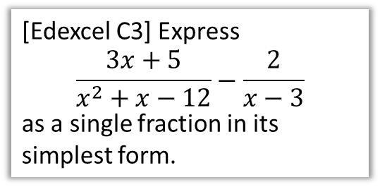
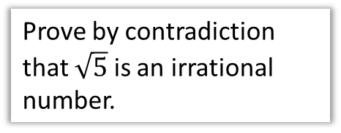
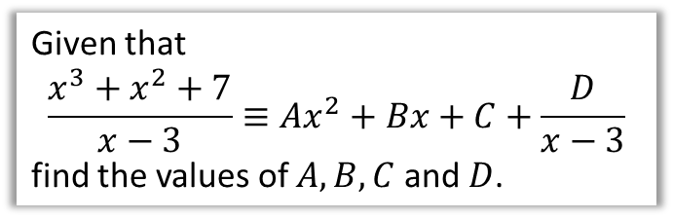
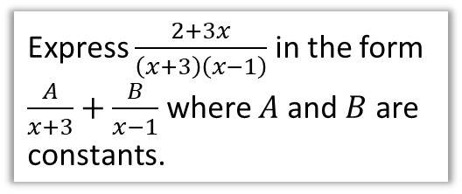

Chapter Overview
Apart from the initial portion on proof, this chapter concerns manipulation of algebraic fractions.
1:: Proof By Contradiction
2:: $+÷×−$ Algebraic Fractions
Prove by contradiction that $\sqrt{5}$ is an irrational number.
[Edexcel C3] Express
$$\frac{3x+5}{x^{2}+x−12}−\frac{2}{x−3}$$
as a single fraction in its simplest form.
3:: Express a fraction using partial fractions.
4:: Divide algebraic expressions, and convert an improper fraction into partial fraction form.
Express $\frac{2+3x}{\left(x+3\right)\left(x−1\right)}$ in the form $\frac{A}{x+3}+\frac{B}{x−1}$ where $A$ and $B$ are constants.
Given that
$$\frac{x^{3}+x^{2}+7}{x−3}≡Ax^{2}+Bx+C+\frac{D}{x−3}$$
find the values of $A,B,C$ and $D$.

Slide 4
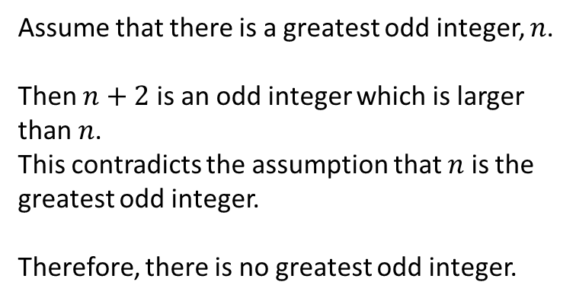
1 :: Proof By Contradiction
! To prove a statement is true by contradiction:
Assume that the statement is in fact false.
Prove that this would lead to a contradiction.
Therefore we were wrong in assuming the statement was false, and therefore it must be true.
Prove that there is no greatest odd integer.
? Assumption
Assume that there is a greatest odd integer, $n$.
Then $n+2$ is an odd integer which is larger than $n$.
This contradicts the assumption that $n$ is the greatest odd integer.
Therefore, there is no greatest odd integer.
How to structure/word proof:
“Assume that [negation of statement].”
[Reasoning followed by…] “This contradicts the assumption that…” or “This is a contradiction”.
“Therefore [restate original statement].”
? Show contradiction
? Conclusion

Slide 5
Negating the original statement
The first part of a proof by contradiction requires you to negate the original statement.
What is the negation of each of these statements? (Click to choose)
“There are infinitely many prime numbers.”
“All Popes are Catholic.”
“If it is raining, my garden is wet.”
“There are infinitely many non-prime (i.e. composite) numbers.”
“There exists a Pope who is not Catholic.”
“It is not raining and my garden is dry.”
“There are finitely many prime numbers.”
“No Popes are Catholic.”
“It is not raining and my garden is wet.”
“There are finitely many non-composite numbers.”
“Dr Frost is the Pope.”
“It is raining and my garden is not wet.”
Comments: The negation of “all are” is not “none are”. So the negation of “everyone likes green” wouldn’t be “no one likes green”, but: “not everyone likes green”. Do not confuse a ‘negation’ with the ‘opposite’.
Comments: If you have a conditional statement like “If A then B”, then the negation is “A and not B”, i.e. the condition is true, but the conclusion is false/negated.

Slide 6

More Examples
Prove by contradiction that if $n^{2}$ is even, then $n$ must be even.
? Assumption
Assume there exists a number $n$ such that $n^{2}$ is even, but $n$ is not even.
$n$ is odd therefore $n=2k+1$ for some integer $k$.
$$n^{2}={\left(2k+1\right)}^{2}=4k^{2}+4k+1 \\ =2\left(2k^{2}+2k\right)+1$$
which is odd.
This contradicts the assumption that $n^{2}$ is even.
Therefore if $n^{2}$ is even then $n$ must be even.
Remember the negation of “if A then B” is “A and not B”.
? Show contradiction
? Conclusion

Slide 7
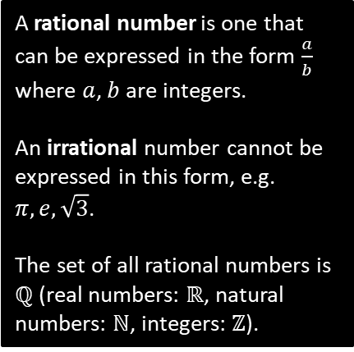
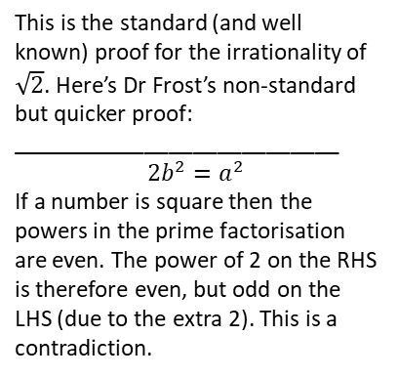

More Examples
Prove by contradiction that $\sqrt{2}$ is an irrational number.
? Assumption
Assume that $\sqrt{2}$ is a rational number.
Then $\sqrt{2}=\frac{a}{b}$, where $a$ and $b$ are integers and $\frac{a}{b}$ is a fraction in its simplest form.
$$∴2=\frac{a^{2}}{b^{2}} ⇒ 2b^{2}=a^{2}$$
Since LHS is even, $a^{2}$ is even, and therefore $a$ is even.
Therefore let $a=2k$ where $k$ is an integer.
$$2b^{2}={\left(2k\right)}^{2}=4k^{2} \\ b^{2}=2k^{2}$$
Since RHS is even, $b^{2}$ is even, and therefore $b$ is even.
But then $a$ and $b$ are both even, contradicting that $\frac{a}{b}$ is a fraction in its simplest form.
Therefore $\sqrt{2}$ is irrational.
A rational number is one that can be expressed in the form $\frac{a}{b}$ where $a$, $b$ are integers.
An irrational number cannot be expressed in this form, e.g. $π, e, \sqrt{3}$.
The set of all rational numbers is $ℚ$ (real numbers: $ℝ$, natural numbers: $ℕ$, integers: $ℤ$).
? Show contradiction
This is the standard (and well known) proof for the irrationality of $\sqrt{2}$. Here’s Dr Frost’s non-standard but quicker proof:
___________________________
$$2b^{2}=a^{2}$$
If a number is square then the powers in the prime factorisation are even. The power of 2 on the RHS is therefore even, but odd on the LHS (due to the extra 2). This is a contradiction.
? Conclusion

Slide 8

More Examples
Prove by contradiction that there are infinitely many prime numbers.
? Assumption
This proof is courtesy of Euclid, and is one of the earliest known proofs.
Assume that there is a finite number of prime numbers.
Therefore we can list all the prime numbers:
$$p_{1}, p_{2}, p_{3},…,p_{n}$$
Consider the number:
$$N=(p_{1}×p_{2}×…×p_{n})+1$$
When you divide $N$ by any of $p_{1}$, $p_{2}, …,p_{n}$, the remainder will always be 1.
Therefore $N$ is not divisible by any of these primes.
Therefore $N$ must itself be prime, or its prime factorisation contains only primes not in our original list.
This contradicts the assumption that $p_{1}, p_{2},…,p_{n}$ contained the list of all prime numbers.
Therefore, there are an infinite number of primes.
? Show contradiction
? Conclusion

Slide 9
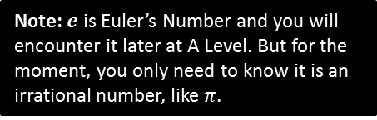
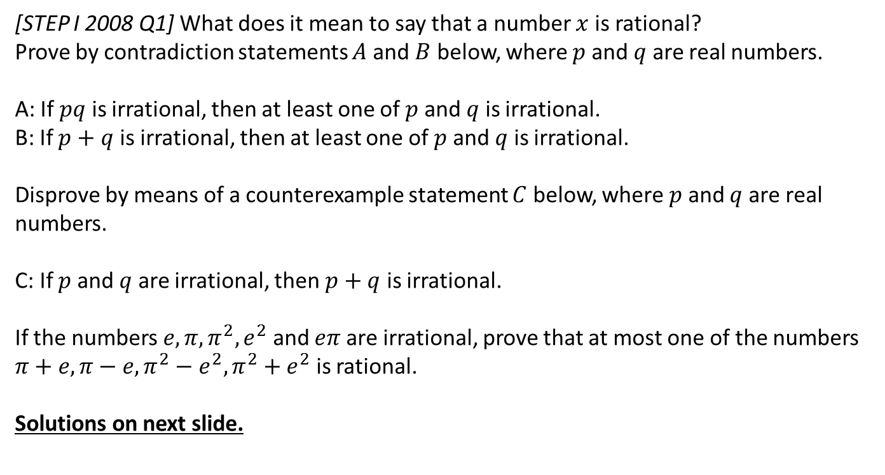
Exercise 1A
Pearson Pure Mathematics Year 2/AS
Pages 4-5
Extension
[STEP I 2008 Q1] What does it mean to say that a number $x$ is rational?
Prove by contradiction statements $A$ and $B$ below, where $p$ and $q$ are real numbers.
A: If $pq$ is irrational, then at least one of $p$ and $q$ is irrational.
B: If $p+q$ is irrational, then at least one of $p$ and $q$ is irrational.
Disprove by means of a counterexample statement $C$ below, where $p$ and $q$ are real numbers.
C: If $p$ and $q$ are irrational, then $p+q$ is irrational.
If the numbers $e,π,π^{2}, e^{2}$ and $eπ$ are irrational, prove that at most one of the numbers $π+e, π−e, π^{2}−e^{2}, π^{2}+e^{2}$ is rational.
Solutions on next slide.
Note: $e$ is Euler’s Number and you will encounter it later at A Level. But for the moment, you only need to know it is an irrational number, like $π$.

Slide 10
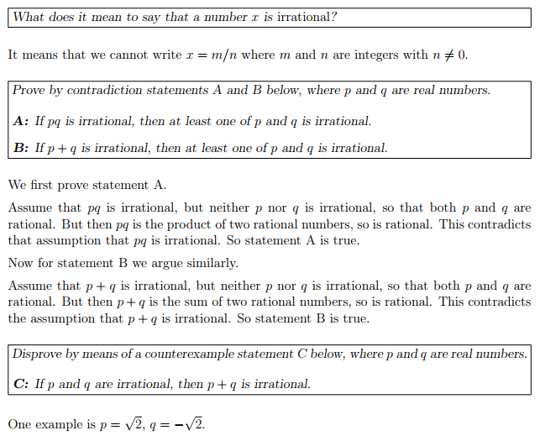
Solution to Extension Problem
?
?
?

Slide 11
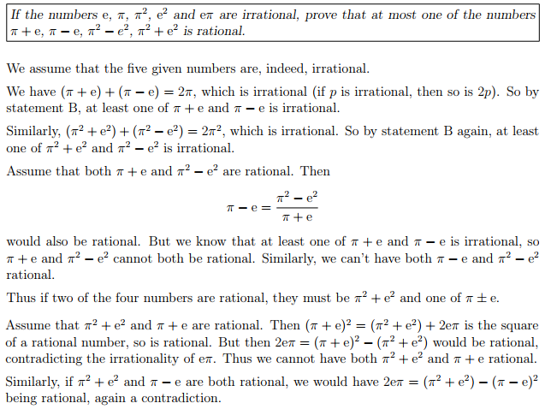
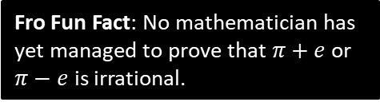
Solution to Extension Problem
?
Fro Fun Fact: No mathematician has yet managed to prove that $π+e$ or $π−e$ is irrational.

Slide 12
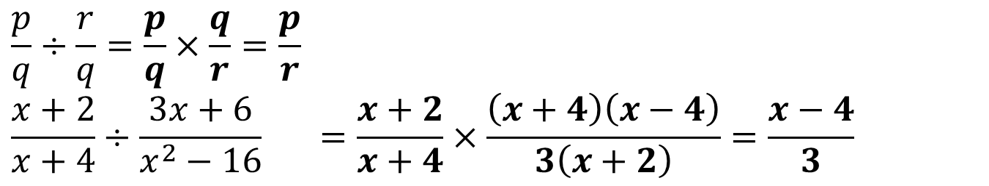
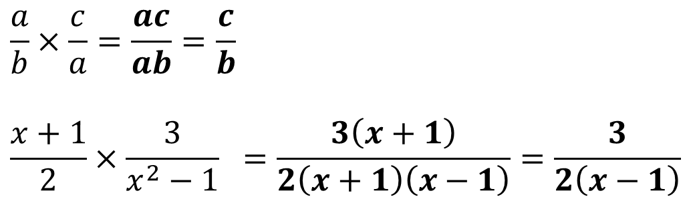
2a :: Multiplying/Dividing Algebraic Fractions
As your saw at GCSE level, multiplying algebraic fractions is no different to multiply numeric fractions.
You may however need to cancel common factors, by factorising where possible.
?
$$\frac{a}{b}×\frac{c}{a}=\frac{ac}{ab}=\frac{c}{b}$$
$$\frac{x+1}{2}×\frac{3}{x^{2}−1} =\frac{3\left(x+1\right)}{2\left(x+1\right)\left(x−1\right)}=\frac{3}{2\left(x−1\right)}$$
?
To divide by a fraction, multiply by the reciprocal of the second fraction.
?
$$\frac{p}{q}÷\frac{r}{q}=\frac{p}{q}×\frac{q}{r}=\frac{p}{r} \\ \frac{x+2}{x+4}÷\frac{3x+6}{x^{2}−16} =\frac{x+2}{x+4}×\frac{\left(x+4\right)\left(x−4\right)}{3\left(x+2\right)}=\frac{x−4}{3}$$
?

Slide 13
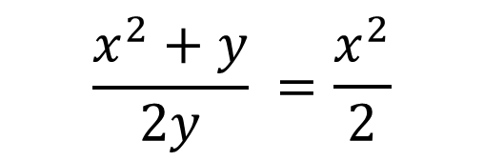
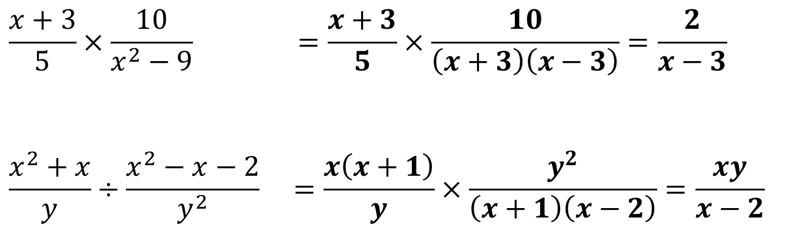

Test Your Understanding
?
$$\frac{x+3}{5}×\frac{10}{x^{2}−9} =\frac{x+3}{5}×\frac{10}{\left(x+3\right)\left(x−3\right)}=\frac{2}{x−3}$$
$$\frac{x^{2}+x}{y}÷\frac{x^{2}−x−2}{y^{2}} =\frac{x\left(x+1\right)}{y}×\frac{y^{2}}{\left(x+1\right)\left(x−2\right)}=\frac{xy}{x−2}$$
?
Common student “Crime against Mathematics”:
Cancelling in fractions only occurs by dividing. But the student has subtracted $y$ in the numerator.
$$\frac{x^{2}+y}{2y} =\frac{x^{2}}{2}$$
?

Slide 14
Exercise 1B
Pearson Pure Mathematics Year 2/AS
Pages 6-7

Slide 15
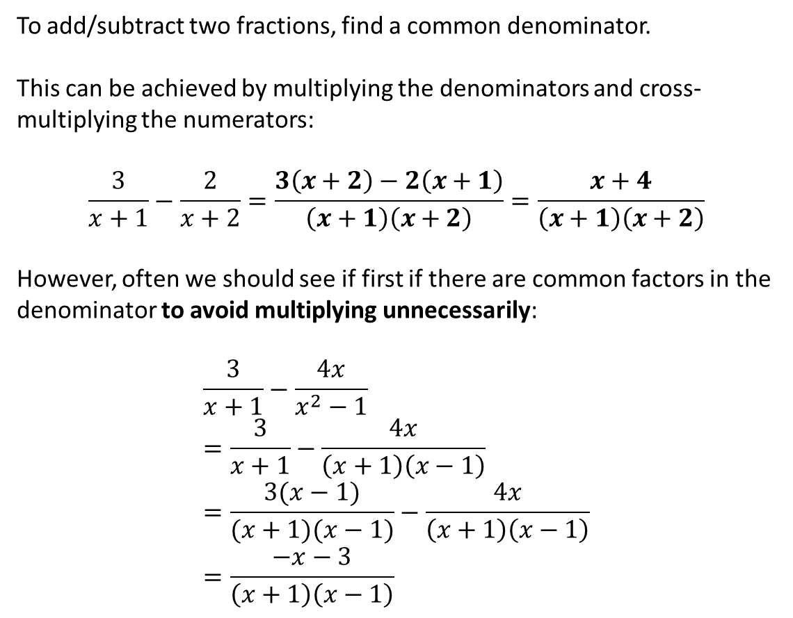
2b :: Adding/Subtracting Algebraic Fractions
To add/subtract two fractions, find a common denominator.
This can be achieved by multiplying the denominators and cross-multiplying the numerators:
$$\frac{3}{x+1}−\frac{2}{x+2}=\frac{3\left(x+2\right)−2\left(x+1\right)}{\left(x+1\right)\left(x+2\right)}=\frac{x+4}{\left(x+1\right)\left(x+2\right)}$$
However, often we should see if first if there are common factors in the denominator to avoid multiplying unnecessarily:
$$\frac{3}{x+1}−\frac{4x}{x^{2}−1} \\ =\frac{3}{x+1}−\frac{4x}{\left(x+1\right)\left(x−1\right)} \\ =\frac{3(x−1)}{(x+1)(x−1)}−\frac{4x}{\left(x+1\right)\left(x−1\right)} \\ =\frac{−x−3}{\left(x+1\right)\left(x−1\right)}$$
?
?

Slide 16
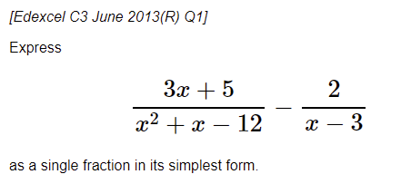
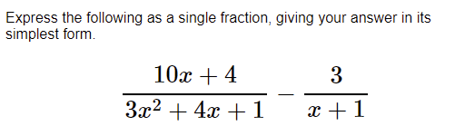


Test Your Understanding
?
$$\frac{1}{x+4}$$
?
$$\frac{1}{3x+1}$$

Slide 17
Exercise 1C
Pearson Pure Mathematics Year 2/AS
Page 8

Slide 18
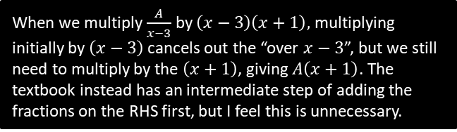
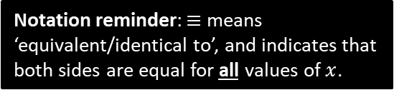





Partial Fractions
If the denominator is a product of a linear terms, it can be split into the sum of ‘partial fractions’, where each denominator is a single linear term.
$$\frac{6x−2}{\left(x−3\right)\left(x+1\right)}≡\frac{A}{x−3}+\frac{B}{x+1}$$
Notation reminder: $≡$ means ‘equivalent/identical to’, and indicates that both sides are equal for all values of $x$.
Method 1: Substitution
Method 2: Comparing Coefficients
?
?
$$6x−2≡A\left(x+1\right)+B\left(x−3\right)$$
Let $x=−1$:
$$−8=−4B → B=2$$
Let $x=3$:
$$16=4A → A=4$$
$$∴\frac{6x−2}{\left(x−3\right)\left(x+1\right)}≡\frac{4}{x−3}+\frac{2}{x+1}$$
We don’t like fractions, so multiply through by denominator of LHS.
See note below.
$$6x−2≡A\left(x+1\right)+B\left(x−3\right)$$
Comparing coefficients of $x$ terms:
$$6=A+B$$
Comparing constant terms:
$$−2=A−3B$$
Solving simultaneously:
$$A=4, B=2$$
$$∴\frac{6x−2}{\left(x−3\right)\left(x+1\right)}≡\frac{4}{x−3}+\frac{2}{x+1}$$
If two sides are identical, $x$ terms must match, constant terms must match and so on, e.g. if
$$3x+4≡ax+b$$
Then $a=3$ and $b=4$, whereas this is not necessarily true for a normal equality.
Choose values of $x$ that make one of brackets disappear.
When we multiply $\frac{A}{x−3}$ by $\left(x−3\right)\left(x+1\right),$ multiplying initially by $\left(x−3\right)$ cancels out the “over $x−3$”, but we still need to multiply by the $\left(x+1\right)$, giving $A\left(x+1\right)$. The textbook instead has an intermediate step of adding the fractions on the RHS first, but I feel this is unnecessary.

Slide 19

Further Example
Given that $\frac{6x^{2}+5x−2}{x\left(x−1\right)\left(2x+1\right)}≡\frac{A}{x}+\frac{B}{x−1}+\frac{C}{2x+1}$, find the values of the constants $A,B,C$.
?
$$6x^{2}+5x−2≡A\left(x−1\right)\left(2x+1\right)+Bx\left(2x+1\right)+Cx\left(x−1\right)$$
Let $x=1$:
$$9=3B → B=3$$
Let $x=−\frac{1}{2}$:
$$−3=\frac{3}{4}C → C=−4$$
Let $x=0$:
$$−2=−A → A=2$$
$$∴ \frac{6x^{2}+5x−2}{x\left(x−1\right)\left(2x+1\right)}≡\frac{2}{x}+\frac{3}{x−1}−\frac{4}{2x+1}$$

Slide 20

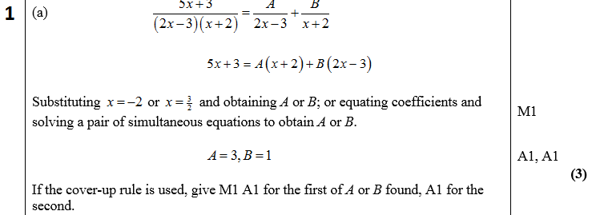
Test Your Understanding
C4 June 2005 Q3a
?

Slide 21
Exercise 1D
Pearson Pure Mathematics Year 2/AS
Page 11

Slide 22
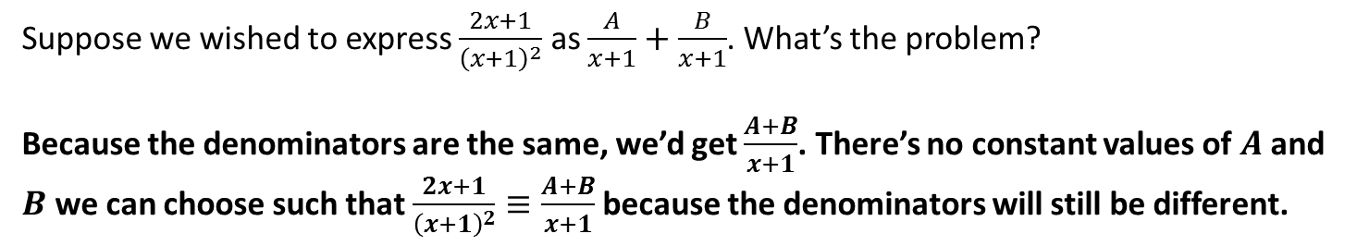

Repeated linear factors
Suppose we wished to express $\frac{2x+1}{{\left(x+1\right)}^{2}}$ as $\frac{A}{x+1}+\frac{B}{x+1}$. What’s the problem?
Because the denominators are the same, we’d get $\frac{A+B}{x+1}$. There’s no constant values of $A$ and $B$ we can choose such that $\frac{2x+1}{{\left(x+1\right)}^{2}}≡\frac{A+B}{x+1}$ because the denominators will still be different.
?
Q
Split $\frac{11x^{2}+14x+5}{{\left(x+1\right)}^{2}\left(2x+1\right)}$ into partial fractions.
The problem is resolved by having the factor both squared and non-squared (explanation of why we do this at the end of these slides).
$$\frac{11x^{2}+14x+5}{{\left(x+1\right)}^{2}\left(2x+1\right)}≡\frac{A}{x+1}+\frac{B}{{\left(x+1\right)}^{2}}+\frac{C}{2x+1}$$
?
$$11x^{2}+14x+5≡A\left(x+1\right)\left(2x+1\right)+B\left(2x+1\right)+C{\left(x+1\right)}^{2}$$
When $x=−1$: $2=−B → B=−2$
When $x=−\frac{1}{2}$: $\frac{3}{4}=\frac{1}{4}C → C=3$
At this point we could substitute something else (e.g. $x=1$) but it’s easier to equate $x^{2}$ terms.
$$11=2A+C \\ A=4$$

Slide 23
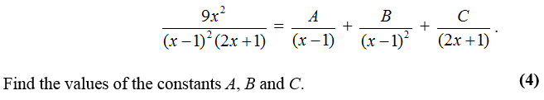
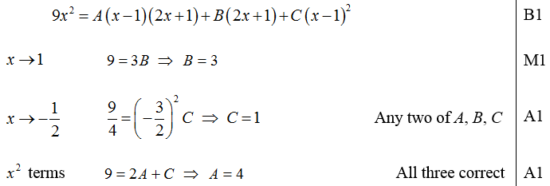
Test Your Understanding
C4 June 2011 Q1
?

Slide 24
Exercise 1E
Pearson Pure Mathematics Year 2/AS
Page 13

Slide 25
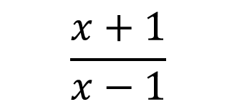
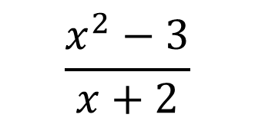
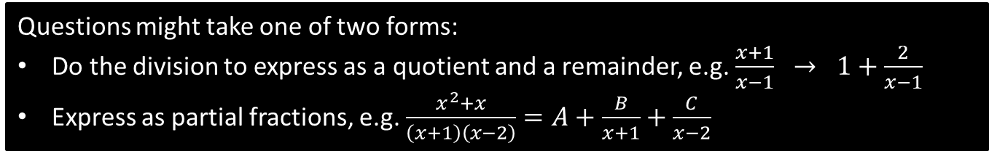
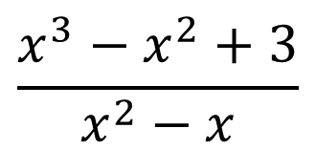
Dealing with Improper Fractions
In Pure Year 1, we saw that the ‘degree’ of a polynomial is the highest power, e.g. a quadratic has degree 2.
An algebraic fraction is improper if the degree of the numerator is at least the degree of the denominator.
$$\frac{x^{3}−x^{2}+3}{x^{2}−x}$$
$$\frac{x^{2}−3}{x+2}$$
$$\frac{x+1}{x−1}$$
A partial fraction is still improper if the degree is the same top and bottom.
Questions might take one of two forms:
Do the division to express as a quotient and a remainder, e.g. $\frac{x+1}{x−1} → 1+\frac{2}{x−1}$
Express as partial fractions, e.g. $\frac{x^{2}+x}{\left(x+1\right)\left(x−2\right)}=A+\frac{B}{x+1}+\frac{C}{x−2}$

Slide 26

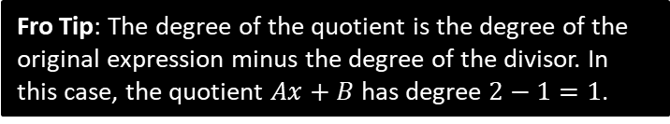

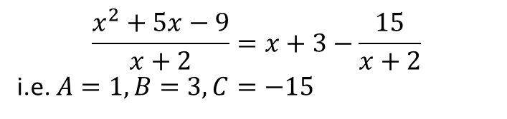
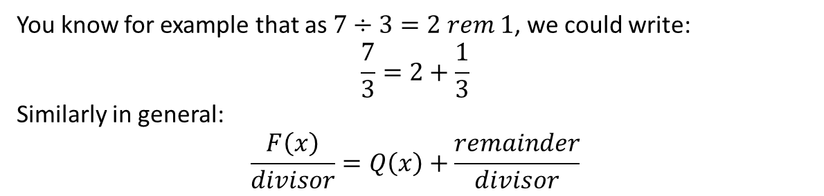




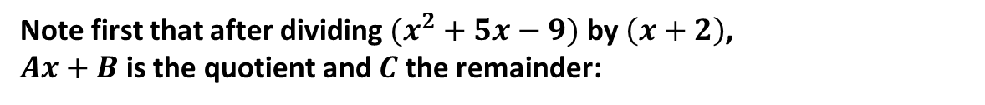

Reducing to Quotient and Remainder
You know for example that as $7÷3=2 rem 1$, we could write:
$$\frac{7}{3}=2+\frac{1}{3}$$
Similarly in general:
$$\frac{F\left(x\right)}{divisor}=Q\left(x\right)+\frac{remainder}{divisor}$$
Quotient
If $\frac{x^{2}+5x−9}{x+2}=Ax+B+\frac{C}{x+2}$, determine the values of $A$, $B$ and $C$.
?
Note first that after dividing $(x^{2}+5x−9)$ by $\left(x+2\right)$,
$Ax+B$ is the quotient and $C$ the remainder:
$$x + 3$$
$$x+2$$
$$x^{2}+5x−9$$
$$\frac{x^{2}+5x−9}{x+2}=x+3−\frac{15}{x+2}$$
i.e. $A=1, B=3, C=−15$
$$x^{2}+2x$$
$$3x−9$$
$$3x+6$$
$$−15$$
Fro Tip: The degree of the quotient is the degree of the original expression minus the degree of the divisor. In this case, the quotient $Ax+B$ has degree $2−1=1$.

Slide 27
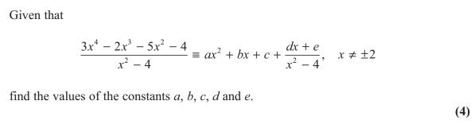
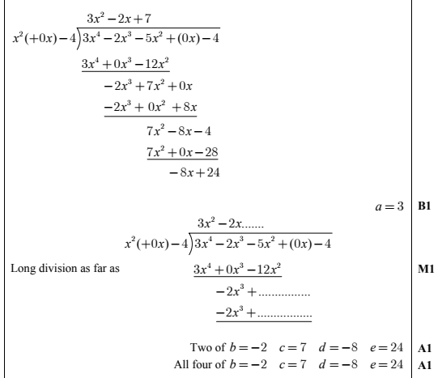
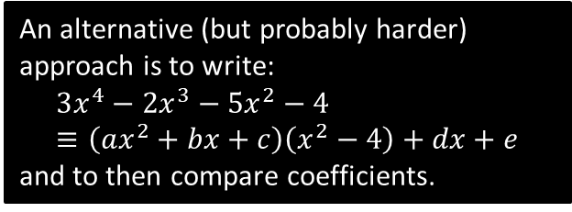
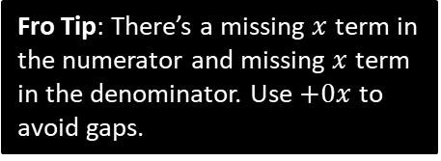
Test Your Understanding
Edexcel C4 June 2013 Q1
Fro Tip: There’s a missing $x$ term in the numerator and missing $x$ term in the denominator. Use $+0x$ to avoid gaps.
?
An alternative (but probably harder) approach is to write:
$$3x^{4}−2x^{3}−5x^{2}−4≡\left(ax^{2}+bx+c\right)\left(x^{2}−4\right)+dx+e$$
and to then compare coefficients.

Slide 28
Exercise 1F
Pearson Pure Mathematics Year 2/AS
Pages 16-17

Slide 29


Dealing with Improper Fractions
Q
Split $\frac{3x^{2}−3x−2}{\left(x−1\right)\left(x−2\right)}$ into partial fractions.
Method 1: Algebraic Division
Method 2: Using One Identity
?
?
$$\frac{3x^{2}−3x−2}{\left(x−1\right)\left(x−2\right)}≡\frac{3x^{2}−3x−2}{x^{2}−3x+2}$$
Dividing algebraically gives:
$$3+\frac{6x−8}{x^{2}−3x+2}$$
Turn numerator back:
$$=3+\frac{6x−8}{\left(x−1\right)\left(x−2\right)}$$
Let $\frac{6x−8}{\left(x−1\right)\left(x−2\right)}≡\frac{A}{x−1}+\frac{B}{x−2}$
$$A=2$$
$$B=4$$
So $\frac{3x^{2}−3x−2}{\left(x−1\right)\left(x−2\right)}≡3+\frac{2}{x−1}+\frac{4}{x−2}$
Let:
$$\frac{3x^{2}−3x−2}{\left(x−1\right)\left(x−2\right)}≡A+\frac{B}{x−1}+\frac{C}{x−2}$$
$$3x^{2}−3x−2≡A\left(x−1\right)\left(x−2\right)+B\left(x−2\right)+C\left(x−1\right)$$
If $x=2$: $4=C$
If $x=1$: $−2=−B → B=2$
Comparing coefficients of $x^{2}$:
$3=A$
Bropinion: I personally think the second method is easier. And mark schemes present it as “Method 1” – implying more standard!

Slide 30


Test Your Understanding
C4 Jan 2013 Q3
?

Slide 31
Exercise 1G
Pearson Pure Mathematics Year 2/AS
Page 18

Slide 32





Informal proof of method for repeated factors
If a factor is repeated, why do have a partial fraction with the squared and one without?
When we split into partial fractions, we want each fraction to be non-top-heavy algebraic fractions – recall this means that the ‘order’ of the numerator has to be less than the order of the denominator. We assume the most generic non-top-heavy fraction possible, i.e. where the order of the numerator is one less than the denominator…
order 1
Since the denominator is quadratic (order 2), we want the most generic possible numerator whilst avoiding the fraction being top heavy, i.e. linear (order 1).
Just putting $\frac{B}{x^{2}}$ wouldn’t be good enough because there *might* have been an $x$ term in the numerator.
$$\frac{3x^{2}+1}{\left(x+1\right)x^{2}}=\frac{A}{x+1}+\frac{Bx+C}{x^{2}}$$
order 2
$$\frac{3x^{2}+1}{\left(x+1\right)x^{2}}=\frac{A}{x+1}+\frac{Bx}{x^{2}}+\frac{C}{x^{2}}$$
Split the fraction.
We can see therefore we have both the $x$ with an without the squared in the denominator.
$$\frac{3x^{2}+1}{\left(x+1\right)x^{2}}=\frac{A}{x+1}+\frac{B}{x}+\frac{C}{x^{2}}$$

Slide 33







Informal proof of method for repeated factors
This is easy enough if the repeated factor is $x^{2}$, but what about more general repeated linear factors?
$$\frac{3x^{2}+1}{x{\left(x+1\right)}^{2}}=\frac{A}{x}+\frac{Bx+C}{{\left(x+1\right)}^{2}}$$
We want something in the numerator where a $(x+1)$ will cancel, so a bit of clever manipulation is required.
$$\frac{3x^{2}+1}{x{\left(x+1\right)}^{2}}=\frac{A}{x}+\frac{B\left(x+1\right)−B+C}{{\left(x+1\right)}^{2}}$$
Split the fraction as before.
$$\frac{3x^{2}+1}{x{\left(x+1\right)}^{2}}=\frac{A}{x}+\frac{B\left(x+1\right)}{{\left(x+1\right)}^{2}}+\frac{C−B}{{\left(x+1\right)}^{2}}$$
$$\frac{3x^{2}+1}{x{\left(x+1\right)}^{2}}=\frac{A}{x}+\frac{B}{x+1}+\frac{D}{{\left(x+1\right)}^{2}}$$
$C−B$ is just a generic constant, so replace with a single constant.

