Slide 1

MechYr2 Chapter 8 :: Further Kinematics
jfrost@tiffin.kingston.sch.uk
www.drfrostmaths.com
@DrFrostMaths
Last modified: 4th August 2018

Slide 2








www.drfrostmaths.com
Everything is completely free.
Why not register?
Register now to interactively practise questions on this topic, including past paper questions and extension questions (including MAT + UKMT).
Teachers: you can create student accounts (or students can register themselves), to set work, monitor progress and even create worksheets.
With questions by:
Dashboard with points, trophies, notifications and student progress.
Questions organised by topic, difficulty and past paper.
Teaching videos with topic tests to check understanding.

Slide 3
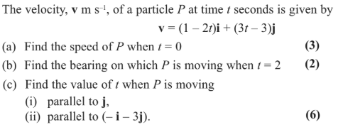
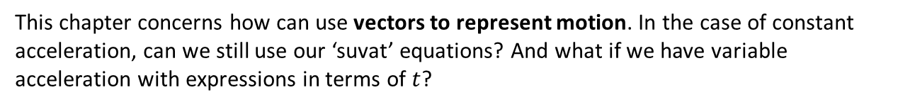
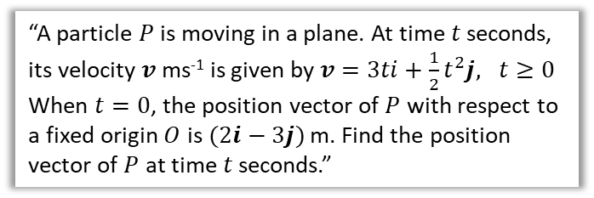
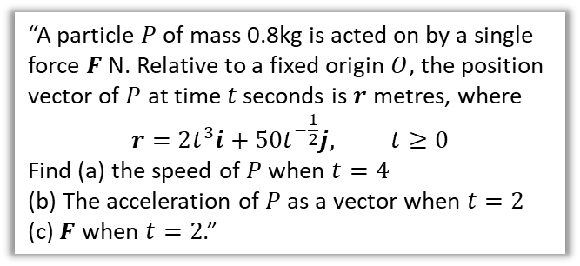
Overview
This chapter concerns how can use vectors to represent motion. In the case of constant acceleration, can we still use our ‘suvat’ equations? And what if we have variable acceleration with expressions in terms of $t$?
1:: Vector equations for motion.
2:: Variable acceleration with vectors.
“A particle $P$ of mass 0.8kg is acted on by a single force $F$ N. Relative to a fixed origin $O$, the position vector of $P$ at time $t$ seconds is $r$ metres, where
$$r=2t^{3}i+50t^{−\frac{1}{2}}j, t≥0$$
Find (a) the speed of $P$ when $t=4$
(b) The acceleration of $P$ as a vector when $t=2$
(c) $F$ when $t=2$.”
3:: Integration with vectors to find velocity/displacement
“A particle $P$ is moving in a plane. At time $t$ seconds, its velocity $v$ ms⁻¹ is given by $v=3ti+\frac{1}{2}t^{2}j, t≥0$
When $t=0$, the position vector of $P$ with respect to a fixed origin $O$ is $(2i−3j)$ m. Find the position vector of $P$ at time $t$ seconds.”
Note for teachers: The first item was in the old M1 with projectile motion in M2. Variable acceleration was in M2.

Slide 4



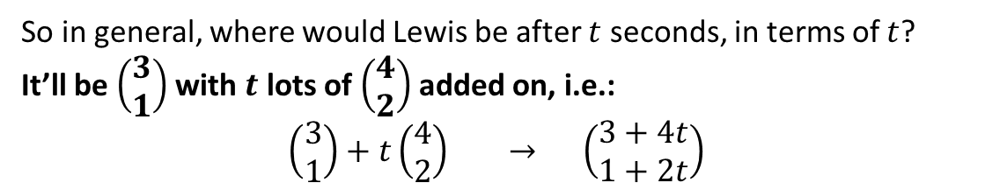


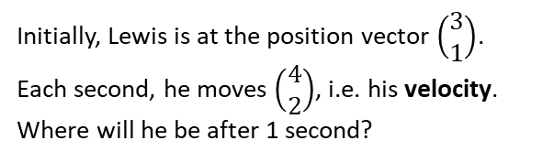
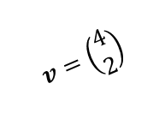




Vector motion
Initially, Lewis is at the position vector $\left(\begin{matrix}3 \\ 1\end{matrix}\right)$. Each second, he moves $\left(\begin{matrix}4 \\ 2\end{matrix}\right)$, i.e. his velocity.
Where will he be after 1 second?
$$t=2$$
$$t=1$$
$$\left(\begin{matrix}11 \\ 5\end{matrix}\right)$$
$$t=0$$
$$v=\left(\begin{matrix}4 \\ 2\end{matrix}\right)$$
$$\left(\begin{matrix}7 \\ 3\end{matrix}\right)$$
After after 2 seconds?
$$\left(\begin{matrix}3 \\ 1\end{matrix}\right)$$
So in general, where would Lewis be after $t$ seconds, in terms of $t$?
It’ll be $\left(\begin{matrix}3 \\ 1\end{matrix}\right)$ with $t$ lots of $\left(\begin{matrix}4 \\ 2\end{matrix}\right)$ added on, i.e.:
$$\left(\begin{matrix}3 \\ 1\end{matrix}\right)+t\left(\begin{matrix}4 \\ 2\end{matrix}\right) → \left(\begin{matrix}3+4t \\ 1+2t\end{matrix}\right)$$
?
! Position vector $r$ of particle:
$$r=r_{0}+vt$$
where $r_{0}$ is initial position and $v$ is velocity.
Fro Note: I don’t really remember as a formula as such though, but as ‘common sense’ using the reasoning above.
Fro Note II: Further Mathematicians who have finished Vectors in Core Pure Yr1 may see the similarities with vector equations of straight lines.

Slide 5

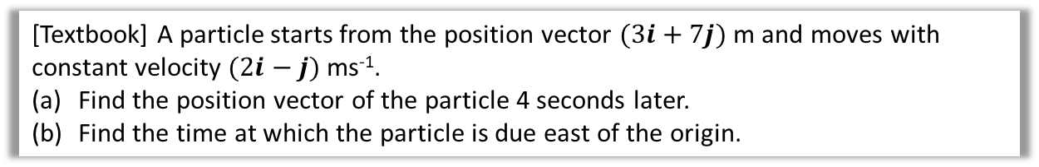

Example
[Textbook] A particle starts from the position vector $(3i+7j)$ m and moves with constant velocity $(2i−j)$ ms⁻¹.
Find the position vector of the particle 4 seconds later.
Find the time at which the particle is due east of the origin.
a
$$r=\left(\begin{matrix}3 \\ 7\end{matrix}\right)+4\left(\begin{matrix}2 \\ −1\end{matrix}\right)=\left(\begin{matrix}11 \\ 3\end{matrix}\right) \\ =\left(\begin{matrix}11 \\ 3\end{matrix}\right) m$$
If due East, then the $j$ component is 0:
$$r=\left(\begin{matrix}3 \\ 7\end{matrix}\right)+t\left(\begin{matrix}2 \\ −1\end{matrix}\right)=\left(\begin{matrix}3+2t \\ 7−t\end{matrix}\right)$$
$7−t=0 → t=7$ seconds
?
Fropinion: I prefer to avoid the $i$ and $j$ notation and write in conventional vector form. They’re easier to manipulate.
b
?

Slide 6

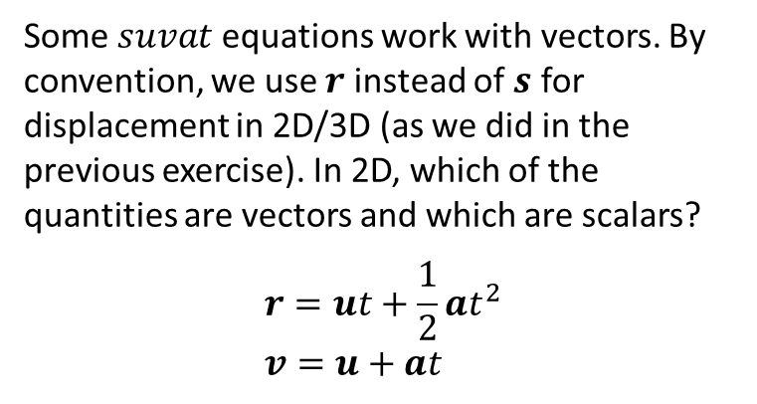
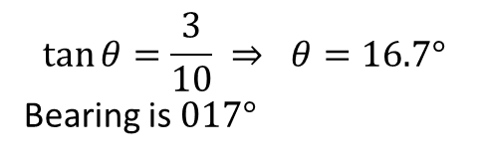
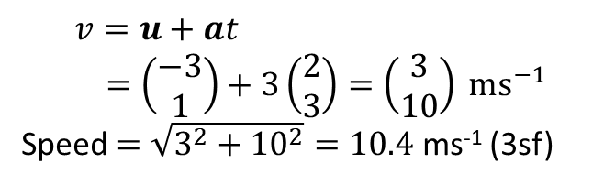
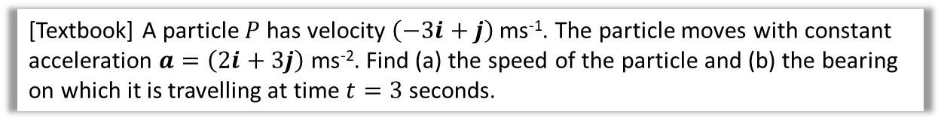

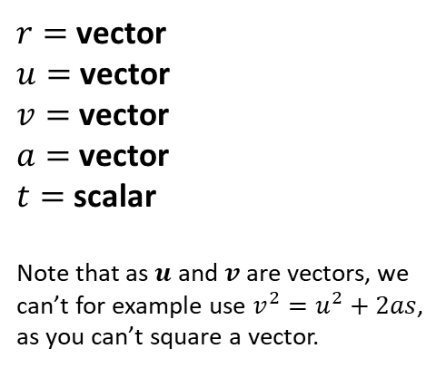

$suvat$… but with vectors!
Some $suvat$ equations work with vectors. By convention, we use $r$ instead of $s$ for displacement in 2D/3D (as we did in the previous exercise). In 2D, which of the quantities are vectors and which are scalars?
$$r=ut+\frac{1}{2}at^{2} \\ v=u+at$$
$r=$ vector
$u=$ vector
$v=$ vector
$a=$ vector
$t=$ scalar
Note that as $u$ and $v$ are vectors, we can’t for example use $v^{2}=u^{2}+2as$, as you can’t square a vector.
?
?
?
?
[Textbook] A particle $P$ has velocity $\left(−3i+j\right)$ ms⁻¹. The particle moves with constant acceleration $a=\left(2i+3j\right)$ ms⁻². Find (a) the speed of the particle and (b) the bearing on which it is travelling at time $t=3$ seconds.
a
?
b
$$3$$
?
$$\tan{θ}=\frac{3}{10} ⇒ θ=16.7°$$
Bearing is $017°$
$$v=u+at \\ =\left(\begin{matrix}−3 \\ 1\end{matrix}\right)+3\left(\begin{matrix}2 \\ 3\end{matrix}\right)=\left(\begin{matrix}3 \\ 10\end{matrix}\right) ms^{−1}$$
Speed $=\sqrt{3^{2}+{10}^{2}}=10.4$ ms⁻¹ (3sf)
$$10$$
$$θ$$
The velocity vector gives the direction of motion. Just draw it out to establish angles.
Remember that speed is the scalar for of velocity, so find magnitude of the vector.

Slide 7

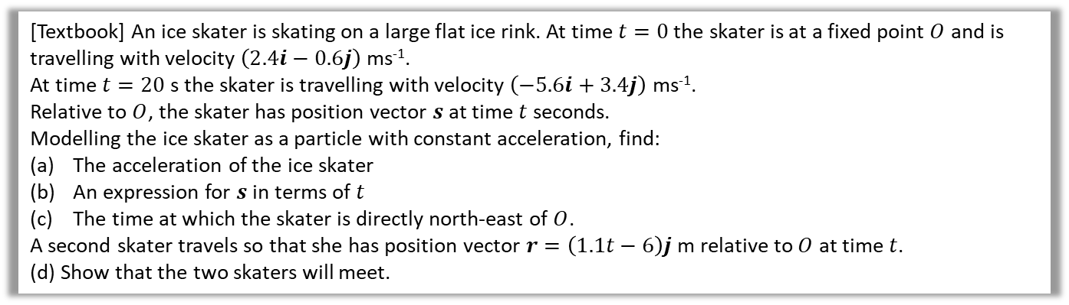


Further Example
[Textbook] An ice skater is skating on a large flat ice rink. At time $t=0$ the skater is at a fixed point $O$ and is travelling with velocity $\left(2.4i−0.6j\right)$ ms⁻¹.
At time $t=20$ s the skater is travelling with velocity $\left(−5.6i+3.4j\right)$ ms⁻¹.
Relative to $O$, the skater has position vector $s$ at time $t$ seconds.
Modelling the ice skater as a particle with constant acceleration, find:
The acceleration of the ice skater
An expression for $s$ in terms of $t$
The time at which the skater is directly north-east of $O$.
A second skater travels so that she has position vector $r=\left(1.1t−6\right)j$ m relative to $O$ at time $t$.
(d) Show that the two skaters will meet.
When north-east of $O$, the $i$ component will be the same as the $j$ component.
$$2.4t−0.2t^{2}=−0.6t+0.1t^{2} \\ 3t\left(1−0.1t\right)=0 \\ t=0 or t=10$$
When they meet, two position vectors will be the same:
$$\left(\begin{matrix}2.4t−0.2t^{2} \\ −0.6t+0.1t^{2}\end{matrix}\right)=\left(\begin{matrix}0 \\ 1.1t−6\end{matrix}\right)$$
$$2.4t−0.2t^{2}=0 → 2t\left(12−t\right)=0 \\ t=0 or t=12$$
When $t=0$, $−0.6\left(0\right)+0.1\left(0^{2}\right)=0$
But $1.1\left(0\right)−6=−6$ so do not meet when $t=0$
When $t=12$, $−0.6\left(12\right)+0.1\left({12}^{2}\right)=7.2$ and $1.1\left(12\right)−6=7.2$ so skaters meet when $t=12$ seconds.
c
$$s$$
a
Using $v=u+at$,
$$\left(\begin{matrix}−5.6 \\ 3.4\end{matrix}\right)=\left(\begin{matrix}2.4 \\ −0.6\end{matrix}\right)+20a \\ 20a=\left(\begin{matrix}−8 \\ 4\end{matrix}\right) \\ a=\left(\begin{matrix}−0.4 \\ 0.2\end{matrix}\right) ms^{−2}$$
Using $s=ut+\frac{1}{2}at^{2}$,
$$s=\left(\begin{matrix}2.4 \\ −0.6\end{matrix}\right)t+\frac{1}{2}\left(\begin{matrix}−0.4 \\ 0.2\end{matrix}\right)t^{2} \\ =\left(\begin{matrix}2.4t−0.2t^{2} \\ −0.6t+0.1t^{2}\end{matrix}\right) m$$
?
?
d
?
b
?

Slide 8
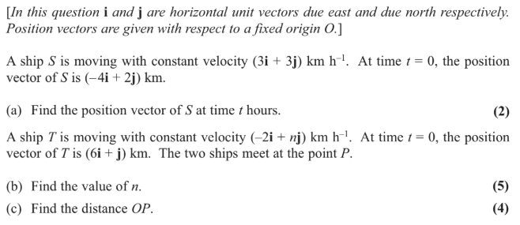
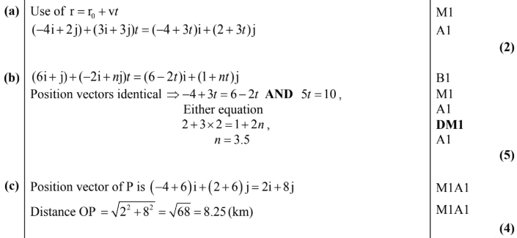
Test Your Understanding
Edexcel M1(Old) May 2013(R) Q6
?
?
?

Slide 9
Exercise 8A
Pearson Stats/Mechanics Year 2
Pages 162-164

Slide 10



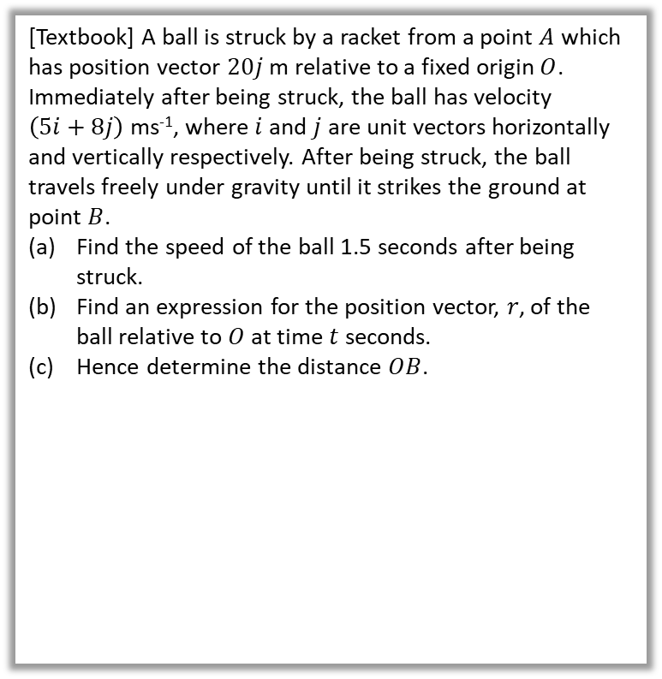



Vector methods for projectiles
Previously we considered the initial speed of the projectile and the angle of projection. But we could also use a velocity vector to represent the initial projection (vectors have both direction and magnitude) and subsequent motion.
[Textbook] A ball is struck by a racket from a point $A$ which has position vector $20j$ m relative to a fixed origin $O$. Immediately after being struck, the ball has velocity $\left(5i+8j\right)$ ms⁻¹, where $i$ and $j$ are unit vectors horizontally and vertically respectively. After being struck, the ball travels freely under gravity until it strikes the ground at point $B$.
Find the speed of the ball 1.5 seconds after being struck.
Find an expression for the position vector, $r$, of the ball relative to $O$ at time $t$ seconds.
Hence determine the distance $OB$.
a
$$v=u+at \\ =\left(\begin{matrix}5 \\ 8\end{matrix}\right)+\left(\begin{matrix}0 \\ −9.8\end{matrix}\right)t=\left(\begin{matrix}5 \\ 8−9.8t\end{matrix}\right)$$
When $t=1.5, v=\left(\begin{matrix}5 \\ −6.7\end{matrix}\right)$
Speed $=\left|v\right|=\sqrt{5^{2}+{6.7}^{2}}=8.4$ms⁻¹
Displacement relative to $A$:
$$r_{A}=ut+\frac{1}{2}at^{2} \\ =\left(\begin{matrix}5 \\ 8\end{matrix}\right)t+\frac{1}{2}\left(\begin{matrix}0 \\ −9.8\end{matrix}\right)t^{2}=\left(\begin{matrix}5t \\ 8t−4.9t^{2}\end{matrix}\right)$$
So position relative to $O$:
$$r_{O}=\left(\begin{matrix}0 \\ 20\end{matrix}\right)+\left(\begin{matrix}5t \\ 8t−4.9t^{2}\end{matrix}\right) \\ =\left(\begin{matrix}5t \\ 8t−4.9t^{2}+20 \end{matrix}\right)$$
When $j$-component is 0:
$$8t−4.9t^{2}+20=0 → t=2.995…$$
$i$-component: $5t=15$ m (2sf)
?
b
?
$$\left(5i+8j\right) ms^{−1}$$
$$A$$
$$20m$$
c
?
$$O$$
$$B$$

Slide 11
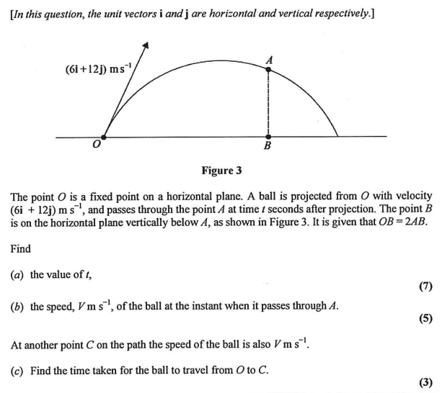
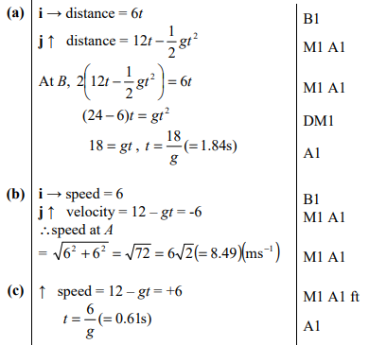
Test Your Understanding
Edexcel M2(Old) Jan 2012 Q7
?
?
?

Slide 12
Exercise 8B
Pearson Stats/Mechanics Year 2
Pages 166-167

Slide 13





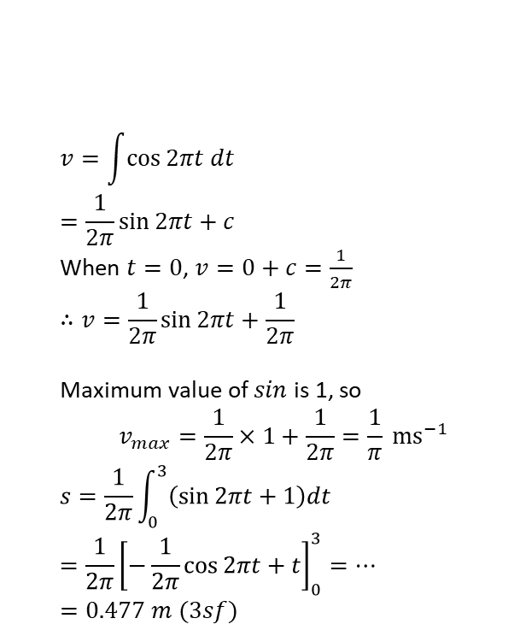

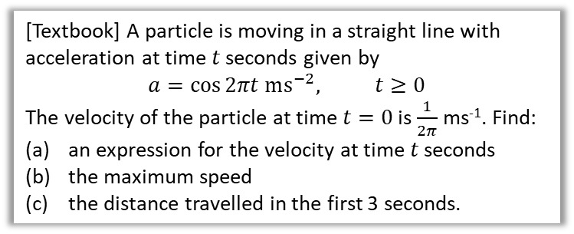

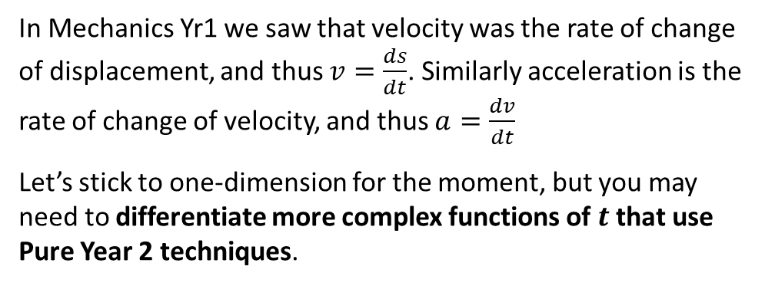
Variable Acceleration in One Dimension
In Mechanics Yr1 we saw that velocity was the rate of change of displacement, and thus $v=\frac{ds}{dt}$. Similarly acceleration is the rate of change of velocity, and thus $a=\frac{dv}{dt}$
Let’s stick to one-dimension for the moment, but you may need to differentiate more complex functions of $t$ that use Pure Year 2 techniques.
$$s$$
$$∫v dt$$
$$\frac{d}{dt}$$
$$v$$
$$∫a dt$$
$$\frac{d}{dt}$$
$$a$$
a
$$v=\int{\cos{2πt dt}} \\ =\frac{1}{2π}\sin{2πt}+c$$
When $t=0$, $v=0+c=\frac{1}{2π}$
$$∴v=\frac{1}{2π}\sin{2πt}+\frac{1}{2π}$$
Maximum value of $sin$ is 1, so
$$v_{max}=\frac{1}{2π}×1+\frac{1}{2π}=\frac{1}{π} ms^{−1}$$
$$s=\frac{1}{2π}\int_{0}^{3}{\left(\sin{2πt}+1\right)dt} \\ =\frac{1}{2π}{\left[−\frac{1}{2π}\cos{2πt}+t\right]}_{0}^{3}=…=0.477 m (3sf)$$
?
[Textbook] A particle is moving in a straight line with acceleration at time $t$ seconds given by
$$a=\cos{2πt ms^{−2}, t≥0}$$
The velocity of the particle at time $t=0$ is $\frac{1}{2π}$ ms⁻¹. Find:
an expression for the velocity at time $t$ seconds
the maximum speed
the distance travelled in the first 3 seconds.
Remember with ‘reverse chain rule’, we divide by constant in front of variable.
b
?
Finding area under velocity-time graph.
c
?
Can tidy up integral by factorising out common factor.

Slide 14

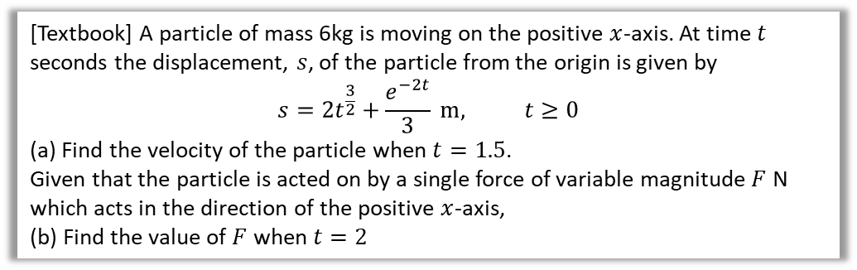
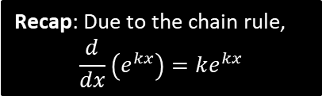
Test Your Understanding
[Textbook] A particle of mass 6kg is moving on the positive $x$-axis. At time $t$ seconds the displacement, $s$, of the particle from the origin is given by
$$s=2t^{\frac{3}{2}}+\frac{e^{−2t}}{3} m, t≥0$$
(a) Find the velocity of the particle when $t=1.5$.
Given that the particle is acted on by a single force of variable magnitude $F$ N which acts in the direction of the positive $x$-axis,
(b) Find the value of $F$ when $t=2$
a
$v=\frac{ds}{dt}=3t^{\frac{1}{2}}−\frac{2}{3}e^{−2t} ms^{−1}$
When $t=1.5$ seconds:
$$v=3×{1.5}^{0.5}−\frac{2}{3}e^{−3}=3.64 ms^{−1}$$
$$a=\frac{dv}{dt}=1.5t^{−0.5}+\frac{4}{3}e^{−4}=1.0850…ms^{−2} \\ F=ma=6×1.0850…=6.51 N$$
Recap: Due to the chain rule,
$$\frac{d}{dx}\left(e^{kx}\right)=ke^{kx}$$
?
b
?

Slide 15
Exercise 8C
Pearson Stats/Mechanics Year 2
Pages 168-170

Slide 16
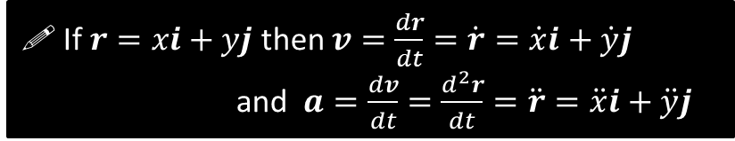


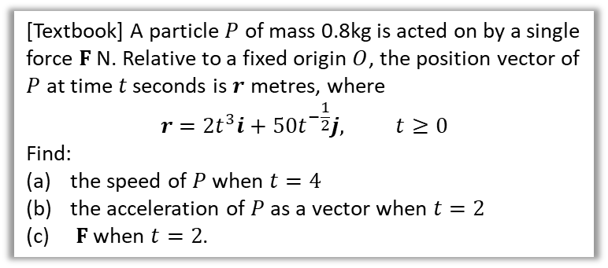
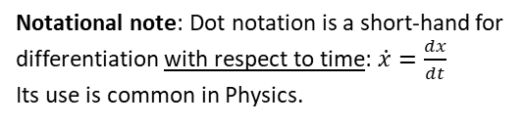
Differentiating Vectors
Suppose that $v=\left(\begin{matrix}t^{2} \\ \sin{t}\end{matrix}\right)$. What would be the acceleration?
We can simply differentiate the $i$ and $j$ components independently:
$$a=\frac{dv}{dt}=\left(\begin{matrix}2t \\ \cos{t}\end{matrix}\right)$$
?
! If $r=xi+yj$ then $v=\frac{dr}{dt}=\dot{r}=\dot{x}i+\dot{y}j$
and $a=\frac{dv}{dt}=\frac{d^{2}r}{dt}=\ddot{r}=\ddot{x}i+\ddot{y}j$
Notational note: Dot notation is a short-hand for differentiation with respect to time: $\dot{x}=\frac{dx}{dt}$
Its use is common in Physics.
$v=\dot{r}=\left(\begin{matrix}6t^{2} \\ −25t^{−\frac{3}{2}}\end{matrix}\right) ms^{−1}$
When $t=4, v=\left(\begin{matrix}96 \\ −\frac{25}{8}\end{matrix}\right)$
Speed $=\sqrt{{96}^{2}+{\left(\frac{25}{8}\right)}^{2}}=96.1{ms}^{−1}$
$$a=\dot{v}=\left(\begin{matrix}12t \\ \frac{75}{2}t^{−\frac{3}{2}}\end{matrix}\right)ms^{−2}$$
When $t=2, a=\left(\begin{matrix}24 \\ 6.6291…\end{matrix}\right) ms^{−2}$
$$F=ma=0.8\left(\begin{matrix}24 \\ 6.6291…\end{matrix}\right)=\left(\begin{matrix}19.2 \\ 5.30\end{matrix}\right) N$$
[Textbook] A particle $P$ of mass 0.8kg is acted on by a single force $F$ N. Relative to a fixed origin $O$, the position vector of $P$ at time $t$ seconds is $r$ metres, where
$$r=2t^{3}i+50t^{−\frac{1}{2}}j, t≥0$$
Find:
the speed of $P$ when $t=4$
the acceleration of $P$ as a vector when $t=2$
$F$ when $t=2$.
a
?
b
?
c
?

Slide 17
Exercise 8D
Pearson Stats/Mechanics Year 2
Pages 171-173

Slide 18
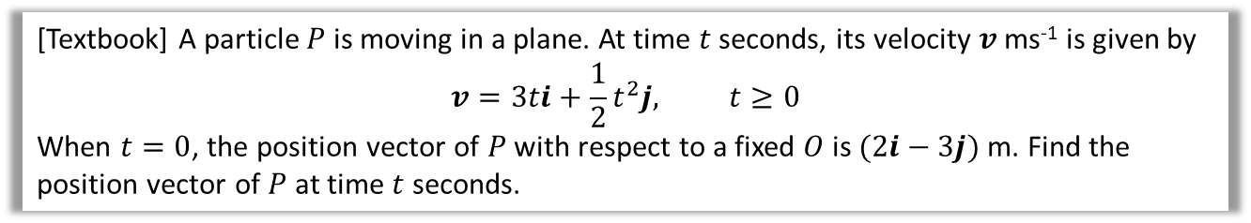

Integrating Vectors
We can similarly integrate the $i$ and $j$ components to get from acceleration to velocity and velocity to displacement.
[Textbook] A particle $P$ is moving in a plane. At time $t$ seconds, its velocity $v$ ms⁻¹ is given by
$$v=3ti+\frac{1}{2}t^{2}j, t≥0$$
When $t=0$, the position vector of $P$ with respect to a fixed $O$ is $(2i−3j)$ m. Find the position vector of $P$ at time $t$ seconds.
?
$$r=\int{\left(\begin{matrix}3t \\ \frac{1}{2}t^{2}\end{matrix}\right)dt}=\left(\begin{matrix}\frac{3}{2}t^{2} \\ \frac{1}{6}t^{3}\end{matrix}\right)+c$$
When $t=0,$
$$r=\left(\begin{matrix}0 \\ 0\end{matrix}\right)+c=\left(\begin{matrix}2 \\ −3\end{matrix}\right) → c=\left(\begin{matrix}2 \\ −3\end{matrix}\right)$$
$∴r=\left(\begin{matrix}\frac{3}{2}t^{2} \\ \frac{1}{6}t^{3}\end{matrix}\right)+\left(\begin{matrix}2 \\ −3\end{matrix}\right)=$ $\left(\begin{matrix}\frac{3}{2}t^{2}+2 \\ \frac{1}{6}t^{3}−3\end{matrix}\right) m$
The constant of integration is a vector.

Slide 19



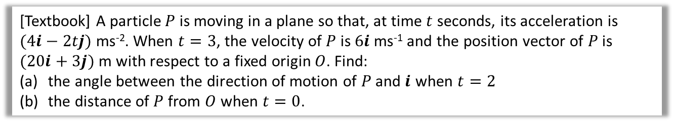


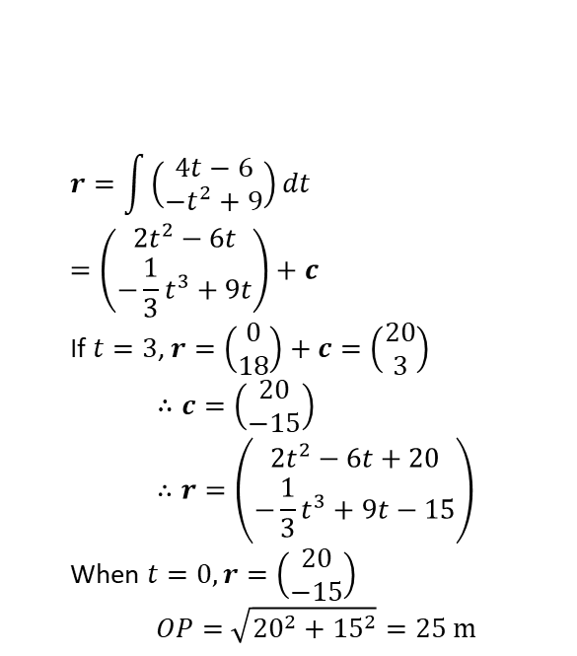


Further Example
[Textbook] A particle $P$ is moving in a plane so that, at time $t$ seconds, its acceleration is $(4i−2tj)$ ms⁻². When $t=3$, the velocity of $P$ is $6i$ ms⁻¹ and the position vector of $P$ is $(20i+3j)$ m with respect to a fixed origin $O$. Find:
the angle between the direction of motion of $P$ and $i$ when $t=2$
the distance of $P$ from $O$ when $t=0$.
a
?
b
?
The direction of motion is the velocity:
$$v=∫\left(\begin{matrix}4 \\ −2t\end{matrix}\right)dt=\left(\begin{matrix}4t \\ −t^{2}\end{matrix}\right)+c$$
When $t=3, v=\left(\begin{matrix}12 \\ −9\end{matrix}\right)+c=\left(\begin{matrix}6 \\ 0\end{matrix}\right)$
$$∴c=\left(\begin{matrix}6 \\ 0\end{matrix}\right)−\left(\begin{matrix}12 \\ −9\end{matrix}\right)=\left(\begin{matrix}−6 \\ 9\end{matrix}\right) \\ ∴v=\left(\begin{matrix}4t−6 \\ −t^{2}+9\end{matrix}\right) ms^{−1}$$
When $t=2,$ $v=\left(\begin{matrix}2 \\ 5\end{matrix}\right)$
$$r=\int{\left(\begin{matrix}4t−6 \\ −t^{2}+9\end{matrix}\right)dt} \\ =\left(\begin{matrix}2t^{2}−6t \\ −\frac{1}{3}t^{3}+9t\end{matrix}\right)+c$$
If $t=3$, $r=\left(\begin{matrix}0 \\ 18\end{matrix}\right)+c=\left(\begin{matrix}20 \\ 3\end{matrix}\right)$
$$∴c=\left(\begin{matrix}20 \\ −15\end{matrix}\right) \\ ∴r=\left(\begin{matrix}2t^{2}−6t+20 \\ −\frac{1}{3}t^{3}+9t−15\end{matrix}\right)$$
When $t=0, r=\left(\begin{matrix}20 \\ −15\end{matrix}\right)$
$$OP=\sqrt{{20}^{2}+{15}^{2}}=25 m$$
Use $t=3$ to get constant of integration.
$$θ=\tan^{−1}\left(\frac{5}{2}\right)=68.2°$$
$$5$$
$$θ$$
$$i$$
$$2$$

Slide 20
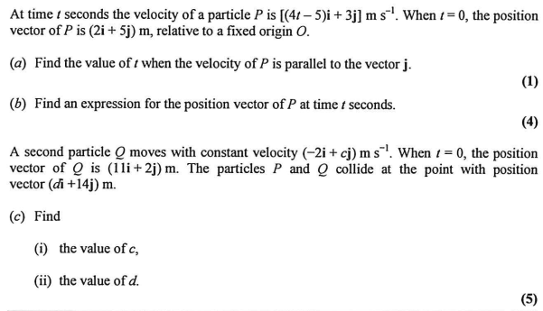
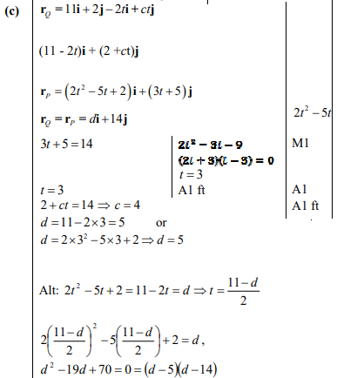
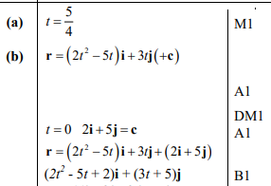
Test Your Understanding
Edexcel M2(Old) Jan 2013 Q4
?
?
?

Slide 21
Exercise 8E
Pearson Stats/Mechanics Year 2
Pages 175-176

Slide 22
You have reached the end of maths.*
* At A Level.

