Slide 1

MechYr1 Chapter 9 :: Constant Acceleration
jfrost@tiffin.kingston.sch.uk
www.drfrostmaths.com
@DrFrostMaths
Last modified: 5th August 2018

Slide 2








www.drfrostmaths.com
Everything is completely free.
Why not register?
Register now to interactively practise questions on this topic, including past paper questions and extension questions (including MAT + UKMT).
Teachers: you can create student accounts (or students can register themselves), to set work, monitor progress and even create worksheets.
With questions by:
Dashboard with points, trophies, notifications and student progress.
Questions organised by topic, difficulty and past paper.
Teaching videos with topic tests to check understanding.

Slide 3








RECAP :: Displacement-Time Graphs
Describe the motion of each object:
$$s (m)$$
$$s (m)$$
$$s (m)$$
$$t (s)$$
$$t (s)$$
$$t (s)$$
?
?
?
Object is stationary.
Object is moving with constant velocity.
Object is accelerating.
Velocity is the rate of change of displacement
(i.e. gradient of displacement-time graph)
?
Displacement from starting point
Time taken
?
Average Velocity $=$
The distinction is important. If you went out then some time later travelled back home, your average velocity is 0 because your eventual displacement is 0!
Total distance travelled
Time taken
Average Speed $=$
?

Slide 4







Example
[Textbook] A cyclist rides in a straight line for 20 minutes. She waits for half an hour, then returns in a straight line to her starting point in 15 minutes. This is a displacement-time graph for her journey.
Work out the average velocity for each stage of the journey in km h⁻¹.
Write down the average velocity for the whole journey.
Work out average speed for the whole journey.
$$d (km)$$
$$A$$
$$B$$
5
$$O$$
$$C$$
20
50
65
$$t (mins)$$
$$OA: \frac{5}{20}=0.25 km \min^{−1}=15km h^{−1} \\ AB:0 km h^{−1} \\ BC:−\frac{5}{15}=−\frac{1}{3} km \min^{−1}=20 km h^{−1}$$
0 (as displacement is 0)
Total distance: 10km. Total time: 65 mins
$$Avg speed=\frac{10}{65}=\frac{2}{13} km \min^{−1}=9.23 km h^{−1} (3sf)$$
a
?
b
?
c
?

Slide 5
Exercise 9A
Pearson Stats/Mechanics Year 1
Pages 132-133
(Classes in a rush may wish to skip this exercise)

Slide 6



RECAP :: Velocity-Time Graphs
Describe the motion of each object:
$$v (ms^{−1})$$
$$v (ms^{−1})$$
$$v (ms^{−1})$$
$$t (s)$$
$$t (s)$$
$$t (s)$$
?
Object has constant acceleration (as velocity is increasing at constant rate).
?
Object is moving with constant velocity (as change in velocity is 0).
?
Object is stationary.
Acceleration is the rate of change of velocity
(i.e. gradient of velocity-time graph)
?
?
The area under a velocity-time graph gives the distance travelled.
Fro Note: We’ll see later in Chapter 11 that when we differentiate displacement we get velocity, and therefore integrating velocity gives displacement. But we know that integrating finds the area under the graph.

Slide 7


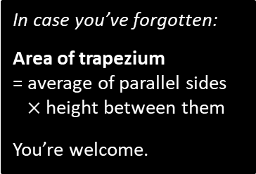

Examples
[Textbook] The figure shows a velocity-time graph illustrating the motion of a cyclist moving along a straight road for a period of 12 seconds. For the first 8 seconds, she moves at a constant speed of 6 m s⁻¹. She then decelerates at a constant rate, stopping after a further 4 seconds.
Find the displacement from the starting point of the cyclist after this 12 second period.
Work out the rate at which the cyclist decelerates.
$$v (ms^{−1})$$
6
$$t (s)$$
8
12
a
?
In case you’ve forgotten:
Area of trapezium
= average of parallel sides
$×$ height between them
You’re welcome.
Area of trapezium:
$$\frac{8+12}{2}×6=60 m$$
Using the gradient:
$$−\frac{6}{4}=−1.5 ms^{−2}$$
b
?

Slide 8




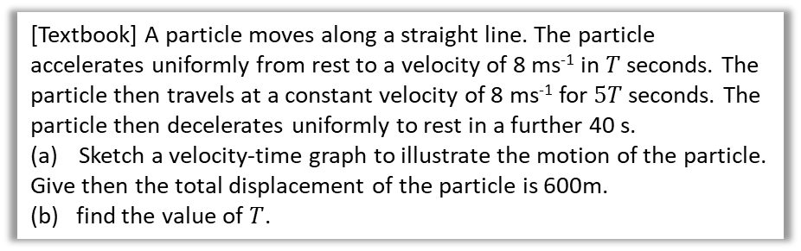






Algebraic Example
[Textbook] A particle moves along a straight line. The particle accelerates uniformly from rest to a velocity of 8 ms⁻¹ in $T$ seconds. The particle then travels at a constant velocity of 8 ms⁻¹ for $5T$ seconds. The particle then decelerates uniformly to rest in a further 40 s.
Sketch a velocity-time graph to illustrate the motion of the particle.
Give then the total displacement of the particle is 600m.
(b) find the value of $T$.
b
Using area:
$$\frac{5T+\left(6T+40\right)}{2}×8=600 \\ 44T+160=600 \\ T=10$$
a
?
?
$$v (ms^{−1})$$
$$A$$
$$B$$
8
$$O$$
$$C$$
$$t (s)$$
$$T$$
$$5T$$
$$40$$
Fro Tip: Sometimes it’s easier to indicate the period of time that has passed (using arrows) rather than the time at the end of the interval.

Slide 9
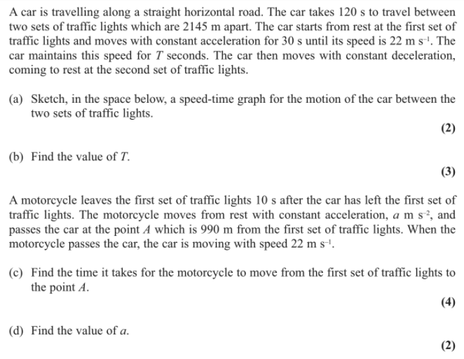
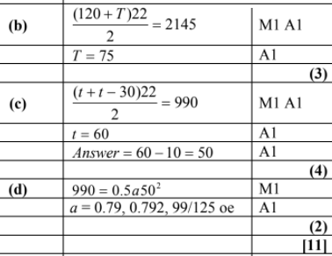
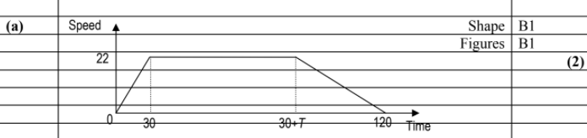
Test Your Understanding
Edexcel M1 May 2013
?
?
?
You won’t likely have the knowledge for (d) yet…
?

Slide 10
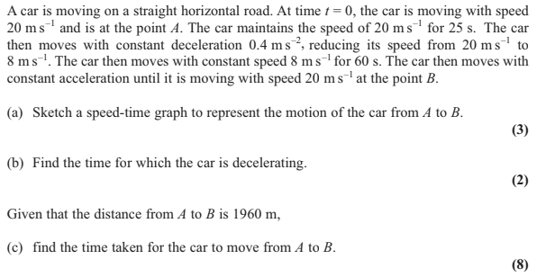
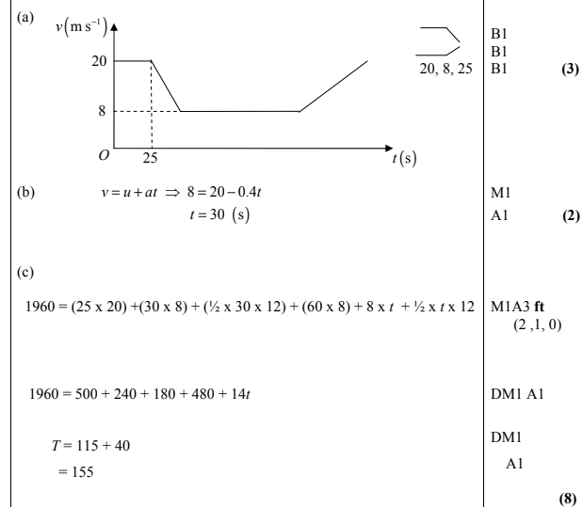
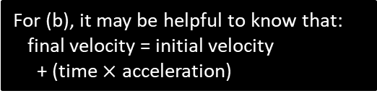
Exercise 9B
Pearson Stats/Mechanics Year 1
Pages 135-136
Edexcel M1 May 2012 Q4
?
?
?
For (b), it may be helpful to know that:
final velocity = initial velocity
+ (time $×$ acceleration)

Slide 11
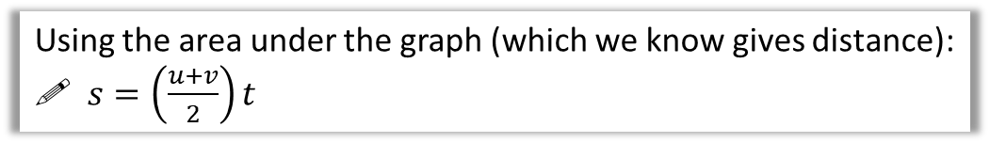

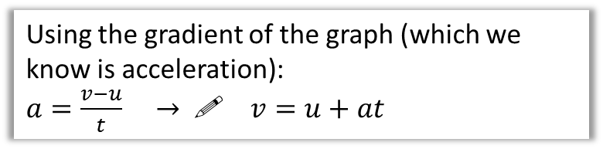
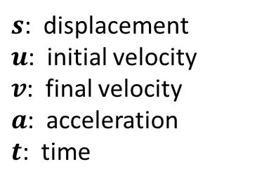
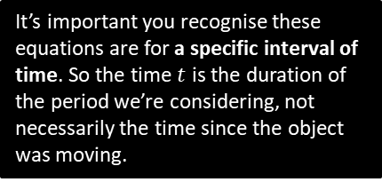


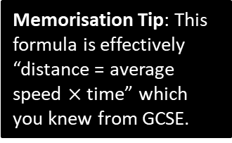
“suvat” equations (Part 1)
When there is constant acceleration, there are a variety of formulae which relate the following 5 quantities:
Velocity
It’s important you recognise these equations are for a specific interval of time. So the time $t$ is the duration of the period we’re considering, not necessarily the time since the object was moving.
$s$: displacement
$u$: initial velocity
$v$: final velocity
$a$: acceleration
$t$: time
$$v$$
$$u$$
Time
$$t$$
Each “suvat” equation we will see involves 4 of the 5 quantities. Typically in a problem we’ll know 3 of the quantities and we wish to find an unknown 4th quantitiy. We therefore select the appropriate equation.
Using the gradient of the graph (which we know is acceleration):
$a=\frac{v−u}{t} →$! $v=u+at$
You are expected to be able to prove each “suvat” question using the above graph.
?
Using the area under the graph (which we know gives distance):
! $s=\left(\frac{u+v}{2}\right)t$
Memorisation Tip: This formula is effectively “distance = average speed $×$ time” which you knew from GCSE.
?

Slide 12

Examples
[Textbook] A cyclist is travelling along a straight road. She accelerates at a constant rate from a velocity of 4 ms⁻¹ to a velocity of 7.5 ms-1 in 40 seconds. Find:
the distance she travels in these 40 seconds
her acceleration in these 40 seconds.
$$s=?, u=4, v=7.5, \\ a=?, t=40$$
$$s=\left(\frac{u+v}{2}\right)t=\left(\frac{4+7.5}{2}\right)×40 \\ =230 m$$
$$v=u+at \\ 7.5=4+40a \\ a=0.0875$$
a
?
Always write each letter of suvat, putting a “?” for any quantities you need to find.xx
b
?

Slide 13

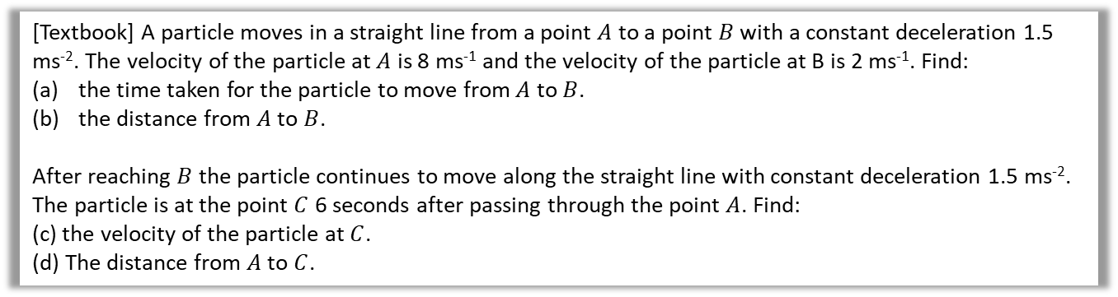

Examples
[Textbook] A particle moves in a straight line from a point $A$ to a point $B$ with a constant deceleration 1.5 ms⁻². The velocity of the particle at $A$ is 8 ms⁻¹ and the velocity of the particle at B is 2 ms⁻¹. Find:
the time taken for the particle to move from $A$ to $B$.
the distance from $A$ to $B$.
After reaching $B$ the particle continues to move along the straight line with constant deceleration 1.5 ms⁻². The particle is at the point $C$ 6 seconds after passing through the point $A$. Find:
(c) the velocity of the particle at $C$.
(d) The distance from $A$ to $C$.
a
$$s=?, u=8, v=2, a=−1.5, t=?$$
$$v=u+at \\ 2=8−1.5t$$
$t=4$ s
$s=\left(\frac{u+v}{2}\right)t=\left(\frac{8+2}{2}\right)×4=20$m
As stated before, think about what period of time we’re considering.
?
$$u=8, a=−1.5, t=6, v=?$$
$$v=u+at \\ =8+\left(−1.5\right)×6=−1$$
$∴$ velocity is 1ms⁻¹ in the direction $\vec{BA}$ (i.e. backwards)
$s=\left(\frac{u+v}{2}\right)t=\left(\frac{8−1}{2}\right)×6=21$m
c
?
b
?
d
?

Slide 14

Test Your Understanding
[Textbook] A car moves from traffic lights along a straight road with constant acceleration. The car starts from rest at the traffic lights and 30 second later the car passes a speed-trap where it is registered as travelling at 45 km h⁻¹. Find:
the acceleration of the car
the distance between the traffic lights and the speed-trap.
Tip: Ensure everything is in SI units first.
a
?
$$45×\frac{1000}{3600}=12.5 ms^{−1}$$
$$u=0, v=12.5, t=30, a=?, s=?$$
$$v=u+at \\ 12.5=0+30a → a=\frac{5}{12} ms^{−2}$$
$s=\left(\frac{u+v}{2}\right)t=\left(\frac{0+12.5}{2}\right)×30=187.5$m
b
?

Slide 15
Exercise 9C
Pearson Stats/Mechanics Year 1
Pages 140-141

Slide 16








“suvat” equations (Part 2)
The other “suvat” equations can be derived using $v=u+at$ and $s=\left(\frac{u+v}{2}\right)t$.
Eliminating $t$:
$$t=\frac{v−u}{a} \\ s=\left(\frac{u+v}{2}\right)\left(\frac{v−u}{a}\right) \\ =…$$
Eliminating $v$:
$$s=\left(\frac{u+u+at}{2}\right)t \\ =\left(\frac{2u+at}{2}\right)t$$
?
?
! $v^{2}=u^{2}+2as$
! $s=ut+\frac{1}{2}at^{2}$
Eliminating $u$:
$$u=v−at \\ s=\left(\frac{v−at+v}{2}\right)t \\ =\left(\frac{2v−at}{2}\right)t$$
?
Fro Note: Because this is quadratic in $t$, we typically end up with two different possible times.
Fro Note: I have never seen an exam question that uses this $suvat$ formula.
! $s=vt−\frac{1}{2}at^{2}$

Slide 17
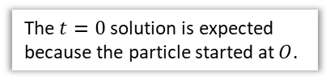
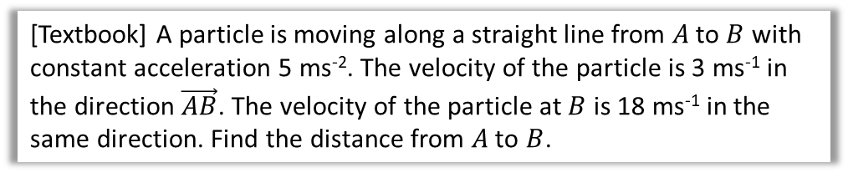

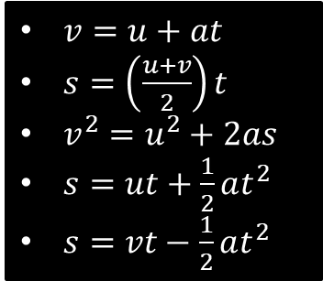

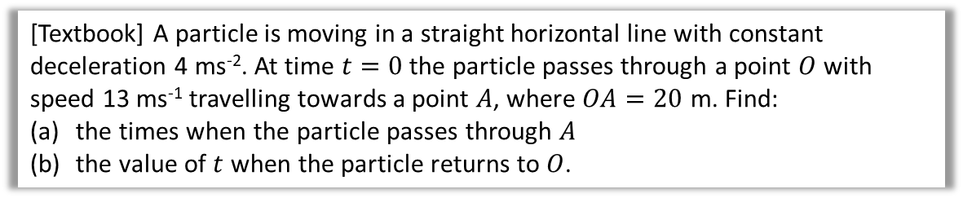
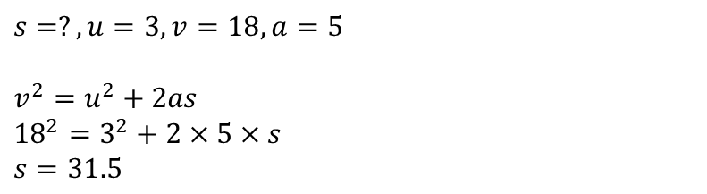
Examples
[Textbook] A particle is moving along a straight line from $A$ to $B$ with constant acceleration 5 ms⁻². The velocity of the particle is 3 ms⁻¹ in the direction $\vec{AB}$. The velocity of the particle at $B$ is 18 ms⁻¹ in the same direction. Find the distance from $A$ to $B$.
$v=u+at$
$s=\left(\frac{u+v}{2}\right)t$
$v^{2}=u^{2}+2as$
$s=ut+\frac{1}{2}at^{2}$
$s=vt−\frac{1}{2}at^{2}$
$$s=?, u=3, v=18,a=5$$
$$v^{2}=u^{2}+2as \\ {18}^{2}=3^{2}+2×5×s \\ s=31.5$$
[Textbook] A particle is moving in a straight horizontal line with constant deceleration 4 ms⁻². At time $t=0$ the particle passes through a point $O$ with speed 13 ms⁻¹ travelling towards a point $A$, where $OA=20$ m. Find:
the times when the particle passes through $A$
the value of $t$ when the particle returns to $O$.
$$s=20, u=13, a=−4,t=?$$
$$s=ut+\frac{1}{2}at^{2} \\ 20=13t−\frac{1}{2}×4t^{2} \\ 2t^{2}−13t+20=0 \\ \left(2t−5\right)\left(t−4\right)=0 \\ t=\frac{5}{2}, t=4$$
b
$$s=0, u=13, a=−4, t=? \\ s=ut+\frac{1}{2}at^{2} \\ 0=13t−2t^{2} \\ =t\left(13−2t\right) \\ t=0, or t=\frac{13}{2}$$
Particle returns after 6.5 s
a
?
?
The $t=0$ solution is expected because the particle started at $O$.

Slide 18
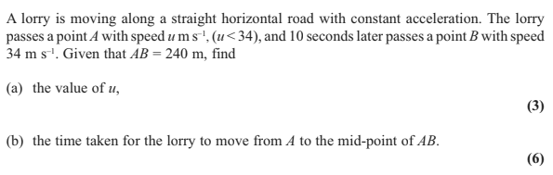
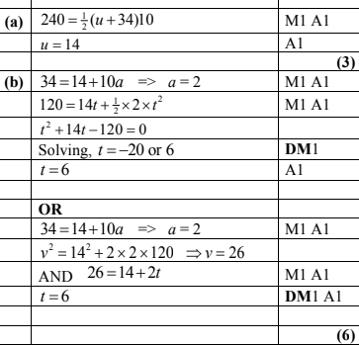
Test Your Understanding
Edexcel M1 May 2013 Q4
?
?

Slide 19
Exercise 9D
Pearson Stats/Mechanics Year 1
Pages 145-146

Slide 20
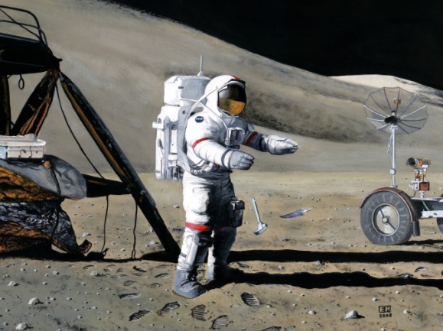
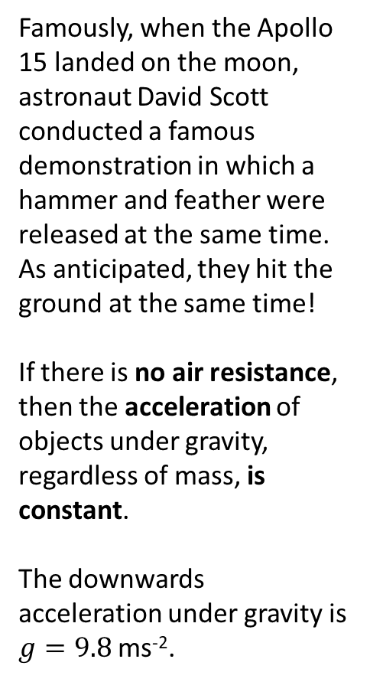
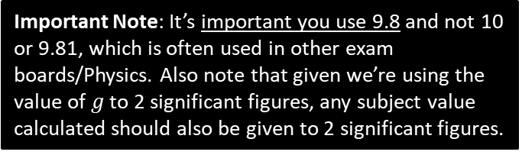
Vertical Motion Under Gravity
Famously, when the Apollo 15 landed on the moon, astronaut David Scott conducted a famous demonstration in which a hammer and feather were released at the same time. As anticipated, they hit the ground at the same time!
If there is no air resistance, then the acceleration of objects under gravity, regardless of mass, is constant.
The downwards acceleration under gravity is $g=9.8$ms⁻².
Important Note: It’s important you use 9.8 and not 10 or 9.81, which is often used in other exam boards/Physics. Also note that given we’re using the value of $g$ to 2 significant figures, any subject value calculated should also be given to 2 significant figures.

Slide 21
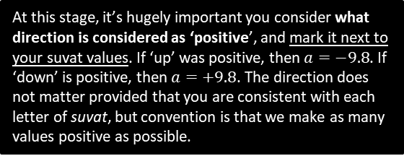
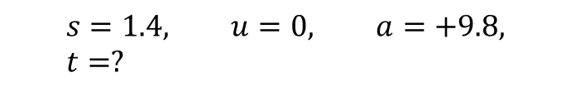
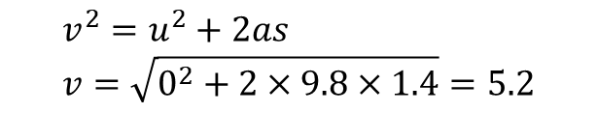
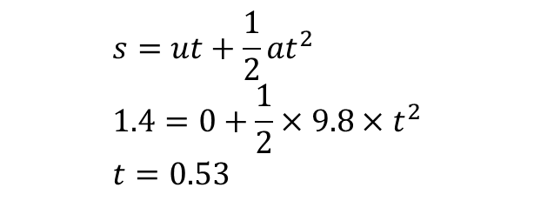
Example
[Textbook] A book falls off the top shelf of a bookcase. The shelf is 1.4 m above a wooden floor. Find:
the time the book takes to reach the floor,
the speed with which the book strikes the floor.
At this stage, it’s hugely important you consider what direction is considered as ‘positive’, and mark it next to your suvat values. If ‘up’ was positive, then $a=−9.8$. If ‘down’ is positive, then $a=+9.8$. The direction does not matter provided that you are consistent with each letter of suvat, but convention is that we make as many values positive as possible.
?
$$s=1.4, u=0, a=+9.8, t=?$$
a
?
?
?
$$s=ut+\frac{1}{2}at^{2} \\ 1.4=0+\frac{1}{2}×9.8×t^{2} \\ t=0.53$$
b
?
$$v^{2}=u^{2}+2as \\ v=\sqrt{0^{2}+2×9.8×1.4}=5.2$$
As per previous slide, quote only to 2 significant figures. You may be penalised if you quote more!

Slide 22
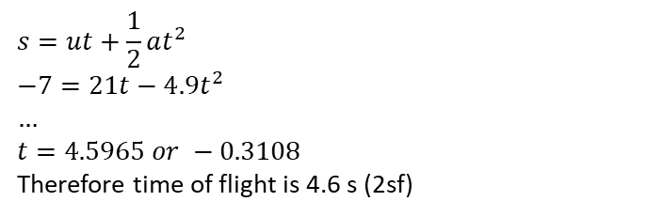
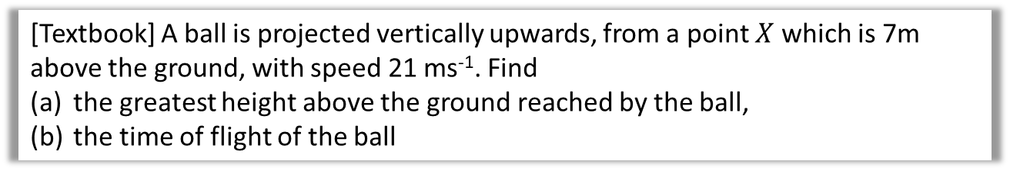


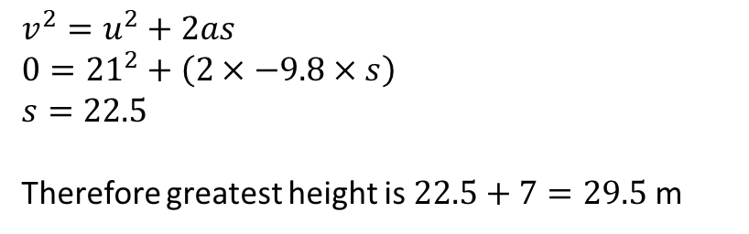
Further Example
[Textbook] A ball is projected vertically upwards, from a point $X$ which is 7m above the ground, with speed 21 ms⁻¹. Find
the greatest height above the ground reached by the ball,
the time of flight of the ball
?
?
?
$$s$$
a
?
$$s=?, u=21, v=0, a=−9.8,$$
?
$$v^{2}=u^{2}+2as \\ 0={21}^{2}+\left(2×−9.8×s\right) \\ s=22.5$$
Therefore greatest height is $22.5+7=29.5$ m
$$7$$
b
?
?
?
$$s=−7, u=21, a=−9.8, t=?$$
$$s=ut+\frac{1}{2}at^{2} \\ −7=21t−4.9t^{2} \\ … \\ t=4.5965 or −0.3108$$
Therefore time of flight is 4.6 s (2sf)
?

Slide 23
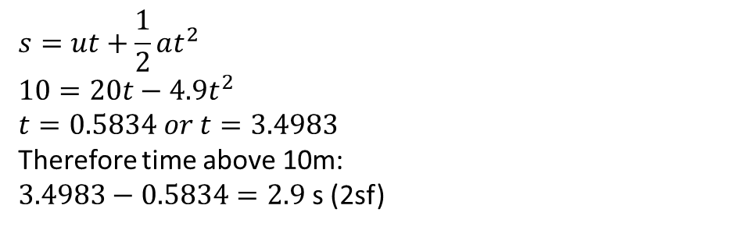
A further common type of question…
A ball is projected vertically upwards from ground level at a speed of 20 ms⁻¹.
Determine the amount of time the ball is at least 10m above ground level.
?
$$s=10, u=20, a=−9.8, t=?$$
a
?
?
?
10m
$$s=ut+\frac{1}{2}at^{2} \\ 10=20t−4.9t^{2} \\ t=0.5834 or t=3.4983$$
Therefore time above 10m:
$3.4983−0.5834=2.9$ s (2sf)
?
Froculator Tip: Be sure to use the quadratic solver on your calculator (within ‘Equation’ mode on the ClassWiz).

Slide 24
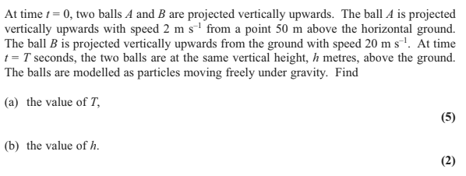
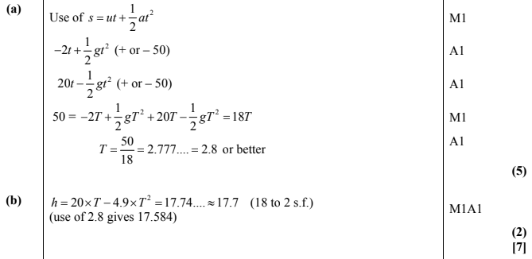
Test Your Understanding
Edexcel M1 May 2013(R) Q4
?
?

Slide 25
Exercise 9E
Pearson Stats/Mechanics Year 1
Pages 151-152

