Slide 1

MechYr1 Chapter 8 :: Introduction to Mechanics
jfrost@tiffin.kingston.sch.uk
www.drfrostmaths.com
@DrFrostMaths
Last modified: 5th August 2018

Slide 2








www.drfrostmaths.com
Everything is completely free.
Why not register?
Register now to interactively practise questions on this topic, including past paper questions and extension questions (including MAT + UKMT).
Teachers: you can create student accounts (or students can register themselves), to set work, monitor progress and even create worksheets.
With questions by:
Dashboard with points, trophies, notifications and student progress.
Questions organised by topic, difficulty and past paper.
Teaching videos with topic tests to check understanding.

Slide 3



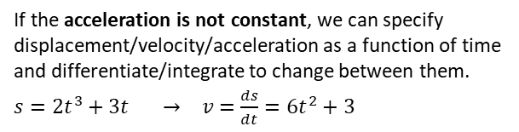




Mechanics, broadly speaking, concerns motion, forces, and how the two interrelate.
This chapter just gives you an overview of what you’ll be covering in Year 1 and how it all links together.
Forces
Motion
At GCSE you may have encountered displacement-time and velocity-time graphs:
You will later encounter force diagrams. This considers the forces acting at a particular point.
Some forces you might consider…
The gradient gives the velocity
The gradient gives the acceleration
Reaction force (that prevents object sinking into the table!)
string
displacement
velocity
Friction (which resists motion)
The bridge!
Area under graph gives distance.
Tension
$$F=ma$$
time
time
object
Newton’s 2nd Law allows us to connect the force world ($F$) with the motion world (acceleration $a$) if the object is moving.
table
Given constant acceleration we have 5 quantities of motion (“$suvat$”):
$s=$ displacement
$u=$ initial velocity
$v=$ final velocity
$a=$ acceleration
$t=$ time
The weight of the object.
which we will see are linked by various equations:
$$s=ut+\frac{1}{2}at^{2} \\ s=\left(\frac{u+v}{2}\right)t \\ v^{2}=u^{2}+2as \\ v=u+at$$
Forces can be considered as vectors.
The magnitude of the force vector gives the ‘size’ of the force.
We often consider forces in a particular direction. e.g. If the object above is stationary, the forces left must equal the force right, and forces up equal forces down (Newton’s 1st Law).
Often we need to consider the forces at multiple different points if objects are connected, e.g. with pulleys:
$$a$$
$$T$$
$$T$$
$$a$$
If the acceleration is not constant, we can specify displacement/velocity/acceleration as a function of time and differentiate/integrate to change between them.
$s=2t^{3}+3t → v=\frac{ds}{dt}=6t^{2}+3$
4kg
3kg
$$4g$$
$$3g$$

Slide 4
Modelling Assumptions
As with many areas of applied maths, we often have to make various modelling assumptions, to make the maths cleaner or to use well-known mathematical approaches.
Here are common modelling assumptions often made in Mechanics: !
Particle
Dimensions of object are negligible
Means: Mass of object concentrated at single point. Rotational forces/air resistance can be ignored.
Smooth/light pulley
No friction.
Means: Tension the same in string either side of pulley.
Pulley has no mass.
Fro Tip: Particularly make note of underlined text!
Inextensible string
String does not stretch under load.
Means: Acceleration the same in any connected objects.
Rough/Smooth surface
Means: Objects in contact with surface does/does not experience friction.
Rod
One dimension is negligible, like a pole or beam.
Means: Mass is concentrated along line. Rigid.
Peg/Support
A support from which a body can be suspended or rested.
Means: Dimensionless and fixed. Can be rough or smooth depending on question.

Slide 5

SI units
The SI units are a standard system of units, used internationally (“Système International d’unités”). These are the ones you will use:
Quantity | Unit | Symbol
Mass | kilogram | kg
Length/Displacement | metre | m
Time | Seconds | s
Speed/Velocity | metres per second | m s⁻¹
Acceleration | metres per second per second | m s⁻²
Force/Weight | newton | N (= kg m s⁻²)
This unit is consistent with force being mass $×$ acceleration

Slide 6







Vectors $↔$ Scalars
In Mechanics you will often need to convert to/from the scalar form of a quantity and the vector form.
Scalar Form | Vector Form
Distance | Displacement
Speed | Velocity
$$B$$
$$B$$
?
5m
$$\left(\begin{matrix}3 \\ 4\end{matrix}\right)m$$
?
Other quantities which can be vectors or scalars:
Force, acceleration
Quantities which can only be scalars:
Time, mass
$$A$$
$$A$$
?
! A scalar quantity has magnitude (i.e. size) only.
The 5m is a distance.
The value is always positive.
! A vector quantity also has direction.
The vector equivalent of distance is displacement.
?
Fro Note: 1-dimensional vectors are still different from scalars. Consider the displacement on a 1-dimensional line in a particular direction. If we’d gone backwards 3 units…
Positive direction
?
Distance: 3m
Displacement: -3m
Note: we don’t write the brackets around 1D vectors. So 1D vectors look like scalars, except they’re allowed to be positive or negative.
?
$$Finish$$
$$Start$$
3m

Slide 7
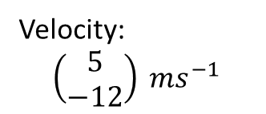
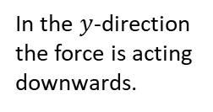


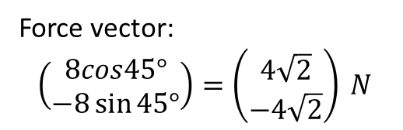
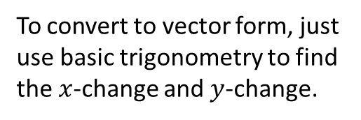





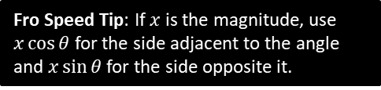
Vectors $↔$ Scalars
Scalar Form
Vector Form
$$B$$
?
To convert to vector form, just use basic trigonometry to find the $x$-change and $y$-change.
5m
$$\left(\begin{matrix}5\cos{60°} \\ 5\sin{60°}\end{matrix}\right)=\left(\begin{matrix}2.5 \\ 4.33\end{matrix}\right) m$$
Fro Speed Tip: If $x$ is the magnitude, use $x\cos{θ}$ for the side adjacent to the angle and $x\sin{θ}$ for the side opposite it.
$$60°$$
$$A$$
?
Speed:
$$\sqrt{5^{2}+{\left(−12\right)}^{2}}=13 ms^{−1}$$
Velocity:
$$\left(\begin{matrix}5 \\ −12\end{matrix}\right) ms^{−1}$$
To convert scalar form, just find the magnitude of the vector using Pythagoras.
?
$$45°$$
Force vector:
$$\left(\begin{matrix}8cos45° \\ −8\sin{45°}\end{matrix}\right)=\left(\begin{matrix}4\sqrt{2} \\ −4\sqrt{2}\end{matrix}\right) N$$
In the $y$-direction the force is acting downwards.
$$8 N$$

Slide 8
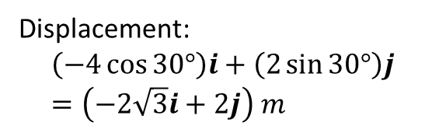
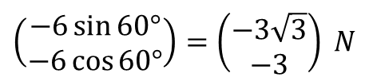




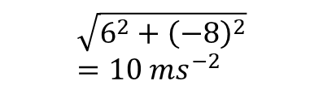

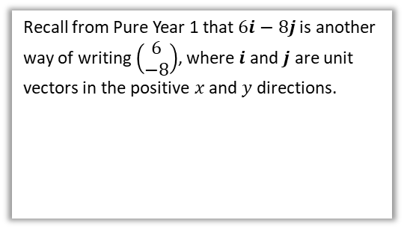
Further Examples
Scalar Form
Vector Form
?
6 N
$$\left(\begin{matrix}−6\sin{60°} \\ −6\cos{60°}\end{matrix}\right)=\left(\begin{matrix}−3\sqrt{3} \\ −3\end{matrix}\right) N$$
$$60°$$
Recall from Pure Year 1 that $6i−8j$ is another way of writing $\left(\begin{matrix}6 \\ −8\end{matrix}\right)$, where $i$ and $j$ are unit vectors in the positive $x$ and $y$ directions.
?
$$\sqrt{6^{2}+{\left(−8\right)}^{2}}=10 ms^{−2}$$
$$\left(6i−8j\right) ms^{−2}$$
$$i$$
$$j$$
?
Displacement:
$$\left(−4\cos{30°}\right)i+\left(2\sin{30°}\right)j \\ =\left(−2\sqrt{3}i+2j\right) m$$
$$30°$$
$$4 m$$

Slide 9
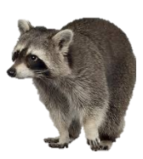





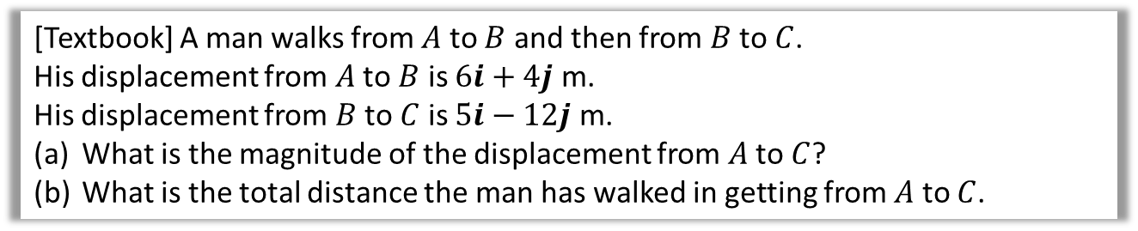



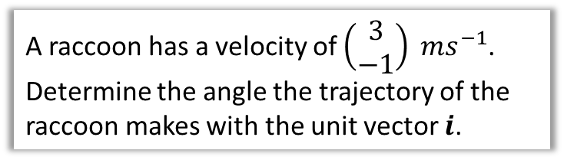
Test Your Understanding
[Textbook] A man walks from $A$ to $B$ and then from $B$ to $C$.
His displacement from $A$ to $B$ is $6i+4j$ m.
His displacement from $B$ to $C$ is $5i−12j$ m.
What is the magnitude of the displacement from $A$ to $C$?
What is the total distance the man has walked in getting from $A$ to $C$.
? Suitable Diagram
a
$$\vec{AC}=\vec{AB}+\vec{BC} \\ =11i−8j \\ \left|\vec{AC}\right|=\sqrt{{11}^{2}+8^{2}}=13.6 km$$
$$\left|\vec{AB}\right|=\sqrt{6^{2}+4^{2}}=7.21 km \\ \left|\vec{BC}\right|=\sqrt{5^{2}+{12}^{2}}=13 km$$
Total distance:
$$7.21+13=20.21 km$$
$$B$$
?
$$6i+4j$$
$$A$$
$$5i−12j$$
b
?
$$C$$
3
Raccoon
A raccoon has a velocity of $\left(\begin{matrix}3 \\ −1\end{matrix}\right) ms^{−1}$. Determine the angle the trajectory of the raccoon makes with the unit vector $i$.
?
$$θ$$
1
$$θ=\tan^{−1}\left(\frac{1}{3}\right)=18.4° \left(3sf\right)$$

Slide 10
Exercise 8D
Pearson Stats/Mechanics Year 2
Pages 127-129

