Slide 1

iBreastExam
Setup Instructions
UE/CR/01/07-01
Watch in presentation mode for best step-by-step instructions!

Slide 2
Important Links
iBreastExam Operating Guide: Download PDF
iBreastExam Quick Guide: Download PDF
iBreastExam Dashboard Guide: Download PDF and Watch Video
UE LifeSciences Service Desk: Access Service Desk
UE LifeSciences Service Desk Explainer Video: Watch Video
iBreastExam Training Request Form: Request Form Link

Slide 3
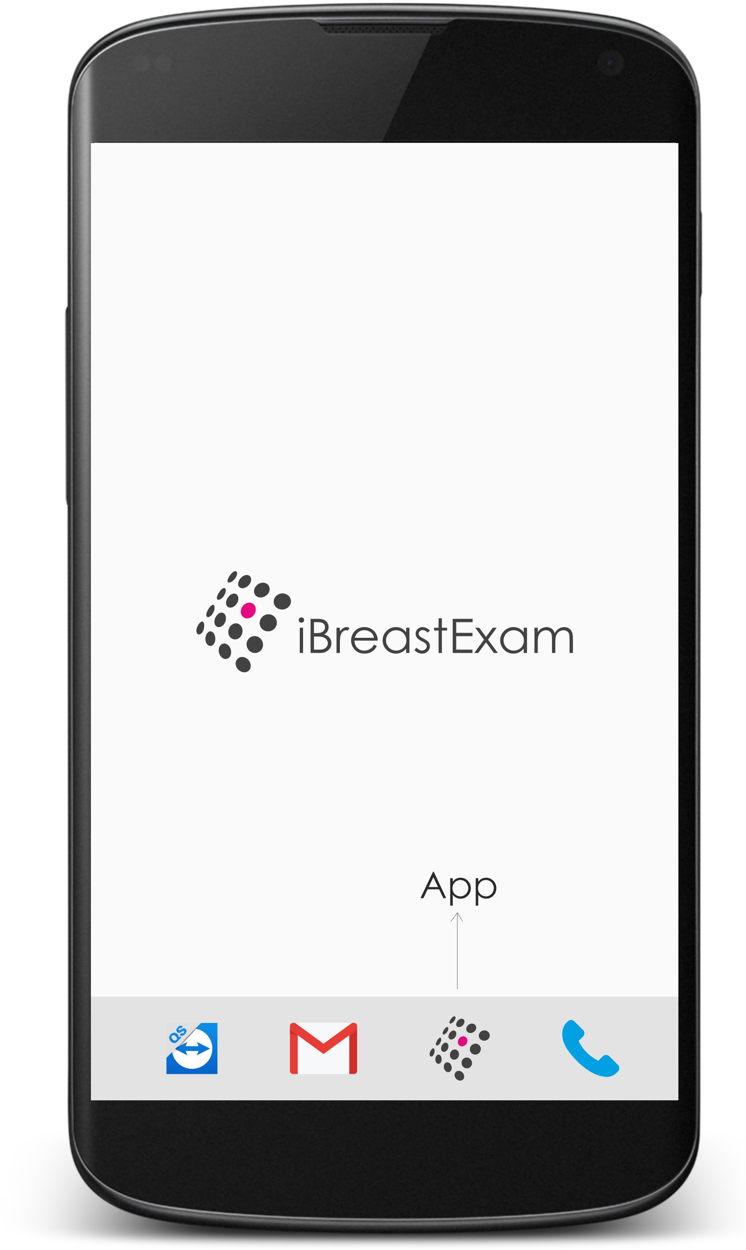
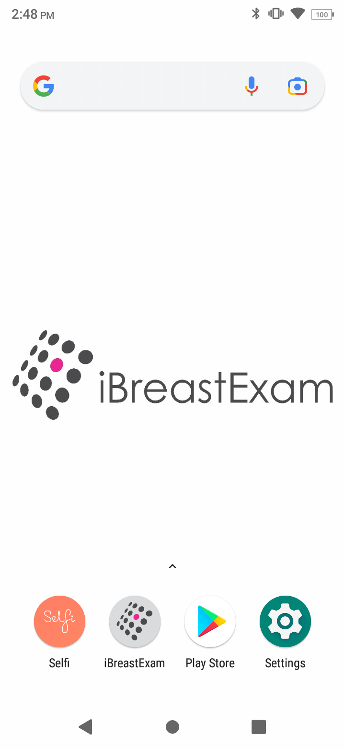
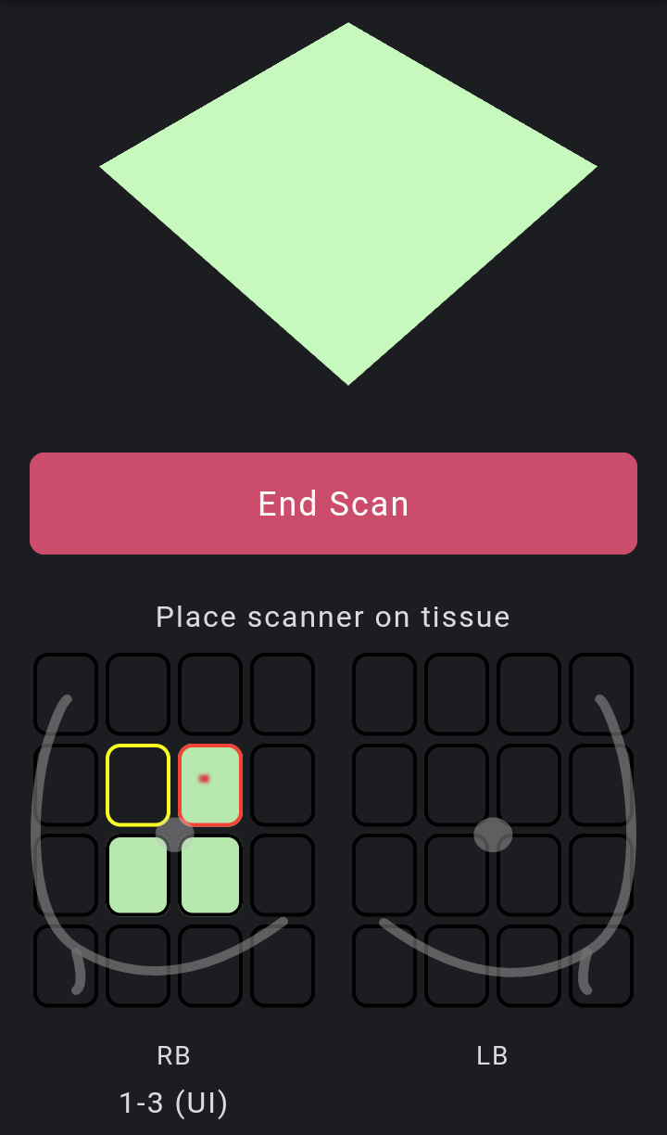
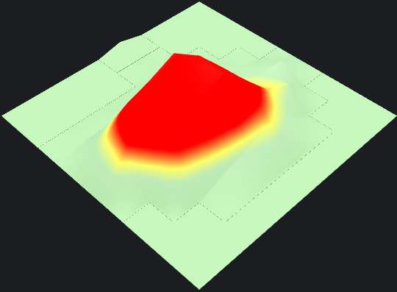
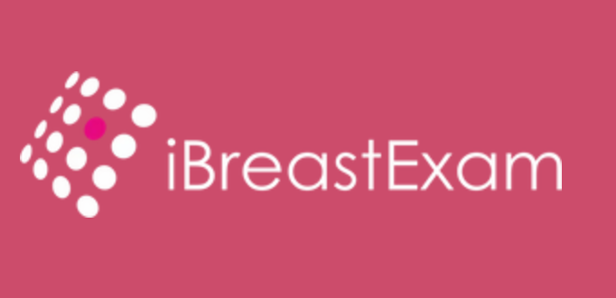
Skip if you receive phones from UE LifeSciences
Get a (compatible) Mobile Phone
iBreastExam App works on:
Phone brands*: Lenovo, Samsung, Redmi, iPhone
Android v8.0 and above
iOS v16.0 and above
Phone Specifications:
Memory: 3 GB RAM | 32 GB ROM
Display: 14.48 cm (5.5 - 5.7 inch)
Resolution: 720 x 1440 pixels
Battery: Minimum 3,000 mAh
Processor: Preferred Snap Dragon
*) Other brands may not be completely compatible.

Slide 4
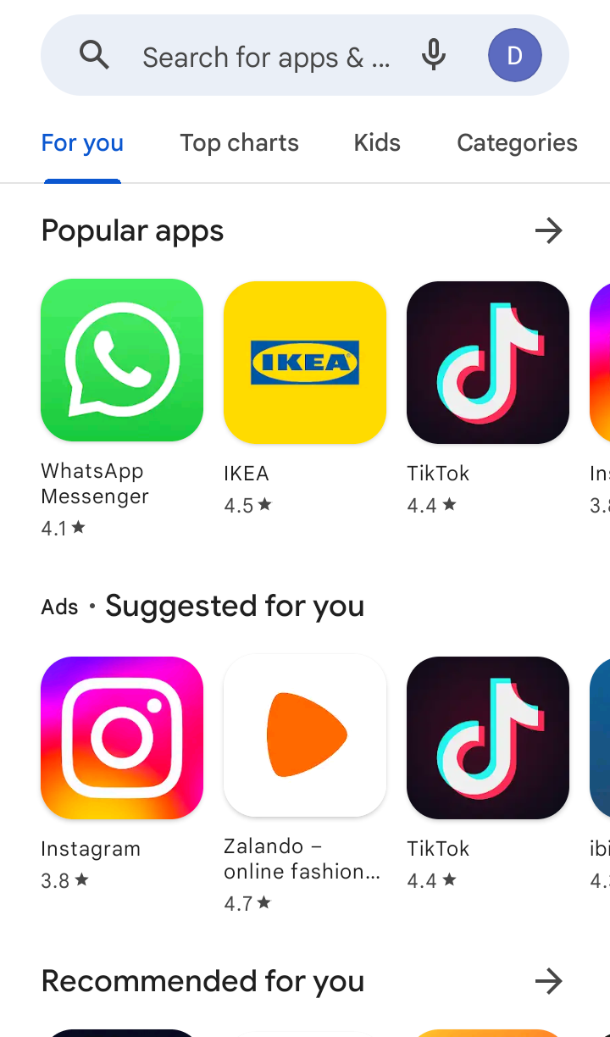
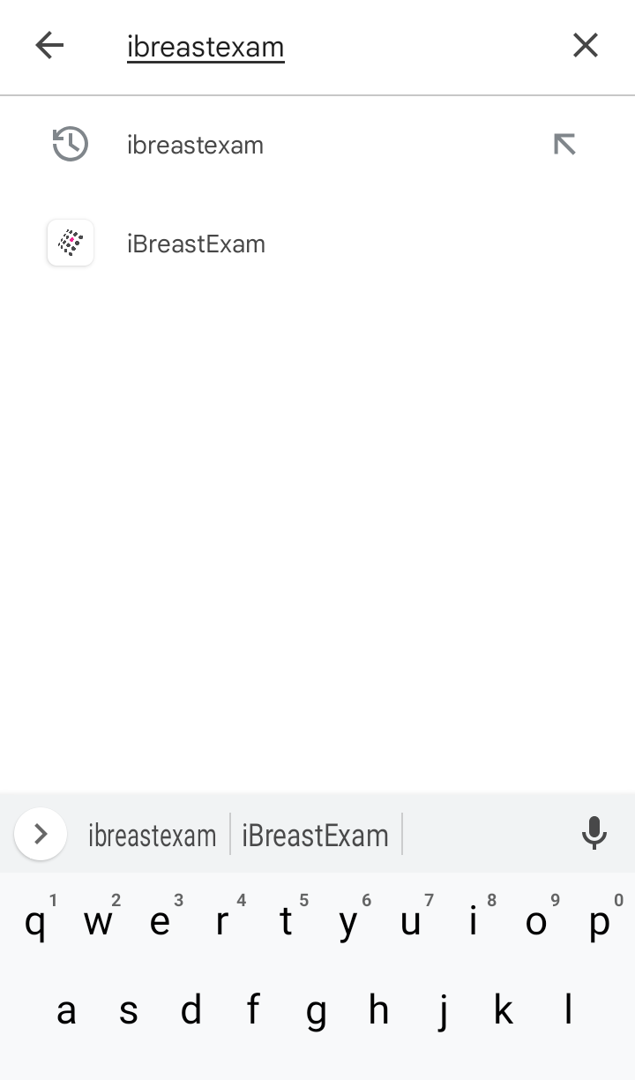
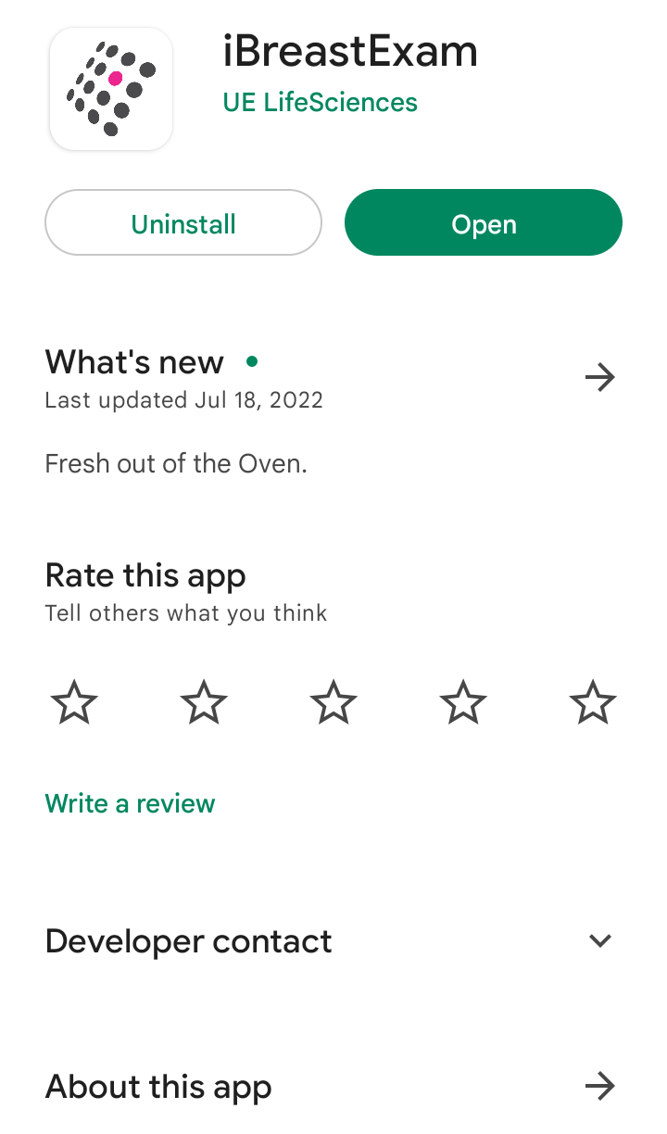


Skip if you receive phones from UE LifeSciences
Download (or Update) the App
!
✓
Important: Do NOT delete the app if you have un-synced patients or reports. These scans will be lost.

Slide 5
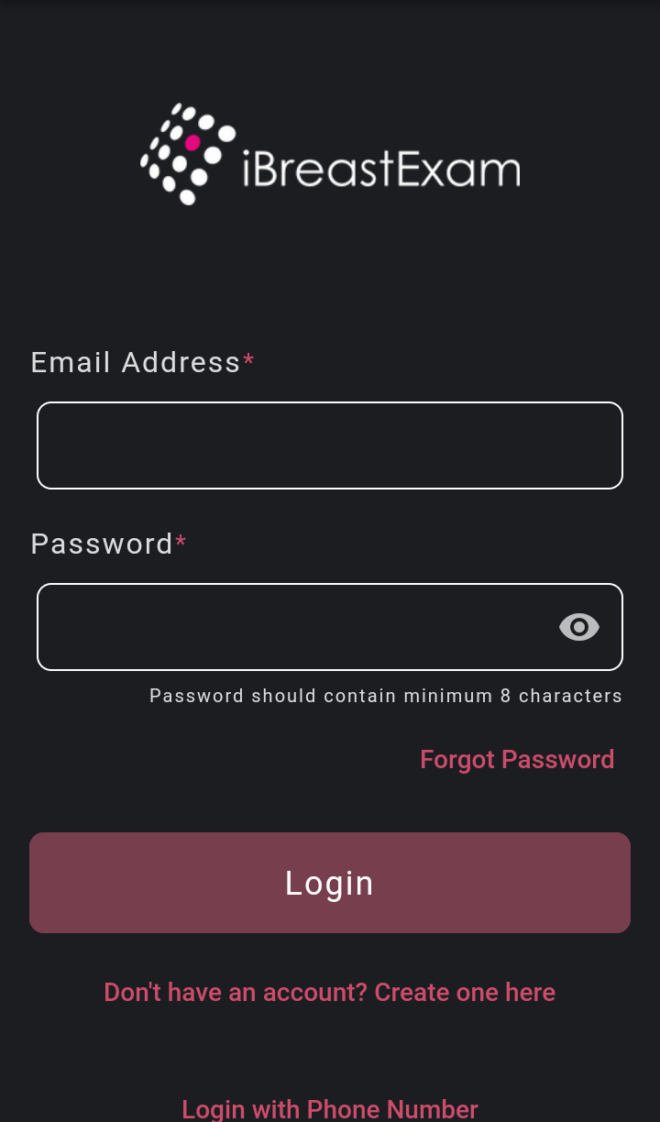
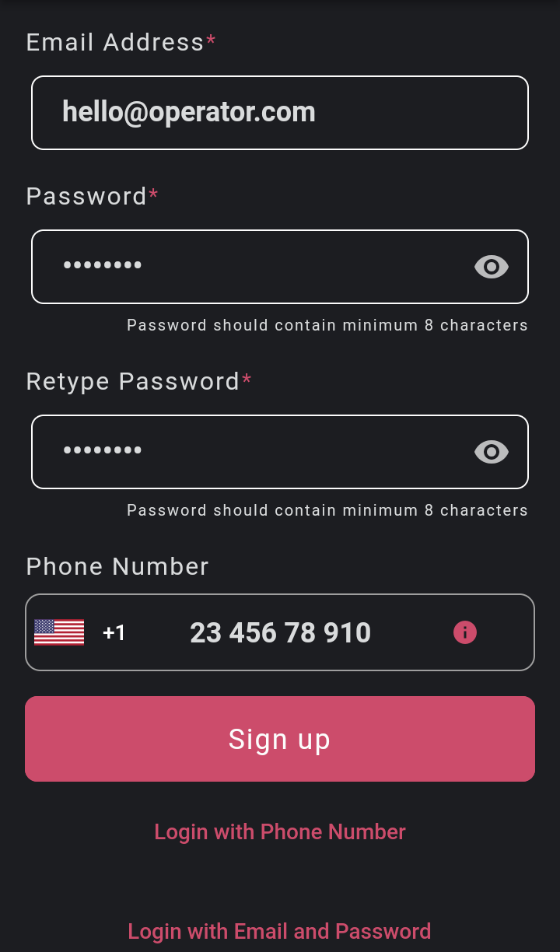
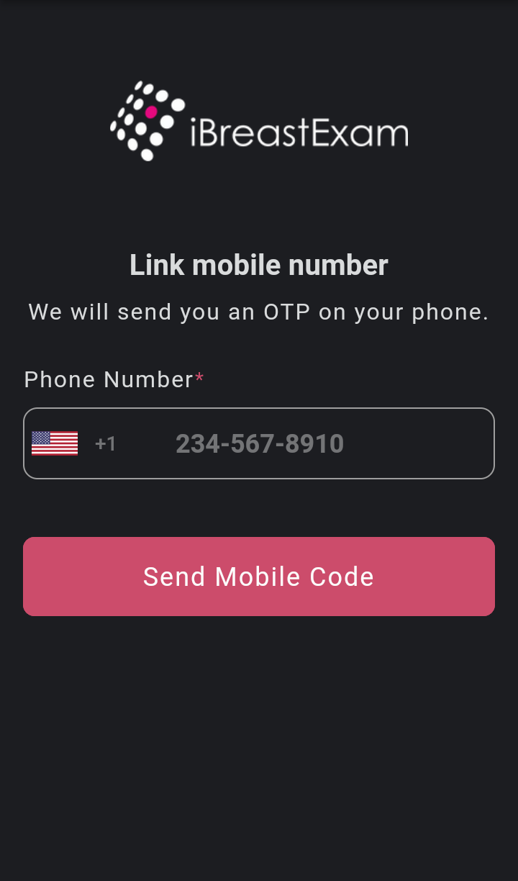
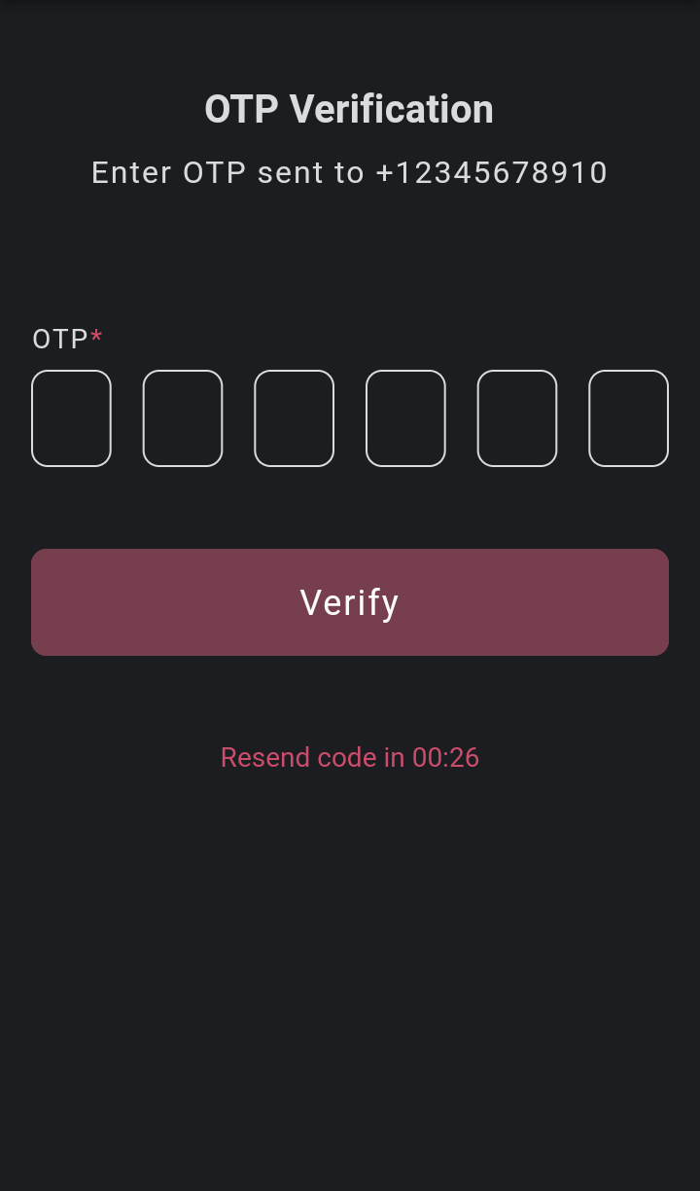
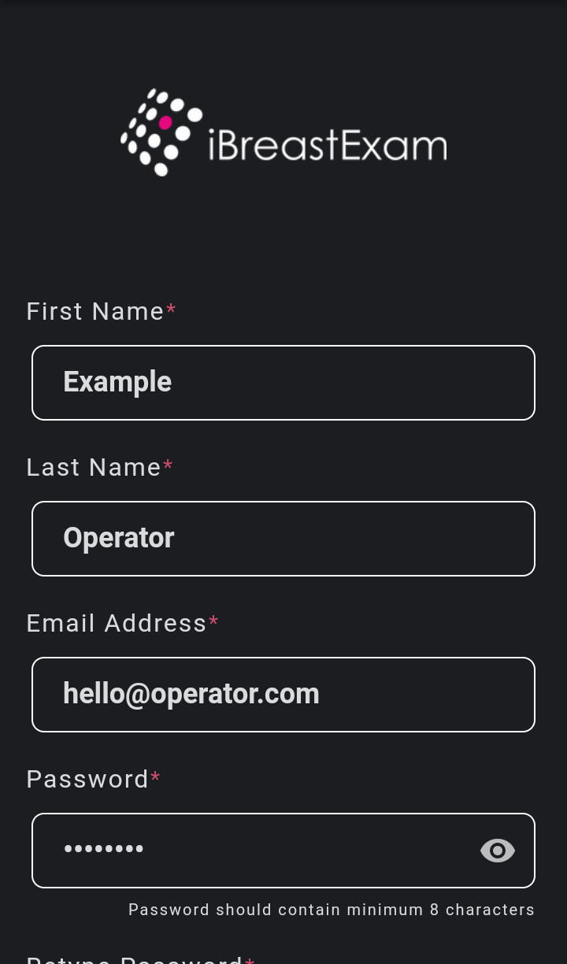
To be completed by each Technician
Create Technician Accounts I/II
Each Technician account requires a unique mobile number and/or email address.
Adding your mobile number is optional but highly recommended, as you cannot add it later.

Slide 6
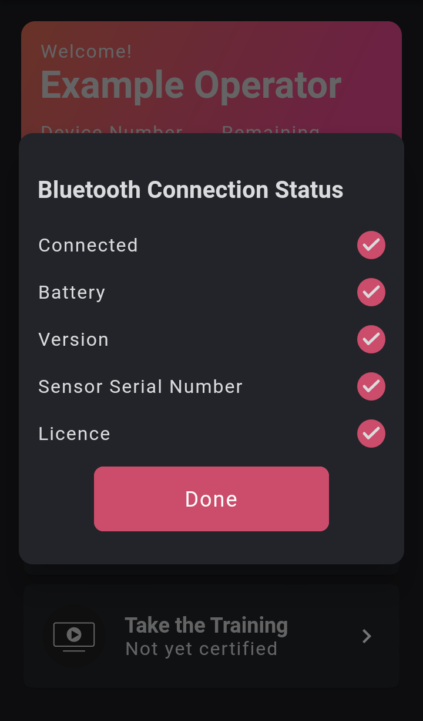
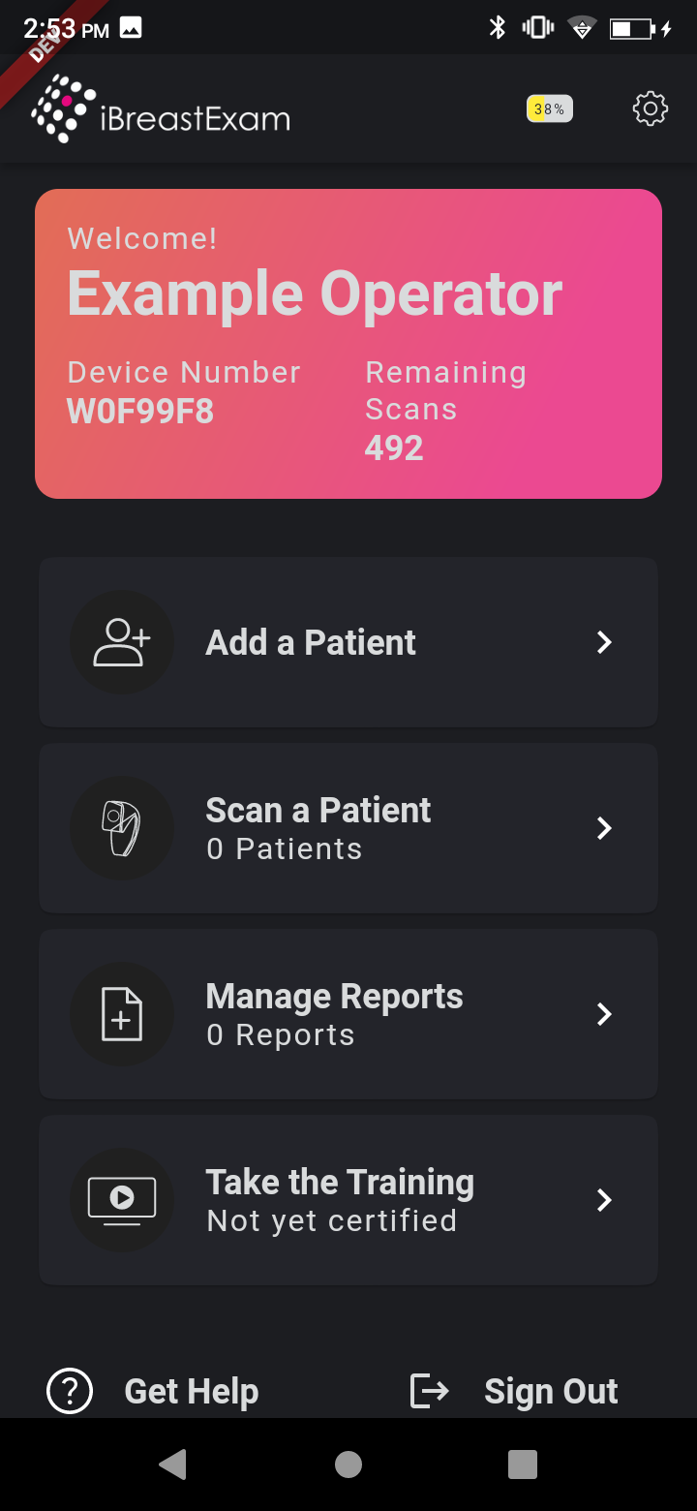
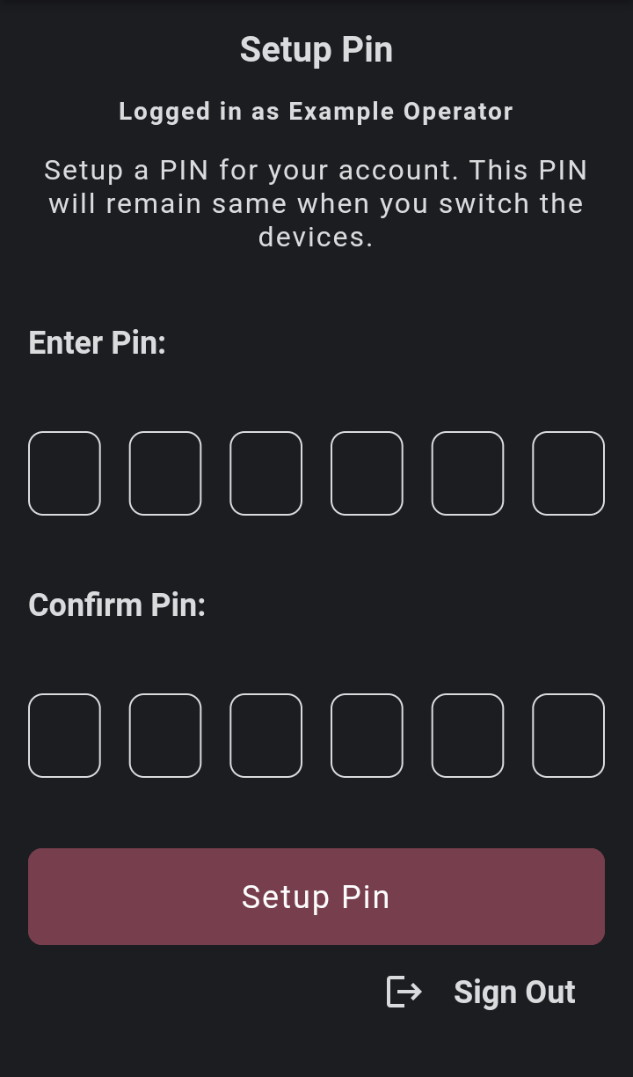
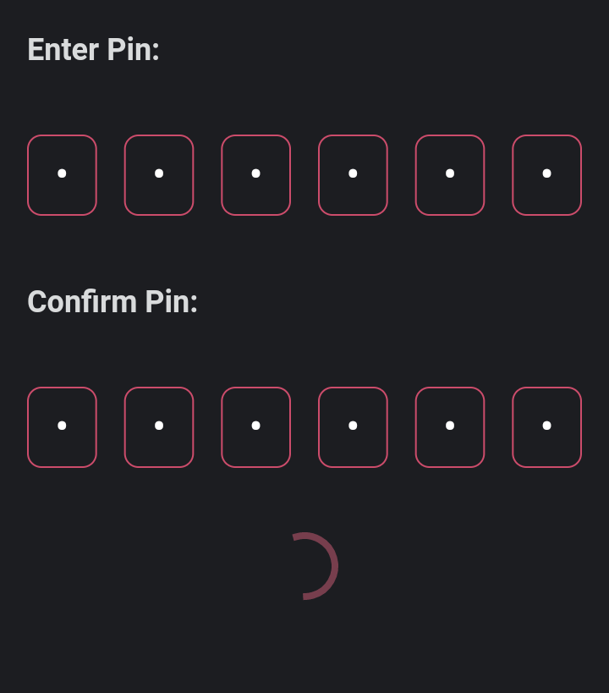
To be completed by each Technician
Create Technician Accounts II/II
500
See instructions under “Connect the Scanner to the App” below.

Slide 7
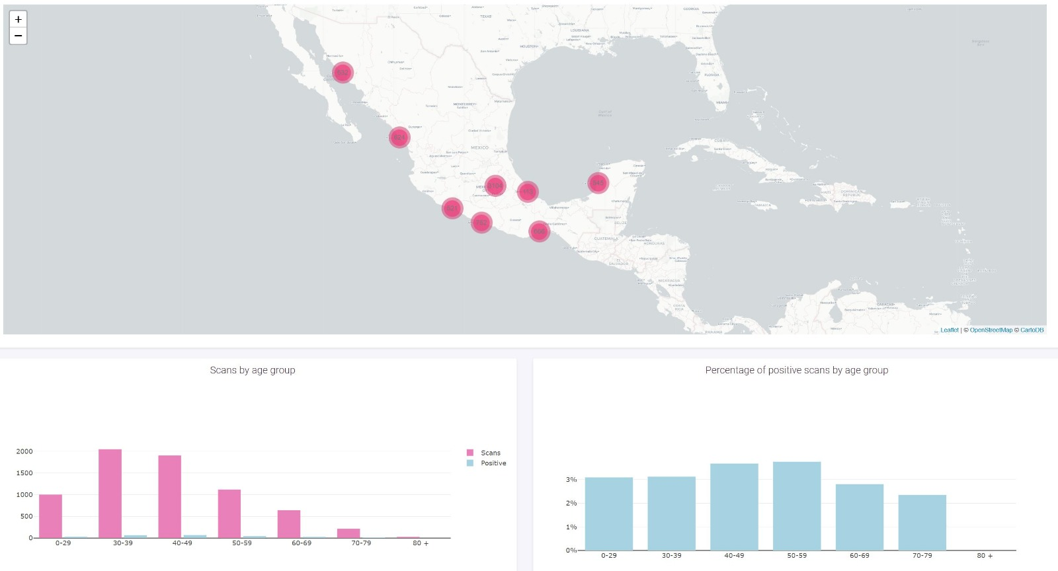
To be completed by the Org Admin
Create an Org Admin Account
The organization’s administrator (different from iBreastExam technicians) will have access to the iBreastExam Dashboard, an online repository of all patients, scans, technicians, and devices.
To be completed by the organization’s administrator (iBreastExam project lead):
Create a technician account on the iBreastExam app (see above).
Send a request with your name to info@uelifesciences.com and your account will be granted org admin privileges.
The Dashboard allows you to:
Remotely create and edit technicians and patients.
Keep track of each technician’s training status.
Keep track of each technician’s and device’s positivity rate.
Replay each scan for quality control.
Download reports as PDFs and CSV files.
→ More information: Dashboard Guide and Dashboard Video.

Slide 8
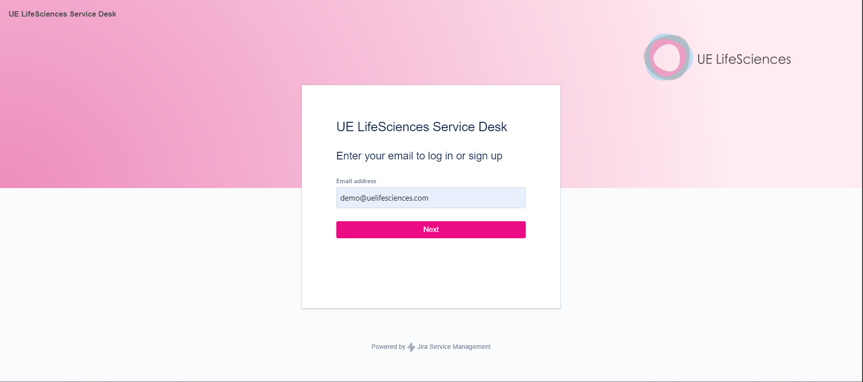
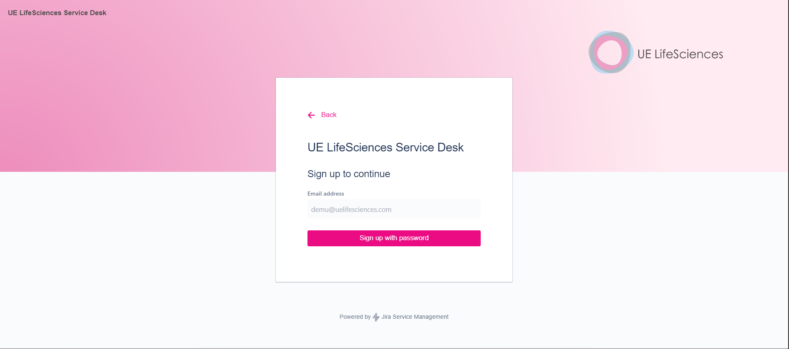
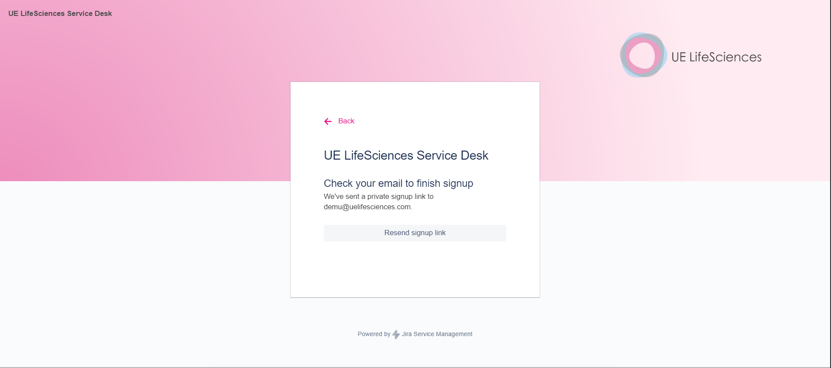
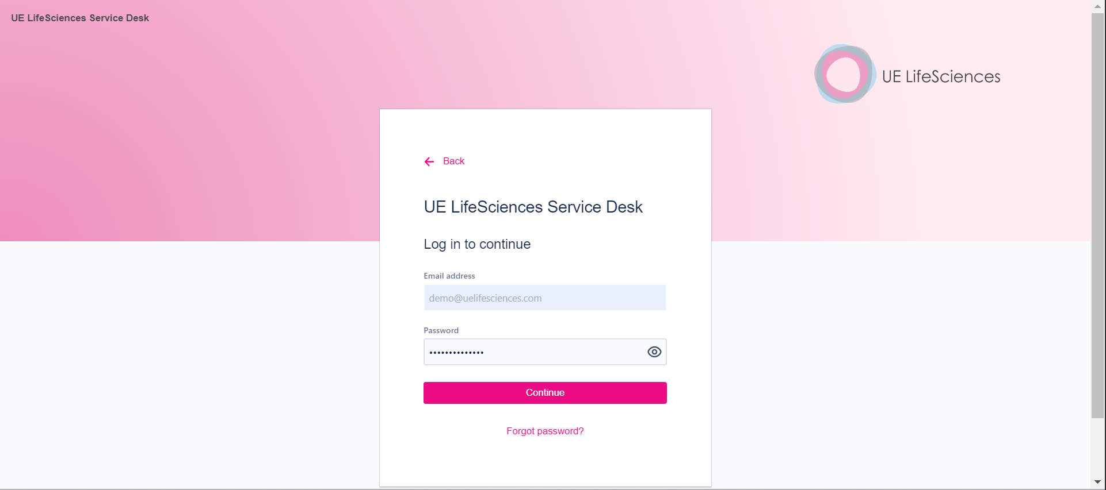
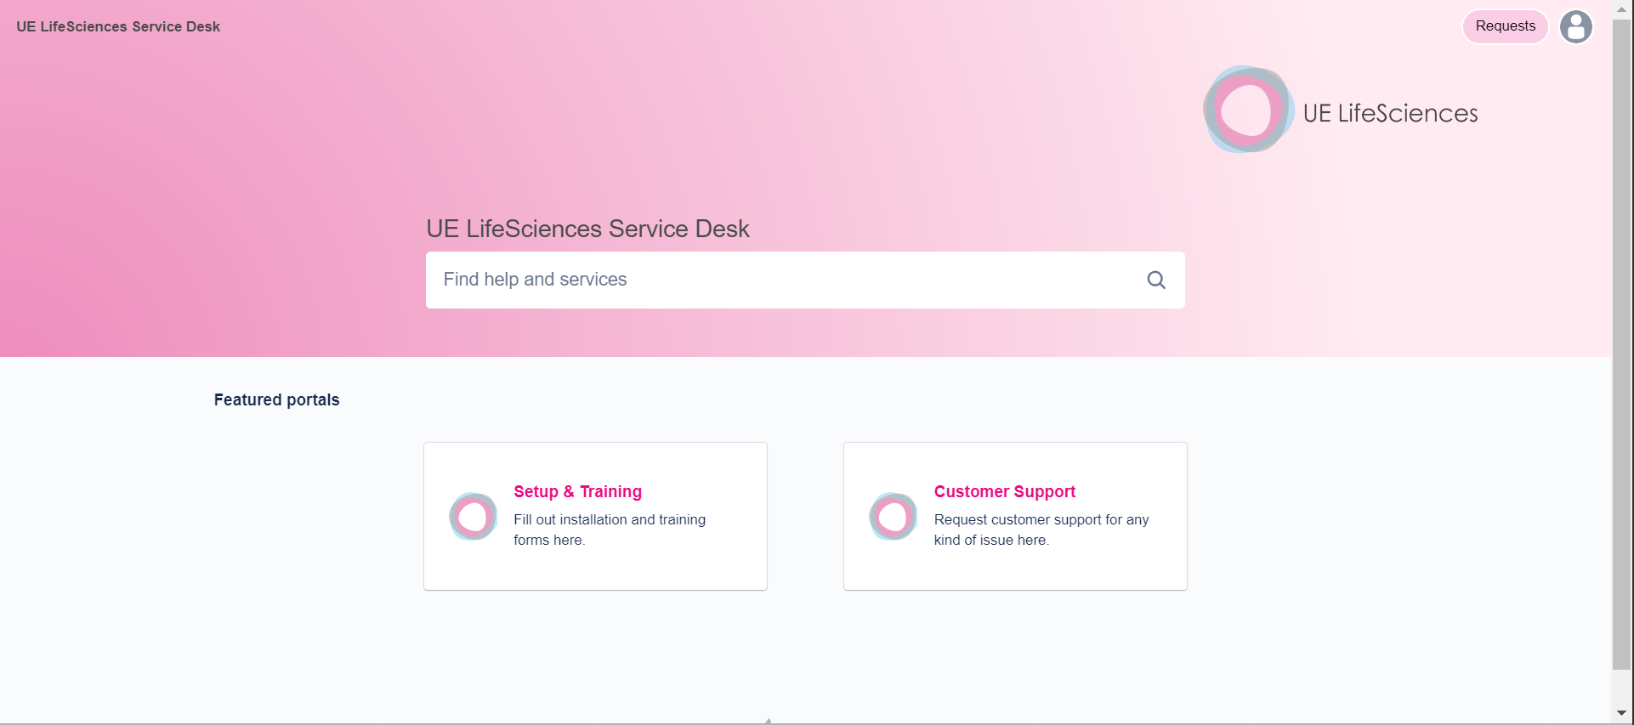
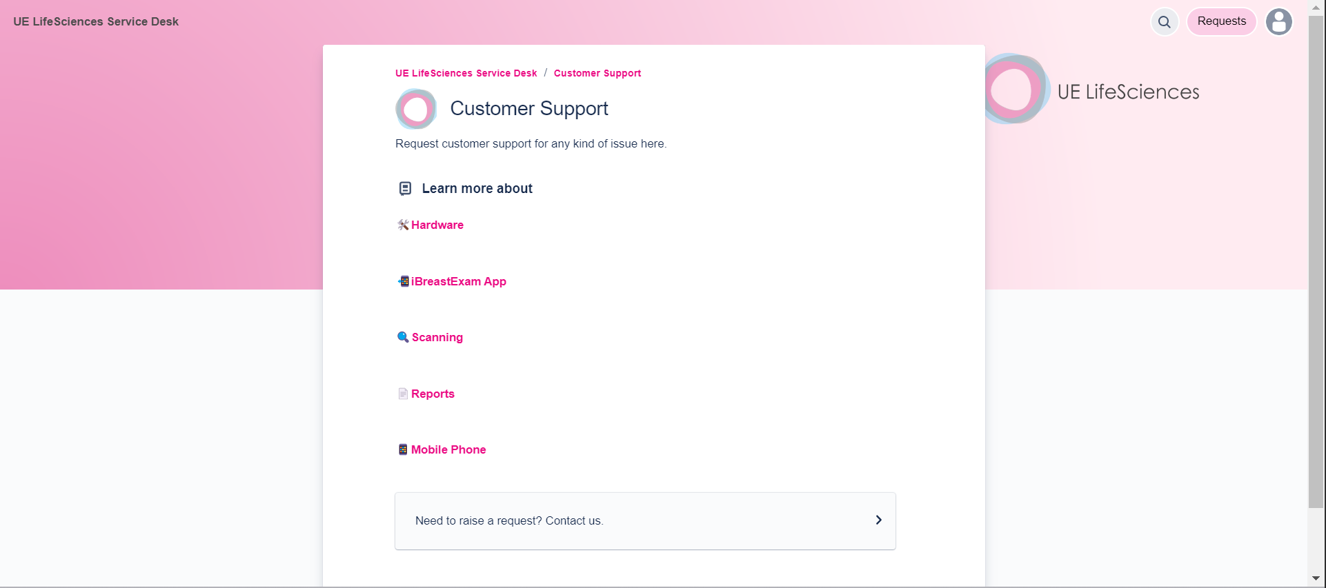
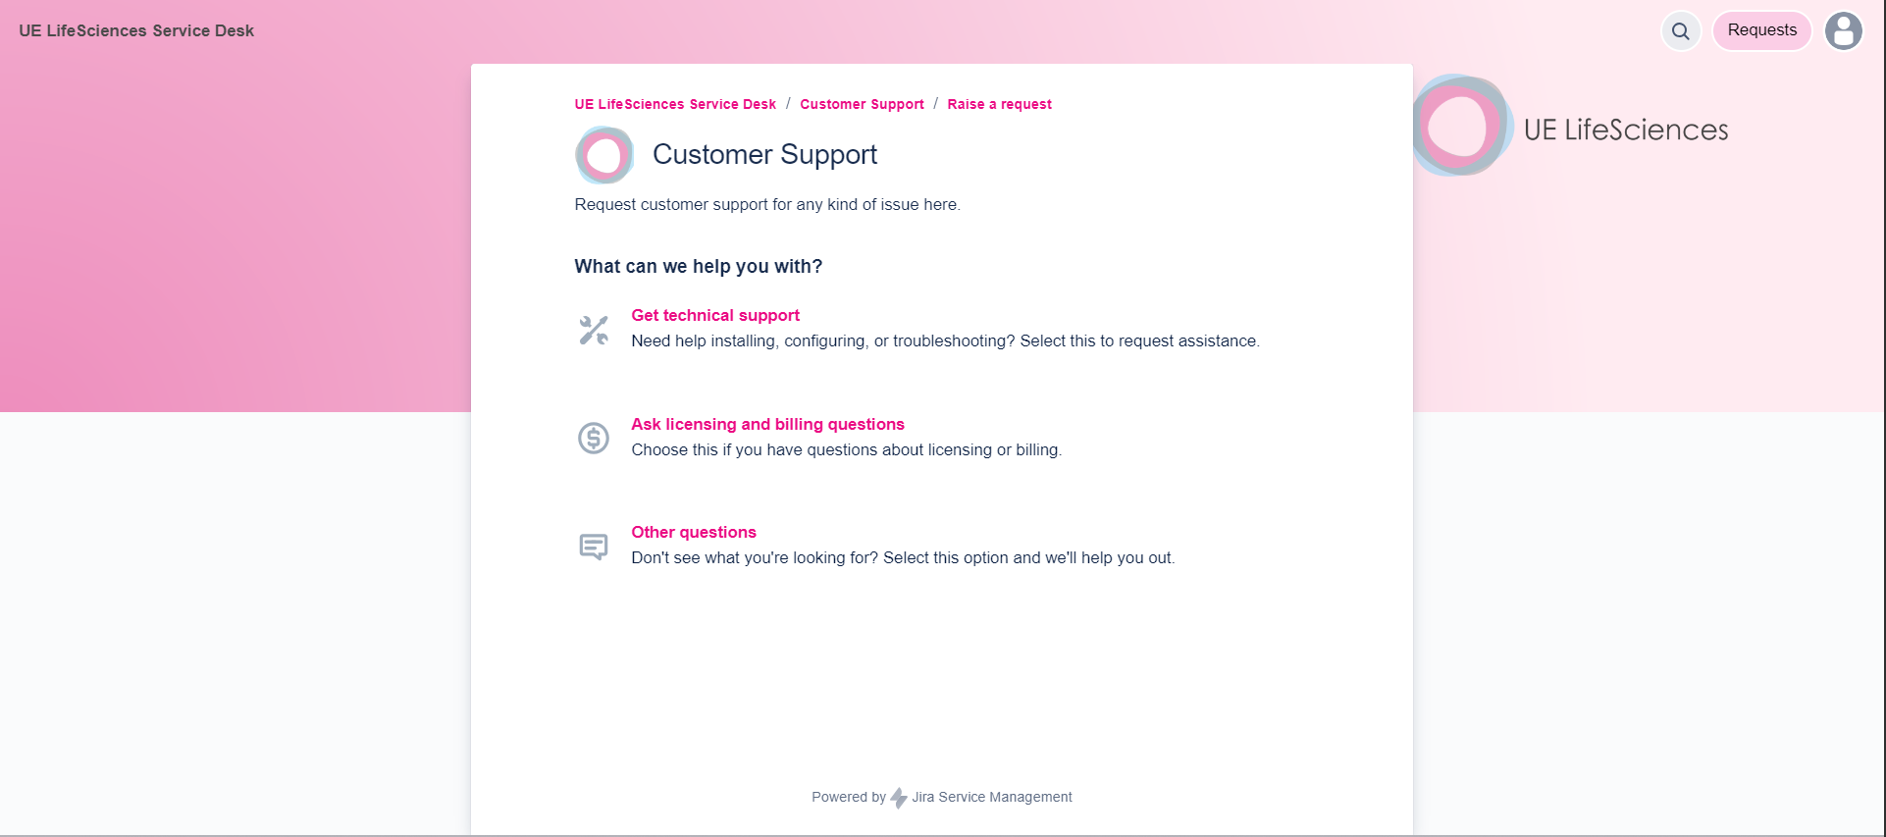
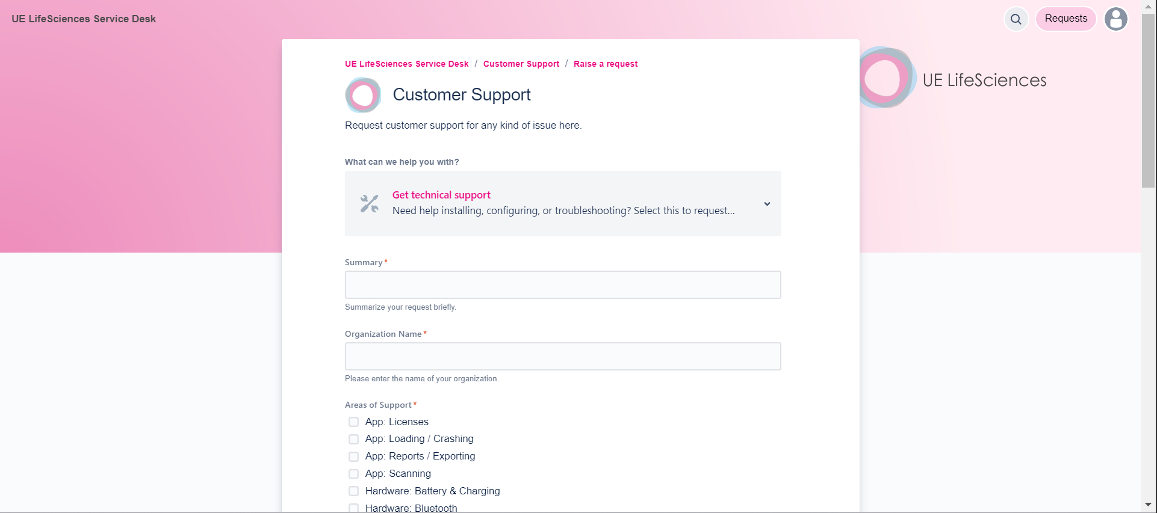
To be completed by the Org Admin
Create a Service Desk Account
Watch the 3-minute video on how our Service Desk works.
Then go to uels.atlassian.net/servicedesk
Skip this step if we have set up an account for you, and simply click on the sign-up link in the email sent to you (subject:
“Finish signing up to UE LifeSciences Service Desk”).

Slide 9
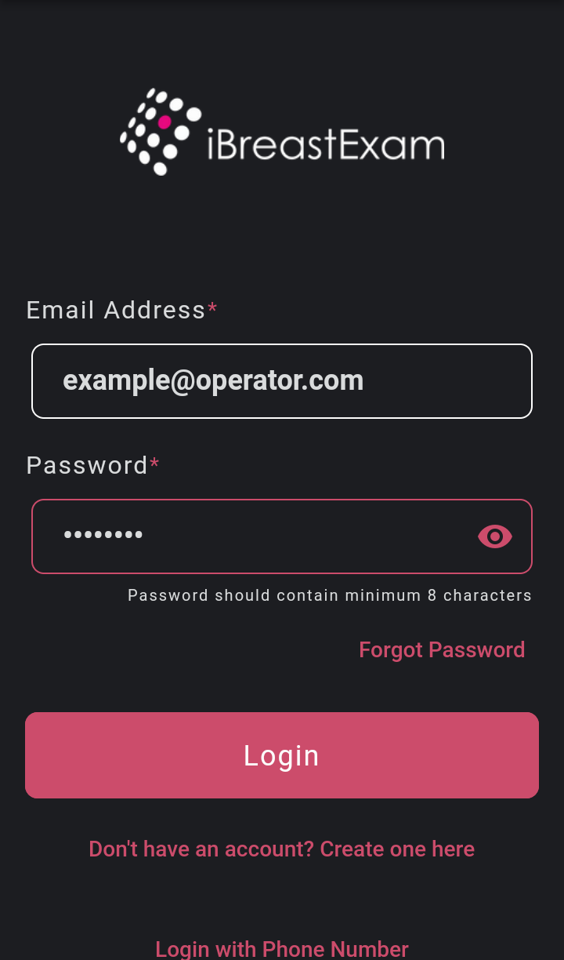
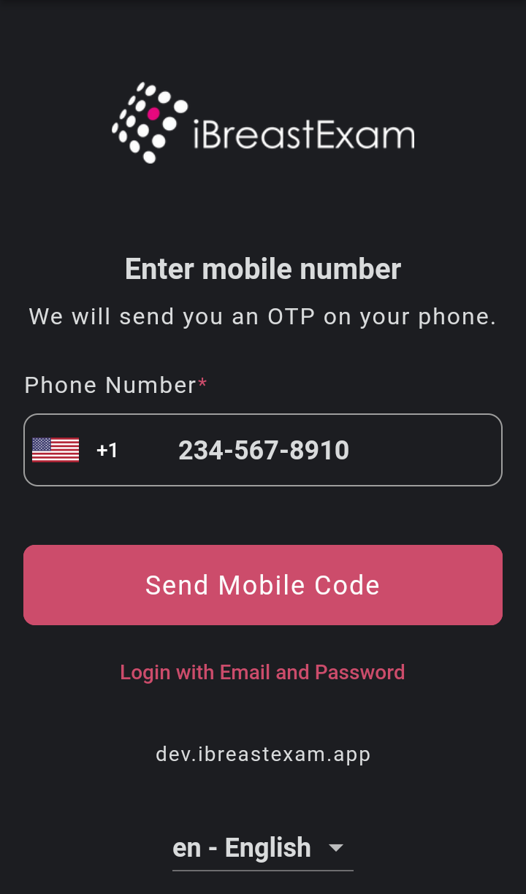
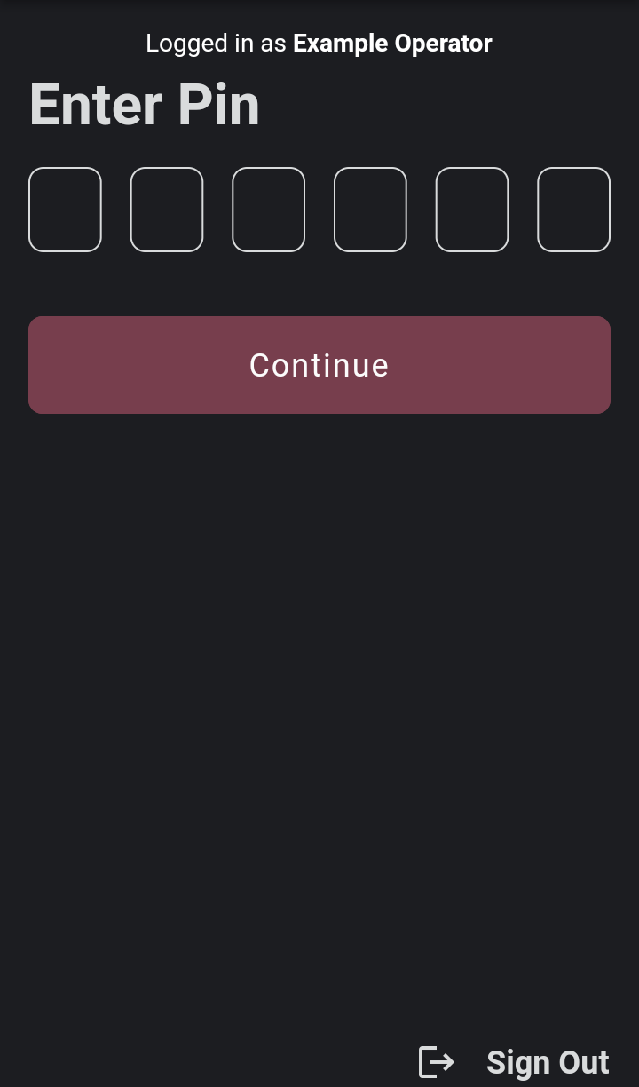
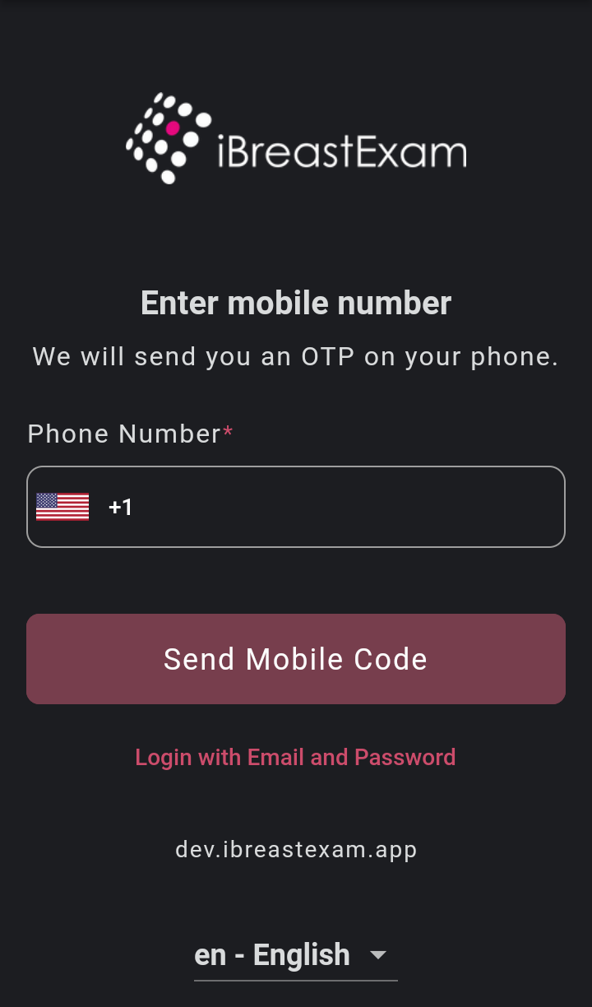
Login to the App
Attention: For security reasons, there is a limit on the number of OTP messages that can be sent to a single phone number within a period of time. If you exceed this limit, these messages will be suspended for 60 min.
Or: Login via mobile number

Slide 10
Main Menu
  Settings
  Device number
  Remaining scans on sensor cartridge
500
  Register patients
  Scan patients
  View and share reports
  Training and certification module
  Access to our Customer Portal

Slide 11
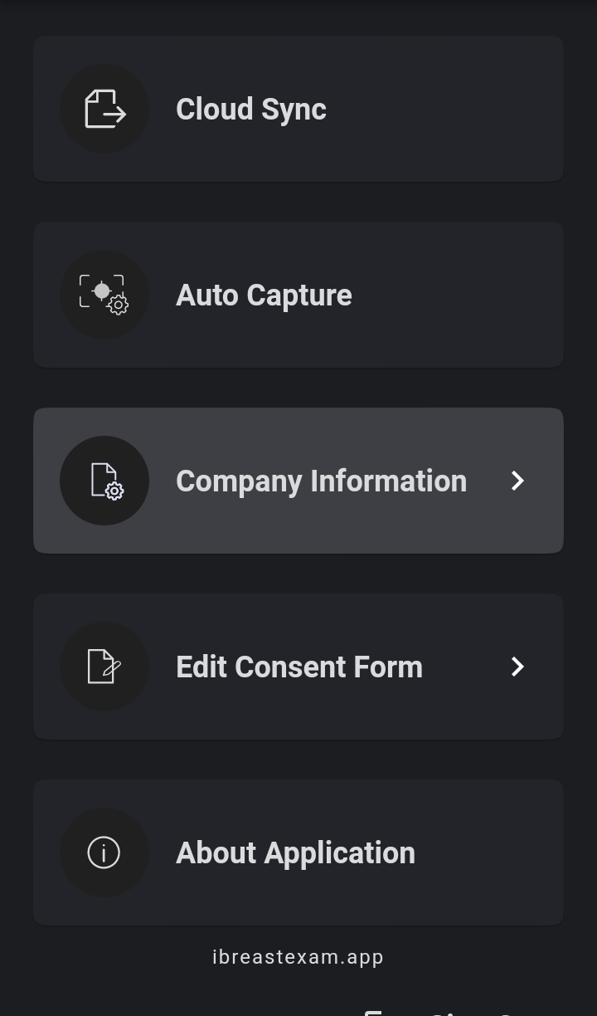
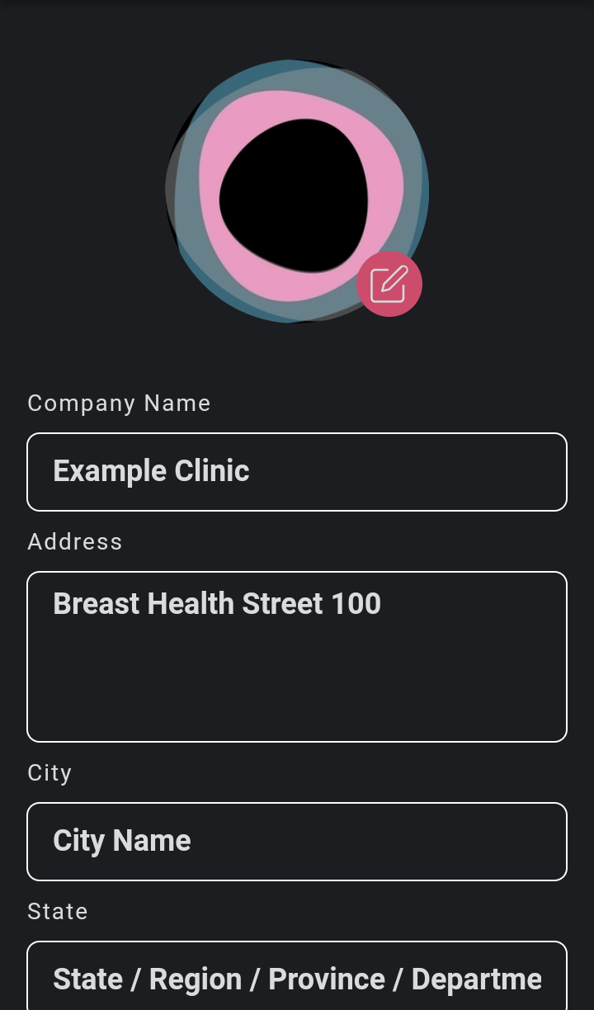
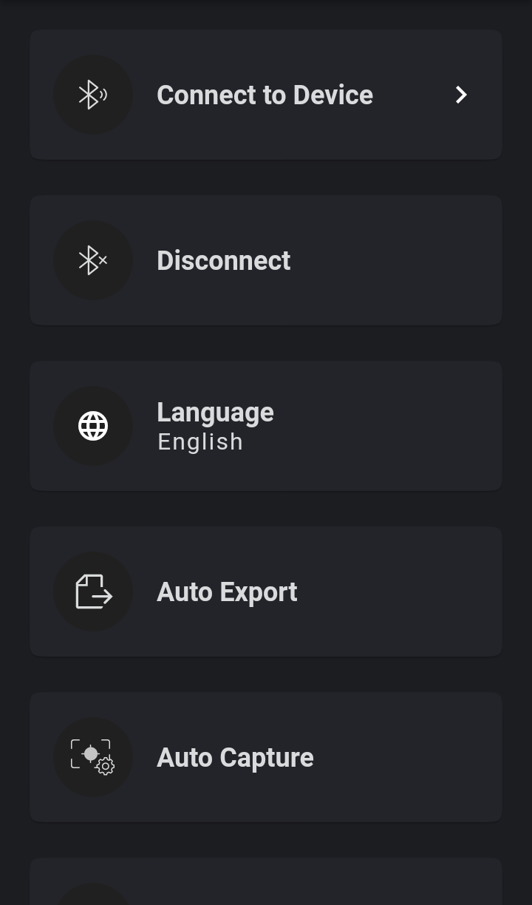
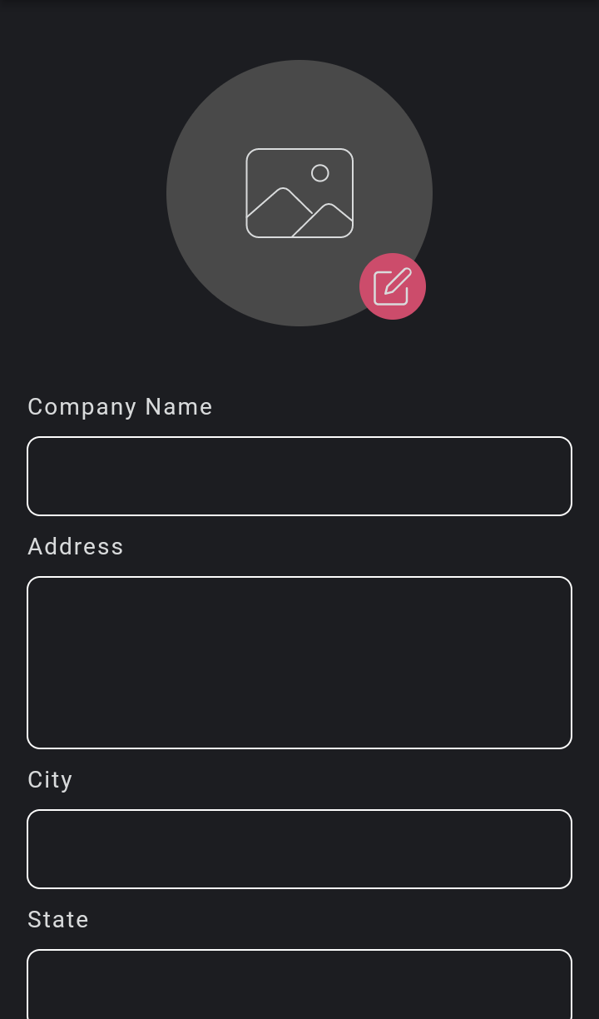
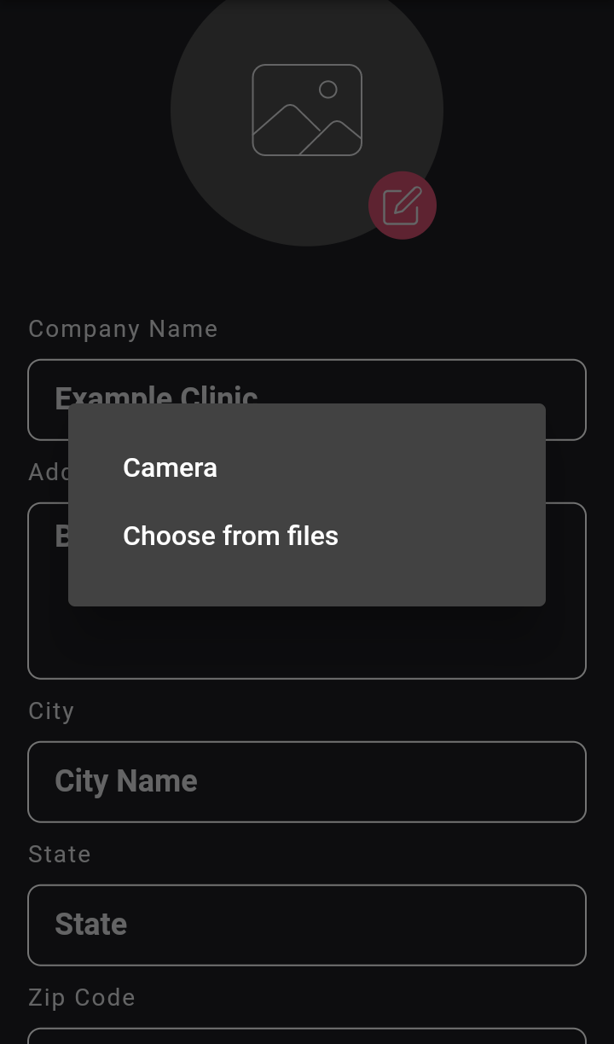
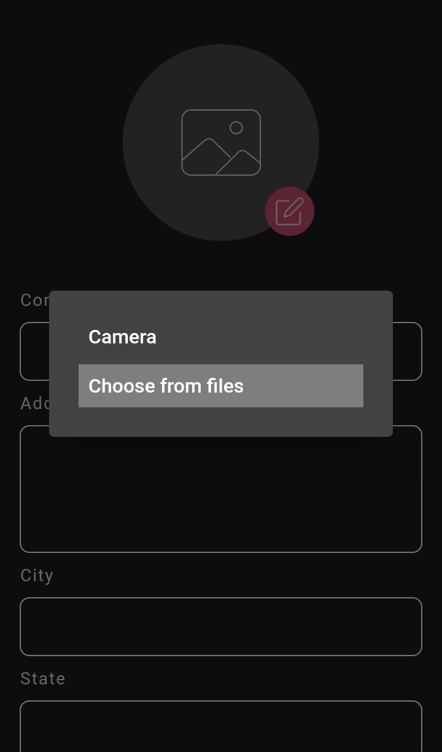
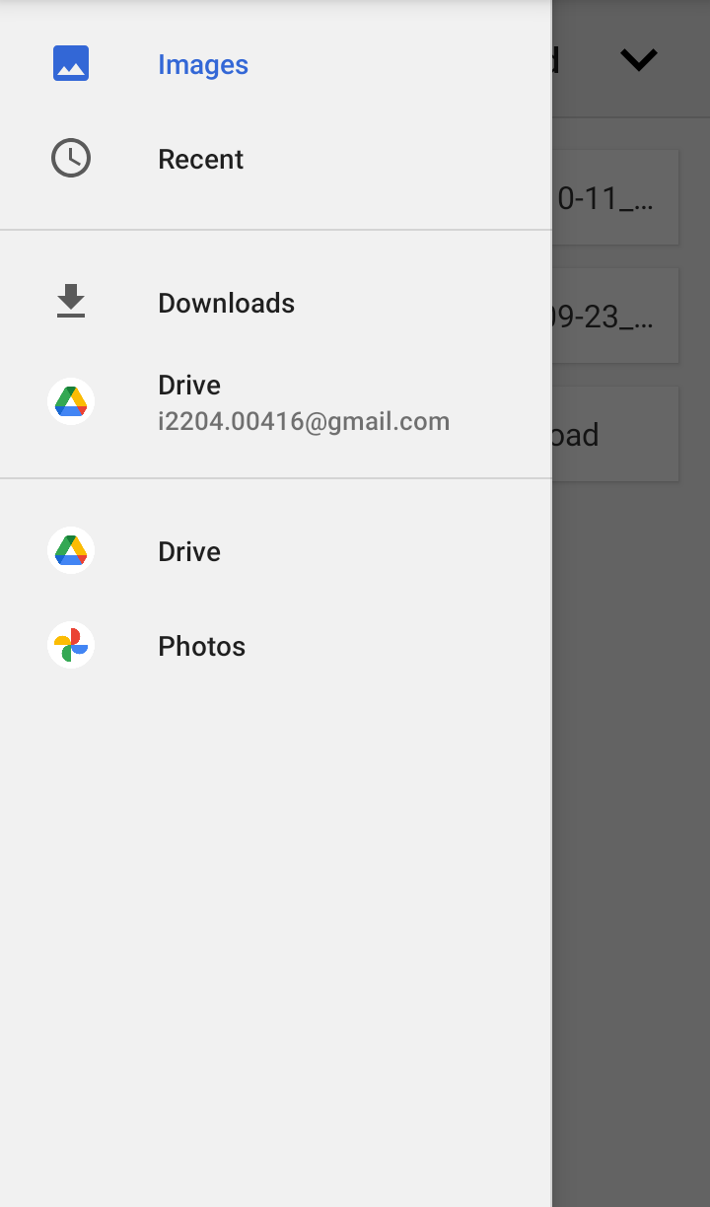
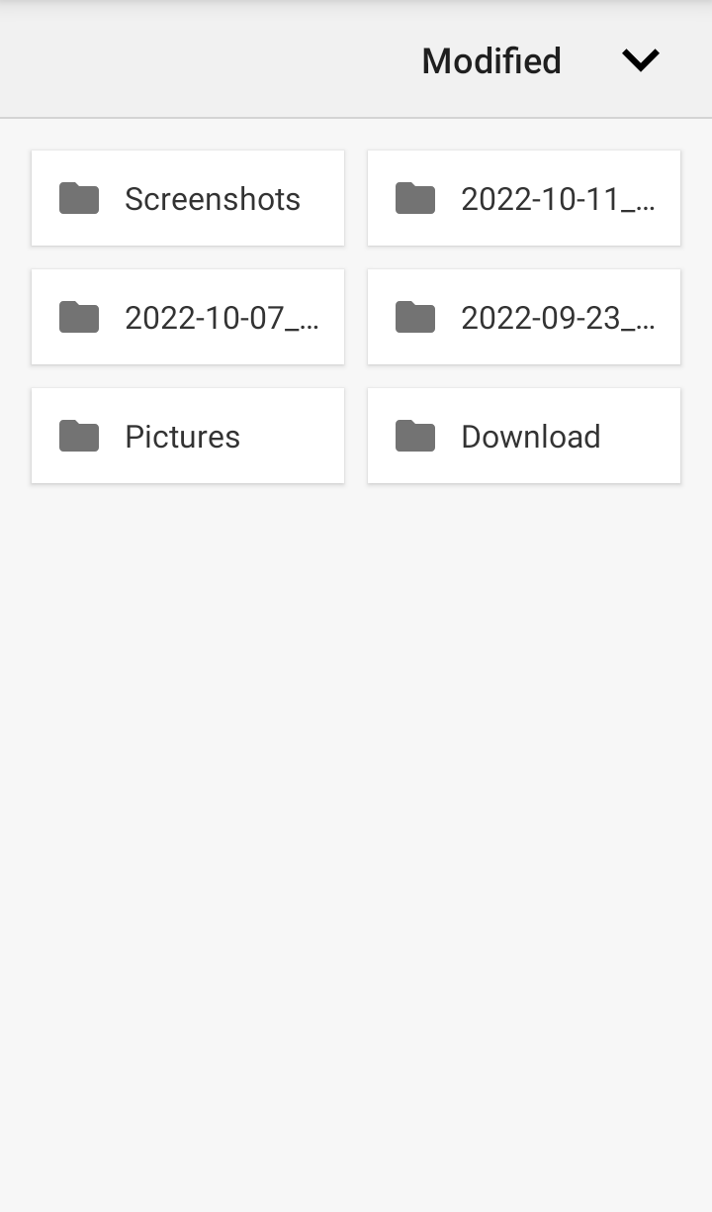
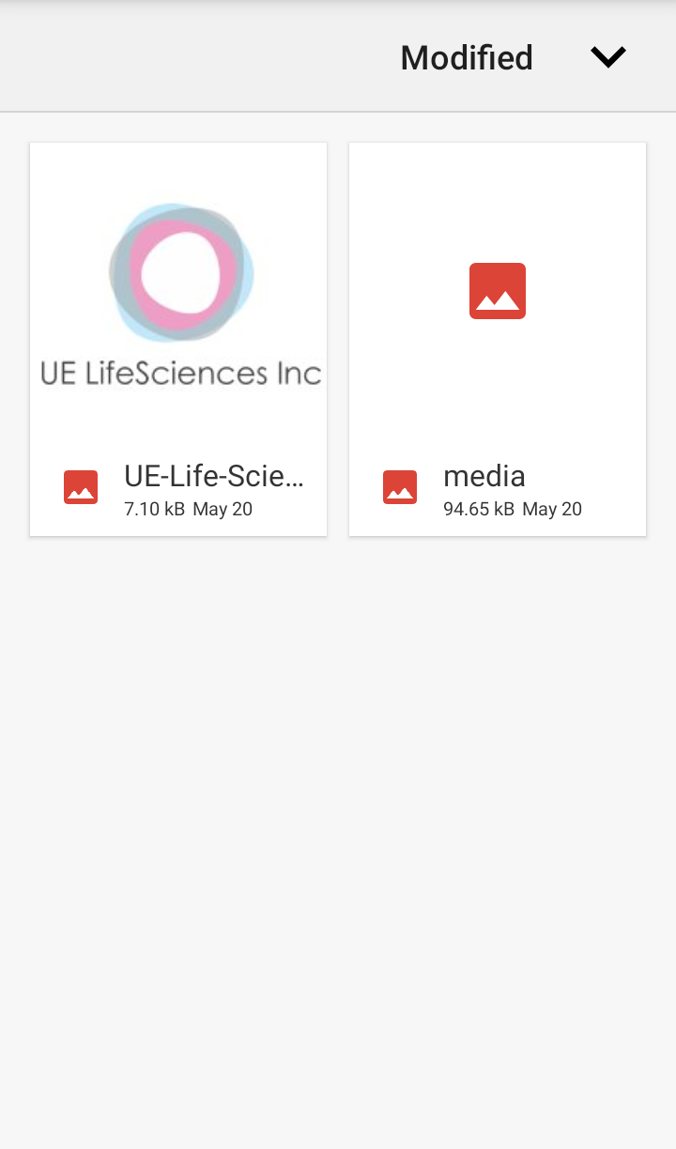
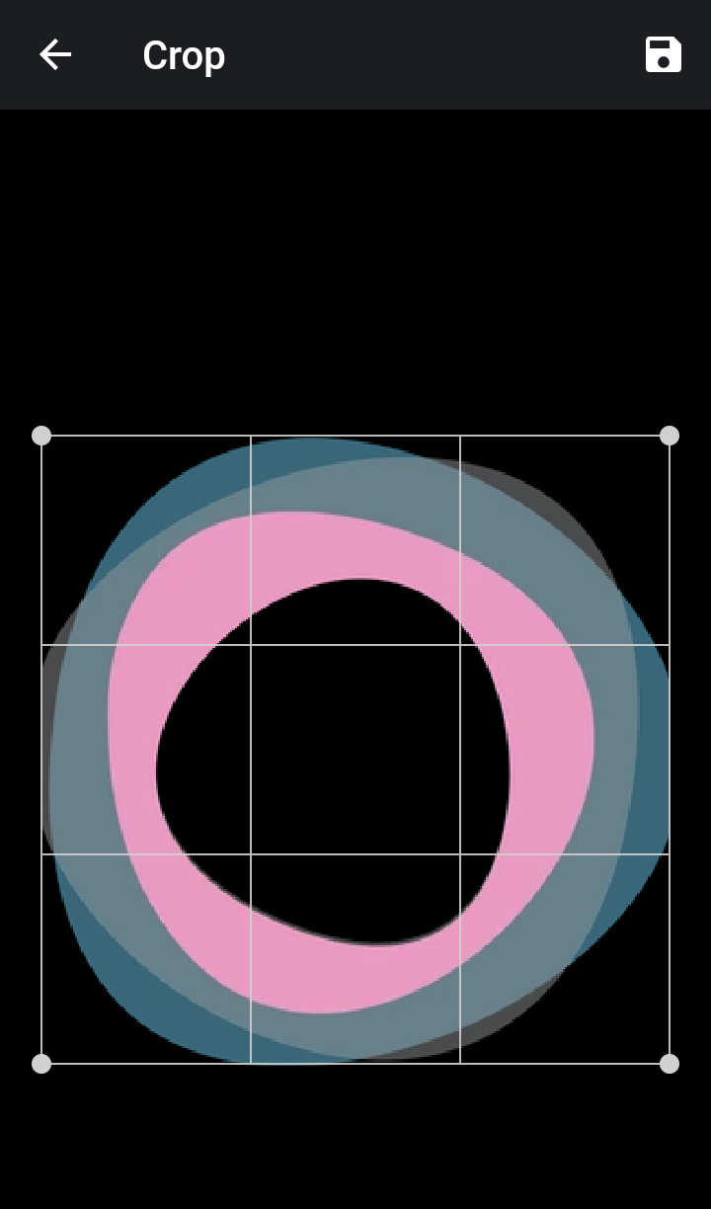
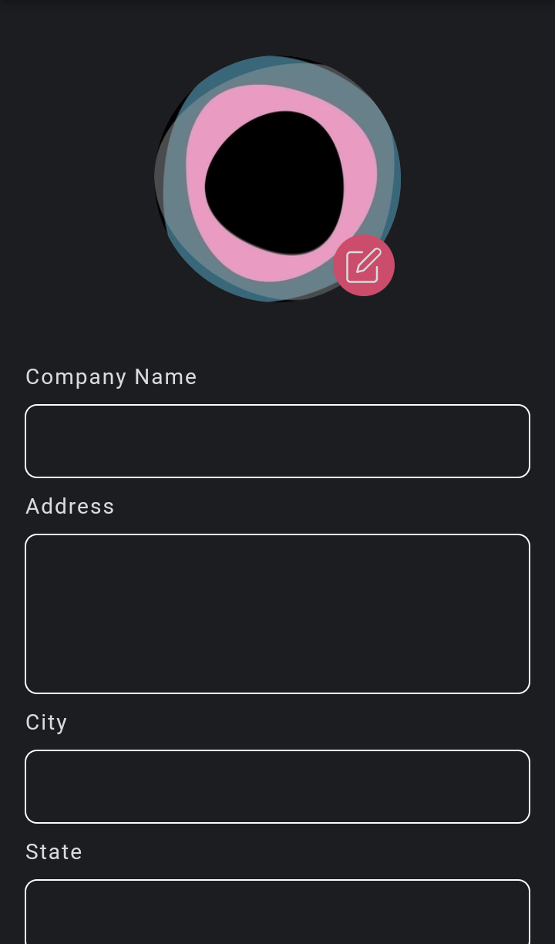
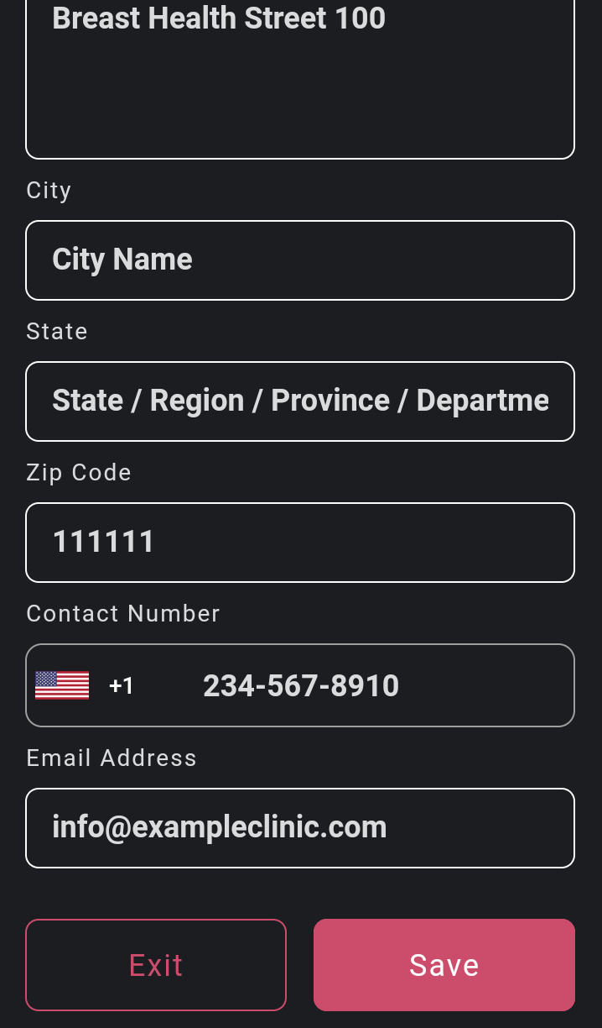
To be completed by each Technician (+ Org Admin if intending to perform scans)
Enter the Company Information
Add your logo in .png or .jpeg
500
500

Slide 12
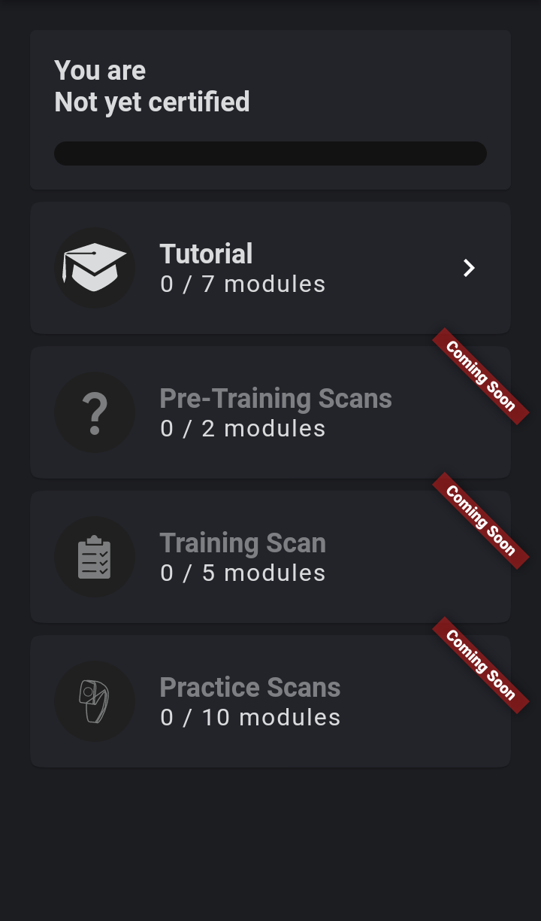
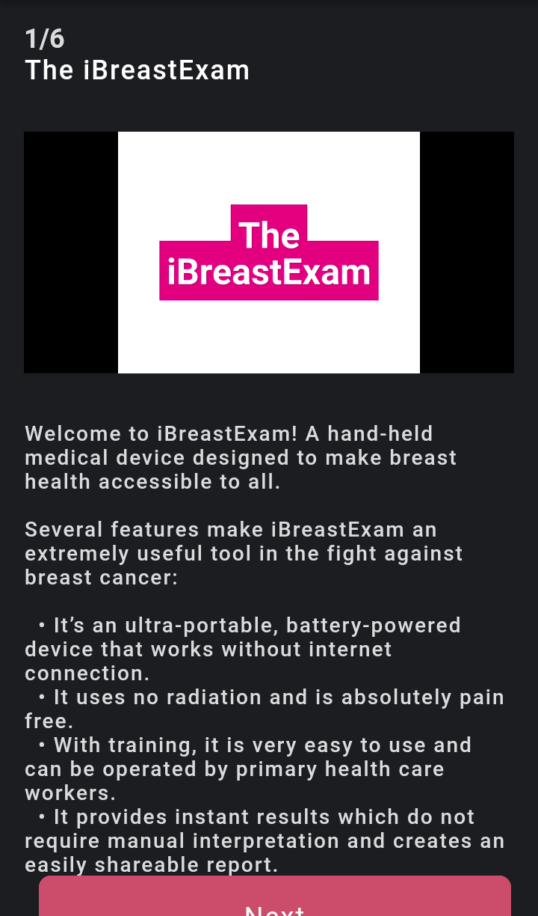
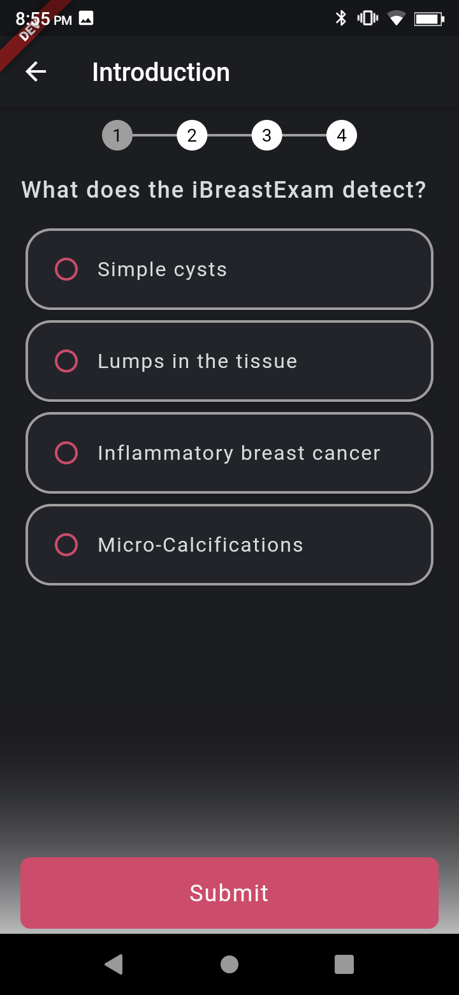
To be completed by each Technician (+ Org Admin if intending to perform scans)
Complete the Tutorial I/II
500
500

Slide 13
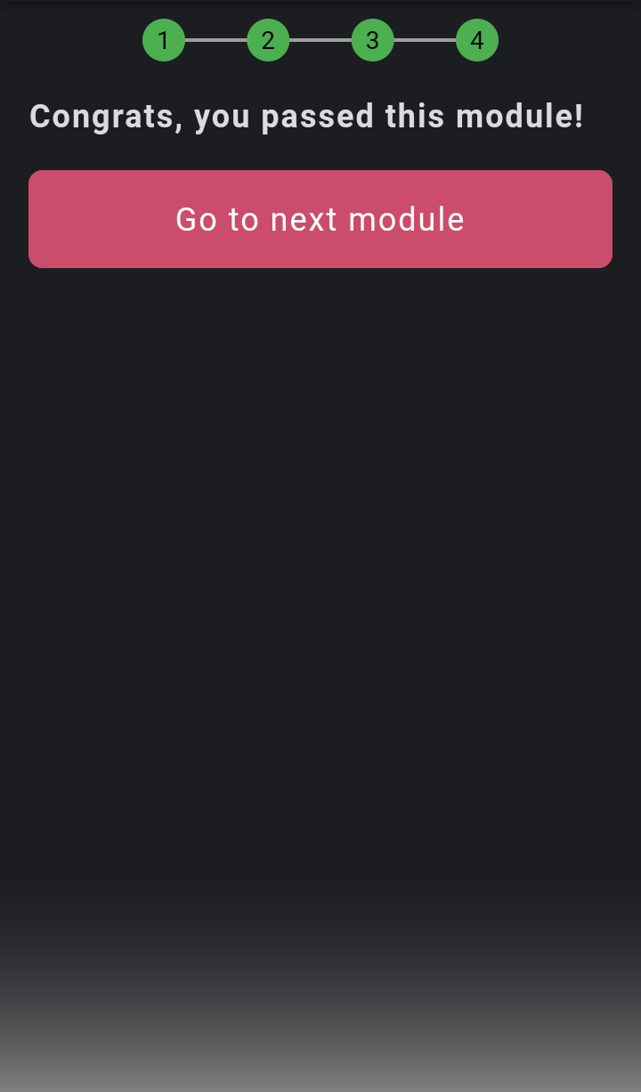
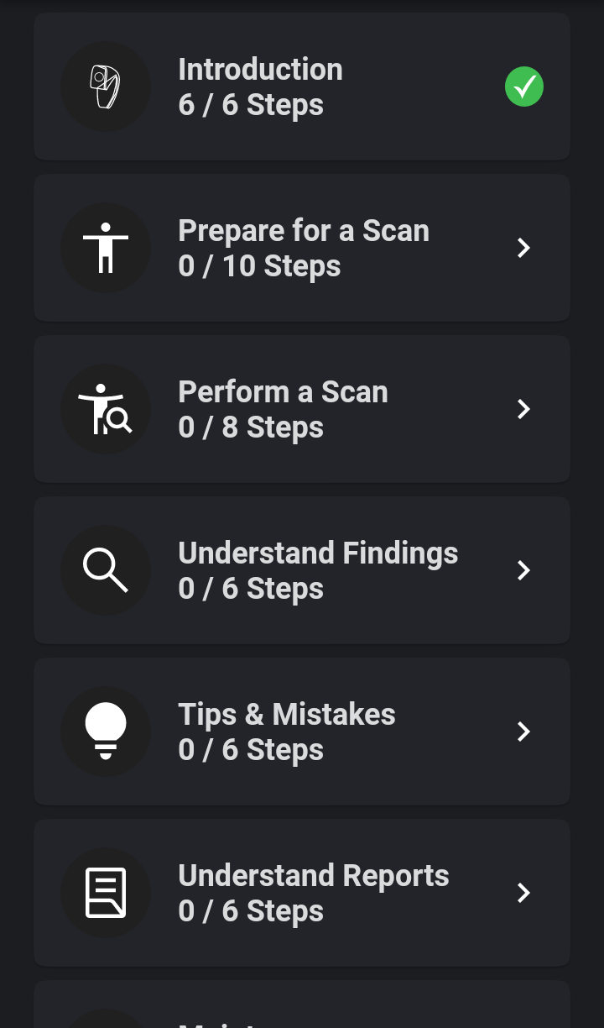
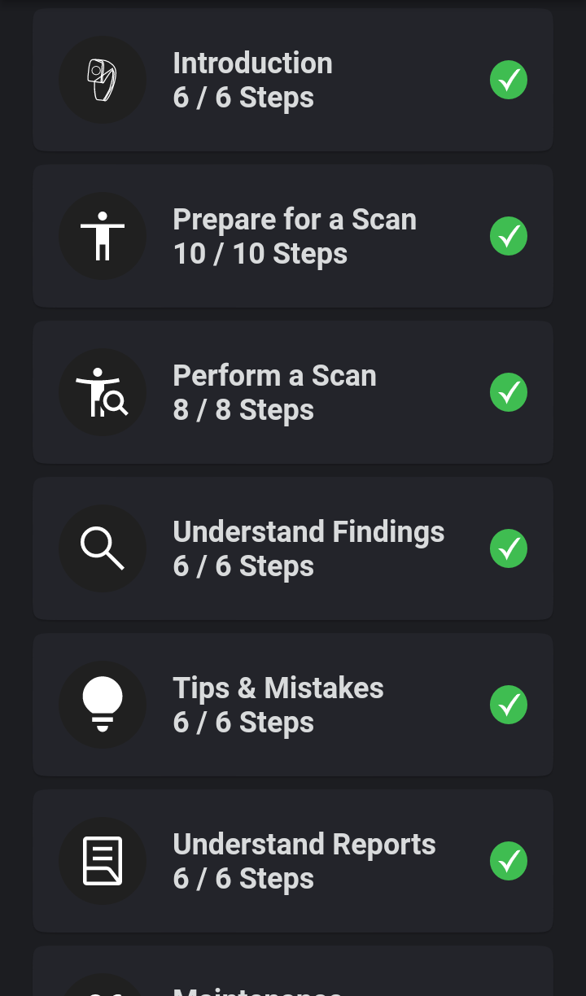
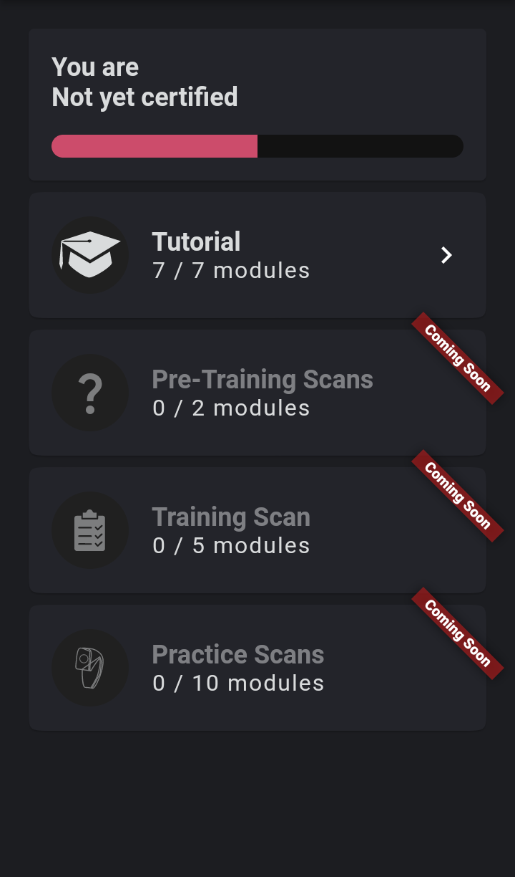
To be completed by each Technician (+ Org Admin if intending to perform scans)
Complete the Tutorial I/II
500
The subsequent steps (Pre-Training, Training, and Practice Scans) will be completed during and after the iBreastExam Training.

Slide 14
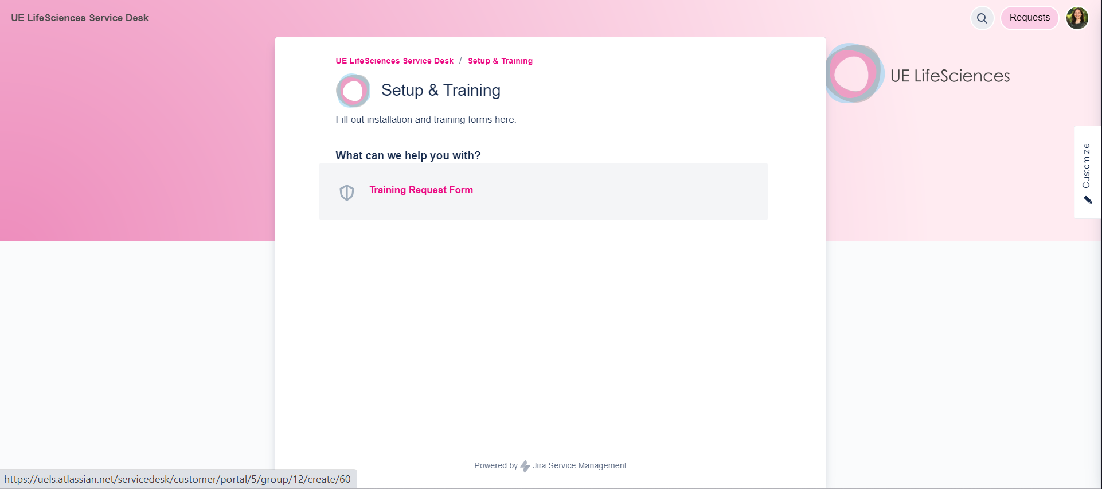

To be completed by the Org Admin
Request an iBreastExam Training
Go to uels.atlassian.net/servicedesk
Or directly to bit.ly/ibreastexam-training
Please ensure that each technician is available for this training and has completed the mandatory iBreastExam Tutorial prior to the training.

Slide 15


To be completed once you receive your iBreastExam unit
Charge the Scanner
Charge the scanner for at least 6h.
Turn the device on and off
(it does not turn off automatically!)
Charging:
Battery light on
Fully charged:
Battery light off
Off:
Power light off
On:
Power light on

Slide 16



To be completed once you receive your iBreastExam unit
Pair the Scanner to the Phone
Turn the scanner on.
[your scanner’s Bluetooth number]
If asked, enter the PIN “1234”.
Tip: Pair one scanner with one mobile phone.

Slide 17



To be completed once you receive your iBreastExam unit
Connect the Scanner to the App
Turn the scanner on (Connection Light below the pink or silver cover is blinking).
Ensure the phone’s Bluetooth is turned on.
Open the iBreastExam app and log in to your account.
The scanner automatically connects to the app (Connection Light stops blinking).
Tap on Done in the Bluetooth Connection Status pop-up message.

Slide 18


UE LifeSciences
early detection. for all.
USA
3401 Market St
Suite 200
Philadelphia
PA 19104
+1.267.225.0453
India
105 B Wing, Brij Bhoomi
Nehru Rd
Vile Parle East
Mumbai 400057
+91.22.2610.2610
Malaysia
B1-1-3A, Solaris Dutamas,
1, Jalan Dutamas 1,
50480
Kuala Lumpur
+60.3.62063079
info@uelifesciences.com

