Slide 1

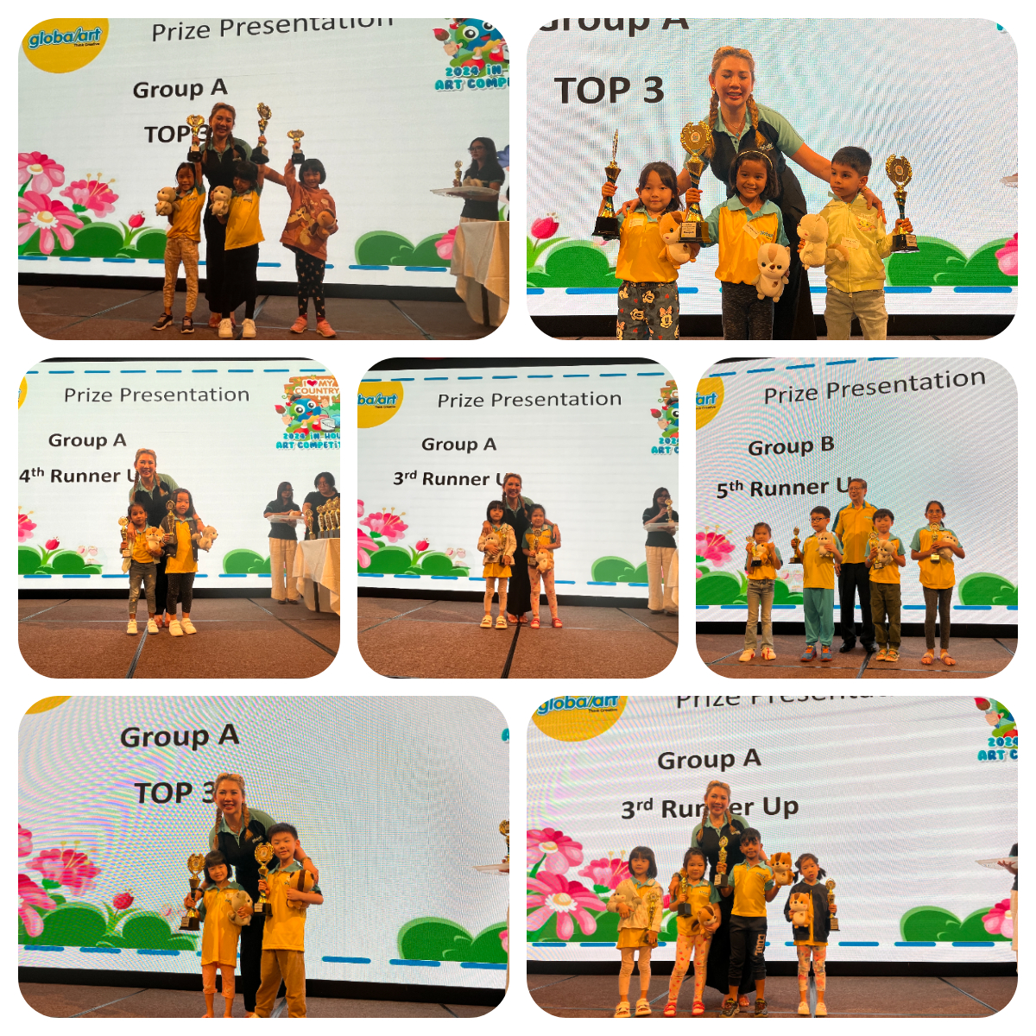
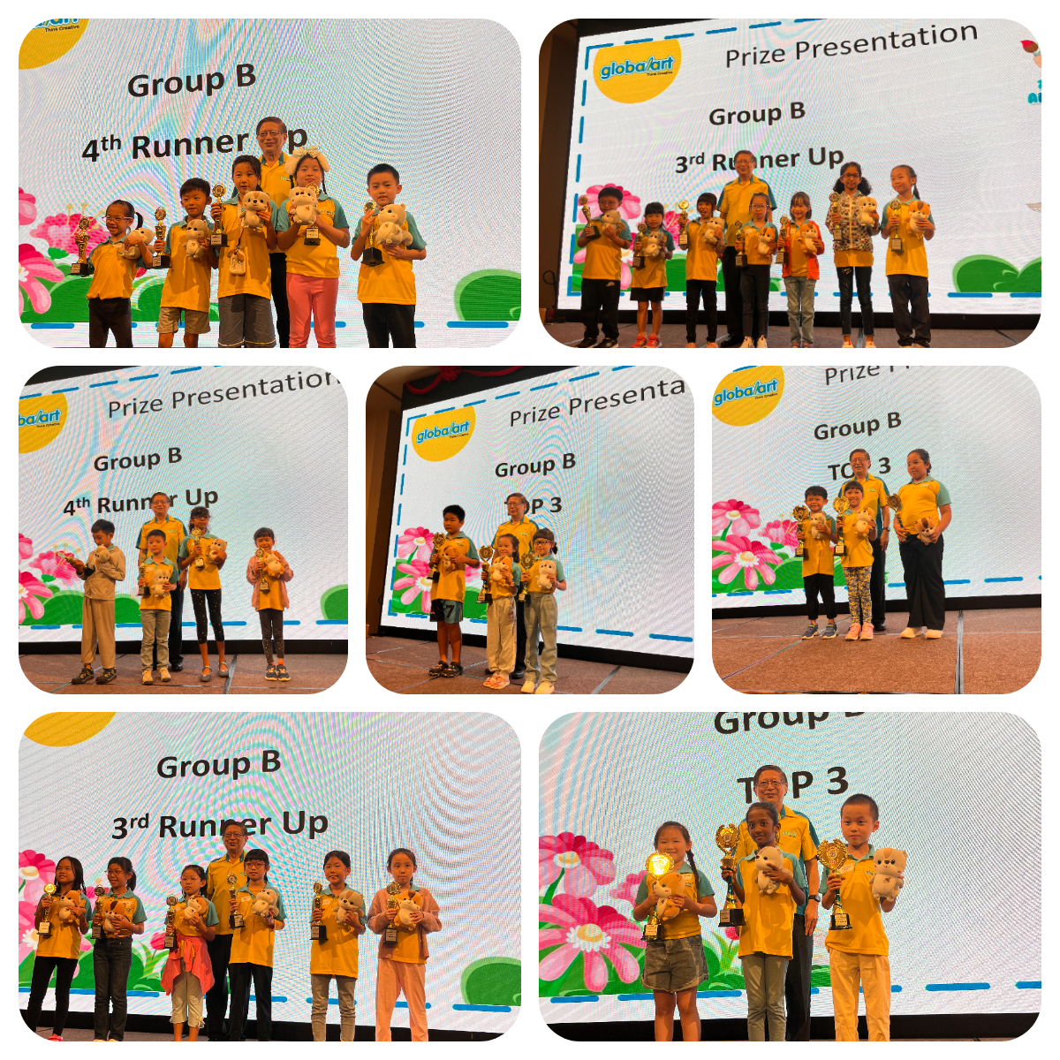
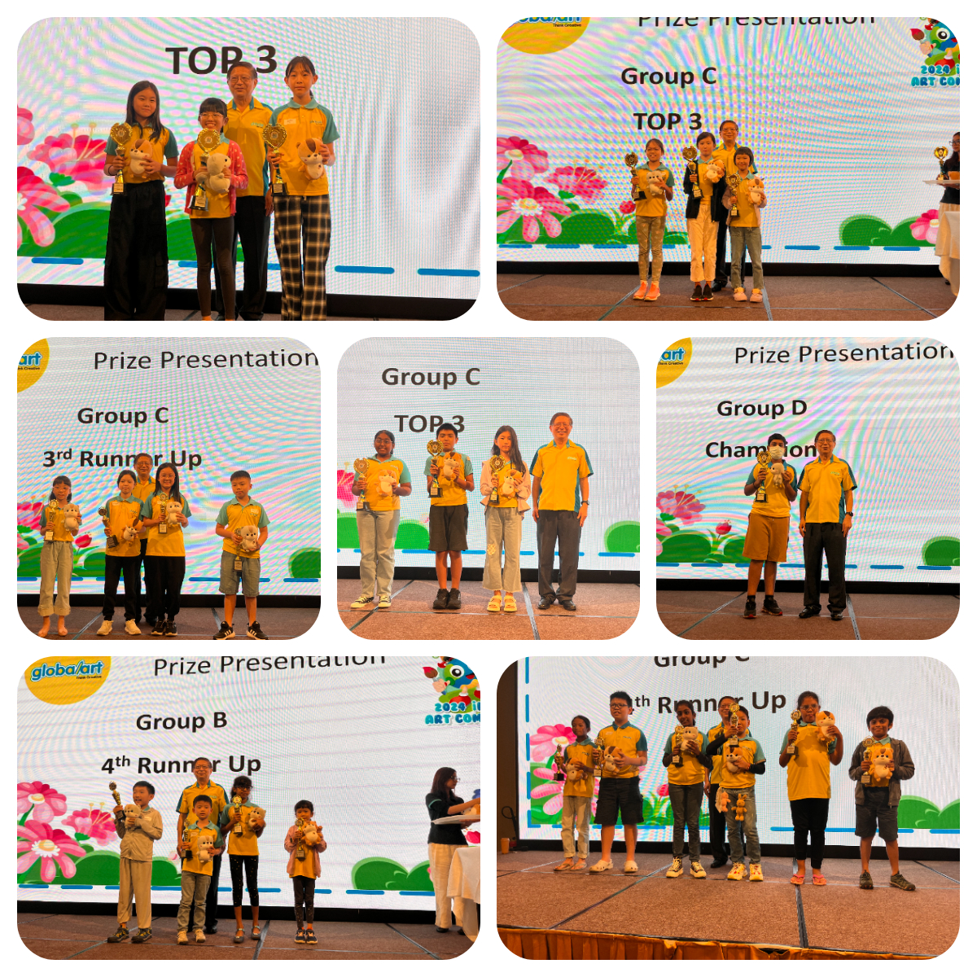
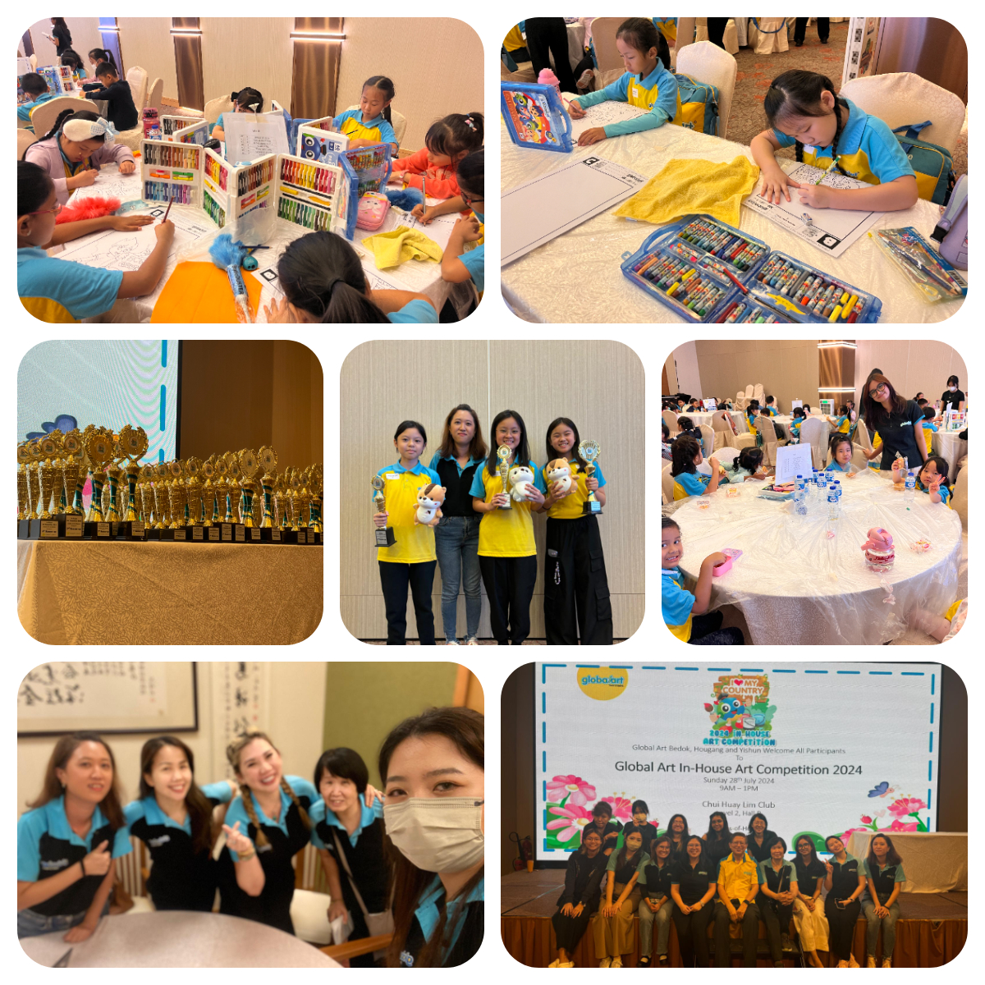
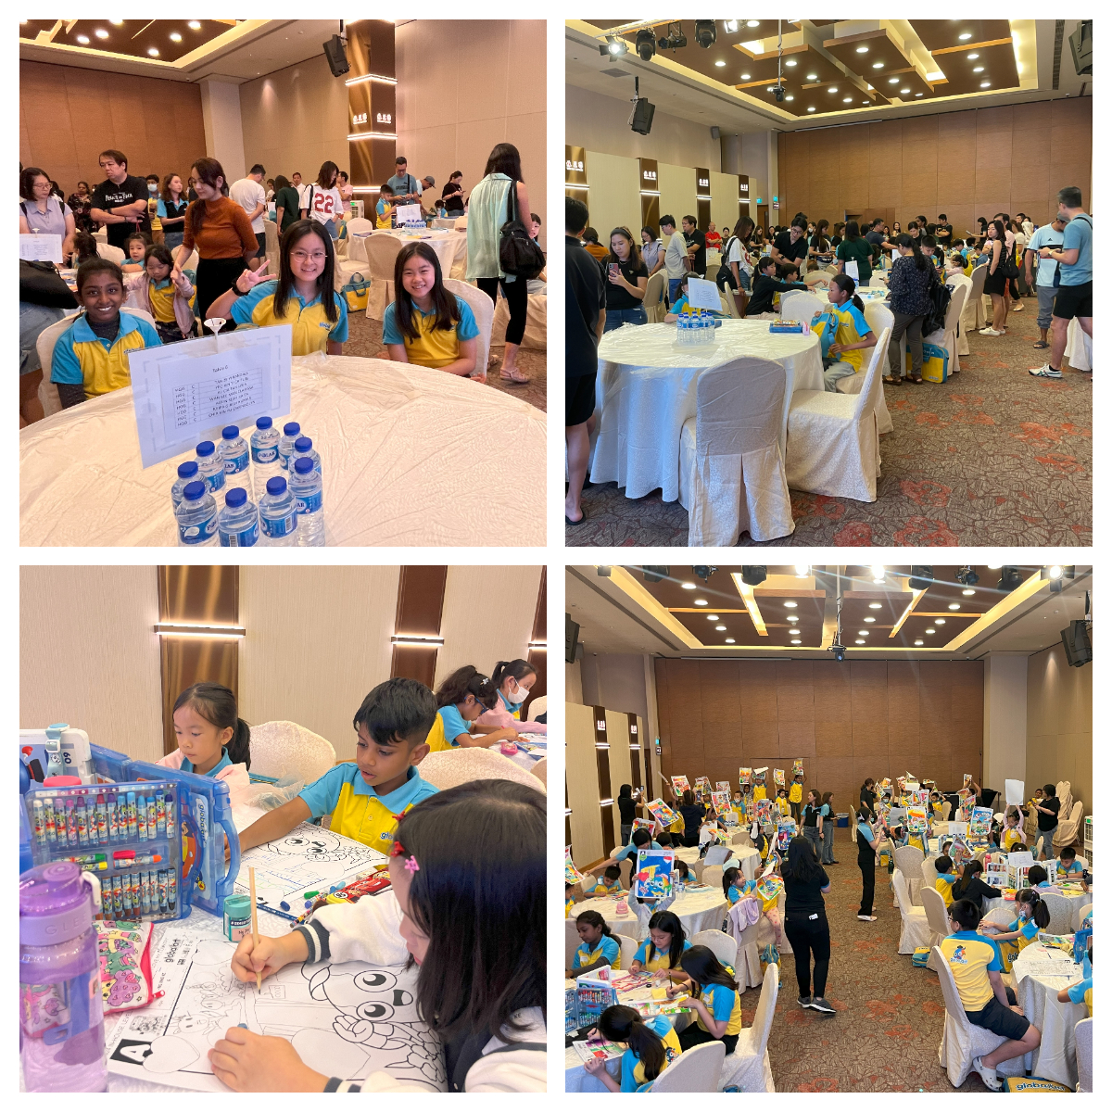
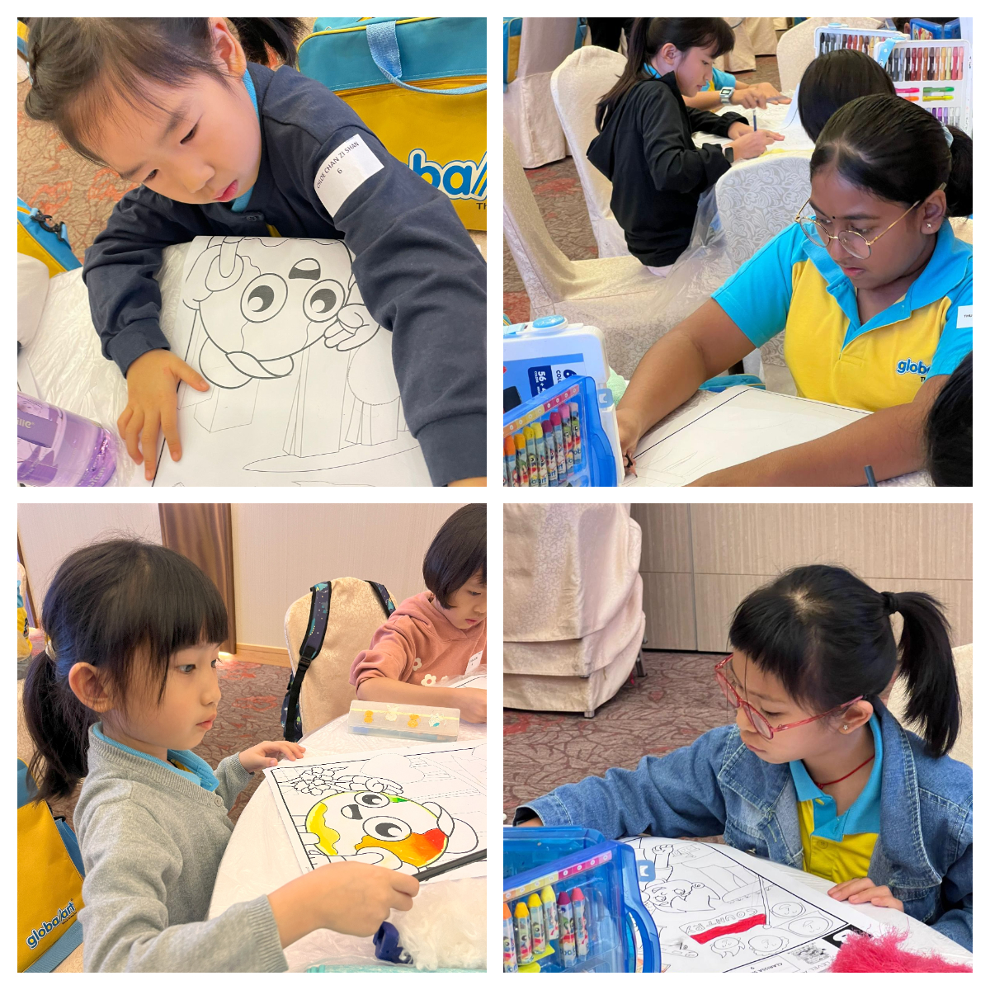
Exciting Updates from Global Art – Jul y / August 2024
2024 Global Art Hougang, Bedok
and Yishun In-House Competition
Congratulations to all the students who participated in the 2024 Global Art Hougang, Bedok and Yishun In-House Competition held in Chui Hwee Lin Club. We had a very successful event in which students showed case their talent. We will be featuring our Top 3 winners in each category as our Young Artists progressively over the next few issues.
Newsletter
July / August 2024
globalarthougangbedokyishun.com.sg
Facebook.com/globalarthggbccysn
Upcoming Events
September
National Art Competition
October
International Grading
November
Open Day
December
Year-End Exhibition

Slide 2
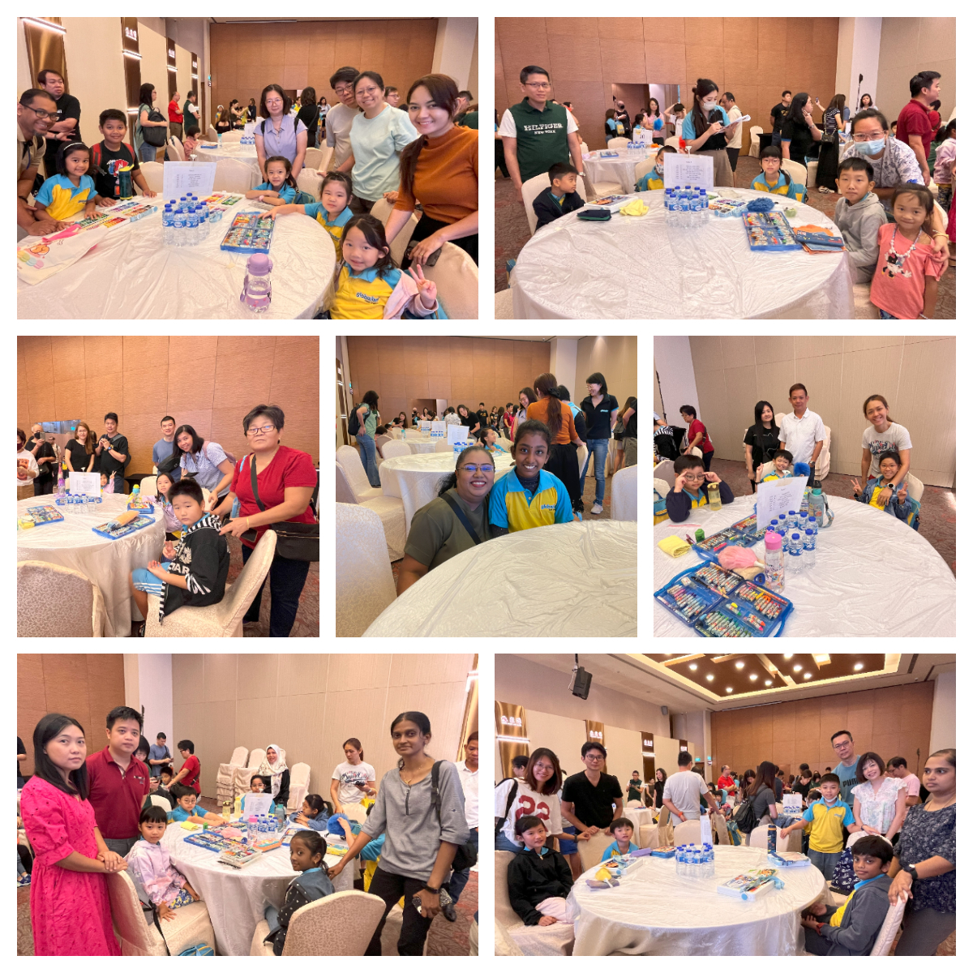
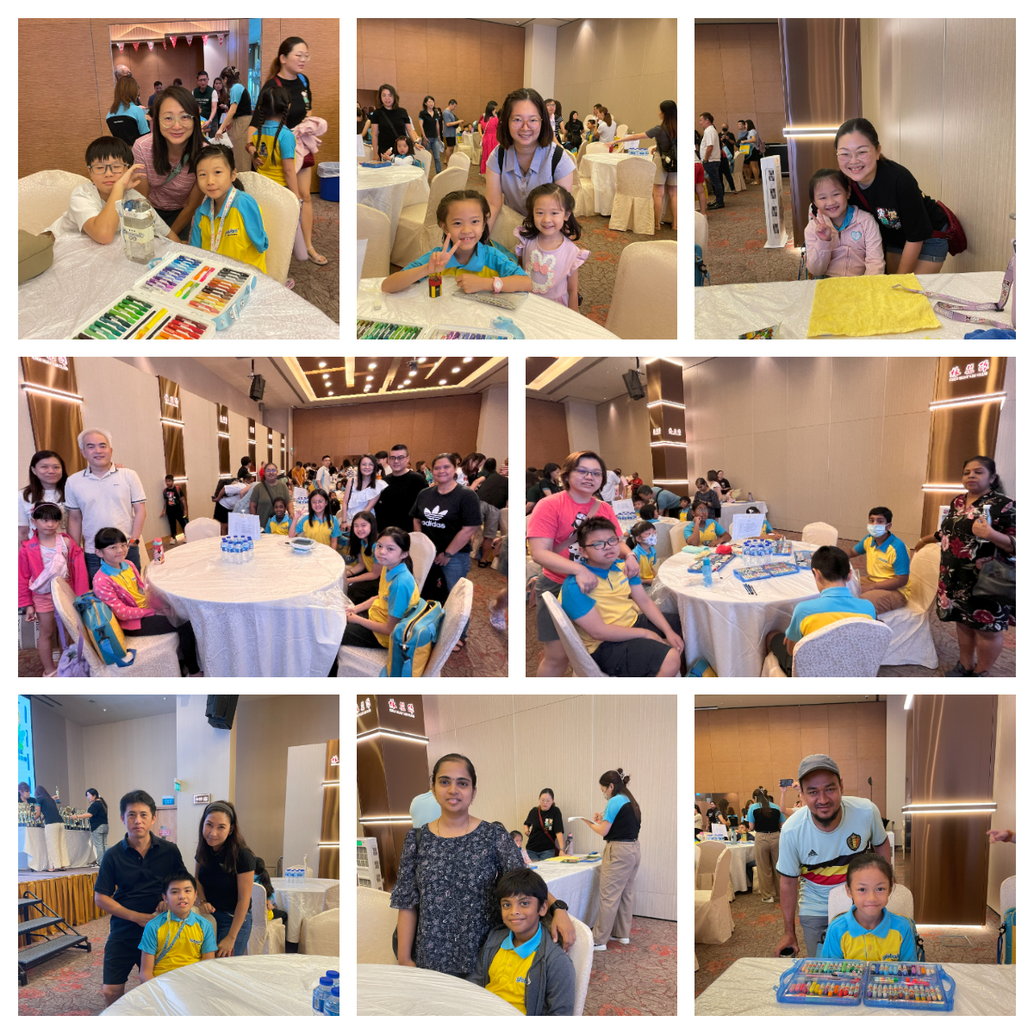
Newsletter
July / August 2024
globalarthougangbedokyishun.com.sg
Facebook.com/globalarthggbccysn
Upcoming Events
September
National Art Competition
October
International Grading
November
Open Day
December
Year-End Exhibition

Slide 3
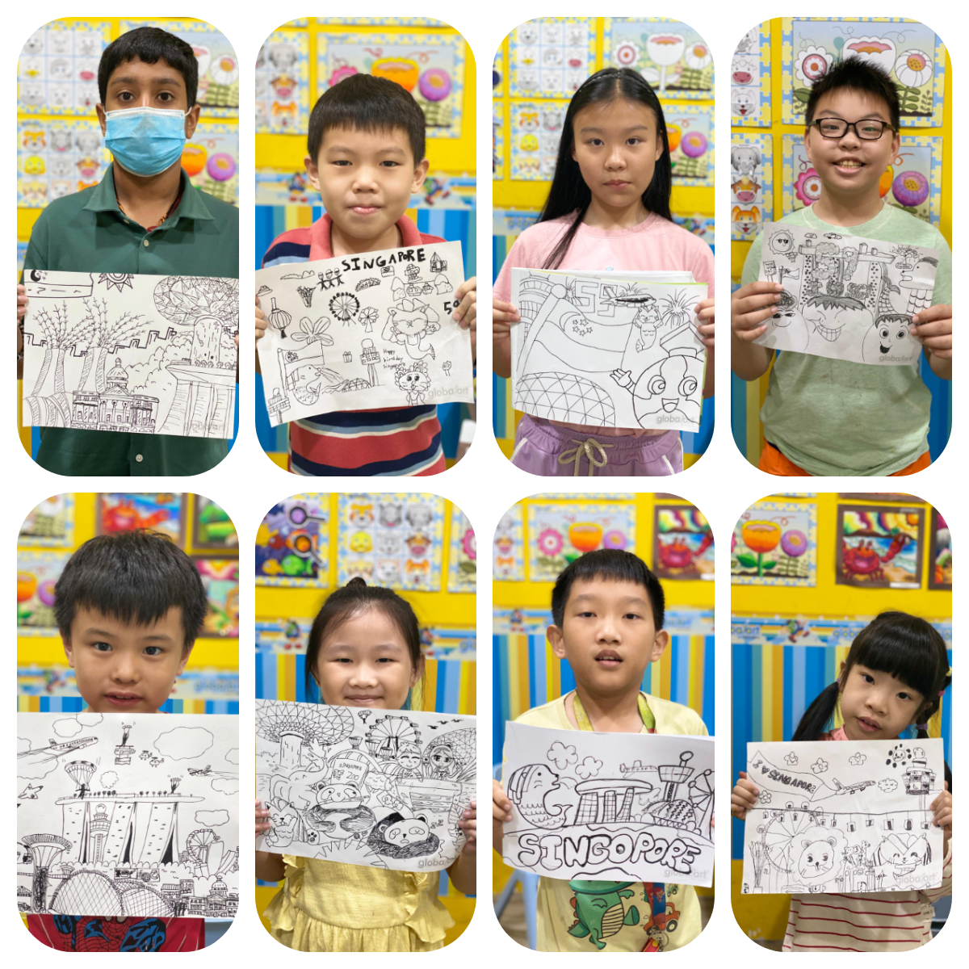
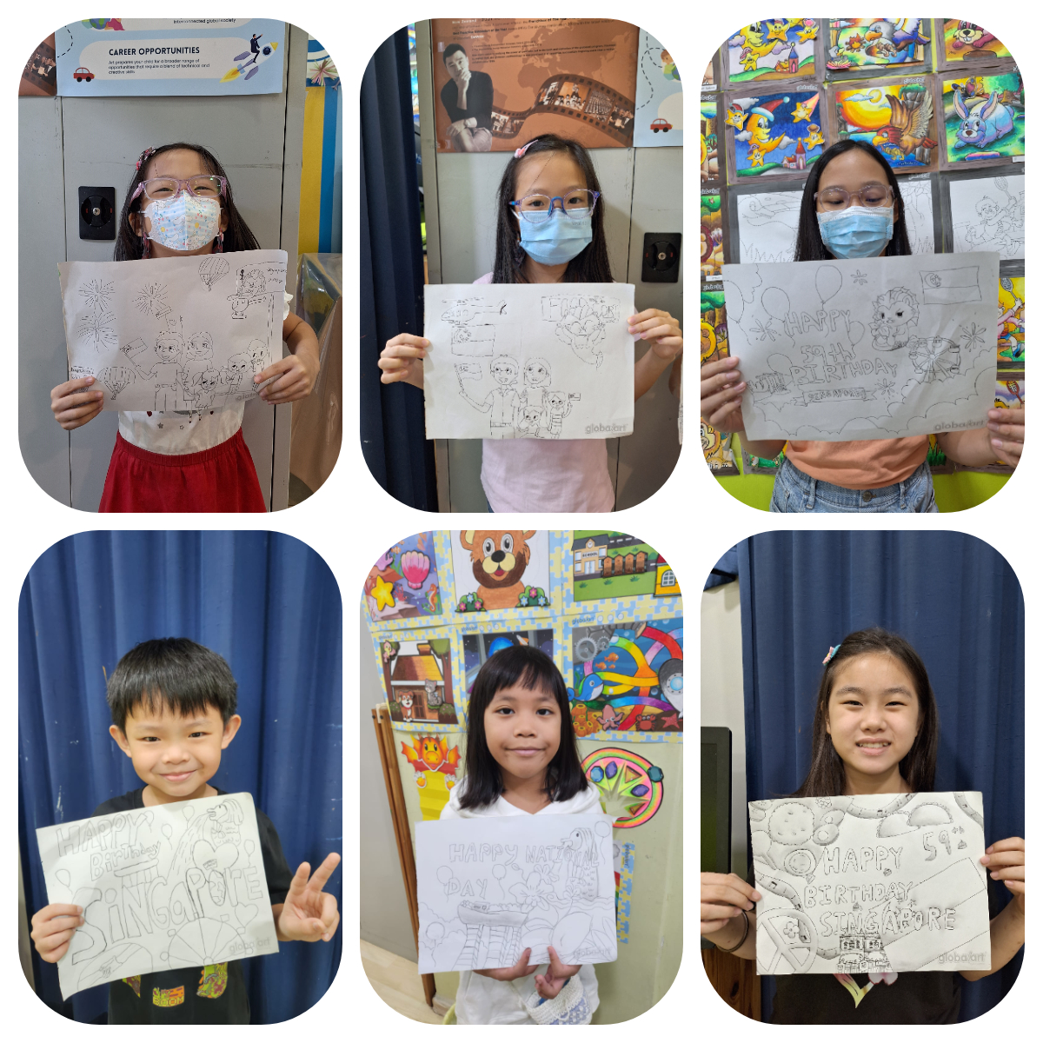
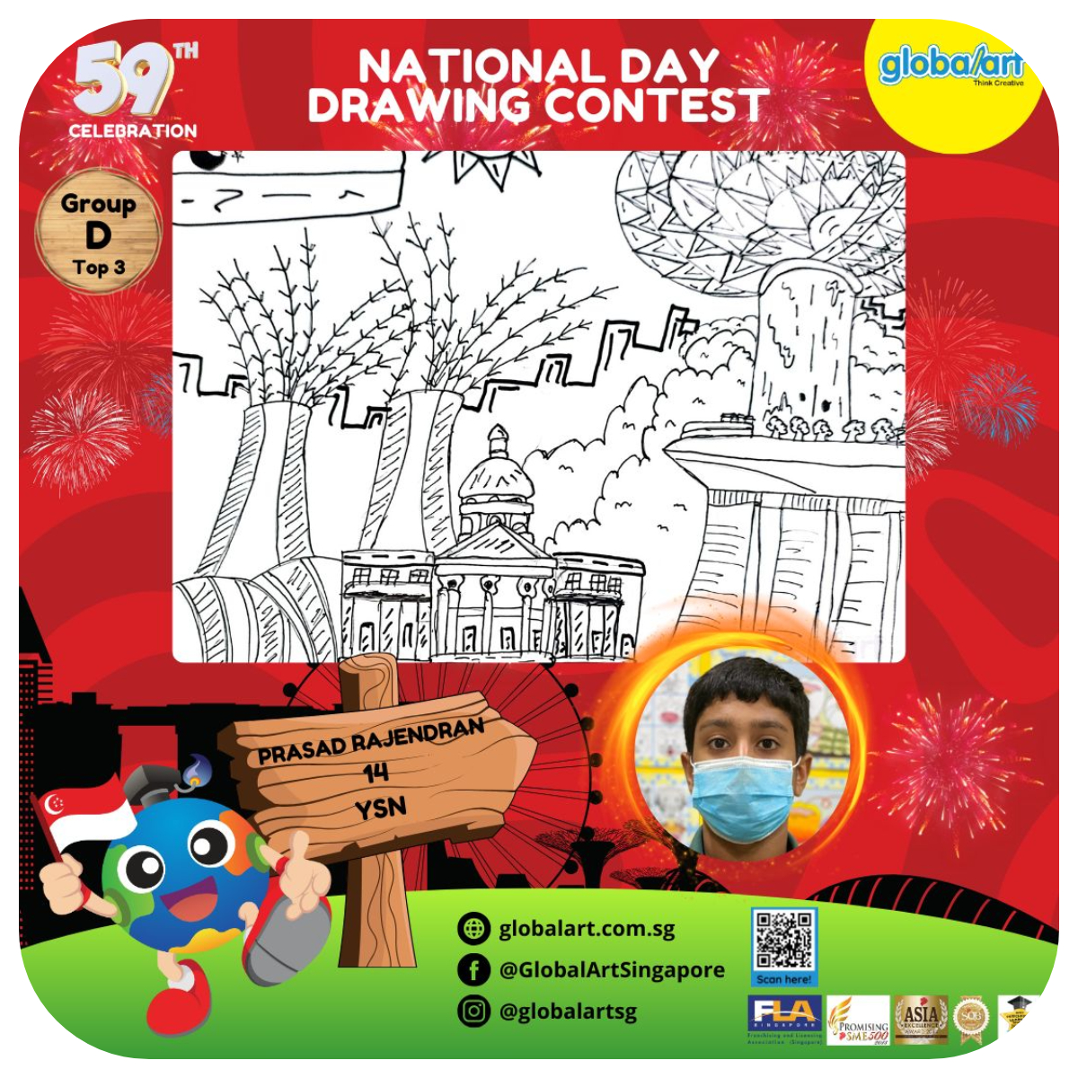
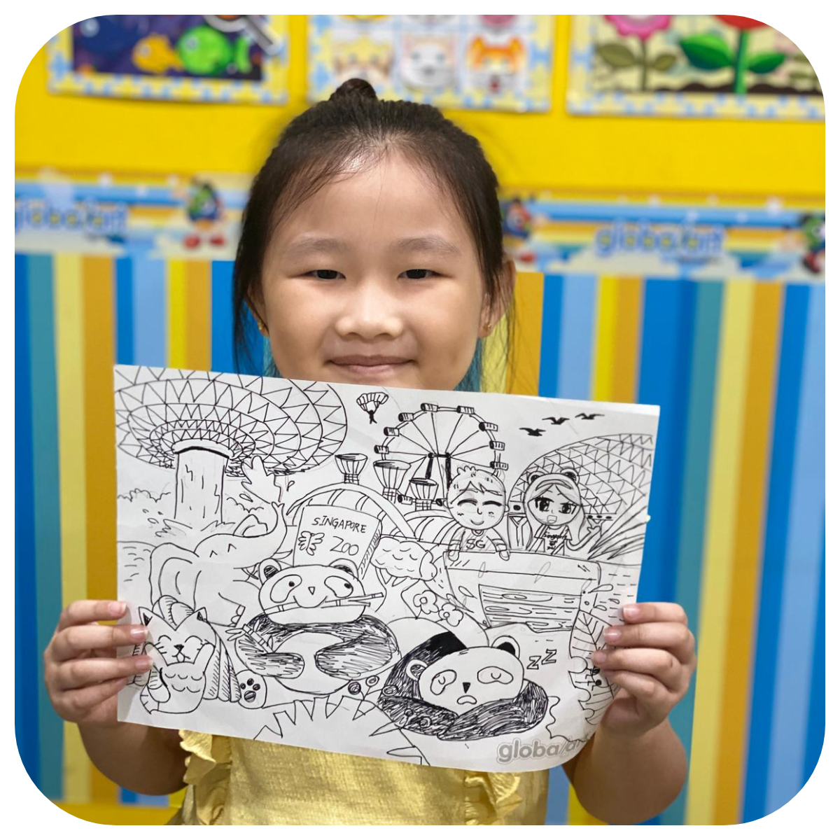
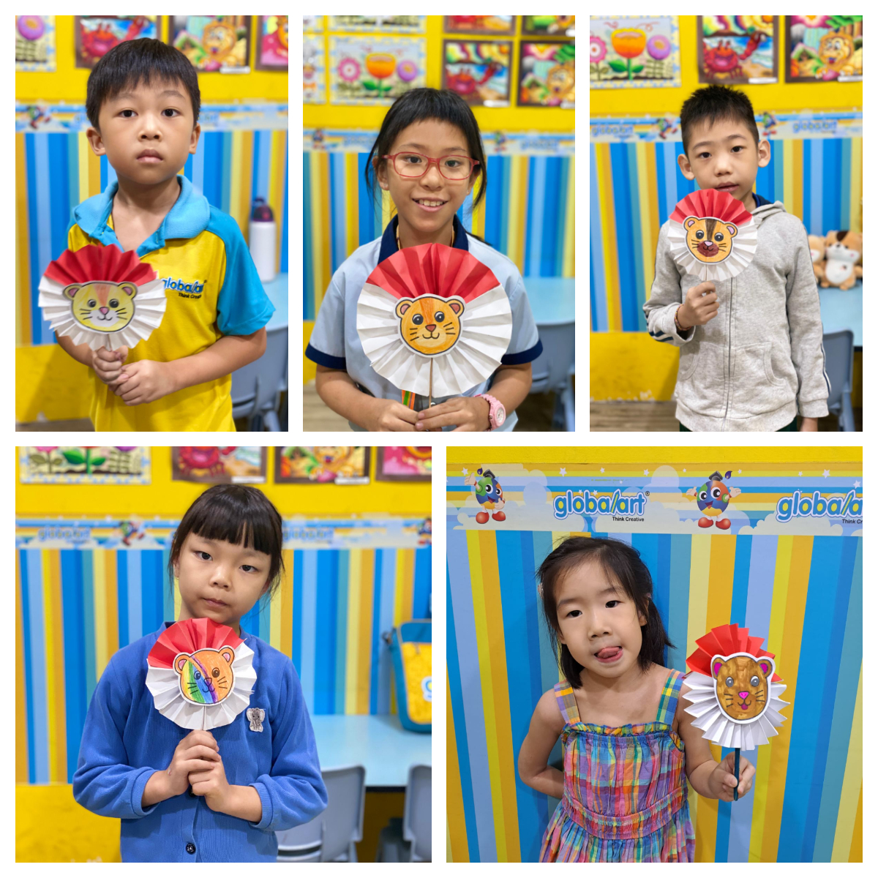
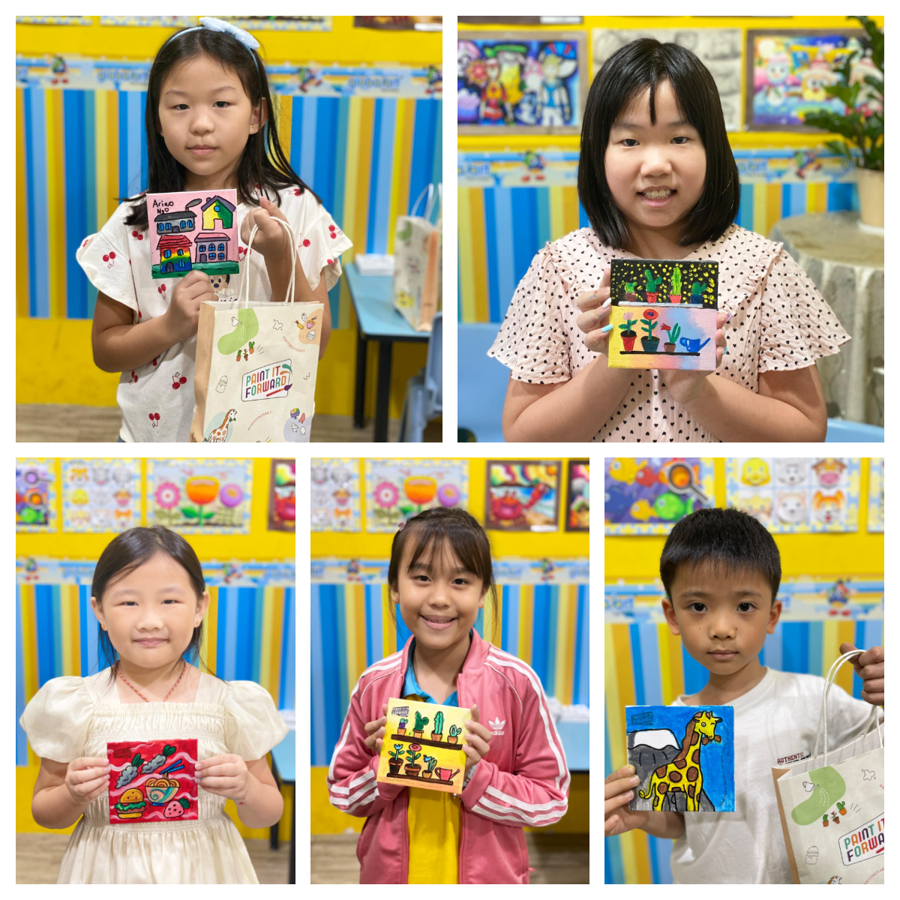
National Day Contests
Newsletter
July / August 2024
globalarthougangbedokyishun.com.sg
Facebook.com/globalarthggbccysn
Open Day in March
Congratulations to Prasad and Yong Qing
Prasad won the Top 3 Award in Group D while Yong Ching won the Most Creative Award in Group B
National Day Crafts
In celebrating National Day, students were treated to making their National Day Craft.
September
National Art Competition
October
International Grading
November
Open Day
December
Year-End Exhibition

Slide 4
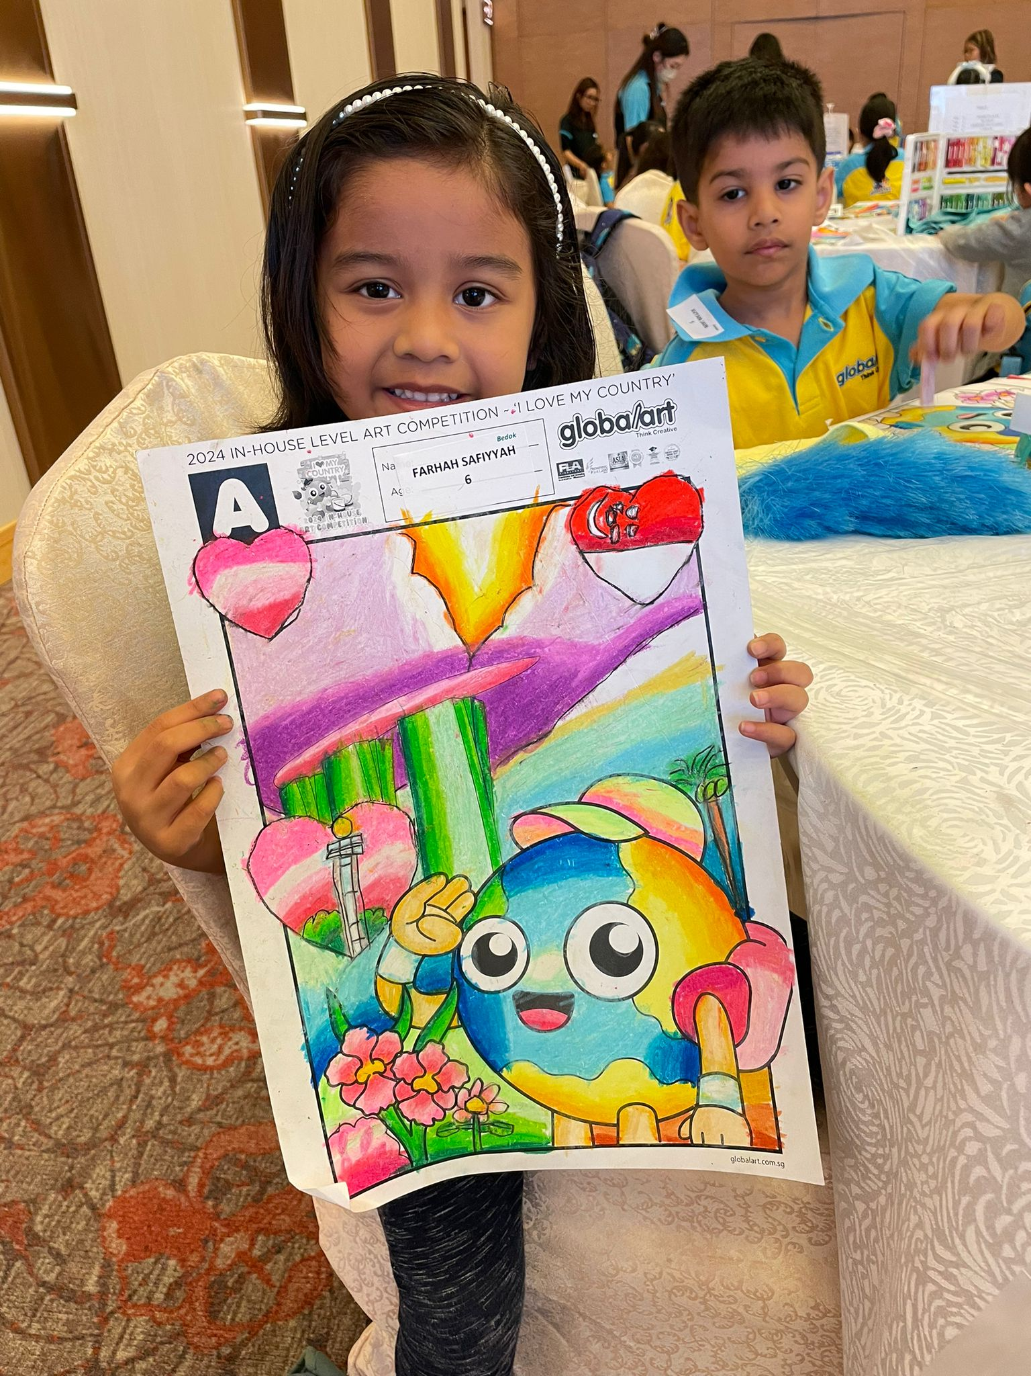
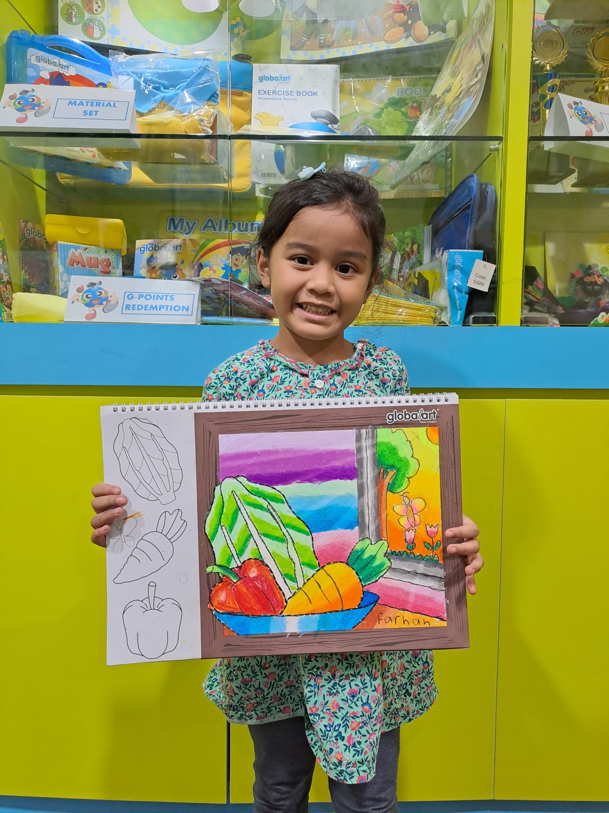
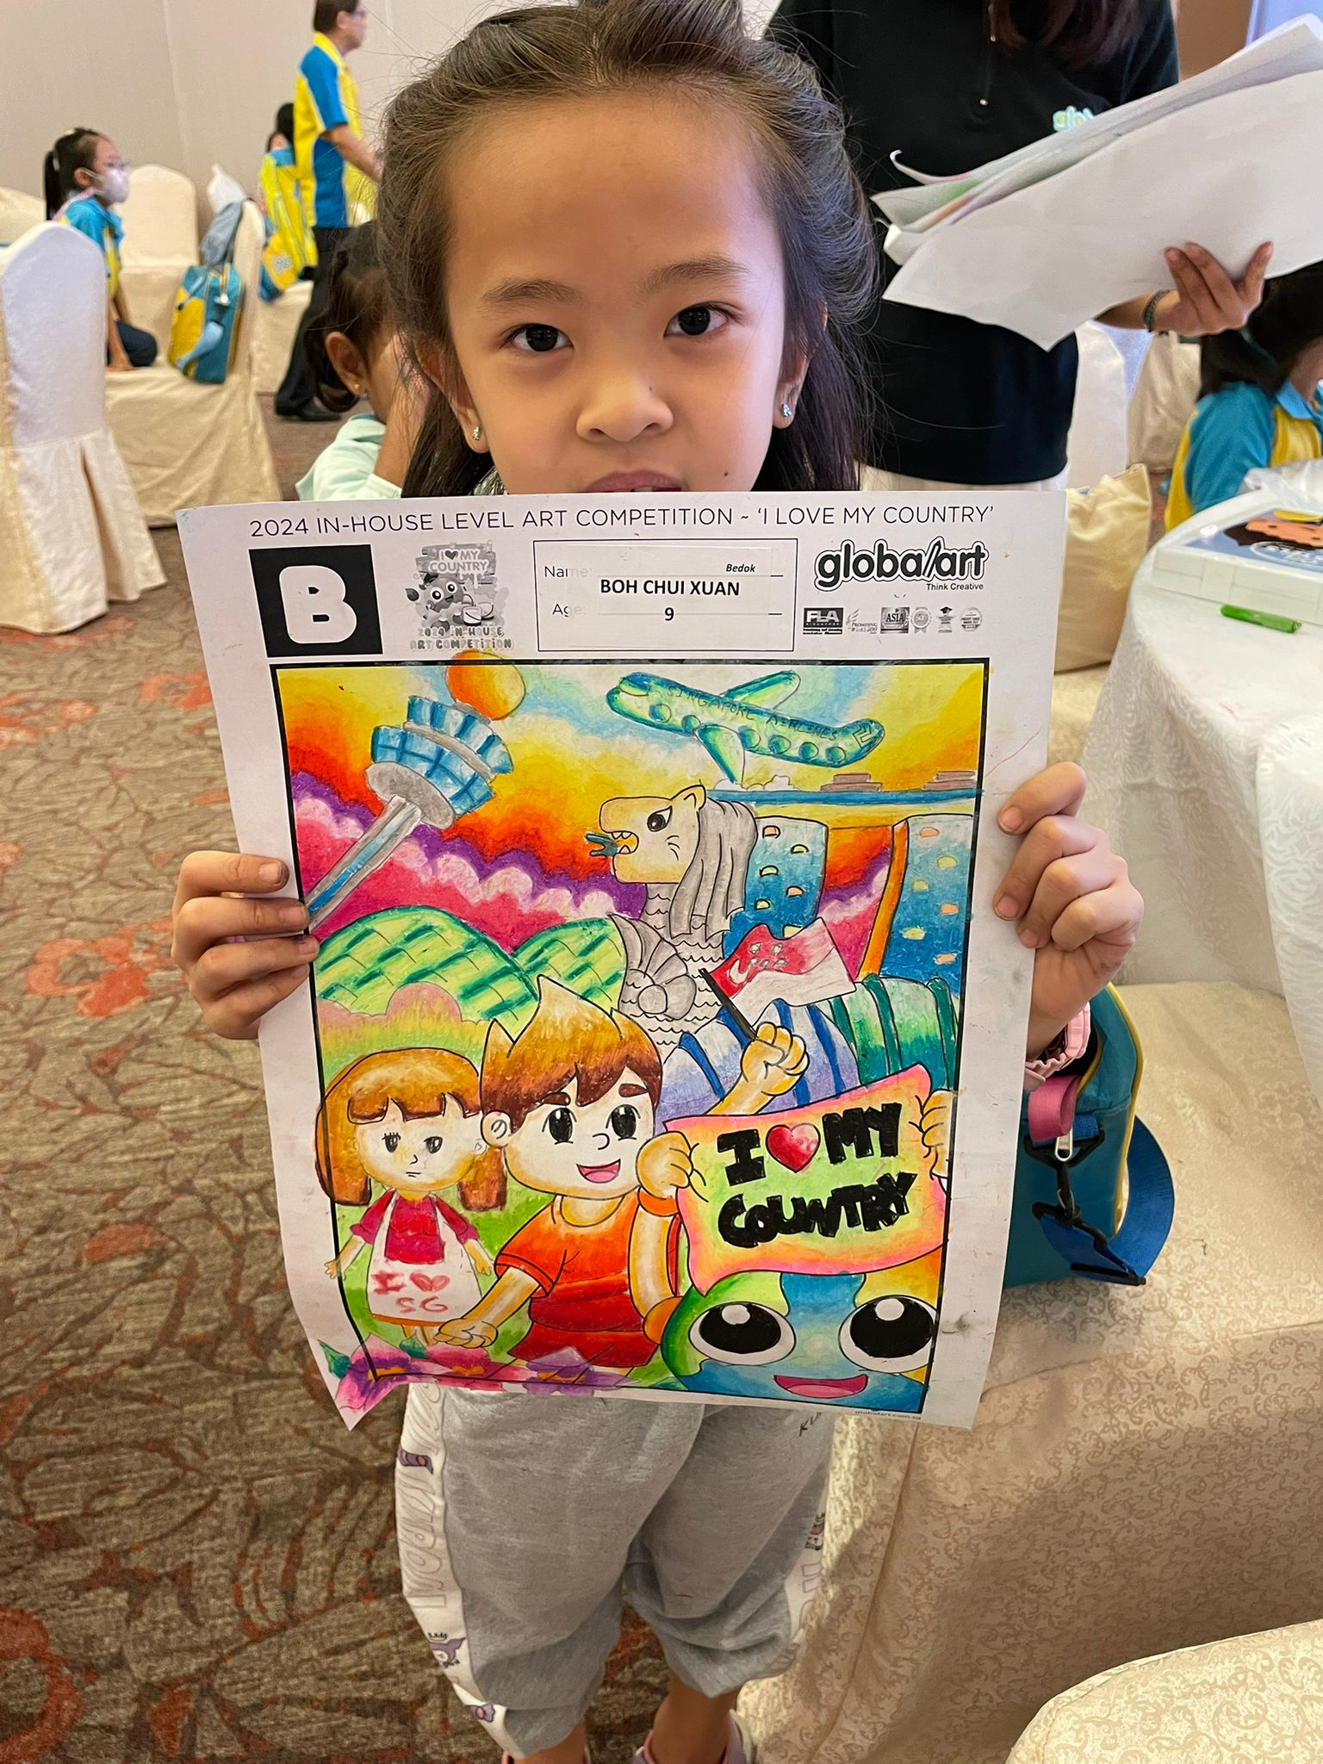
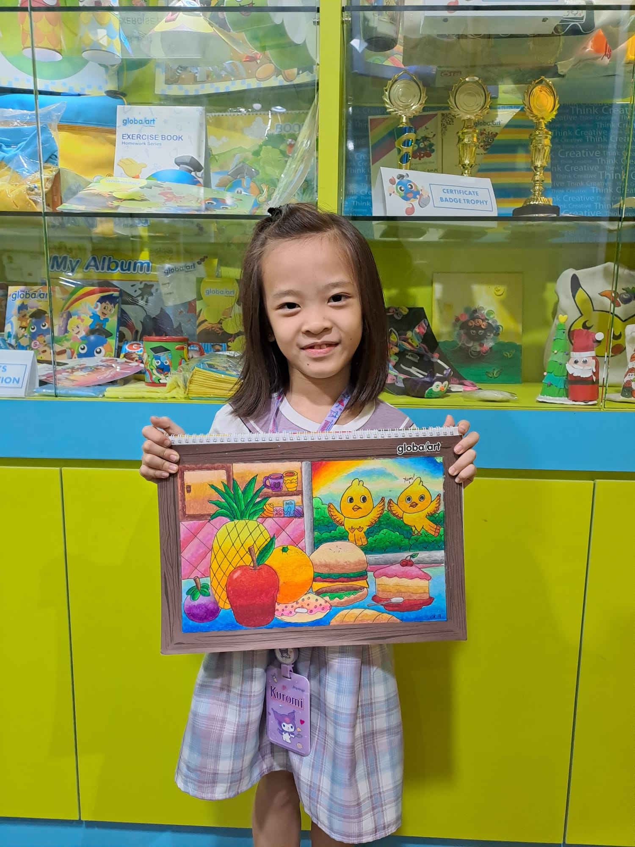
Let’s Meet Our Young Artists of July / August 2024
Farhah “the Colour Queen”
**Joined Us:** March 2024
**Age:** 6
**Current Level:** Foundation 3
**Achievements:**
- 2024 Global Art Bedok In-House Competition, Group A, Champion
Farhah joined our center with a huge love for drawing, and it shows! She’s super focused and always brings her A-game to class. With her calm and patient demeanor, Farhah is a dream to teach. Her artwork is known for its beautiful color combinations and neat presentation. Even though she’s only been with us for a short time, her progress has been incredible. We’re excited to see her tackle more complex subjects and continue to grow as an artist!
Farhah: “I like Global Art because the teacher is kind, and I love learning how to draw.”
Mother: “Since joining Global Art, Farhah has become more confident, not just in her drawings but in herself overall. The classes have been a real boost for her.”
Newsletter
July / August 2024
globalarthougangbedokyishun.com.sg
Facebook.com/globalarthggbccysn
Chui Xuan “the Detail Dynamo”
**Joined Us:** November 2021
**Age:** 9
**Current Level:** Basic Level 1
**Achievements:**
2023 Global Art Bedok In-House Competition, Group B, 1st Runner-Up
2023 Global Art Singapore National Art Competition, 4th Runner-Up
- Apr 2024 Global Art International Student Grading Examination, Foundation, Gold Award
2024 Global Art Bedok In-House Competition, Group B, Champion
Chui Xuan is our little star with an eye for detail! She’s quick to grasp new techniques and loves diving into the nitty-gritty of her art. Her pieces are always precise and beautifully colored. Over the years, she’s shown tremendous growth, and her hard work is paying off. We encourage her to keep challenging herself and setting new goals—there’s no stopping her!
Chui Xuan: “I like Global Art because I get to learn different art techniques.”
Mother: “Her growth has been incredible since starting at Global Art. She’s more confident, and I’m so grateful to Teacher Lum for her dedication and support.”
September
National Art Competition
October
International Grading
November
Open Day
December
Year-End Exhibition

Slide 5
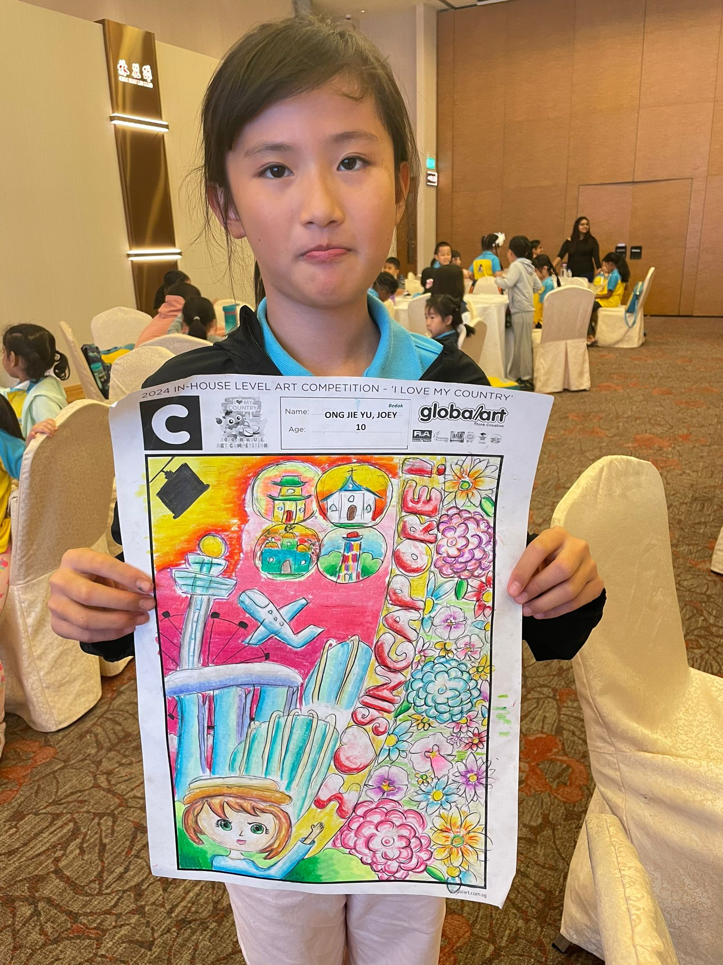
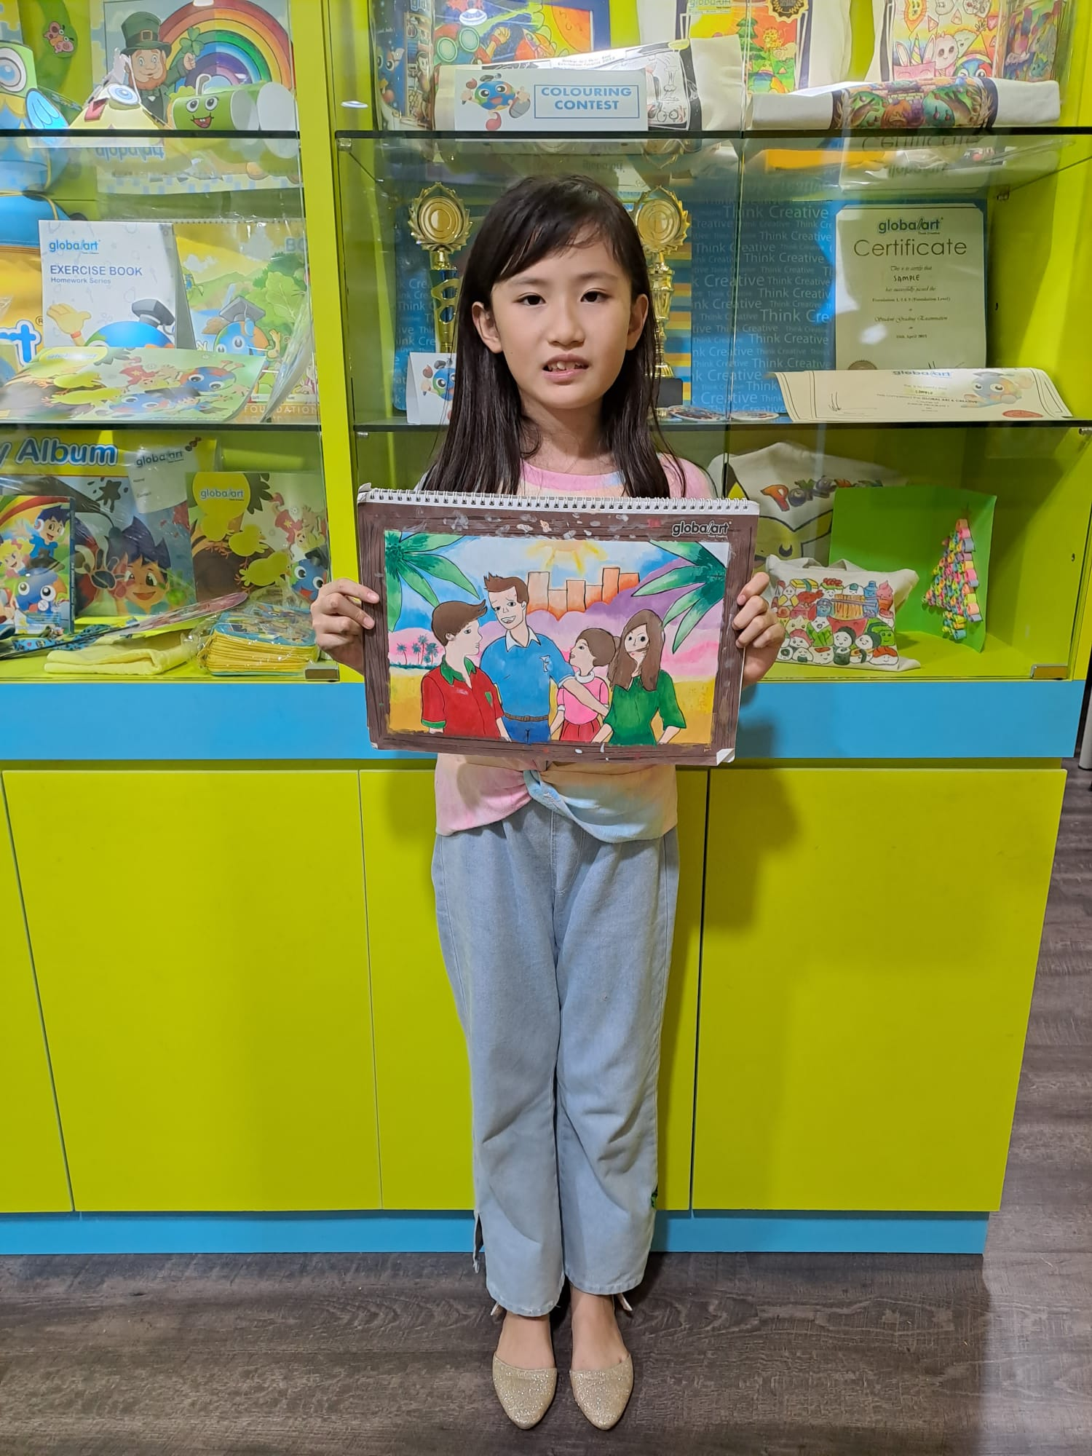
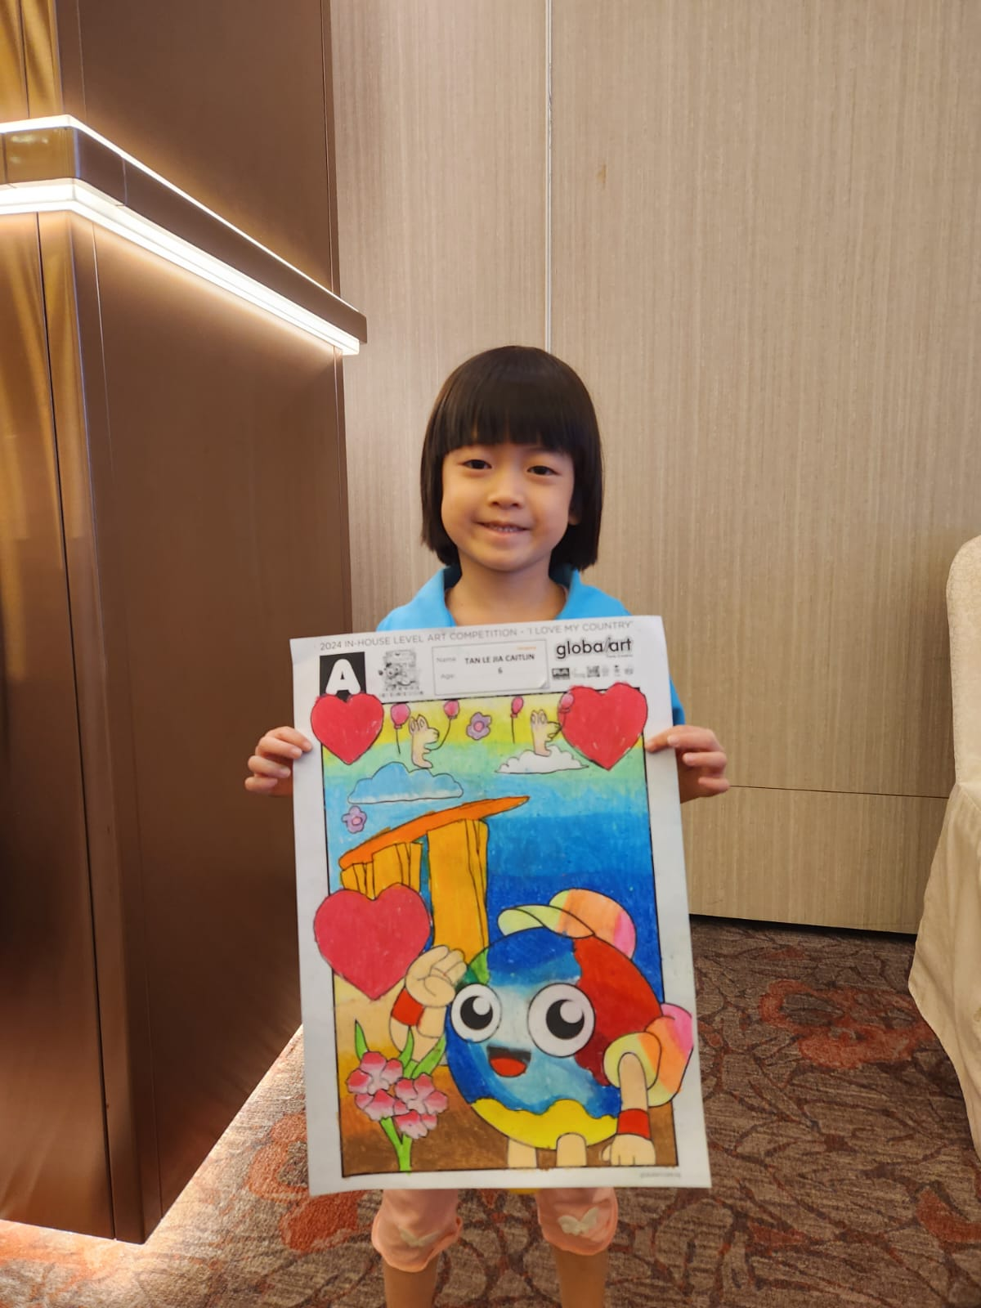
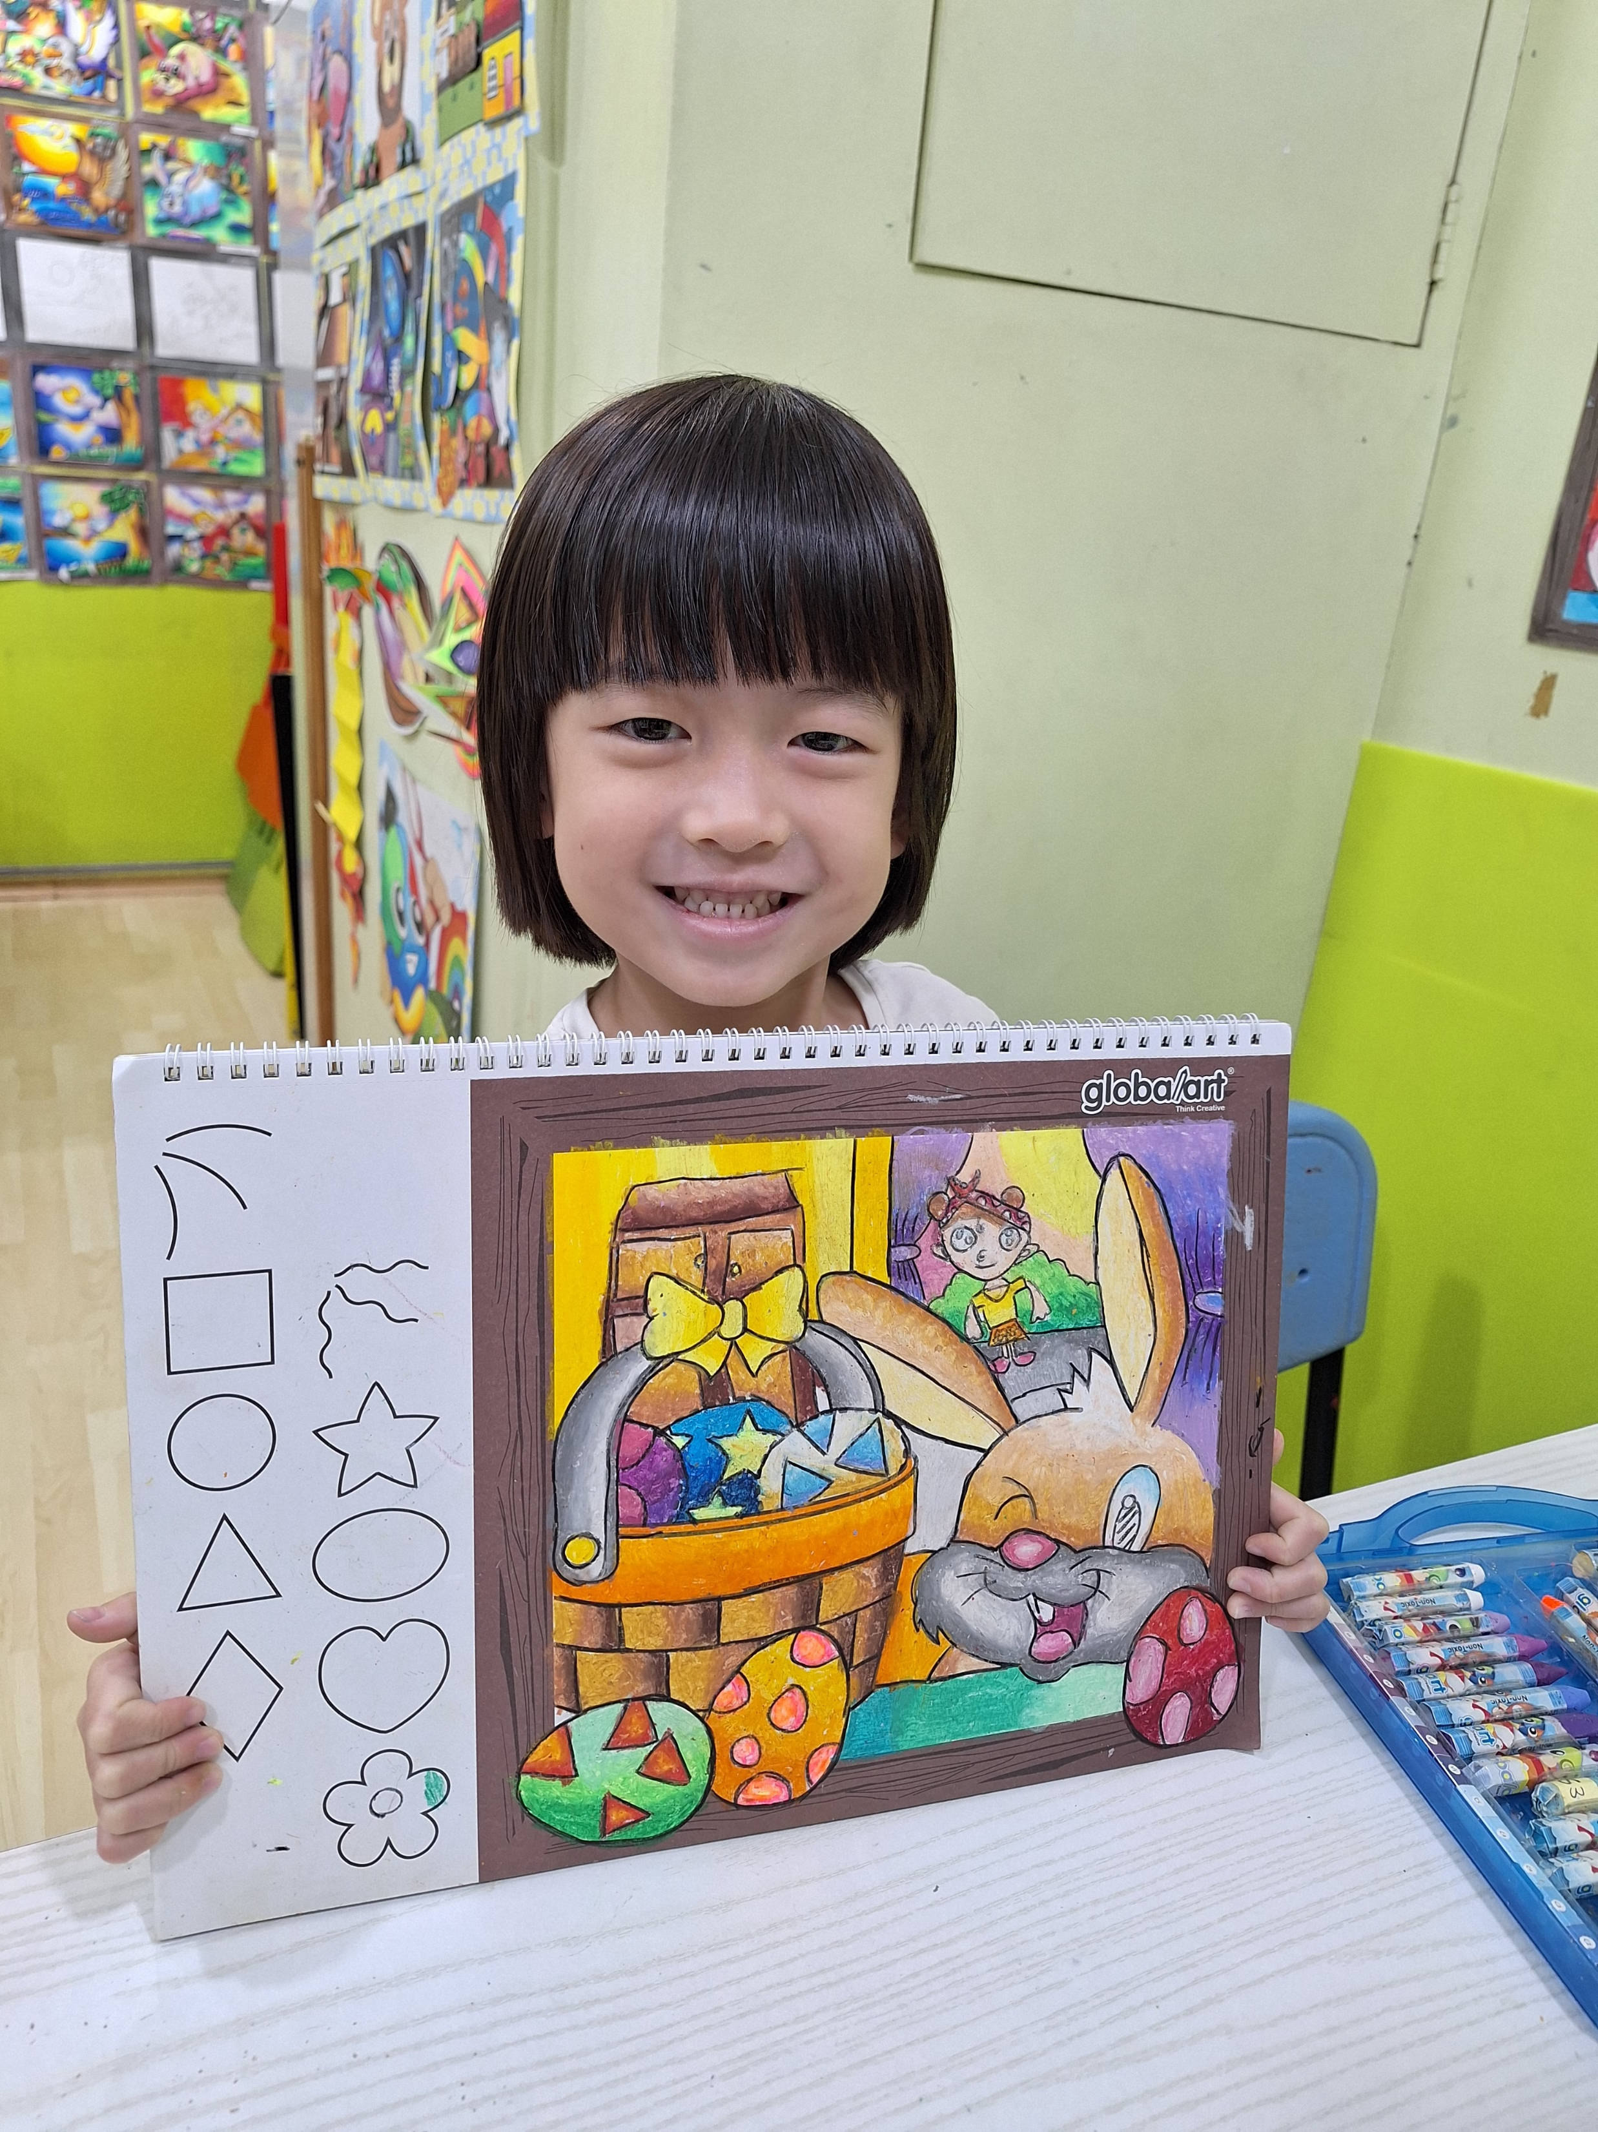
Joey "the Steady Artist”
**Joined Us:** July 2020
**Age:** 10
**Current Level:** Level 3
**Achievements:**
- 2024 Global Art Bedok In-House Competition, Group C, Champion
2023 Global Art Singapore Mother’s Day Competition
Joey is as steady as they come! She’s patient, diligent, and always listens carefully to feedback. Her dedication shines through in her consistent participation in competitions, where she often comes out on top. We’re thrilled to see her progress, especially in translating feedback into practice. Next up for Joey? Mastering the use of color to take her work to the next level!
Joey: “I like the teachers, the classroom, and the lessons because I learn a lot of new things that help me in my daily life.”
Mother: “Joey has really blossomed since starting at Global Art. She’s more confident, creative, and even suggested making artwork as a gift for her friend’s birthday—a big step in showcasing her talent.”
Newsletter
July / August 2024
globalarthougangbedokyishun.com.sg
Facebook.com/globalarthggbccysn
Caitlin “the Quiet Creator"
**Joined Us:** May 2023
**Age:** 6
**Current Level:** Foundation 3
**Achievements:**
2024 Global Art Hougang In-House Competition, Group A, Champion
Caitlin may be quiet, but her art speaks volumes! She loves drawing cute animal characters and focuses deeply on her work in class. We’re encouraging her to explore new themes and try different art styles to broaden her creative horizons. Keep up the amazing work, Caitlin—we’re excited to see where your talent takes you!
Father: “Her drawing and colouring have improved significantly. She can blend and colour beautifully, and sometimes she even does free drawing on her own after school. We’ve seen a lot of progress since she started at Global Art.”
September
National Art Competition
October
International Grading
November
Open Day
December
Year-End Exhibition

Slide 6
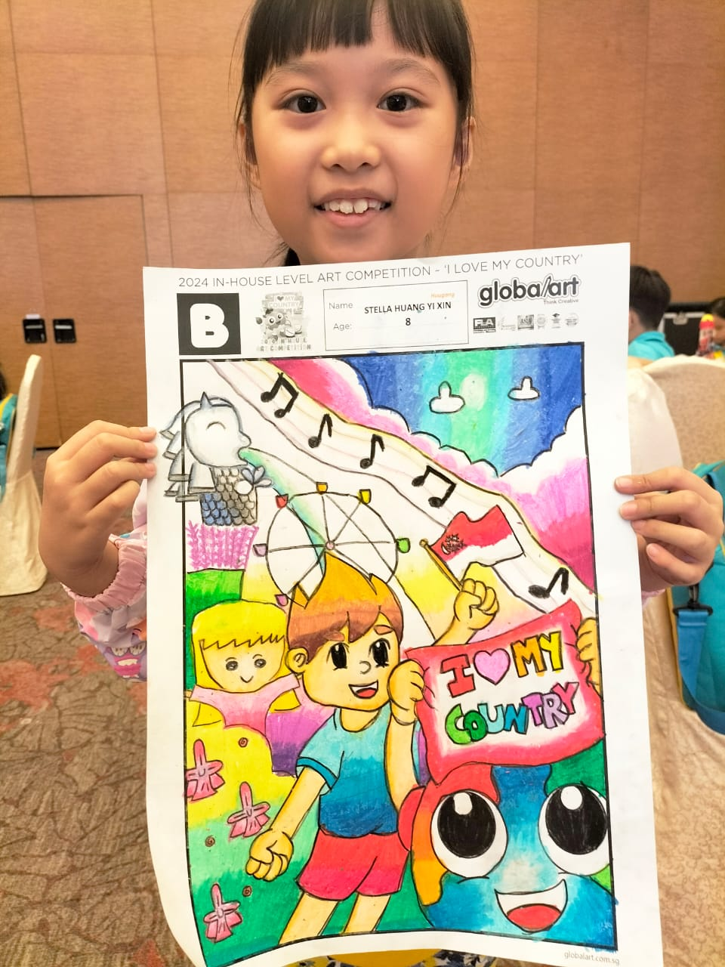
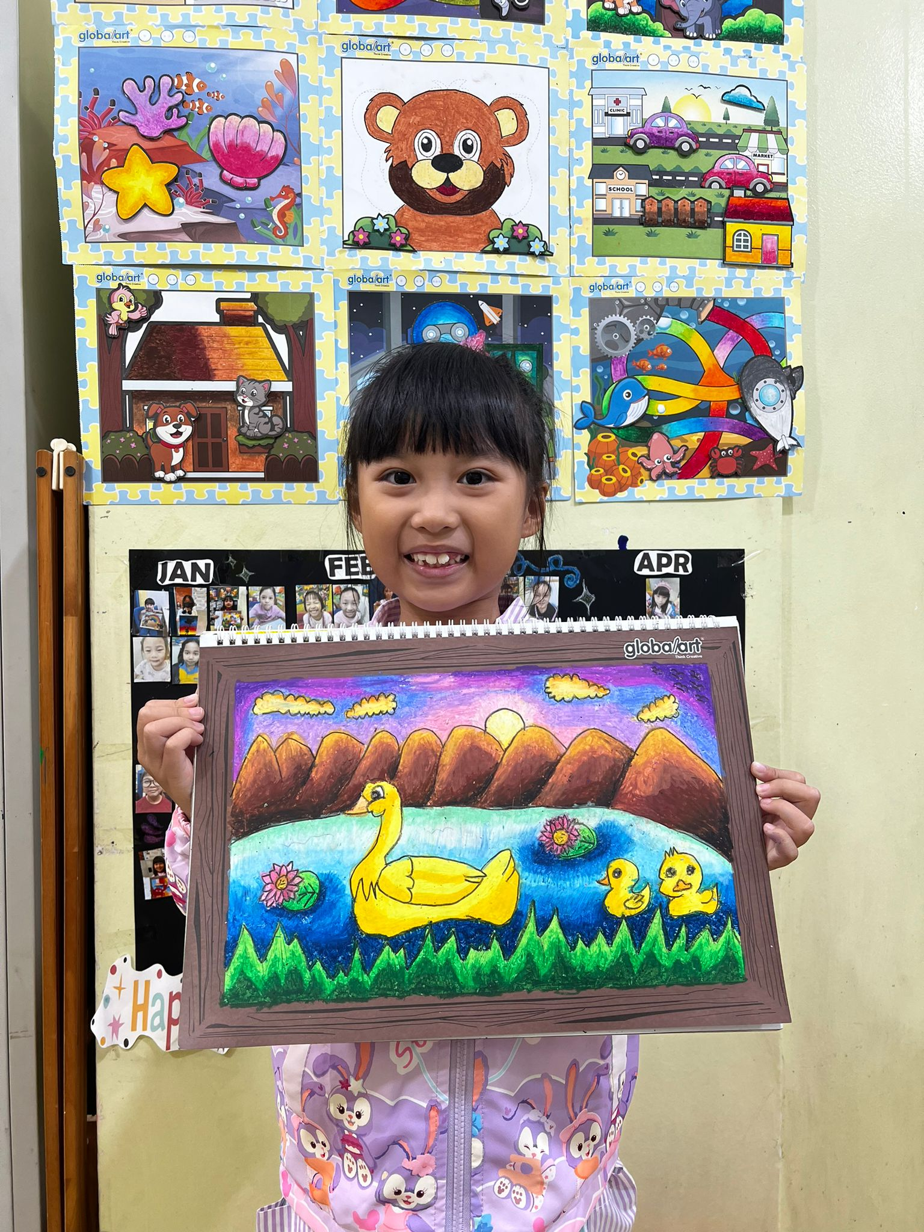
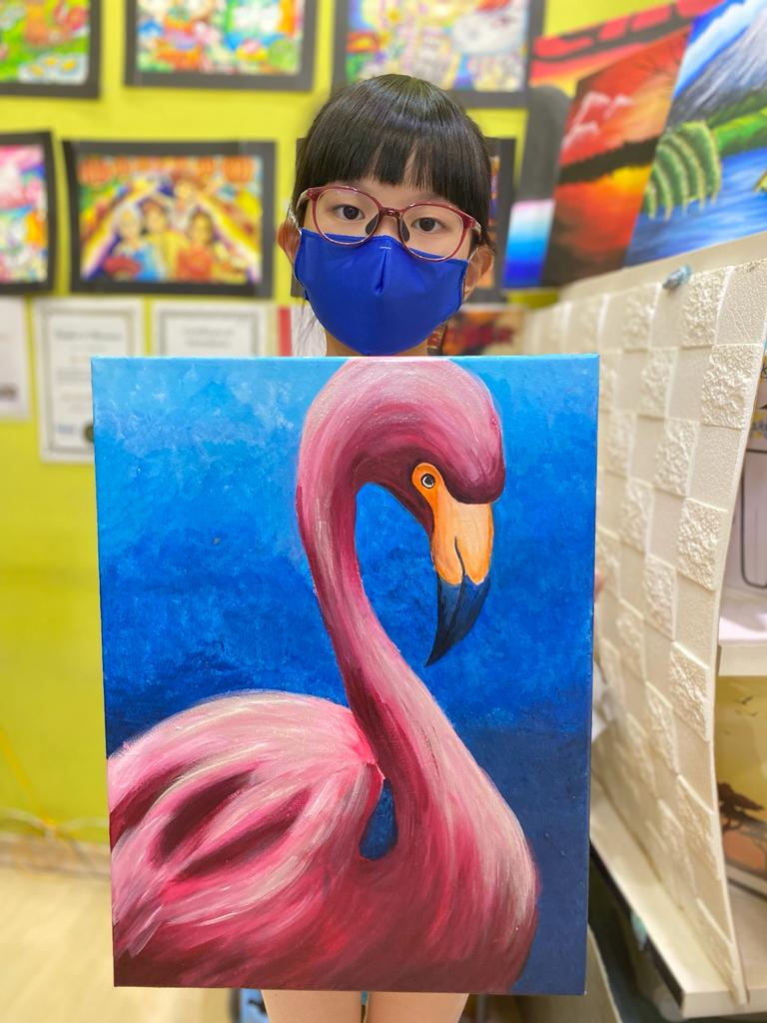
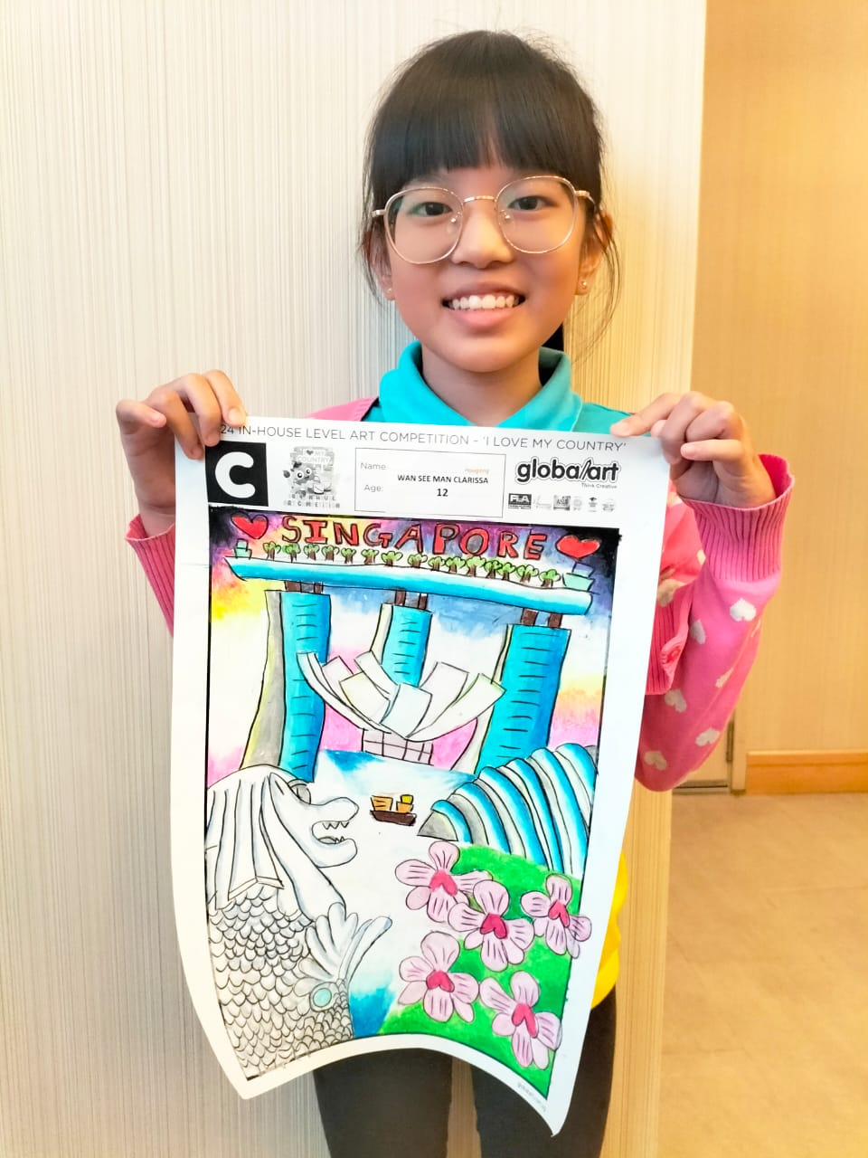
Stella “the Cartoon Connoisseur"
**Joined Us:** March 2021
**Age:** 8
**Current Level:** Basic Level
**Achievements:**
- 2024 Global Art Hougang In-House Competition, Group B, Champion
- 2023 Global Art Singapore National Art Competition, Group B, Best Performance
Stella is our resident cartoon and anime expert! She’s super focused in class and loves creating adorable characters. Stella is always eager to improve and isn’t shy about asking questions when she needs help. We’re looking forward to seeing her dive into more advanced techniques and continue refining her unique style.
Stella: “I like the coloring.”
Mother: “Stella’s creativity and concentration have both improved. After attending Global Art lessons, she’s able to create more imaginative art with the guidance of her teachers.”
Newsletter
July / August 2024
globalarthougangbedokyishun.com.sg
Facebook.com/globalarthggbccysn
Clarissa the “Acrylic Aficionado"
**Joined Us:** January 2021
**Age:** 12
**Current Level:** Acrylic Junior Level
**Achievements:**
- 2024 Global Art Hougang In-House Competition, Group C, Champion
- 2023 Global Art Hougang In-House Competition, Group C, 3rd Runner-Up
Clarissa brings cheer and energy to every class! She loves acrylic painting and is always working on her favorite characters. Clarissa’s independence and proactive approach to learning make her a standout student. We’re excited to see her continue experimenting with new techniques and growing as an artist.
Clarissa: “I like the acrylic lessons.”
Mother: “Clarissa loves her Global Art lessons and puts a lot of effort into learning the skills and techniques. Thanks to the dedicated teachers at Global Art Hougang, her art has really flourished. I’m excited to see her continue growing her passion for art.”
September
National Art Competition
October
International Grading
November
Open Day
December
Year-End Exhibition

Slide 7
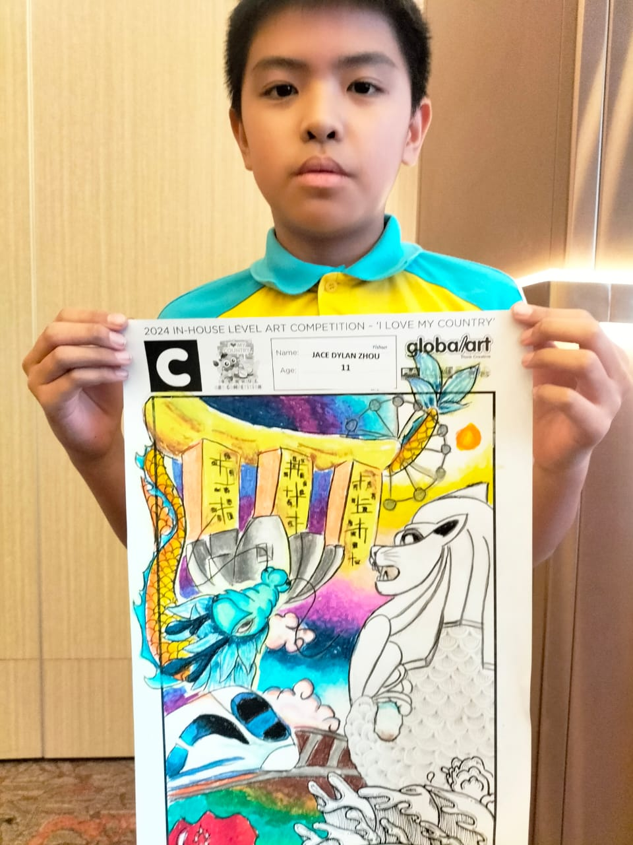
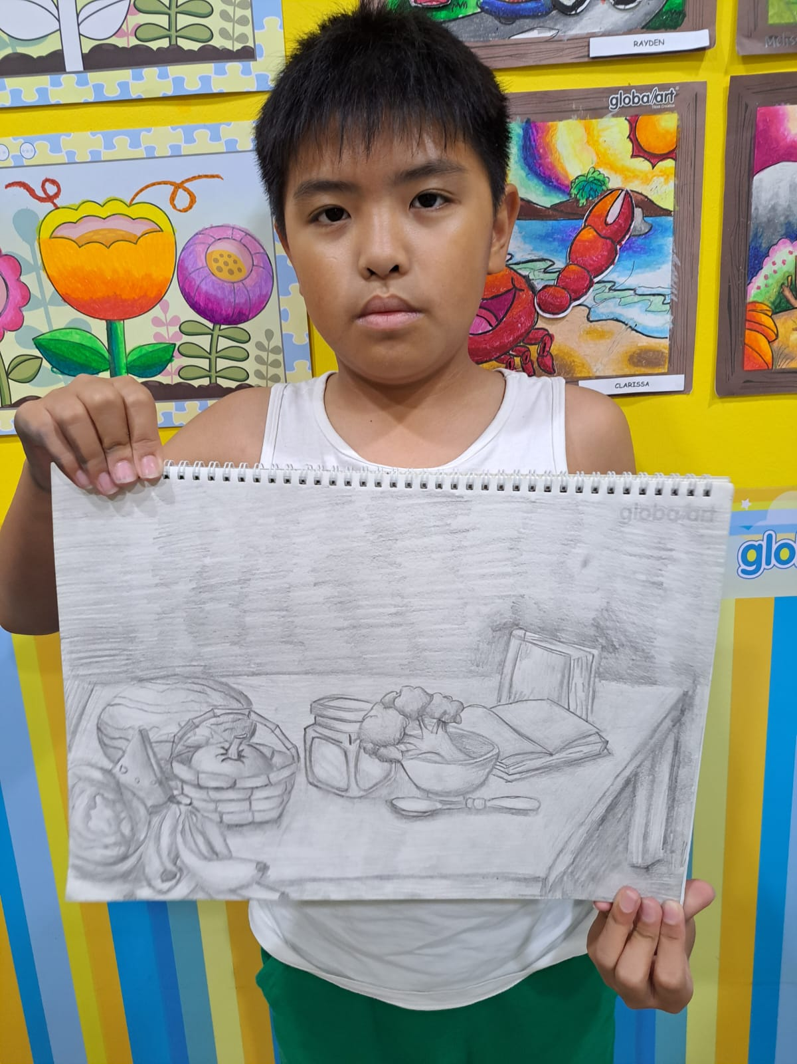
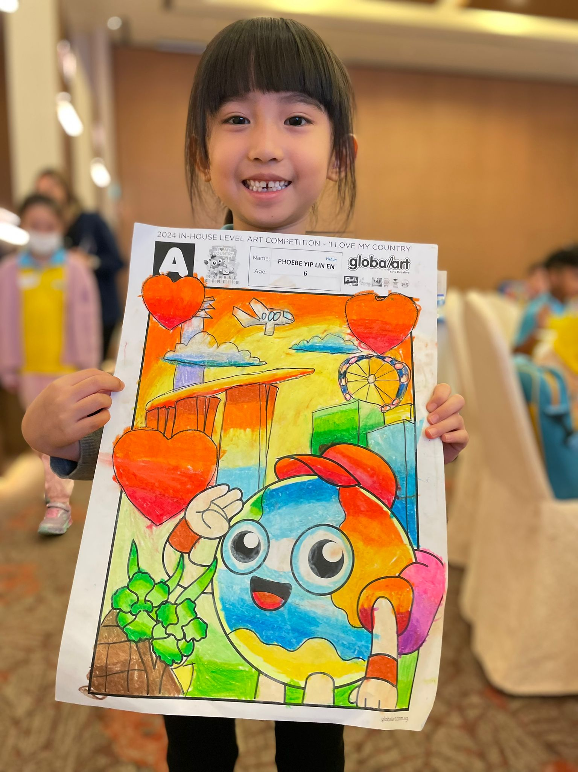
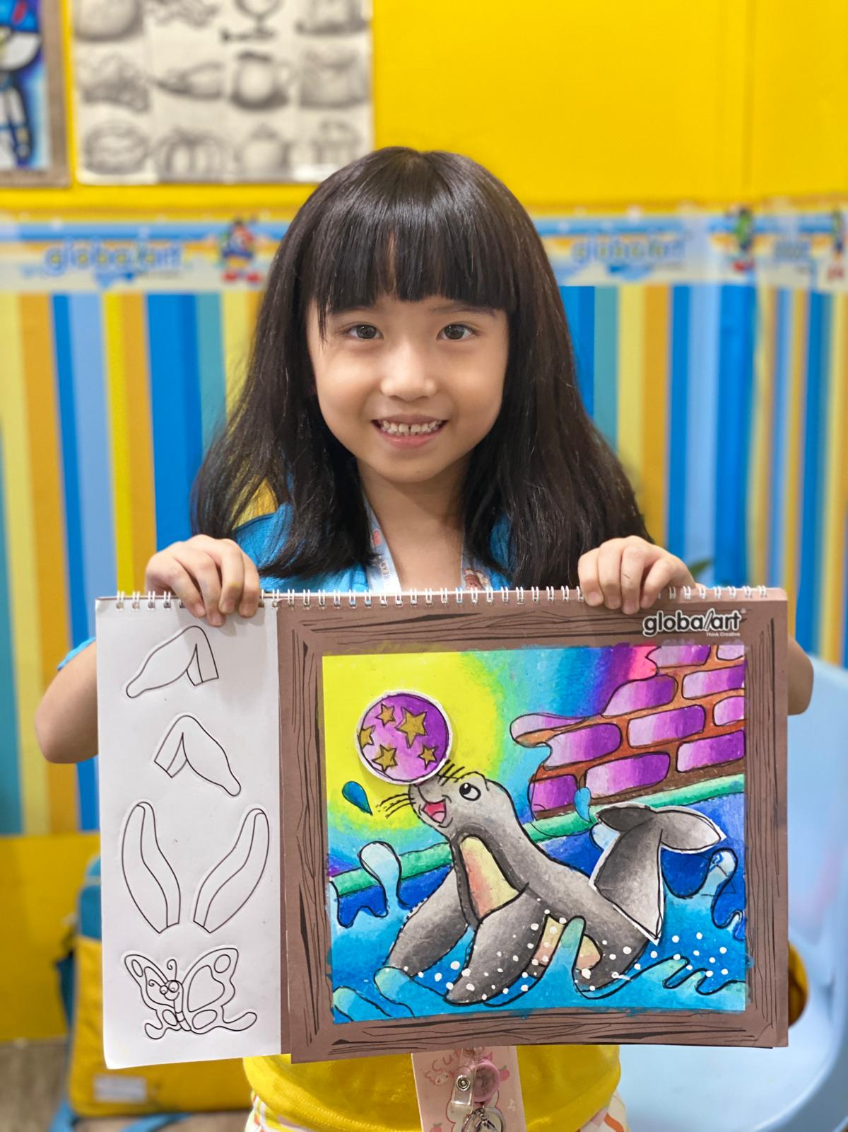
Jace “the Born Artist"
**Joined Us:** May 2023
**Age:** 11
**Current Level:** Advanced 1
**Achievements:**
- 2024 Global Art Yishun In-House Competition, Group C, Champion
2023 Global Art Singapore National Day Competition
Jace is a natural talent! Though he’s soft-spoken, his art speaks for itself. Whether it’s drawing, shading, or painting, Jace excels in every aspect. We’re sure that the sky’s the limit for him, and we can’t wait to see how he continues to soar in the art world!
Jace: “I like the teacher and classroom. I really appreciate the support my teacher has given me; I’ll always enjoy creating my artwork.”
Parent: “Global Art lessons have been great for developing my son’s creativity.”
Newsletter
July / August 2024
globalarthougangbedokyishun.com.sg
Facebook.com/globalarthggbccysn
Upcoming Events
Phoebe “the Sparkle Princess"
**Joined Us:** September 2023
**Age:** 6
**Current Level:** Foundation Level 2
**Achievements:**
- 2024 Global Art Yishun In-House Competition, Group A, Champion
- 2024 Global Art Singapore Mother’s Day Color Contest
Phoebe’s world is full of unicorns, rainbows, and lots of sparkles! She started off a bit shy, but she’s blossomed into a confident and cheerful student who loves sharing her love for art with her classmates. We’re excited to see her continue to develop her skills and bring her magical worlds to life on paper!
Phoebe: “I like the art class.”
Parent: “It’s helped develop her social skills, hand strength, patience, and cultivated her interests.”
September
National Art Competition
October
International Grading
November
Open Day
December
Year-End Exhibition

Slide 8
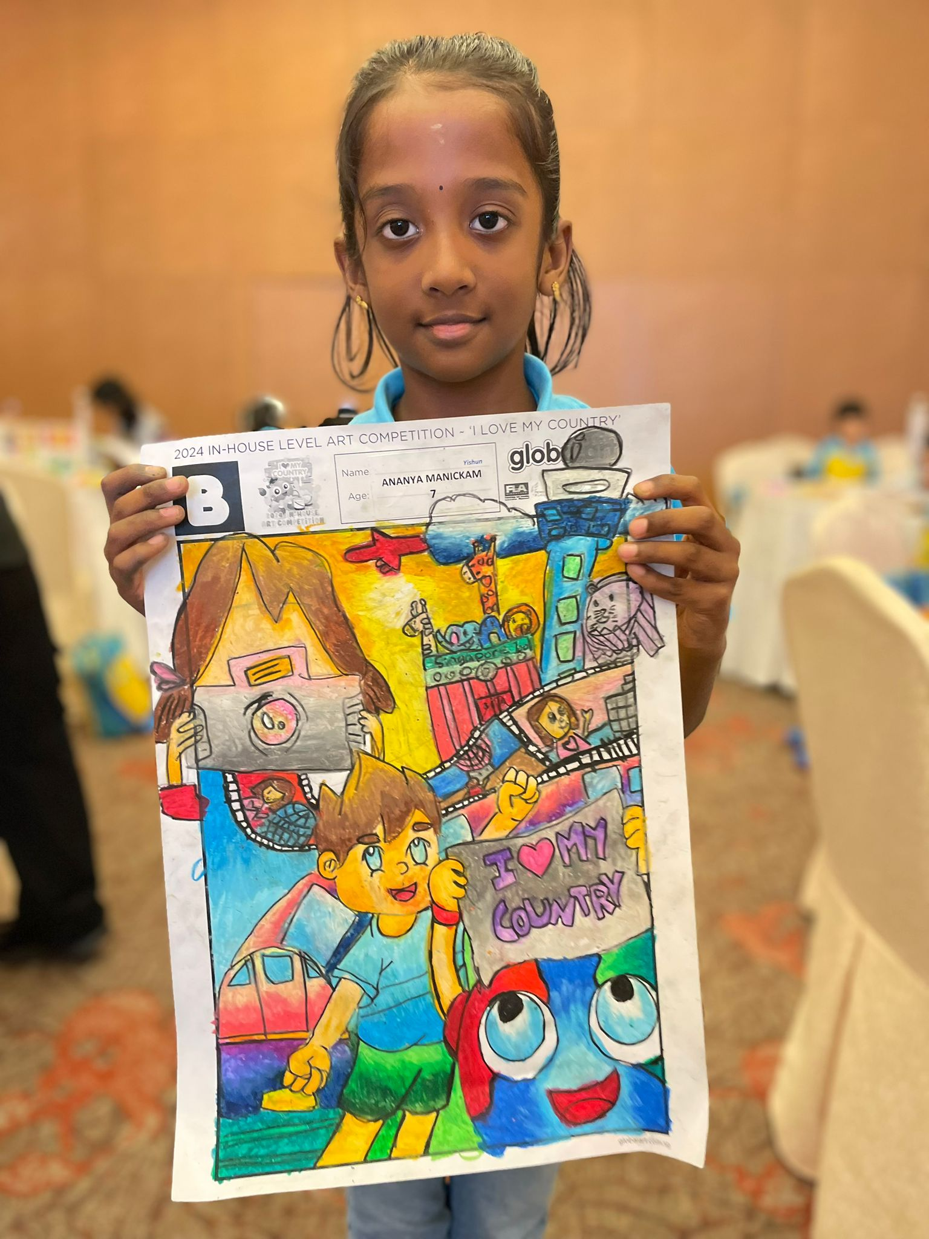
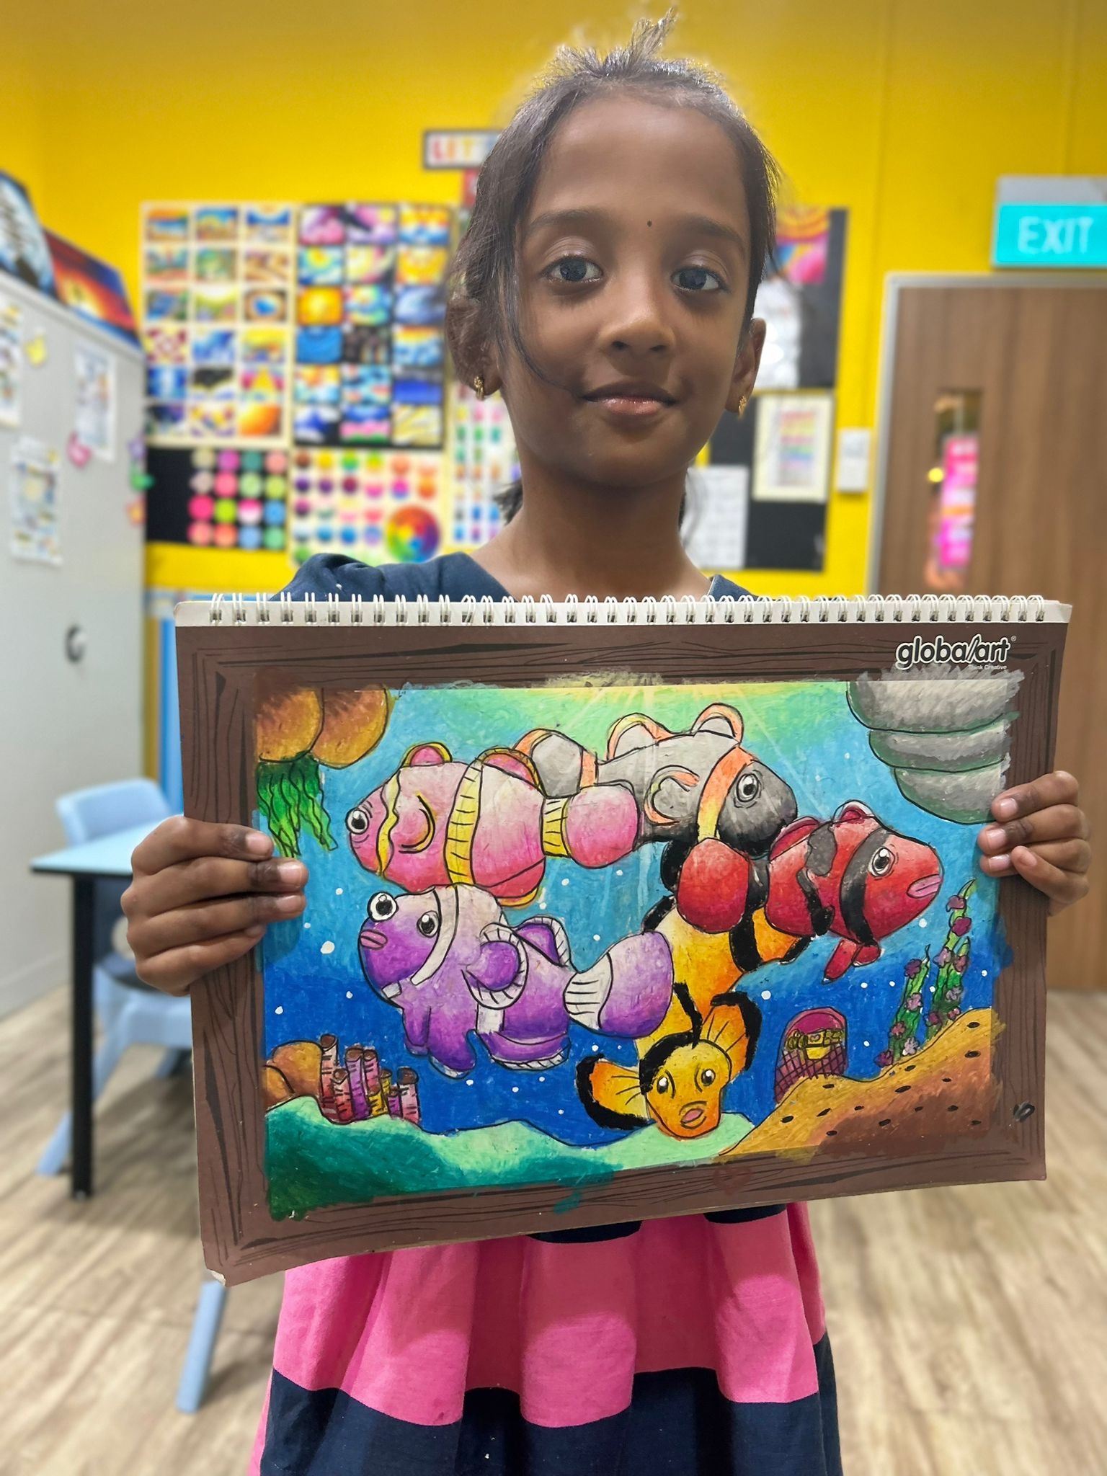
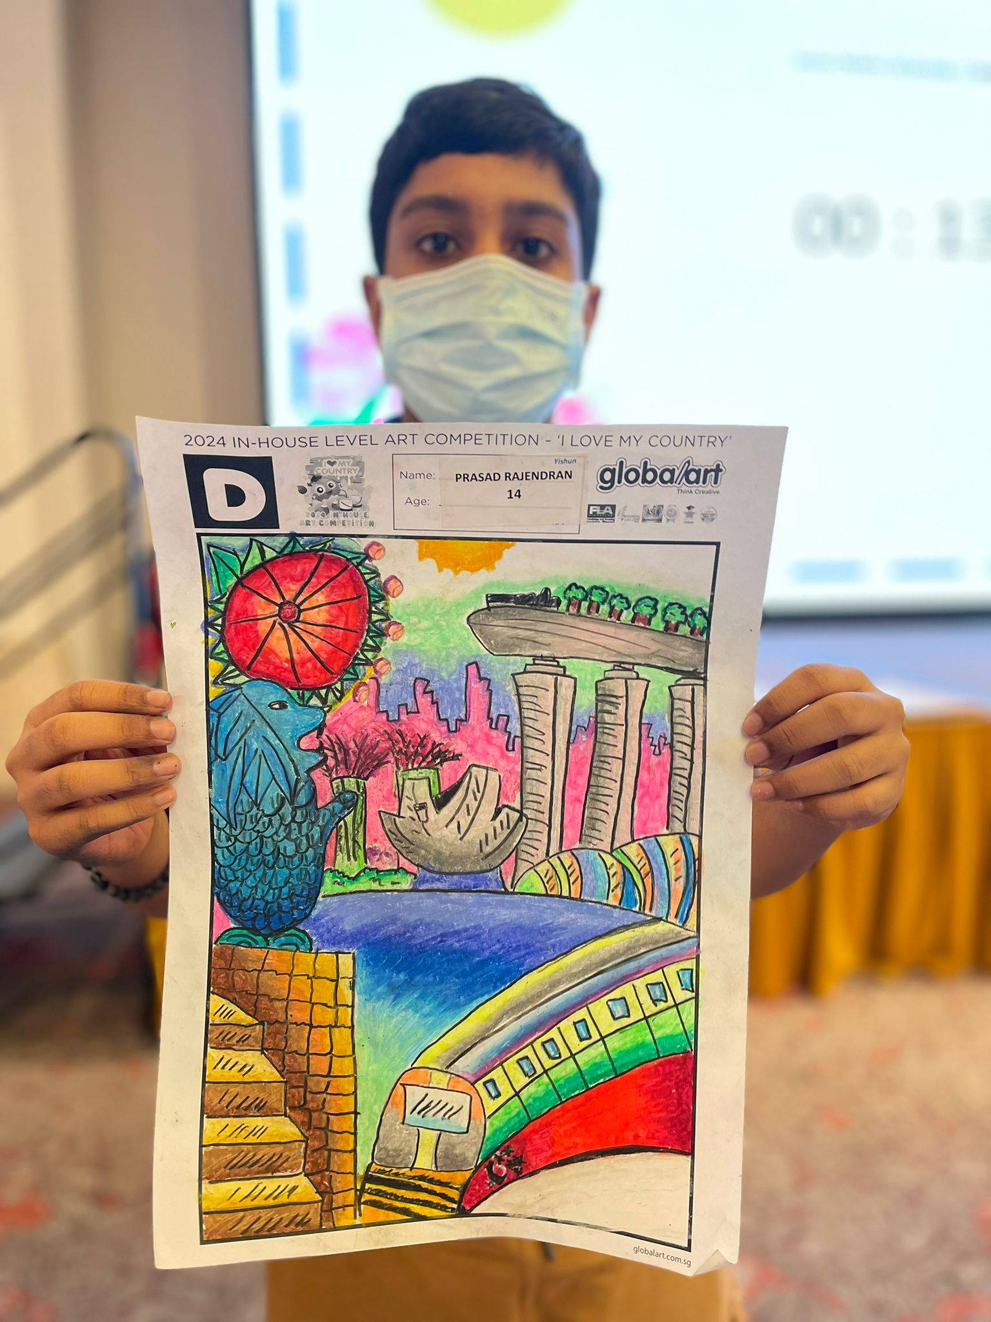
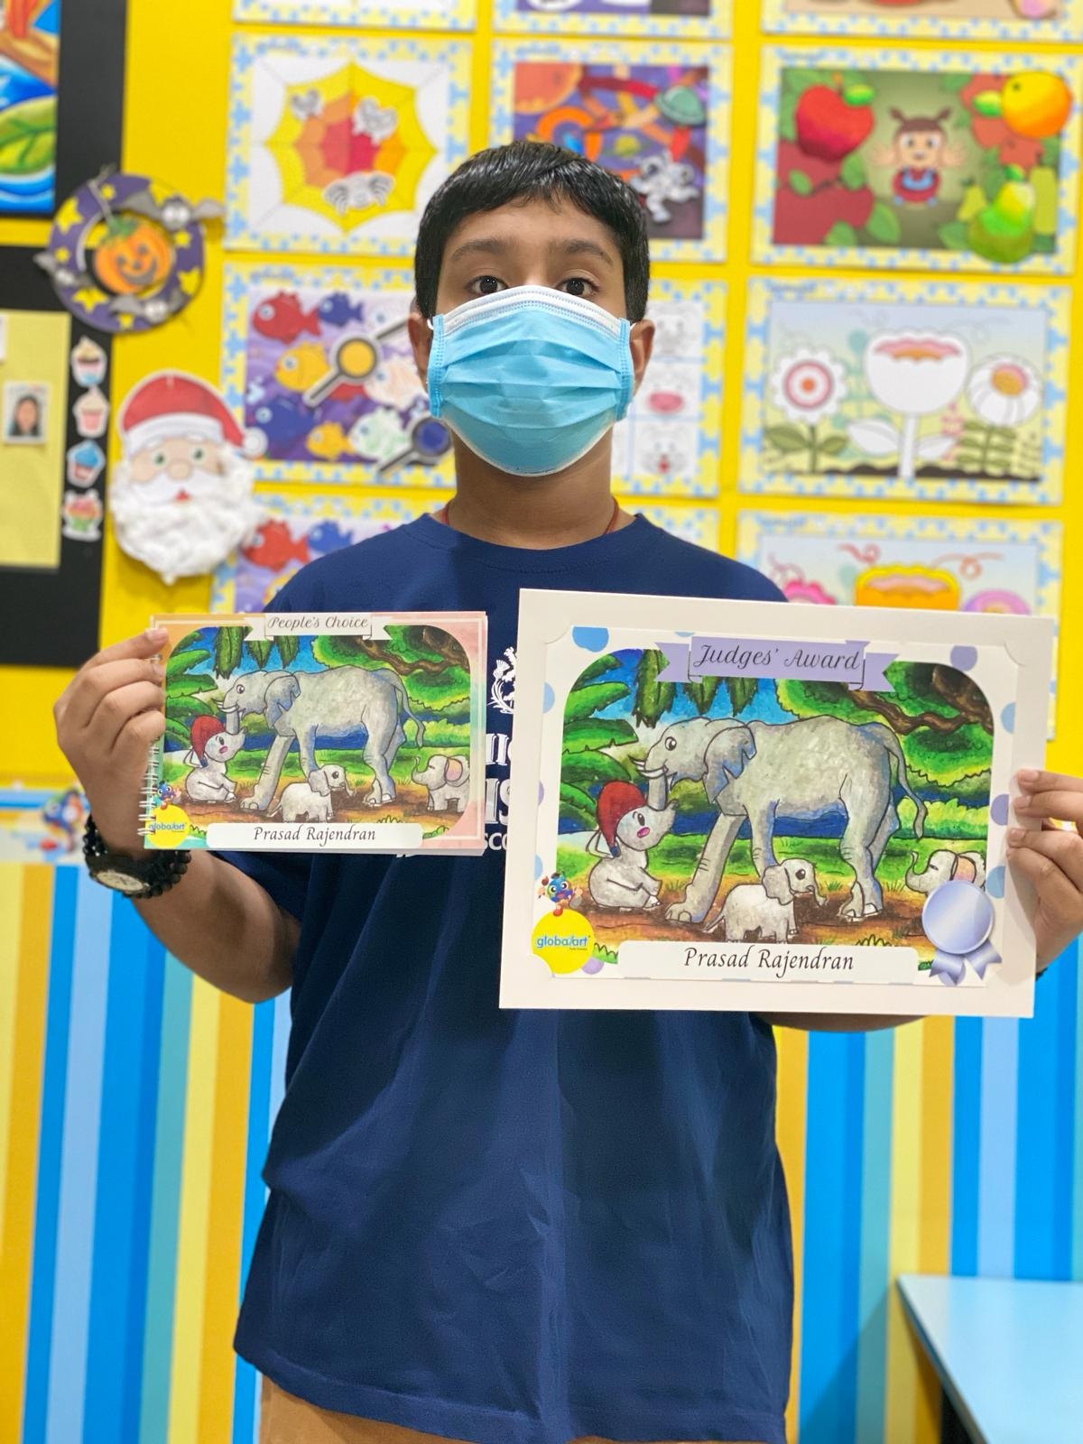
Ananya “the Nature Lover"
**Joined Us:** August 2022
**Age:** 7
**Current Level:** Foundation Level 3
**Achievements:**
- 2024 In-House Competition, Group B, Champion
- 2023 Featured as a Young Artist
Ananya is all about nature and drawing! Her gentle spirit shines through in her beautiful floral and animal drawings. We’re working with her to help her draw on a larger scale to really showcase her coloring skills. Ananya’s imagination and passion for art are truly inspiring—we can’t wait to see her next masterpiece!
Mother: “Ananya happily attends Global Art without any complaints, always looking forward to the next class. She’s improved so much, especially with blending techniques, and even won other competitions using what she’s learned. Teacher Jia Shin has been amazing, patiently helping her grow. We’re so thankful!”
Newsletter
July / August 2024
globalarthougangbedokyishun.com.sg
Facebook.com/globalarthggbccysn
Upcoming Events
Prasad “the Anime Prodigy"
#### 🎨 **"Prasad the Anime Prodigy"**
**Joined Us:** September 2022
**Age:** 14
**Current Level:** Level 3
**Achievements:**
- 2024 Global Art Singapore National Day Coloring Contest, Group D, Top 3 Winner
- 2024 Global Art Yishun In-House Competition, Group D, Champion
Prasad is our anime specialist! Since joining us, his skills have grown by leaps and bounds. He’s got a keen eye for angles and directions, and he’s always up for tackling challenging pieces. We’re encouraging Prasad to ask for help when needed to keep pushing his art to the next level. Keep it up, Prasad—you’re doing great!
Prasad: “I like Global Art because it’s fun to draw and I get to meet other classmates.”
Mother: “Prasad has improved a lot since starting at Global Art—there’s been significant progress. He’s still working on his watercolor skills since he just started, but I’m confident he’ll keep getting better.”
September
National Art Competition
October
International Grading
November
Open Day
December
Year-End Exhibition

