Slide 1
Depicting breed-specific epilepsy prevalence estimates

Slide 2
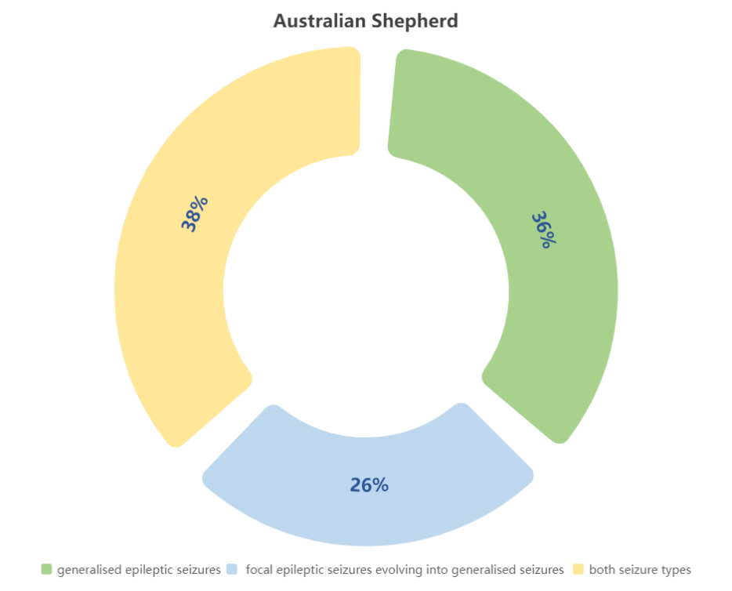
Percentage of seizure types in different breeds of dogs
https://bmcvetres.biomedcentral.com/articles/10.1186/s12917-015-0463-0/tables/2

Slide 3
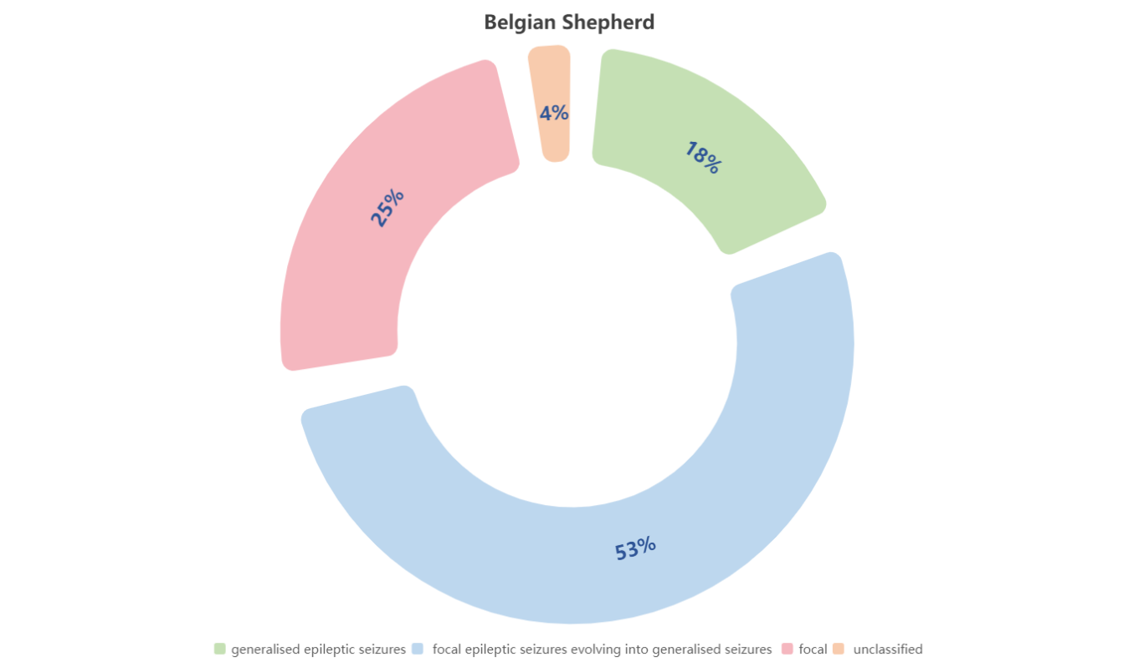

Slide 4
