Slide 1
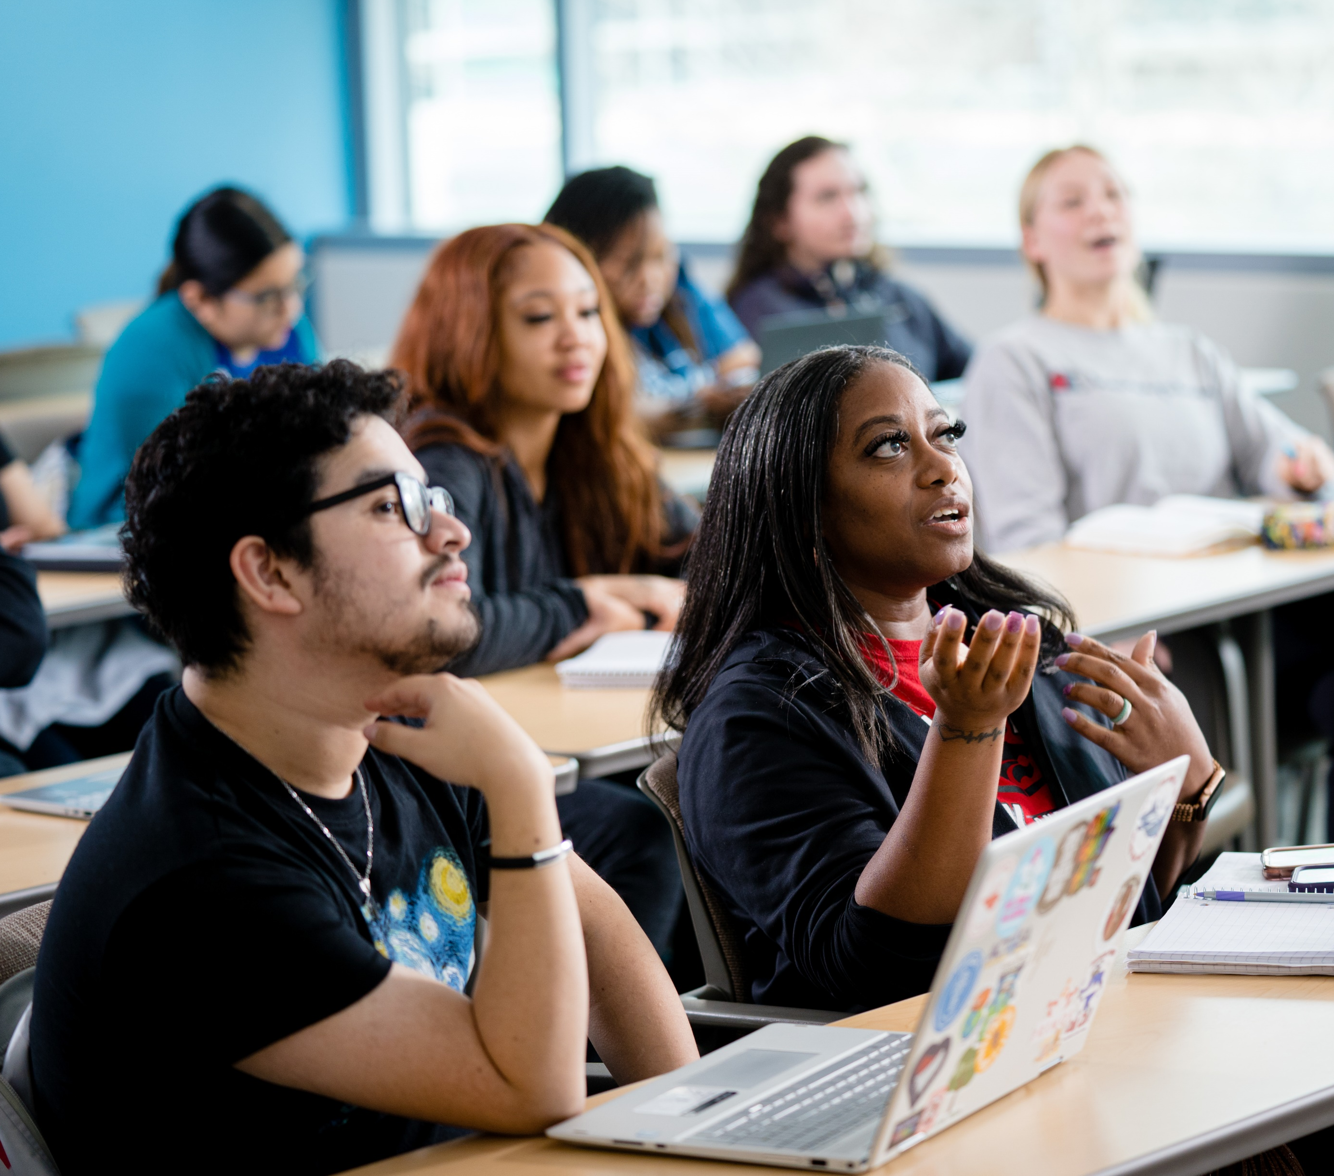
About UGRW
by Angie Cook

Slide 2

Course Description
1200. 3 hours. This interactive writing workshop provides individualized instruction through guided practice, focusing on writing skills essential for success in ENGL 1313 (College Writing 1). Emphasizes audience, purpose, and occasion. Placement in this option is based on TSI Assessment score. Successful completion does not award academic credit or fulfill any degree requirement. Pass/no pass only. Co-Requisite(s):ENGL 1313, same section as UGRW 1200. Course Typically Offered: Fall and Spring.

Slide 3

Syllabus Specifics:
Learning Objectives
At the end of the course, the student will:
Understand, interpret, and critically analyze the content of readings, drawing inferences and evaluating arguments across multiple texts.
Identify and evaluate the rhetorical elements (such as audience, purpose, and message) in diverse texts and apply these insights to one's own writing.
Draft, proofread, and revise college writing assignments, including reading responses, essays, and other forms of academic writing, with attention to audience, purpose, and context.
Demonstrate the ability to write coherently in formal, academic style with correct English mechanics and grammar, while employing appropriate rhetorical strategies for given writing situations.

Slide 4

Course
Outline
Classroom Format
UGRW is a support course for underprepared ENGL 1313 students. Workshop style instruction, versus lecture traditional lecture style, is optimal. Use this time to have students practice the writing and reading skills they need for their ENGL 1313 essays and readings.

Slide 5
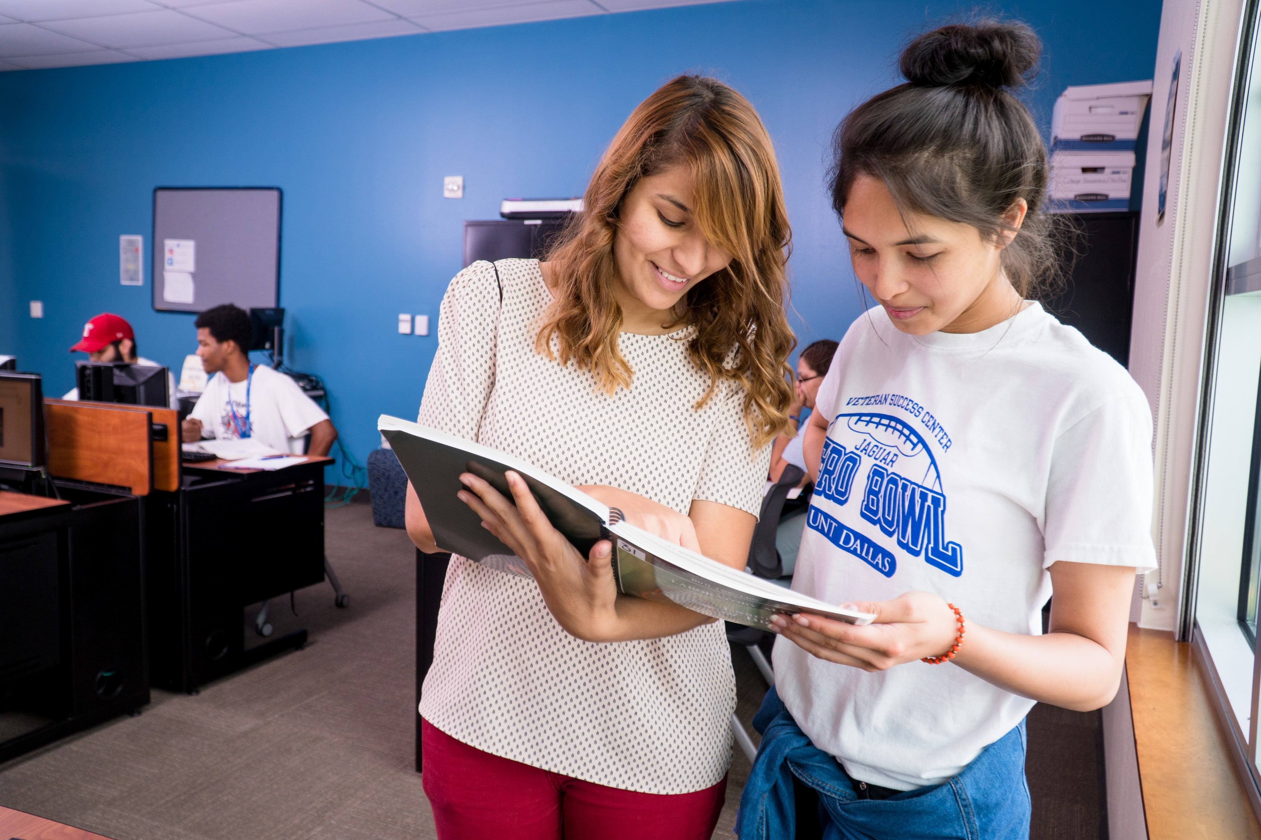
UGRW Resources
Embedded tutors in every corequisite course (more on next slides).
The Learning Commons’ Writing Center: Encourage students to go to the Writing Center.

Slide 6
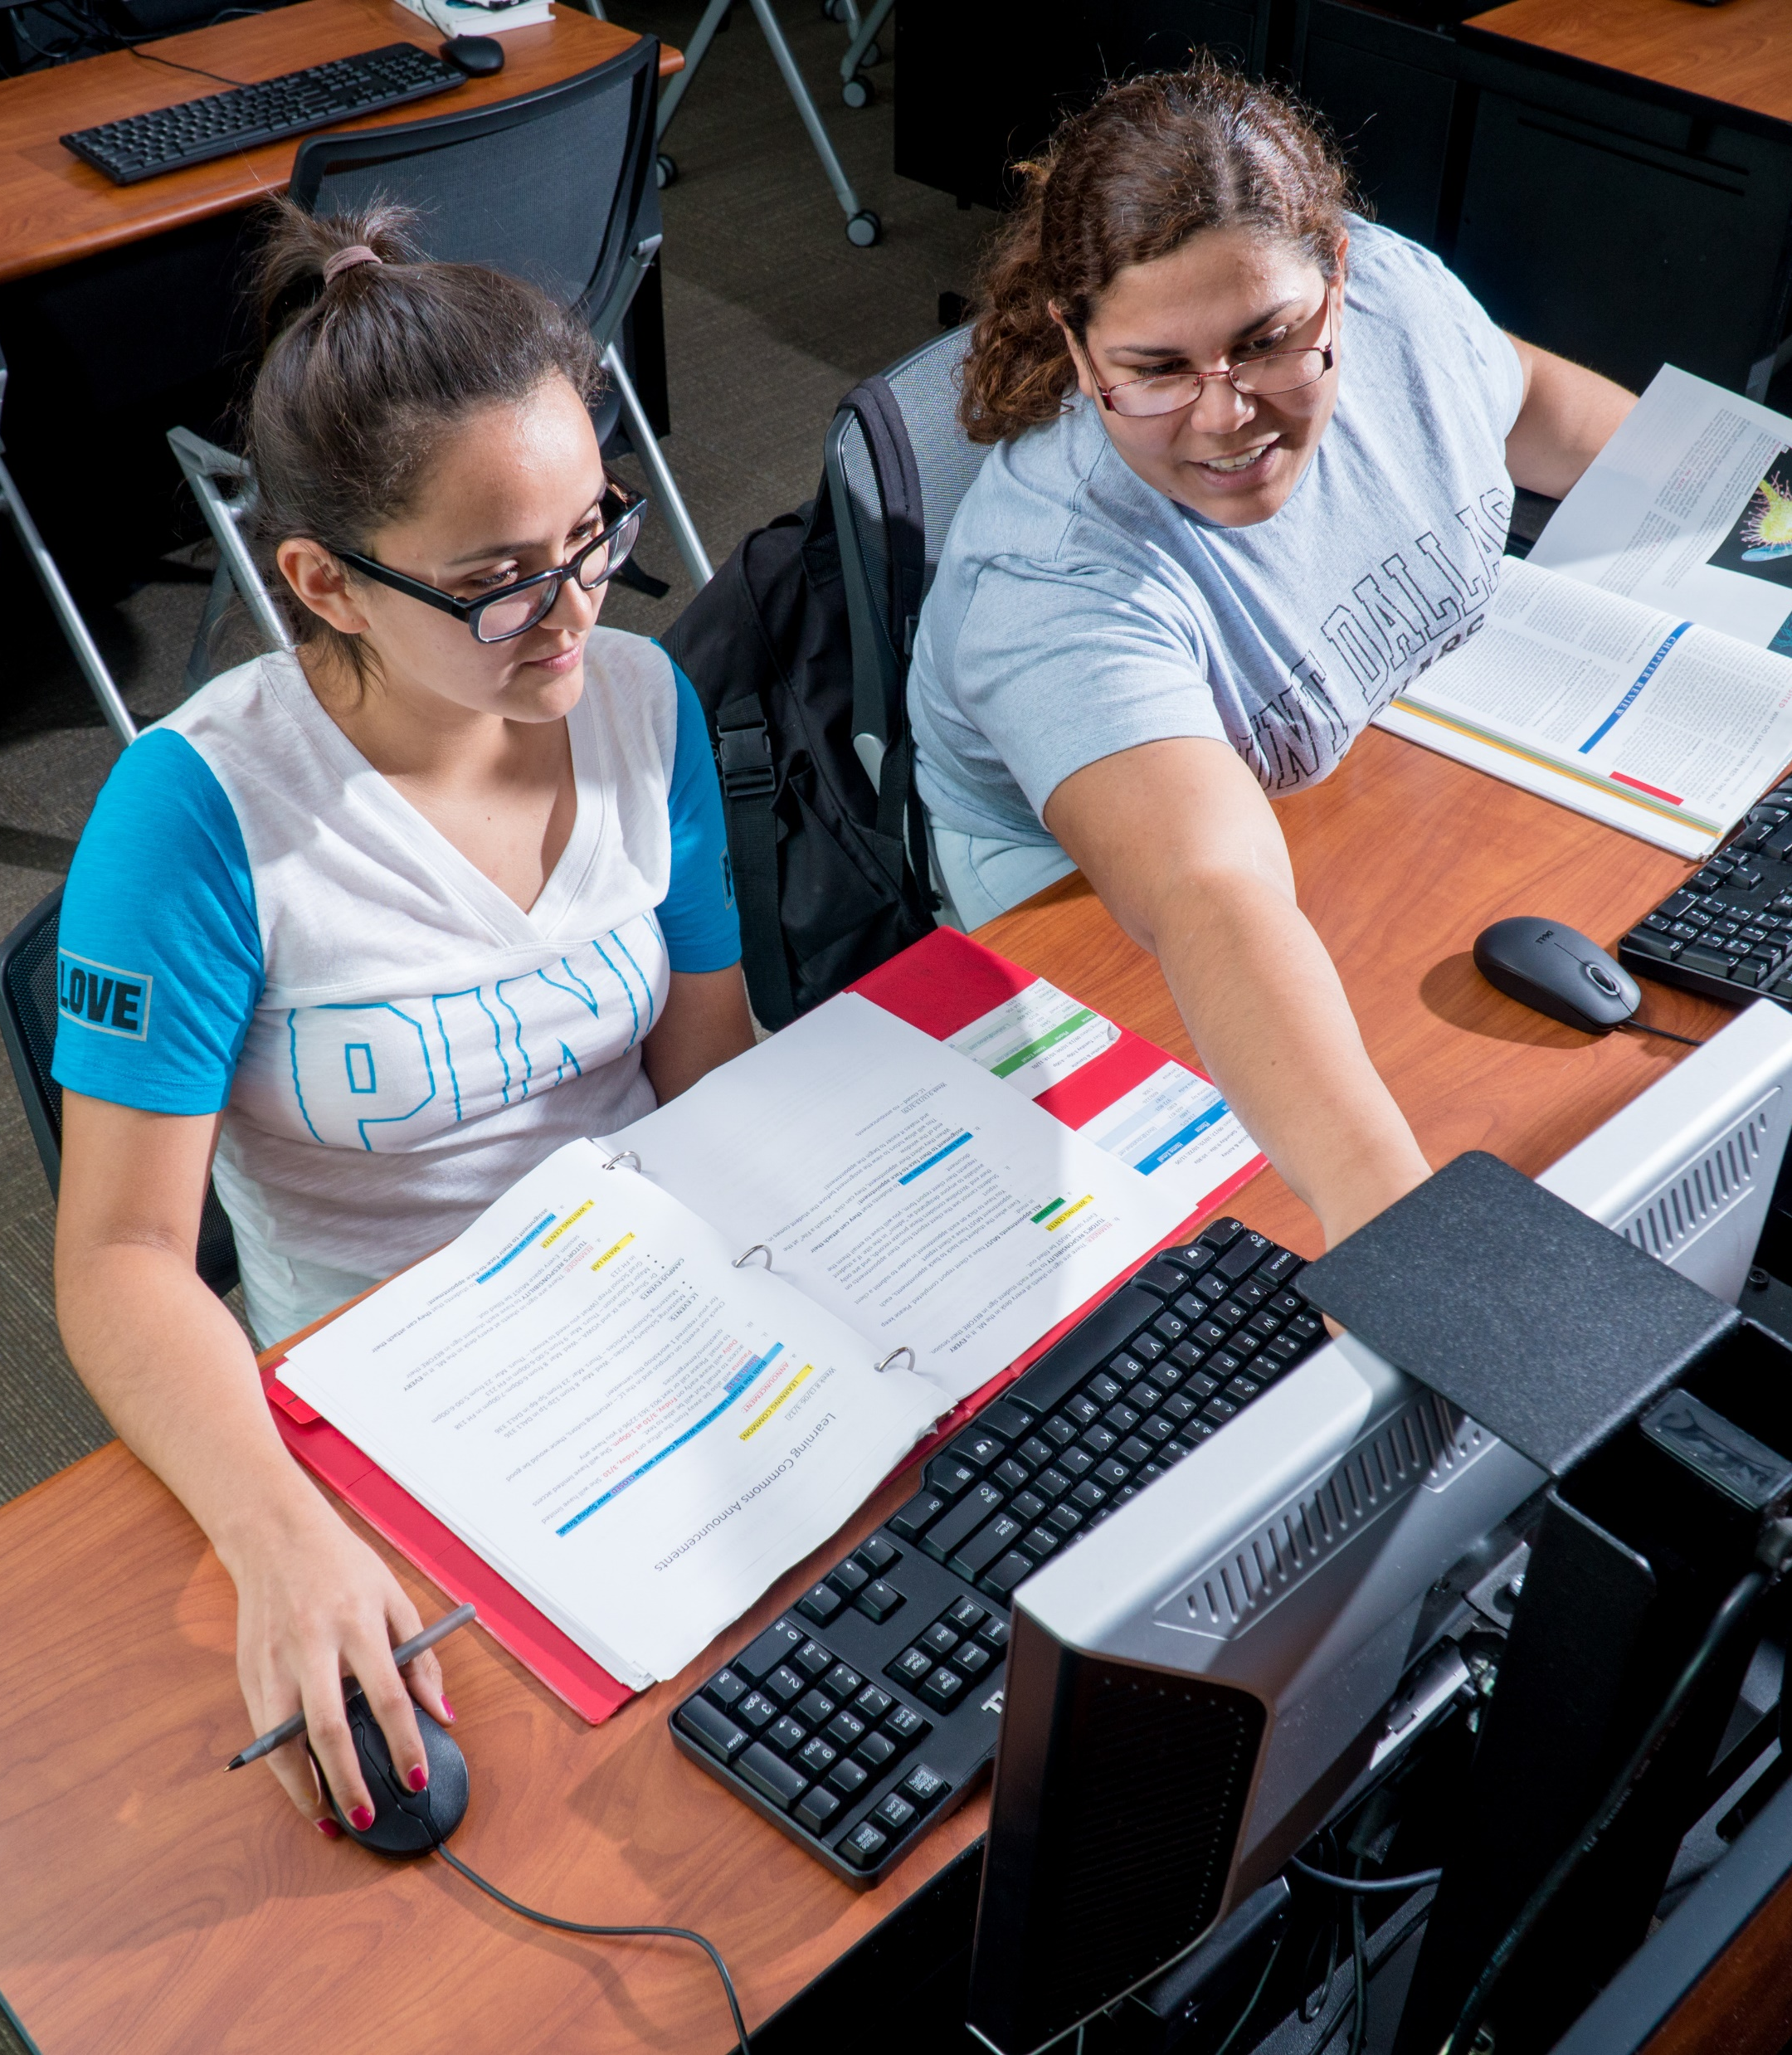
Course
Outline
Embedded Tutors*
Information from Elizabeth Adams,
UNT Dallas Learning Commons Director
The embedded tutoring model provides support to students inside and outside the class through a tutor assigned to the specific course and section. The tutor provides support during class by attending certain class sessions and providing individualized learning assistance during in-class activities. Additionally, the tutor provides one-on-one tutoring sessions outside of class for the students in the assigned section.

Slide 7
Comparison Chart*
Information from Elizabeth Adams,
UNT Dallas Learning Commons Director

Slide 8

For More Exploration
“COREQUISITE WORKS: Student Success Models at the University System of Georgia”
“The Impacts and Experiences of Corequisite Remediation for Latino Students”
“National Report on Developmental Education: Corequisite Reform Is Working”

