Slide 1
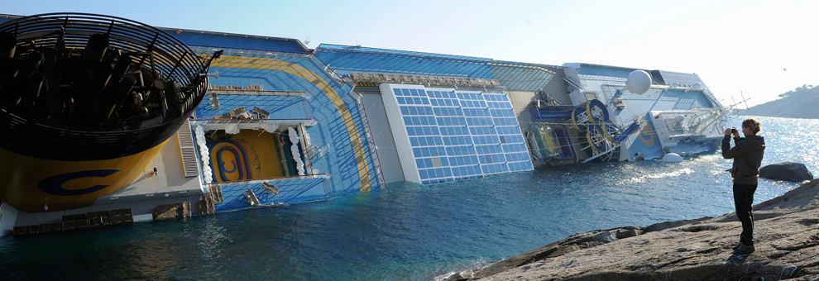


The Tempest
Shipwreck with spectator

Slide 2

From Comedy to romance
Listed initially as comedy in first folio 1623
What is carried over and developed from other comedies?

Slide 3
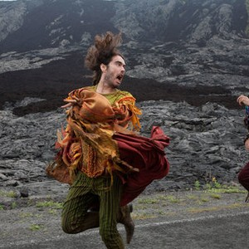
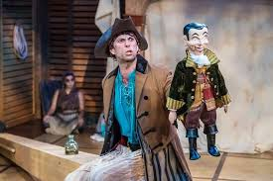
romance
Courtly / aristocratic characters (princes and princesses)
Natural settings, exotic settings, oceans, travel and storms; time and space can be vast
Idealizing and poetic aspects of sex (beautiful/lovely)
Lyrical and poetic; higher style
Marriage as solution to social conflict; cosmic dimensions
Comedy
Bourgeois/ Merchant class
Urban setting/ compact time and space
Physical or animal aspects of sex (funny/gross)
Puns, gags, physical humor
Challenges of married life; “realistic” about relationship between the sexes

Slide 4
Shakespeare’s romances
~ tragicomic elements, with “threats of death and scenes of suffering more acute” than in the comedies
~ supernatural or miraculous devices
~ an atmosphere of wonder and awe, “joy and astonishment,” along with “discordance, irony, and self-consciousness”
~ vast geographies (including natural settings and oceans)
~ novelistic time
(from Raphael Lyne, Shakespeare’s Late Work)
Why? ~
changing theatrical and poetic tastes
~ Shakespeare dissatisfied with tragedy and comedy; looking for new ways to handle plots and persons
~ As Shakespeare grew older, he became “softer” in his poetic and philosophical outlook (and perhaps more religious)

Slide 5
the tempest: performance history during Shakespeare's lifetime
1611: Hallowmas, at Whitehall, in the Banqueting House, Court of James I
1613: Performed again at court for the marriage of Elizabeth, daughter of James, to the Elector Palantine
Likely also performed at the Blackfriars (the Kings’ Men’s new indoor private theater) and at the Globe

Slide 6
act one, scene one: in medias res
Master: Boatswain!
Boatswain: Here, master: what cheer?
Master: Good, speak to the mariners: fall to’t, yarely, or we run ourselves aground: bestir, bestir. [Exit] [Enter Mariners]
Boatswain: Heigh, my hearts! cheerly, cheerly, my hearts! yare, yare! Take in the topsail. Tend to the master’s whistle. Blow, till thou burst thy wind, if room enough!
[Enter ALONSO, SEBASTIAN, ANTONIO, FERDINAND, GONZALO, and others]
Alonso: Good boatswain, have care. Where’s the master? Play the men.
Boatswain: I pray now, keep below.
Antonio: Where is the master, boatswain?
Boatswain: Do you not hear him? You mar our labour: keep your cabins: you do assist the storm.
Gonzalo: Nay, good, be patient.
Boatswain: When the sea is. Hence! What cares these roarers for the name of king? To cabin: silence! trouble us not.
Gonzalo: Good, yet remember whom thou hast aboard.
Boatswain: None that I more love than myself. You are a counsellor; if you can command these elements to silence, and work the peace of the present, we will not hand a rope more; use your authority: if you cannot, give thanks you have lived so long, and make yourself ready in your cabin for the mischance of the hour, if it so hap. Cheerly, good hearts! Out of our way, I say.
What do we learn about Gonzalo? Alonso? The Boatswain?
What techniques does Shakespeare use to represent the storm?

Slide 7
Shakespeare’s ship of state
Shakespeare’s ship houses two separate groups: the sailors and their royal passengers. Each is organized hierarchically and depends on the proper operation of the chain of command (“Boatswain!” “Here master, what cheer?” “Good -- speak to the mariners”). Although the King of Naples has the highest status on ship, the fact of emergency subordinates his authority to that of the crew. The refusal of Antonio to accept this indicates his disordered personality and his own unfitness to rule anyone or anything (“You mar our labour. Keep your cabins -- you do assist the storm”).
Gonzalo the councillor is caught between the two groups: he wants to defend the honor and authority of his royal masters, but he also seems to accept that matters are out of their hands.
The tempest renders social status superfluous: “What cares these roarers for the name of king?” In a state of emergency, inherited status and social distinctions matter very little. Skill, responsiveness to the changing situation, a willingness to follow procedures, and an ability to work as a group matter very much indeed.

Slide 8
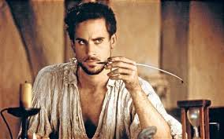
spelling test playwright or playwrite?
playwright from play + wright, an artifcer or handicraftsman. ---> Cartwright, wagonwright, ploughwright, shipwright.
How is the writer of plays like the builder of a ship?
How is a ship like a theater?

Slide 9
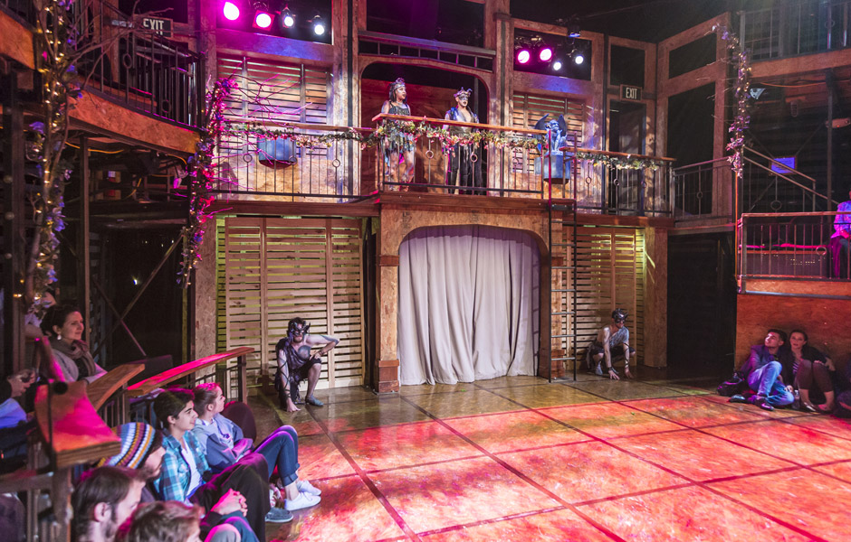
stage as ship / ship as stage
specialized spaces with several levels:
deck / main stagecabins / back stage, under stagemasts / gallery the sea / the space of the theater
collaborative work, onstage and offstage; hierarchy + cooperation
different sets of theatrical makers: actors ~passengers stage hands and stage manager ~ the crewdirector ~ pilot or navigator [gubernator]
complex, expensive, risky.....

Slide 10
Miranda views the storm
Act One, Scene Two: The View from Shore
from tempest, chaos, and noise
to calmness and observation
from action (in medias res) to narration (once upon a time)
from sea to land
from emergency to spectacle

Slide 11
narration widens the temporal and geographical reach of the play. Prospero addresses three different on-stage audiences, demonstrating three different functions and styles of narration:
Prospero-Miranda: father-child Narrative as Story / History.
Prospero-Ariel: servant Narrative as Contract
Prospero-Caliban: servant/slave Narrative and Counter-Narrative

Slide 12
Miranda
from Latin, something to be wondered at; a thing of wonder
Wonder and atmosphere of romance
Passive and sweet and just a little wild?
Felicity Jones as Miranda, in The Tempest, directed by Julie Taymor, 2011 (film)

Slide 13
Character analysis
If by your art, my dearest father, you have
Put the wild waters in this roar, allay them.
The sky, it seems, would pour down stinking pitch,
But that the sea, mounting to the welkin's cheek,
Dashes the fire out. O, I have suffered
With those that I saw suffer: a brave vessel--
Who had, no doubt, some noble creature in her--
Dashed all to pieces! O, the cry did knock
Against my very heart-- poor souls, they perish'd.
Had I been any god of power, I would 10
Have sunk the sea within the earth or ere
It should the good ship so have swallowed, and
The fraughting souls within her.
PROSPERO
Be collected.
No more amazement. Tell your piteous heart
There's no harm done.
MIRANDA
O, woe the day!
(I.ii.1 - 17)
Miranda = sympathetic, sentimental, vulnerable, obedient
Miranda= feisty, headstrong, human rights activist

Slide 14
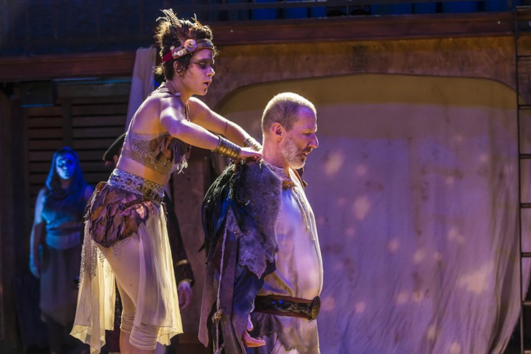
Prospero
Prospero: from “prosperous,” to flourish, be wealthy, be fortunate
key words: provide, provision, providence (and provisional?)
art, magic
The magician and scientist
The theatrical director and producer
The ruler

Slide 15
Prospero
My brother and thy uncle, call'd Antonio--
I pray thee mark me, that a brother should
Be so perfidious--he whom next thyself
Of all the world I loved, and to him put
The manage of my state, as at that time 70
Through all the signories it was the first,
And Prospero the prime duke, being so reputed
In dignity, and for the liberal arts
Without a parallel; those being all my study,
The government I cast upon my brother
And to my state grew stranger, being transported
And rapt in secret studies. Thy false uncle--
Dost thou attend me?
MIRANDA
Sir, most heedfully.
PROSPERO
Being once perfected how to grant suits,
How to deny them, who to advance and who 80
To trash for overtopping, new created
The creatures that were mine, I say: or changed 'em,
Or else new formed 'em; having both the key
Of officer and office, set all hearts i’th’ state
To what tune pleased his ear, that now he was
The ivy which had hid my princely trunk,
And sucked my verdure out on't-- thou attend'st not!
(I.ii.66-86)
Prospero = benign, providential, father figure
Or irresponsible, controlling, not to be trusted

Slide 16
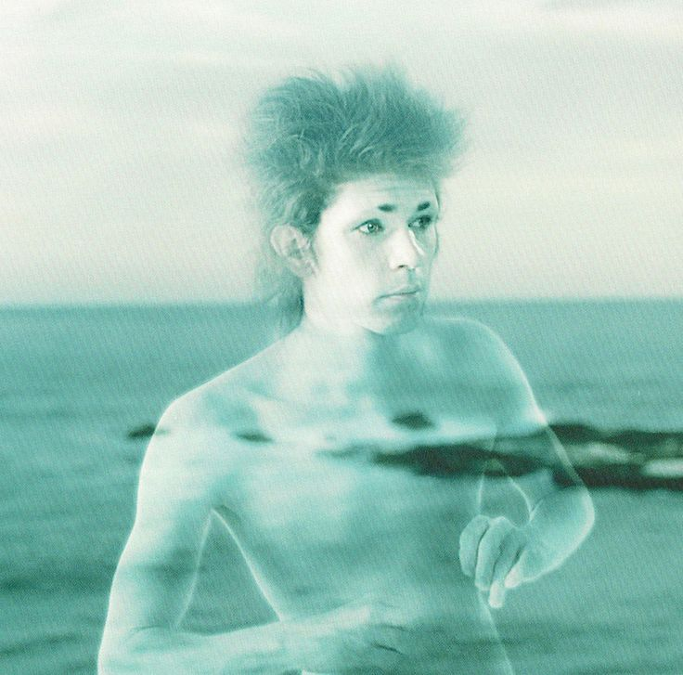
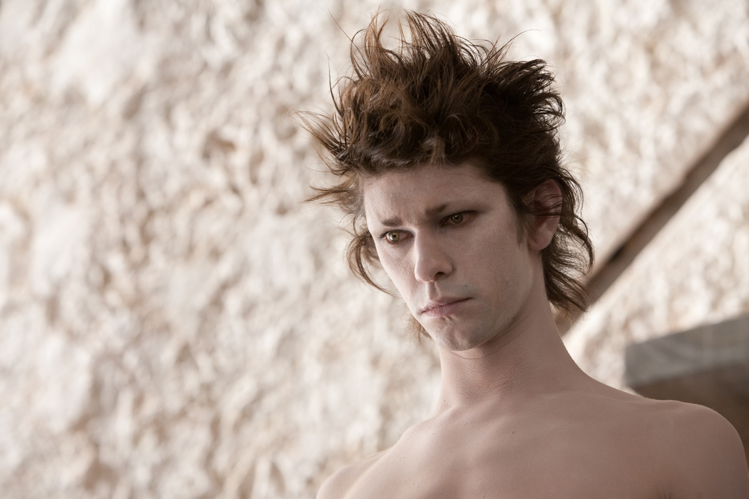
Ariel
Ariel: air as atmosphere; air as song, breath, music
Native to island
Supernatural
Male and female characteristics
Obedient or edgy?

Slide 17
Caliban
Caliban: anagram of “cannibal” (a new world new word)
Born on island
Earth to ariel’s air
Earth= passions and place
Algiers (Algeria); north African
Orphan to foster child to slave (lupton)
Djimon Hounsou as Caliban in Julie Taymor film

Slide 18
Caliban
I must eat my dinner.
This island's mine by Sycorax my mother,
Which thou tak’st from me. When thou cam’st first,
Thou strok’st me and made much of me; wouldst give me
Water with berries in't, and teach me how
To name the bigger light, and how the less,
That burn by day and night; and then I loved thee,
And show'd thee all the qualities o’ th’ isle,
The fresh springs, brine-pits, barren place and fertile--
Cursed be I that did so! All the charms
Of Sycorax, toads, beetles, bats, light on you! 340
For I am all the subjects that you have,
Which first was mine own king, and here you sty me
In this hard rock, whiles you do keep from me
The rest o' the island.
(I.ii.330-334)
Caliban = abused, sensitive savage, potentially noble
Or
Incorrigible, villainous, subhuman

Slide 19
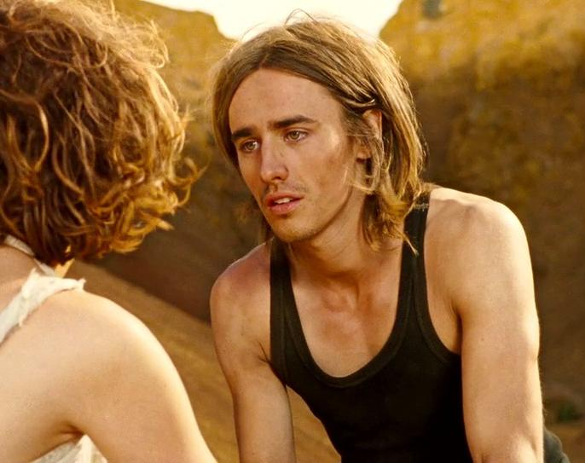
Where should this music be? i’ the air or the earth?
It sounds no more: and sure, it waits upon
Some god o’ the island. Sitting on a bank,
Weeping again the king my father’s wreck,
This music crept by me upon the waters,
Allaying both their fury and my passion
With its sweet air: thence I have follow’d it,
Or it hath drawn me rather. But ‘tis gone.
No, it begins again.
[ARIELsings]
Full fathom five thy father lies;
Of his bones are coral made;
Those are pearls that were his eyes:
Nothing of him that doth fade
But doth suffer a sea-change
Into something rich and strange.
Sea-nymphs hourly ring his knell
Hark! now I hear them,—Ding-dong, bell.
Ferdinand. The ditty does remember my drown’d father.
This is no mortal business, nor no sound
That the earth owes. I hear it now above me.
What is the role of music in this scene? What is the song about? Why has it become a kind of “theme song” for The Tempest? How does Ferdinand respond to it? Who is its source?

Slide 20
Metaphorization and romance: Fantastic
Full fathom five thy father lies;
Of his bones are coral made;
Those are pearls that were his eyes:
Nothing of him that doth fade
But doth suffer a sea-change
Into something rich and strange. (Ariel, Act 1, Scene 2)
How does this capture the theme of transformation in the play?

Slide 21
Metaphorization as romance process
from shipwreck to spectator
from action to narration
as a process of suspension, rendering of event into image and spectacle
~ tragedy diverted into comedy (= romance)
~ drama converted into masque (courtly spectacle involving dance, music, allegorical imagery)
What paralyzes Ferdinand?
Magic and his attraction to miranda
Shock and trauma at loss of his father
The magic in the play often has naturalistic parallels. Why?
Are there other moments of suspension and paralysis in the play?
Sleep as suspension; sleep like the ocean?

Slide 22
Action becomes metaphor: The Ship of State
tempest
shipwreck
competing jurisdictions
(crew and royal passengers)
action becomes metaphor
layered, dreamlike but also speculative and philosophical character of the play; sense that is is always unfolding on at least two levels, the action itself and some other form of meaning (allegorical, mythical, dreamlike)
Can you think of other examples?

Slide 23
Metaphorization in The Tempest
The Tempest is one of Shakespeare’s most metaphorical and allegorical plays. Almost everything and everyone in the play is both itself and something else. Fantasy and reality, magical and naturalistic explanations, dramatic action and symbolic meaning, and consciousness and setting flow among each other in a continuous figure-eight.
The play itself tends to start and stop, ebb and flow: the storm becomes stilled into spectacle; Ferdinand lacks momentum; the marriage masque moves slowly; and characters have a tendency to tie themselves into knots, or to fall asleep in class.
Shakespeare thematizes the special texture and rhythm of his most speculative and fantastic drama in the extraordinary song by Ariel. In The Tempest, actions undergo sea-changes, crystallizing into mesmerizing images of suspension, paralysis, amazement, wonder, and dream.

Slide 24
Gonzalo’s Utopia
I' th' commonwealth I would by contraries
Execute all things, for no kind of traffic
Would I admit; no name of magistrate;
Letters should not be known; riches, poverty,
And use of service, none; contract, succession,
Bourn, bound of land, tilth, vineyard, none;
No use of metal, corn, or wine, or oil;
No occupation; all men idle, all
And women too, but innocent and pure;
No sovereignty --
SEBASTIAN: Yet he would be king on 't
ANTONIO: The latter end of his commonwealth forgets the beginning.
GONZALO: All things in common nature should produce
Without sweat or endeavor; treason, felony,
Sword, pike, knife, gun, or need of any engine
Would I not have; but nature should bring forth
Of its own kind all foison, all abundance,
To feed my innocent people.
SEBASTIAN: No marrying 'mong his subjects?
ANTONIO: None, man, all idle: whores and knaves.
GONZALO: I would with such perfection govern, sir,
T' excel the Golden Age. (2.1
How does his utopia present a legitimate aspiration put forward by Shakespeare?
How is this vision challenged in the play?

Slide 25
Caliban in pain
Caliban in Pain: Act two, Scene Two
[Enter CALIBAN with a burden of wood. A noise of thunder heard]
All the infections that the sun sucks up
From bogs, fens, flats, on Prosper fall and make him
By inch-meal a disease! His spirits hear me
And yet I needs must curse. But they’ll nor pinch,
Fright me with urchin—shows, pitch me i’ the mire,
Nor lead me, like a firebrand, in the dark
Out of my way, unless he bid ‘em; but
For every trifle are they set upon me;
Sometime like apes that mow and chatter at me
And after bite me, then like hedgehogs which
Lie tumbling in my barefoot way and mount
Their pricks at my footfall; sometime am I
All wound with adders who with cloven tongues
Do hiss me into madness.
~ What is the nature of Caliban’s afflictions? what kinds of torments does Prospero subject him to? why these and not others??
~ Is there a subjective or internal as well as an objective or external component to Caliban’s suffering? If so, how would you explain this?

Slide 26
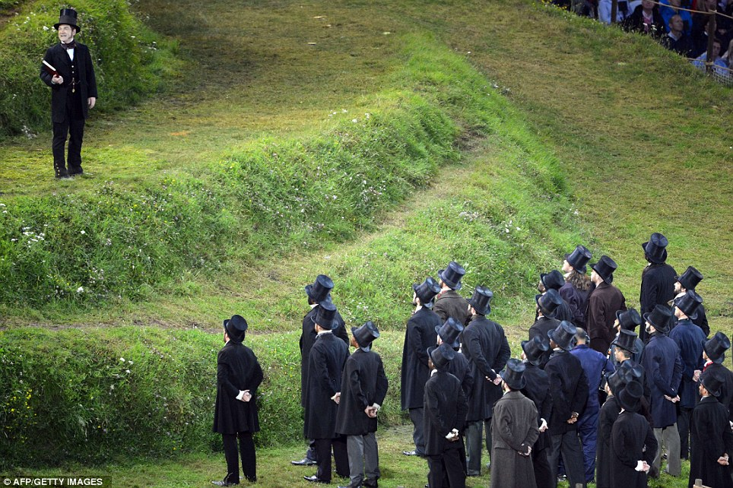
Dreaming the Island
Be not afeard; the isle is full of noises,
Sounds and sweet airs, that give delight and hurt not.
Sometimes a thousand twangling instruments
Will hum about mine ears, and sometime voices
That, if I then had waked after long sleep,
Will make me sleep again: and then, in dreaming,
The clouds methought would open and show riches
Ready to drop upon me that, when I waked,
I cried to dream again. 3.2
~ What causes the music? Do you think Prospero is the composer? Ariel? the island itself?
~ What are some of its associations and effects?
~ How does Caliban respond to it? How do we feel about Caliban in this speech? What qualities does he manifest?
~ What is the relationship between music and dreaming? between consciousness and setting or locale?
Why do you think Danny Boyle chose to feature this particular speech at the opening of the London Olympics? Why did he put it in the mouth of a Victorian engineer?

Slide 27
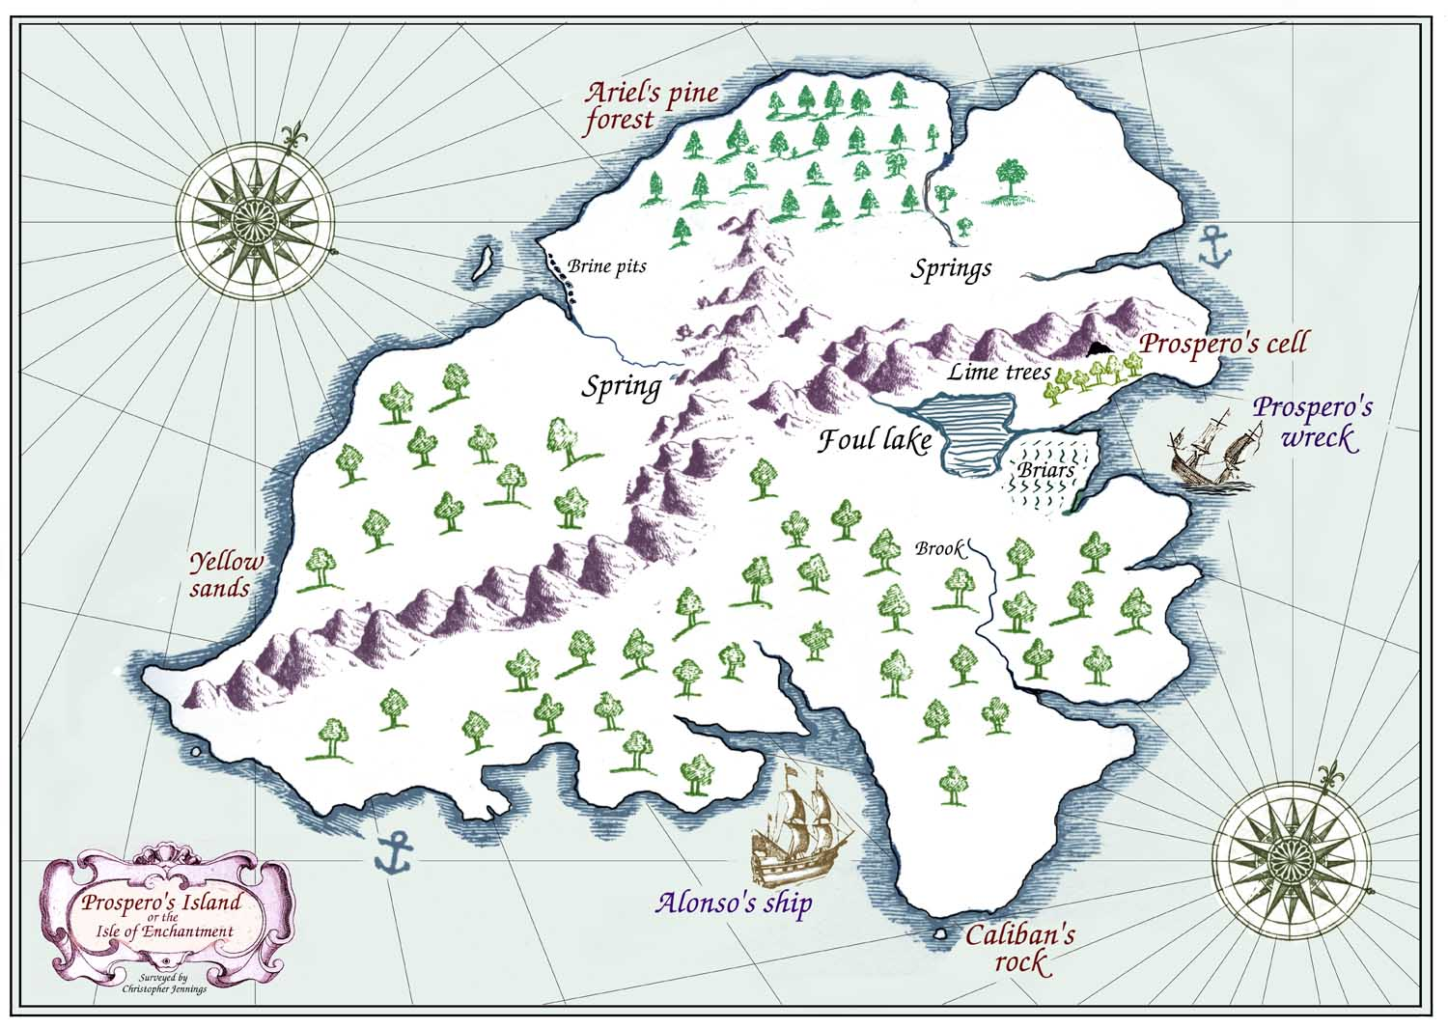
Resolutions

Slide 28
“We are such stuff as Dreams are made of”
Prospero’s Masque
~ Why does Prospero perform the betrothal masque?
~ How does Prospero describe the masque here?
Why is the masque interrupted?
The wedding masque in The Tempest is an allusion to
the court masques performed at the Whitehall Banqueting
House and brings into the play a broad range of
Renaissance thought about royalty, its manifestations and
the nature of royal power.
ARIEL
What would my potent master? Here I am.
PROSPERO
Thou and thy meaner fellows your last service
Did worthily perform; and I must use you
In such another trick. Go bring the rabble,
O'er whom I give thee power, here to this place.
Incite them to quick motion, for I must
Bestow upon the eyes of this young couple
Some vanity of mine art: it is my promise,
And they expect it from me. 4.1

Slide 29
PROSPERO:
O good Gonzalo,
My true preserver, and a loyal sir
To him you follow'st! I will pay thy graces
Home both in word and deed. Most cruelly
Didst thou, Alonso, use me and my daughter:
Thy brother was a furtherer in the act.
Thou art pinch'd fort now, Sebastian. Flesh and blood,
You, brother mine, that entertain'd ambition,
Expell'd remorse and nature; who, with Sebastian,
Whose inward pinches therefore are most strong,
Would here have kill'd your king; I do forgive thee,
Unnatural though thou art. (V.68-79)
Acts of acknowledgment and forgiveness
“The rarer action is in virtue not in vengeance” (prospero 5.1)
Who/what is forgiven at the end of the play?
Which discoveries seem like rebirths in Act V?

Slide 30
How many goodly creatures are there here!
How beauteous mankind is! O brave new world,
That has such people in't!”
(V.i.182-185)
Why are Miranda and ferdinand playing chess at the end of the play? What does this suggest about her educational process?

Slide 31
Acts of acknowledgment and forgiveness
Prospero on Caliban: “This thing of darkness I / Acknowledge mine.” (V.i.275-76)
How do we understand this line at a narrative level?
How do we understand this line at a metaphorical level?
What evidence is there that Caliban has learned something from his experience?
“The rarer action is in virtue not in vengeance” (prospero 5.1)

Slide 32
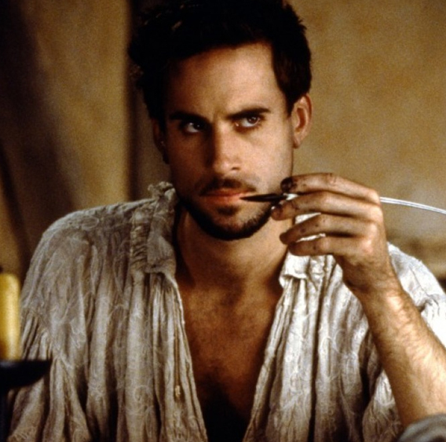
Now my charms are all overthrown,
And what strength I have's mine own,
Which is most faint: now, 'tis true,
I must be here confined by you,
Or sent to Naples. Let me not,
Since I have my dukedom got
And pardon'd the deceiver, dwell
In this bare island by your spell;
But release me from my bands (10)
With the help of your good hands:
Gentle breath of yours my sails
Must fill, or else my project fails,
Which was to please. Now I want
Spirits to enforce, art to enchant,
And my ending is despair,
Unless I be relieved by prayer,
Which pierces so that it assaults
Mercy itself and frees all faults.
As you from crimes would pardon'd be, (20)
Let your indulgence set me free.
Prospero/ Shakespeare?

