Slide 1
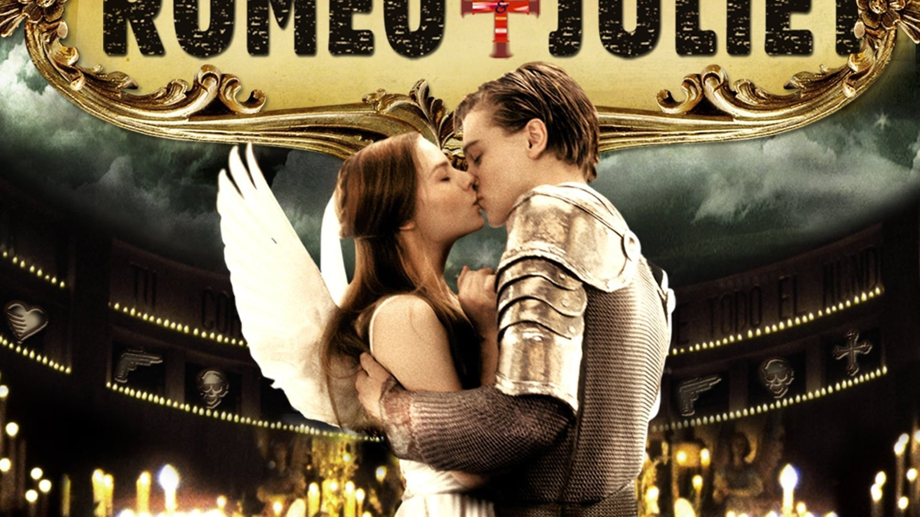
Romeo and Juliet

Slide 2
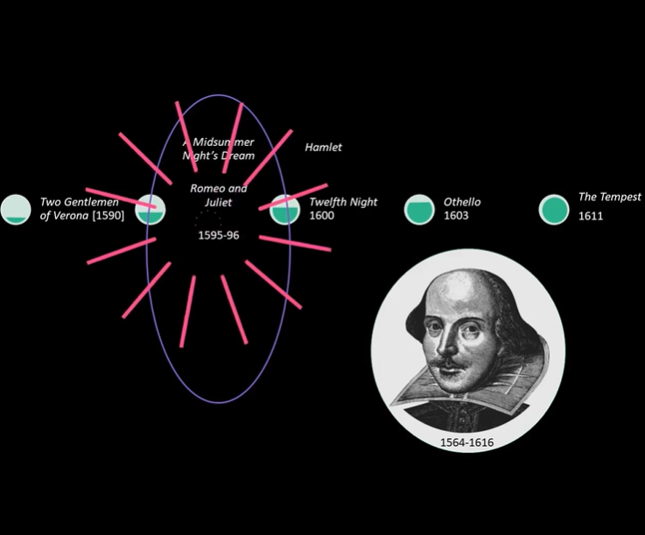
Dr. Lupton, E9

Slide 3
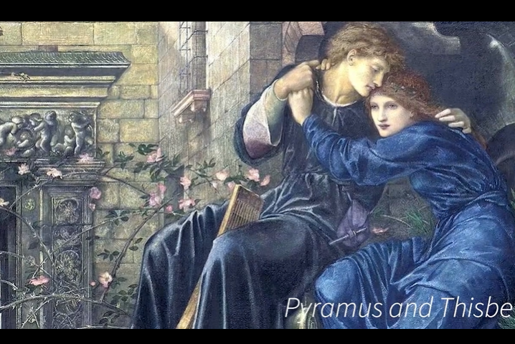

Slide 4
MSND and RJ
Shakespeare’s thinking process
Compelling narrative

Slide 5





Adaptations of Romeo and Juliet

Slide 6
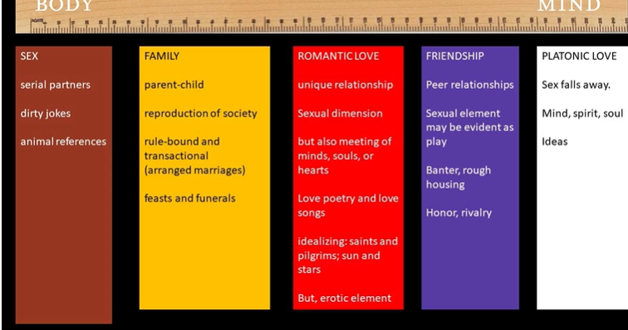
Notes:
Conflicts of various forms of love; made the play resonant in cultural contexts; a more deeply a play about the clash about different types of love

Slide 7
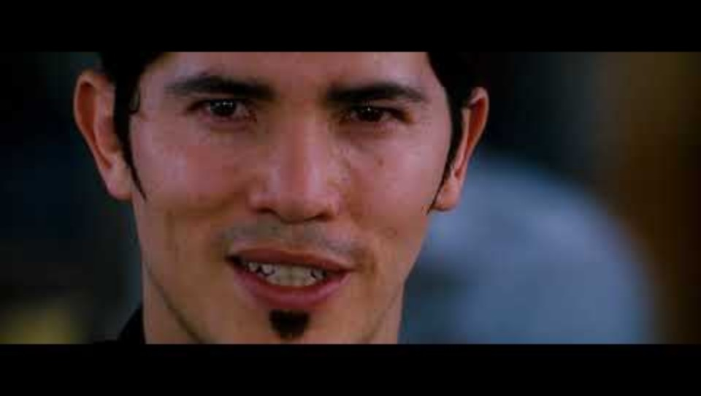

Slide 8
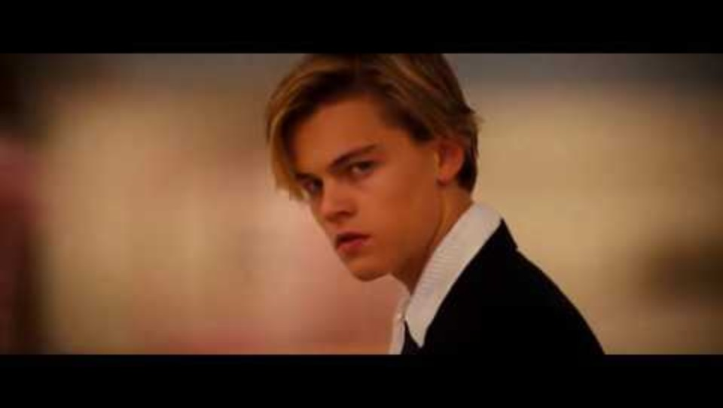
Meeting Romeo

Slide 9
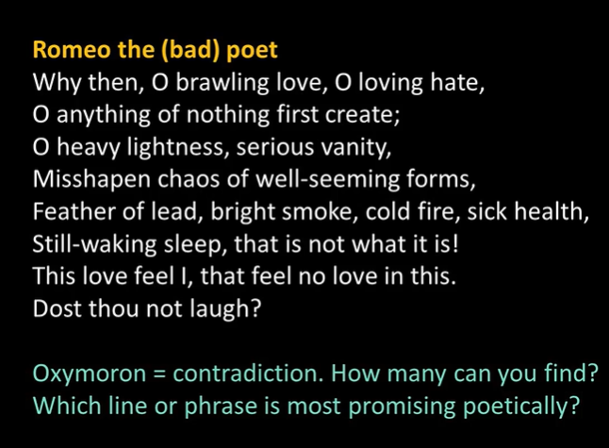
Romeo in Love
Sensitive; poetic; not part of the opening fight
Act 1, Scene 1, lines 170 -
Notes:
Best line: “misshapen chaos of well-seeming forms”; birth of love poetry; state of being in love

Slide 10
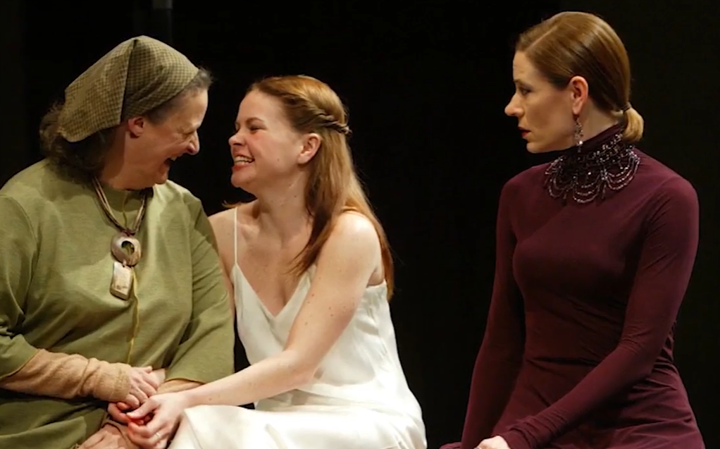
Meeting Juliet

Slide 11
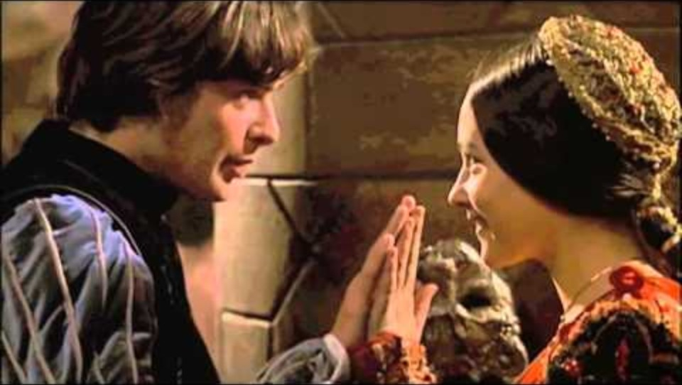
Uninvited Guests…love at first sight?

Slide 12
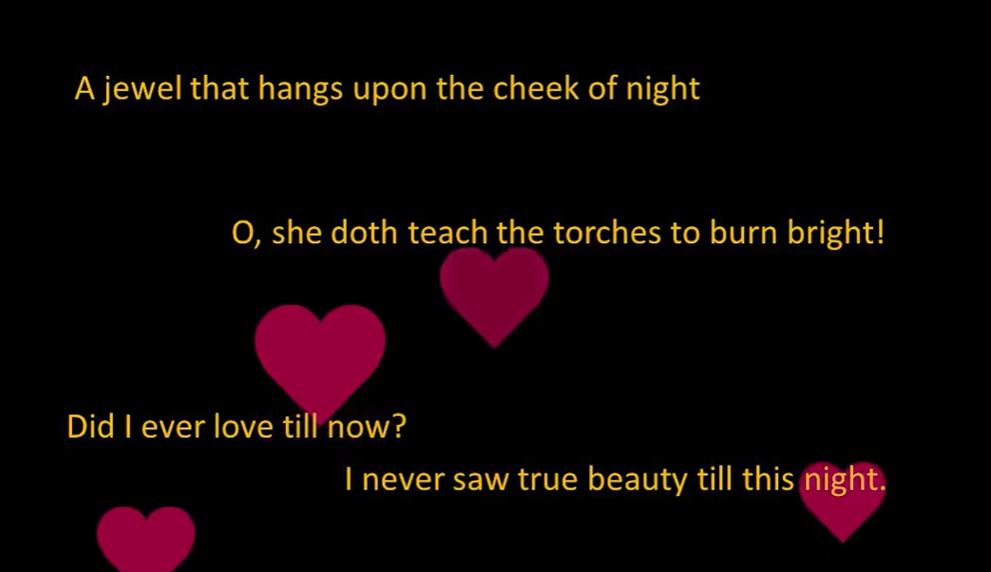

Slide 13

Love by first …sonnet?
How does Romeo’s language /poetry change after meeting Juliet?

Slide 14
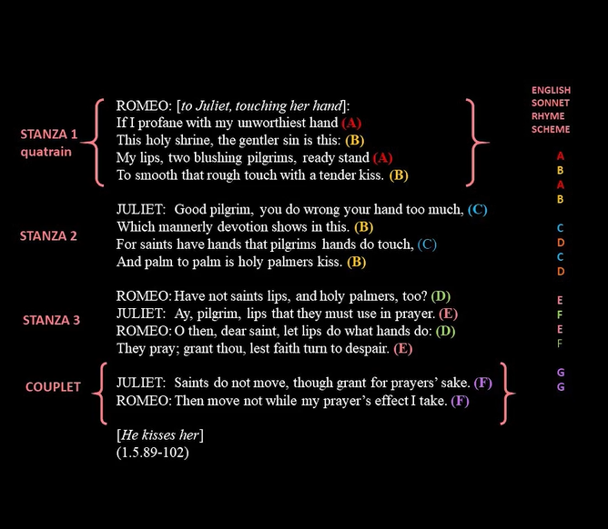
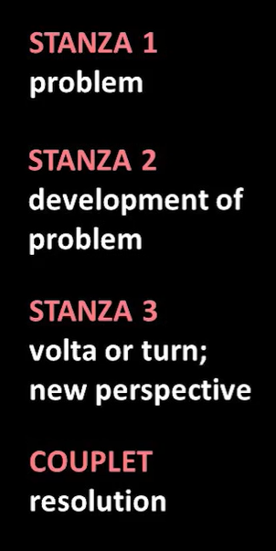
A world made of poetry
Dr. Helfer, E9
Act 1, Scene 5
Notes:
How he can take her hand from Paris is the problem; Romeo in love with Rosaline a bad imitation of love poetry;

Slide 15
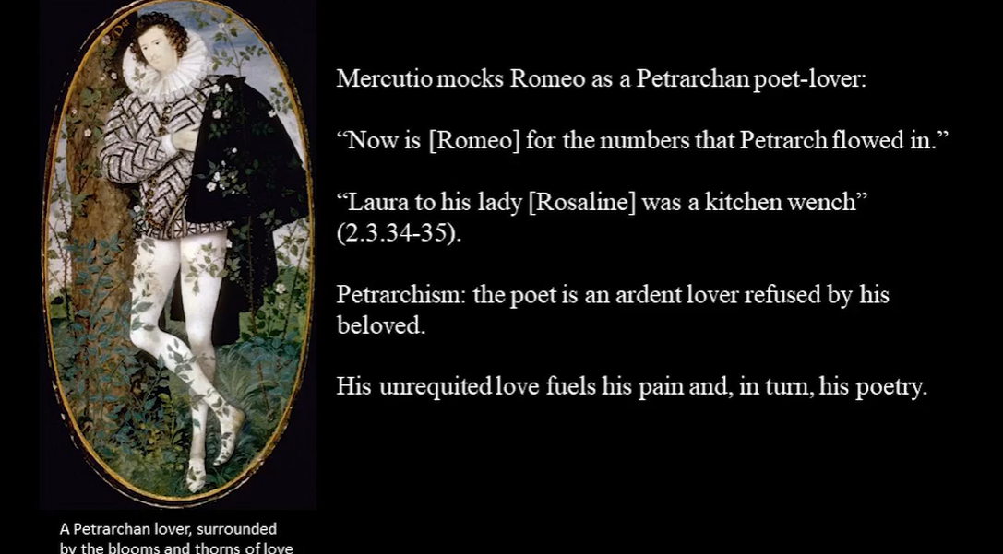

Slide 16
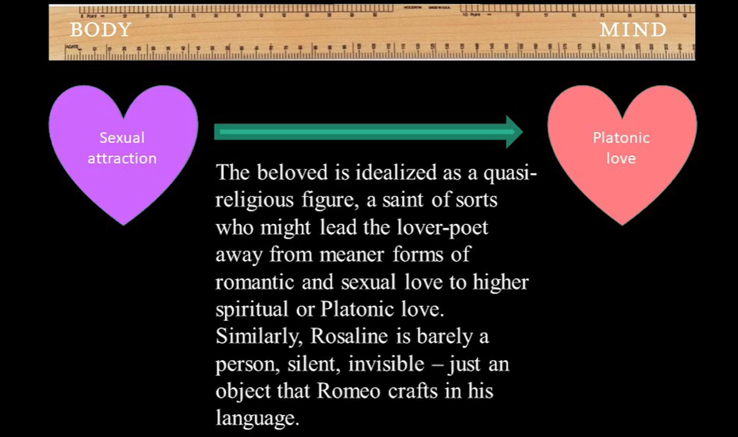
Notes:
RJ love is true love because the intensity of the language changes

Slide 17
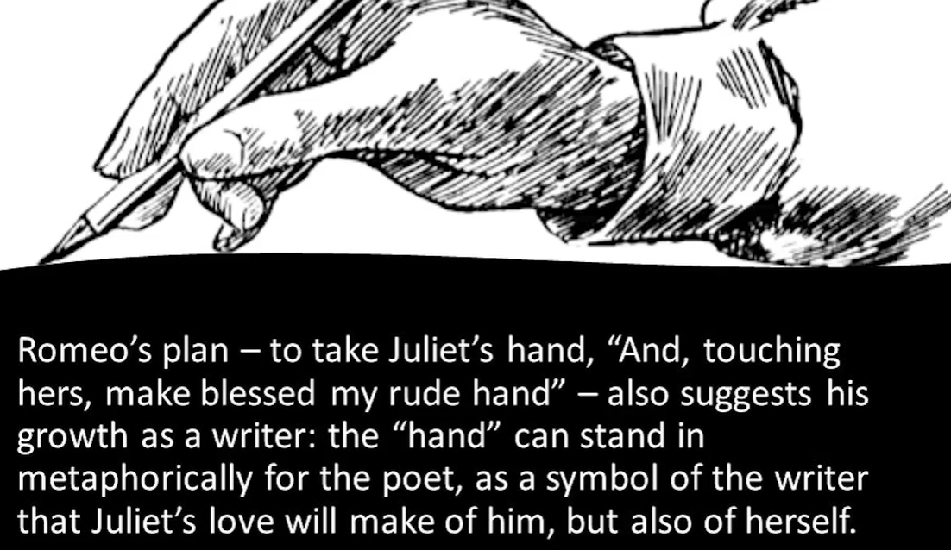

Slide 18
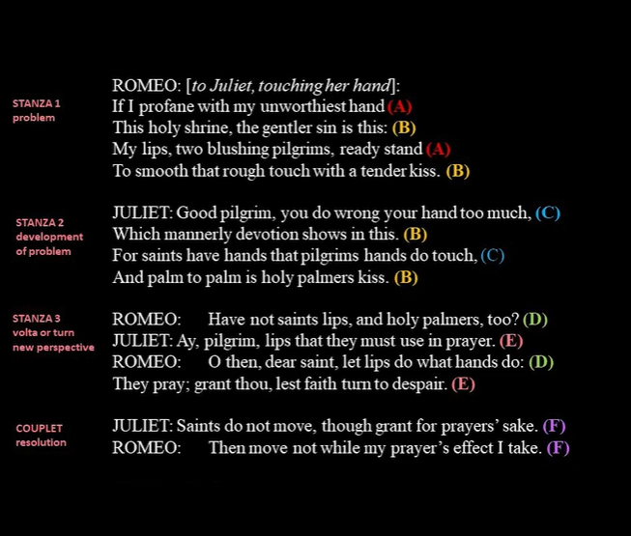
Notes:
Construct sonnet equally; equal amount of lines from R and J; co authored and more than one voice not a typical sonnet; so their love is different

Slide 19
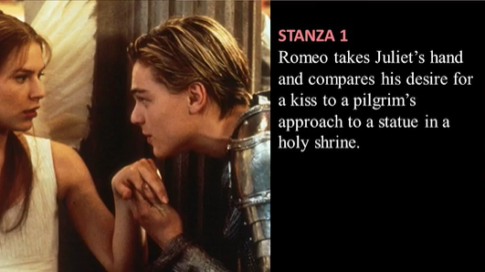
Notes:
Romeo is the pilgrim; Juliet is the saint

Slide 20
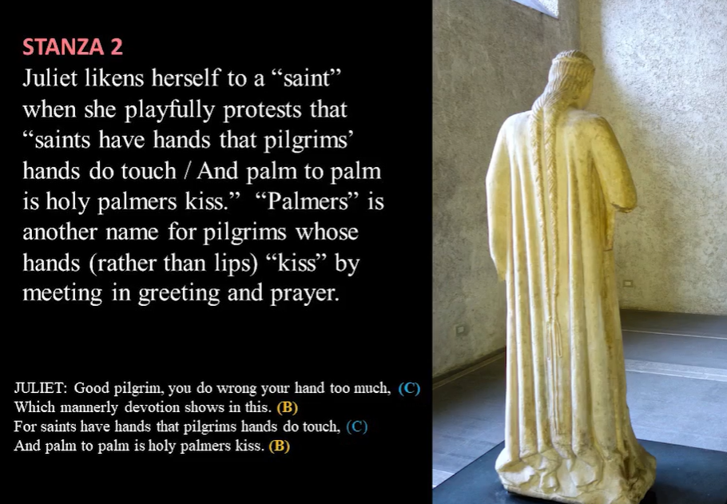

Slide 21
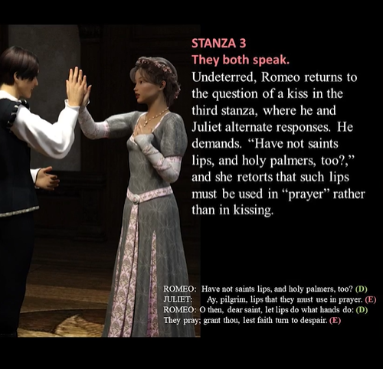
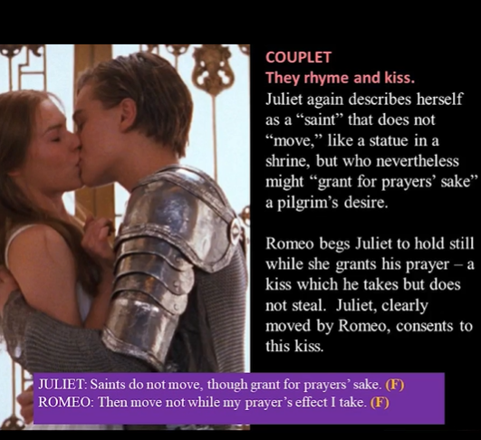

Slide 22
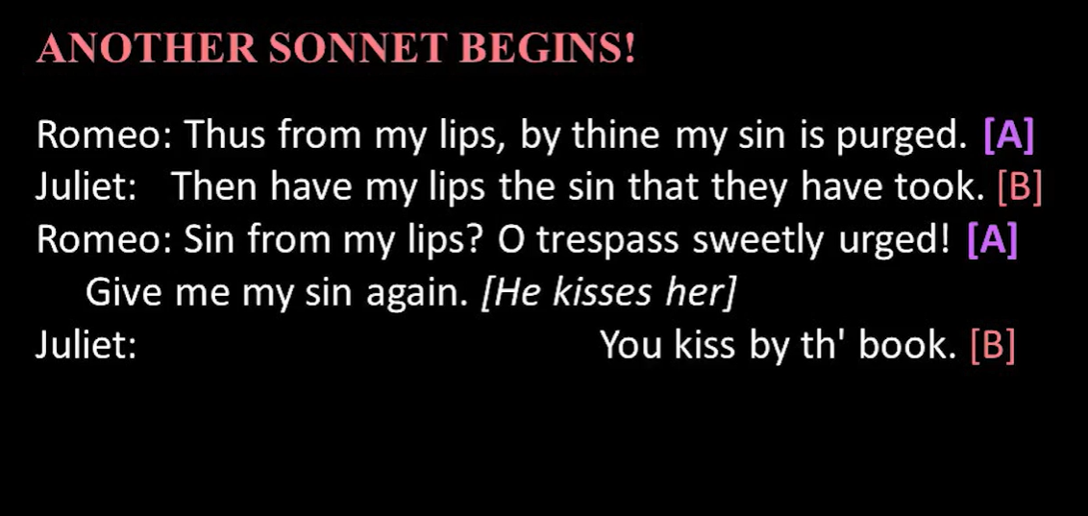

Slide 23
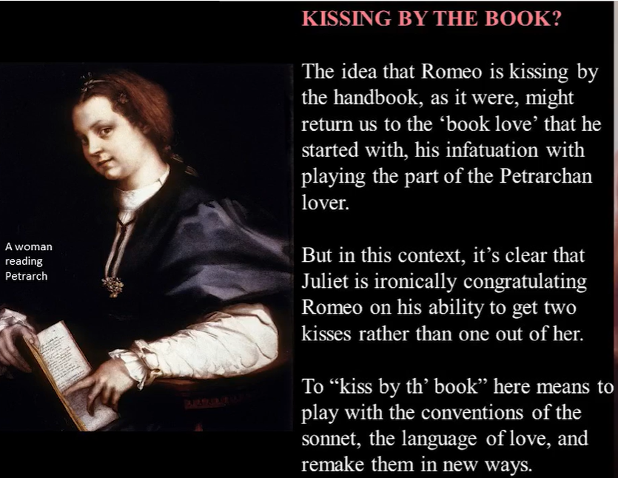

Slide 24
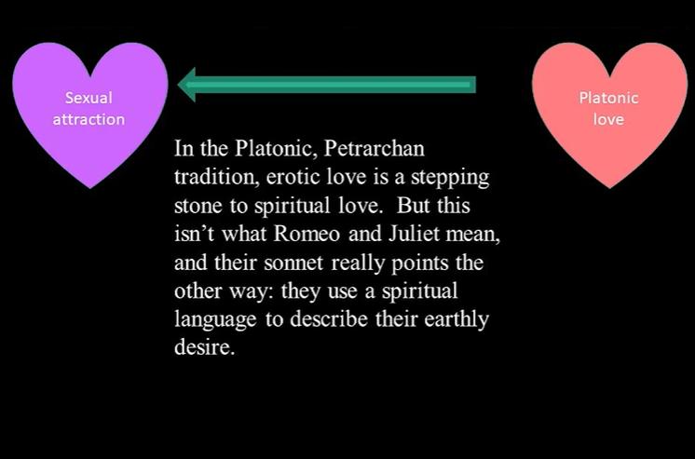
Notes:
The elevator in which they create their own world

Slide 25
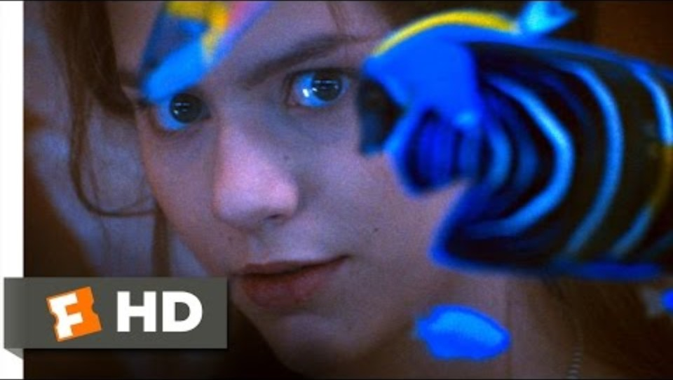

Slide 26
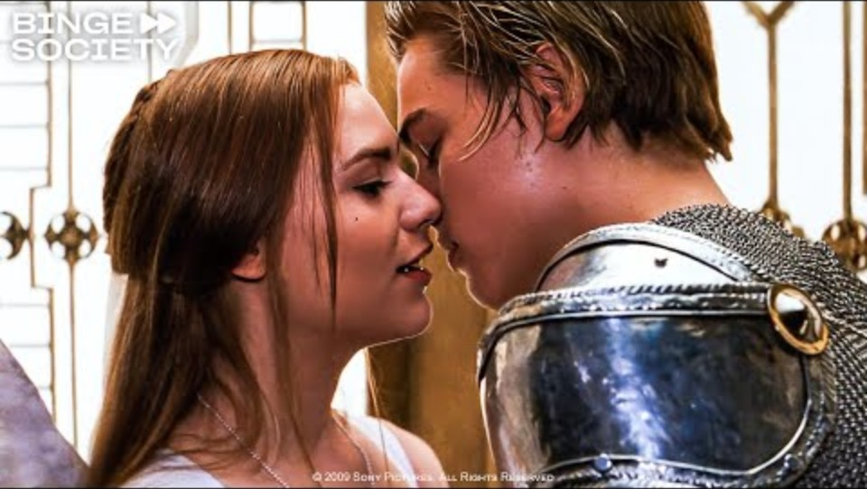

Slide 27
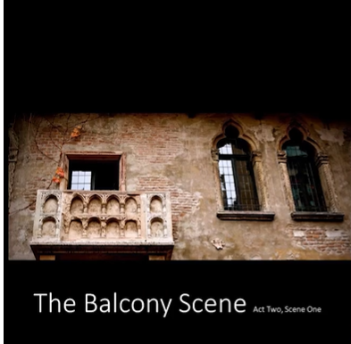
The Balcony Scene
Notes:
Vertical dimensions of stage and relationship vs. horizontal of sonnet; yearning and separation; philosophical on nature of names

Slide 28
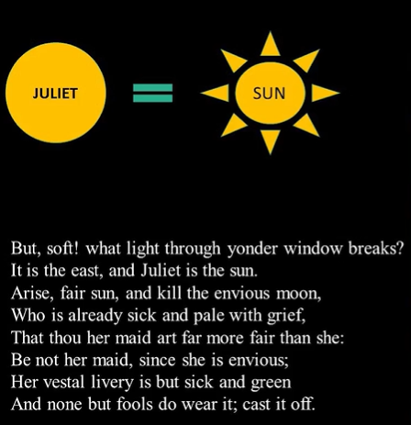
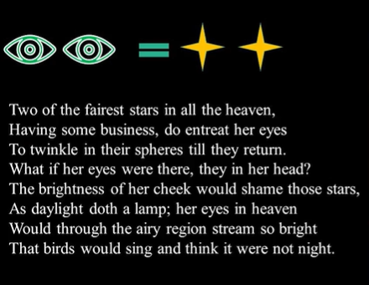
Act 2, Scene 2
Notes:
How is Juliet like the sun? She is luminous. She teaches the torches to burn bright; sun associate with moon- don’t be like the moon cold Rosaline; eyes like stars that want to exchange placed with the stars and here yes being in heaven; what would that be like? Sun is brighter than any stars; so bring that the birds think it would singing

Slide 29
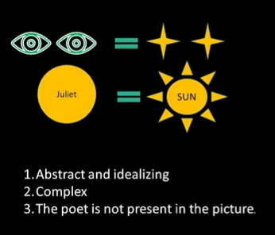
What are the characteristics of these metaphors?
Notes:
The “mind” or cerebral not sensual really;

Slide 30
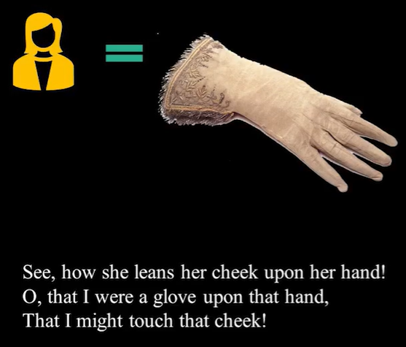
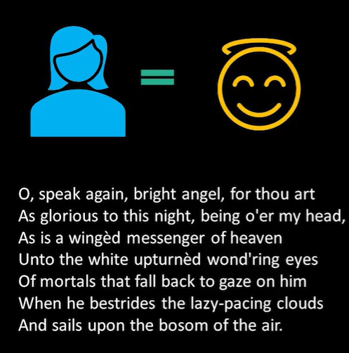
Notes:
Brings her in contact with the beloved and tactile;

Slide 31
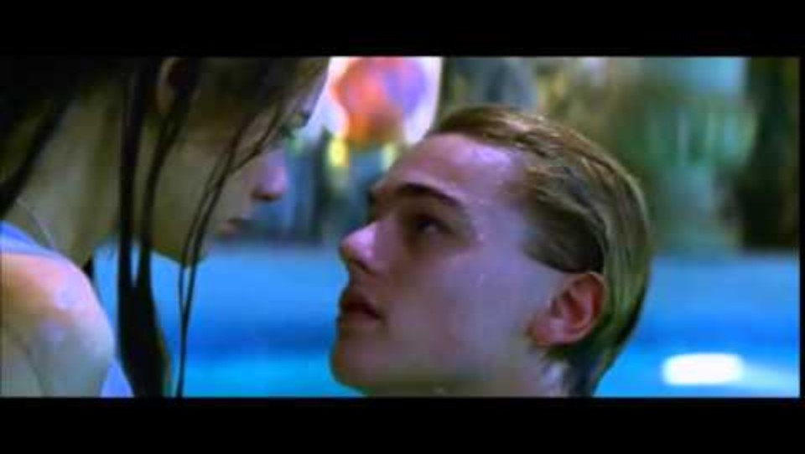

Slide 32
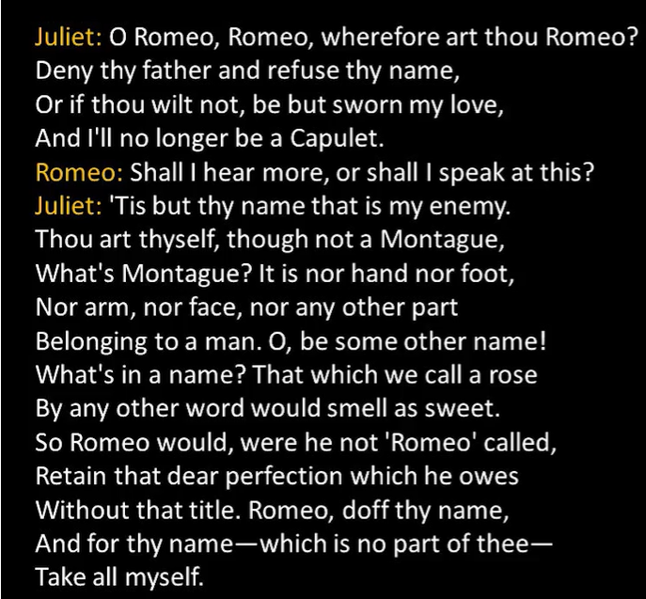
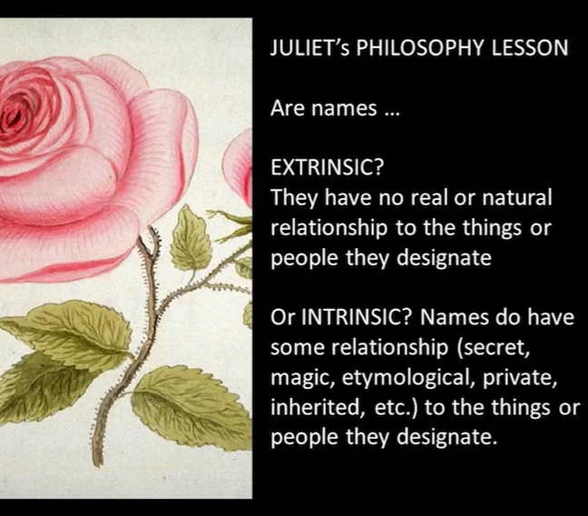
A meditation/essay on names

Slide 33
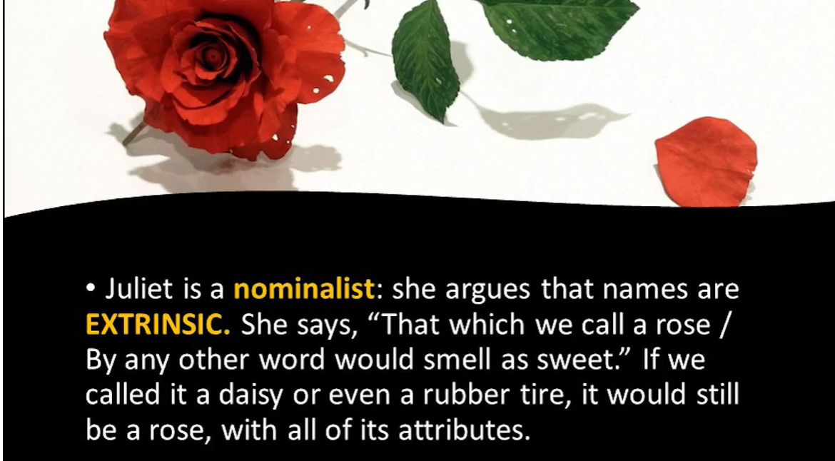
Notes:
Juliet’s argument but does the play support this thesis

Slide 34
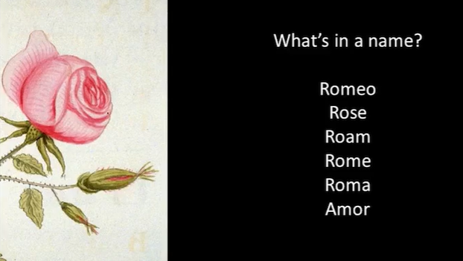
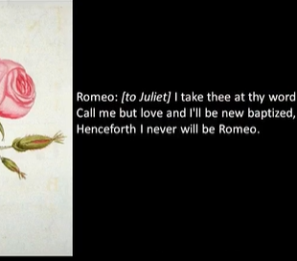
Creating a new world together…newly baptized
What is the status of names in RJ?
Notes:
The play shows how names are both extrinsic and intrinsic- changing the power that names have over us requires real work socially and politically, virtues of courage and fidelity

Slide 35

Friar Lawrence: With baleful weeds and precious-juicèd flowers.
The Earth that’s nature’s mother is her tomb;
10 What is her burying grave, that is her womb;
And from her womb children of divers kind
We sucking on her natural bosom find,
Many for many virtues excellent,
None but for some, and yet all different.
15 O, mickle is the powerful grace that lies
In plants, herbs, stones, and their true qualities.
For naught so vile that on the Earth doth live
But to the Earth some special good doth give;
Nor aught so good but, strained from that fair use,
20 Revolts from true birth, stumbling on abuse.
Virtue itself turns vice, being misapplied,
And vice sometime by action dignified.
Enter Romeo.
Within the infant rind of this small flower
Poison hath residence and medicine power.
For this, being smelt, with that part cheers each part;
Being tasted, stays all senses with the heart.
Two such opposèd kings encamp them still,
In man as well as herbs—grace and rude will. (2.3)

Slide 36
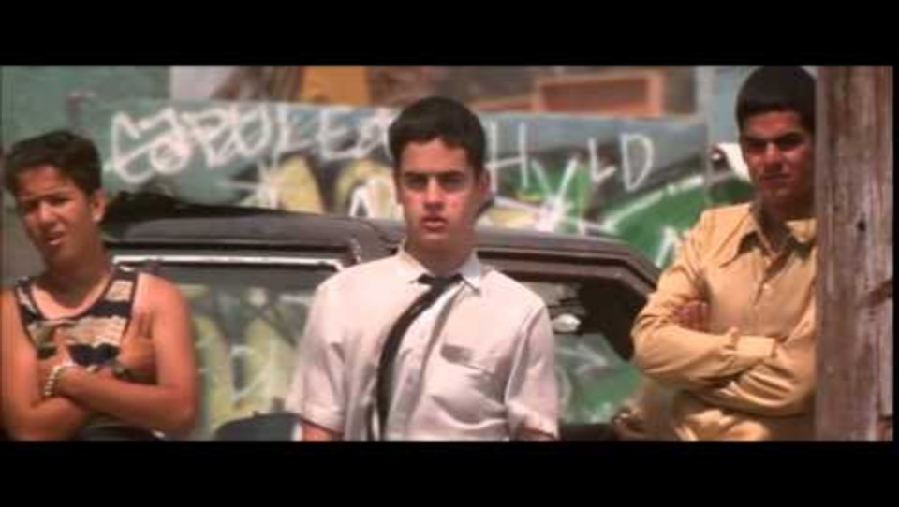
Dilemma of the Duel

Slide 37
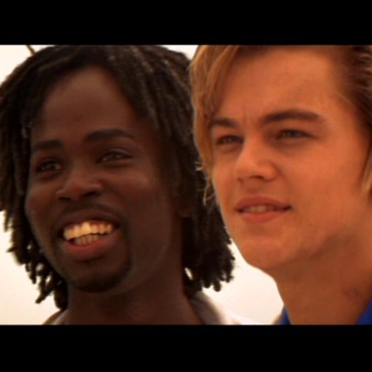
Discuss:
Taking the values of Shakespeare age into consideration, do you think Romeo was right in choosing to avenge Mercutio’s death, which he has accidentally caused, by fighting Tybalt? Or do you think he should have tried to find a way to step out of the conflict? If you were Benvolio, how would you advise Romeo?

Slide 38
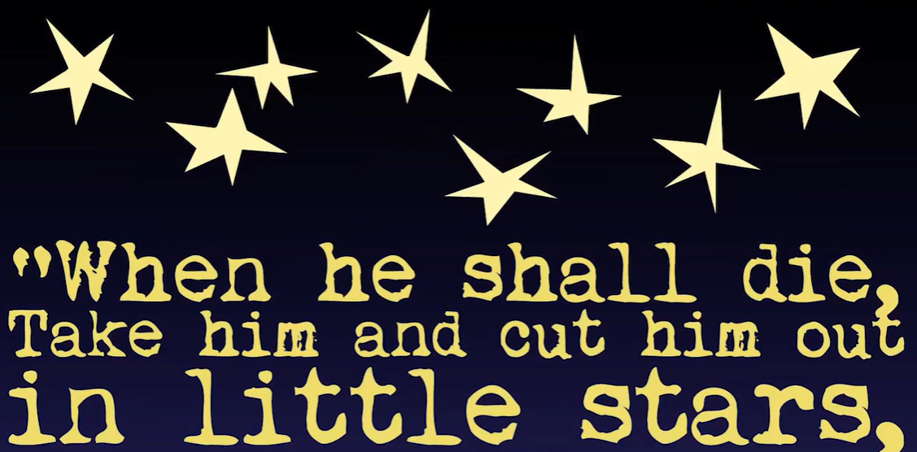
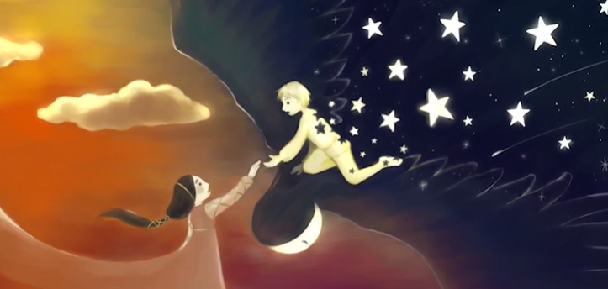
Juliet’s Poetry
Romeo as king of the Night (Hades)

Slide 39
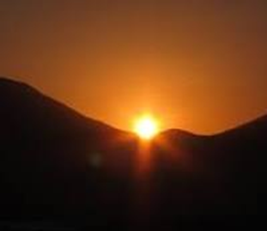
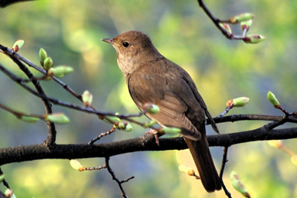
Lark and Nightengale (3.5)

Slide 40
Aubade: a poem for the dawn
JULIET
Wilt thou be gone? It is not yet near day.
It was the nightingale, and not the lark,
That pierced the fearful hollow of thine ear.
Nightly she sings on yond pomegranate tree.
Believe me, love, it was the nightingale.
ROMEO
It was the lark, the herald of the morn,
No nightingale. Look, love, what envious streaks
Do lace the severing clouds in yonder east.
Night’s candles are burnt out, and jocund day
Stands tiptoe on the misty mountain-tops.
I must be gone and live, or stay and die.
JULIET
Yond light is not daylight, I know it, I.
It is some meteor that the sun ⌜exhaled⌝
To be to thee this night a torchbearer
And light thee on thy way to Mantua.
Therefore stay yet. Thou need’st not to be gone.
ROMEO
Let me be ta’en; let me be put to death.
I am content, so thou wilt have it so.
I’ll say yon gray is not the morning’s eye;
’Tis but the pale reflex of Cynthia’s brow.
Nor that is not the lark whose notes do beat
The vaulty heaven so high above our heads.
I have more care to stay than will to go.
Come death and welcome. Juliet wills it so.
How is ’t, my soul? Let’s talk. It is not day.
JULIET
It is, it is. Hie hence, begone, away!
It is the lark that sings so out of tune,
Straining harsh discords and unpleasing sharps.
Some say the lark makes sweet division.
This doth not so, for she divideth us.
Some say the lark and loathèd toad ⌜changed⌝ eyes.
O, now I would they had changed voices too,
Since arm from arm that voice doth us affray,
Hunting thee hence with hunt’s-up to the day.
O, now begone. More light and light it grows.
Notes:
Division: musical term of diving up musical intervals

Slide 41
Juliet’s Courage (4.3)
JULIET
Farewell.—God knows when we shall meet again.
I have a faint cold fear thrills through my veins
That almost freezes up the heat of life.
I’ll call them back again to comfort me.—
Nurse!—What should she do here?
My dismal scene I needs must act alone.
Come, vial.⌜She takes out the vial.⌝
What if this mixture do not work at all?
Shall I be married then tomorrow morning?
⌜She takes out her knife
and puts it down beside her.⌝
No, no, this shall forbid it. Lie thou there.
What if it be a poison which the Friar
Subtly hath ministered to have me dead,
Lest in this marriage he should be dishonored
Because he married me before to Romeo?
I fear it is. And yet methinks it should not,
For he hath still been tried a holy man.
How if, when I am laid into the tomb,
I wake before the time that Romeo
Come to redeem me? There’s a fearful point.
Shall I not then be stifled in the vault,
To whose foul mouth no healthsome air breathes in,
And there die strangled ere my Romeo comes?
Or, if I live, is it not very like
The horrible conceit of death and night,
Together with the terror of the place—
As in a vault, an ancient receptacle
Where for this many hundred years the bones
Of all my buried ancestors are packed;
Where bloody Tybalt, yet but green in earth,
Lies fest’ring in his shroud; where, as they say,
At some hours in the night spirits resort—
Alack, alack, is it not like that I,
So early waking, what with loathsome smells,
And shrieks like mandrakes torn out of the earth,
That living mortals, hearing them, run mad—
O, if I ⌜wake,⌝ shall I not be distraught,
Environèd with all these hideous fears,
And madly play with my forefathers’ joints,
And pluck the mangled Tybalt from his shroud,
And, in this rage, with some great kinsman’s bone,
As with a club, dash out my desp’rate brains?
O look, methinks I see my cousin’s ghost
Seeking out Romeo that did spit his body
Upon a rapier’s point! Stay, Tybalt, stay!
Romeo, Romeo, Romeo! Here’s drink. I drink to
thee.⌜She drinks and falls upon her bed
within the curtains.⌝
Notes:
Courage as a virtue needs an audience

Slide 42
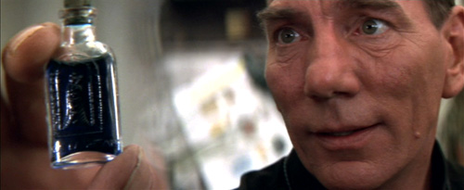

Slide 43
Into the Crypt
O my love, my wife,
Death, that hath sucked the honey of thy breath,
Hath had no power yet upon thy beauty.
Thou art not conquered. Beauty’s ensign yet
95 Is crimson in thy lips and in thy cheeks,
And death’s pale flag is not advancèd there.—
Tybalt, liest thou there in thy bloody sheet?
O, what more favor can I do to thee
Than with that hand that cut thy youth in twain
100 To sunder his that was thine enemy?
Forgive me, cousin.—Ah, dear Juliet,
Why art thou yet so fair? Shall I believe
That unsubstantial death is amorous,
And that the lean abhorrèd monster keeps
105 Thee here in dark to be his paramour?
For fear of that I still will stay with thee
And never from this ⌜palace⌝ of dim night
Depart again. Here, here will I remain
With worms that are thy chambermaids. O, here
110 Will I set up my everlasting rest
And shake the yoke of inauspicious stars
From this world-wearied flesh! Eyes, look your last.
Arms, take your last embrace. And, lips, O, you
The doors of breath, seal with a righteous kiss
115 A dateless bargain to engrossing death.
⌜Kissing Juliet.⌝
Come, bitter conduct, come, unsavory guide!
Thou desperate pilot, now at once run on
The dashing rocks thy seasick weary bark!
Here’s to my love. ⌜Drinking.⌝ O true apothecary,
120 Thy drugs are quick. Thus with a kiss I die.
⌜He dies.⌝

Slide 44
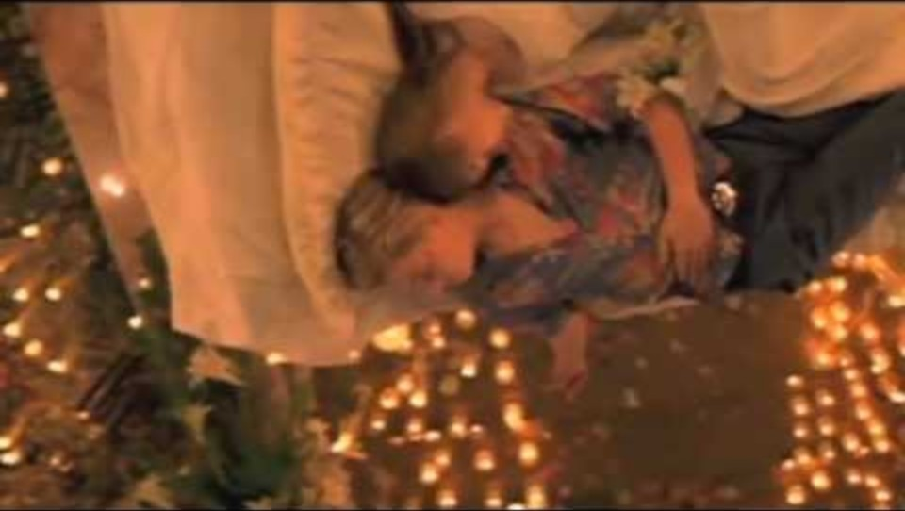

Slide 45
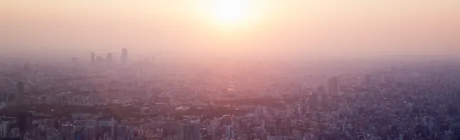
PRINCE
A glooming peace this morning with it brings.
The sun for sorrow will not show his head.
Go hence to have more talk of these sad things.
Some shall be pardoned, and some punishèd.
For never was a story of more woe
Than this of Juliet and her Romeo.

