Slide 1


Slide 2
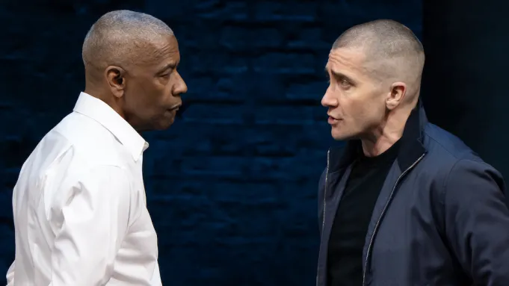

Slide 3
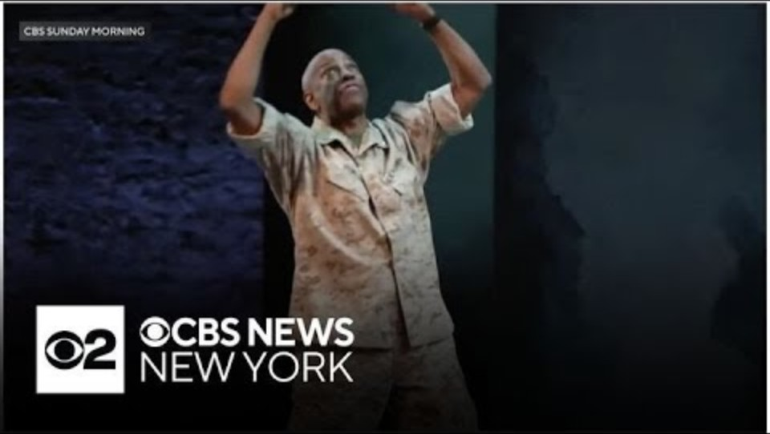

Slide 4
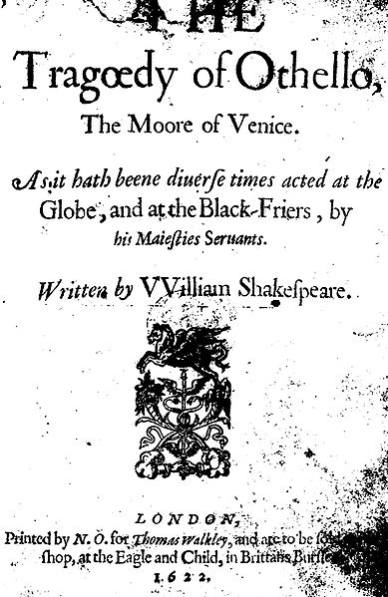
Othello
Believed to have been written in approximately 1603, and based on Giraldi Cinthio’s Gli Hecatommithi (1565).
First performance on November 1, 1604, at Whitehall Palace in London.
Subsequent performances took place in 1610 at the Globe and at Oxford.
It played at the Blackfriars Theatre in 1625 and 1639.

Slide 5
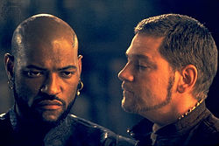
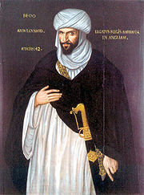
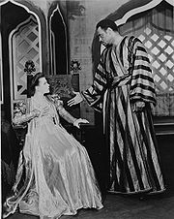
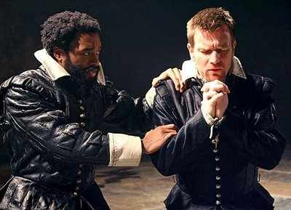
Shakespeare’s Moor
A "Moor” is a Muslim of North African ancestry, but the understanding (or misunderstanding) of this term by the Elizabethan English is far less stable.
The Moor of Venice has been interpreted widely from a pale-skinned Arab to a Black African and beyond. Theater and film productions take a stance on this question in their casting of the role.
For several centuries, Othello was played by white actors wearing black-face.
Critics have scrutinized the prejudices of Shakespeare’s for the historical and cultural context of the play.
When Othello was first written the African slave trade was just beginning in London
Othello’s “blackness” has also been read as a metaphorical state rather than a physical description (like the state of his soul or his position as an outsider).
Notes:
Think about these issues in relation to production and staging.
So it ought not be surprising that some of the most successful productions have invoked memories of slavery in America, or apartheid in South Africa - for these too have their historical roots in the same soil as Shakespeare's play, though it is a darker aspect of Othello's history, one which many readers have preferred to lighten. (www.studyworld.com)

Slide 6
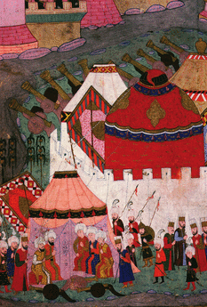
Ottoman –Venetian Wars
“What has often been forgotten is that while Spanish, Portuguese, English, and Dutch ships sailed to the New World and beyond, beginning the exploration and conquest of foreign lands, the Ottoman Turks were rapidly colonizing European territory. Thus, in the sixteenth and seventeenth centuries, the Europeans were both colonizers and colonized, and even the English felt the power of the Turkish threat to Christendom” (Vitkus, Turning Turk).
Ottoman Empire height of power, Suleiman the Magnificent (1520-1566)
The Battle of Lepanto, north of Cyprus 1571 (Christian Victory)
Fall of Cyprus, 1573 (Ottoman Victory)
Venice loses Cyprus to the Turkish forces of Selim II, ending over 80 years of Venetian rule on the island…the backdrop for Shakespeare’s Othello
The Siege of Vienna, 1529 Habsburg-Valois-Ottoman Wars, 1494–1559 (Christian victory but disturbing to Europe)

Slide 7
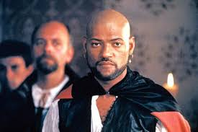
The “Valiant Moor” (1.3) vs. the “extravagant and wheeling stranger” (1.1)
FIRST SENATOR
Here comes Brabantio and the valiant Moor.
Enter Brabantio, Othello, Cassio, Iago, Roderigo, and
Officers.
DUKE
Valiant Othello, we must straight employ you
Against the general enemy Ottoman.
Herald: It is Othello’s pleasure, our noble and valiant
general (2.2)

Slide 8
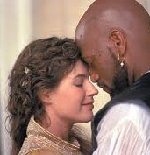
Storytelling
Othello: Yet, by your gracious patience,
I will a round unvarnished tale deliver
Of my whole course of love—what drugs, what
charms,
What conjuration, and what mighty magic
(For such proceeding I am charged withal)
I won his daughter. (1.3.105-111)

Slide 9
Autobiography (1.3)
OTHELLO
Her father loved me, oft invited me,
Still questioned me the story of my life
From year to year—the ⟨battles,⟩ sieges, ⟨fortunes⟩
That I have passed.
I ran it through, even from my boyish days
To th’ very moment that he bade me tell it,
155 Wherein I spoke of most disastrous chances:
Of moving accidents by flood and field,
Of hairbreadth ’scapes i’ th’ imminent deadly
breach,
Of being taken by the insolent foe
160 And sold to slavery, of my redemption thence,
And portance in my traveler’s history,
Wherein of antres vast and deserts idle,
Rough quarries, rocks, ⟨and⟩ hills whose ⟨heads⟩
touch heaven,
165 It was my hint to speak—such was my process—
And of the cannibals that each ⟨other⟩ eat,
The Anthropophagi, and men whose heads
⟨Do grow⟩ beneath their shoulders. These things to
hear
170 Would Desdemona seriously incline.
But still the house affairs would draw her ⟨thence,⟩
Which ever as she could with haste dispatch
She’d come again, and with a greedy ear
Devour up my discourse. Which I, observing,
175 Took once a pliant hour, and found good means
To draw from her a prayer of earnest heart
That I would all my pilgrimage dilate,
Whereof by parcels she had something heard,
But not ⟨intentively.⟩ I did consent,
180 And often did beguile her of her tears
When I did speak of some distressful stroke
That my youth suffered. My story being done,
She gave me for my pains a world of ⟨sighs.⟩
She swore, in faith, ’twas strange, ’twas passing
185 strange,
’Twas pitiful, ’twas wondrous pitiful.
She wished she had not heard it, yet she wished
That heaven had made her such a man. She thanked
me,
190 And bade me, if I had a friend that loved her,
I should but teach him how to tell my story,
And that would woo her. Upon this hint I spake.
She loved me for the dangers I had passed,
And I loved her that she did pity them.
195 This only is the witchcraft I have used.
Here comes the lady. Let her witness it.

Slide 10
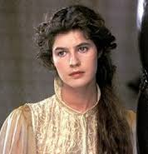
Desdemona’s Defense
DESDEMONA
That I love the Moor to live with him
My downright violence and storm of fortunes
May trumpet to the world. My heart’s subdued
Even to the very quality of my lord.
I saw Othello’s visage in his mind,
And to his honors and his valiant parts
Did I my soul and fortunes consecrate.
So that, dear lords, if I be left behind,
A moth of peace, and he go to the war,
The rites for why I love him are bereft me
And I a heavy interim shall support
By his dear absence. Let me go with him.

Slide 11
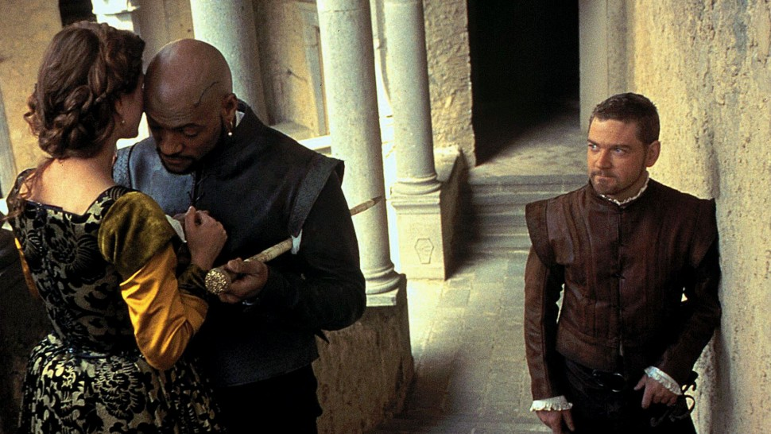
“Honest Iago”
OTHELLO So please your Grace, my
ancient.
A man he is of honesty and trust.
To his conveyance I assign my wife,
Othello: “My life upon her faith! Honest Iago” (1.3)

Slide 12
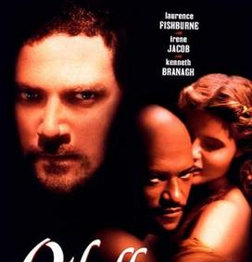
“Motiveless Malignancy” (Coleridge)
Iago: Thus do I ever make my fool my purse.
For I mine own gained knowledge should profane
If I would time expend with such ⟨a⟩ snipe
But for my sport and profit. I hate the Moor,
430 And it is thought abroad that ’twixt my sheets
’Has done my office. I know not if ’t be true,
But I, for mere suspicion in that kind,
Will do as if for surety. He holds me well.
The better shall my purpose work on him.
435 Cassio’s a proper man. Let me see now:
To get his place and to plume up my will
In double knavery—How? how?—Let’s see.
After some time, to abuse Othello’s ⟨ear⟩
That he is too familiar with his wife.
440 He hath a person and a smooth dispose
To be suspected, framed to make women false.
The Moor is of a free and open nature
That thinks men honest that but seem to be so,
And will as tenderly be led by th’ nose
445 As asses are.
I have ’t. It is engendered. Hell and night
Must bring this monstrous birth to the world’s light.
⟨He exits.⟩ 1.3

Slide 13
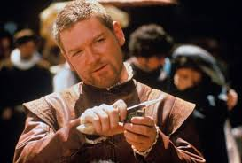
IAGO
That Cassio loves her, I do well believe ’t.
That she loves him, ’tis apt and of great credit.
310 The Moor, howbeit that I endure him not,
Is of a constant, loving, noble nature,
And I dare think he’ll prove to Desdemona
A most dear husband. Now, I do love her too,
Not out of absolute lust (though peradventure
I stand accountant for as great a sin)
But partly led to diet my revenge
For that I do suspect the lusty Moor
Hath leaped into my seat—the thought whereof
Doth, like a poisonous mineral, gnaw my inwards,
And nothing can or shall content my soul
Till I am evened with him, wife for wife,
Or, failing so, yet that I put the Moor
At least into a jealousy so strong
at judgment cannot cure. Which thing to do,
325 If this poor trash of Venice, whom I trace
For his quick hunting, stand the putting on,
I’ll have our Michael Cassio on the hip,
Abuse him to the Moor in the ⟨rank⟩ garb
(For I fear Cassio with my ⟨nightcap⟩ too),
Make the Moor thank me, love me, and reward me
For making him egregiously an ass
And practicing upon his peace and quiet
Even to madness. ’Tis here, but yet confused.
Knavery’s plain face is never seen till used.
He exits. (2.1)

Slide 14
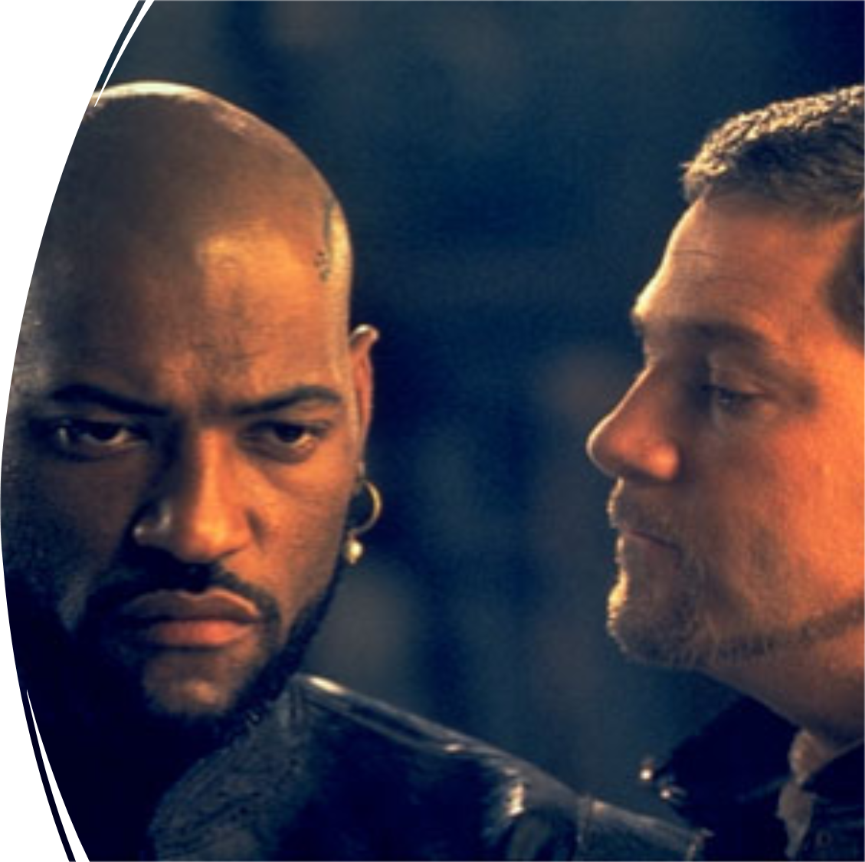
IAGO
And what’s he, then, that says I play the villain,
When this advice is free I give and honest,
Probal to thinking, and indeed the course
To win the Moor again? For ’tis most easy
Th’ inclining Desdemona to subdue
In any honest suit. She’s framed as fruitful
As the free elements. And then for her
To win the Moor—⟨were ’t⟩ to renounce his baptism,
All seals and symbols of redeemèd sin—
His soul is so enfettered to her love
That she may make, unmake, do what she list,
Even as her appetite shall play the god
With his weak function. How am I then a villain
To counsel Cassio to this parallel course
Directly to his good? Divinity of hell!
When devils will the blackest sins put on,
They do suggest at first with heavenly shows,
As I do now. For whiles this honest fool
Plies Desdemona to repair his fortune,
And she for him pleads strongly to the Moor,
I’ll pour this pestilence into his ear:
That she repeals him for her body’s lust;
And by how much she strives to do him good,
She shall undo her credit with the Moor.
So will I turn her virtue into pitch,
And out of her own goodness make the net
That shall enmesh them all. (2.3)
Enter Roderigo.

Slide 15

Auricular Persuasions
Compare Othello’s first autobiography (1.3.127) with Iago’s soliloquy (1.3.375) as well as Iago’s opening racial attacks on Othello? What is the significance of the faculty of hearing? How does this compare to the faculty of sight?

Slide 16
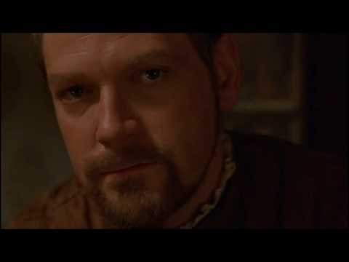

Slide 17
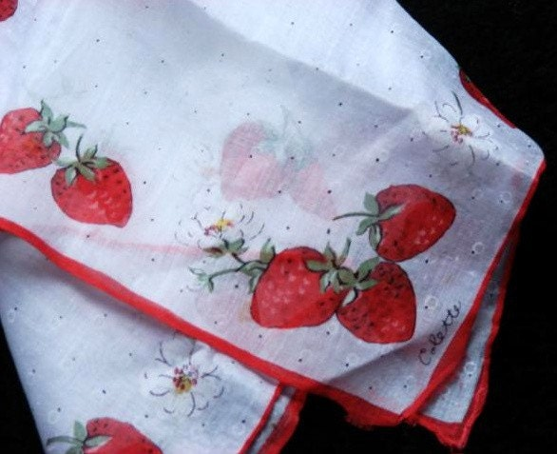
Directions: read this scene with your partner. First read the scene as one who is
1. indifferent to knowledge
and then as one who is
2. eager for knowledge
In a short paragraph, answer these questions: How does the status of knowledge affect how you would read the lines? What lines would you emphasize more? What does this short exchange reveal about the significance of the handkerchief and the reliability of “ocular proof”?
EMILIA
290 I am glad I have found this napkin:
291 This was her first remembrance from the Moor.
292 My wayward husband hath a hundred times
293 Woo'd me to steal it; but she so loves the token,
294 For he conjured her she should ever keep it,
295 That she reserves it evermore about her
296 To kiss and talk to. I'll have the work ta'en out,
297 And give't Iago: what he will do with it
298 Heaven knows, not I;
299 I nothing but to please his fantasy.
Re-enter Iago.
IAGO
300 How now! what do you here alone?
EMILIA
301 Do not you chide; I have a thing for you.
IAGO
302 A thing for me? it is a common thing—
EMILIA
303 Ha!
IAGO
304 To have a foolish wife.
EMILIA
305 O, is that all? What will you give me now
306 For the same handkerchief?
IAGO
306 What handkerchief?
EMILIA
307 What handkerchief?
308 Why, that the Moor first gave to Desdemona;
309 That which so often you did bid me steal.
IAGO
310 Hast stol'n it from her?
EMILIA
311 No, 'faith; she let it drop by negligence.
312 And, to the advantage, I, being here, took't up.
313 Look, here it is.
IAGO
313 A good wench; give it me.
EMILIA
314 What will you do with 't, that you have been so earnest
315 To have me filch it?
IAGO [Snatching it.]
315 Why, what's that to you?
EMILIA
316 If it be not for some purpose of import,
317 Give't me again: poor lady, she'll run mad
318 When she shall lack it.
IAGO
319 Be not acknown on 't; I have use for it.
320 Go, leave me. Exit Emilia.
321 I will in Cassio's lodging lose this napkin,
322 And let him find it. Trifles light as air
323 Are to the jealous confirmations strong
324 As proofs of holy writ: this may do something.
325 The Moor already changes with my poison:
326 Dangerous conceits are, in their natures, poisons.
327 Which at the first are scarce found to distaste,
328 But with a little act upon the blood
329 Burn like the mines of sulphur.

Slide 18
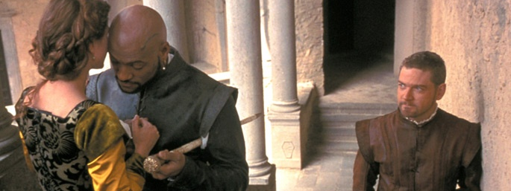
Temptation Scene 3.3.90
Analyze Iago’s rhetoric.

Slide 19

Internalization of Iago’s Racialized rhetoric (“us vs. them”)
3.3.230-280: “Not to affect many proposed matches/Of her own clime, complexion and degree”…
3.3.356: Othello’s descent into the web of jealousy: “Farewell the tranquil mind”…
3.3.385: Othello’s internalization of his outsider status, his “blackness” as a symbol of his difference as well as a spiritual state of doubt; loss of certitude, loss of faith in himself and Desdemona.
3.3.441: break from self; bargain with the “devil”; new betrothal

Slide 20
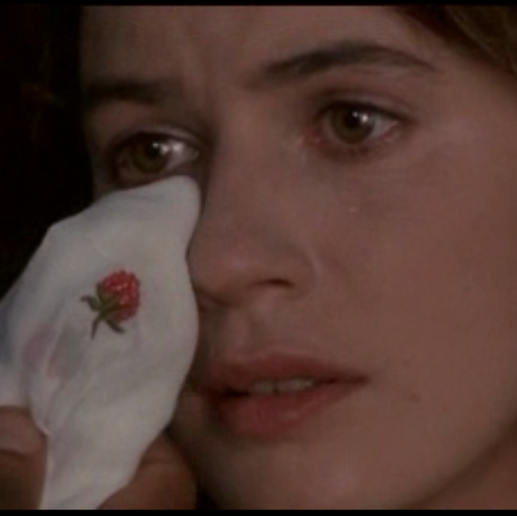
Compare and contrast Othello's two autobiographical statements (1.3.128- on his courtship) and (3.4.53- on the origins of the handkerchief). How does Othello's place or ethos as storyteller shift? What does this change suggest about his evolving sense of identity?

Slide 21
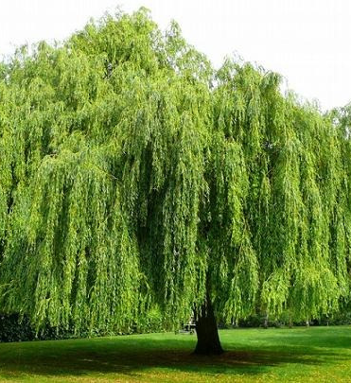
“Ocular proof” and Willow Song (Act 4)

Slide 22
Othello’s Autobiographies
How does Othello’s final speech differ from his first autobiography and his account of the handkerchief? Pay attention to language and formal elements—word choice, symbols, imagery, allusions, metaphors and so on.
1. The first autobiography (courtship, I.iii)
Othello narrates the exotic, as an observer and explorer, in the tradition of Odysseus and Aeneas.
2. The second autobiography (handkerchief, III.iv)
Othello draws on the exotic in order to manipulate, frighten and confuse Desdemona. He is allowing himself to be drawn into the exotic chain of creatures and places from which he had worked to distinguish himself from in Act I
The final autobiography (suicide speech, V.ii)
In this final accounting, Othello takes ownership of his own fall into “barbarism,” but he also reminds his audience of his service to the state. Othello is both the epic narrator and the exotic object of narration. By killing himself as the “circumcised Turk”, he reaffirms his commitment to Venice, to Christianity, and to Desdemona, but only by cutting off his very life.

Slide 23
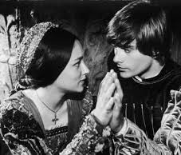
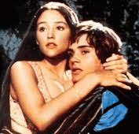
Tragedy
‘serious subject’ ‘persons of significance’
effect on audience is pity and fear
purgation through catharsis
tragic flaw (hamartia)
dramatic irony
recognition of the downfall
inner character/psychology
Aristotle’s Poetics

Slide 24
Aristotle’s Definition of Tragedy
“Tragedy, then, is a representation of an action that is serious, complete, and of some magnitude; in language that is pleasurably embellished, the different forms of embellishment occurring in separate parts; presented in the form of action, not narration; by means of pity and fear bringing about the catharsis of such emotions.”
(Poetics, Chapter 6)
Notes:
“By ‘language that is pleasurably embellished’ I refer to language possessing rhythm and melody
“by ‘the different forms of embellishment occurring in separate parts’ I mean that some parts are composed in verse alone, and others again make use of song.” (Poetics, 64)

Slide 25
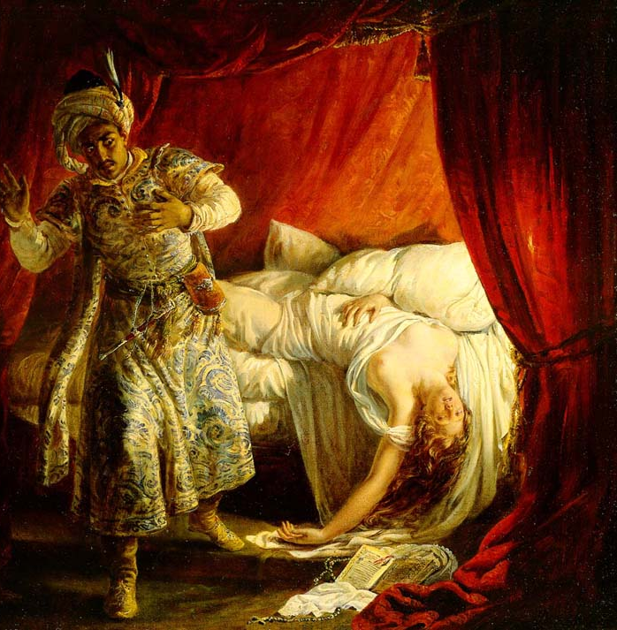
From Traveler to Turk
…”OTHELLO IS A DRAMA OF CONVERSION, in particular a conversion to certain forms of faithlessness deeply feared by Shakespeare's audience. The collective anxiety about religious conversion felt in post-Reformation England focused primarily on Roman Catholic enemies who threatened to convert Protestant England by the sword, but the English also had reason to feel trepidation about the imperial power of the Ottoman Turks, who were conquering and colonizing Christian territories in Europe and the Mediterranean. English Protestant texts, both popular and learned, conflated the political/external and the demonic/internal enemies, associating both the Pope and the Ottoman sultan with Satan or the Antichrist. According to Protestant ideology, the Devil, the Pope, and the Turk all desired to "convert" good Protestant souls to a state of damnation, and their desire to do so was frequently figured as a sexual/sensual temptation of virtue, accompanied by a wrathful passion for power” (Vitkus, Turning Turk)

Slide 26
Manifest Hostility and Hidden Hospitality in Othello
“In the world of theology and philosophy, hospitality embodies a singular, absolute law, an ethical imperative to welcome and serve the Other regardless of one’s own needs or desires. The Biblical injunction to “love your neighbor as yourself” is in part a command to be hospitable” (Kevin Curran)
Hospitality from the Latin hostis : “guest” or “enemy”
Moments of hidden hospitality in both Othello and Merchant are primers in deciphering the extent of Shakespeare’s global visions and the interdependence of such vistas within his society. When Othello defends his amicable relationship with Desdemona and Brabantio before the Duke, he describes a Brabantio we never encounter—the welcoming, hospitable European who opened his door to a stranger and not the startled, hostile father waking to the infectious alarms of Iago’s racializing rhetoric. Following the Duke’s invitation to speak—“Say it, Othello” (1.3.127)—Othello begins with a reference to this earlier invitation: “Her father loved me, oft invited me,/Still questioned me the story of my life/From year to year” (1.3.128-130). Like the image of the “beast with two backs” (1.1.116), such a vision of loving and edifying intercultural hospitality is too unseemly to stage; nevertheless, the narration of a hospitable golden age signals toward a cultural and literary reserve of cosmopolitan co-existence and interfaith exchanges that is pivotal for the new worlds Shakespeare engenders.

