Slide 1

The Big Why?
Oh the Humanities!

Slide 2
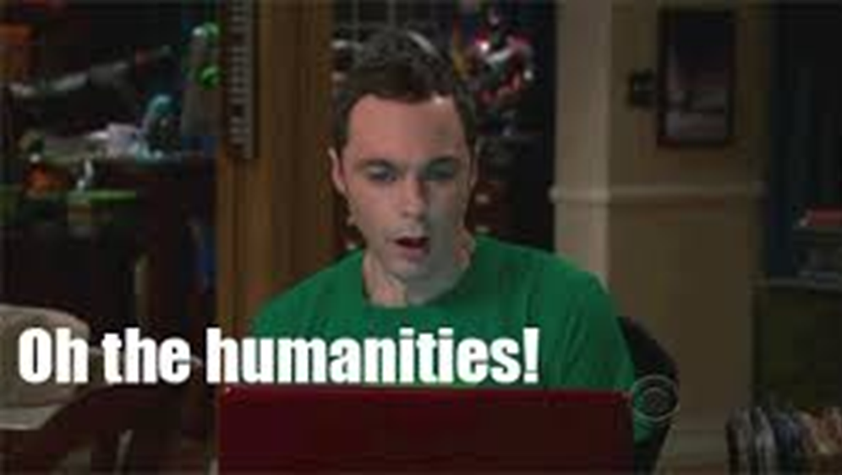

Slide 3
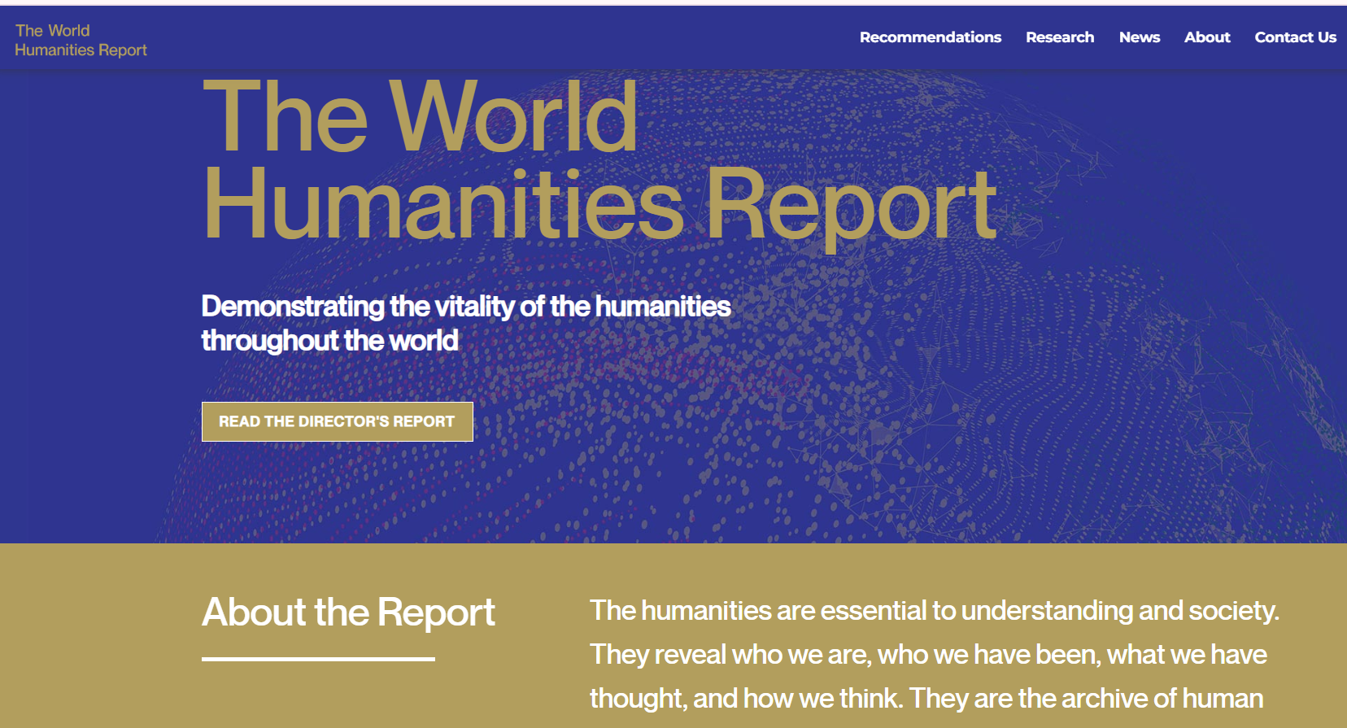
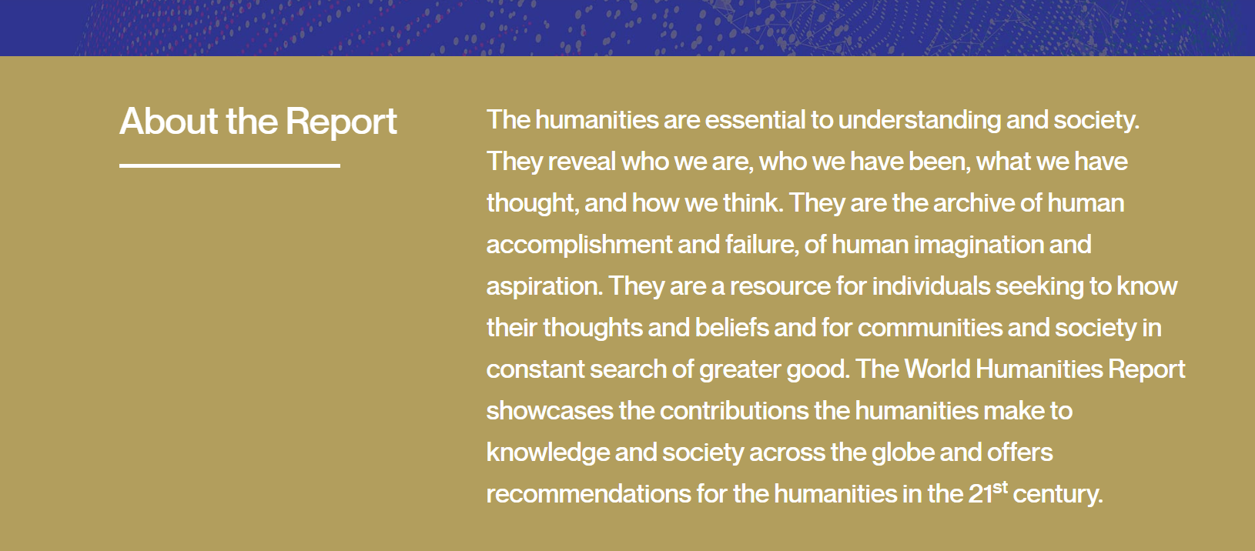
Why do we study English literature?

Slide 4
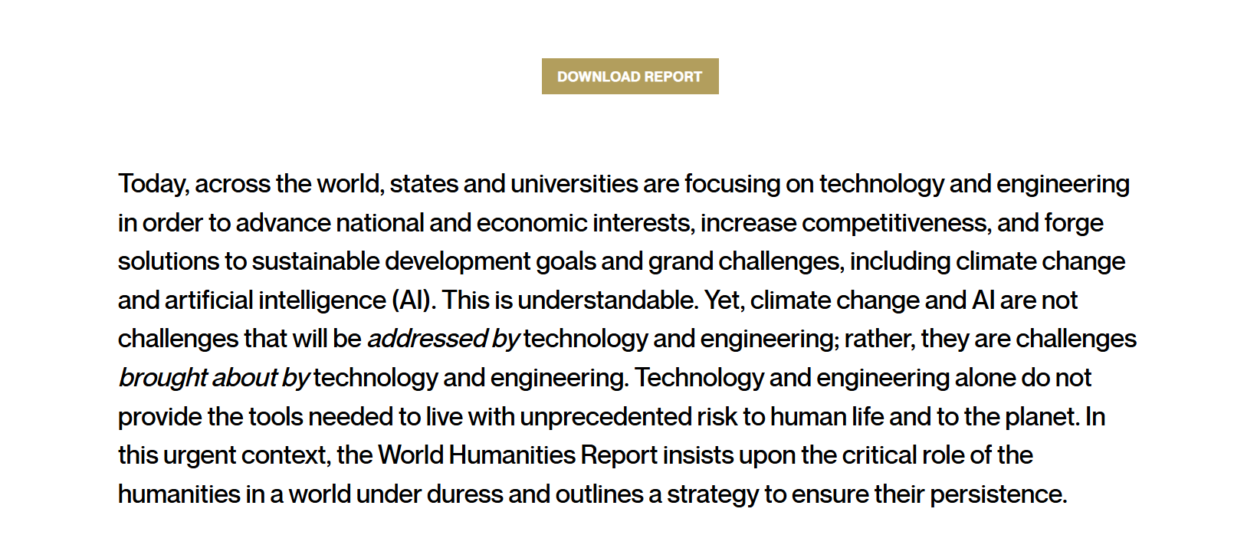

Slide 5
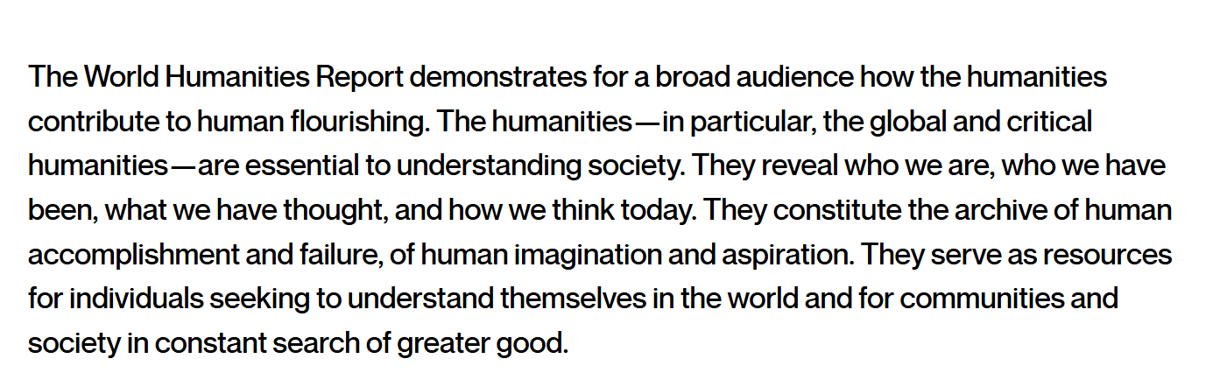

Slide 6
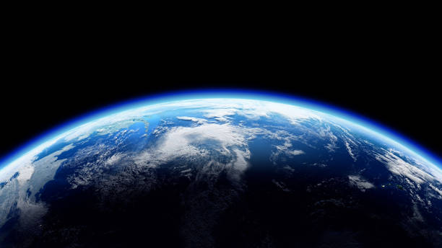
A wondrous world…
Prospero: We are such stuff
As dreams are made on, and our little life
Is rounded with a sleep (4.1)
GONZALO If in Naples
I should report this now, would they believe me?
If I should say I saw such ⌜islanders⌝—
For, certes, these are people of the island—
Who, though they are of monstrous shape, yet note
Their manners are more gentle, kind, than of
Our human generation you shall find
Many, nay, almost any (3.3)
MIRANDA, ⌜rising and coming forward⌝ O wonder!
How many goodly creatures are there here!
How beauteous mankind is! O, brave new world
That has such people in ’t! (5.1)

Slide 7
Ben Okri, The Mystery Feast
"There is nothing that expresses the roundedness of human beings more than storytelling. Stories are the highest technology of being.
There is in story the greatest psychology of existence, of living. Indeed there is in story something semi-divine. The nature of story itself is linked to the core of creation. Story belongs to the micro-moment after the big bang. It belongs to the micro-moment after the “let there be light!” act of creation.
We live in a time in which we are being told that the main things of value are the things of science and the things of technology. Our lives are being compressed into this technological reality. But it is worth remembering the many-sidedness of being human. Great evil befalls us when we restrict ourselves to just one side of our being.
It is important that we don’t become machines, that we don’t become computers. We contain machines. We contain computers. We contain all of nature, the seas, the mountains, the constellations, and the nearly infinite spaces.
At the heart of all science – its experiments, its theories, its mathematics, its discoveries, its interpretations – is the story instinct. The scientific mind would be impossible without the story DNA, without the story-seeing brain cells. The mind’s aspects do not operate in isolation. Every human being immersed in the cyclorama of reality is implicated in the cosmic story-making nature of reality. Maybe this story-making quality of reality is what constitutes the heart of our existence.
At every moment we are in a micro or macro “once upon a time” sea of existence. In every moment we are part of the infinite stories that the universe is telling us, and that we are telling the universe.
but then maybe this storytelling quality of mind is itself a paradox and a metaphor of that which we are finally meant to discover. The kiss that awakens the princess from her bed of sleep is not just the kiss of romance but maybe also the kiss of enlightenment. A true awakening is an enlightenment. This is especially so when you consider sleep as the metaphor of our unawakened condition in the true wonder of reality.

Slide 8
The great stories, which appear all over the world in different variations, are intuitions sensed about this mysterious nature of the absolute reality. Great stories have lightness and multi-dimensional agility. They speak constantly to different levels in us. They speak to us at the level that we are on.
The story about the seven dwarves can be a coded reference to class conditions in society. It could also be the imagination’s grasp of fundamental patterns at work in the cellular dimension of our bodies. It could be a metaphysical understanding of the mystery of numbers. The story is never really just about seven dwarves, or it would not linger in the imagination.
We treat stories like dustbins into which we dispose our lowest sense of possibilities. The tale of the Emperor’s New Clothes is alluded to whenever we talk about something that is less than it appears to be. That same story can be just as much about the power of true seeing. In a world of advertisements, obsession with fame, in which the hyped is more valued than the true, the tale of the Emperor’s New Clothes gains significant resonance. Most of what we pursue, what we are obsessed with, what confuses and humiliates us, most of what society projects at us, the inflated notions of success, are all Emperor’s New Clothes. We have bought into the way of seeing that believes all the illusions are actually the velvet royal cloak, richly to be desired. We need to be that little boy who can see most of the stuff of society as exactly what it is – mass projection and emptiness.
One story read the right way can turn our false world upside down and restore to us a true sense of sanity. For the world drives us mad with its foolishness. It has been doing this for centuries. We have slowly become aware of it and have distilled our awareness. We have planted that distillation in the most memorable and indestructible place we can find. We have made that place a constant guide to ourselves in our endless incarnations. The place in which we plant them are stories.
Stories are the infinite seeds that we have brought with us through the millennia of walking the dust of the earth. They are our celestial pods. They are our alchemical cauldrons. If we listen to them right, if we read them deeply, they will guide us through the confusion of our lives, and the diffusion of our times."

Slide 9
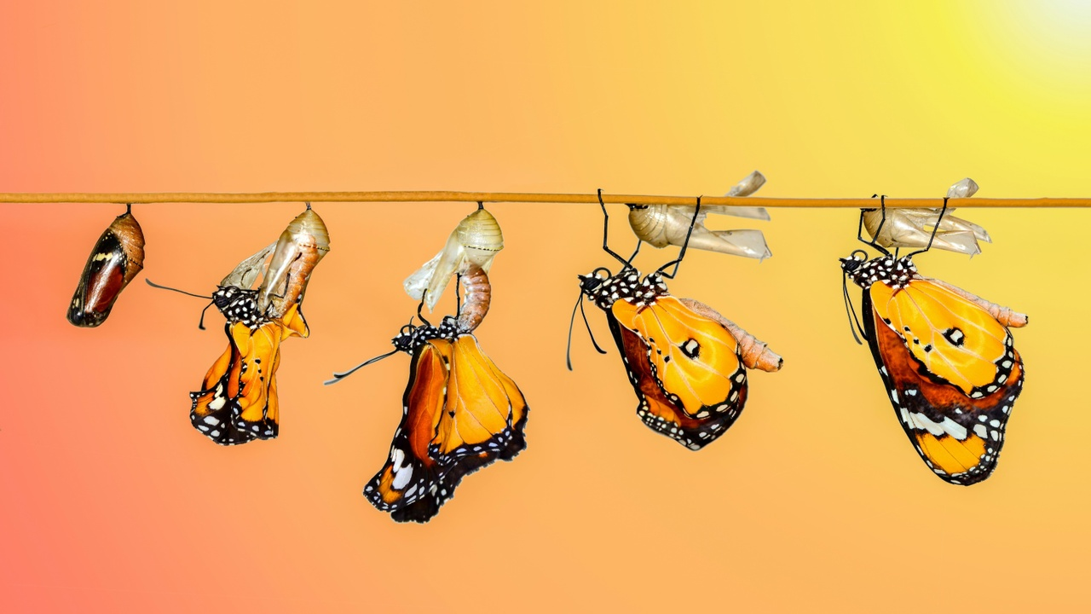
For your final ePortfolio entry, consider the idea of transformation in relation to narrative ethics theory in The Tempest and in your study of Shakespeare: what is a transformation? Which characters undergo a transformation? In The Mystery Feast, Ben Okri claims that "stories are the infinite seeds that we have brought with us through the millennia of walking the dust of the earth. They are our celestial pods. They are our alchemical cauldrons. If we listen to them right, if we read them deeply, they will guide us through the confusion of our lives, and the diffusion of our times" while Aminatta Forna argues in "Selective Empathy" that "Reading makes you a more highly functioning person. In other words—reading makes you a better person" (34). Both Okri and Forna direct us to the transformative potential of narratives (stories). Has reading Shakespeare's works transformed you or a part of you? Have you undergone a "sea-change" (mentally, psychologically, spiritually) or experienced an alchemical reaction of sorts?
(this ePortfolio is very good practice for the type of integrative writing we want to include in our final paper!)

Slide 10
