Slide 1

A Midsummer Night’s Dream

Slide 2
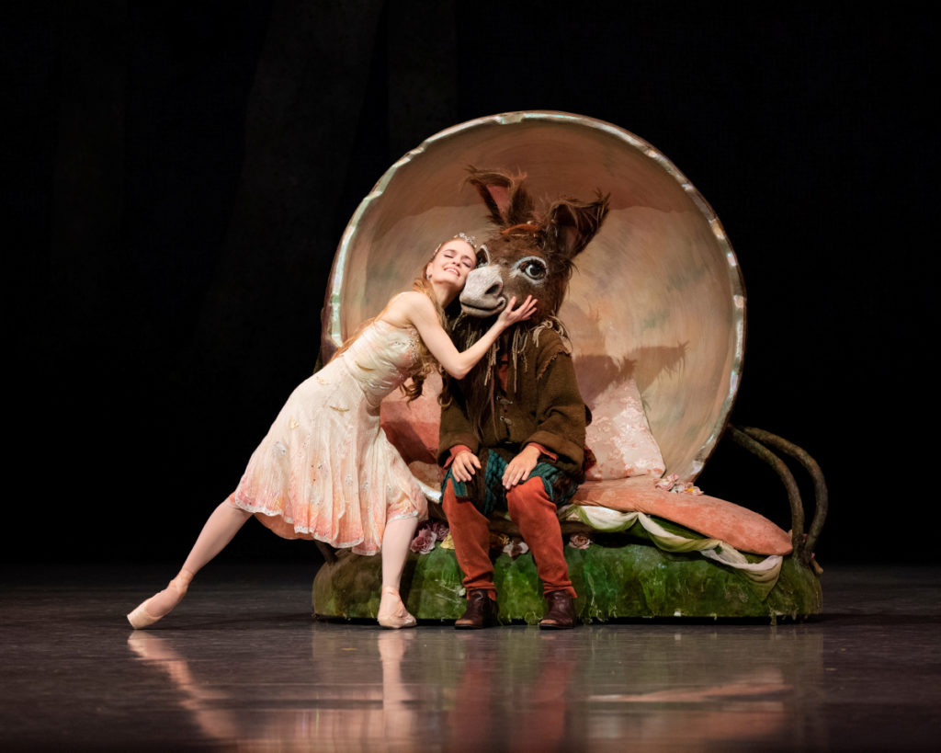
1595 – court wedding or aristocratic wedding and also an open air theater
Explore and celebrate the follies of love

Slide 3
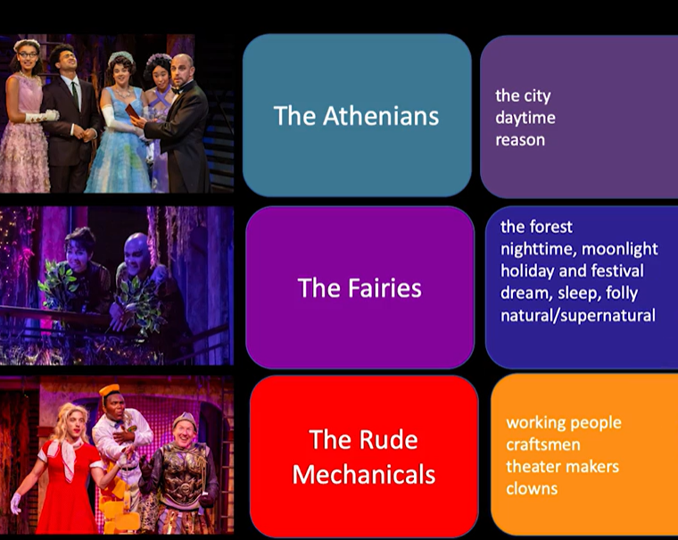
A Wedding Cake Layers
Adapted Lupton, E9

Slide 4
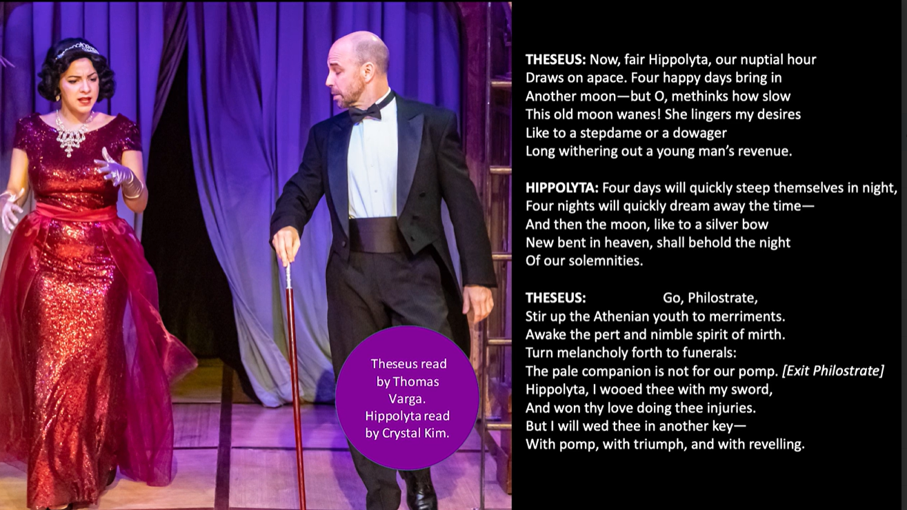

Slide 5
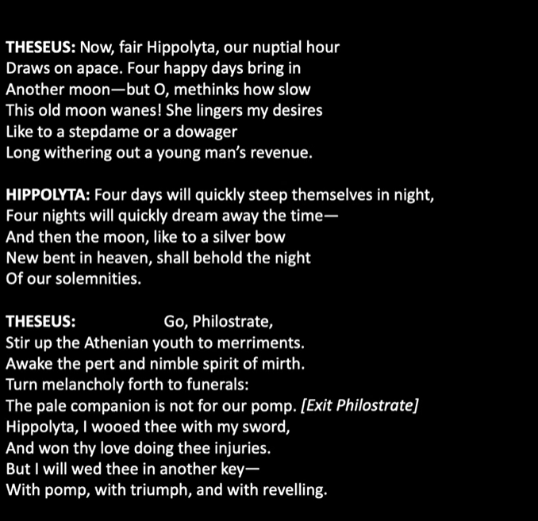
Tone?
What does this conversation reveal about Theseus and Hippolyta?

Slide 6
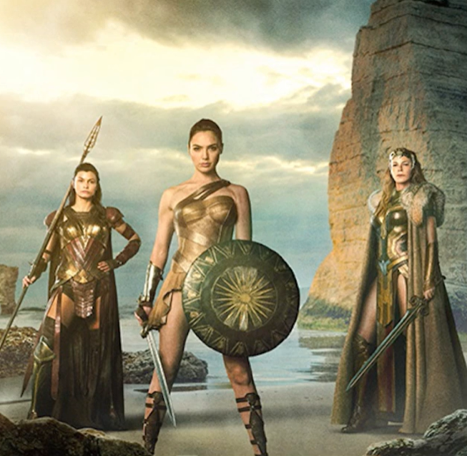
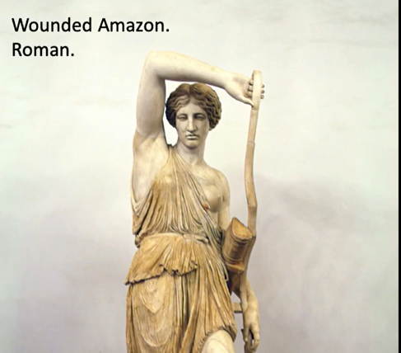
Amazon kingdom

Slide 7
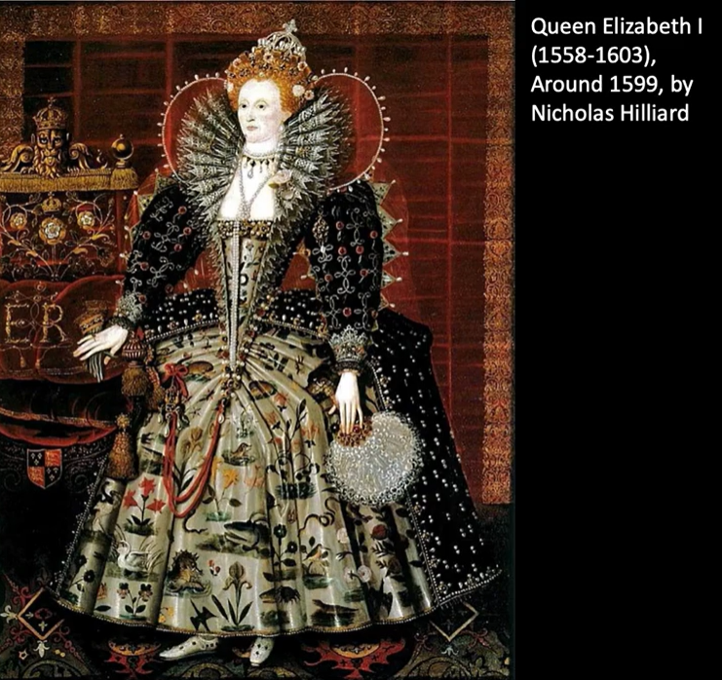
An “Amazon Queen”

Slide 8
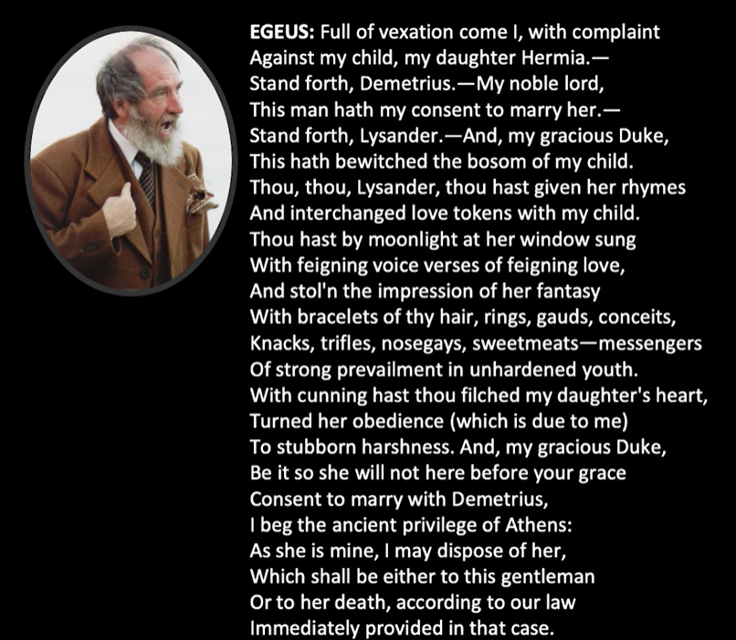
What does Egeus accuse Lysander of?

Slide 9
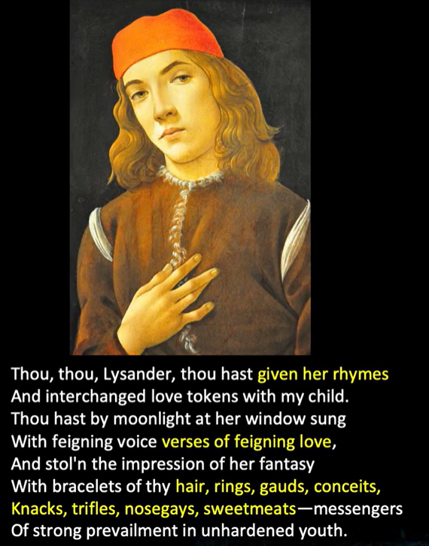
What has Lysander used to woo?

Slide 10
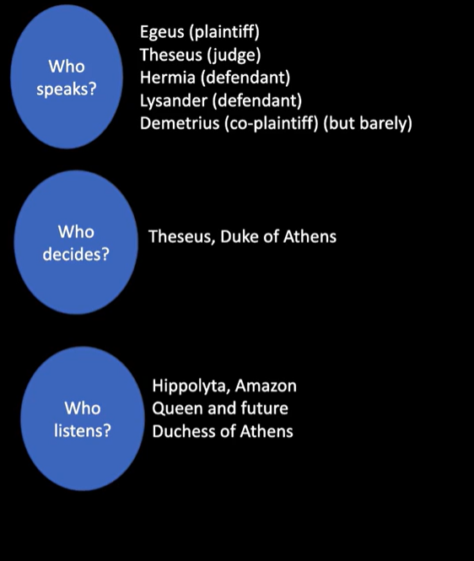
Who speaks, who decides, and who listens?

Slide 11
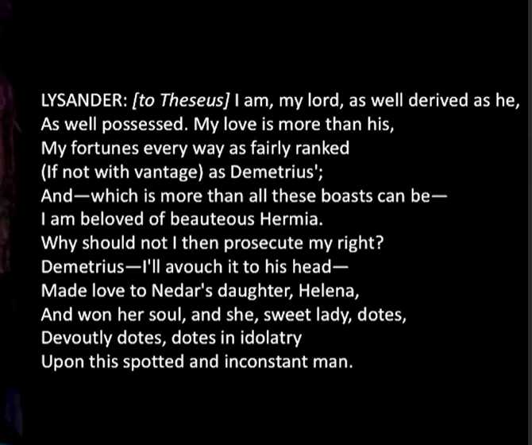
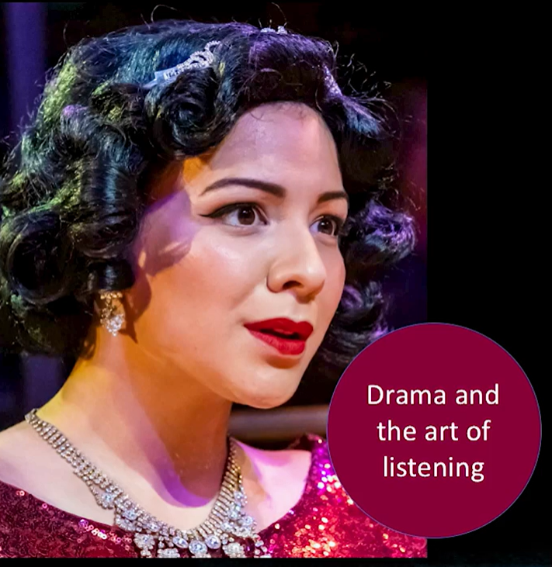
Interchangeable youth?

Slide 12
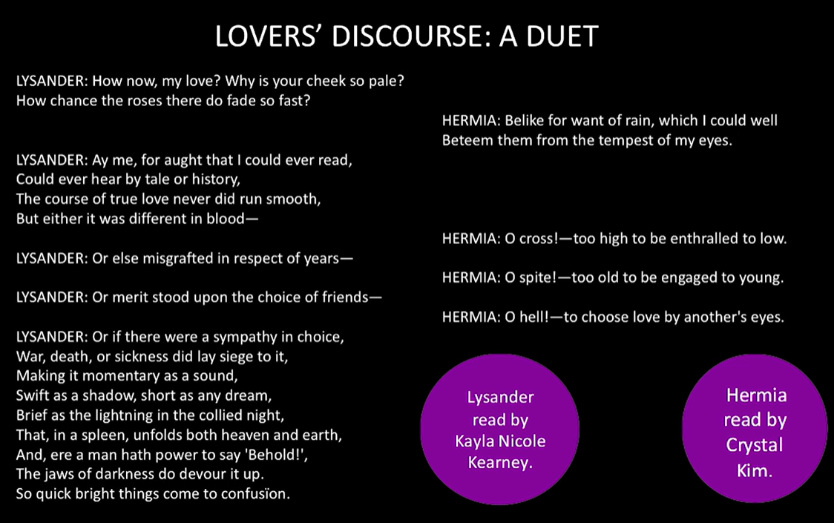
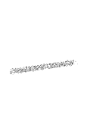

Shakes’ inventory; poetic capacity
Various well-known stories

Slide 13
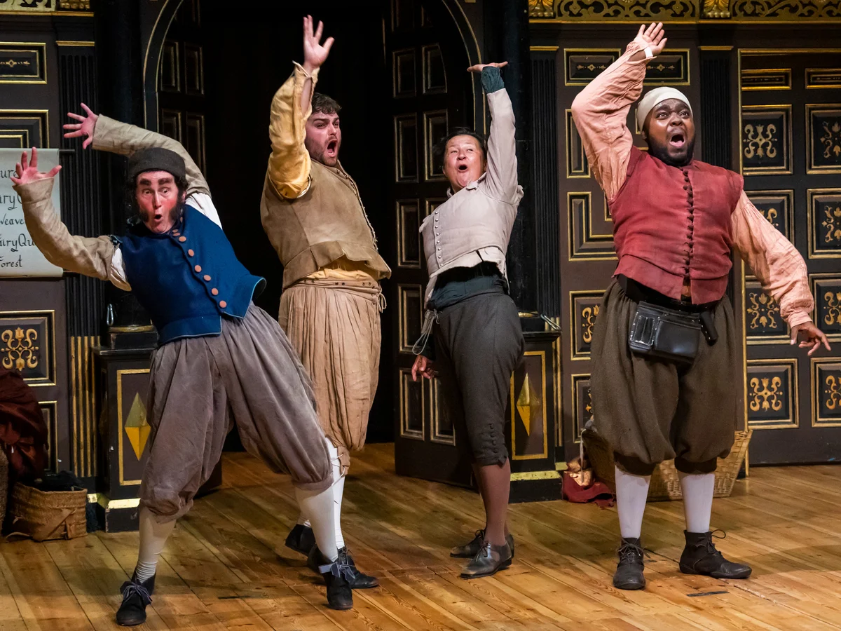
Rude Mechanicals: Working Men of Athens
Craft or trade
Part in the drama
Quince: carpenter and director
Nick Bottom: the weaver and hero (wants to be all!)
Consider: laughing with? Laughing at?

Slide 14
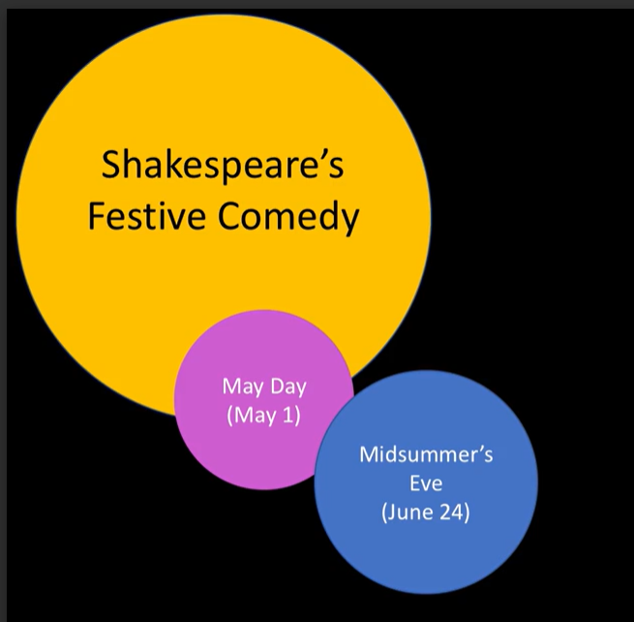
Act 2: Into the Woods
Holiday of May Day: young go into the woods to collect greenery
Midsummer: festive holiday
An element of play not belief

Slide 15
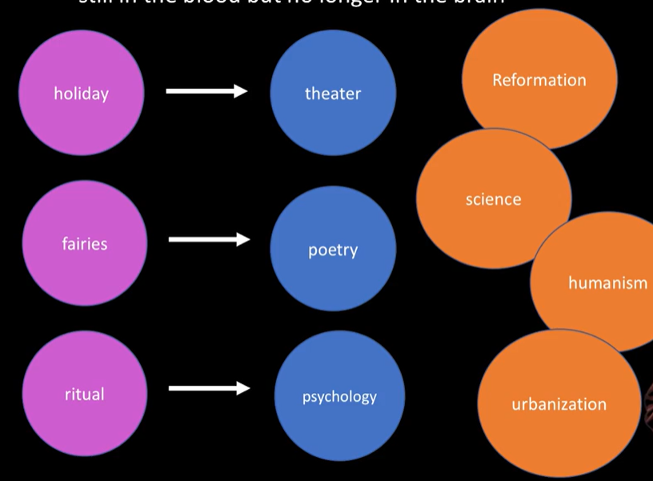
A time of change (16th Century thought)

Slide 16
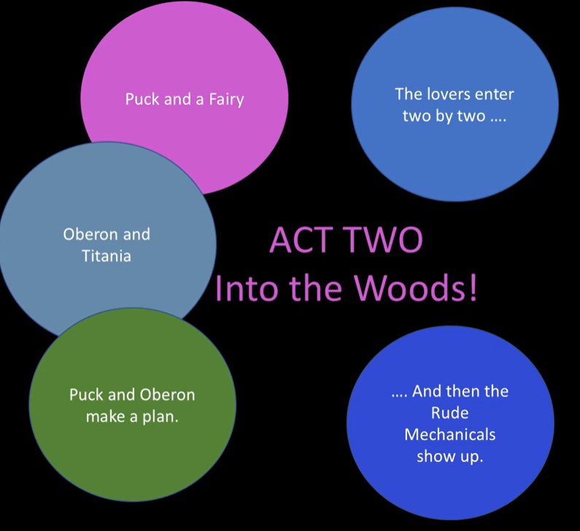

Slide 17
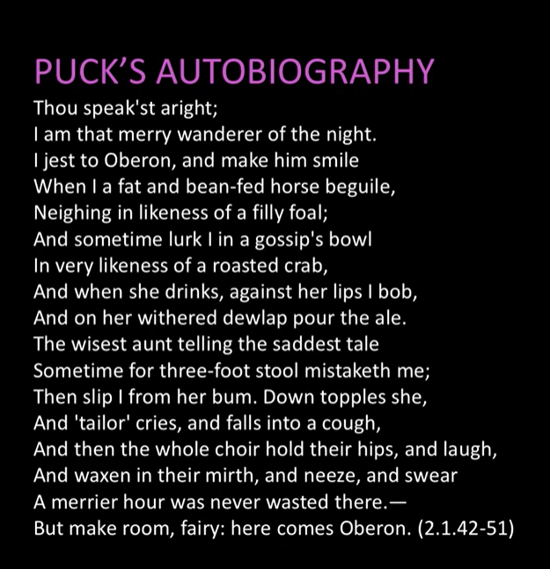
The Spirit of Accident
Recollecting his mischievous deeds and cues for physical actions (voice changes, etc).
Ways to explain the unexplainable
Folk traditions and irony of false causality
An ethnography of how Puck is written into folk imagination by the working class people

Slide 18
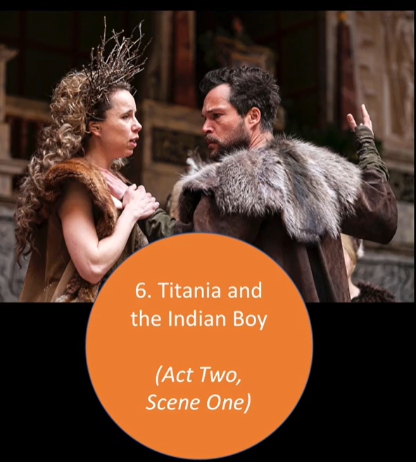
Their argument
“Ill met by moonlight, proud Titania”

Slide 19
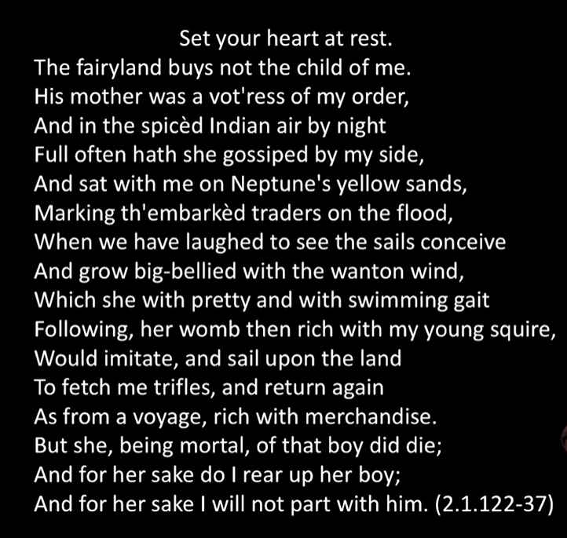
A Custody Battle
Mood changes
Votress: a priestess of the fairy queen; friends; theme of female friendshp
Trade and imperialism
Central image:

Slide 20
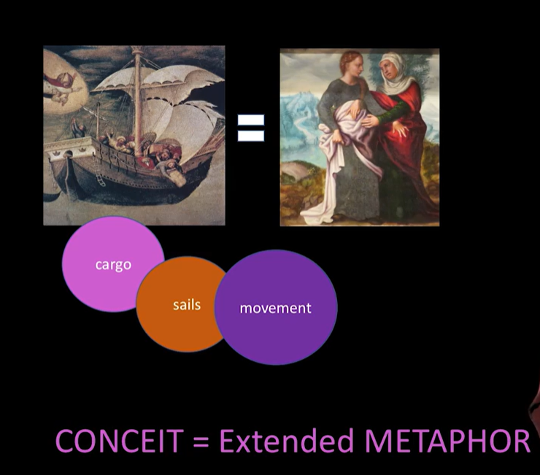

Slide 21
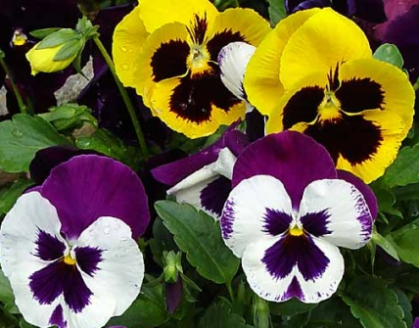
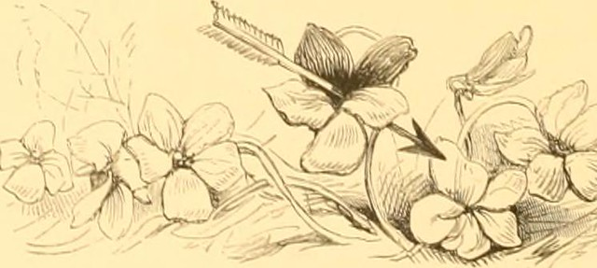
OBERON
Well, go thy way. Thou shalt not from this grove
Till I torment thee for this injury.—
My gentle Puck, come hither. Thou rememb’rest
Since once I sat upon a promontory
155 And heard a mermaid on a dolphin’s back
Uttering such dulcet and harmonious breath
That the rude sea grew civil at her song
And certain stars shot madly from their spheres
To hear the sea-maid’s music.
ROBIN I remember.
OBERON
That very time I saw (but thou couldst not),
Flying between the cold moon and the Earth,
Cupid all armed. A certain aim he took
At a fair vestal thronèd by ⌜the⌝ west,
165 And loosed his love-shaft smartly from his bow
As it should pierce a hundred thousand hearts.
But I might see young Cupid’s fiery shaft
Quenched in the chaste beams of the wat’ry moon,
And the imperial vot’ress passèd on
170 In maiden meditation, fancy-free.
Yet marked I where the bolt of Cupid fell.
It fell upon a little western flower,
Before, milk-white, now purple with love’s wound,
And maidens call it “love-in-idleness.”
175 Fetch me that flower; the herb I showed thee once.
The juice of it on sleeping eyelids laid
Will make or man or woman madly dote
Upon the next live creature that it sees.
Fetch me this herb, and be thou here again
180 Ere the leviathan can swim a league.
p. 47
ROBIN
I’ll put a girdle round about the Earth
In forty minutes.⌜He exits.⌝
OBERON Having once this juice,
I’ll watch Titania when she is asleep
185 And drop the liquor of it in her eyes.
The next thing then she, waking, looks upon
(Be it on lion, bear, or wolf, or bull,
On meddling monkey, or on busy ape)
She shall pursue it with the soul of love.
190 And ere I take this charm from off her sight
(As I can take it with another herb),
I’ll make her render up her page to me.
But who comes here? I am invisible,
And I will overhear their conference.

Slide 22
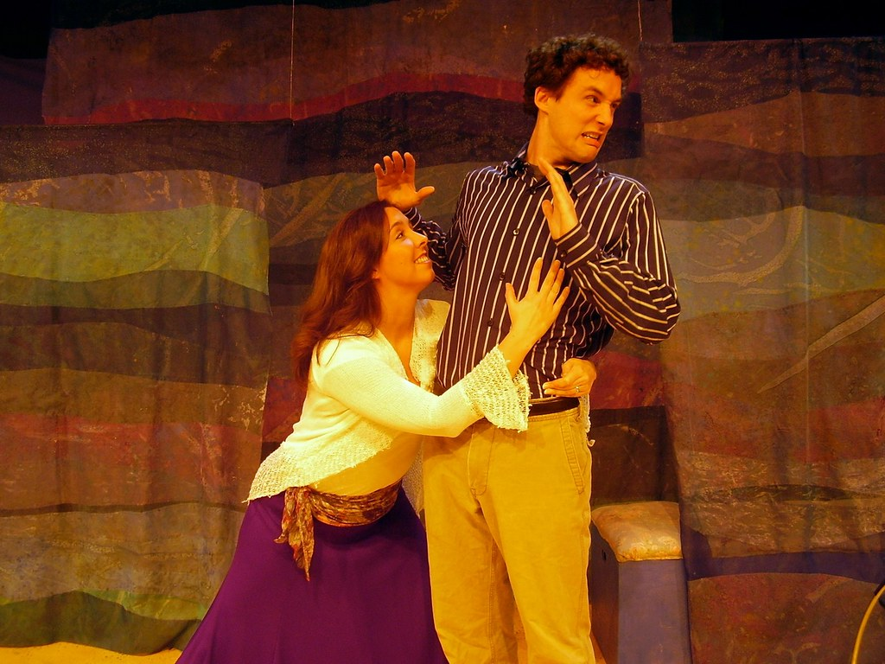
“I am your spaniel” (Helena, 2.1)

Slide 23
Enter Demetrius, Helena following him.
DEMETRIUS
I love thee not; therefore pursue me not.
Where is Lysander and fair Hermia?
The one I’ll stay; the other stayeth me.
Thou told’st me they were stol’n unto this wood,
And here am I, and wood within this wood
200 Because I cannot meet my Hermia.
Hence, get thee gone, and follow me no more.
HELENA
You draw me, you hard-hearted adamant!
But yet you draw not iron, for my heart
Is true as steel. Leave you your power to draw,
And I shall have no power to follow you.
DEMETRIUS
Do I entice you? Do I speak you fair?
Or rather do I not in plainest truth
Tell you I do not, ⌜nor⌝ I cannot love you?
HELENA
And even for that do I love you the more.
I am your spaniel, and, Demetrius,
The more you beat me I will fawn on you.
Use me but as your spaniel: spurn me, strike me,
Neglect me, lose me; only give me leave
(Unworthy as I am) to follow you.
What worser place can I beg in your love
(And yet a place of high respect with me)
Than to be usèd as you use your dog?
DEMETRIUS
Tempt not too much the hatred of my spirit,
For I am sick when I do look on thee.
HELENA
And I am sick when I look not on you.
DEMETRIUS
You do impeach your modesty too much
To leave the city and commit yourself
Into the hands of one that loves you not,
To trust the opportunity of night
And the ill counsel of a desert place
With the rich worth of your virginity.
HELENA
Your virtue is my privilege. For that
It is not night when I do see your face,
Therefore I think I am not in the night.
230 Nor doth this wood lack worlds of company,
For you, in my respect, are all the world.
Then, how can it be said I am alone
When all the world is here to look on me?
DEMETRIUS
I’ll run from thee and hide me in the brakes
235 And leave thee to the mercy of wild beasts.
HELENA
The wildest hath not such a heart as you.
Run when you will. The story shall be changed:
Apollo flies and Daphne holds the chase;
The dove pursues the griffin; the mild hind
240 Makes speed to catch the tiger. Bootless speed
When cowardice pursues and valor flies!DEMETRIUS
I will not stay thy questions. Let me go,
Or if thou follow me, do not believe
But I shall do thee mischief in the wood.
HELENA
Ay, in the temple, in the town, the field,
You do me mischief. Fie, Demetrius!
Your wrongs do set a scandal on my sex.
We cannot fight for love as men may do.
We should be wooed and were not made to woo.
⌜Demetrius exits.⌝
250 I’ll follow thee and make a heaven of hell
To die upon the hand I love so well. (2.1)

Slide 24
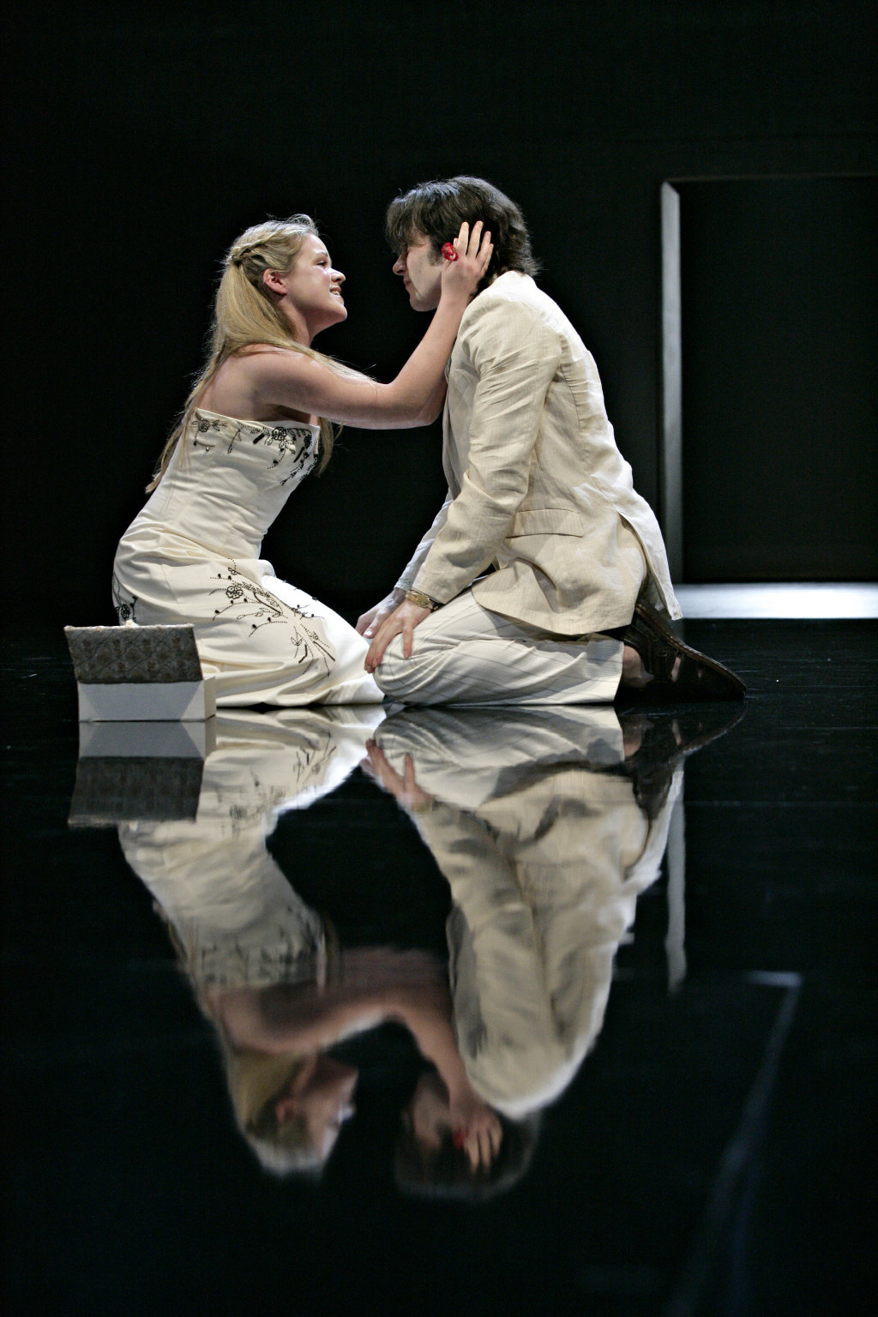
Hermia and Lysander
“Two bosoms interchainèd with an oath” (Lysander)

Slide 25
LYSANDER
Fair love, you faint with wand’ring in the wood.
And, to speak troth, I have forgot our way.
We’ll rest us, Hermia, if you think it good,
And tarry for the comfort of the day.
HERMIA
⌜Be⌝ it so, Lysander. Find you out a bed,
For I upon this bank will rest my head.
LYSANDER
One turf shall serve as pillow for us both;
One heart, one bed, two bosoms, and one troth.
HERMIA
Nay, good Lysander. For my sake, my dear,
Lie further off yet. Do not lie so near.
LYSANDER
O, take the sense, sweet, of my innocence!
Love takes the meaning in love’s conference.
I mean that my heart unto yours ⌜is⌝ knit,
So that but one heart we can make of it;
Two bosoms interchainèd with an oath—
So then two bosoms and a single troth.
Then by your side no bed-room me deny,
For lying so, Hermia, I do not lie.
HERMIA
Lysander riddles very prettily.
Now much beshrew my manners and my pride
If Hermia meant to say Lysander lied.
But, gentle friend, for love and courtesy,
Lie further off in human modesty.
Such separation, as may well be said,
Becomes a virtuous bachelor and a maid.
So far be distant; and good night, sweet friend.
Thy love ne’er alter till thy sweet life end!
LYSANDER
“Amen, amen” to that fair prayer, say I,
And then end life when I end loyalty!
Here is my bed. Sleep give thee all his rest!

Slide 26
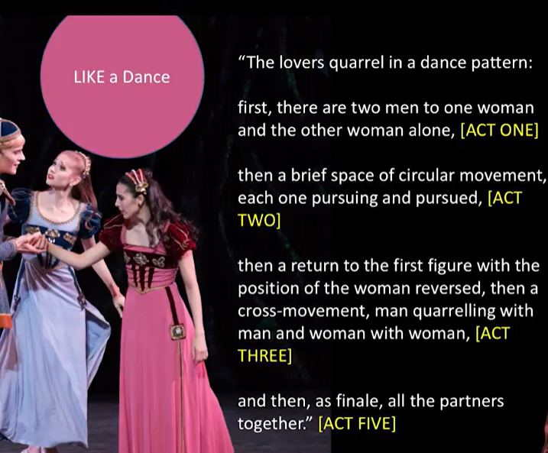


Slide 27
HELENA
O, I am out of breath in this fond chase.
The more my prayer, the lesser is my grace.
Happy is Hermia, wheresoe’er she lies,
For she hath blessèd and attractive eyes.
How came her eyes so bright? Not with salt tears.
If so, my eyes are oftener washed than hers.
100 No, no, I am as ugly as a bear,
For beasts that meet me run away for fear.
Therefore no marvel though Demetrius
Do as a monster fly my presence thus.
What wicked and dissembling glass of mine
Made me compare with Hermia’s sphery eyne?
But who is here? Lysander, on the ground!
Dead or asleep? I see no blood, no wound.—
Lysander, if you live, good sir, awake.
LYSANDER, ⌜waking up⌝
And run through fire I will for thy sweet sake.
Transparent Helena! Nature shows art,
That through thy bosom makes me see thy heart.
Where is Demetrius? O, how fit a word
Is that vile name to perish on my sword!
HELENA
Do not say so. Lysander, say not so. What though he love your Hermia? Lord, what
though?
Yet Hermia still loves you. Then be content.
LYSANDER
Content with Hermia? No, I do repent
The tedious minutes I with her have spent.
Not Hermia, but Helena I love.
Who will not change a raven for a dove?
The will of man is by his reason swayed,
And reason says you are the worthier maid.
Things growing are not ripe until their season;
So I, being young, till now ripe not to reason.
And touching now the point of human skill,
Reason becomes the marshal to my will
And leads me to your eyes, where I o’erlook
Love’s stories written in love’s richest book.
HELENA
Wherefore was I to this keen mockery born?
When at your hands did I deserve this scorn?
Is ’t not enough, is ’t not enough, young man,
That I did never, no, nor never can
Deserve a sweet look from Demetrius’ eye,
But you must flout my insufficiency?
Good troth, you do me wrong, good sooth, you do,
In such disdainful manner me to woo.
But fare you well. Perforce I must confess
I thought you lord of more true gentleness.
O, that a lady of one man refused
Should of another therefore be abused!
(2.2)

Slide 28
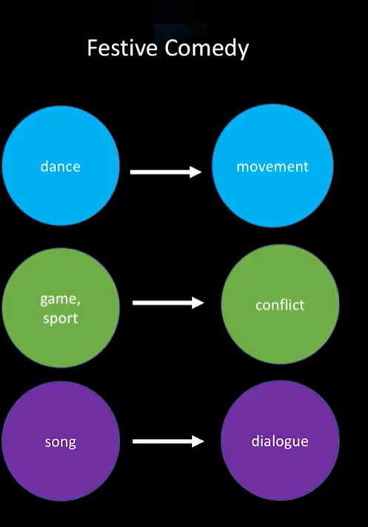
A combination of “holiday” traditions (dances, games, song) and theater makes up festive comedy

Slide 29
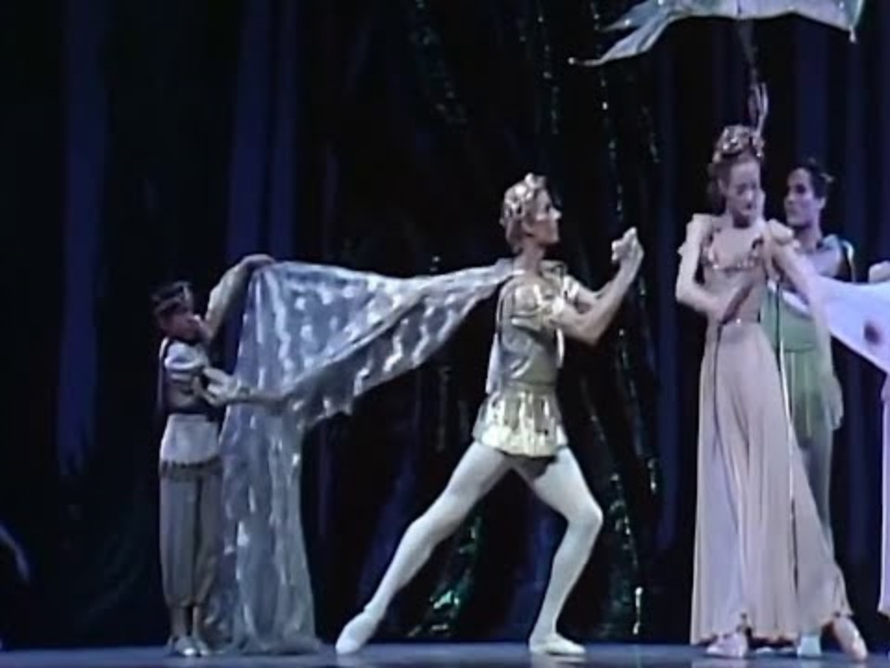
Color coded ballet : Helena + Demetrius Lover’s Quarrel (1:07)

Slide 30
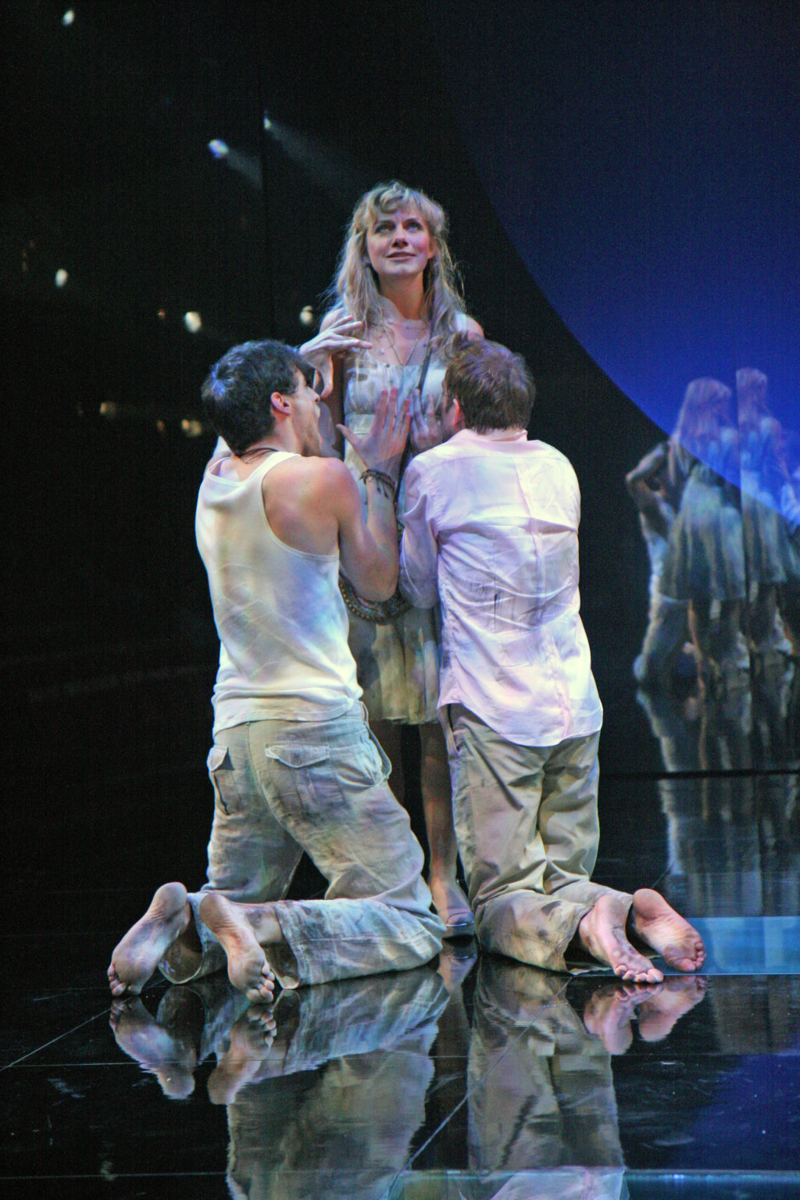
HELENA
Wherefore was I to this keen mockery born?
When at your hands did I deserve this scorn?(2.2)

Slide 31
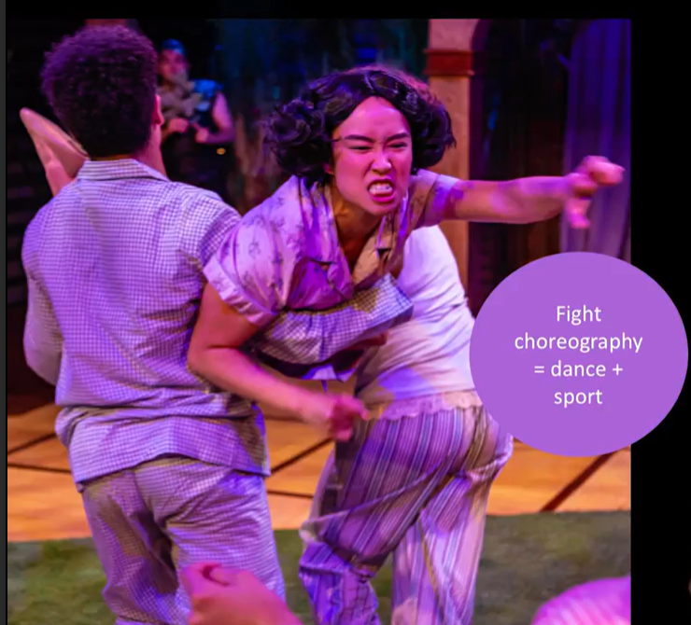
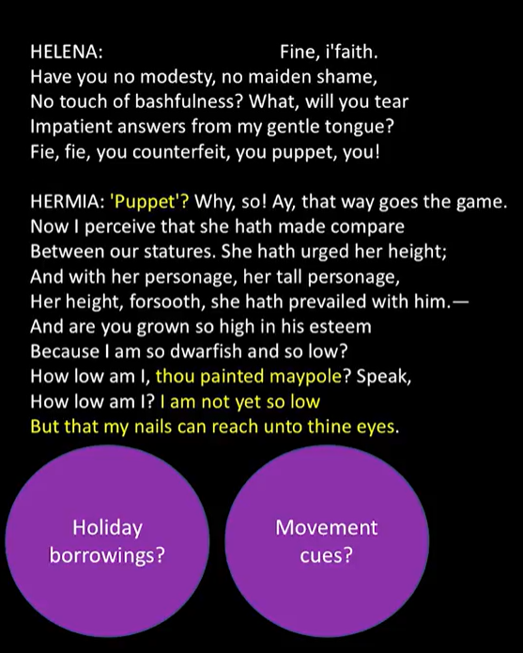
(3.2)

Slide 32
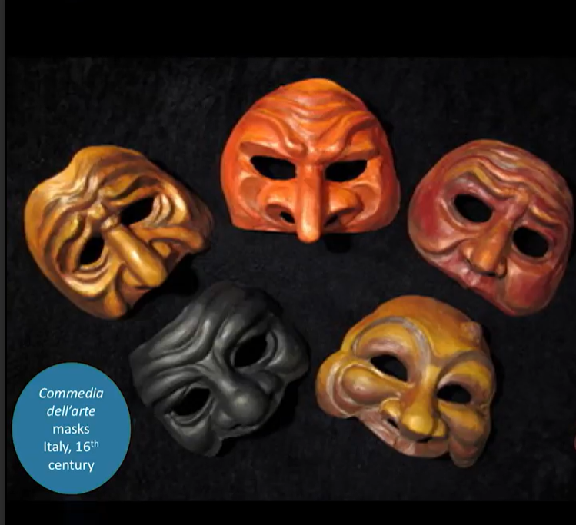
Masks and Metamorphosis harlequin (clown) masks + animal qualities

Slide 33
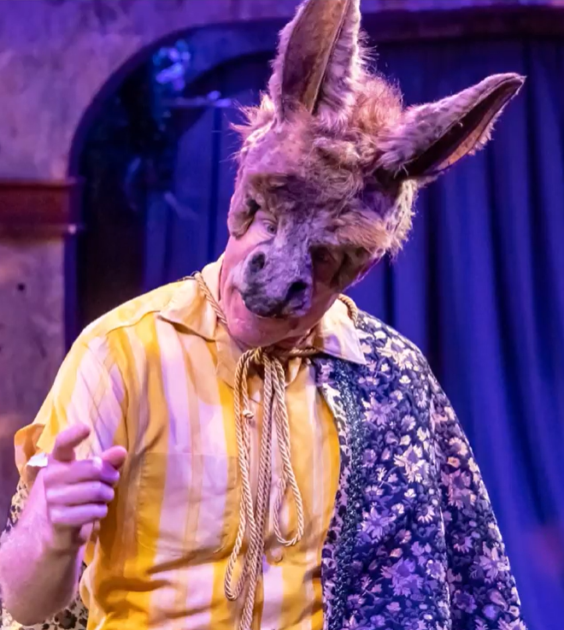
“Thou art translated” (3.1)

Slide 34
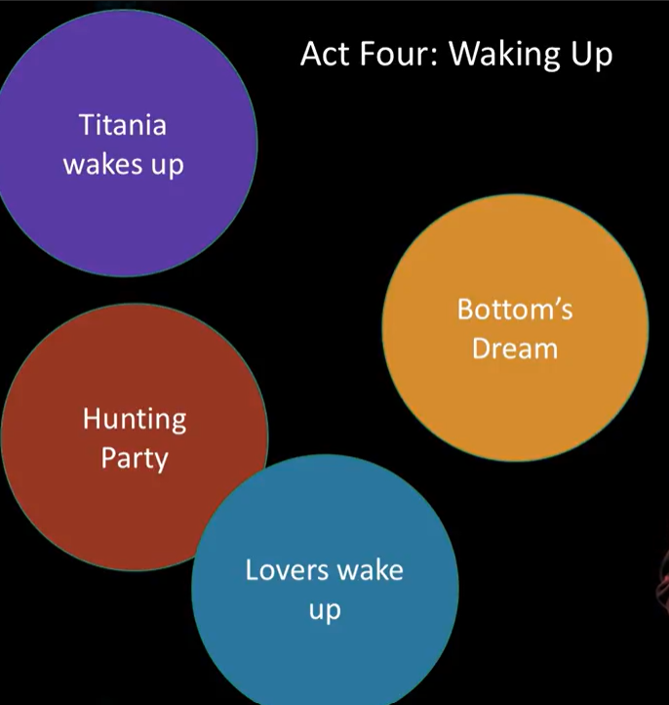
Act 4: The Dawn

Slide 35
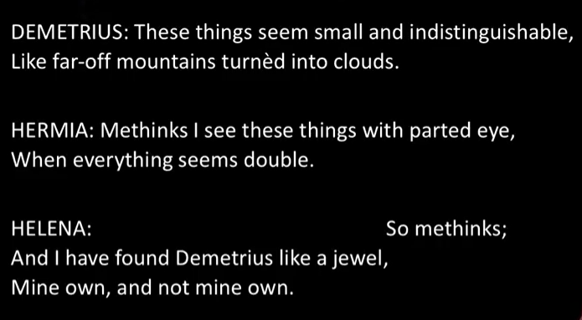
Optical Metaphors: waking up and transformed relationship to love

Slide 36
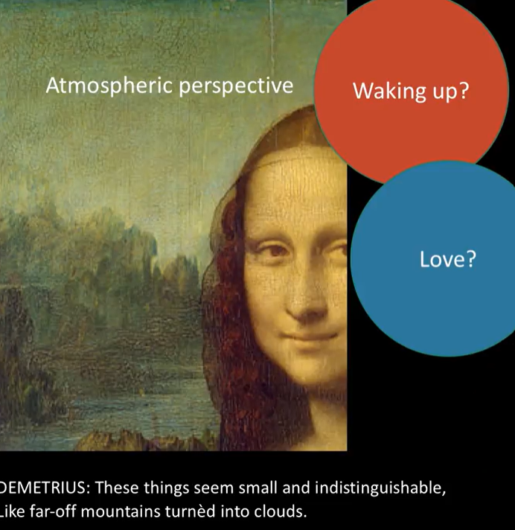

Slide 37
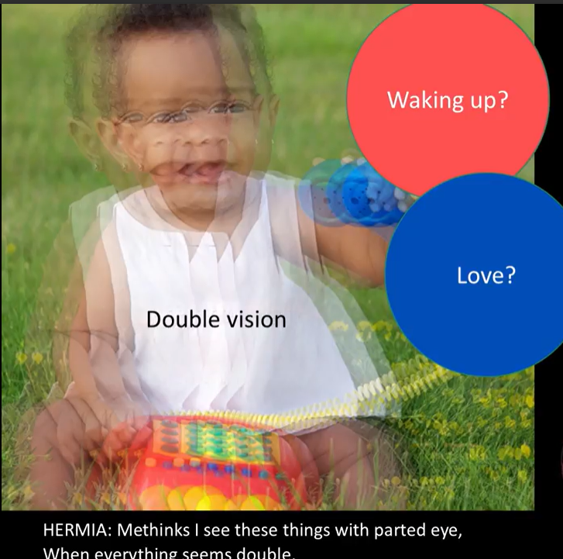

Slide 38
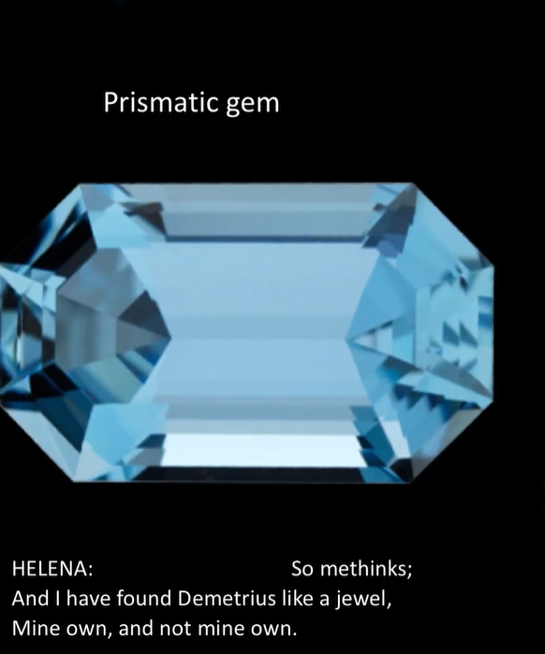

Slide 39
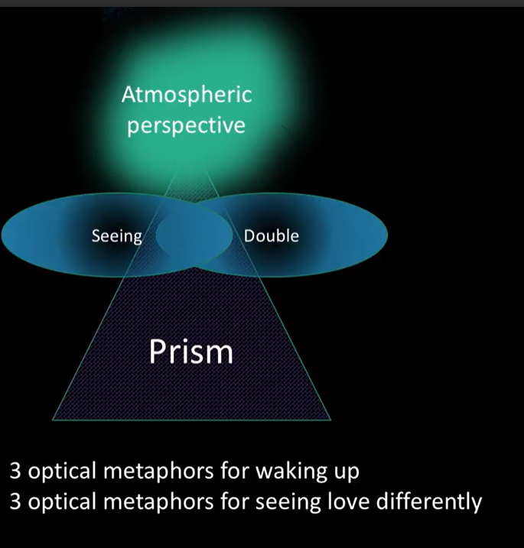

Slide 40
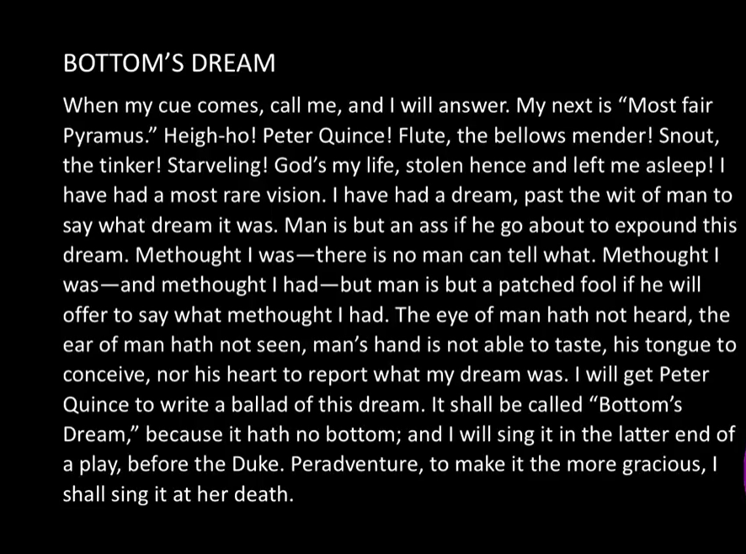

Slide 41
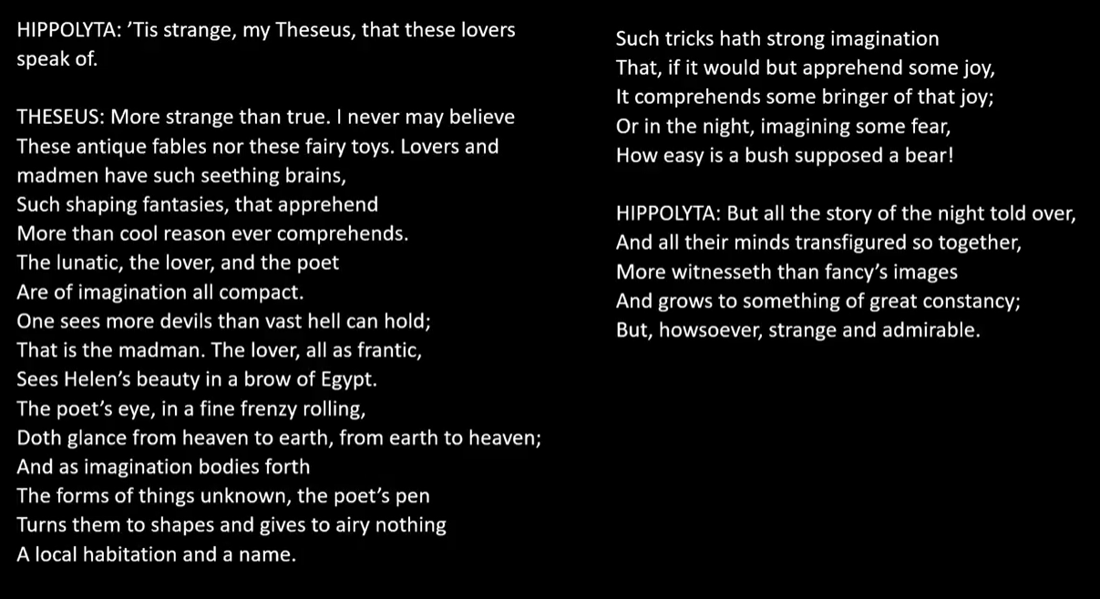
a poetics of the imagination; poetry shapes vague fantasy into something concrete; makes imaginary real within the space of art/theater
Play represents his concepts! In order to write about desire we need the irrational space of forest.

Slide 42
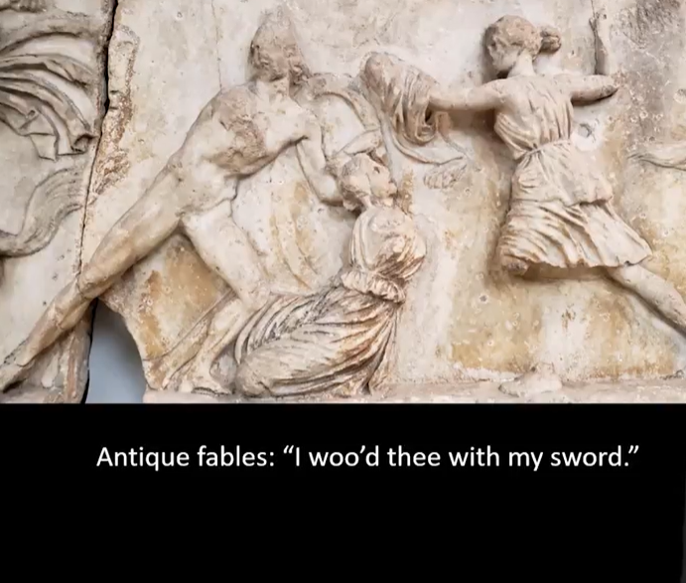
Irony:
Theseus/Hippolyta as imaginative figures (Greek mythology; slay the Minotaur
Imagination shapes reality: what is real and what is a dream?

Slide 43
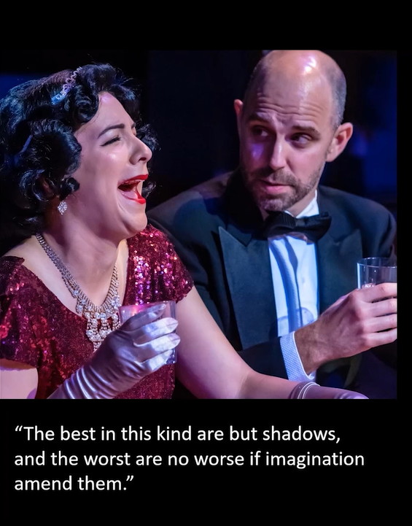
Poor acting leaves “power” with the audience; good acting has power on the stage

Slide 44
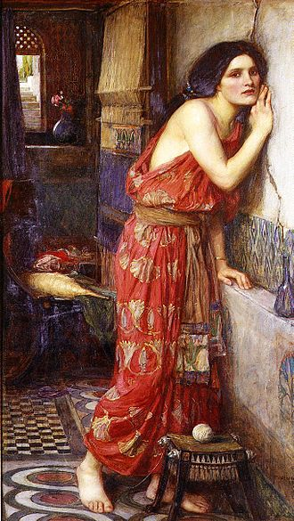
Pyramus and Thisbe: A Tragic Reminder

Slide 45
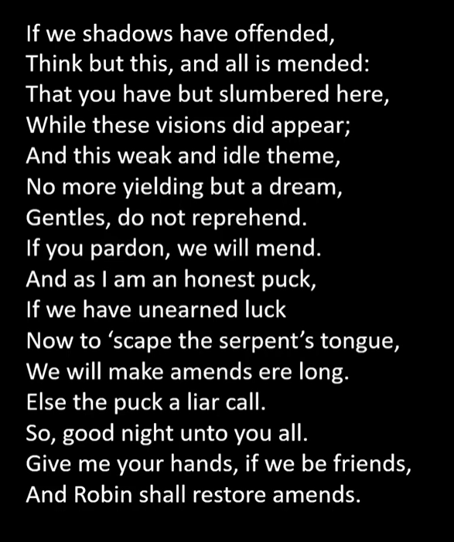
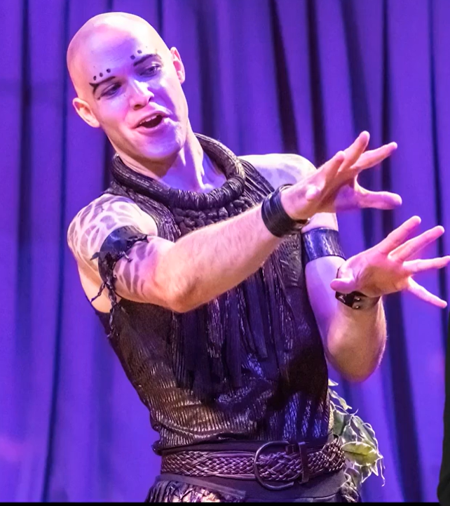
Puck’s Epilogue
Transition from fantasy to reality
Responds to Theseus’ critique: this is only a dream (separate fantasy and reality)
Recalls Bottom’s Dream: wants to turn into art; Puck says to turn art into a dream
“All the world’s a stage”: boundaries of fantasy and reality hard to discern; blurred boundaries

