Slide 1
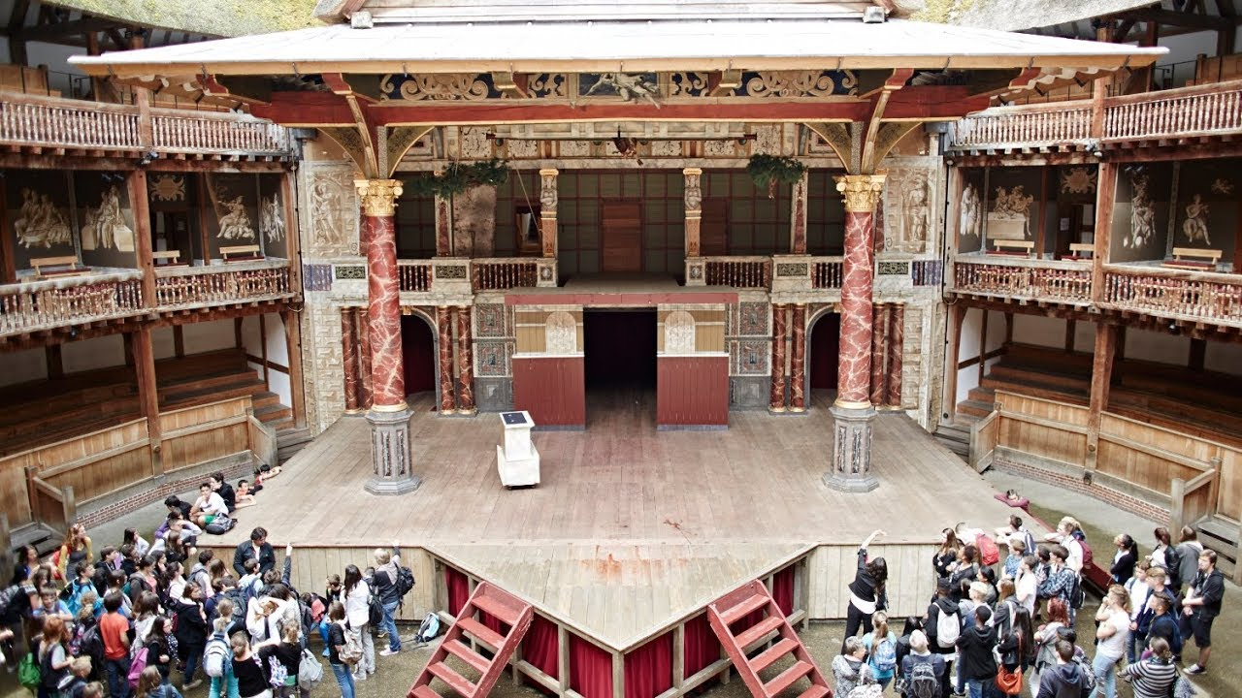
Shakespeare’s Theater

Slide 2
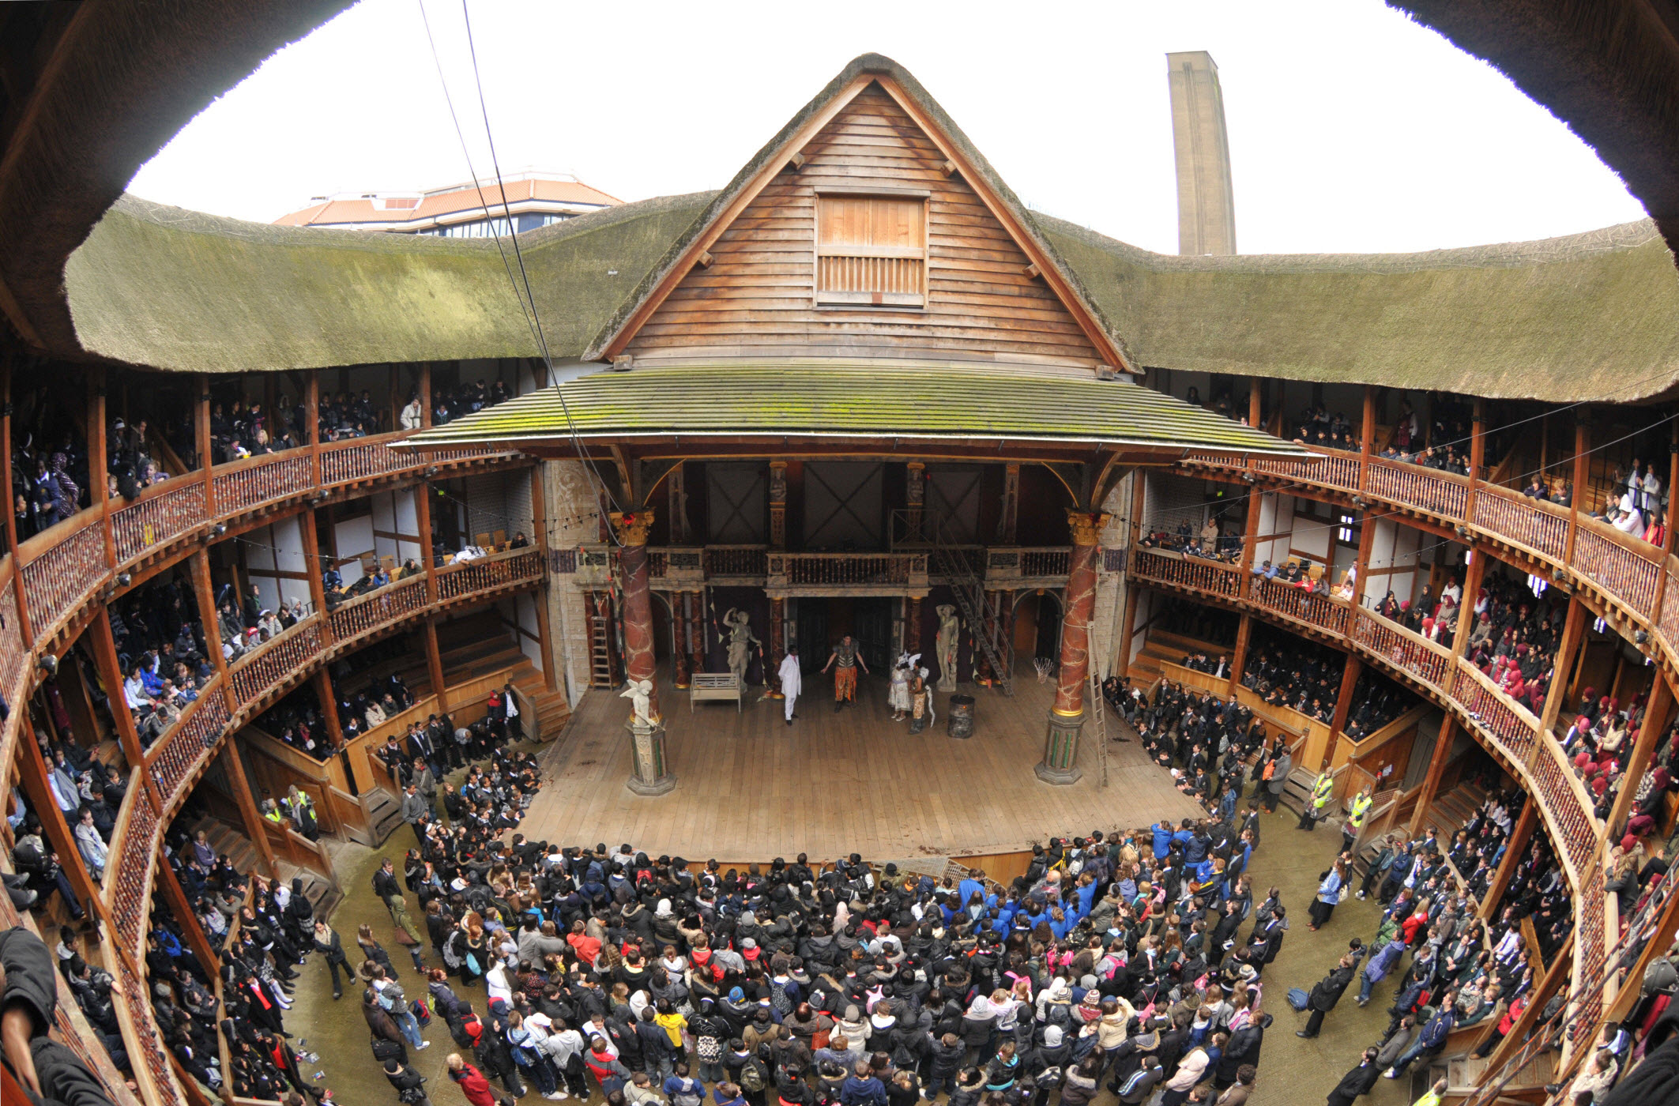
Heavens
Court patrons
Balcony
Middle class
Three stage doors
Groundlings

Slide 3
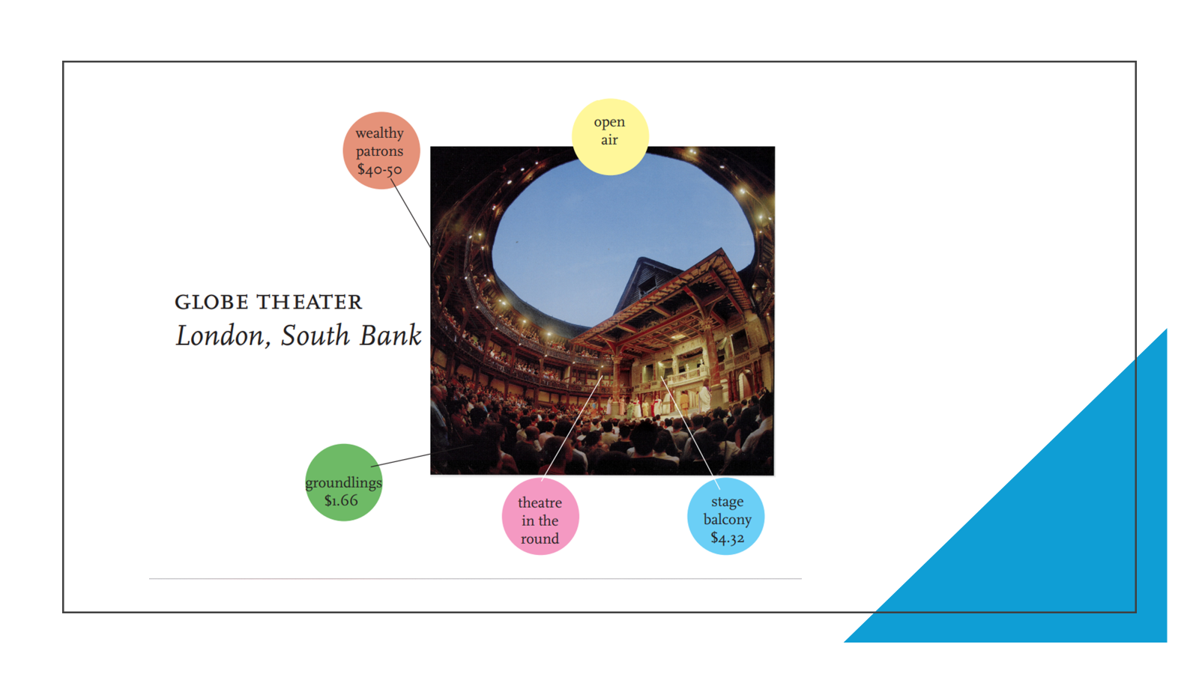

Slide 4
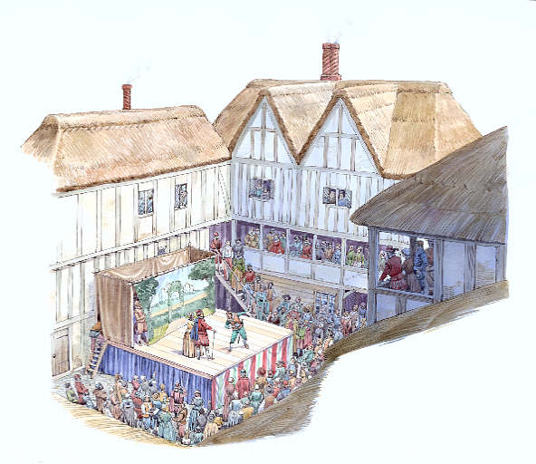
Renaissance
Theater was the most popular entertainment and past-
Time for the citizens of London during Elizabeth’s reign
Plays were originally performed solely by male actors; boys played the female parts
There was no curtain, and only a few necessary pieces of scenery, such as a throne or a rock
Pioneered the concept of pre-paying for a performance rather than taking a collection afterwards
Theaters usually located in the suburbs of London, outside of the city proper; this ensured freedom from the city authorities who were hostile to public performances
Shakespeare’s acting company, known first as the Lord Chamberlain’s Men and later as the King’s Men, put on plays in any number of places—from the courts of Queen Elizabeth I and King James I to churches and guildhalls in the countryside.

Slide 5
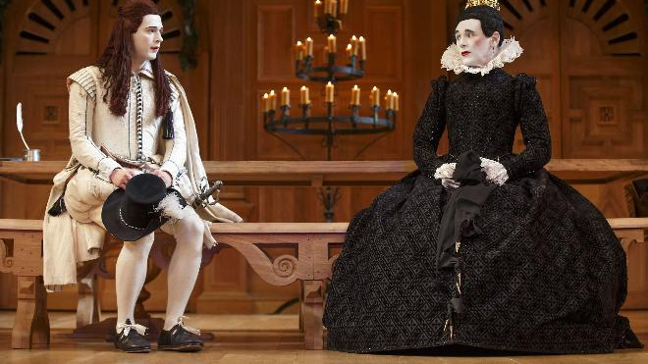
All the parts were played by men.

Slide 6
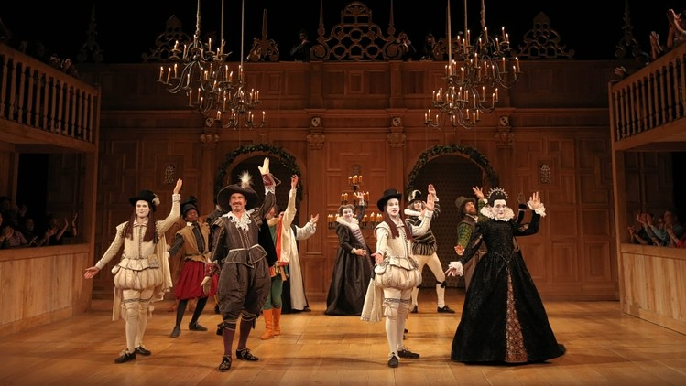
Plays ended with a jig (even tragedies)!
Notes:
CLIP: https://uci.yuja.com/V/Video?v=354560&node=1696475&a=1790846568&autoplay=1
play until 2:18.

Slide 7
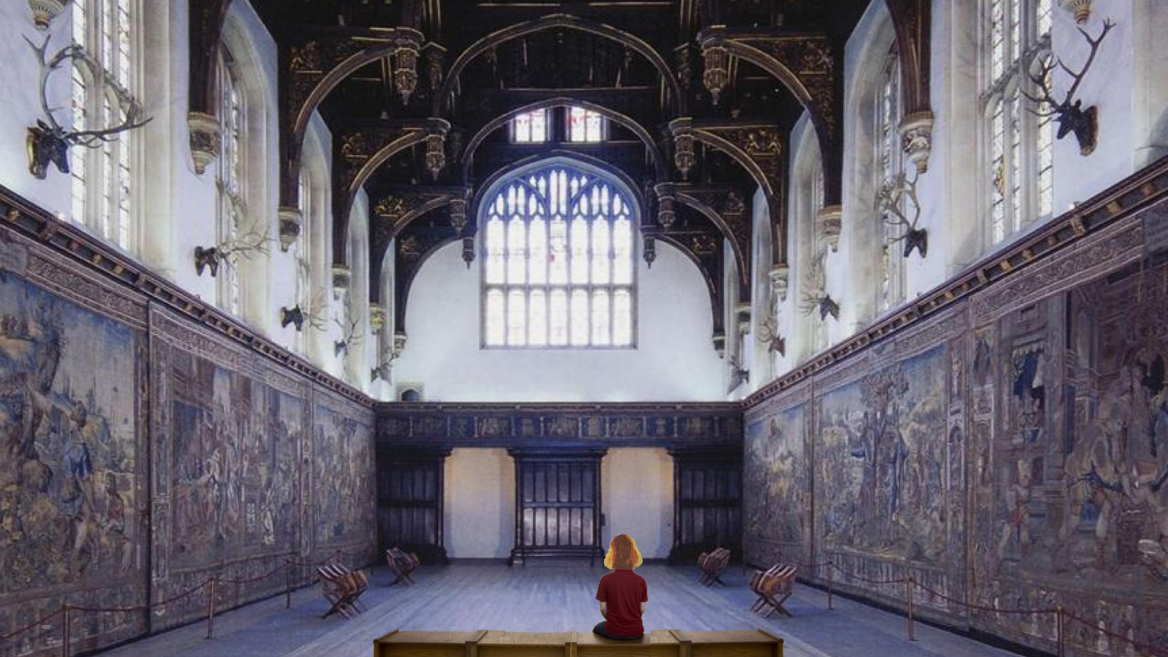
Hampton Court Palace, outside of London

Slide 8
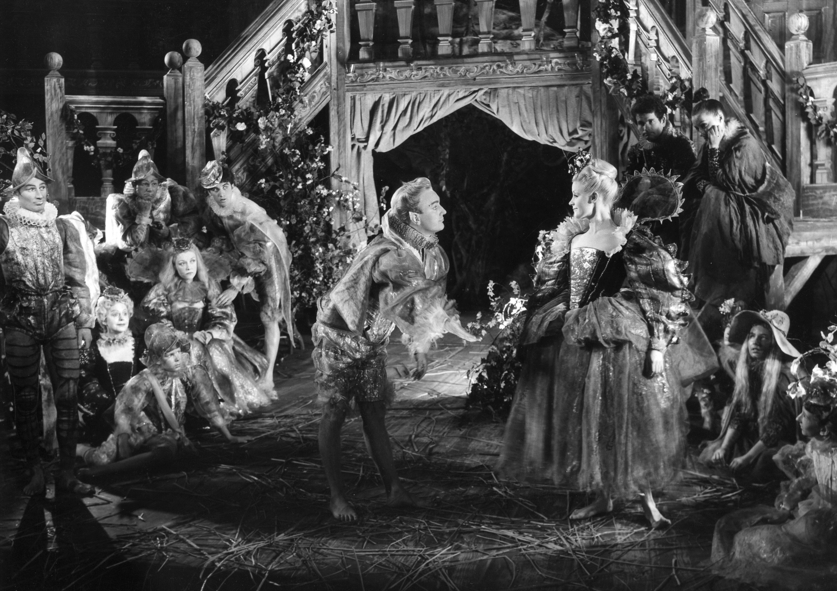
Entertainments in great houses

Slide 9
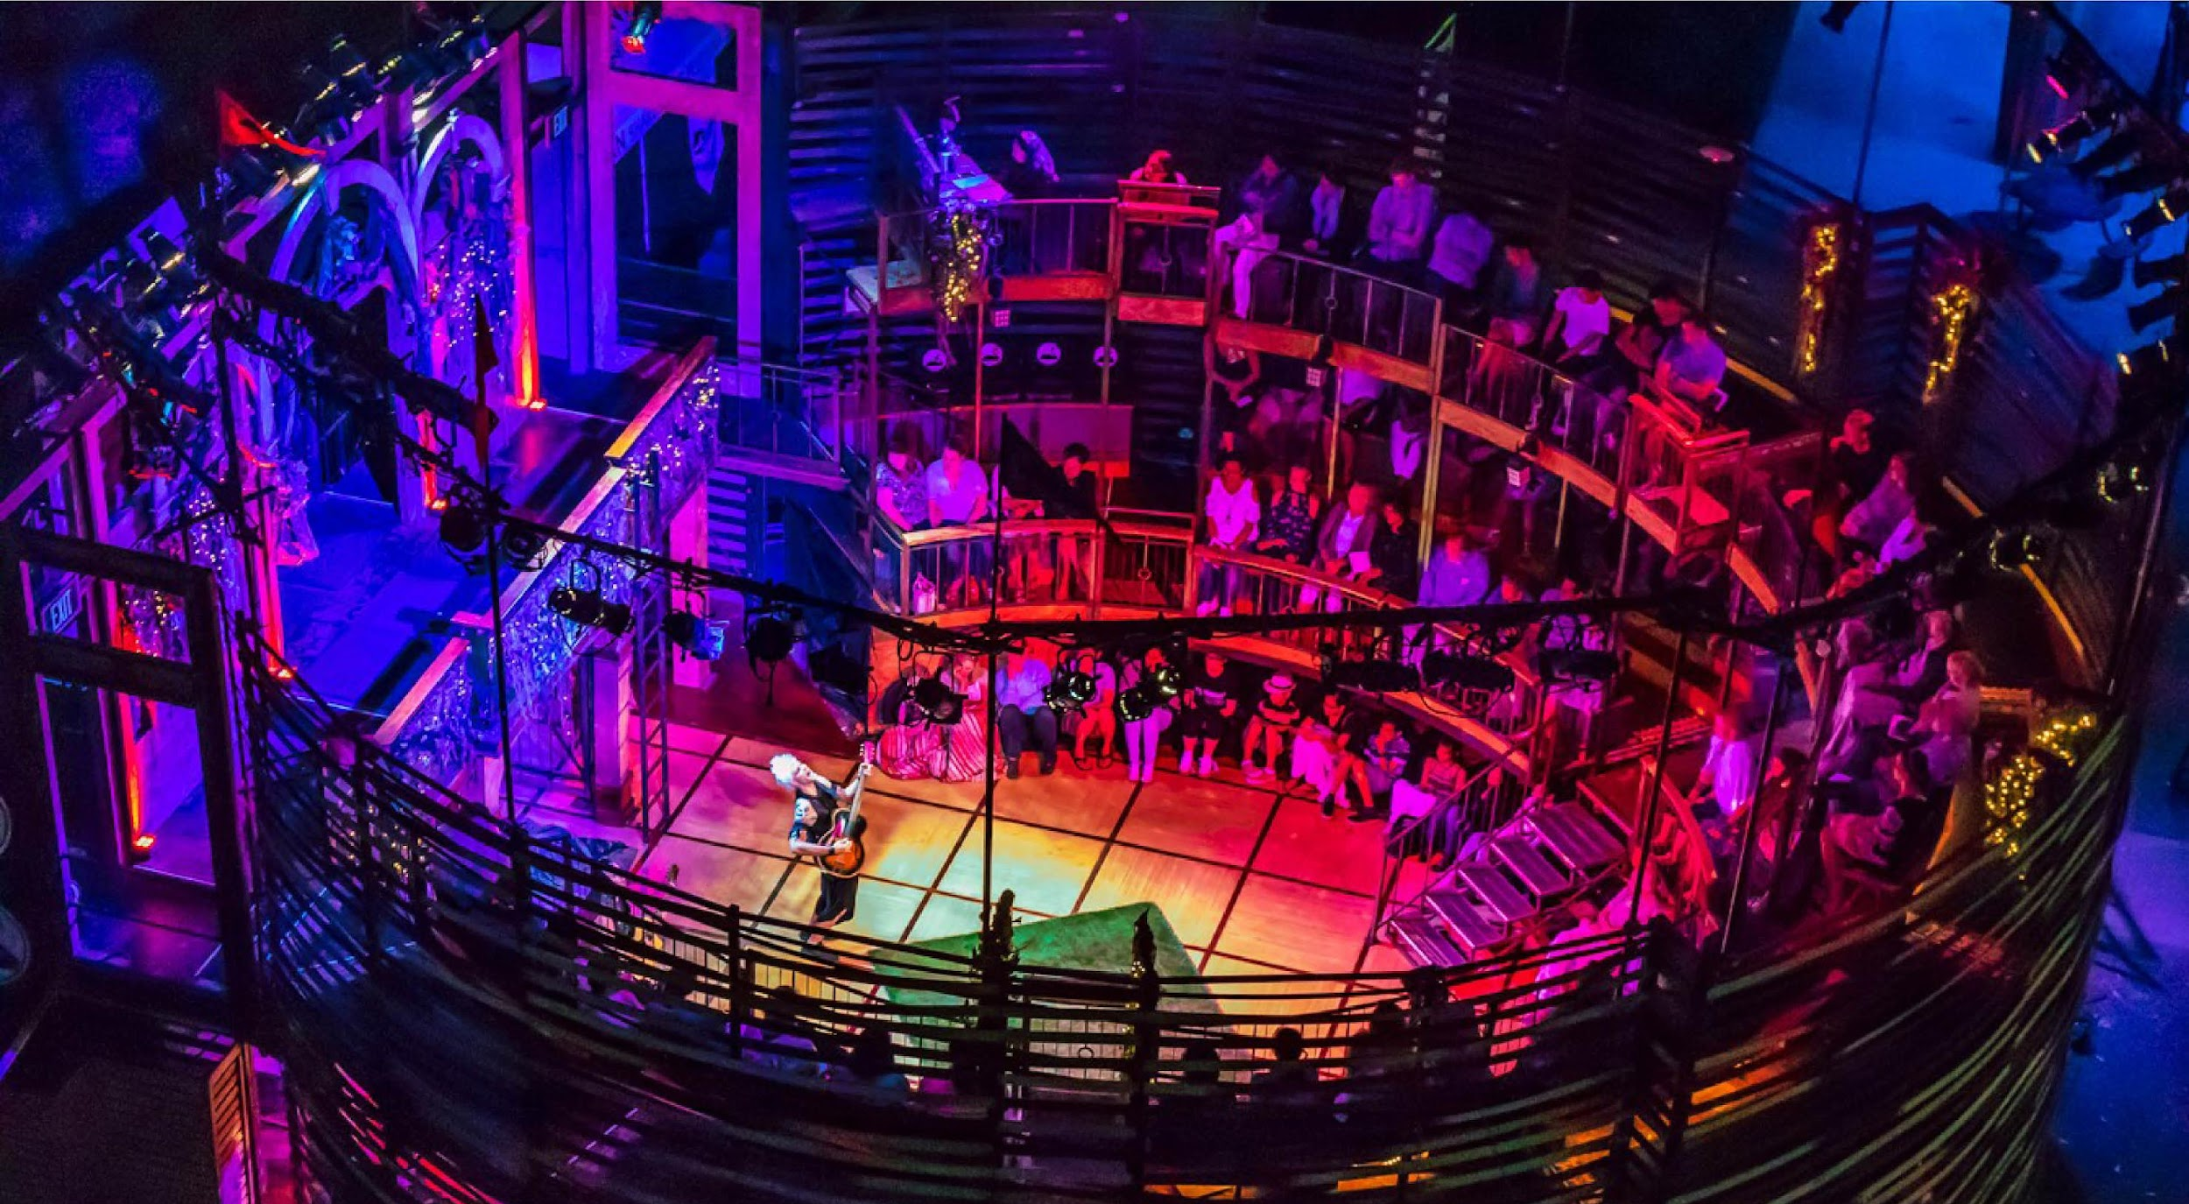
New Swan Shakespeare Theater at UC Irvine

