Slide 1




Coach & AD Meeting
October 17, 2023
Jim Murray
President
Tom Bernhardt
Treasurer

Slide 2

Why This Forum
**
Better Communication
Mutual Understanding
Rules Updates/Points of Emphasis (POE)
Working Together For The Betterment of The Game

Slide 3
Meeting Topics
Officials Requirements
Rules Change Summary
Rules Changes
Points of Emphasis
Facilities
&
Announcers
Communication
&
Sportsmanship
* All PlayPic images provided in this presentation provided by the NFHS
** Additional photos are stock images from the internet
*** GCBOA stock image

Slide 4
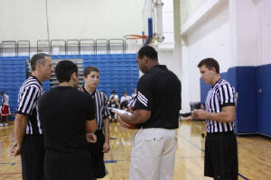
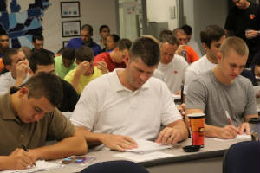
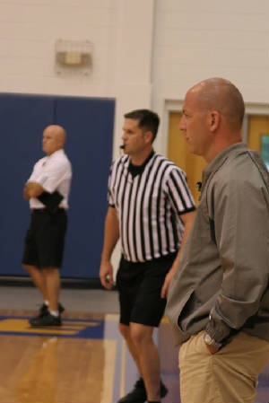
Officials Requirements
Register with the FHSAA
Background Investigation (JLA)
Get in shape
Participate in Classroom Training
Participate in On-Court Training
Pass Rules Test – FHSAA issued
Be Evaluated on Their Performance

Slide 5


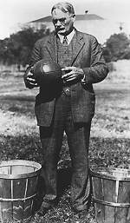
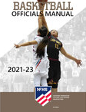
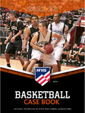


Officials Requirements – cont.
**
**
The Original 13 Rules of Basketball
What you should also know.
  Basketball is the fastest game confined to the smallest space.
  Has more participants than any other sport in the space allocated.
  Despite popular opinion, basketball is a contact sport , but with limitations
Processing what you know.
  The distance from your eyes to your mouth is approx. 3 inches
  So, blowing the whistle after you see something shouldn’t be that hard.
  The approx. time to process the 400 pages of information is about 1-2/10’s of a second.
Communication
  Communication is not covered in the 400 pages of rules and procedures.
  Good officials know the rules, Very good officials know the rules but are great communicators.
  Communication with coaches and players is paramount to any official’s success.
Today’s Rules – (Roughly 400 Pages of Rules & Procedures)
  NFHS Rules Book – 100 pages
    Approx. 100 sections
  NFHS Case Book – 100 pages
    Covers approx. 1/10th of the rule's application from the rules book
  NFHS Officials Manual – 100 pages
    Basics of position, signals, etc.
  FHSAA Officials Guidebook – 80 pages
    Rules for Associations, Members, Pay, Rankings, etc.
  NCAA (Men/Women) Rules
    Approx. 150 pages ea.

Slide 6
Rule Change Summary
New Rules for 2023 – 2024 Season
Uniform bottoms must all match
Undershirts worn under visiting team jerseys to be black or a single solid color similar to the torso of the jersey. All teammates wearing undershirts must wear the same solid color
No more 1 and 1 after 7th team foul to 2 shouts after 10th. Award 2 shouts on the 5th team foul and every non-shooting fouls that quarter. This resets with each quarter.
New throw in sport in front court. Just 4
The official administering a throw-in to the wrong team to correct the mistake before the first dead ball after the ball becomes live unless there is a change of possession.
Establishes that a player may step out of bounds without penalty unless they are the first player to touch the ball after returning to the court or if they left the court to avoid a violation

Slide 7
Rule Changes
Uniform bottoms must all match
Undershirts worn
3-4-5 — Clarifying the requirements for uniform bottoms makes it easier for coaches and athletic directors to address the individual needs of their student-athletes when ordering uniforms. Teammates must all wear like-colored uniform bottoms but may wear multiple styles. This clarification allows for an athlete to wear a skirt or pants of the same color as the athlete’s teammates without contacting the state association for a uniform accommodation.
3-5-6 — Allowing undershirts worn under visiting team jerseys to be black or the single solid color similar to the torso of the jersey will assist schools with hard to match colors easily comply with the rules. Schools can now allow teammates to wear black undershirts and avoid searching for solid shirts that match the visiting team jersey. It is important to note that all teammates wearing undershirts must wear the same solid color.

Slide 8
Rule Changes
Eliminating the Bonus
4-8-1 — Eliminating the one-and-one, shooting two free throws after a team’s fifth foul in a quarter and resetting the fouls after each quarter has the potential to provide a better flow by allowing teams that run into early foul trouble the opportunity to self-correct their style of play at the outset of both the second and fourth quarters. Second, by eliminating the one-and-one, the number of opportunities for correctable errors that result from awarding an unmerited free throw or failing to award a merited free throw are significantly reduced. Finally, the guarantee of two free throws eliminates the physical play that has often been associated with rebounding action on the first free throw.

Slide 9
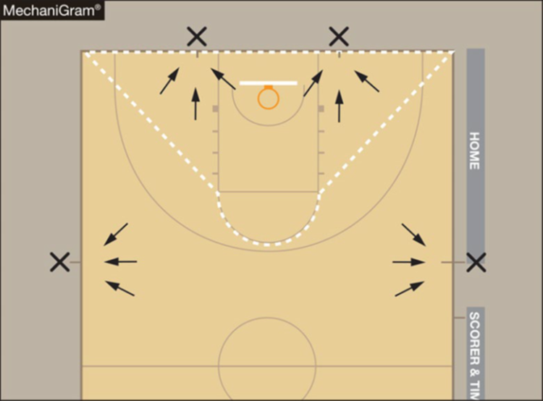
Rule Changes
Resumption of Play Procedures/Throw-Ins
Rule 7-5-2 thru 4
ART. 2 . . . After an out-of-bounds violation in either the frontcourt or the backcourt by either team as in 9-3, the throw-in shall be at the designated spot nearest to where the ball went out of bounds.
ART. 3 . . . After a violation (9-4 through 9-13) by either team, a foul by either team before the bonus is in effect or any other stoppage in play, the throw-in location will be determined by the location of the violation/foul or the location of the ball when the stoppage occurs:
a. If the throw-in is to be in the team's frontcourt, it shall be at either the nearest 28-foot mark along each sideline or the nearest spot 3-feet outside the lane line along the end line.
b. If the throw-in is to be in the team's backcourt, the throw-in shall be at the designated spot nearest to where the foul, violation or other stoppage in play occurred.

Slide 10
Rule Changes
Resumption of Play Procedures/Throw-Ins
ART. 4 . . . Officials shall determine the designated spot by using an imaginary line drawn from the intersection of the end line with the sideline to each lane line where it intersects with the free-throw line including the semicircle. If the stoppage of play occurs inside the imaginary line, the designated spot shall be the nearest point on the end line 3-feet outside the lane line. If the stoppage occurs outside the imaginary line, the designated spot shall be the nearest sideline at the 28-foot line.

Slide 11
Rule Changes
Throw-in Mistake
7-6-6 — Allowing the official administering a throw-in to the wrong team to correct the mistake before the first dead ball after the ball becomes live unless there is a change of possession provides an appropriate amount of time to correct a mistake. Previously, the mistake had to be corrected before the ball was put into play.

Slide 12
Rule Changes
1st to Touch
9-3-3 — Establishing that a player may step out of bounds without penalty unless they are the first player to touch the ball after returning to the court or if they left the court to avoid a violation allows the game to continue without stoppage when the player’s actions did not create an advantage. When an advantage is gained by a player purposely leaving the court and being the first one to touch the ball or leaving the court to avoid a violation, an advantage is gained, and a violation has occurred.

Slide 13
Point of Emphasis
Uniforms, Equipment and Apparel
  Uniform jerseys must comply with the rules listed in 3-4, 3-5 and 3-6. The rules are concise and clear regarding what is and is not permissible on the jersey.
  Uniform requirements MAY NOT be altered by mutual agreement between schools or coaches.
  With the adoption of Rule 3-4-5, uniform bottoms must be like-colored among teammates.
  Rolling and/or tucking of uniform bottoms is permissible, as long as the compression tights/sleeves, if worn, are color compliant.
  Undershirts, arm sleeves, knee sleeves lower leg sleeves are permissible MUST adhere to the rules.

Slide 14
Point of Emphasis
Bench Decorum
  Coaches who leave the expanded bench area to engage officials inappropriately are subject to a warning or a bench technical foul.
  Player and coach behavior, which in the official's judgment is determined to be a taunt of an opponent or a disrespectful act toward an official, shall be penalized by assessing a technical foul.
  Assistant coaches are not authorized to approach the scorer's table at any time. The head coach is permitted to go to the scorer's table to request a 60-second time-out to confer with personnel regarding a correctable error or to prevent or rectify a timing or scoring mistake/ error or an alternating possession mistake.
  Bench decorum warning and technical fouls.

Slide 15
Facility Requirements
Home Bookkeeper (Black & White Shirt)
Procession Arrow
“X” on Floor at the Table
Marked Coach’s Box (starting at 28’ line to End line)
Identify contact for Game Management
Parking Close to Gym
Escorts
Secure Locker Room
Clean Space
Hot Showers
Game Film
Facility Requests

Slide 16
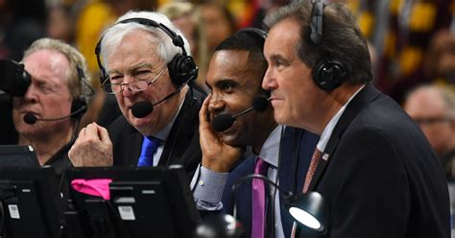
Announcer Rules
**
What May Be Announced:
  Player who scored
  Player charged with foul
  Player attempting free throw
  Team granted a time out & Length of time out
  Player entering game
  Team Rosters
What Shall Not Be Announced:
  Number of points player scored
  Number of fouls on player
  Number of team fouls
  Number of team time outs or number remaining
  Time remaining in the quarter/game
  Type of foul or violation
  Emphatic 2- or 3- point goal
https://www.nfhs.org/activities-sports/basketball/

Slide 17
Communications
Officials
Table
Coach’s
Administration
Players
Law Enforcement
Facility

Slide 18
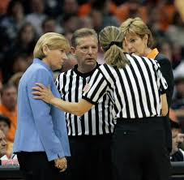
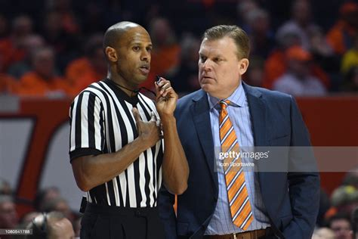
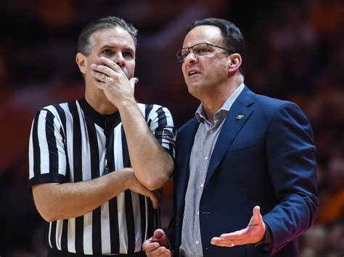
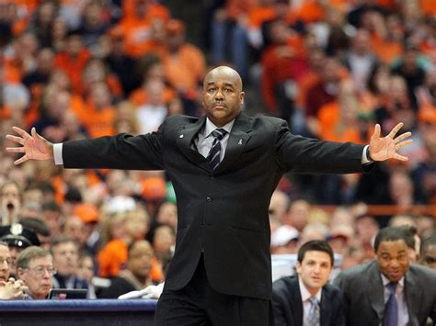
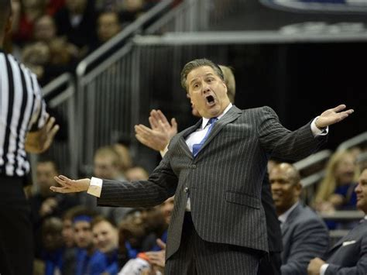
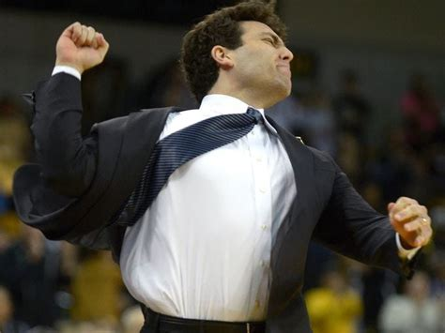
Communications
The Timer and Official Scorekeeper are part of the Official's crew
There is a difference between talking and communicating
Non-verbal communication

Slide 19
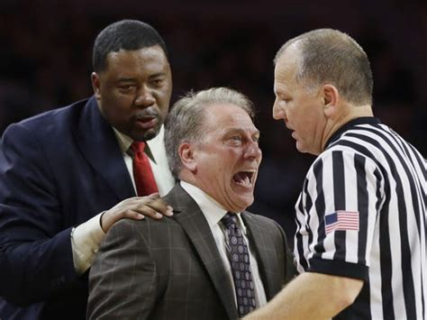
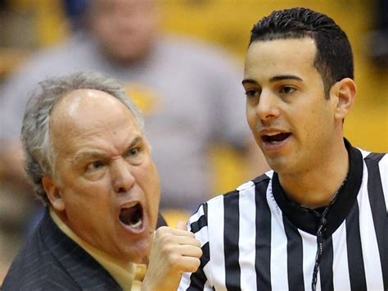
Sportsmanship
This applies to players, coaches, bench personnel, table personnel and spectators
Address early and often if needed
Get game administration involved or law enforcement if needed
Contest officials should never engage with spectators who are exhibiting unsporting behavior.
School administration is responsible for dealing with unruly spectators prior to, during and after the contest.
If spectators are using demeaning or profane language at officials, coaches or players – or at others in the stands – those individuals should be removed from the contest by school administration.
*
**

Slide 20


Thank You for Being a Valued Partner

Slide 21
Questions
Jim Murray
President
Tom Bernhardt
Treasurer

