Slide 1
‘DELIVERING ON THE PROMISE’
A STRATEGIC COMMUNICATIONS PLAN BY BEVERLY JAMES
JULY 8, 2024

Slide 2
Agenda
Introduction
Situational/SWOT Analysis
SMART Goals
Strategies, Objectives, Tactics, Benchmarks
Communication Methods
Team Member Roles/Deliverables
Budget
Summary
Notes:
We celebrate UDC’s identity as the District’s high-quality, accessible, public university, building upon its legacy as a proud HBCU. To support and ensure the success of the “Delivering on the Promise” Strategic Plan, I have created a strategic communications plan that aligns with the president’s vision and the overall plan’s goals, strategies, and objectives.

Slide 3
Introduction
This strategic communications plan aligns with President Edington’s vision and UDC’s overarching strategic plan, “Delivering on the Promise.”
As UDC moves forward to fulfill its promise to establish a public higher education model of urban student success, increase the number of UDC degrees and credentials awarded, and graduate transformative urban leaders who are lifelong learners, this plan will amplify UDC’s efforts to articulate a new vision.

Slide 4
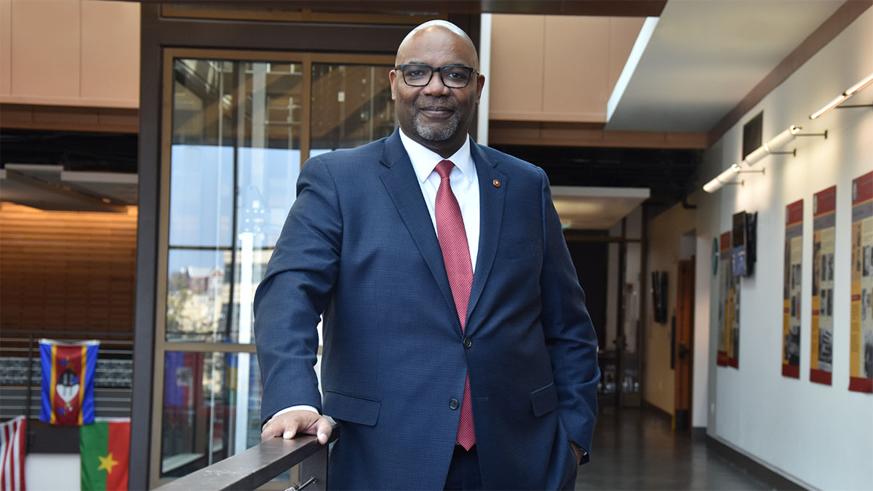
UDC President Dr. Maurice Edington,
via the Washington Post
“We are very unique because we have pathways at every level: a certificate, an AA degree, a bachelor’s degree, a doctoral degree, a JD. We have to make sure the community is aware not just that we have them, but that those are pathways to success. And then, [we have to] continue to retool what we do internally, get better at the things that need improvement. There’s no magic. It’s a bricks-and-mortar approach.”

Slide 5
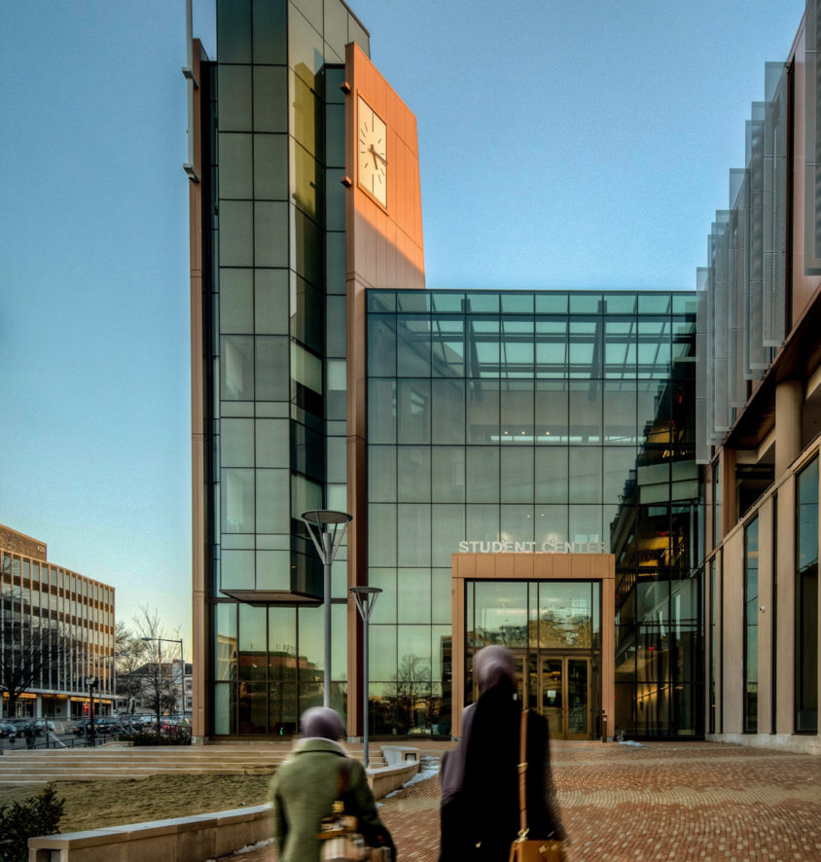
Situational Analysis
Home to more than 70 degree programs, UDC was established in 1851. UDC is:
the only public university in the nation’s capital.
the nation’s only land-grant HBCU in an urban setting.
possibly the only university that offers workforce development programs, a community college, undergraduate programs, and a law school.
First Ph.D. graduates in 2023.

Slide 6

Situational Analysis
Continuing the work started with UDC’s previous strategic plan (2019-2022), we are guided by three goals:
Establish a public higher education model of urban student success.
Increase the number of UDC degrees and credentials awarded.
Graduate transformative leaders, who are lifelong learners.
Building on its rich legacy of social justice, opportunity, and high-quality education for all, UDC moves boldly into the future.

Slide 7
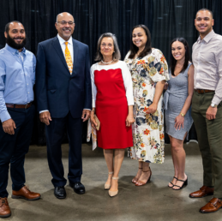
Target Audiences
Internal:
  Students, staff, faculty, alumni
External:
  Alumni
  Lawmakers
  Local residents
  Community and faith leaders
  Local, regional, and national media
  Trade, international media outlets
  Social and digital media influencers
  Corporate and nonprofit principals
  NGO
  District public and private K-12 schools

Slide 8
Key Messaging
UDC is a world-class flagship university for the nation’s capital.
UDC is a national model for urban student success.
UDC is the District’s workforce and economic mobility engine.
UDC is a research and innovation hub addressing the District’s critical needs.
UDC unites all stakeholders to support a shared vision for ONE UDC.

Slide 9
SWOT Analysis: Strengths
Location! Set in the nation’s capital means students have access to some of the most influential leaders/mentors, limitless opportunities for internships, fellowships, and future employment, year-round cultural events, and the nation’s premier museums.
Multiple nationally-ranked programs: Computer Science (#1 among HBCUs), School of Business and Public Administration AACSB International accredited, Law School is ranked #13 for Best Clinical Training Law Program, U.S. News & World Report.
UDC is ranked #30 among all HBCUs.
Relevant, in-demand programs: Aviation Maintenance Technology, Computer Science/Network Security, Procurement and Public Contracting (Certificate), Urban Sustainability, Teacher Education from elementary to secondary to special education.
UDC likely has the strongest ties to local public and private K-12 schools.
Notes:
Positive attributes that we can have and can leverage. LOCATION: Opportunities available in government, nonprofit, education, and corporations.

Slide 10
SWOT Analysis: Weaknesses
UDC continues to battle a perception problem. District natives associate the university with past years of evolving, short-term leadership, underfunding, and stagnant programs.
Competition with the number of colleges and universities in the District is high. Also, many local students use the District of Columbia Tuition Assistance Grant (DCTAG) to attend other institutions.
Weak HBCU brand locally and nationally.
Persistent budget cuts in the 1990s that still affect the university today.
Notes:
INTERNAL negative gaps that we need to overcome.

Slide 11
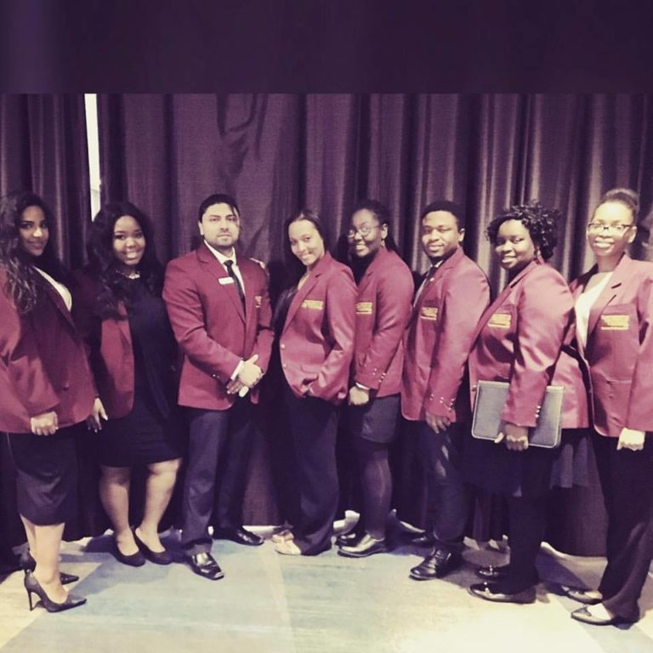
SWOT Analysis: Opportunities
Chance to train students and alumni to create UDC Ambassadors.
Offer USA-based study abroad to students interested in government employment.
Improved networking opportunities and communication channels for alumni.
Target mid to high-income households to make UDC their “school of first choice.”
HBCU applications are surging.
Notes:
External factors and trends that can benefit UDC or create new possibilities.

Slide 12
SWOT Analysis: Threats
Higher education is being hit on all sides, from the COVID-19 pandemic, political and racial unrest, and a glaring skills gap as technology outpaces curricula. Consequently, we have lower enrollments at institutions, loss of traditional jobs, and the need for training for newly created careers. Threats include:
Fewer high school graduates are going straight to college.
Undergraduate student enrollment fell by over 900,000 students, or almost 6% of total enrollment during the Covid-19 pandemic, and the decline continues.
Community colleges suffered the biggest drop in enrollment from 2019-2021, plummeting by more than 10%. Most students said it was because of a job.
Artificial intelligence, online learning, and virtual reality are changing the education landscape and career requirements. Technology is still costly to incorporate into higher education.
Notes:
External risks and factors that limit options. MARKET TRENDS. Community college students are historically low-income, first-time college attendees.

Slide 13
SWOT Analysis: Threats
Alarming stats show that UDC must launch strategic efforts to develop and maintain dominancy on its home turf:
Federal workers are fleeing the District, and agencies are looking to students to fill the gaps. So, universities are building outposts in Washington D.C. At least 50 universities have built satellite campuses in the nation’s capital, according to data from the Washington, D.C., Economic Partnership.
Our competition includes Arizona State, the University of Arizona, Texas A&M, the University of Southern California, Purdue, Princeton and Johns Hopkins. It’s a study-abroad phenomenon for students interested in classes, internships, and networking with insiders for future job opportunities in the nation’s capital.
SOURCE: Inside the Race to Build College Outposts in Washington - POLITICO
Notes:
External risks and factors that limit options. MARKET TRENDS. Community college students are historically low-income, first-time college attendees.

Slide 14
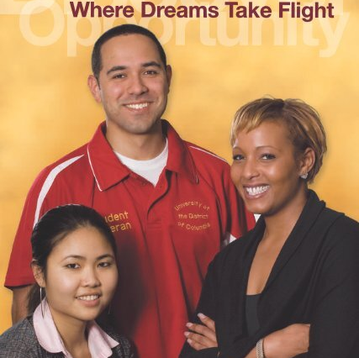
SMART Goal #1: Identity
Celebrate and publicize UDC’s uniqueness as we focus on institutional reputation and brand.
Notes:
Specific, measurable, achievable, relevant, time bound.

Slide 15
Strategies: Goal #1
Create a strategic communications and branding plan that aligns with “Delivering on the Promise.”
Position top faculty and administrators as thought leaders in urban, public higher education, HBCUs and on research.
Create media relations plan to boost relationships and improve quality and quantity of hits.
Promote “UDC Promise,” which will offer free community college to District residents.

Slide 16
Objectives: Goal #1
To position UDC key faculty and administrators as thought leaders in urban, public higher education.
To position UDC as a “school of first choice.”
To help increase enrollment, retention, and completion rates.
To publicize opportunities for students in other states to participate in a “Nation’s Capital Study Abroad” program.

Slide 17
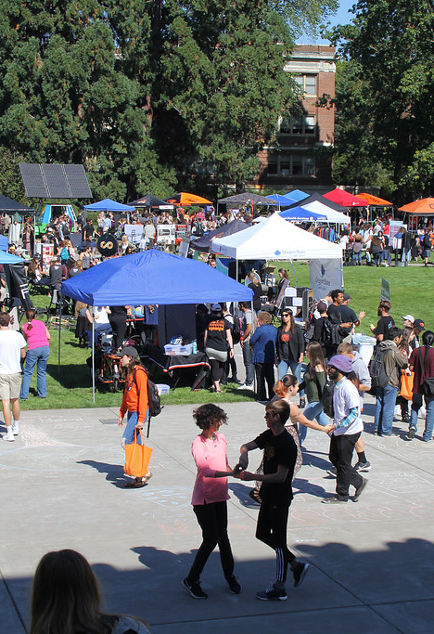
Tactics: Goal #1
Social/Digital Media:
Redesign the UDC website to feature press releases, vignettes, and news appearances.
Use internal social and digital media tools to maximize the visibility of rankings, news appearances, student and alumni successes, and donor stories.
Use SEO best practices to ensure web pages and social media posts rank high in searches.
Track success by using social media analytics tools such as Hootsuite and MailChimp.
Bloggers/Vloggers: offer high-value content and build website traffic and brand awareness.
Create a content calendar to ensure a steady flow of consistent messaging.
This Photo by Unknown Author is licensed under CC BY-SA

Slide 18
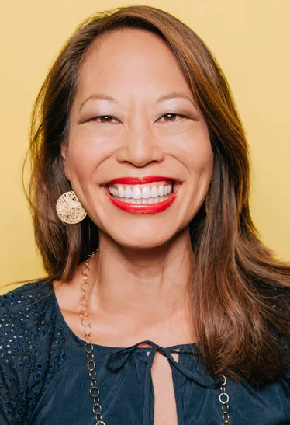
Tactics: Goal #1
Traditional Media:
Help Dr. Edington and top faculty write blogs and op-eds positioning themselves as thought leaders and UDC as a top educational choice.
Target various outlets, including:
  Radio: WKYS, WPGC, WHUR, WMUC, WAMU
  Publications: Baltimore magazine, Washington Post, Washington Times, Washington Informer, The Conversation.
  Agencies: Chambers of Commerce for DC, Maryland, and Virginia; DC Mayor’s Office, Council of the District of Columbia, Advisory Neighborhood Commissions.
  Trade outlets: U.S. News & World Report, The Chronicle of Higher Education, Inside Higher Ed, Educational Leadership, National Geographic Education Blog, NNPA.
Notes:
Aisla Chang, host of NPR’s All Things Considered

Slide 19
Tactics: Goal #1
Marketing/Branding/Advertising:
Market programs with individual website pages and pamphlets. Add links to promos on the main website.
  DAWN Initiative
  UDC Promise
  Comprehensive Student Success Center
  Dual Enrollment/Early College
  Employer Partnership
  Workforce Development
Create program vignettes featuring students and alumni for the main website.
Use a consulting firm to help create an advertisement campaign for billboards, social media, print, web-based, radio, and TV.

Slide 20
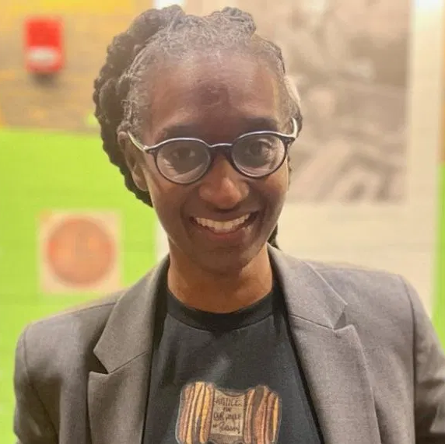
Tactics: Goal #1
Brand Ambassadors:
Use media training to prepare student leaders and alumni to be brand ambassadors.
Incorporate students/alumni in media pitches and make them available to reporters.
Help students/alumni write op-eds for their local hometown, regional, and national newspapers.
Notes:
Law School alumna LaRuby May of Pensacola

Slide 21
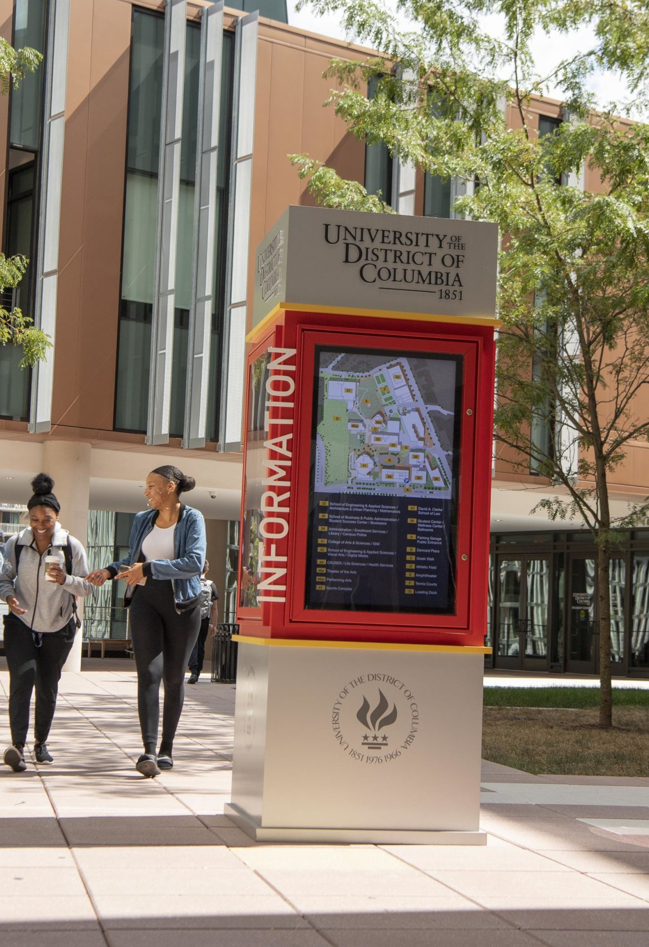
Benchmarks: Goal #1
Implement the communication plan and achieve the engagement targets within six months.
25% increase in reach and engagement on social media posts and advertisements linking back to main UDC website.
Improved reputation ratings from initial surveys to year-end surveys.
100% increase in media placements, including op-eds and story pitches.
Notes:
Google Analytics and social media analytic tools to measure reach and engagement.

Slide 22
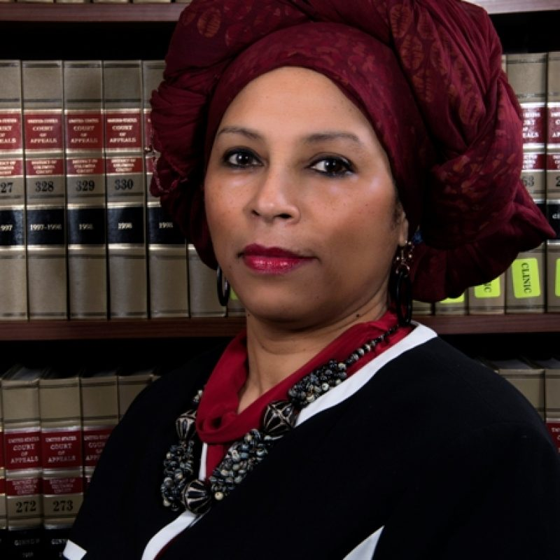
SMART Goal #2: Experience
Build staff, faculty, and student excitement and passion for UDC by publicizing opportunities to learn and thrive.
Notes:
Specific, measurable, achievable, relevant, time bound.

Slide 23
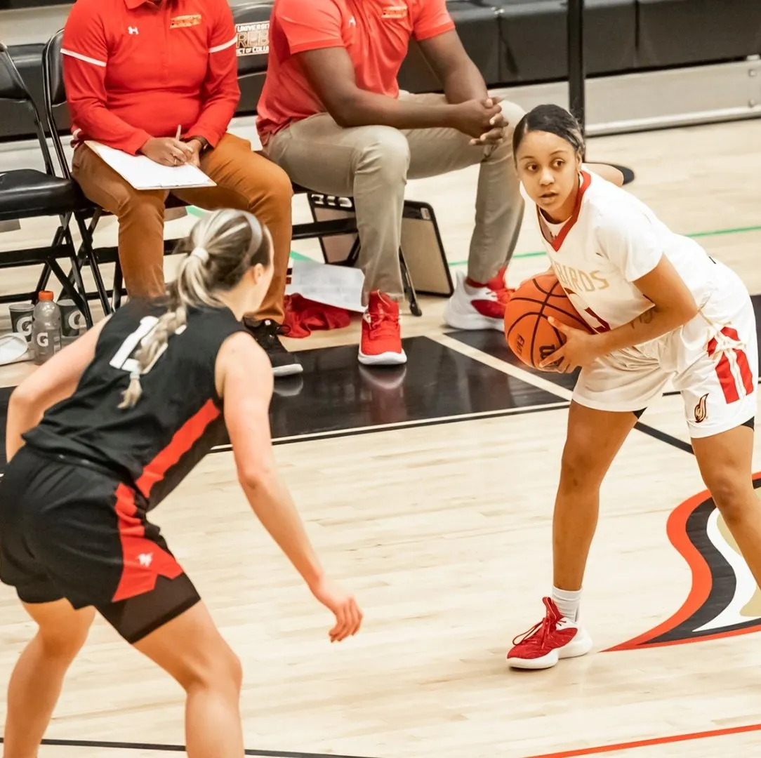
Strategy: Goal #2
Begin planning for a 2026 “Founder’s Celebration” to mark the 175th anniversary.
Leverage University Athletics to boost and improve ties with community members.
Collaborate with Enrollment Office to publicize scholarships and alliances with education partners.
Promote professional development, faculty and staff retention initiatives, and recognition programs.

Slide 24
Objectives: Goal #2
To celebrate and promote UDC’s rich history as an HBCU.
To improve UDC brand as the nation’s only urban land-grant university.
To strengthen ties with community members and leaders, and policy makers.
To increase knowledge of and participation in employee development, training, retention, and recognition programs.

Slide 25
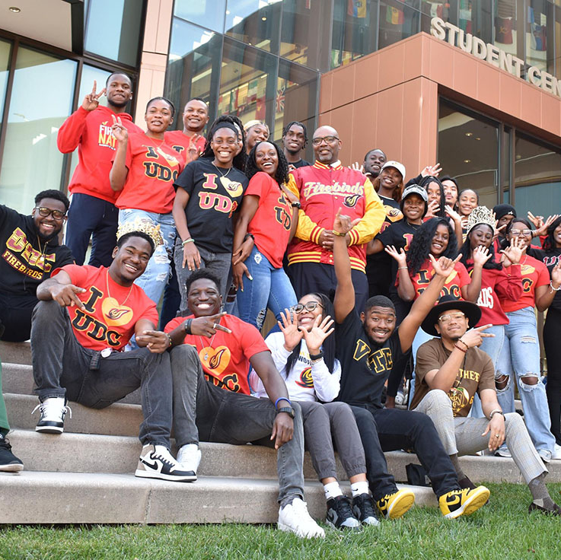
Tactics: Goal #2
Social Media:
Use internal social and digital media tools to feature and promote student, faculty, and staff events.
Create a web page for the 175th Founders’ Day Celebration and promote on social media.
Use main website and social media posts to promote all events that are open to the public.
Traditional Media:
Create PSAs to promote events on local stations and partner with popular radio personalities to host events.
Write press releases, newsletters and op-eds to promote major events in external and internal publications.
Pitch feature ideas to promote 175th Founders’ Day Celebration and athletic events.

Slide 26
Benchmarks: Goal #2
Reach fundraising goals and event attendance goals for 175th anniversary.
25% increase in participation in student, athletic, and staff events.
20% increase in faculty and staff development programs.

Slide 27
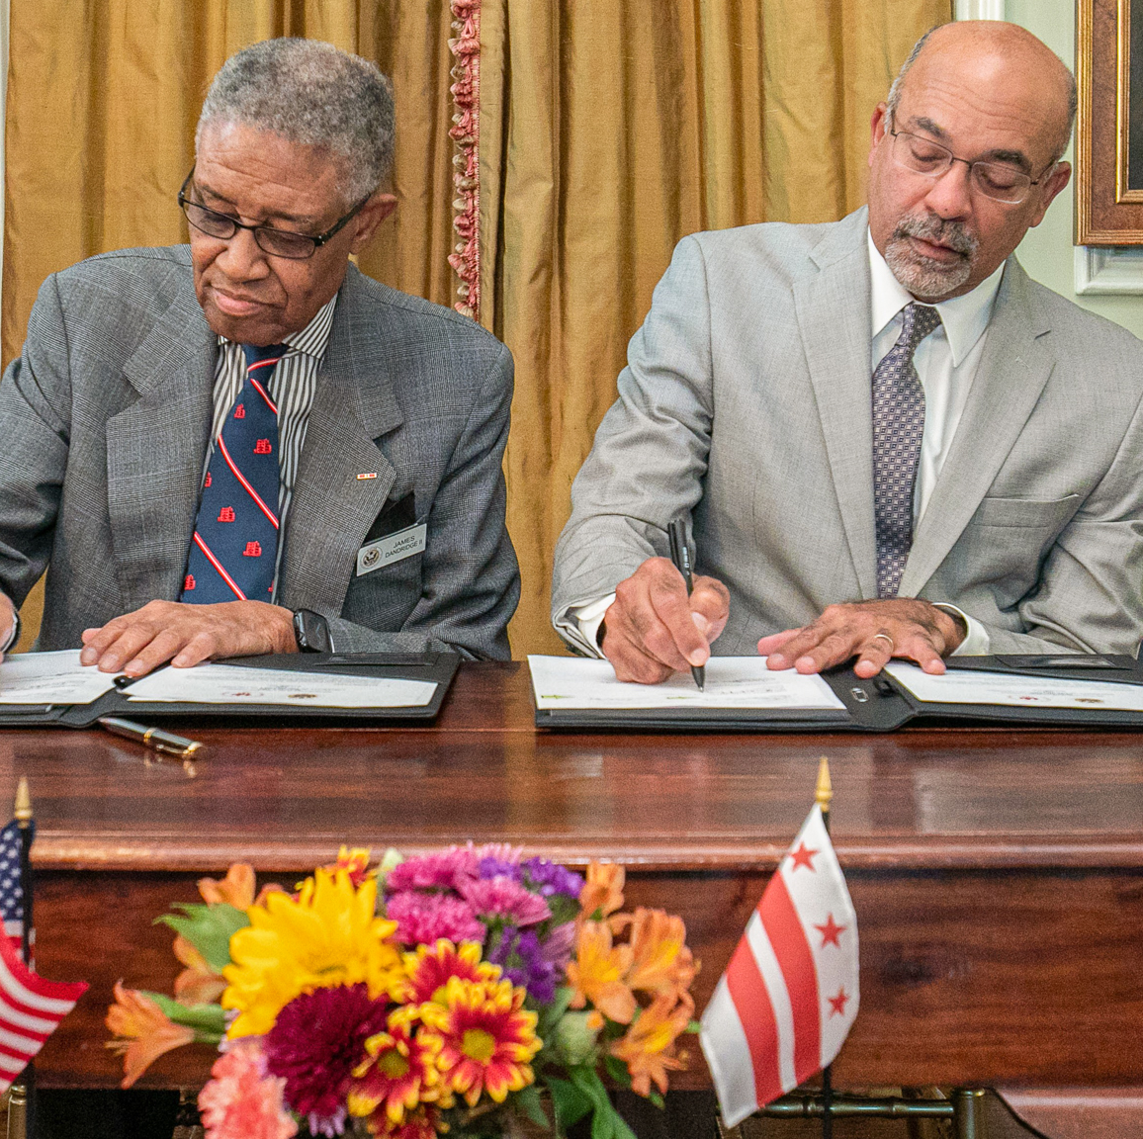
SMART Goal #3: Partnerships
Support efforts to create and maintain relationships with external stakeholders.
Notes:
Specific, measurable, achievable, relevant, time bound.

Slide 28
Strategies: Goal #3
Promote fundraising efforts to include stewardship, donor appreciation, and alumni engagement.
Publicize events with lawmakers, community and faith leaders, and residents.
Collaborate with the newly-created Office of Educational Outreach and Strategic Partnerships to amplify their efforts to expand partnerships with the Office of the State Superintendent of Education (OSSE), DC Public Schools (DCPS), DC Public Charter Schools (DCPCS), and other local education and government entities.
Market and publicize DAWN initiative to reach more K-12 students and staff.

Slide 29
Objectives: Goal #3
To strengthen ties with community and corporate leaders, and policy makers.
To increase donor and alumni fundraising campaign participation.
To strengthen relationships with K-12 students, staff, and administrators.

Slide 30

Tactics: Goal #3
Social/Digital Media:
Include donor and student-recipient vignettes on the main UDC website. Use QR codes to link.
Use internal social and digital media tools to maximize the visibility of donor stories.
Use SEO best practices to ensure web pages and social media posts rank high in searches.
Use relevant keywords strategically on website pages, course offering pages, URLs, H1 tags, meta descriptions, image tags, and file names.

Slide 31
Tactics: Goal #3
Traditional Media:
Write stories for web-based and print publications on why donors give and how students are impacted.
Create a “Where are they Now?” series of short stories on how donor gifts impacted a department, student, faculty, UDC facility, etc.
Create content for brochures, with QR codes to link to stories from mobile devices.
Help donors, corporate, and government partners write op-eds about the importance of collaborating with UDC to create future leaders. Target trade publications.
This Photo by Unknown Author is licensed under CC BY-SA

Slide 32
Benchmarks: Goal #3
Reach fundraising goals and event attendance goals for 175th anniversary.
25% increase in attendance at student, athletic, faculty, and staff events.
20% increase in faculty and staff development programs.

Slide 33
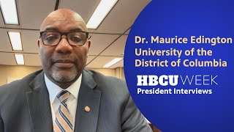
Communication Methods
Online Presence: UDC Website
Media Relations: Press releases, op-eds
Storytelling
Social Media
Public Relations: Events
Word of Mouth

Slide 34
Team Member Roles, Deliverables
Director of Media Relations: Coordinates all external content and creates communications plan to include expectations for quantity and quality of press releases, some op-eds, and pitches.
Media Relations Specialist: Writes content for press releases, websites, and newsletters. Focuses on storytelling.
Marketing Specialist: Writes marketing content for digital, social and traditional advertisement campaign.
Social Media Specialist: Creates all social media content for main website and major web program pages, using SEO best practices to ensure web pages and social media posts rank high in searches. Delivers weekly and monthly reports.
Graphic Designer: Creates all collateral for UDC digital/social, traditional marketing and communications initiatives, including print products.
Photographer and Videographer
Digital/Web Designer: Collaborates with AVP and consultant to help redesign/rebrand website and all digital products.

Slide 35

Budgeting
Salaries for additional staff
Annual advertising budget
Funding for website redesign/rebrand

Slide 36

Looking Ahead
Redesign strategic marketing communications plan to target national and international students.
publicize new programs to create more study-abroad opportunities for students at other institutions across the nation.
Continue to position Dr. Edington as a thought leader on urban, public education.

Slide 37
I don’t know what the future holds, but if you are willing to take the harder way, the more complicated way, then you will not regret it. This is your time.
Chadwick Boseman

Slide 38
Thank You
CONTACT:
Beverly James
386-279-2931
beverlyjames1217@gmail.com

