Slide 1





Homework Assignment 1
Due: Oct 12, 2025, 12:00pm.
Detailed Submission Guidelines: TBA by your TA.
Your have 5 Options:
“I’m a baby. Give me time to grow.”
“Strong & confident —that’s me.”
“Ready to compete with the smartest of the smartest.”
“Interested in hands-on work only.”
“I came to enjoy the beauty of math.”
Rookie
Veteran
All Star
Hacker
Poet

Slide 2
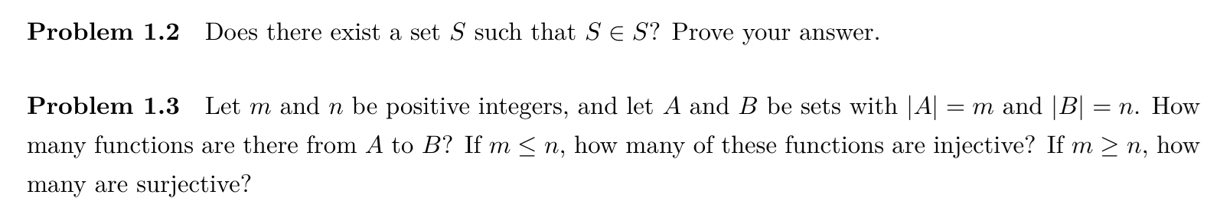
For Rookies
Textbook, Problems 1, 5.
Additional Problems:

Slide 3
For Veterans and All Stars
Textbook, Problems 1, 5, 9.
Textbook, Problems 5, 9, 10.

Slide 4
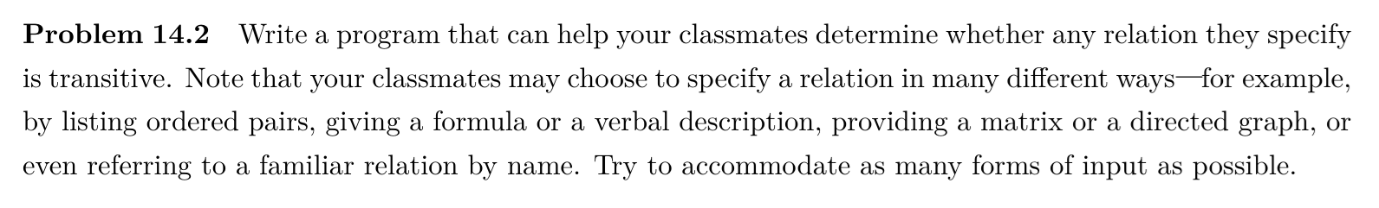
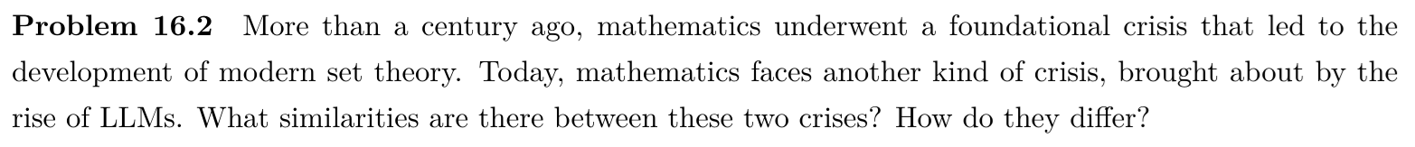
For Hackers and Poets
Additional Problem:
Additional Problem:

Slide 5

The meaning of problem difficulty estimate
0.0 ─ Trivial and boring.
1.0 ─ Learn the course materials, and you’ll be fine.
2.0 ─ Expect a sense of achievement when you’re done.
3.0 ─ Life is hard, just like this problem.
4.0 ─ Blame me.

Slide 6
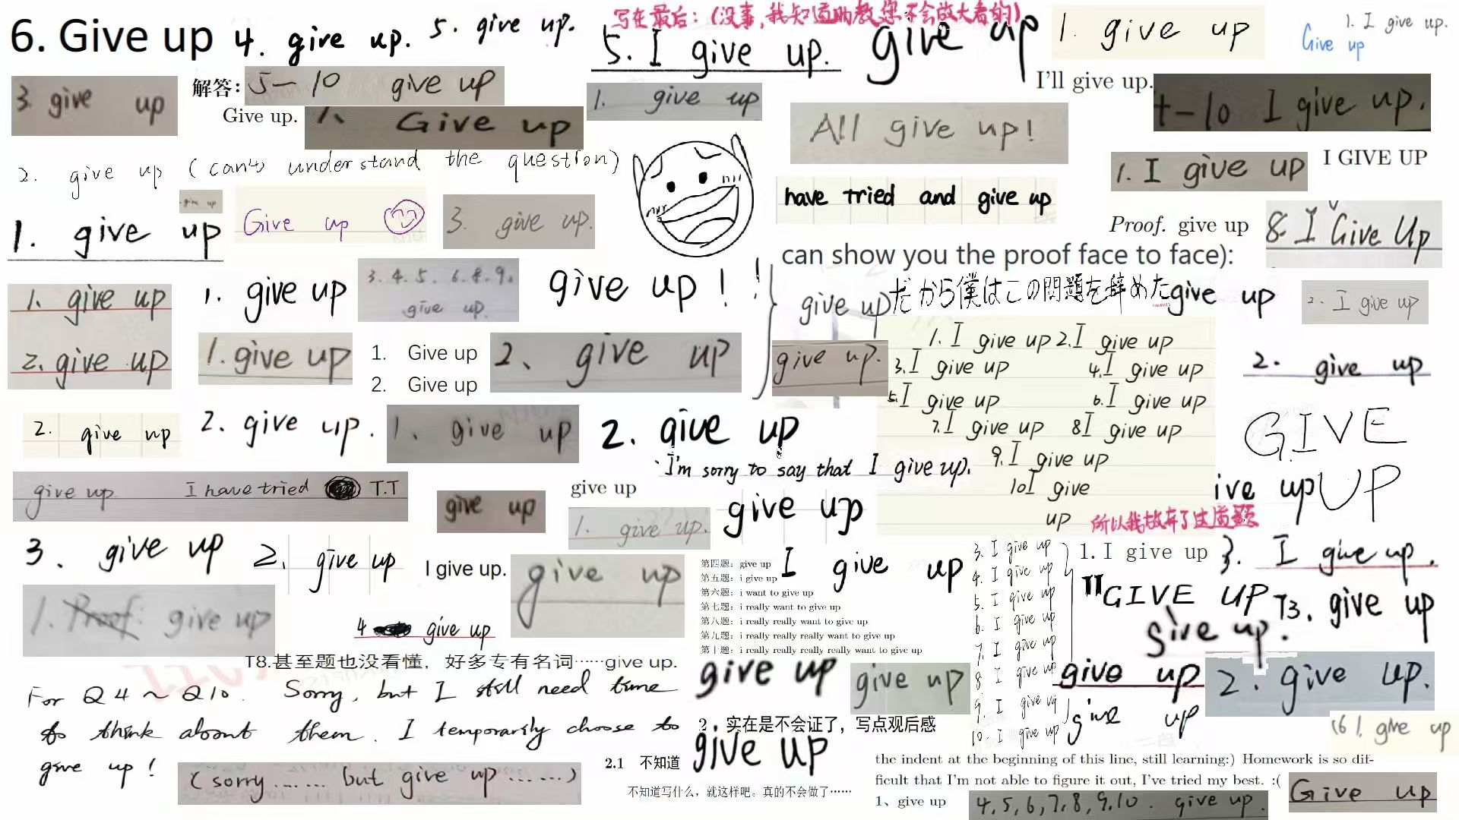
Bear in mind: OK to give up!
As long as you submit your work in time, and follow all the guidelines, you won’t lose any point for giving up on any/all problem(s).

