Slide 1
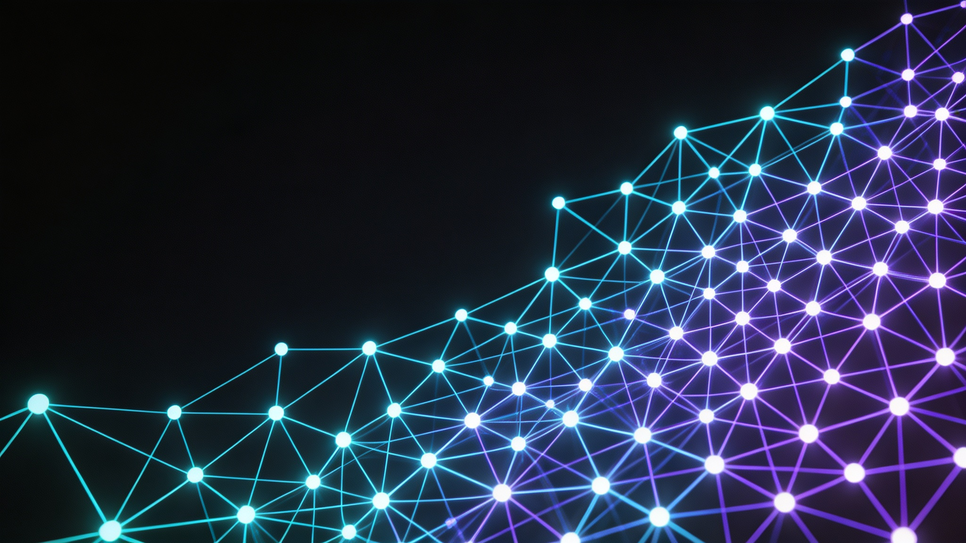
A Friendly Introduction to Information and Computational Sciences
Sheng Zhong
Nanjing University

Slide 2
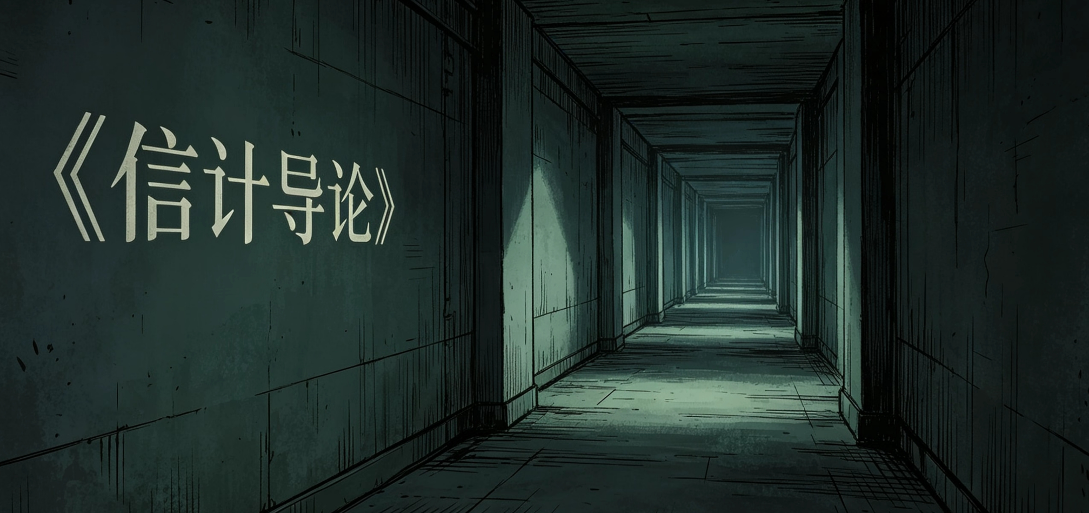
Introduction to Information and Computational Sciences
What does it cover?
Why is it useful (or maybe not)?
Problems that you’ll love (or hate)
About grading
Final thoughts

Slide 3
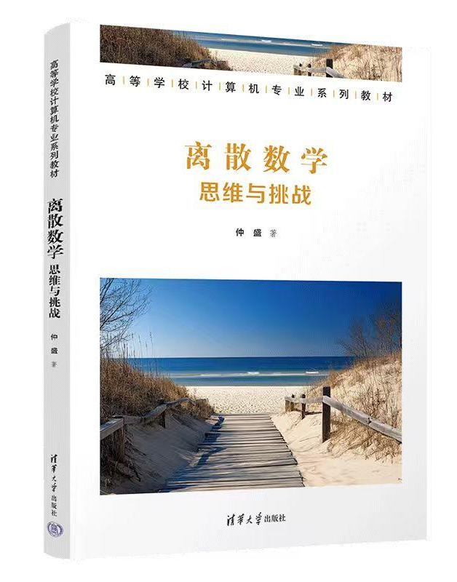
What does it cover？
与同类教材相似，略有增加
内容与同类教材基本类似，略有拓展
01.Set Theory
03. Group Theory
04. Number Theory
02.Recurrences
05.Graph Theory
06. Introduction to TCS
(This Course)
(My Discrete Math Course Next Semester)

Slide 4
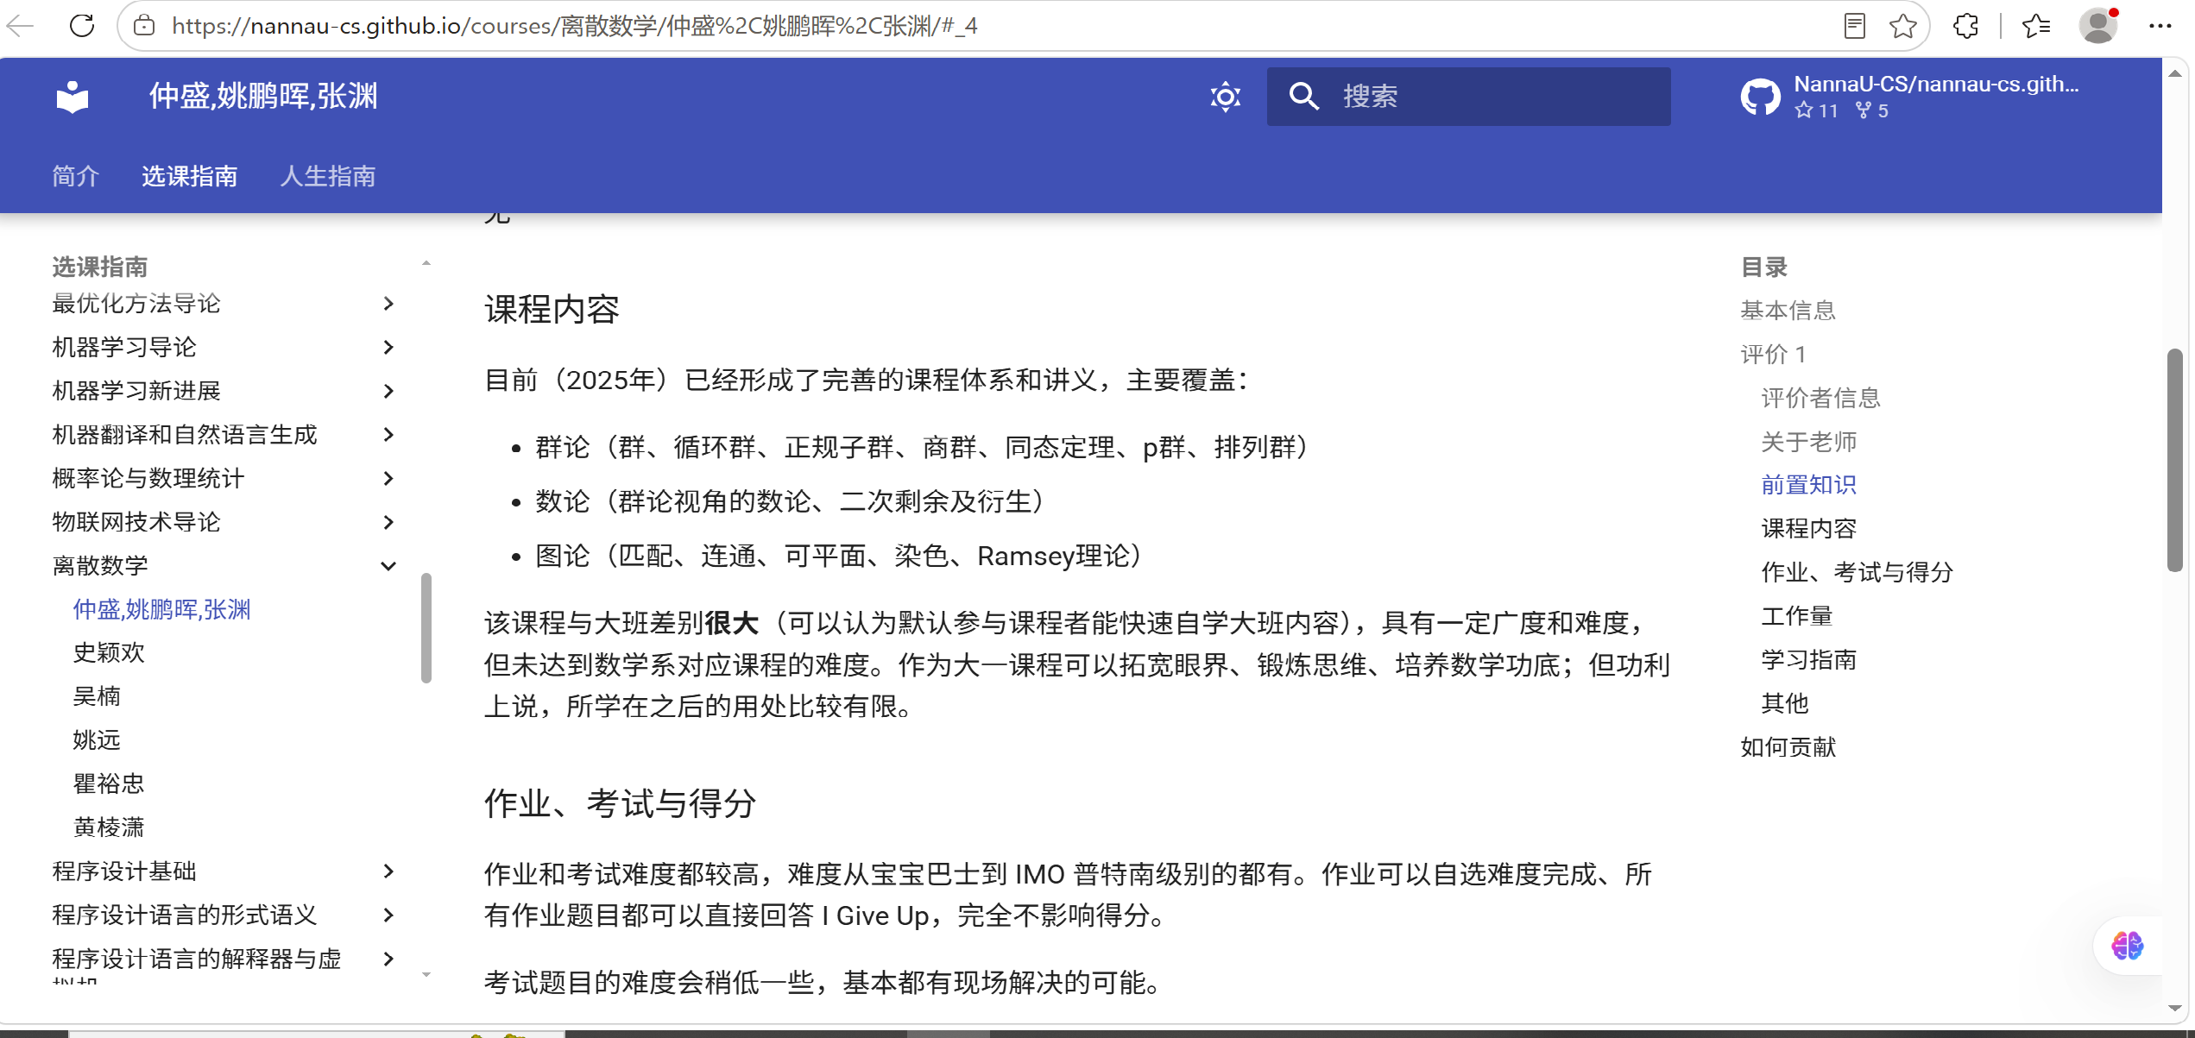

Is It Useful at all?
So, what is the point of learning it, especially when AI can easily tackle all kinds of math?

Slide 5
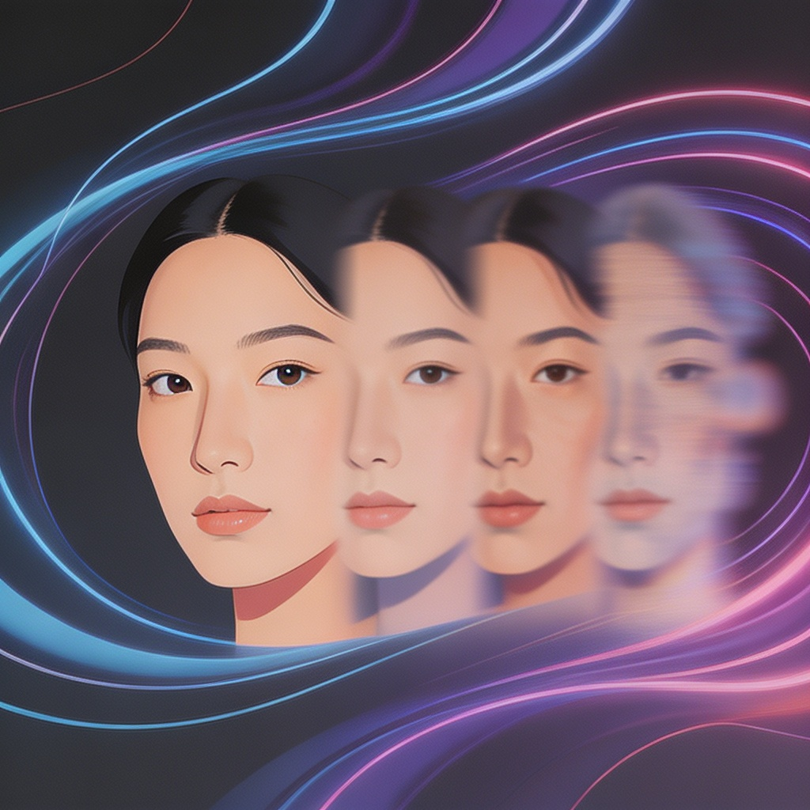
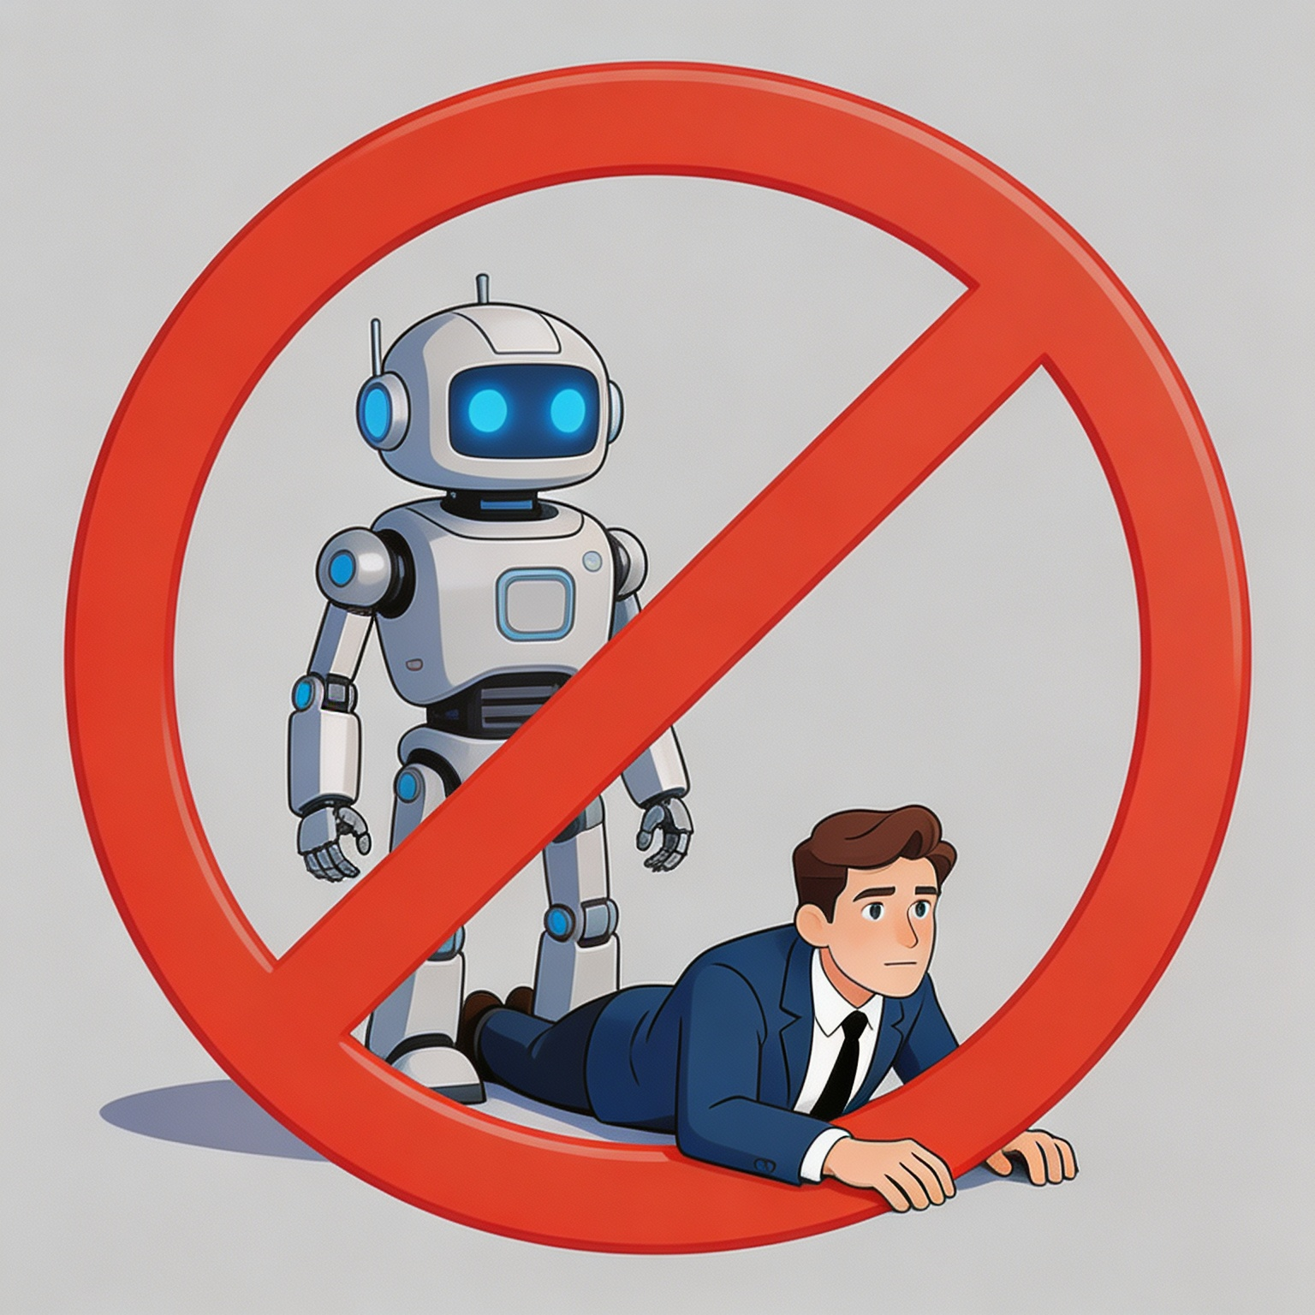
Two Arguments
A practical answer
A pursuit of human dignity
● As a future computer scientist/software engineer, you must be able to understand and verify the correctness of mathematical claims made by an AI.
● When you enjoy the benefits brought by AI technologies without understanding them, you risk becoming a pet of AI.

Slide 6
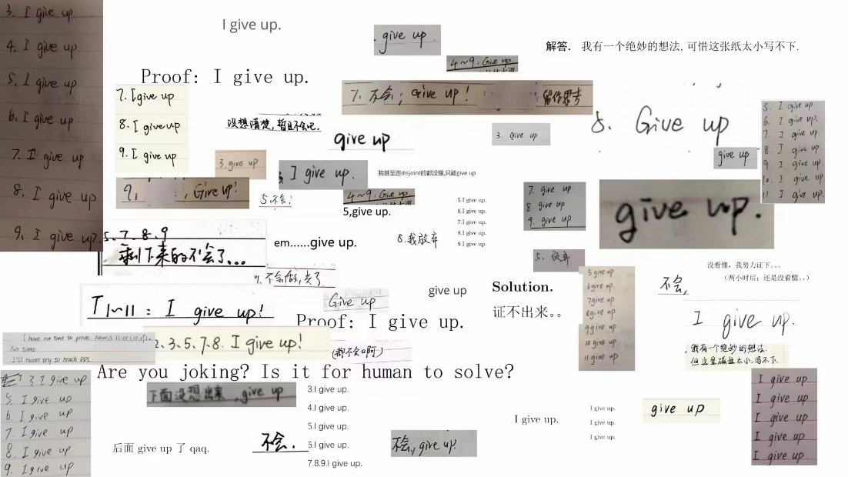
The problems that you will love/hate
When Homework 1 is released, many of you will run away.
Because our problems are TOUGH.
Good news: You can “give up” any problem(s) without losing a single point.
Of course, the problems are so nice that you may not want to give up… In the history, a few super strong students solved all homework problems in the entire academic year.

Slide 7
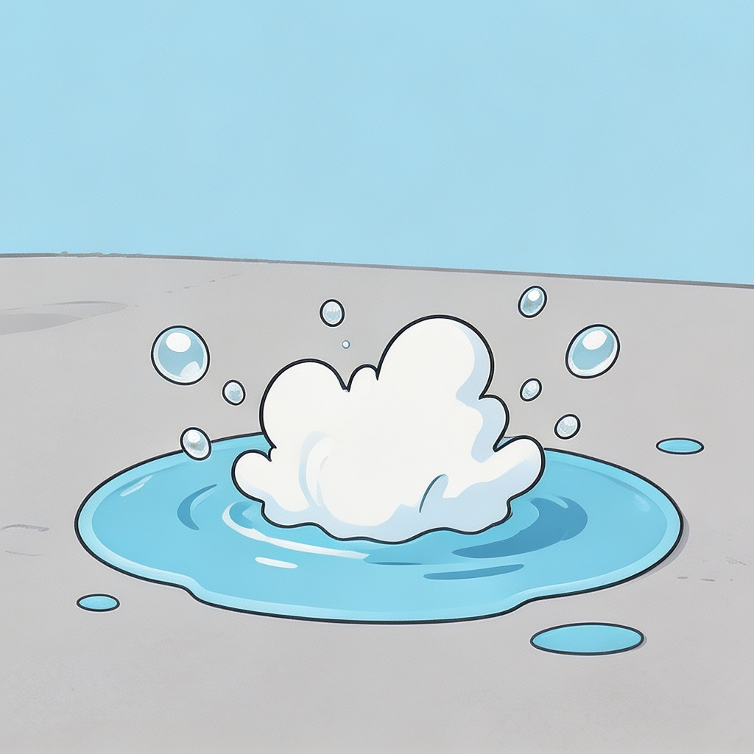
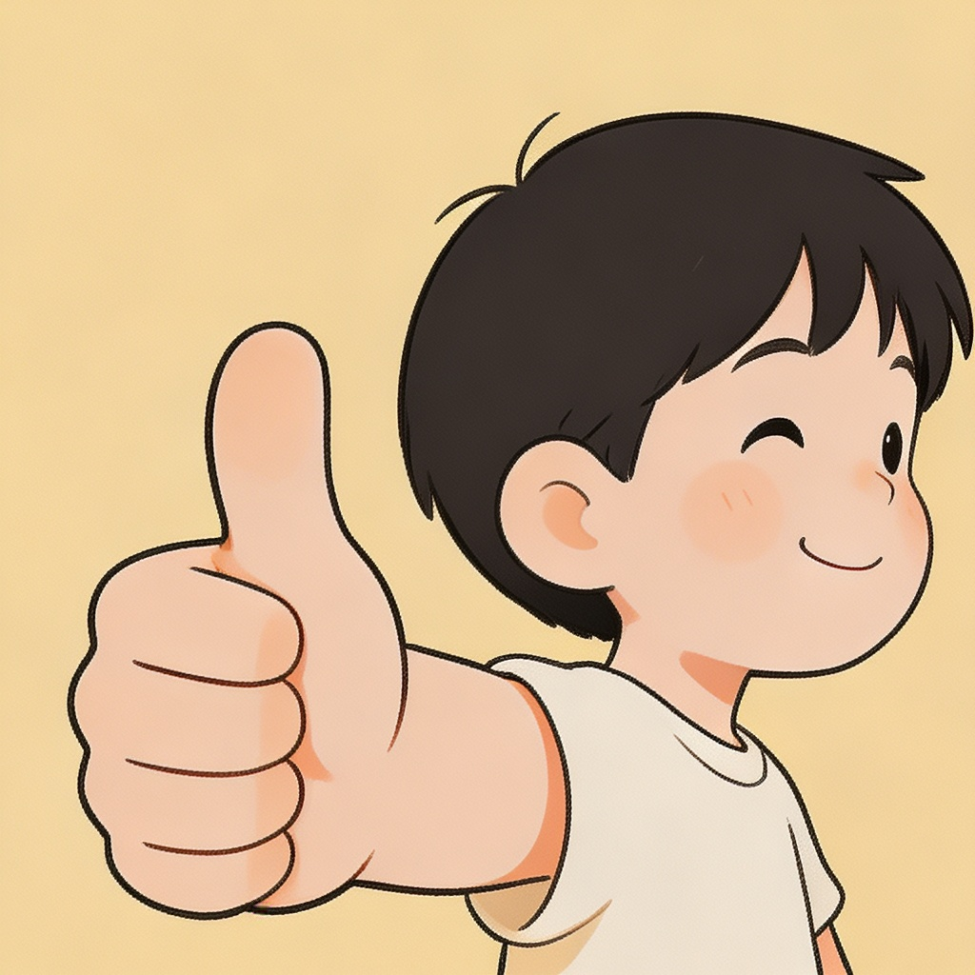
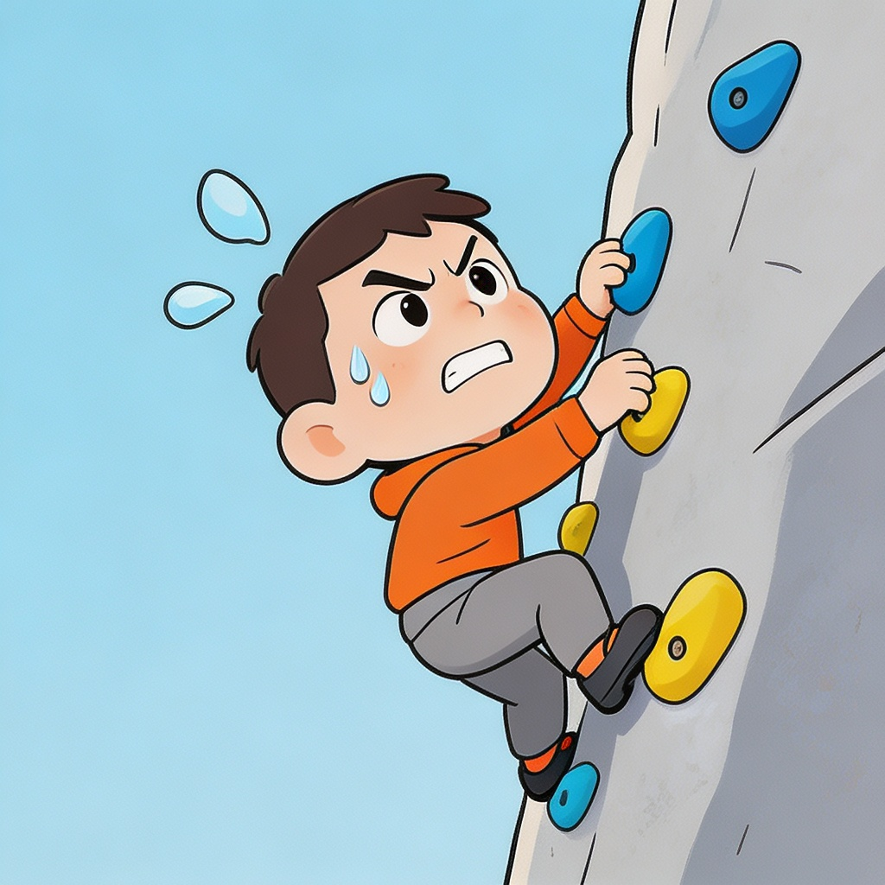
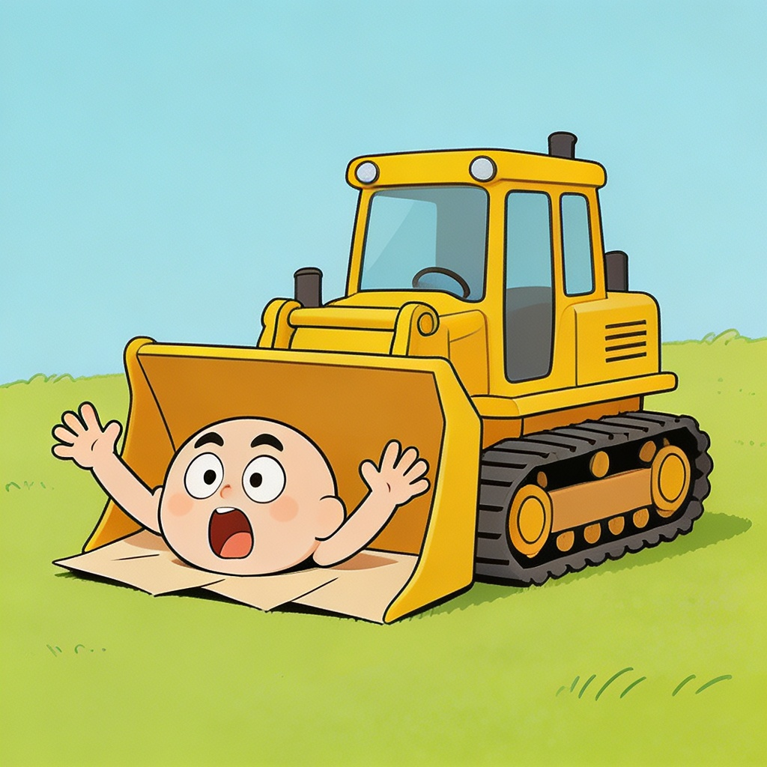
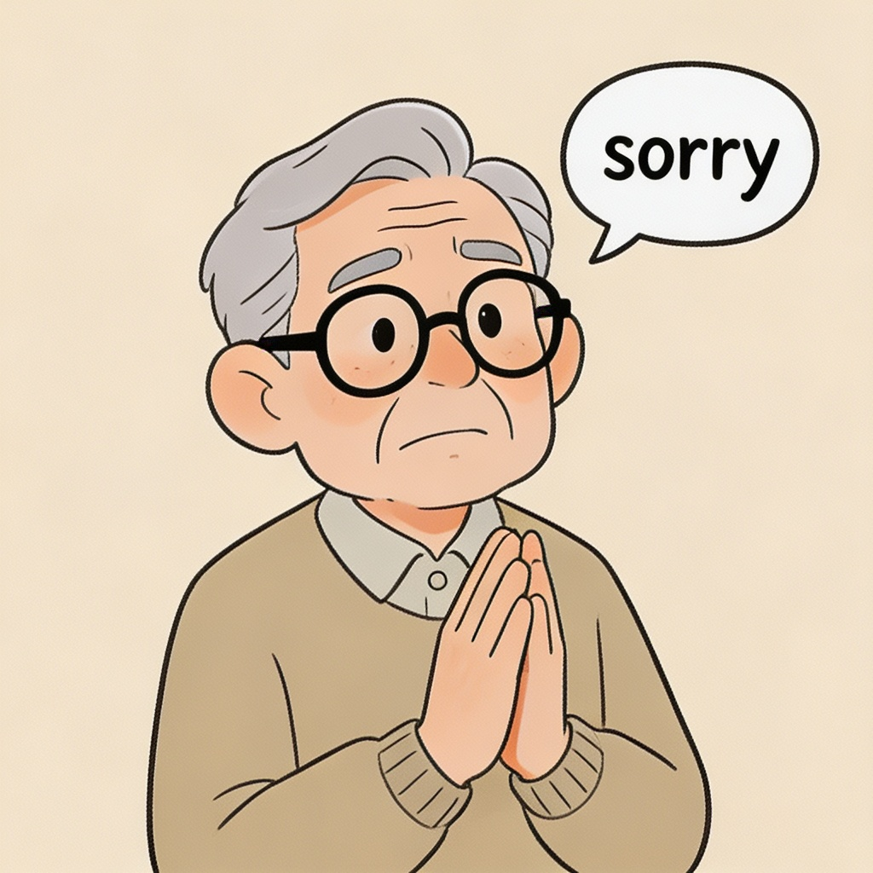
The problems that you will love/hate
Most problems have been rated by our previous students, on a scale of 0-4:
LEVEL 0
“也太容易了，水题一道。”
Just Trivial
LEVEL 1
“像你这么聪明，肯定会做。”
You need to know the basics
LEVEL 2
“挑战自己，也很有趣吧？”
Somewhat Tricky
LEVEL 3
“漫漫人生路，遇到困难是常有的事。”
A Real Challenge
LEVEL 4
“对不起，全是老师的错！”
My Bad

Slide 8
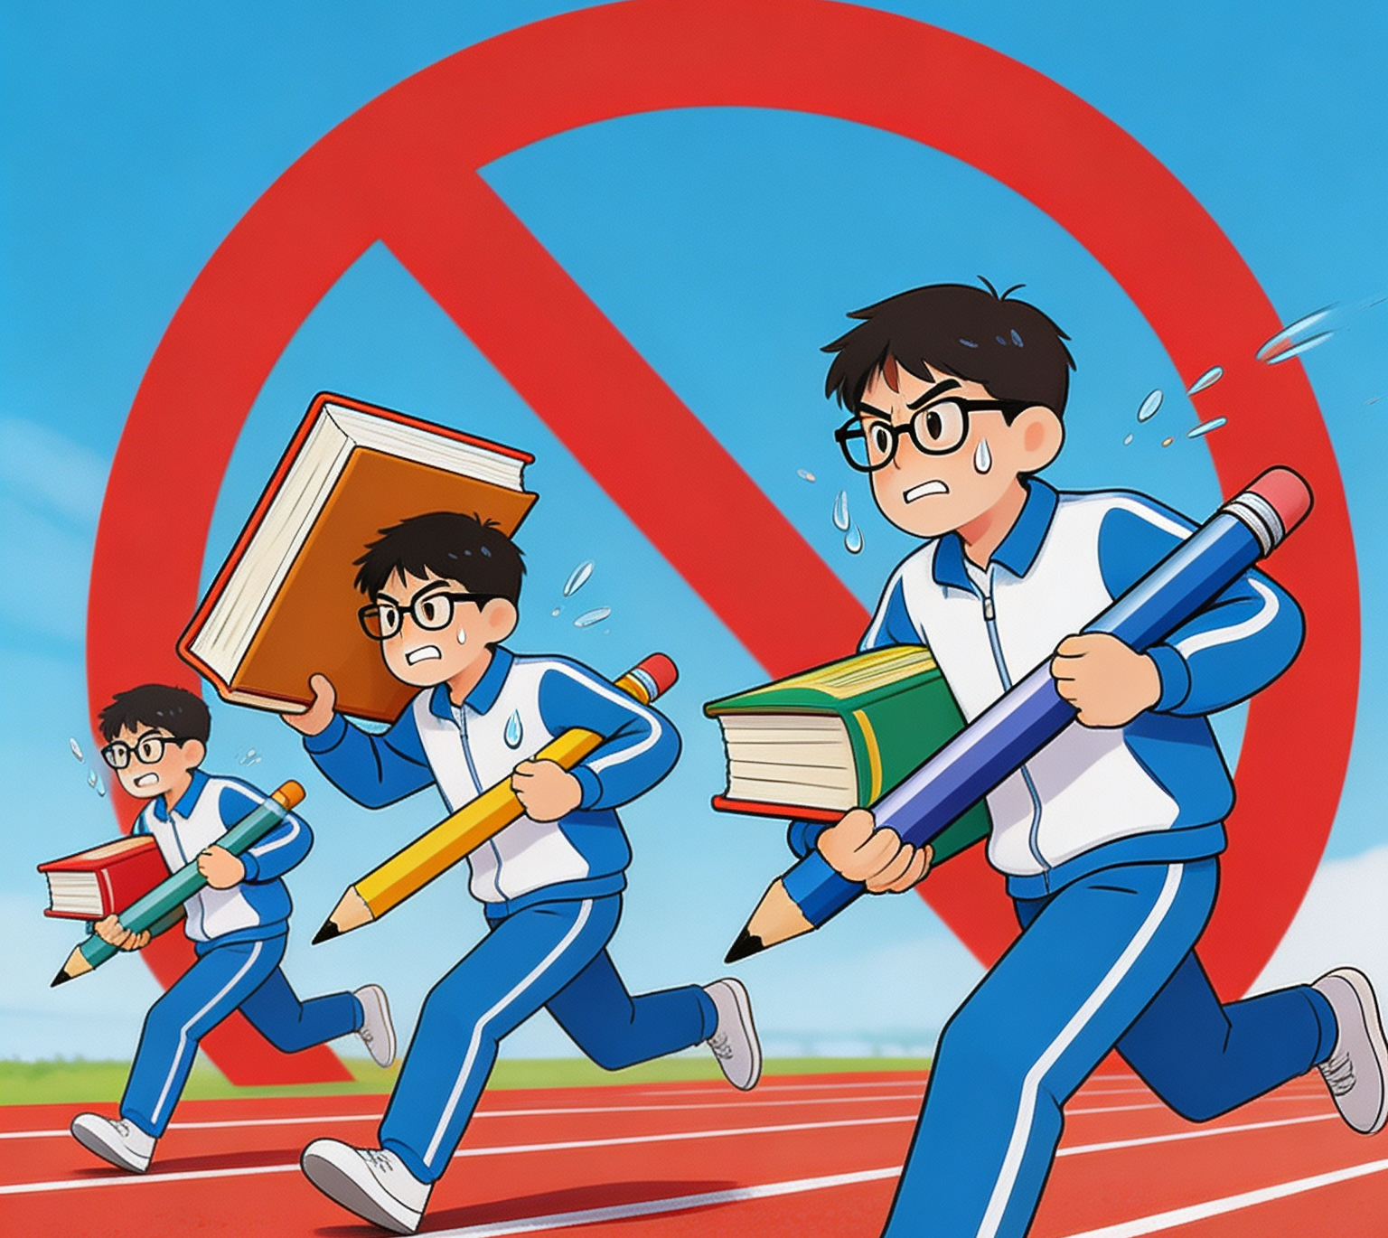
The problems that you will love/hate
Anxiety comes with difficulty levels
I know you guys will compete with each other to see “who is the best,”regardless of my instructions.
My suggestion：
While the solution of a hard problem is worth celebrating, failing to solve easier problems is not a shame.
My warning：
Stop! You are not an athlete. You are a student.

Slide 9
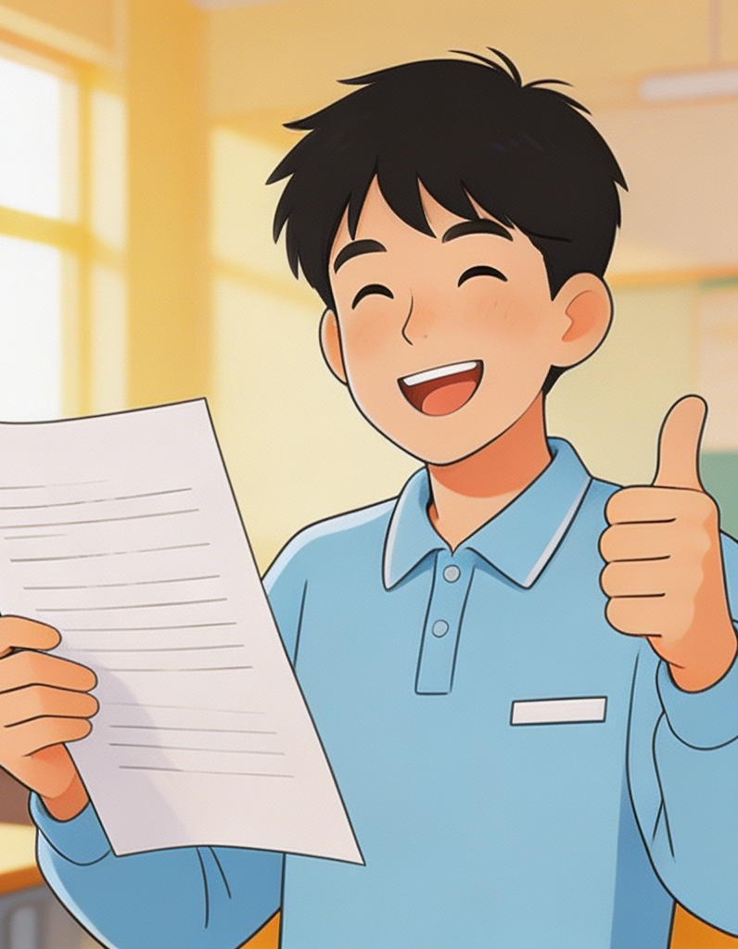

Do NOT be “good”
By my standard
Nobody needs to do every problem in the book.
Rote citation makes you weaker, not stronger.
A“good student”by high school standard
“I will solve every problem in the book.”
“I will become stronger through rote citation.”
My observations:
Struggle with difficult problems is not a shame. Facing challenges is part of the learning process.
When you “solve” a hard problem in minutes, the strength you find in yourself is nothing but an illusion, because you are simply reproducing the solution of a previously seen similar problem, without in-depth thinking.

Slide 10
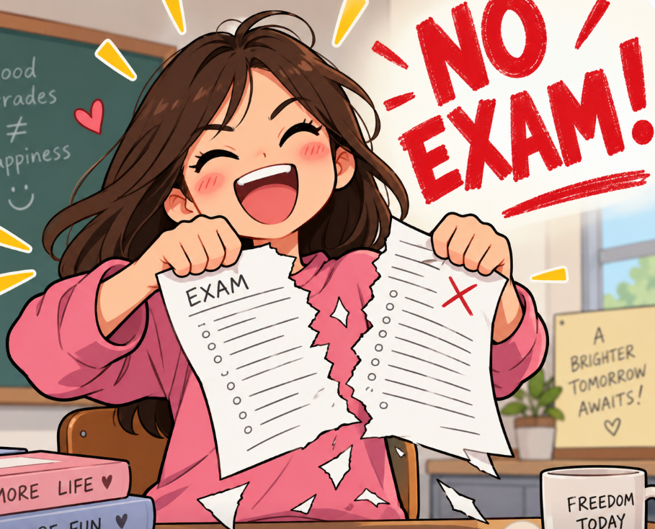
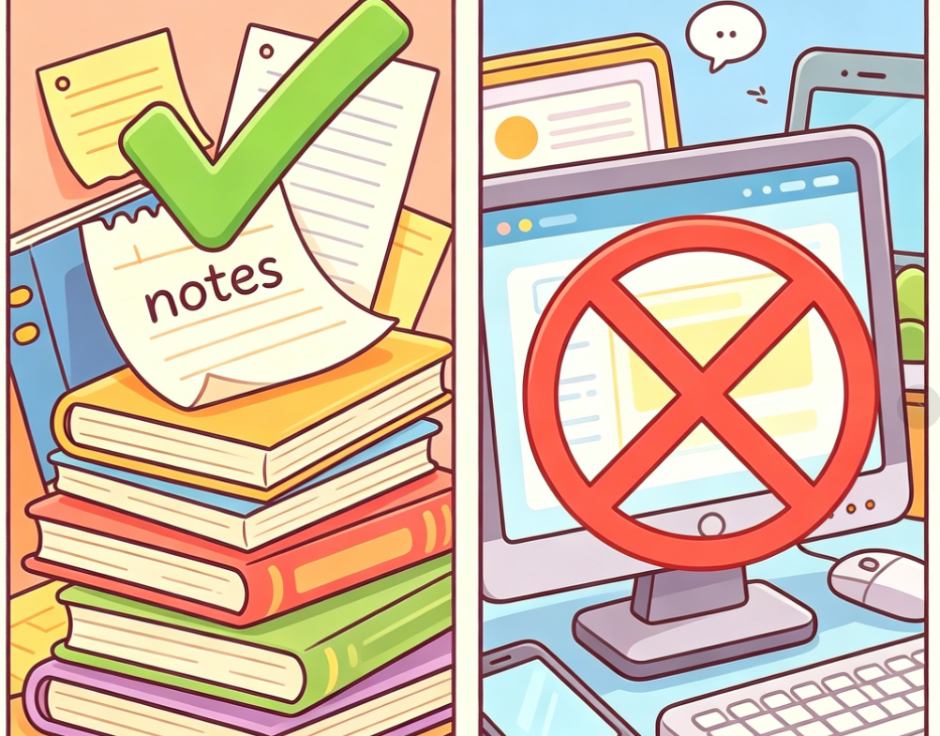
About grading
Good news: There is no exam.
Bad(?) news: There are two in-class contests.
Open book, but absolutely NO eletronic devices!

Slide 11
About grading
Your grade = min {80 + bonus points – penalty points, 100}.
To get bonus points:
Answer my question correctly.
Volunteer to present a solution in a recitation session.
Performance in our contest.
Other opportunities designated by me.
To get penalty points:
Fail to submit a homework assignment in time.
Cheat in our contest.
Course related misbehavior.
Other violations designated by me.
与同类教材相似，略有增加

Slide 12
Final Thoughts
This is not a math course, although it appears to be.
      It is a course of thinking..
Theorems covered are unimportant.
The number of problems you solve is unimportant, too.
Learn to be an independent thinker.
Learn to deal with the challenges in your real life.
与同类教材相似，略有增加

Slide 13
