Slide 1
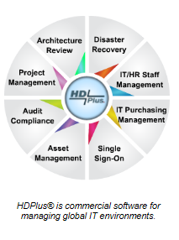
HDPlus
Project Management
                HDPlus, Inc.
                Landline: +01 888 277-8216
                Fax +01 888 277-8235
                Cellphone: +01 317 331-3038
                Email: ghorlander@hdplus4it.com
                www.hdplus4it.com

Slide 2
Project Management made easy!
HDPlus Project Management is focused on simplifying project management.
The gate review process:
  Gate reviews are imported from the template library
  The gate review process can be scheduled and linked to calendars by HDPlus along with steering committee meetings
  During the gate review process, any item requiring attention or a gate that fails can be immediately marked as priority action, assigned, and a ticket automatically created to track the action item.
All time and cost are tracked by project ID.
Linkage to ERP systems for importing and exporting project costs are included.
Ad Hoc reporting and a powerful search engine included.
Your data is not trapped in HDPlus, extensive support of import and export capabilities.
Mobil and Desktop ready. Update projects from your iPhone.

Slide 3
Slide Deck
The next group of slides are sample screen shots designed to show a brief glimpse of some of the features of HDPlus. Please note this is not intended as a full demo of the solution, and is best viewed in presentation mode.
The enclosed slides are of the desktop version, all browsers are supported, and all functionality fully supported on mobile devices: iPhone, iPad, Android, and Windows phone.
FYI – HDPlus was originally developed as an iPhone application.
Thank you for your interest in HDPlus.

Slide 4
Gate Review Process

Slide 5
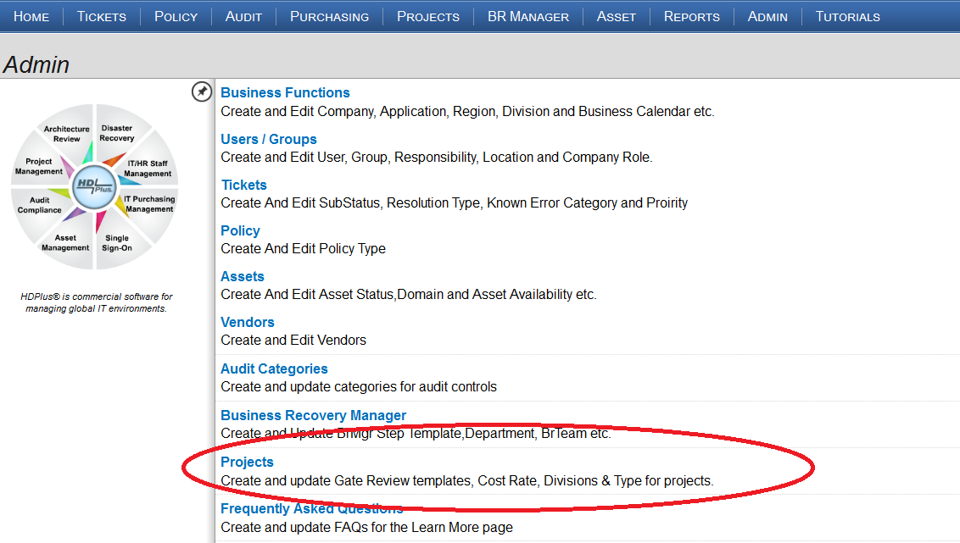
Gate Reviews and related project task (located in the admin section)

Slide 6
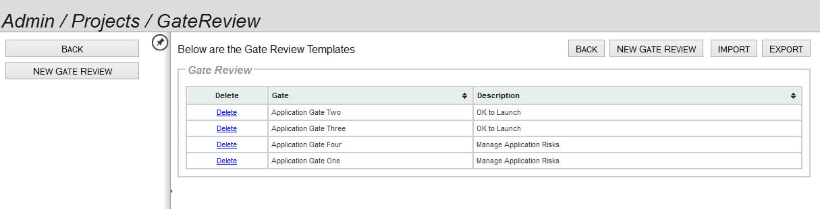
Multiple gate review templates can be created
Throughout all HDPlus modules, your data is not trapped. Full import and export capabilities are always available.

Slide 7
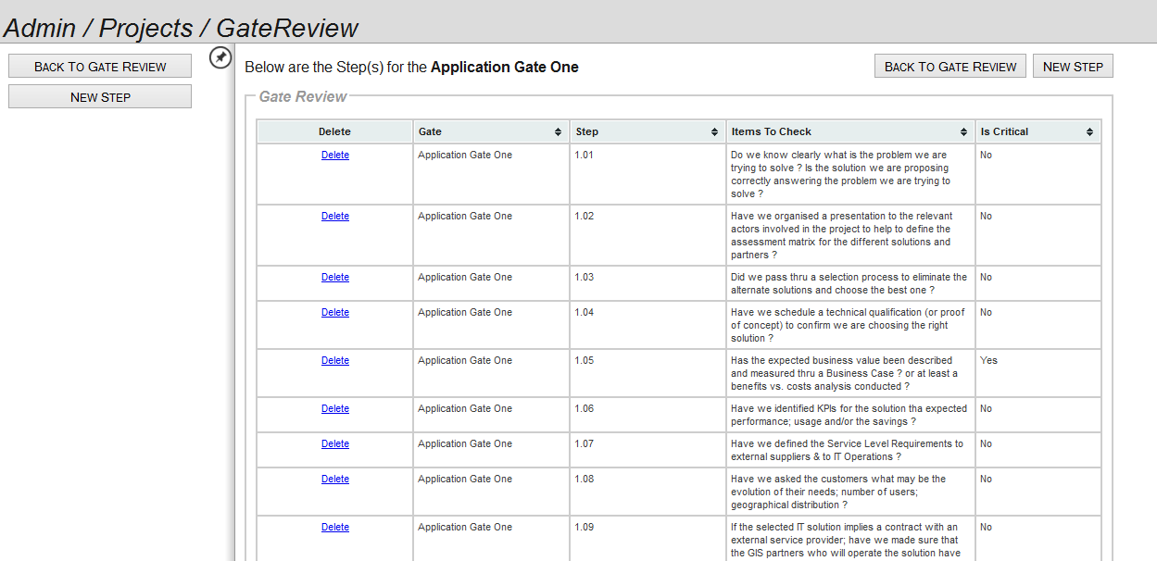
Gate Review Template (admin section)
If a particular gate is marked as a critical step fails a gate review, the issue must be resolved to continue.

Slide 8
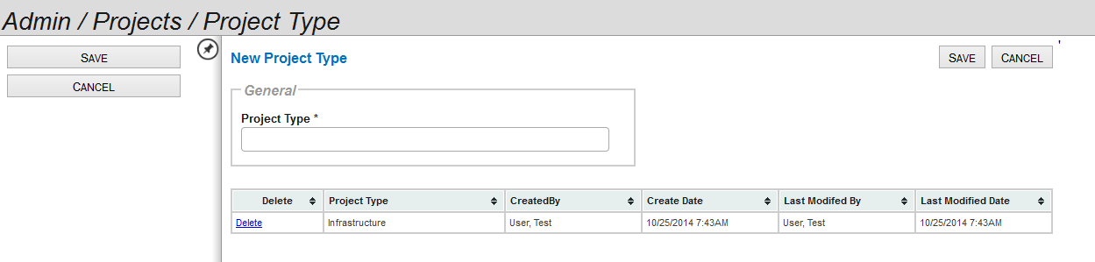
Project types can be defined and tracked

Slide 9
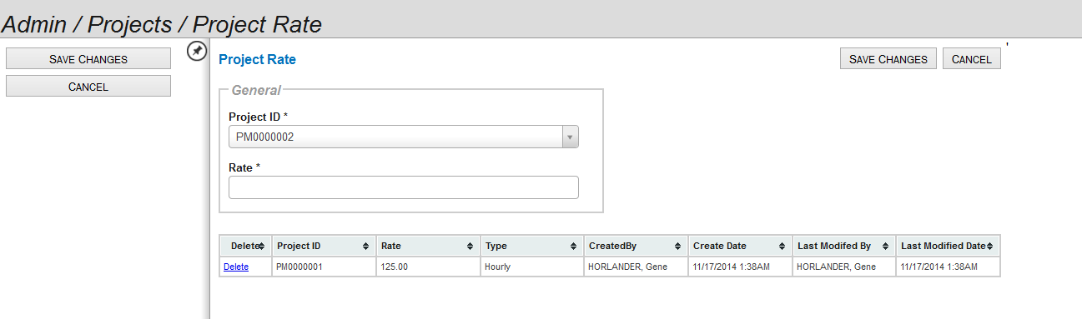
Project rates can be defined, globally or by project

Slide 10
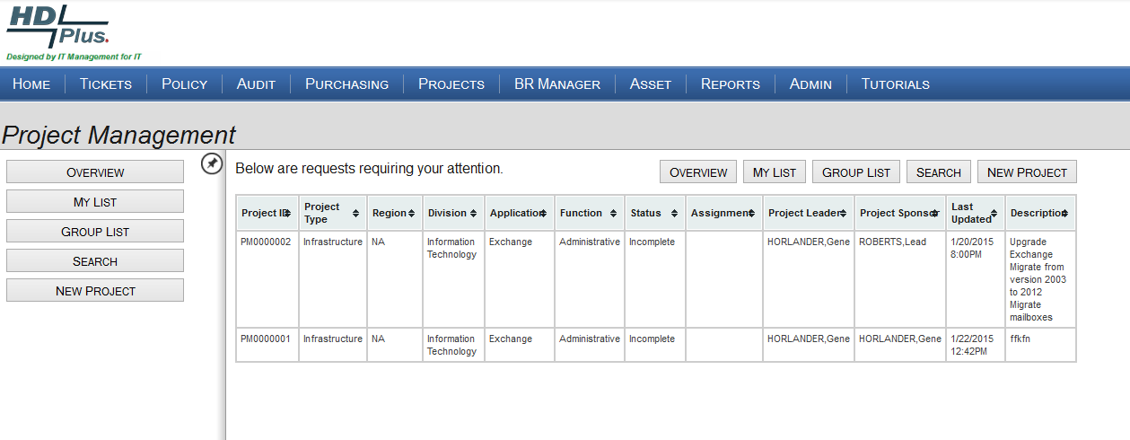
If you are assigned to a project, it will appear in your “My List” screen.
Select project PM000002

Slide 11
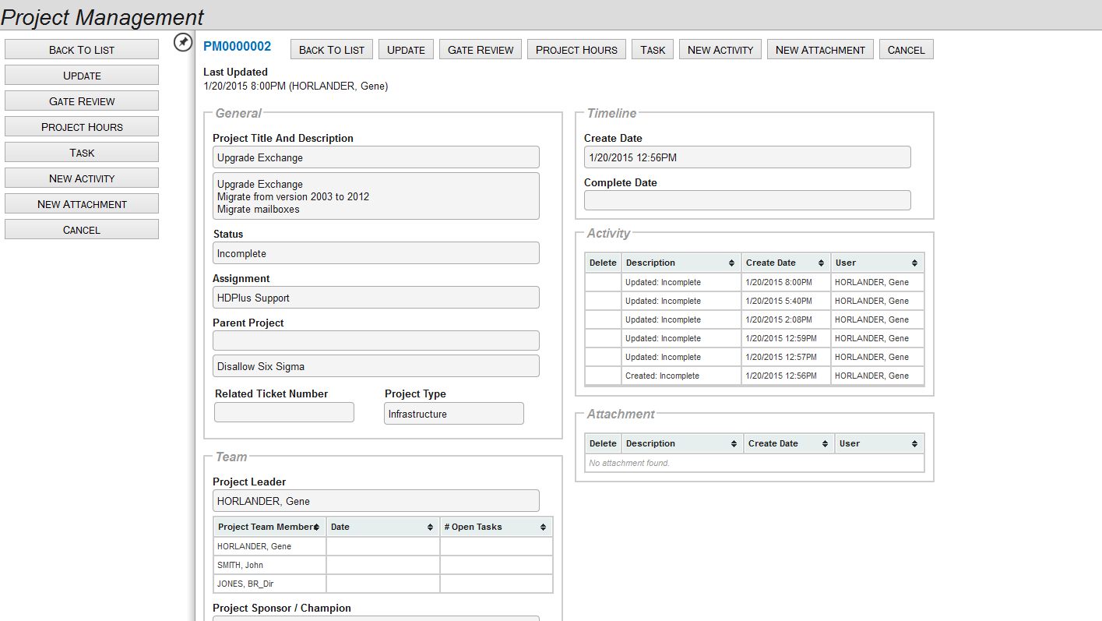
Project home screen
Update gate reviews, enter hours, add tasks

Slide 12
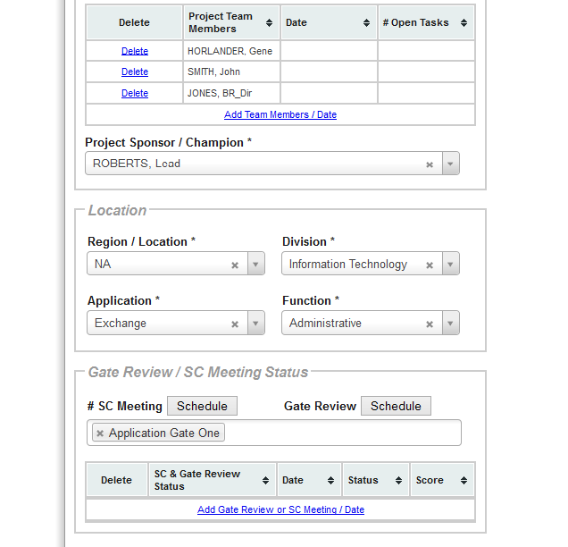
To schedule a gate review
First, select a gate review from the template library. Second, click on schedule gate review.

Slide 13
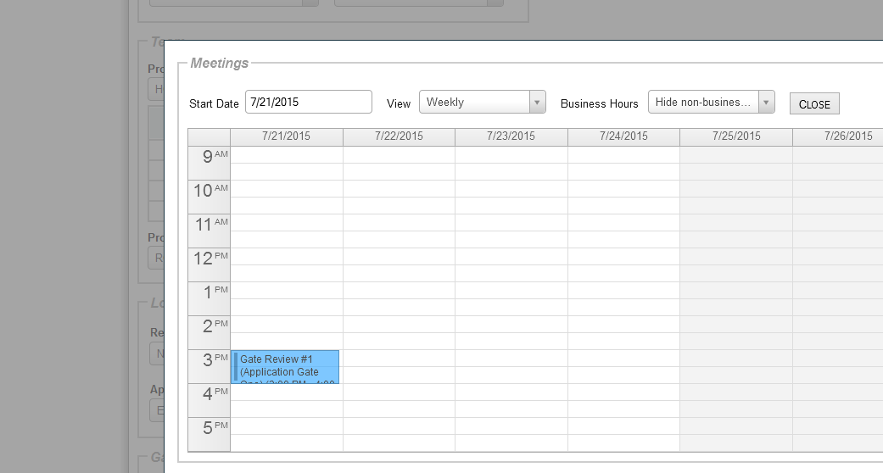
Calendar updates
In this example, Gate Review One was scheduled and automatically sent an update to the attendees via their Outlook calendar.

Slide 14
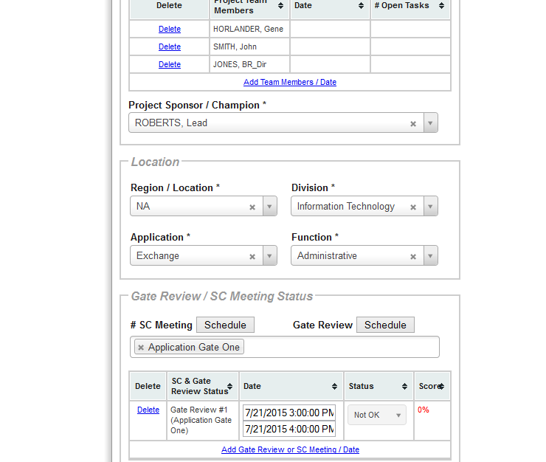
Gate One is scheduled
Gate one review is scheduled, current status is “Not OK;” which means that at this point no steps in the gate review have been reviewed, also note the percentage completion is, as expected, zero.

Slide 15
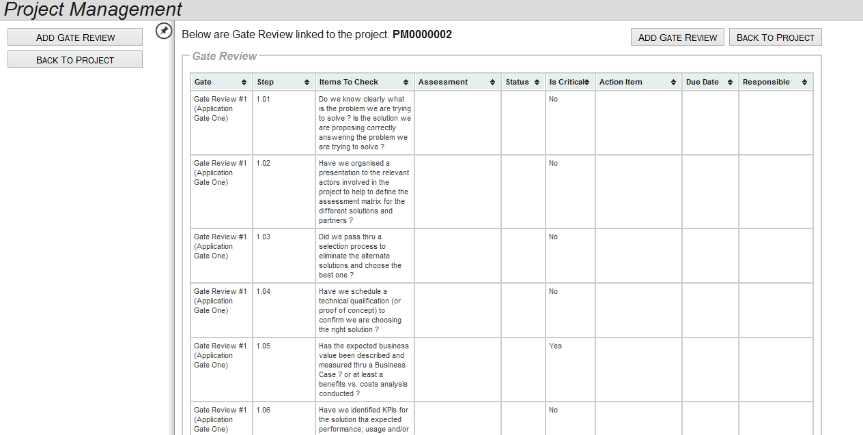
After selecting “Gate Review” from the menu the gate review starts by displaying detail steps.
Typically gate reviews are a special meetings led by the project manager with project members attending.
Project PM0000002, Gate Review One, first step is 1.01

Slide 16
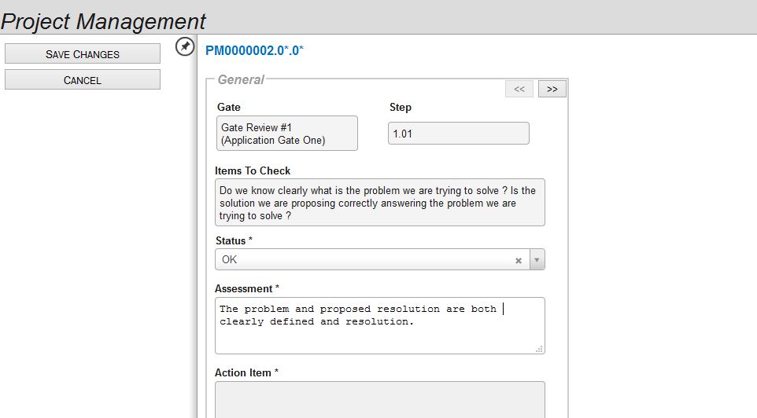
Step 1.01 is displayed
During the review, the team determined that the status for step 1.01 is OK, and updated the screen. Notice that if a step is OK, the action item area is grayed out; since no action is required. We can move to the next step by clicking the right arrow.

Slide 17
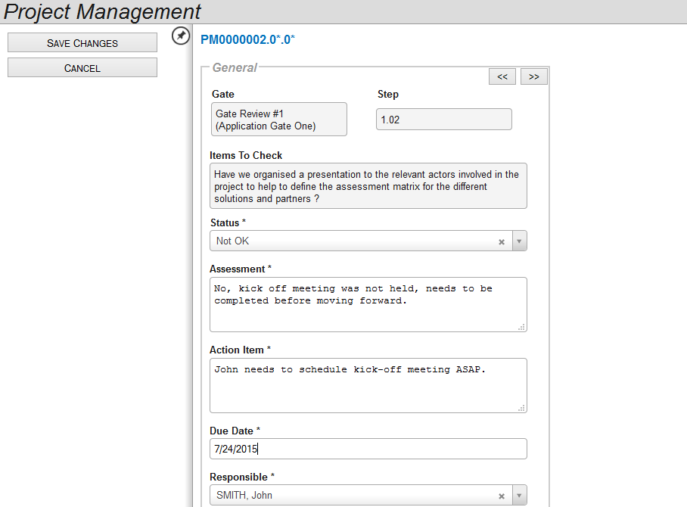
Step 1.02 is displayed
Status for step 1.02 was Not OK, and as a result an action item is assigned to a project team member, in this case John Smith.

Slide 18
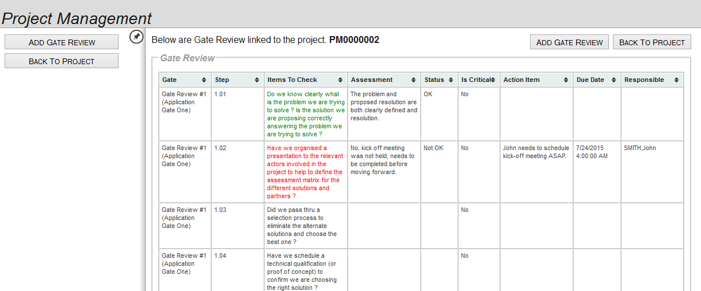
Fate Review Summary Screen
Status for step 1.02 is Not OK, notice red; however step 1.01 was OK and is green.

Slide 19
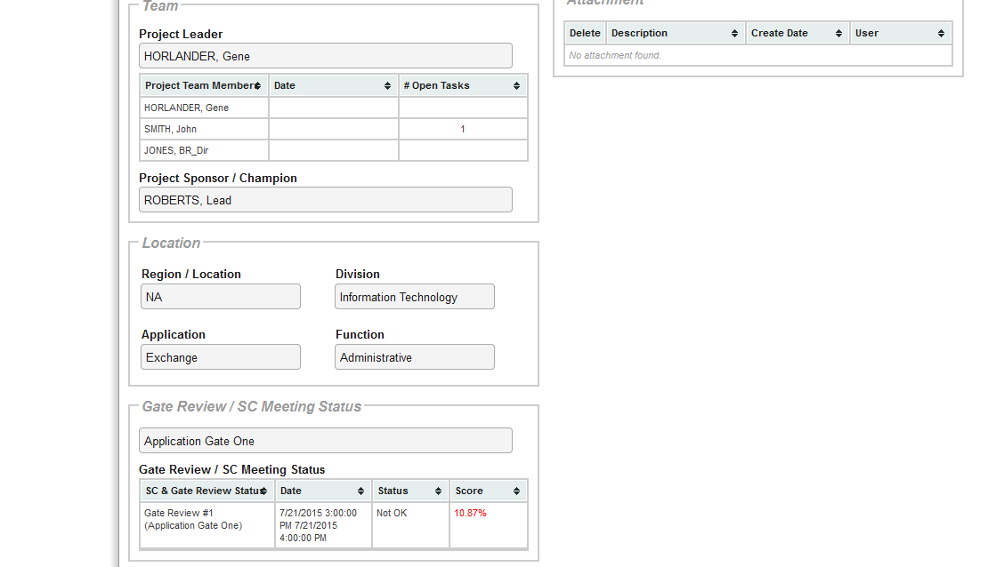
Project Status
At this point John Smith has an action item, also note overall gate review status is Not OK, and gate review progress is only 10.87% complete.

Slide 20
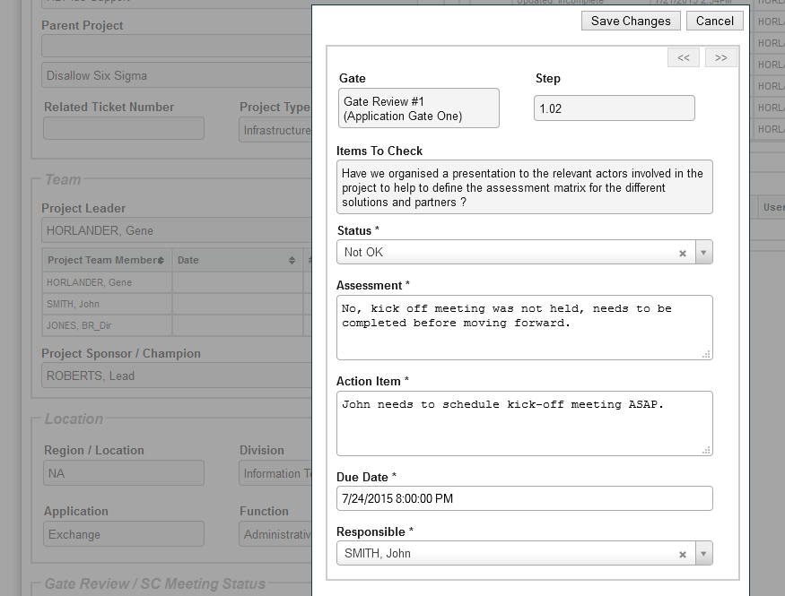
John’s action item
John will receive an automated email notifying him of the action item.

Slide 21
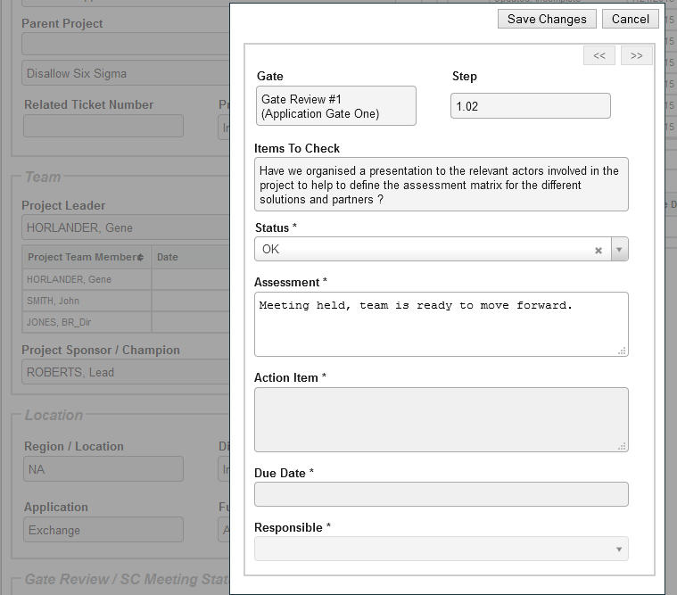
John updated action item
John logged in, selected the project from his “My List” of projects, and updated his action item. This step automatically updated the project step status, and notifies project manager the task has been completed.

Slide 22
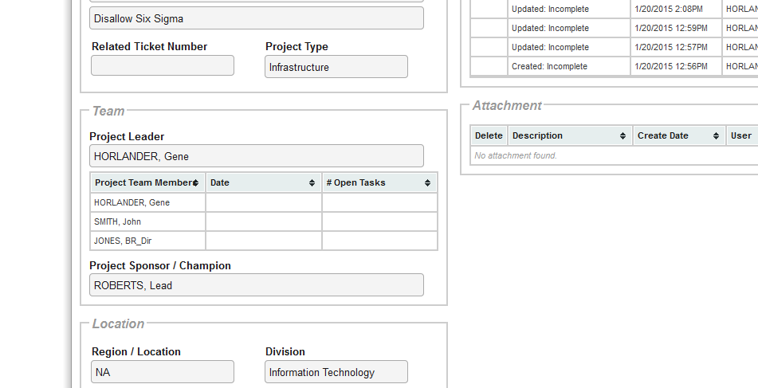
The project manager logs in and sees that John’s action item has been removed.
Action item was completed and closed.

Slide 23
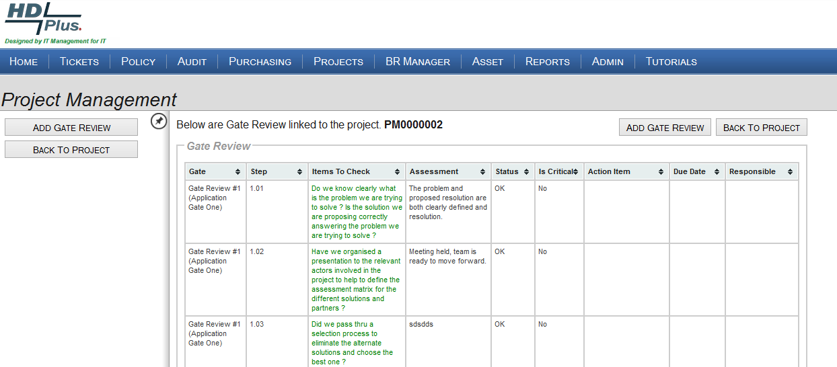
Project Gate review summary has been updated
Step 1.02 is now OK.

