Slide 1
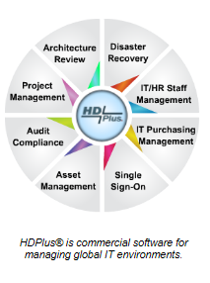
HDPlus
Asset Management
                HDPlus, Inc.
                Landline: +01 888 277-8216
                Fax +01 888 277-8235
                Cellphone: +01 317 331-3038
                Email: ghorlander@hdplus4it.com
                www.hdplus4it.com

Slide 2
HDPlus Asset Management Module
The Asset Management modules tracks all aspects of hardware and software assets including:
  Description, asset ID, physical location, serial number, IP address, and MAC address.
Asset Value and Support relationships:
  Date installed, purchase price, current value, depreciation schedule, lease information, and maintenance information.
Asset Status:
  Who is responsible for support, last activity, last backup, last patch, last image, and current version.
Asset Recovery:
  Work instructions to recovery the asset, up-stream and down-stream assets impacted, attachments documenting configuration, design details, and special procedures.
Vendor and Contract details:
  Lease or maintenance vendor contact information, when placed in service, copy of contract, and reminders when renewal is due or lease is expiring.
Ad Hoc reporting and a powerful search engine included, mobile and desktop ready.
Your data is not trapped in HDPlus, extensive support of import and export capabilities.

Slide 3
Slide Deck
The next group of slides are sample screen shots designed to show a brief glimpse of some of the features of HDPlus. Please note this is not intended as a full demo of the solution, and is best viewed in presentation mode.
The enclosed slides are of the desktop version, all browsers are supported, and all functionality fully supported on mobile devices: iPhone, iPad, Android, and Windows phone.
FYI – HDPlus was originally developed as an iPhone application.
Thank you for your interest in HDPlus.

Slide 4
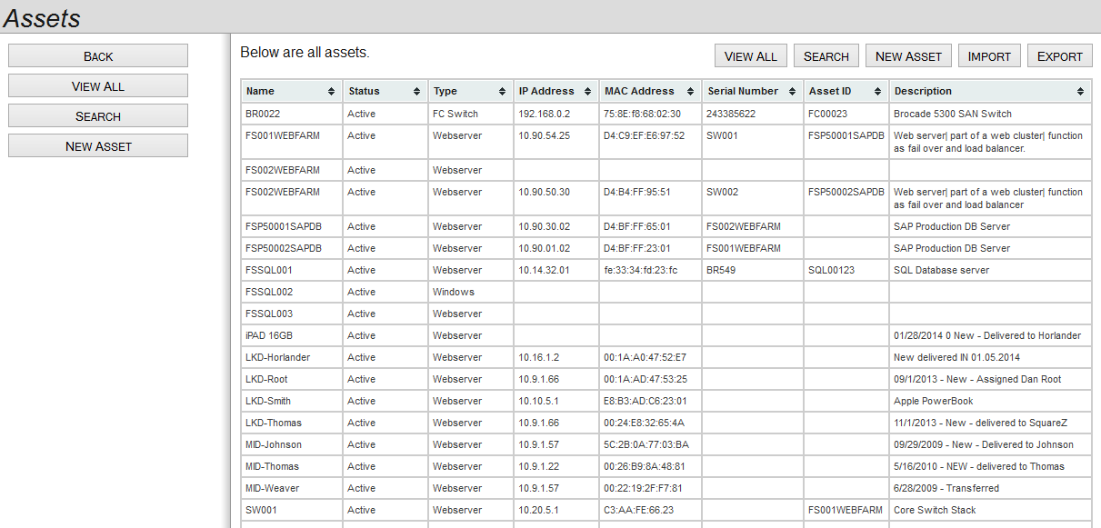
Data is not trapped in HDPlus, throughout the system, Import and Export capability is built-in

Slide 5
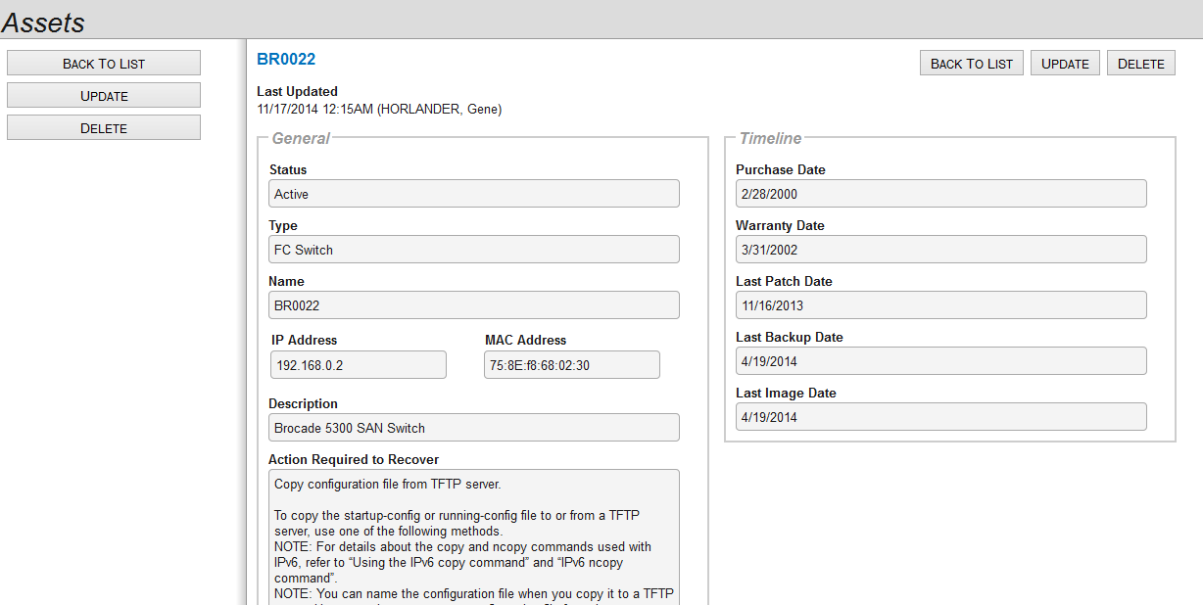
Asset status, type, name, IP, Mac address, and description
Extensive tracking of asset activities, from purchase date used to calculate depreciation to Last Image Date, provides an improved day-to-day asset management capability.

Slide 6
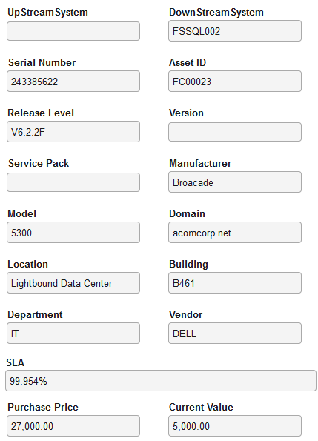
Up Stream and Down Stream impact, used to assess impact of a change control, disaster recovery, and/or workflow management
Key support info: s/n, release level, location, and SLA
Purchase tacking and depreciation.

Slide 7
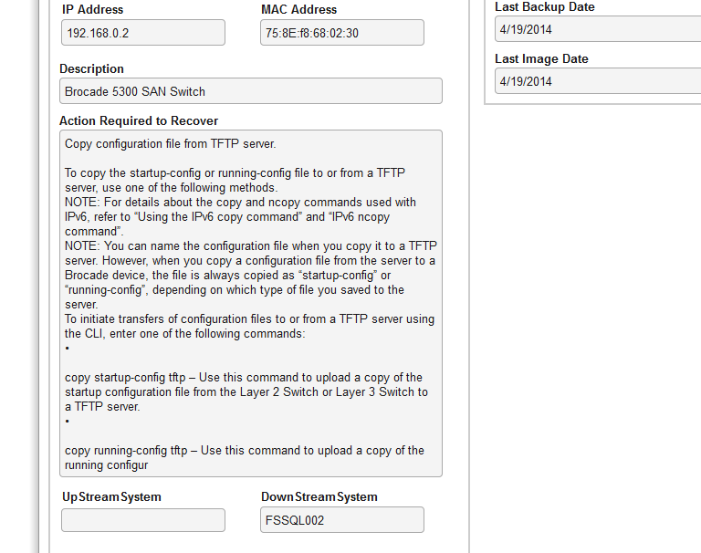
Action Required to Recover a device provides detail description for this asset, used in disaster recovery and also in workflow management.

Slide 8
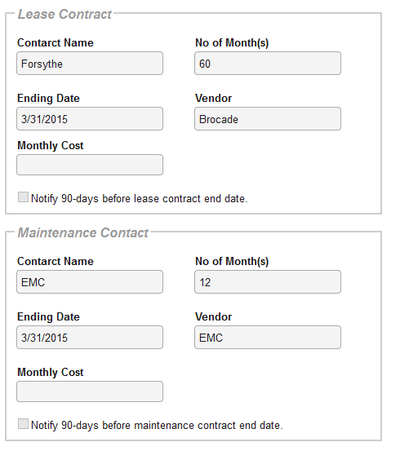
The same capability is available for leasing.
Turn on reminder, enables HDPlus to generate a reminder when contract is ending.

Slide 9
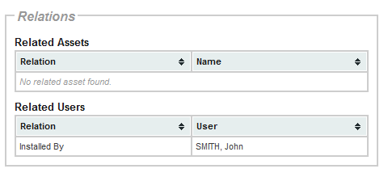
Relationship tracking identifies who is assigned to support this asset, and historical tracking of activities related to the asset.

