Slide 1
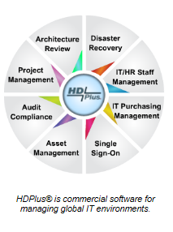
BRMGR
Recovery Management
                HDPlus, Inc.
                Landline: +01 888 277-8216
                Fax +01 888 277-8235
                Cellphone: +01 317 331-3038
                Email: ghorlander@hdplus4it.com
                www.hdplus4it.com

Slide 2
Automated DR planning with BrMGR
The BRMGR (Business Recovery Manager) module is facilitated by automation built into the system. When the design process is completed your organization will have a fully documented plan including task ownership, staff dispatching, all properly sequenced, resulting in a viable disaster recovery and/or business continuity strategy. BRMGR doesn’t stop there, the plan is continuously monitored to ensure it remains current and viable.
BRMGR is a combined planning and implementation tool providing ultimate flexibility and protection for the entire company. While not all businesses will need the full capability of BR planning, most require some level of risk mitigation; BRMGR provides this level of protection for a single application, a complete department, or the entire company!
BRMGR is a tool designed to reduce risk and to help the business be prepared for the potential of a devastating disaster which could result in a costly outage or significant financial damage to your company.
BRMGR is designed to work with popular Helpdesk management tools or it can operate independently.

Slide 3
A disaster could potentially shut you down!
“Forty percent of businesses do not reopen after a disaster and another 25 percent fail within one year according to the Federal Emergency Management Agency (FEMA). Similar statistics from the United States Small Business Administration indicate that over 90 percent of businesses fail within two years after being struck by a disaster.” (http://www.sba.gov/content/disaster-planning)
“According to the Institute for Business and Home Safety, an estimated 25 percent of businesses do not reopen following a major disaster. You can protect your business by identifying the risks associated with natural and man-made disasters, and by creating a plan for action should a disaster strike (http://www.chamber101.com/2programs_committee/natural_disasters/disasterpreparedness/Forty.htm

Slide 4
BRMGR can support multiple DR teams simultaneously, providing a coordinated, well controlled recovery.
A disaster strikes, and IT staff are hurriedly dispatched to the computer room or data center to get key systems back on line. Without a plan, or a coordinated and tested approach, the probability is high that the company will suffer significant damage.
People under stress attempting to recovery complex systems is a receipt for another disaster.
BRMGR will begin dispatching emails and text messages to designated staff of what to do, when to do it, and in what order, with validated “pre-tested” instructions and documentation to their mobile devices. As sequenced steps are executed, BRMGR tracks and updates the executive dashboard keeping management and key staff fully updated on status. The multiple streams of communications keep the process under control, teams are not working in silos, the recovery is coordinated, and normal operations returned as quickly and efficiently as possible.

Slide 5
BRMGR also keeps your recovery plans - Ready.
The BRMGR dashboard is a critical component of the BRMGR. Communication and alerting are paramount to surviving a devastating disaster. The execution and communications during such an event are important processes that help maintain clear objectives for your business. Moreover, knowing how “BR Ready” the company is at all times, especially under Sarbanes Oxley guidelines, is not only advised, but may be a legal requirement.
BRMGR not only helps build and test the recovery plans, but keeps them current and ready.
When a plan moves to execution status, it is not put on a shelf, but continues to be monitored by BRMGR validating staff assignments and assets. Links to HR systems and asset management are monitored for changes and continuously compared to the plan. Should changes in staff or assets assigned to a recovery plan change status an alert is generated by BRMGR to key management and may escalate to executive management if action is not taken to ensure the plan effectiveness has not been compromised.

Slide 6
BRMGR demo
The next group of slides will take a typical recovery situation from beginning to end.
  The automation templates are shown
  How to build a plan
  Test it
  Move a tested plan to execution status
Notes are added to help explain each step and “fly-in” to the slide at appropriate times, therefore viewing this document in presentation mode is recommend.

Slide 7
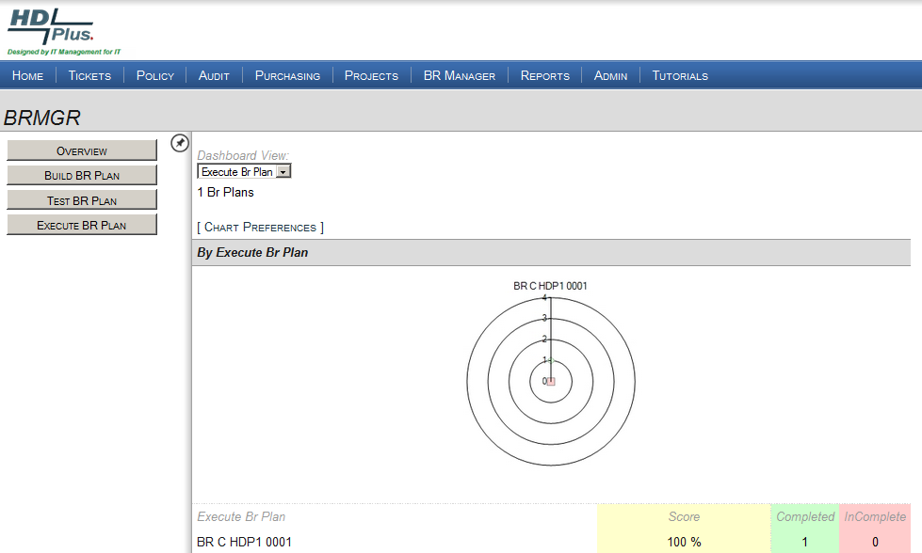
BRMGR – Recovery Management by HDPlus

Slide 8
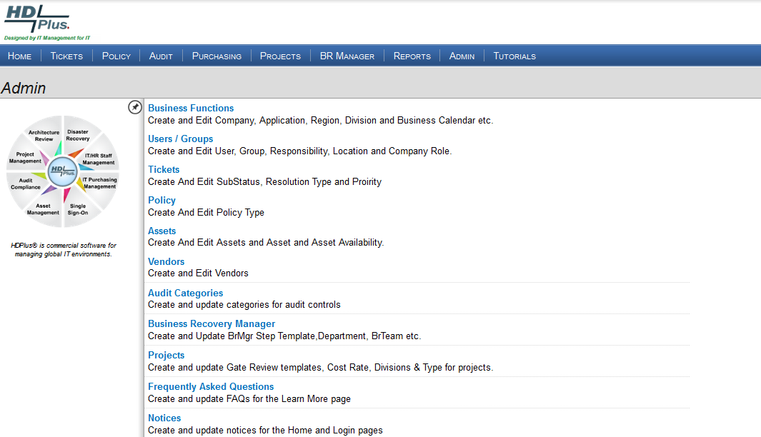
BRMGR administrative functions

Slide 9
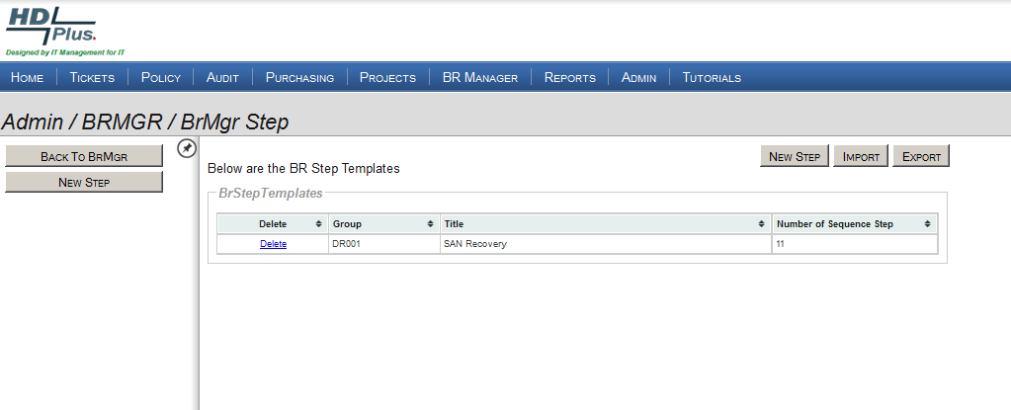
In the Admin section of HDPlus is a repository for recovery plan templates
All plans and templates can be imported or exported.
Example recovery template
for this demo

Slide 10
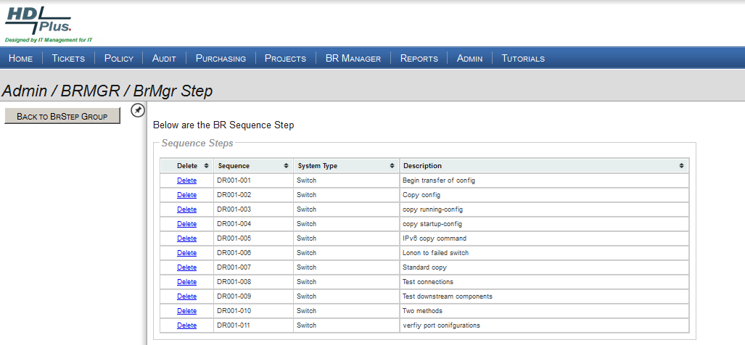
By expanding the sample SAN switch recovery plan you can view each of eleven steps.
Steps can be added, modified, or deleted
as needed.
Double click to view
the contents.

Slide 11
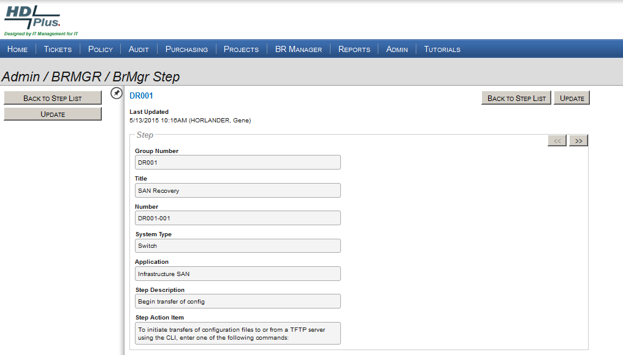
Detailed view of Step 001
Left or right arrows
are used to view
steps in the plan.

Slide 12
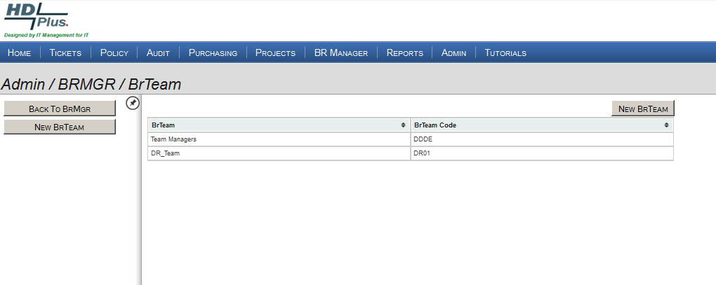
Additional functions in the Admin section of HDPlus include creating DR and/or BC Teams

Slide 13
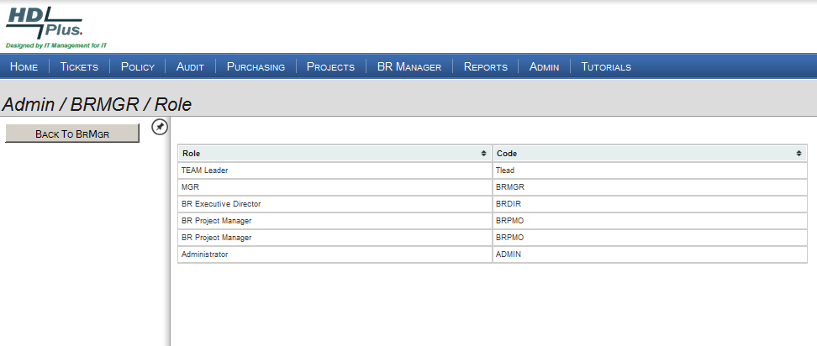
… and creating roles related to recovery management assignments
In BRMGR, only the
BR Executive Director role or backup has the authority to execute a disaster.

Slide 14
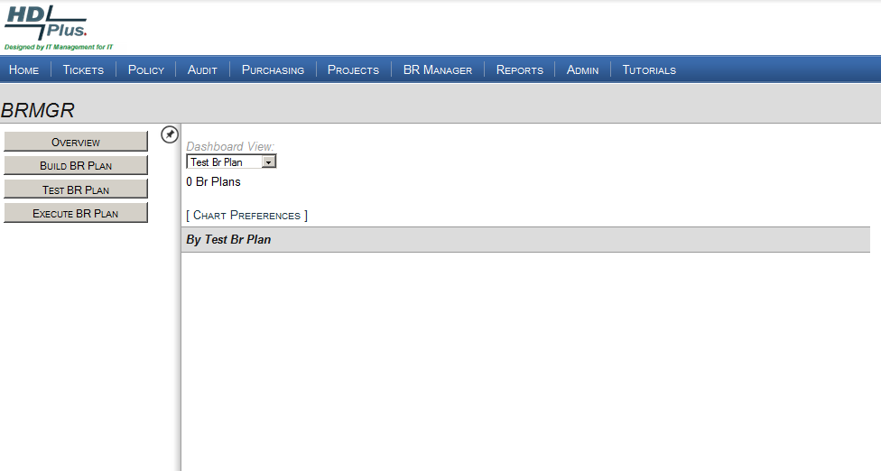
There are three steps of Disaster Recovery plan creation: Build, Test, and Execute

Slide 15
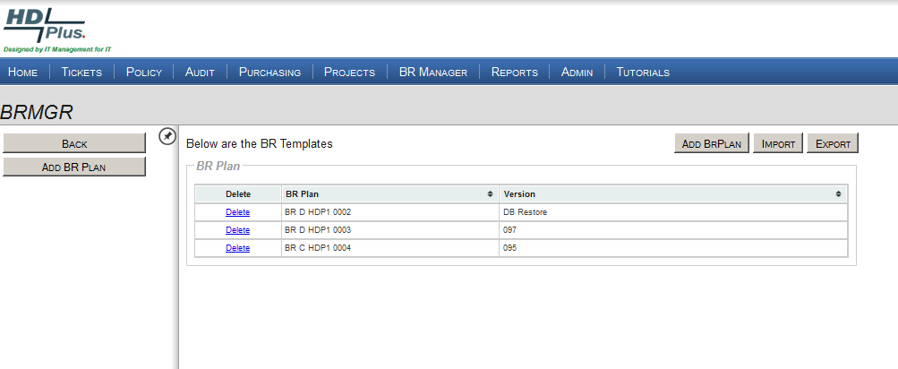
Step One: Build a new plan
Build a plan from scratch.
..or Import a
previously built plan.

Slide 16
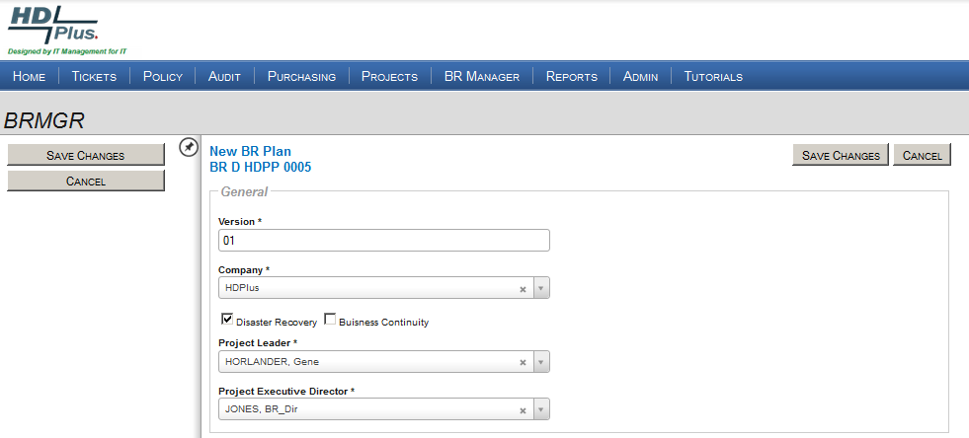
HDPlus identifies the Project Leader and Executive Director assigned to the new DR plan
The plan number is comprised of:
The plan identifier: D for Disaster Recovery,
C for Business Continuity, or B for “Both”
2) HDPP is the company identifier,
In this example, 0005 identifies the fifth plan created.
4) HDPlus can support multiple plans and
multiple companies.

Slide 17
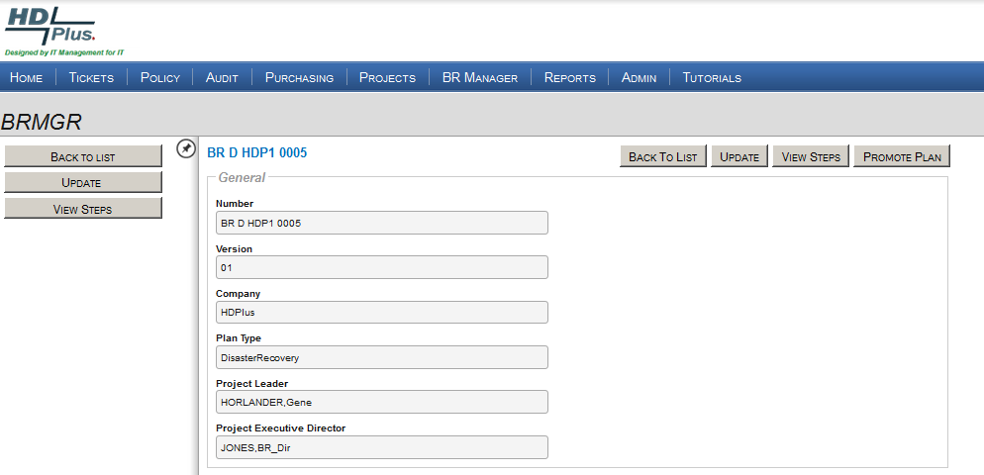
Next step, create the sequential steps of the plan

Slide 18
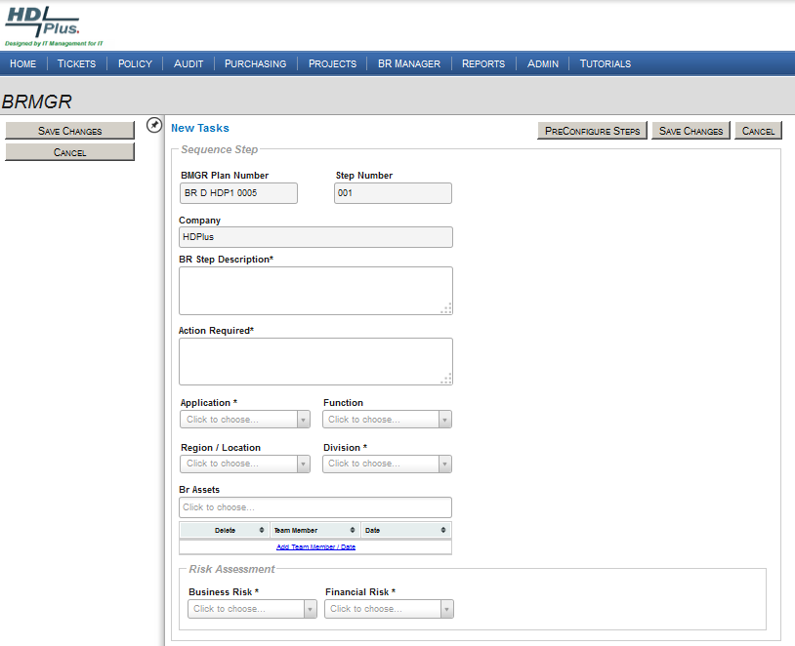
Each step in the plan is fully documented and numbered.
A DR plan can be categorized by Application, Function, Region/location,
Division, or by Asset.
As noted, the recovery task is assigned to the correct individual
…risk assessment denoted

Slide 19
Pre-configured Plans/Steps
In this example, the Pre-Configured Steps are selected

Slide 20
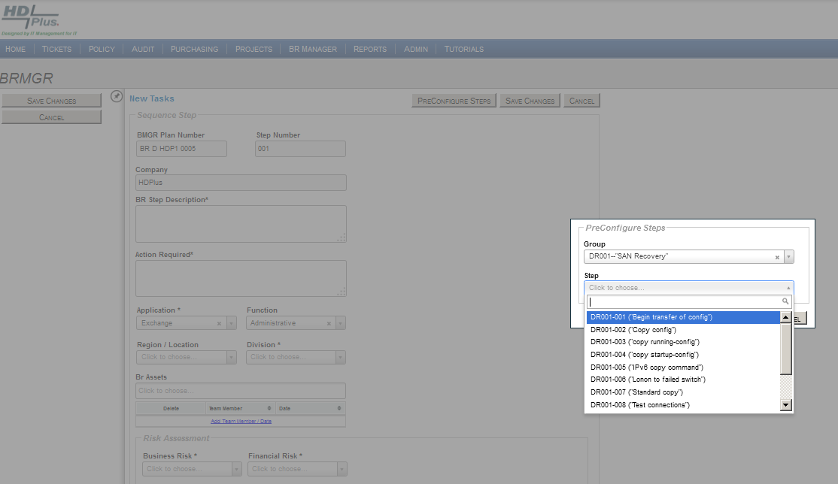
…next choose desired plan from templates
The pop-up displays existing
templates.
Select a group and an individual
step, or allow the default to
import all steps in the selected group.

Slide 21
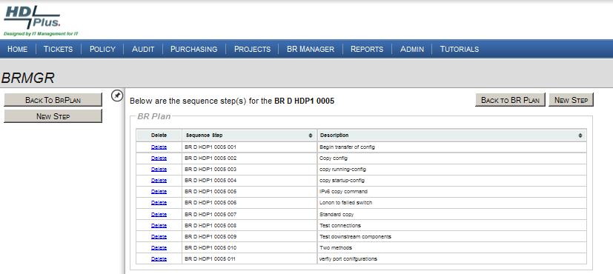
The DR template and all pre-configured steps are then imported into the current DR plan.
Steps can also be imported individually

Slide 22
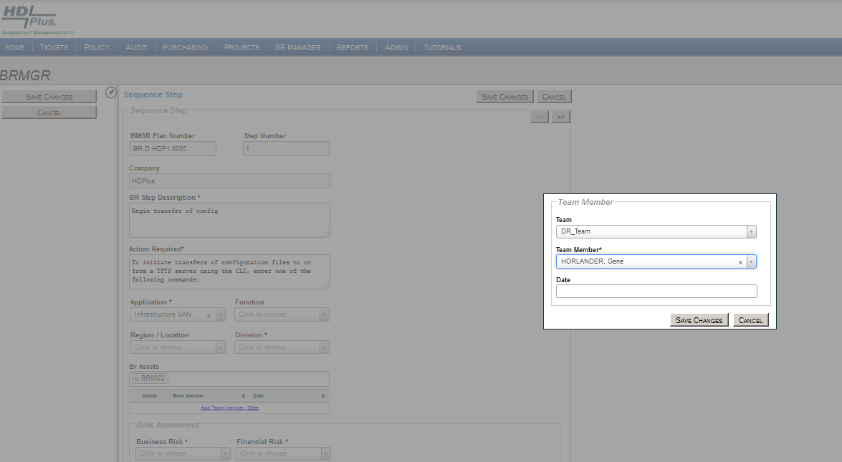
Technical resources are assigned to each step.
Technical resources are tracked in the HDPlus staff management module including multiple methods of contacting the resource, who the backup individual is, the individual’s manager, and level of technical responsibility.

Slide 23
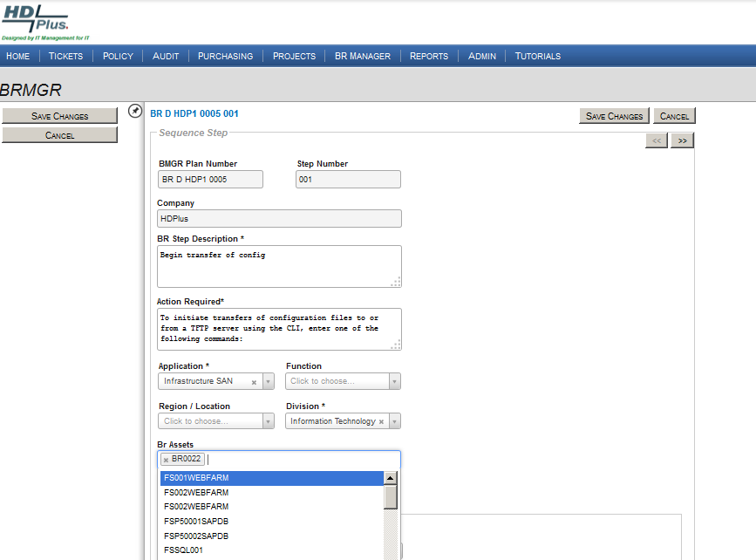
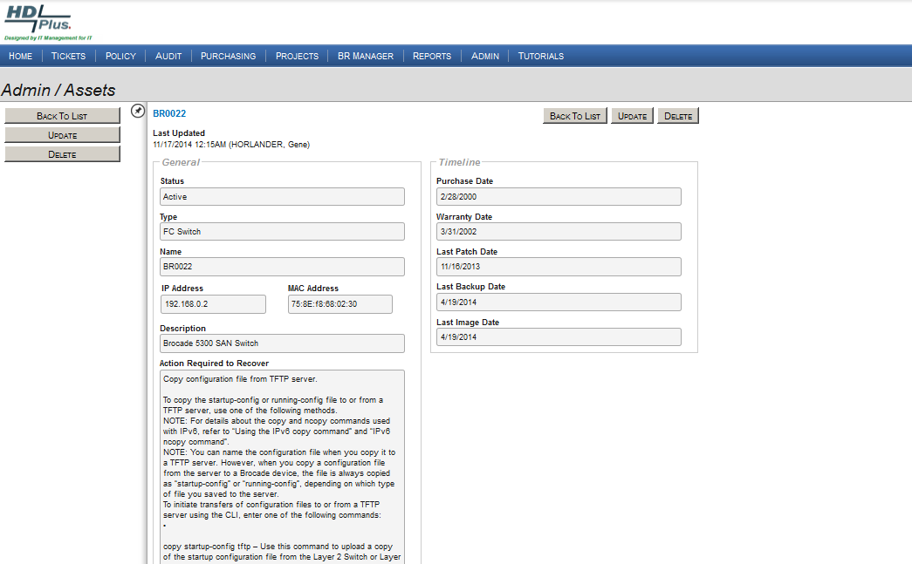
Assets are assigned to the DR plan from the Asset Management module (right side).
HDPlus Asset module tracks key asset information including: IP address, MAC address, application(s) supported, upstream and downstream assets/applications, maintenance contracts, vendors, and reminders when a contract is due.
… service packs, last patch date, patch level, last backup, vendor, OS, etc.

Slide 24
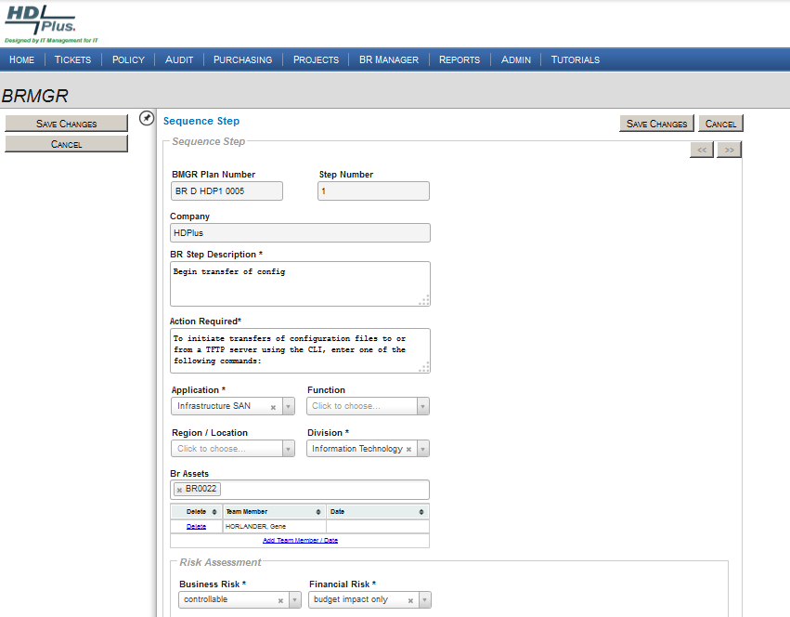
Each step provides the following: instructions, asset identification, and designated individual.

Slide 25
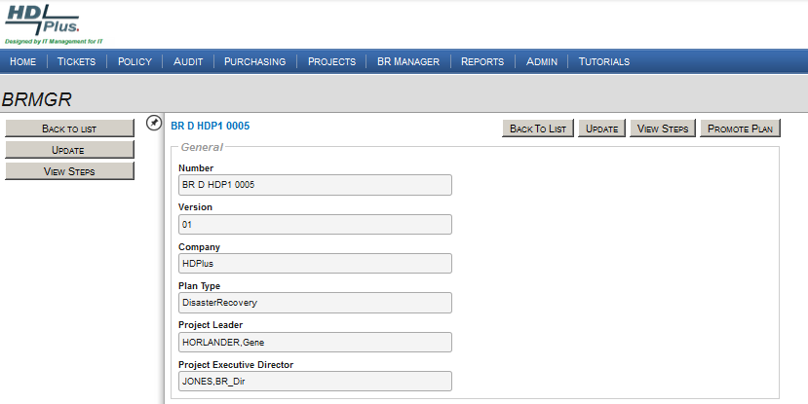
When a plan is completely documented, the plan is escalated to the “test” process.

Slide 26
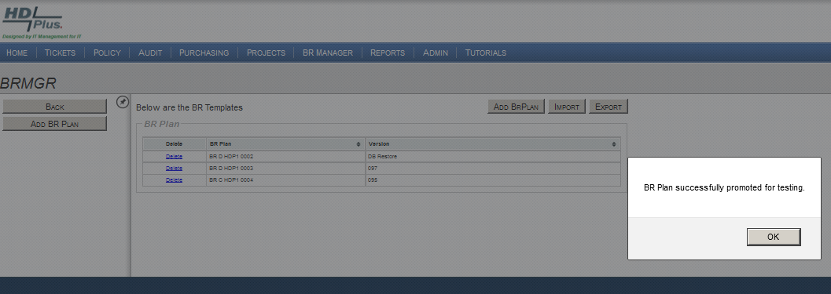
The BR plan is promoted

Slide 27
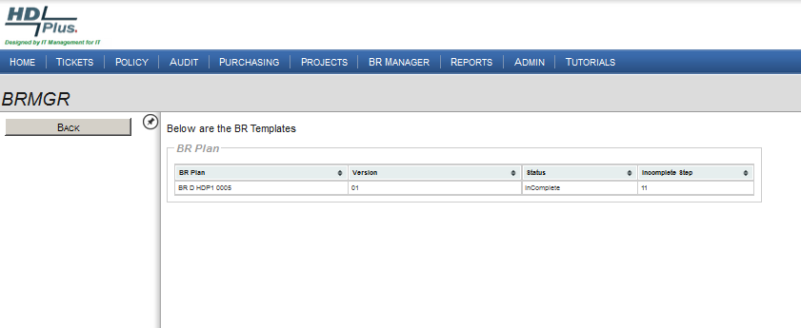
This example denotes eleven sequenced DR Plan steps to recover this device.

Slide 28
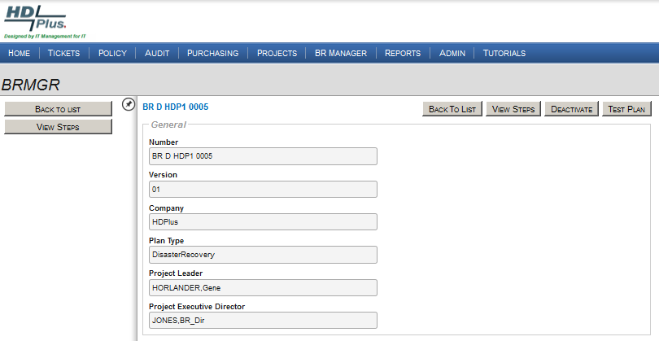
Test can be conducted on the entire plan or for individual steps only

Slide 29
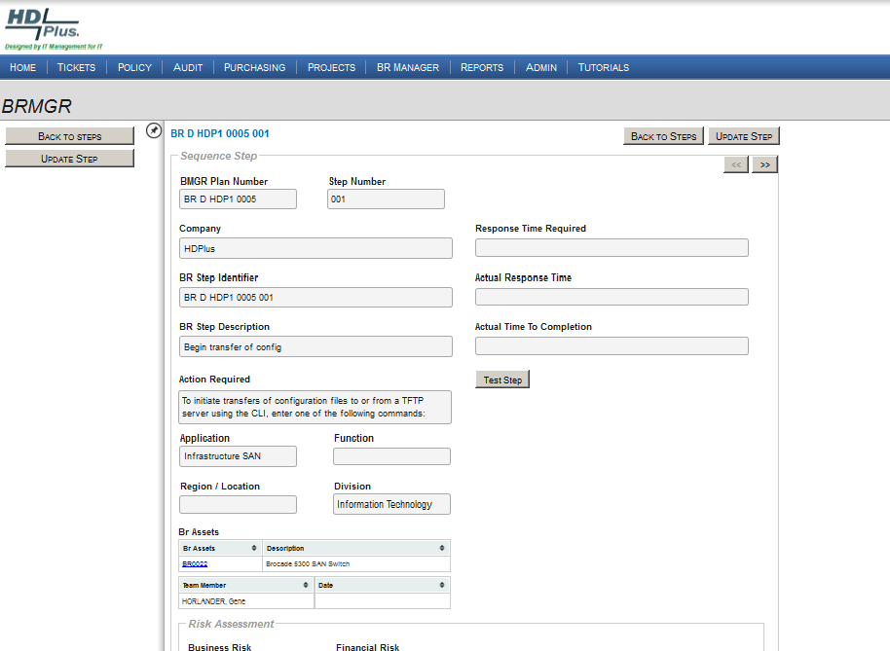
In this demo an individual step will be tested.

Slide 30
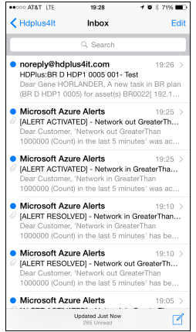
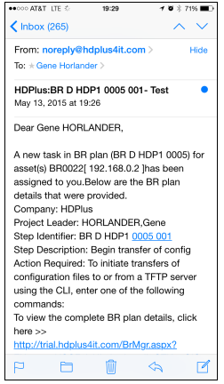
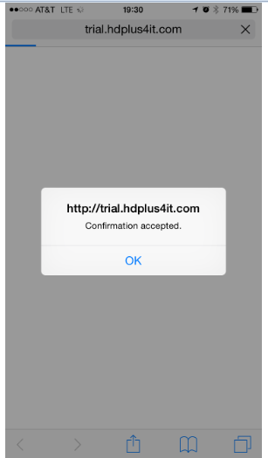
BRMGR “testing” sent an email to the assigned technician, the sequence is shown below (iPhone).
Technician responded to the instructions,
Technician received
email or text message
or both depending on option settings.
… and BRMGR responded
… by clicking link embedded in the email – note date and time.

Slide 31
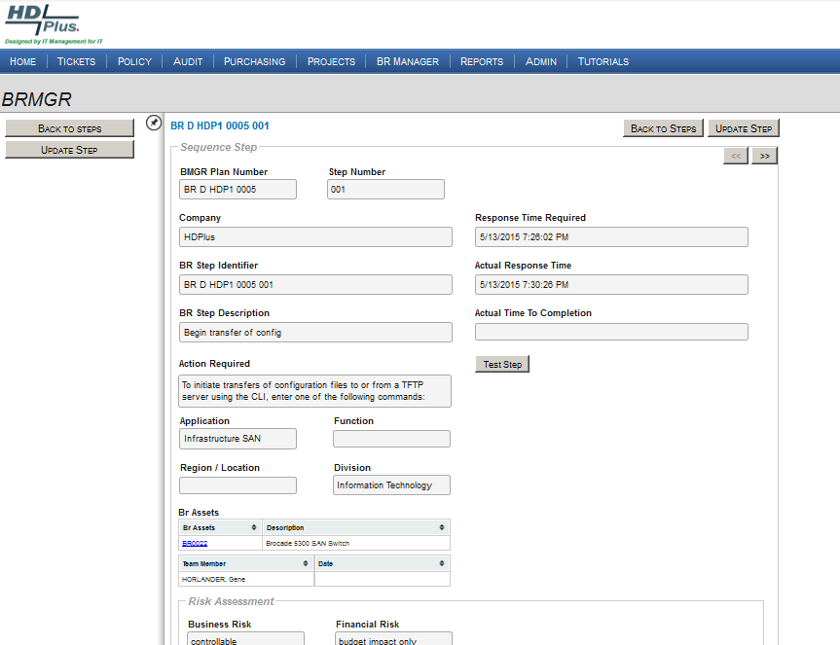
Response received from technician
Note data and time recorded in BRMGR from technician’s email response shown in previous slide.

Slide 32

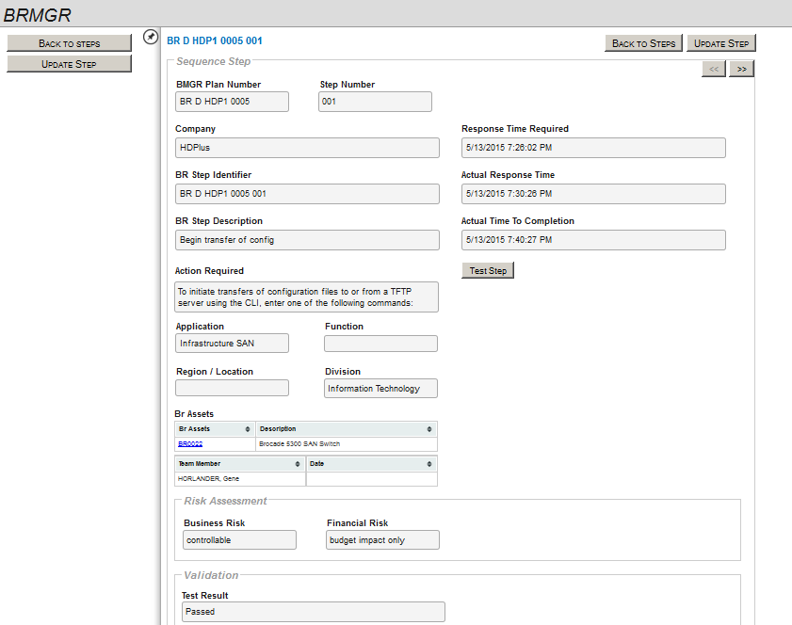
This sequence step has passed testing

Slide 33
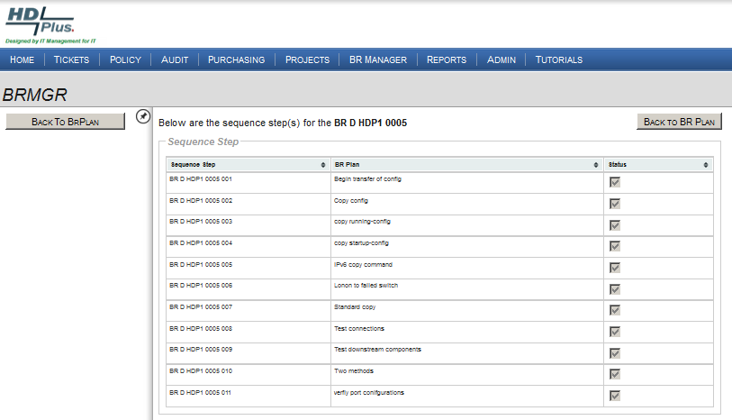
Testing continues until all steps have passed
Completed

Slide 34
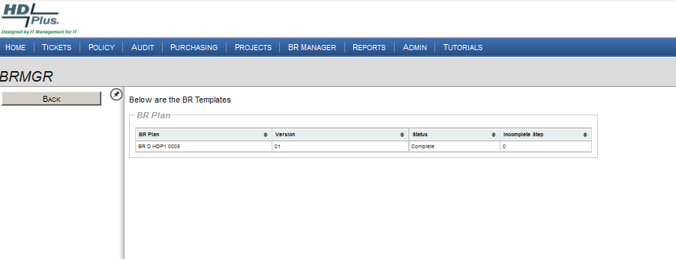
The DR Plan passed testing

Slide 35
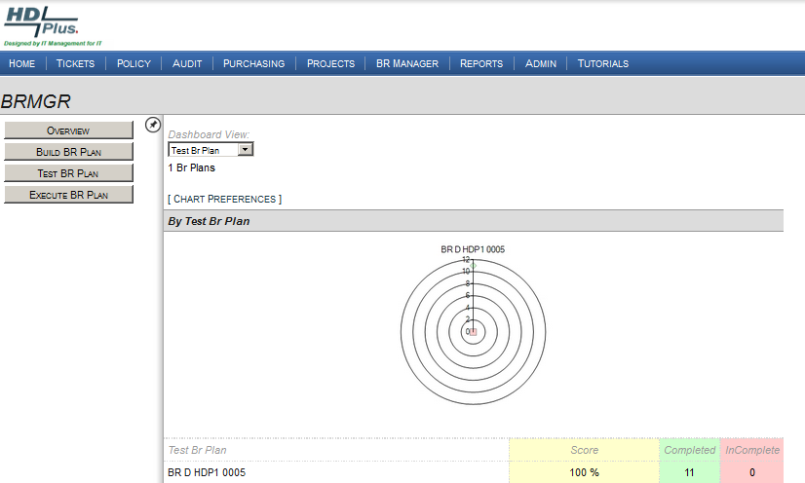
BR D HDP1 0005 is ready for promotion to production

Slide 36
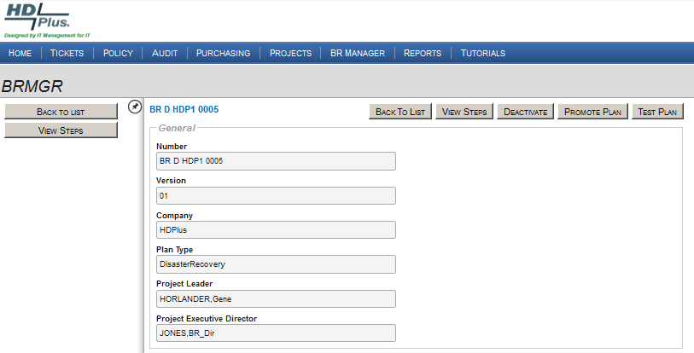
DR Plan can be promoted by the DR Executive Director only

Slide 37
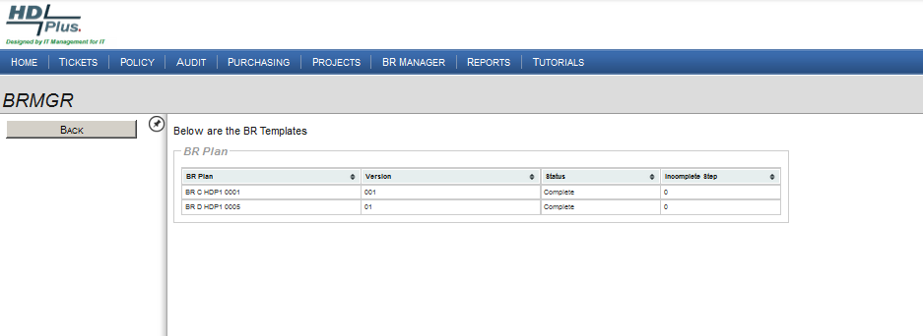
Status of completed plans, shows
BR D HDP1 0005 as Ready

Slide 38
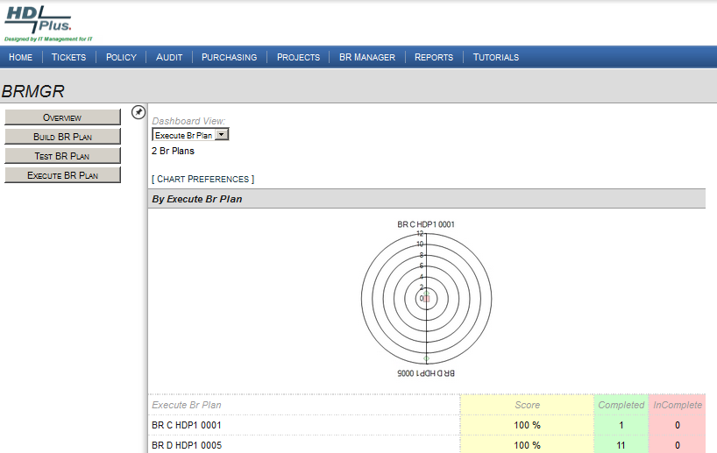
KPI view of completed plans

Slide 39
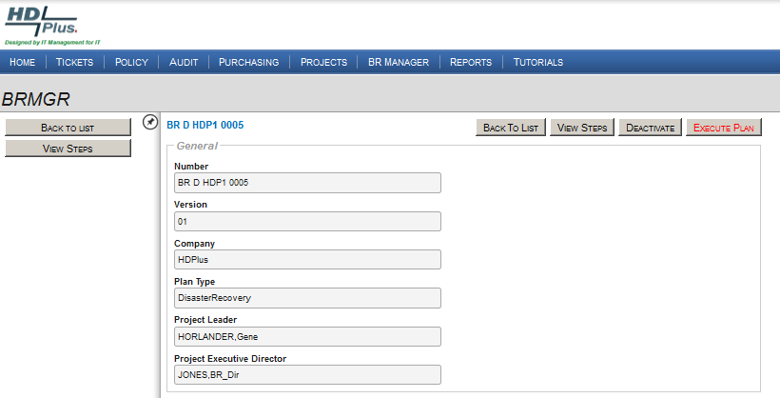
The execution of a DR plan requires an Executive Director level approval

Slide 40
Summary
BRMGR will guide teams through the process of building/developing a DR plan.
BRMGR can ease the workload by making use of pre-built DR templates
BRMGR manages the DR Plan communications, testing, and validation, ensuring all DR Plan team members understand their DR Plan responsibilities
At anytime during the build and test phases, should a step fail. HDPlus automatically generates a incident ticket and manages the ticket via traditional escalation and alerting until issue is resolved.
When a plan is complete, BRMGR continues to monitor the Readiness of the Plan.

Slide 41
Closing …
How DR Ready is your organization?
Please contact us for an on-line demo, or a free 90-day proof of concept.
Thank you!

Slide 42

                HDPlus, Inc.
                Landline: +01 888 277-8216
                Fax +01 888 277-8235
                Cellphone: +01 317 331-3038
                Email: ghorlander@hdplus4it.com
                www.hdplus4it.com

