Slide 1

Mental Privacy
Neuroethics
Notes:
Name the format: 30 minutes of framing, then 30 minutes that belong to the room. You're seeding a discussion, not lecturing. ~30 sec.

Slide 2
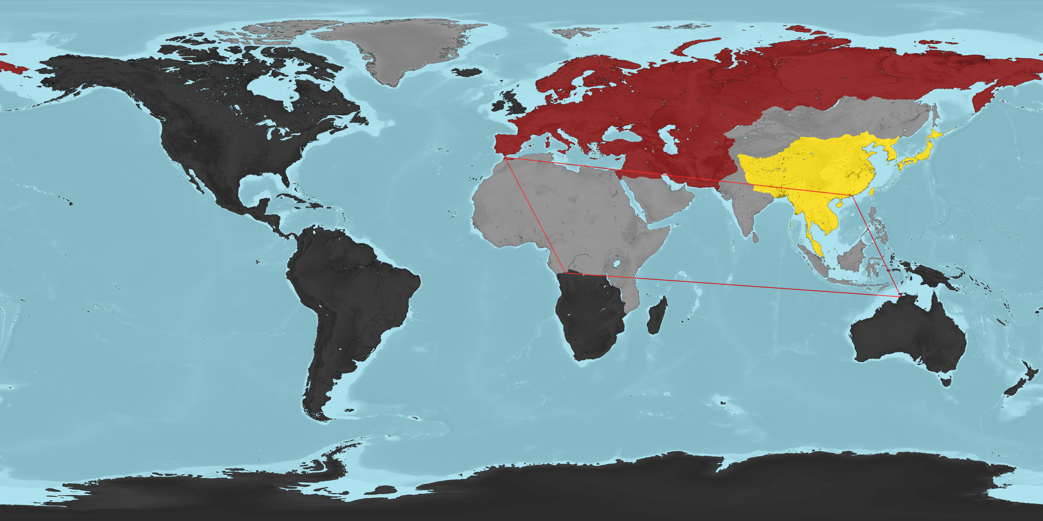

Slide 3


BEFORE ANY THEORY
Start with a scene
The workplace
The courtroom
Your employer issues an EEG headset that logs attention and stress through the day.
A neural lie-detector, marketed as near-infallible, is offered as evidence.
Mental Privacy · Neuroethics Colloquium
2
Notes:
Don't define anything yet — paint both scenes and let the discomfort land. Ask everyone to privately hold ONE reaction; you'll call it back in Cluster A. The gap between this gut feeling and the reality of the tech is the engine of the whole session. ~2 min.

Slide 4




DEFINITIONS
What do we mean by “mental privacy”?
Ienca & Andorno (2017) proposed protecting the mind as four linked rights.
Cognitive liberty
Mental privacy
The right to govern your own mental states.
Control over neural data and what others infer from it.
Mental integrity
Psychological continuity
Protection from unauthorized alteration of the mind.
Protection of your sense of identity over time.
Mental Privacy · Neuroethics Colloquium
3
Notes:
Shared vocabulary, fast — one line each. Mental privacy is only one of four linked rights; that matters when the discussion turns to whether privacy is even the right thing to protect. ~2 min.

Slide 5




THE STUDY AT THE CENTRE
Tang et al. (2023): a semantic decoder
Who
THE BASICS
Jerry Tang & Alex Huth, UT Austin. Nature Neuroscience, 2023.
An AI “semantic decoder” turned fMRI brain activity into a continuous stream of text while someone listened to or silently imagined a story.
How it’s new
Earlier non-invasive decoders got only single words from a fixed list.
This is the first time this worked non-invasively, with open vocabulary, and over long passages.
Why it matters
Aimed at restoring communication after stroke or ALS.
Mental Privacy · Neuroethics Colloquium
4
Notes:
Introduce the centrepiece. This single 2023 study is the spine of the talk. Hit the headline: fMRI brain activity turned into continuous text, non-invasively. Stress why it's a real leap — earlier non-invasive decoders managed only single words from a fixed list. Note the humane motivation (stroke, ALS) so it doesn't read as purely dystopian. ~2.5 min.

Slide 6
HOW THE DECODER WORKS
Reconstructing meaning, not words
1
2
3
4
TRAIN
›
MODEL
›
PROPOSE
›
MATCH
16 hours of podcasts, heard inside an fMRI scanner for each person.
An encoding model learns how meaning maps onto that brain’s response.
A GPT-style language model generates candidate word sequences.
Beam search keeps the candidate whose predicted brain response fits best.
fMRI is too slow to read words, so the decoder recovers the gist (the meaning), instead of a verbatim transcript.
Mental Privacy · Neuroethics Colloquium
5
Notes:
Walk the four-step pipeline slowly — this is where you earn credibility. Train on 16 hrs of fMRI; an encoding model learns the brain→meaning map; a GPT-style model proposes candidate sentences; beam search keeps whichever best predicts the measured brain response. Land the key idea: fMRI is too slow to read words, so it recovers the GIST, not a transcript. That single fact defuses half the hype. ~3 min.

Slide 7



WHAT IT COULD DECODE
It captured meaning across senses
HEARD
DECODED FROM BRAIN ACTIVITY
“I don’t have my driver’s license yet.”
›
“She has not even started to learn to drive yet.”
The wording is inaccurate, but the meaning is preserved. Roughly half the time the decoder tracked the intended meaning closely enough.
Perceived speech
Imagined speech
Silent video
Best fidelity is given when listening to a told story.
Meaning from a silently imagined story is decoded above chance.
Meaning of wordless films is described.
Mental Privacy · Neuroethics Colloquium
6
Notes:
The memorable slide. Read the example pair aloud: heard 'I don't have my driver's license yet' → decoded 'she has not even started to learn to drive yet.' Meaning kept, wording invented, ~half the time. Then the three modalities — flag the striking one: it described events from SILENT films. That proves it decodes meaning, not language. Imagined speech also worked above chance. ~3.5 min.

Slide 8
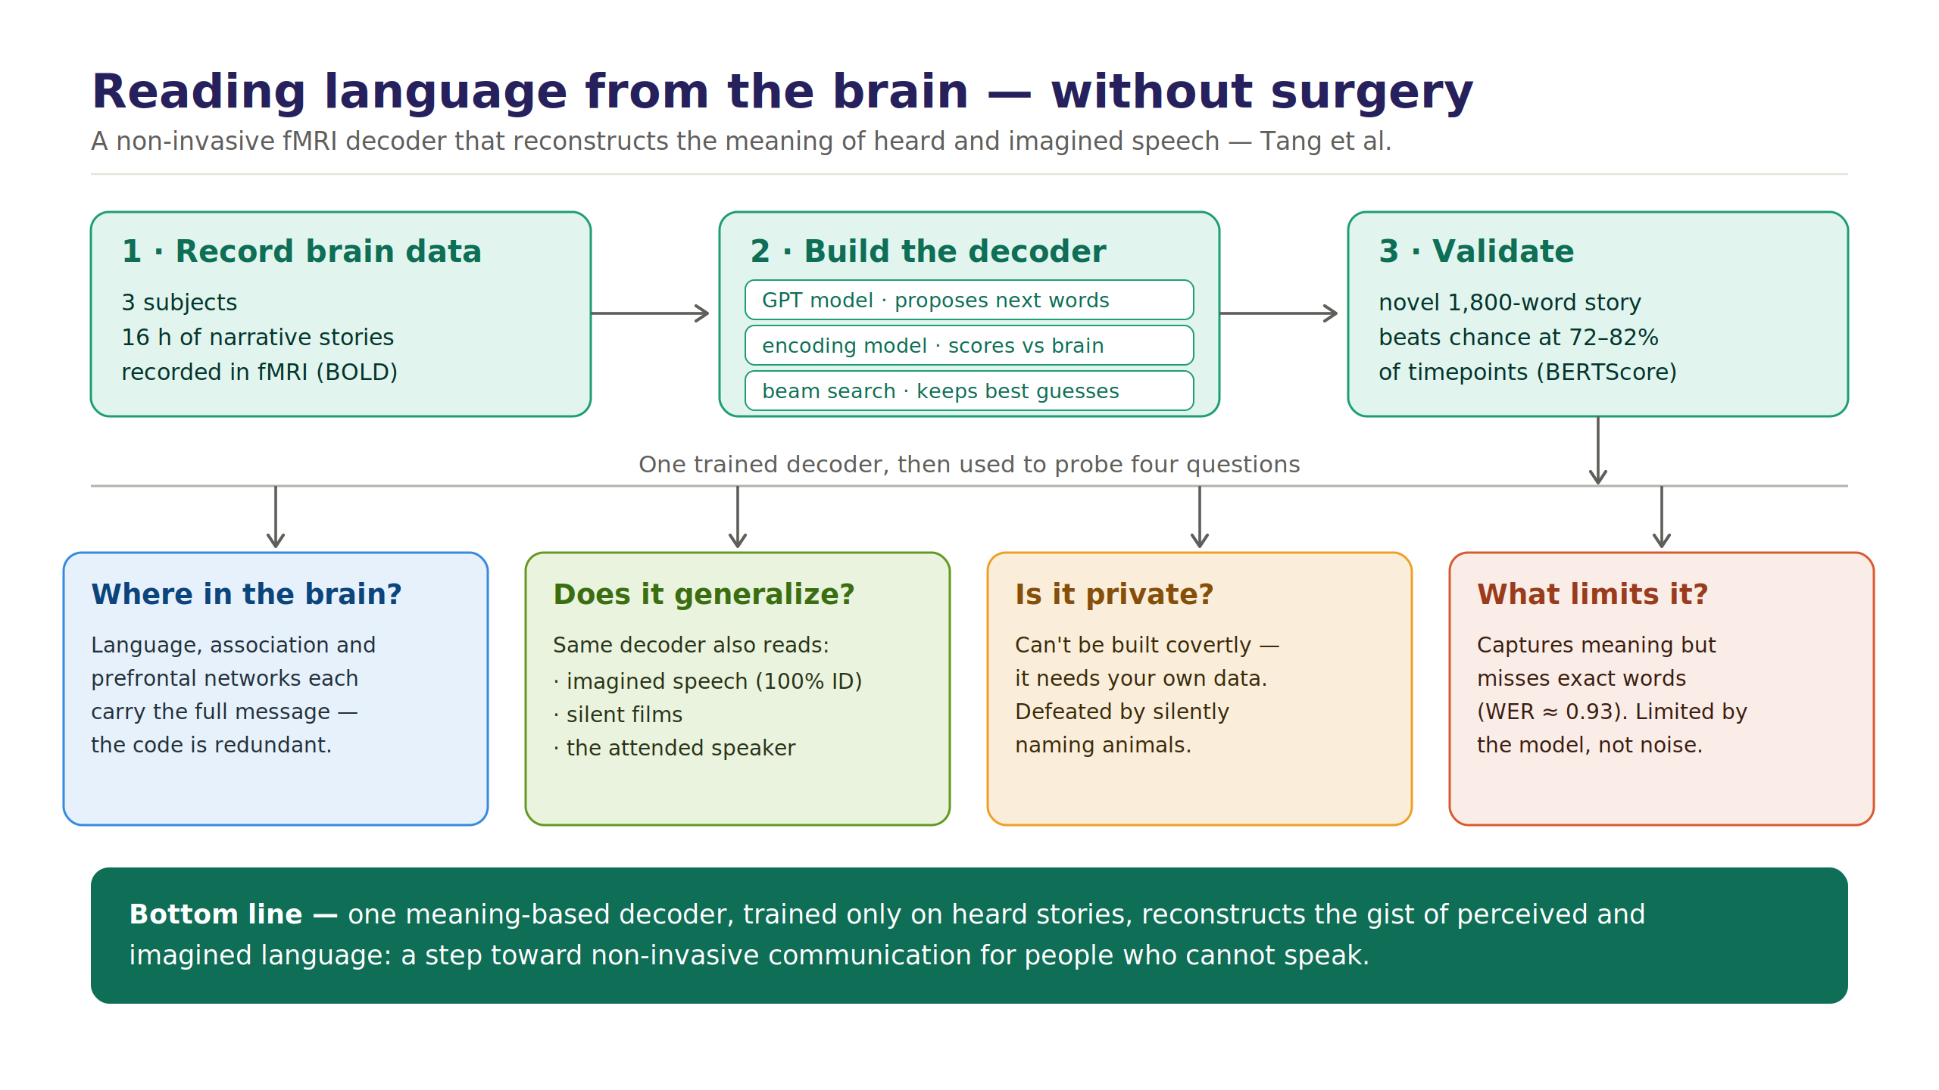

Slide 9

HARD PROBLEM 1
Is the brain really different in kind?
The whole case for special protection rests on one claim: that brain data is unlike any other data.
So: Is there a real difference?
Mental Privacy · Neuroethics Colloquium
9
Notes:
First hard problem — the load-bearing claim. Everything about special protection rests on brain data being 'different in kind.' Give the strongest version (involuntary, intimate) honestly, then flag that 'special-ness' may be intuition dressed as argument. This was the early framing slide — now it's a question for the room, not a given. ~2.5 min.

Slide 10
HARD PROBLEM 2
Was the mind ever private?
We infer mental states constantly from faces or speech.
So: What makes neural decoding cross a line that an interrogator, or an advertisement model, doesn’t, if it does?
Mental Privacy · Neuroethics Colloquium
10
Notes:
Second hard problem. We mind-read socially all the time — faces, speech, clicks. Push them to say what makes neural decoding different. Offer the strongest pro-protection answer (involuntariness + resolution + scale) rather than strawmanning it. Seeds Cluster B. ~2.5 min.

Slide 11
THE OPEN QUESTION
Is the brain truly special and deserving of its own protections, or is "mental privacy" just regular privacy with a scarier name?
Notes:
The bridge. Put the sui generis question on screen and DON'T answer it — say you're handing it over. Pause, let it sit, then move to the open half. ~1.5 min.

