Slide 1
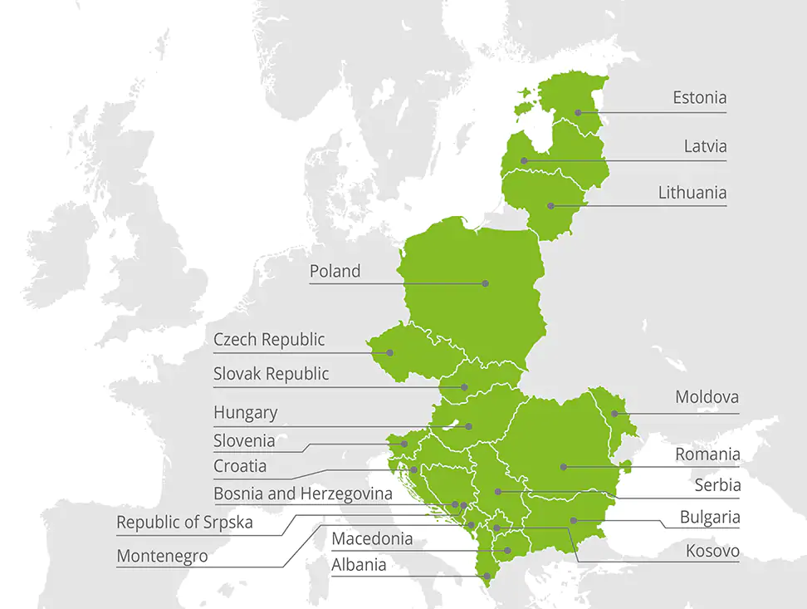

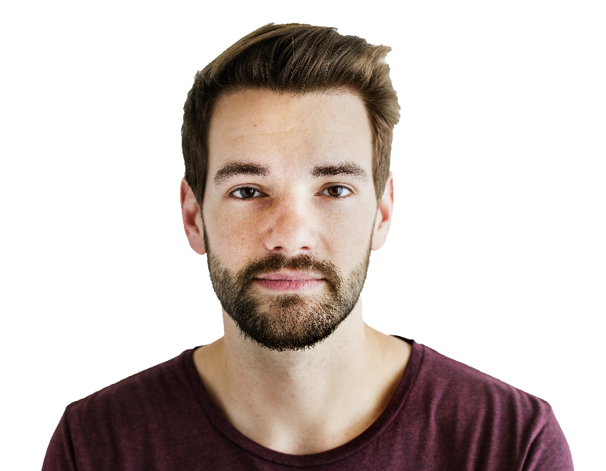

Consulting Company CC
CC Global
CC Central Europe
CC Latvia
The 3rd strongest brand in the world
The strongest and most valuable professional consultancy brand
#1 M&A House in Central Europe
#1 Financial Advisor in Europe and globally by M&A activity
Operating for more than 150 years, offices in more than 150 countries with more than 286,000 employees.
18 countries across Central Europe
More than 4,400 employees
More than 160 employees
Tax
Audit
AIM
Advisory
Legal
Notes:
%%SLIDETTSVOICE%en-US-Standard-A%%SLIDETTSVOICE-END%
Consulting Company Global is the 3rd strongest brand in the world, the strongest and most valuable professional consultancy brand, the number 1 M&A, House in Central Europe and the 1st Financial Advisor in Europe and globally by M and A activity.
We are operating for more than 150 years, offices in more than 150 countries with more than 286,000 employees.

Slide 2
Consulting Company CC
CC Global
CC Central Europe
CC Latvia
The 3rd strongest brand in the world
The strongest and most valuable professional consultancy brand
#1 M&A House in Central Europe
#1 Financial Advisor in Europe and globally by M&A activity
Operating for more than 150 years, offices in more than 150 countries with more than 286,000 employees.
18 countries across Central Europe
More than 4,400 employees
More than 160 employees
Tax
Audit
AIM
Advisory
Legal
Notes:
%%SLIDETTSVOICE%en-US-Standard-H%%SLIDETTSVOICE-END%
Consulting Company Central Europe is present in 18 countries across Central Europe with more than 4,400 employees.

Slide 3
Consulting Company CC
CC Global
CC Central Europe
CC Latvia
The 3rd strongest brand in the world
The strongest and most valuable professional consultancy brand
#1 M&A House in Central Europe
#1 Financial Advisor in Europe and globally by M&A activity
Operating for more than 150 years, offices in more than 150 countries with more than 286,000 employees.
18 countries across Central Europe
More than 4,400 employees
More than 160 employees
Tax
Audit
AIM
Advisory
Legal
Notes:
%%SLIDETTSVOICE%en-US-Standard-A%%SLIDETTSVOICE-END%
Consulting Company Latvia has more than 160 employees.

