Slide 1

Year 7 Area & Perimeter
Dr J Frost (jfrost@tiffin.kingston.sch.uk)
Objectives: Find the area and perimeter of rectangles, triangles, parallelograms, trapeziums, circles (and fractions of circles) and composite shapes.
Use a variety of additive and subtractive techniques to find area of complex shapes, and find fractions of shapes shaded.
Last modified: 22nd July 2018

Slide 2




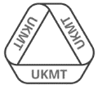
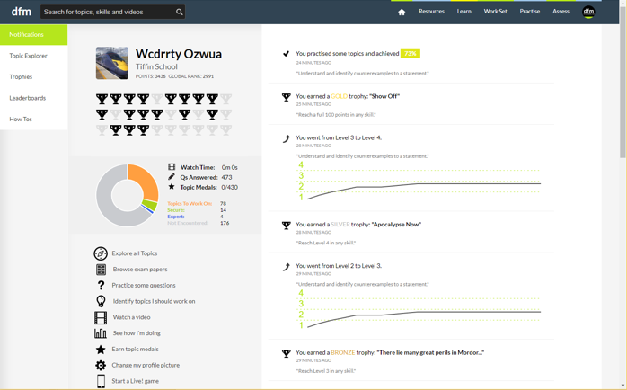
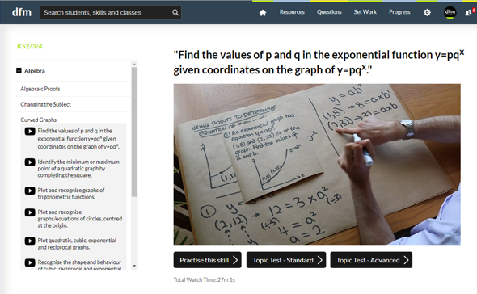
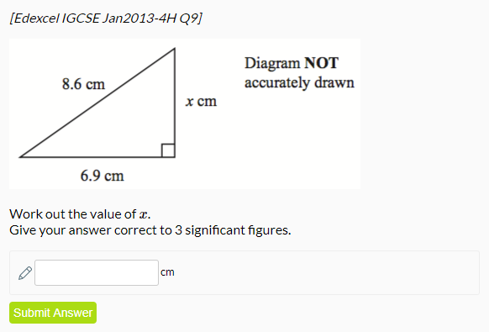
www.drfrostmaths.com
Everything is completely free.
Why not register?
Register now to interactively practise questions on this topic, including past paper questions and extension questions (including UKMT).
Teachers: you can create student accounts (or students can register themselves), to set work, monitor progress and even create worksheets.
With questions by:
Dashboard with points, trophies, notifications and student progress.
Questions organised by topic, difficulty and past paper.
Teaching videos with topic tests to check understanding.

Slide 3
For Teacher Use:
Recommended lesson structure:
Lesson 1: Area and perimeter of rectilinear shapes.
Lesson 2: Area of triangles, parallelograms and trapeziums.
Lesson 3-4: Area and circumference of circles. Fractions of circles.
Lesson 5: Additive and subtractive methods for area. (Including moving parts of a shape to ‘fill in gaps’)
Lesson 6: Levelled Activity: Additive and subtractive methods
Lesson 7: Fraction of area shaded (includes principles of (a) splitting into congruent shapes (b) the area of two triangles with the same base are proportional to the height, and equal if height is same).
Lesson 8: Consolidation/Mini-assessment
Go >
Go >
Go >
Go >
Go >
Go >

Slide 4
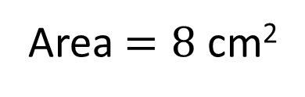
RECAP :: Area of Rectangles
Area means:
the amount of space something takes up in 2D.
?
2cm
Area $=8$ cm²
?
4cm
If the squares are ‘unit squares’ (i.e. have length and height 1) then finding the area amounts to counting squares.
?
Perimeter = 12 cm

Slide 5
Rectilinear Shapes
A rectilinear shape is one whose edges all meet at right angles.
Copy this shape into your books and determine:
The area
The perimeter
2cm
A few thoughts:
Is it possible to find the area in two different ways?
Is there a super clever way to find the perimeter without finding all the lengths?
10cm
3cm
10cm

Slide 6
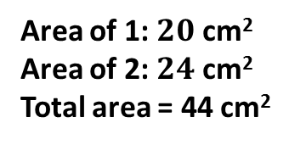

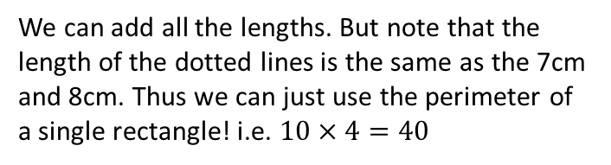
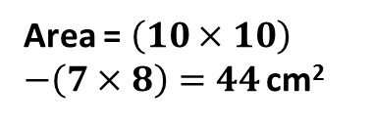
Rectilinear Shapes
2cm
#
7cm
10cm
1
8cm
#
2
3cm
10cm
?
Area $=44$ cm²
Perimeter = 40 cm
?
Show ‘Additive’ Method
Show ‘Subtractive’ Method
We can add all the lengths. But note that the length of the dotted lines is the same as the 7cm and 8cm. Thus we can just use the perimeter of a single rectangle! i.e. $10×4=40$
Area of 1: $20$ cm²
Area of 2: $24$ cm²
Total area = 44 cm²
Area = $\left(10×10\right)$
$−\left(7×8\right)=44$ cm²

Slide 7
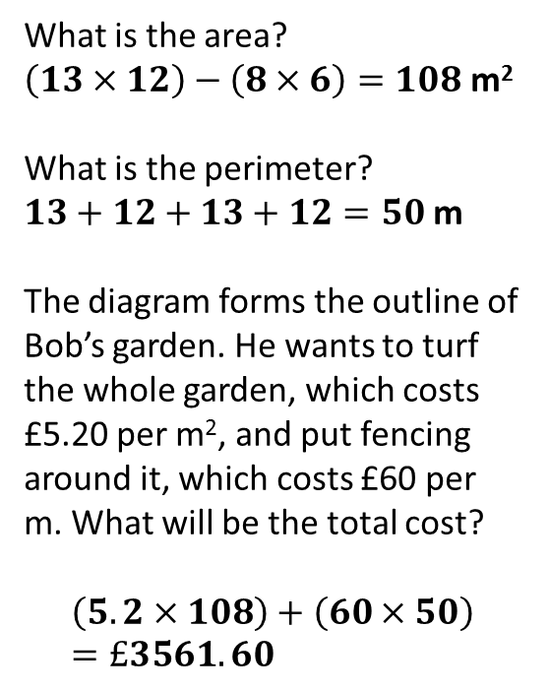
Check Your Understanding
12m
a
What is the area?
$\left(13×12\right)−\left(8×6\right)=108$ m²
What is the perimeter?
$13+12+13+12=50$ m
The diagram forms the outline of Bob’s garden. He wants to turf the whole garden, which costs £5.20 per m², and put fencing around it, which costs £60 per m. What will be the total cost?
$$\left(5.2×108\right)+\left(60×50\right)=£3561.60$$
?
7m
b
?
13m
c
8m
?

Slide 8

Changes which preserve perimeter
(The triangle before cutting is equilateral)
8
8
1
1
We’ve seen that cutting a corner out of a rectangle for example preserves perimeter (the red and blue lines are equal in length)
Perimeter = 23
?
[JMC 2008 Q8] The shape on the right is made up of three rectangles, each measuring 3cm by 1cm. What is the perimeter of the shape?
A 16cm B 18cm C 20cm
D 24cm E More information needed
A
B
C
D
E

Slide 9
Exercise 1
(Questions on provided sheet)
1
7m
6cm
2
22m
a
b
4cm
14m
12m
9cm
?
4m
Area = 34cm²
P = 30cm
?
12m
Boris wants to build a car park. It costs £35 per m² of tarmac and £24 per metre of hedge to go around the border. What is the total cost? £1728 + £9380 = £11108
3m
?
Area = 78m²
P = 38m
2m
?
2cm
?
3
4
5
18m
7cm
2cm
5cm
8cm
16m
8cm
5cm
The perimeter of this shape is 80cm. What is its area?
250cm²
These rectangles are congruent. Find the area and perimeter of the shape. A= 192m² P = 68m
?
Area = 94cm²
P = 50cm
?
?
?

Slide 10
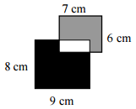
Exercise 1
(Questions on provided sheet)
6
[JMO 2011 A2] Two rectangles measuring 6 cm × 7 cm and 8 cm × 9 cm overlap as shown. The region shaded grey has an area of 32 cm². What is the area of the black region?
Solution: 62 cm²
[JMC 2000 Q12] Four rectangular paper strips, each measuring 10cm by 1cm, are laid flat on a table. Each strip is at right angles to two of the other strips as shown. What is the area of the table covered by the strips?
A 30 cm² B 32 cm² C 34 cm²
D 36 cm² E 38 cm²
Solution: D
[JMC 1998 Q14] How much smaller (in cm²) is the area of a 60cm by 40cm rectangle than that of a square with the same perimeter?
100 cm²
?
7
?
8
?

Slide 11

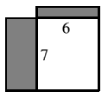

Exercise 1
(Questions on provided sheet)
9
[JMO 2015 A3] The diagram shows one square inside another. The perimeter of the shaded region has length 24 cm. What is the area of the larger square?
Solution: 36 cm²
[JMC 2010 Q15] A 6 by 8 and a 7 by 9 rectangle overlap with one corner coinciding as shown. What is the area (in square units) of the region outside the overlap?
Solution: 27
[Kangaroo Pink 2013 Q2] The diagram shows six identical squares, each containing a shaded region.
How many of the regions have perimeter equal in length to the perimeter of one of the squares?
A 2 B 3 C 4 D 5 E 6
Solution: C
?
10
?
11
?

Slide 12

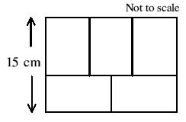
Exercise 1
(Questions on provided sheet)
12
[Junior Kangaroo 2015 Q15] A rectangular garden is surrounded by a path of constant width. The perimeter of the garden is 24 m shorter than the distance along the outside edge of the path. What is the width of the path?
Solution: 3m
[JMC 2004 Q24] Five identical rectangles fit together as shown. What, in cm², is the total area which they cover?
Solution: 270
?
13
?

Slide 13


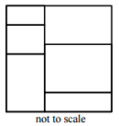
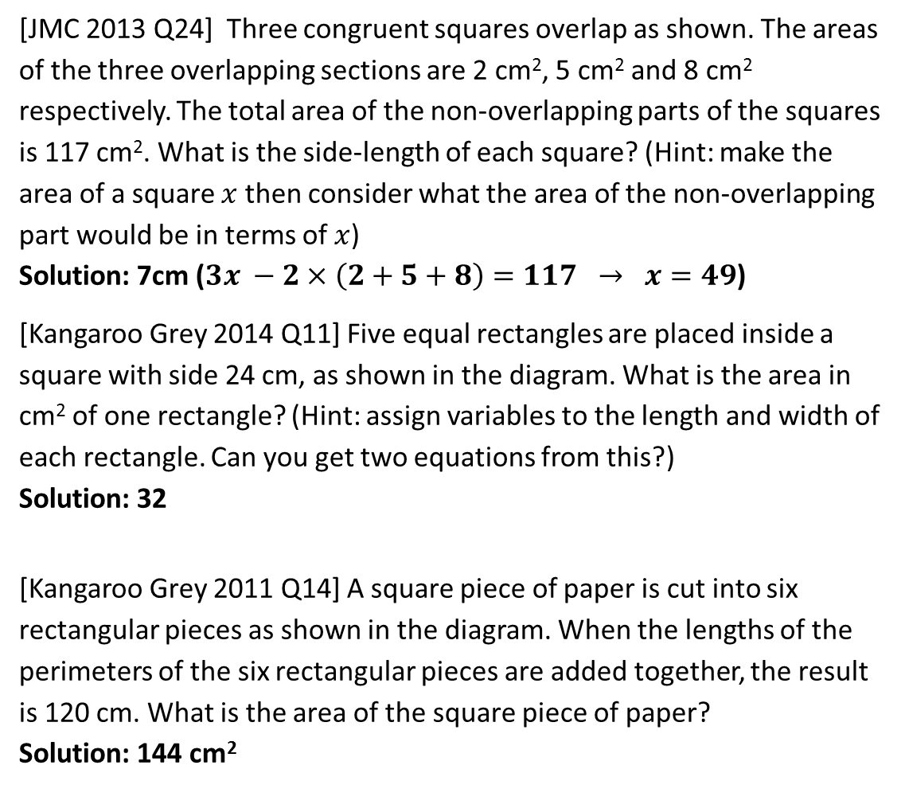
Exercise 1
(Questions on provided sheet)
14
[JMC 2013 Q24] Three congruent squares overlap as shown. The areas of the three overlapping sections are 2 cm², 5 cm² and 8 cm² respectively. The total area of the non-overlapping parts of the squares is 117 cm². What is the side-length of each square? (Hint: make the area of a square $x$ then consider what the area of the non-overlapping part would be in terms of $x$)
Solution: 7cm ($3x −2×\left(2+5+8\right)=117 → x=49$)
[Kangaroo Grey 2014 Q11] Five equal rectangles are placed inside a square with side 24 cm, as shown in the diagram. What is the area in cm² of one rectangle? (Hint: assign variables to the length and width of each rectangle. Can you get two equations from this?)
Solution: 32
[Kangaroo Grey 2011 Q14] A square piece of paper is cut into six rectangular pieces as shown in the diagram. When the lengths of the perimeters of the six rectangular pieces are added together, the result is 120 cm. What is the area of the square piece of paper?
Solution: 144 cm²
?
15
?
16
?

Slide 14

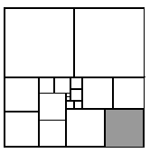
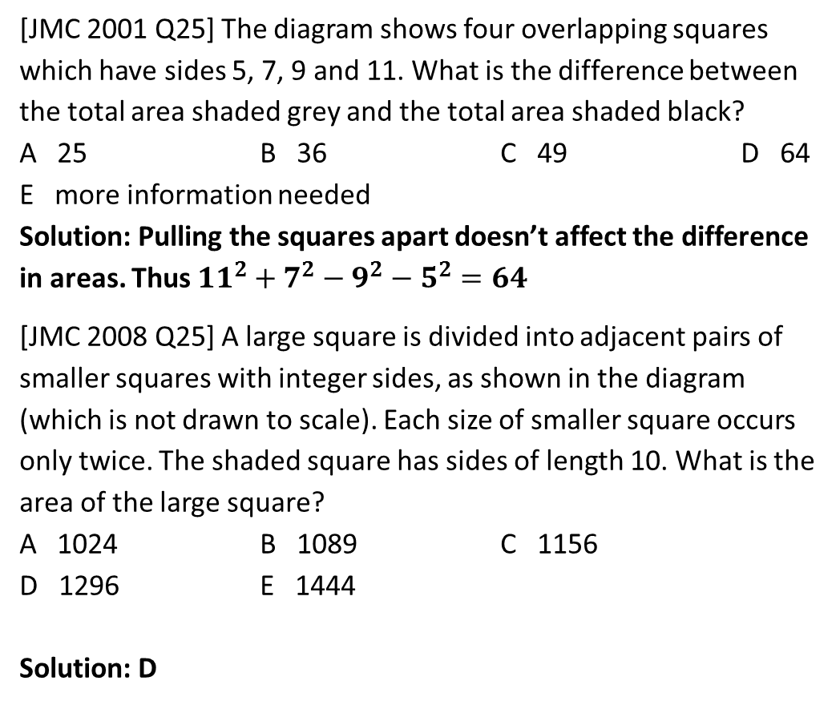
Exercise 1
(Questions on provided sheet)
17
[JMC 2001 Q25] The diagram shows four overlapping squares which have sides 5, 7, 9 and 11. What is the difference between the total area shaded grey and the total area shaded black?
A 25 B 36 C 49 D 64
E more information needed
Solution: Pulling the squares apart doesn’t affect the difference in areas. Thus ${11}^{2}+7^{2}−9^{2}−5^{2}=64$
[JMC 2008 Q25] A large square is divided into adjacent pairs of smaller squares with integer sides, as shown in the diagram (which is not drawn to scale). Each size of smaller square occurs only twice. The shaded square has sides of length 10. What is the area of the large square?
A 1024 B 1089 C 1156
D 1296 E 1444
Solution: D
?
18
?

Slide 15
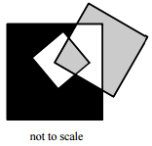
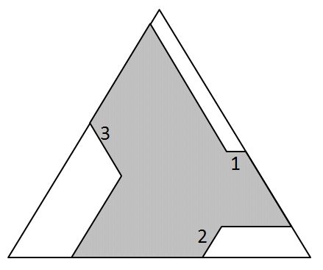
Exercise 1
(Questions on provided sheet)
19
[Kangaroo Grey 2011 Q21] The diagram on the right shows a square with side 3 cm inside a square with side 7 cm and another square with side 5 cm which intersects the first two squares. What is the difference between the area of the black region and the total area of the grey regions?
A 0cm² B 10cm² C 11cm²
D 15cm² E more information needed
Solution: D
[Maclaurin 2006 Q4] The nonagon shown shaded in the diagram has been made by removing three pieces from an equilateral triangle of side 12. All nine edges of the nonagon are parallel to sides of the triangle. Three edges have lengths 1, 2 and 3 as shown.
Calculate the length of the perimeter of the nonagon.
Solution: 30
?
20
?

Slide 16
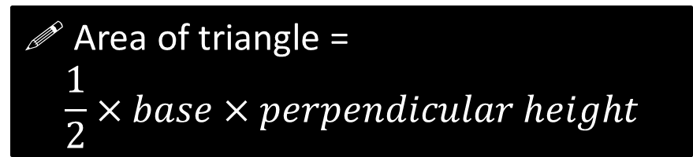
Area of a Triangle
! Area of triangle =
$$\frac{1}{2}×base×perpendicular height$$
perp height
?
base
Examples
5cm
3cm
3cm
4cm
8cm
4cm
6cm
3cm
?
Area = 6cm²
?
?
Area = 12cm²
Area = 12cm²
Bro Note: Notice how the perpendicular height may be measured outside the triangle! Just ensure you measure perpendicular to the base.

Slide 17
Area of a Triangle
7m
Quickfire Questions
4.5m
13m
13m
25m
4m
3m
7m
12m
12.2m
10m
3.5m
24m
6m
10m
?
Area = 6m²
Area = 84m²
?
Area = 60m²
?
?
Area = 21m²
11m
14.4m
14m
7m
4m
14.4m
?
6m
Area = 49m²
?
Area = 10m²

Slide 18
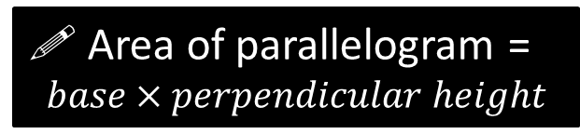
Parallelograms
! Area of parallelogram =
$$base×perpendicular height$$
perp height
?
We can see it’ll be exactly the same formula as a rectangle!
Click for Broanimation
base
Quickfire Questions
Bro Note: This is known as the ‘slant height’, which you should be able to distinguish from the ‘perpendicular height’.
10cm
4cm
8cm
7cm
3cm
4cm
5cm
1cm
6cm
?
Area = 30cm²
?
Area = 32cm²
?
8cm
Area = 42cm²

Slide 19

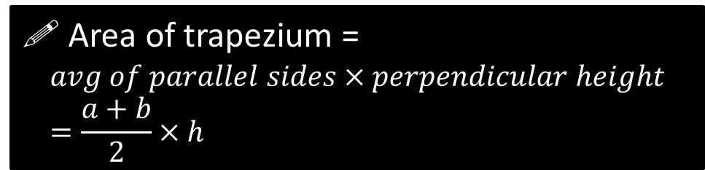
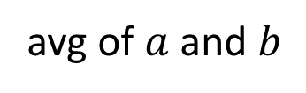


Area of a Trapezium
A trapezium is a quadrilateral with a pair of parallel sides.
! Area of trapezium =
$$avg of parallel sides×perpendicular height \\ =\frac{a+b}{2}×h$$
?
$$a$$
Click for Broanimation
$$h$$
Can you sort of see that if we were to ‘average out’ the two parallel sides and use this as the width of a rectangle, it has the same area as the trapezium?
avg of $a$ and $b$
$$b$$

Slide 20



Area of a Trapezium
Examples
Bro Tip: It may help to identify the parallel sides first (if not already indicated).
7m
5cm
4cm
2cm
8m
10m
?
8m
Area = $3×5=15$ cm²
?
Area = $9×7=63$ m²
9cm
9cm
7cm
?
Area = $7×9=63$ cm²
5cm

Slide 21
Use your diary coloured cards to vote for the correct answer in each question.
(Use the front of your diary for blue)
RED
ORANGE
GREEN
BLUE

Slide 22
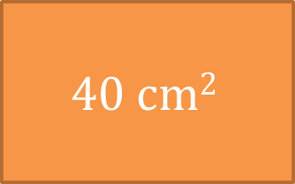
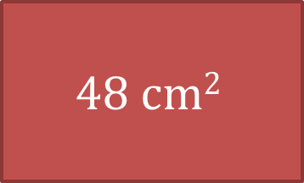
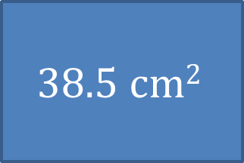
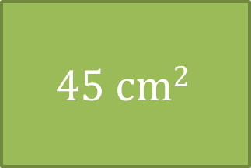
Calculate the area of this shape.
7cm
6cm
5cm
9cm
$$48 cm2$$
$$40 cm2$$
$$45 cm2$$
$$38.5 cm2$$

Slide 23
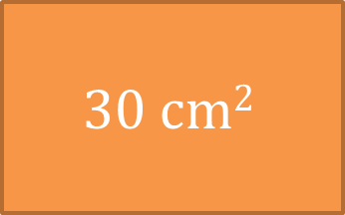
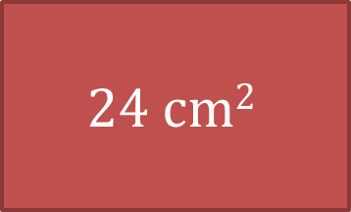
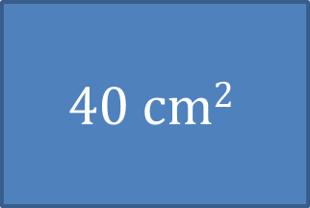
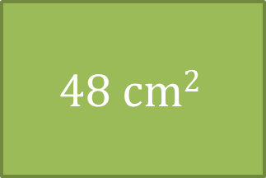
Calculate the area of this shape.
10cm
8cm
6cm
$$24 cm2$$
$$30 cm2$$
$$48 cm2$$
$$40 cm2$$

Slide 24
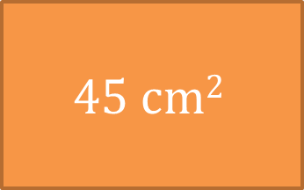
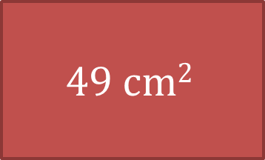
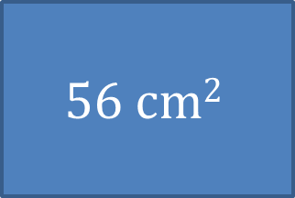
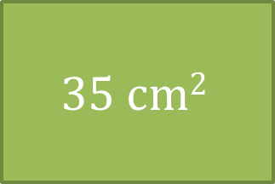
Calculate the area of this shape.
9cm
7cm
2cm
5cm
$$49 cm2$$
$$45 cm2$$
$$35 cm2$$
$$56 cm2$$

Slide 25
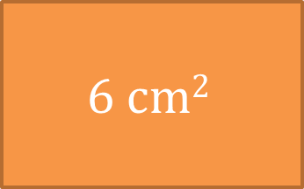
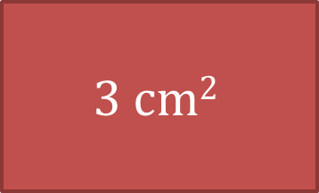
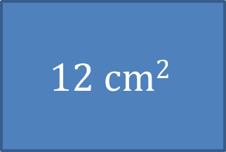
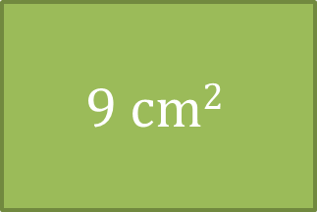
Calculate the area of the shaded area.
3cm
4cm
2cm
$$3 cm2$$
$$6 cm2$$
$$9 cm2$$
$$12 cm2$$

Slide 26
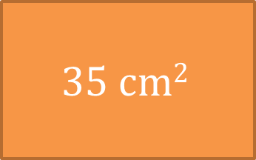
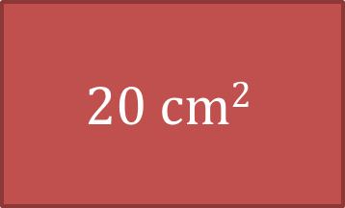
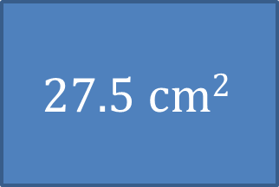
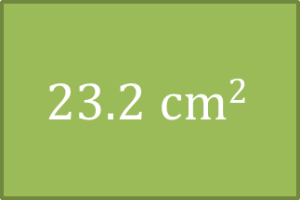
Calculate the area of this shape.
5.8cm
4cm
9.9cm
3cm
5cm
$$20 cm2$$
$$35 cm2$$
$$23.2 cm2$$
$$27.5 cm2$$

Slide 27
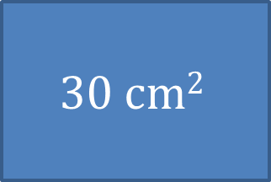
Calculate the area of this shape.
6cm
4cm
10cm
5cm
6cm
$$48 cm2$$
$$40 cm2$$
$$45 cm2$$
$$30 cm2$$

Slide 28
Exercise 2
1
a
b
c
6cm
15cm
12cm
6cm
7cm
5cm
9cm
8cm
12cm
?
?
Area = 54 cm²
Area = 48 cm²
?
9cm
Area = 45 cm²
d
e
5cm
1cm
f
6cm
5cm
3cm
7cm
9cm
2cm
10cm
9cm
?
Area = 27 cm²
?
Area = 63 cm²
?
Area = 21 cm²
g
11cm
h
?
Area = 240 cm²
?
26cm
Area = 34 cm²
26cm
4cm
10cm
7cm
6cm
48cm

Slide 29
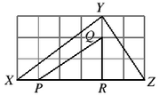
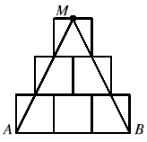
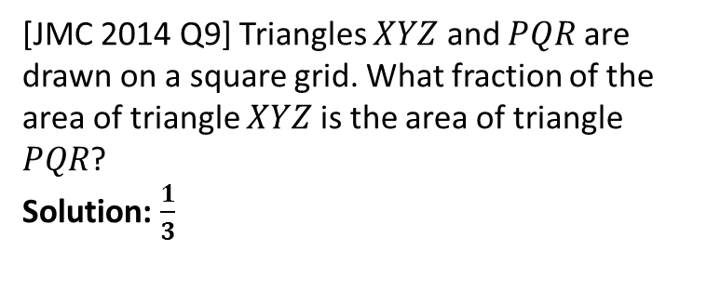
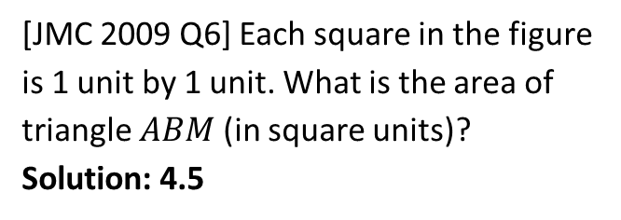
Exercise 2
2
3
?
20cm
If the area is 50cm² and the base 20cm, what is the perpendicular height? Solution: 5cm
[JMC 2014 Q9] Triangles $XYZ$ and $PQR$ are drawn on a square grid. What fraction of the area of triangle $XYZ$ is the area of triangle $PQR$?
Solution: $\frac{1}{3}$
?
4
?
5
Bob has a garden in the shape of a trapezium. If it costs £15.22 per m² of turf, how much will it cost to turf his garden?
Solution: £1522
8m
[JMC 2009 Q6] Each square in the figure is 1 unit by 1 unit. What is the area of triangle $ABM$ (in square units)?
Solution: 4.5
15m
10m
?
?

Slide 30

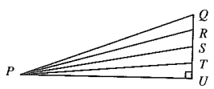
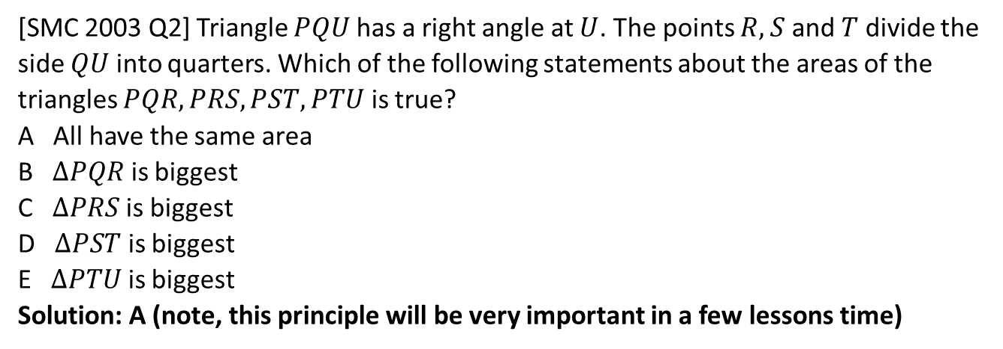
Exercise 2
6
[IMC 2005 Q9] Which of the following shaded regions has an area different from the other shaded regions?
Solution: All have an area of 3 except for D (which has an area of 2.5)
?
7
[SMC 2003 Q2] Triangle $PQU$ has a right angle at $U$. The points $R, S$ and $T$ divide the side $QU$ into quarters. Which of the following statements about the areas of the triangles $PQR, PRS, PST, PTU$ is true?
A All have the same area
B $ΔPQR$ is biggest
C $ΔPRS$ is biggest
D $ΔPST$ is biggest
E $ΔPTU$ is biggest
Solution: A (note, this principle will be very important in a few lessons time)
?

Slide 31












Exercise 2
$$C$$
$$A$$
8
9
6cm
4cm
$$E$$
$$E$$
?
13cm
12cm
$$A$$
$$D$$
$$B$$
$$D$$
9cm
10cm
If $AB=9$cm, $AC=6cm$, $D$ is a point such that $CD$ is perpendicular to $AB$ and $CD=4cm$, $E$ is a point such that $AC$ is perpendicular to $BE$, then what is the length of $BE$?
Solution: 6cm
The really important principle here is that we have multiple choices for the base of the triangle, and that the area of the triangle obviously does not change depending on which we use.
$$B$$
$$C$$
In the diagram, $AB=AD=AE$ and $BD=10$cm. Determine the length $BE$, leaving your answer as a fraction.
Solution: $\frac{240}{13}$ cm
The area of $ΔABD=\frac{1}{2}×10×12=60$
If $M$ is the midpoint of $BE$, then we could have used $AD$ as the base of the triangle and $BM$ as the perpendicular height. So $\frac{1}{2}×13×BD=60$ and hence $BM=\frac{120}{13}$. Therefore $BE=2×\frac{120}{13}$
?
?

Slide 32


Exercise 2
$$a$$
10
6cm
10cm
The area of this parallelogram is 51cm². Determine $a$.
Solution: 7cm
?

Slide 33




Circles
Firstly, can you identify the parts of a circle?
?
circumference
! Area of circle = $πr^{2}$
Circumference = $πd$ or $2πr$
?
?
$π$ is a mathematical constant, with the value $3.14152965…$
You can find it on your calculator (use SHIFT).
It is defined as the scale factor between the diameter of a circle and the circumference, but is used in other parts of maths (e.g. Number Theory!)
?
diameter
?
radius
$$r$$
Side Question: What is the difference in algebra between a variable and a constant?
$π$ is a ‘constant’ because its value is ‘constant’, i.e. it can’t change, and its value is known in advance. A ‘variable’ can vary, e.g. if $x$ represents a length, it’s value could change. Another well known constant is maths is $φ$, which is the Golden Ratio.
?

Slide 34



Circles
Examples
Bro Note: Be careful about BIDMAS. $πr^{2}$ means $π\left(r^{2}\right)$ not ${\left(πr\right)}^{2}$
(Give your answers to 1 decimal place)
Area $=π×3^{2}=28.3$ cm²
Circumference $=2×π×3=18.8$ cm
?
3cm
?
Area $=π×4^{2}=50.3$ m²
Circumference $=π×8=25.1$ cm
8m
?
?

Slide 35



Giving ‘exact’ answers
$$π=3.14159265357989…$$
The digits of $π$ go on forever, and it can’t be expressed as a fraction involving whole numbers.
For that reason, it is not possible to give an exact answer involving $π$ in ‘decimal form’ (i.e. where we list out all the digits), as at some point we’d have to round.
We leave the $π$ in the answer if we wish to express the answer ‘exactly’.
(In maths challenges/Olympiads, you are required to give answers in exact form.)
What is the area of the circle:
In decimal form to 1dp? $314.2$ cm²
In exact form? $100π$ cm²
?
?
10cm
Bro Note: Just as we’d write numbers before variables, e.g. $4x$ and not $x4$, we write numbers before constants, so $100π$ and never $π100$.

Slide 36


Test Your Understanding (so far)
4.6 cm
Give your answers to 1 decimal place.
Area $=π×4.6^{2}=66.5$ cm²
Circumference $=2×π×4.6=28.9$ cm
?
?
Give your answers in exact form.
Area $=64π$
Circumference $=16π$
16
?
?

Slide 37


Game!
Everyone stand up. Each of you will be asked, one at a time, and in your head, to find either the area ($A$) or the circumference ($C$) of a circle. Answer must be in exact form.
If you get it wrong, you sit down, and the person who last sat down has the opportunity to ‘steal’, where they will be able to stand up again if they correct the answer.
Example
4
?
$$C=8π$$
Your teacher may impose a time limit per question.

Slide 38


















Game!
1
1
6
4
4
5
$$C=4π$$
$$A=4π$$
?
?
$$A=25π$$
?
?
$$A=9π$$
?
$$A=π$$
$$C=2π$$
?
8
7
12
7
10
18
?
?
?
$$C=20π$$
$$A=81π$$
?
$$A=36π$$
$$A=49π$$
?
?
$$C=14π$$
$$C=8π$$
3
17
9
14
3
11
$$A=49π$$
$$A=9π$$
?
$$C=3π$$
$$C=22π$$
$$C=17π$$
?
?
?
?
?
$$C=18π$$
(Slide note: You can press anywhere or use the right key to advance)

Slide 39


















Game!
8
7
4
5
18
4
$$A=4π$$
$$C=5π$$
$$A=81π$$
$$A=16π$$
$$A=64π$$
?
?
?
?
$$C=14π$$
?
?
15
13
14
2
15
22
$$A=49π$$
$$A=4π$$
$$C=30π$$
$$A=121π$$
$$C=26π$$
?
?
?
?
?
?
$$C=15π$$
12
1
5
20
19
8
$$A=144π$$
$$C=π$$
$$C=10π$$
$$A=100π$$
$$C=19π$$
$$C=16π$$
?
?
?
?
?
?

Slide 40









Exercise 3
1
Find the area and circumference of the following circles, giving your answer to 1dp.
3
A car wheel of diameter 35cm spins on a road. Over 2000cm, how many full rotations will the wheel have made?
$2000÷\left(π×35\right)=18.2$ times
A circular lawn has radius 50m. Each box of grass seed costs £5.99 and covers 60m² of lawn. What is the cost to seed the whole lawn?
$A=π×{50}^{2}=7854.0$ m²
$7854.0÷60=130.9→131$ boxes
$131×5.99=£784.69$
The radius of the Earth is 6371km. Light can travel 300,000km each second. How many times can light encircle the Earth in a second?
$300000÷40030=7.49$ times
The area of a circular disc is 100cm². What is its diameter? $2×\sqrt{100÷π}=11.3$ cm
As the radius $r$ of a circle increases, which graph shows how (a) the circumference increases and (b) the area increases?
?
a
b
3cm
8cm
4
$A=28.3$ cm²
$C=18.8$ cm
$A=50.3$ cm²
$C=25.1$cm
?
?
?
?
?
c
7.2m
d
6.4m
5
$A=162.9$ m²
$C=45.2$ m
$A=32.2$ cm²
$C=20.1$cm
?
?
?
?
?
2
And give your answer in exact form:
6
?
a
b
7
16
N
$$A=49π$$
$$C=14π$$
$$A=64π$$
$$C=16π$$
?
?
?
(i)
(ii)
(iii)
(iv)
Solution:
i
iii
?
?
$$r$$
$$r$$
$$r$$
$$r$$

Slide 41

Fractions of circles
Give your answer in exact form.
Area
$$=\frac{36π}{4}=9π$$
Perimeter
$$=\frac{12π}{4}+12 \\ =3π+12$$
?
Note ‘perimeter’ and not ‘circumference’.
?
6

Slide 42


A few more examples
Area
$$=\frac{64π}{4}=16π$$
Perimeter
$$=\frac{16π}{4}+16=4π+16$$
?
8
?
Area
$$=\frac{25π}{2} or \frac{25}{2}π$$
Perimeter
$$=\frac{10π}{2}+10=5π+10$$
?
?
10

Slide 43


Test Your Understanding
i
Give your answer to 1dp.
Area
$=\frac{49π}{4}=38.5$ cm²
Perimeter
$=\frac{14π}{4}+14=25.0$ cm
?
?
7cm
ii
Give your answer in exact form.
Area
$$=\frac{64π}{2}=32π$$
Perimeter
$$=\frac{16π}{2}+16=8π+16$$
16
?
?

Slide 44









Exercise 4
1
Find the area and perimeter of the following, giving your answers to 1dp.
3
Give exact answers.
2
a
b
a
b
6cm
1
5cm
$$A=\frac{π}{4} \\ P=\frac{π}{2}+2$$
$$A=\frac{π}{2} \\ P=π+2$$
?
?
$A=14.1$ cm²
$P=15.4$ cm
?
?
$A=19.6$ cm²
$P=17.9$ cm
?
?
?
?
c
d
4
Fred Flintstone’s car has two different wheels: one circular in shape and the other semicircular. The diameter of the semicircular wheel is 1.3m. What radius is needed for the circular wheel so that the wheels make the same number of full circulations over any journey? (Give your answer to 3dp)
Solution: 0.532m
3.7m
5.3m
$A=10.8$ m²
$P=13.2$ m
?
$A=11.0$ m²
$P=13.6$ m
?
?
?
?
2
Give exact answers.
12
a
b
10
1.3m
?
?
$$A=18π \\ P=6π+12$$
$$A=25π \\ P=5π+20$$
?
?

Slide 45


STARTER
[IMC 2011 Q5] The diagram shows a rectangle placed on a grid of 1cm $×$ 1cm squares. What is the area of the rectangle in cm²?
A 15 B $22\frac{1}{2}$
C 30 D 36
E 45
A
B
C
D
E

Slide 46


Additive and Subtractive Methods
A reminder…
12m
Additive method:
(i.e. adding areas)
?
$\left(13×4\right)+\left(8×7\right)=108$ m²
7m
Subtractive method:
(i.e. subtracting areas)
13m
?
$\left(12×13\right)−\left(8×6\right)=108$ m²
4m

Slide 47



Additive Method Examples
10m
8m
6m
10m
8m
?
?
$A=60+\frac{25π}{2}=99.3$ m²
$A=64+8=72$ m²
25m
?
10m
$A=75+25π=153.5$ m²

Slide 48


Test Your Understanding
30m
i
?
Rectangle: $20×10=200$
Circle: $π×5^{2}=25π$
Total $=278.5$ m²
10m
ii
14m
?
Rectangle: $14×12=168$
Trapezium: $10×7=70$
Semicircle: $8π$
Total $=263.1$ m²
DEATH LASER
12m
8m
25m

Slide 49


Subtractive Method Examples
What is the area of the black region in each case? (expressed exactly)
8
20
?
?
$$A=20−50π$$
$$A=64−16π$$

Slide 50




Test Your Understanding
8
i
Exact area of black region:
$$=16π−4π=12π$$
?
4
Bro Tip: Try and combine parts of circles to form full circles where possible.
ii
[JMO 2015 A5] Two circles of radius 1 cm fit exactly between two parallel lines, as shown in the diagram. The centres of the circles are 3 cm apart. What is the area of the shaded region bounded by the circles and the lines?
Solution: Cut two half circles (i.e. one full circle) out of a $2×3$ rectangle, i.e.
$\left(6−π\right)$ cm²
1cm
3cm
?
The brackets ensures the unit of ‘cm²’ applies to the 6 rather than just the $π$ (BIDMAS applies to units as well!)

Slide 51


A More Interesting One…
1
How would you find this shaded area?
We can start with a quarter circle, which has area $\frac{π}{4}$.
We than cut out a triangle with base 1 and height 1. Its area is $\frac{1}{2}$
The area is therefore:
$$\frac{π}{4}−\frac{1}{2}$$
?
1
What about this?
It’s just twice the area before:
$$\frac{π}{2}−1$$
?
Bro Note: Maths Challenge/Olympiad enthusiasts
take note – these two shapes are quite common!

Slide 52



The ‘Frame’ Method
Sometimes we can subtract areas when it isn’t obvious we can do so.
We can do this by drawing a rectangle (i.e. ‘frame’) around the shape.
[Kangaroo Grey 2013 Q15] The diagram shows a shaded quadrilateral $PQRS$ drawn on a grid. Each cell of the grid has sides of length 2 cm. What is the area of quadrilateral $PQRS$?
A 96cm² B 84cm²
C 76cm² D 88cm²
E 104cm²
By starting with the area of the ‘frame’ and subtracting the 4 triangles and 1 square:
$$\left(14×10\right)−\frac{6×8}{2}−\frac{6×2}{2}−\frac{8×2}{2} \\ −\frac{14×2}{2}−\left(2×2\right) \\ =84$$
?
Click to Bro Frame

Slide 53

Check Your Understanding
The pictured triangle is a grid of unit width.
Use the ‘frame method’ to find the area of the triangle.
?
Area $=25−2.5−2−10$
$$=10.5$$

Slide 54


Cutting and Reforming
We have seen we can add areas and subtract areas.
But a third way we can sometimes use is to cut the shape up, and put it back together in such a way that gives us a simpler shape.
[IMC 2004 Q12] This figure is made from a straight line 16cm long and two quarter circles, one with its centre at the midpoint of the straight line. What is the area of the figure (in cm²)?
A 64 B $16π$
C $32+16π$ D $32π$
E $16+8π$
?
8cm
?
Answer: A

Slide 55


Test Your Understanding
[JMO 2014 A4] The figure shows two shapes that fit together exactly. Each shape is formed by four semicircles of radius 1. What is the total shaded area?
4
?
Area $=8$
2

Slide 56






Exercise 5
(Questions on provided sheet)
Find the shaded/enclosed areas (giving your answer exactly).
1
a
b
2
2
c
2
2
1
6
1
1
?
?
?
Solution: $33π$
Solution: $3π$
Solution: $2π$
d
e
f
2
2
8
4
4
Solution: $8+5π$
?
Solution: $32+8π$
?
Solution: $4$
?

Slide 57
Exercise 5
(Questions on provided sheet)
2
If these grids are unit (1cm) width/height, determine the area of the triangles.
?
Solution: 12 cm²
?
Solution: 14.5 cm²
a
b
c
d
?
?
Solution: 10 cm²
Solution: 14 cm²

Slide 58





Exercise 5
(Questions on provided sheet)
3
4
[JMC 2007 Q19] Given $PQ=QR=RS=2$ cm. What in cm², is the area of the shape?
A $5π$ B $9π/2$ C $4π$
D $7π/2$ E $3π$
Solution: A
[JMO 2008 A10] The perimeter of the shape shown on the right is made from 20 quarter-circles, each with radius 2 cm. What is the area of the shape?
Solution: $(64+4π)$ cm²
?
?
5
[IMC 1997 Q17] The point $O$ is the centre of a circle of radius 1 unit, $OA$, $OC$ are radii, and $OABC$ is a square. What is the area of the shaded region (in square units)?
Solution: $1−\frac{π}{4}$
?

Slide 59




Exercise 5
(Questions on provided sheet)
6
[IMC 2009 Q13] The diagram on the right shows a rectangle with sides of length 5cm and 4cm. All the arcs are quarter-circles of radius 2cm. What is the total shaded area in cm²?
A $12−2π$ B $8$ C $8+2π$
D 10 E $20−4π$
Solution: A (by reforming we can form two $3×2$ rectangles with a quarter circle removed)
?
[IMC 2012 Q19] The shaded region shown in the diagram is bounded by four arcs, each of the same radius as that of the surrounding circle. What fraction of the surrounding circle is shaded?
A $\frac{4}{π}−1$ B $1−\frac{π}{4}$ C $\frac{1}{2}$
D $\frac{1}{3}$ E depends on radius
Solution: A
7
?

Slide 60




Exercise 5
(Questions on provided sheet)
8
[STMC Regional 2007/08 Q5] The square in the diagram below has sides of length two units. The shaded sections are enclosed by 4 semi-circles. Calculate the exact value of the total area of the unshaded regions.
Solution: The indicated region is a square with a quarter circle removed, i.e. $1−\frac{π}{4}$. We have eight of these, so $8−2π$
?
[Based on Hamilton 2010 Q4] The diagram shows a quarter-circle with centre O and two semicircular arcs with diameters OA and OB. Let $OA=1$
Calculate the difference between the area of the region shaded grey and the area of the region shaded black.
As per example, each half of grey petal is a quarter circle with a triangle removed, thus area is $2×\left(\frac{π}{4}−\frac{1}{2}\right)=\frac{π}{2}−1$
Black area is a large quarter circle $(π$) with two small quarter circles removed $(2×\frac{π}{4}=\frac{π}{2}$) and a square ($1×1=1$).
Thus area is $π−\frac{π}{2}−1=\frac{π}{2}−1$.
These are the same area, so difference is 0.
N
?

Slide 61

Area/Perimeter Levelled Challenge!
Instructions:
Everyone starts on Level 1 questions.
Write your answers on the provided sheet. Your areas/perimeters must be in exact form.
$A=$ means (shaded) area is wanted. $P=$ means perimeter is wanted.
Once you have completed all the questions for Level 1 you have permission to go to the front of the classroom to check your answers (your teacher will stick the answers to the board).
If these are right you can then ask the teacher for the Level 2 questions. You will need to check your answers for these (and Level 3) with the teacher.
You may work in pairs if you wish.

Slide 62




LEVEL 1 :: Solutions
1
2
2
1
2
1
2
2
?
?
$$A=3.5$$
$$P=6+π$$
3
4
2
3
2
3
$$P=6π$$
$$A=10−π$$
?
?

Slide 63


LEVEL 1 :: Solutions
5
6
8
4
(Hint: count how many quarter circles you have)
$$A=64−2π$$
$$P=16π$$
?
?

Slide 64






LEVEL 2 :: Solutions
1
2
6
1
1
1
$$A=9π$$
?
$$A=6π$$
[Kangaroo Pink 2015 Q2]
?
3
4
[Kangaroo Pink 2005 Q13]
4
2
$$A=8$$
?
$$A=8$$
?

Slide 65




LEVEL 2 :: Solutions
[JMO 2003 A8]
5
There are two semicircles with radius 4cm and four semicircles with radius 2cm.
[IMC 2003 Q17]
6
$$A=64$$
?
1
$$A=2+π$$
?

Slide 66





LEVEL 3 :: Solutions
1
[Kangaroo Grey 2004 Q11]
2
2
2
2
2
2
2
$$A=2$$
?
$$A=15π$$
?
3
2
?
$$A=π−2$$

Slide 67

STARTER :: Fractions of Shapes Shaded
What fraction of the following shapes is shaded?
1
2
?
?
$$\frac{1}{2}$$
$$\frac{1}{4}$$
3
It seems like a good strategy is to break up the picture into shapes of the same size (we say these shapes are ‘congruent’).
?
$$\frac{2}{3}$$

Slide 68


Test Your Understanding
The diagram shows a design formed by drawing six lines in a regular hexagon. The lines divide each edge of the hexagon into three equal parts. What fraction of the hexagon is shaded?
A $\frac{1}{5}$ B $\frac{2}{9}$ C $\frac{1}{4}$ D $\frac{3}{10}$ E $\frac{5}{16}$
Bro Reminder: Remember, the advice was to try and split the diagram up into shapes which are all congruent.
?
After adding the lines to break up the shape into small triangles, we could just count the total triangles and shaded triangles.
But since the pattern in the blue region is repeated, we could just find the fraction shaded in this, which is $\frac{2}{9}$.

Slide 69





Murray Maths
Click for Murranimation >
Murray travels $\frac{2}{3}$ of the way from one corner of his space on the court to the other.
$$\frac{2}{3}$$
Q: What fraction of the court does Murray cover in the horizontal direction?
?
He’ll be $\frac{2}{3}$ of the way across horizontally as well (and also $\frac{2}{3}$ of the way vertically)
$$\frac{2}{3}$$

Slide 70

Comparing Triangles
What can we say about the area of these two triangles?
?
They have the same base and same (perpendicular) height, so must have the same area.
1
1
What fraction of the larger triangle is shaded, and why?
2
?
Suppose we consider the bottom the base.
The bases are the same length.
The small triangle goes a third of the way up the slant height, and thus (using Murray Maths!) the vertical height will also be a third.
Overall therefore the smaller triangle is $\frac{1}{3}$ of the area of the larger triangle.
1

Slide 71



Example
[JMO 2001 A10] What fraction of triangle $ABC$ is shaded?
?
If $AB$ is considered the base this time, the shaded triangle is $\frac{2}{3}$ of the base length.
The slant height is $\frac{1}{3}$ that of the big triangle and thus so is the perpendicular height.
Overall it’s $\frac{1}{3}×\frac{2}{9}=\frac{2}{9}$ of the size.
2
1
2
1
BASE

Slide 72






Test Your Understanding
By considering what fraction the shaded triangle’s base and height is of the larger triangle, work out the fraction of the shape shaded.
Fraction of width $=\frac{1}{2}$
Fraction of (perpendicular) height $=\frac{2}{3}$
Overall fraction $=\frac{1}{2}×\frac{2}{3}=\frac{1}{3}$
1
?
2
?
?
1
1
Harder!
[SMC 2003 Q21] The outer equilateral triangle has area 1. The points $A, B, C$ are a quarter of the way along the sides as shown. What is the area of the equilateral triangle $ABC$?
A $\frac{3}{8}$ B $\frac{7}{16}$ C $\frac{1}{2}$ D $\frac{9}{16}$ E $\frac{5}{8}$
$$\frac{1}{4}$$
?
$$\frac{3}{4}$$
Take bottom left triangle. It’s $\frac{1}{4}×\frac{3}{4}=\frac{3}{16}$ of the area. There’s three of them, so fraction $ABC$ occupies is $1−\frac{3}{16}−\frac{3}{16}−\frac{3}{16}=\frac{7}{16}$

Slide 73


Exercise 6
(Questions on provided sheet)
Q1
The diagram contains six equilateral triangles with sides of length 2 and a regular hexagon with sides of length 1.
What fraction of the whole shape is shaded?
A $\frac{1}{8}$ B $\frac{1}{7}$ C $\frac{1}{6}$ D $\frac{1}{5}$ E $\frac{1}{4}$
?
$$\frac{1}{5}$$

Slide 74



Exercise 6
(Questions on provided sheet)
Q2
The diagram shows an equilateral triangle with its corners at the mid-points of alternate sides of a regular hexagon. What fraction of the area of the hexagon is shaded?
A $\frac{1}{2}$ B $\frac{1}{3}$ C $\frac{3}{8}$ D $\frac{4}{9}$ E $\frac{7}{12}$
?
$$\frac{3}{8}$$

Slide 75


Exercise 6
(Questions on provided sheet)
Q3
[JMC 2007 Q5] In the diagram, the small squares are all the same size. What fraction of the large square is shaded?
A $\frac{9}{20}$ B $\frac{9}{16}$ C $\frac{3}{7}$ D $\frac{3}{5}$ E $\frac{1}{2}$
This pattern is repeated, and 1/2 of each small square is shaded.
?
$$\frac{1}{2}$$

Slide 76

Exercise 6
(Questions on provided sheet)
Q4
[JMC 2001 Q9] In the diagram, a corner of the shaded star is at the midpoint of each side of the large square. What fraction of the large square is covered by the star?
A $\frac{1}{5}$ B $\frac{1}{4}$ C $\frac{1}{3}$ D $\frac{3}{8}$ E $\frac{2}{5}$
?
Each quarter of the shape is repeated. In each quarter, a quarter is shaded.
$$\frac{1}{4}$$

Slide 77

Exercise 6
(Questions on provided sheet)
Q5
[JMC 2015 Q22] The diagram shows a shaded region inside a regular hexagon. The shaded region is divided into equilateral triangles. What fraction of the area of the hexagon is shaded?
A $\frac{3}{8}$ B $\frac{2}{5}$ C $\frac{3}{7}$ D $\frac{5}{12}$ E $\frac{1}{2}$
?
As always it’s helpful to focus on a repeated portion of the shape. We can see the fraction shaded now is:
$$\frac{1}{2}$$
?

Slide 78





















Exercise 6
(Questions on provided sheet)
Q6
Determine the fraction of each square each region within it is.
a
b
?
$$\frac{1}{4}$$
$$\frac{1}{16}$$
$$\frac{1}{16}$$
?
$$\frac{7}{16}$$
?
$$\frac{3}{8}$$
?
$$\frac{1}{4}$$
$$\frac{7}{16}$$
?
?
$$\frac{1}{8}$$
?
c
d
$$\frac{1}{8}$$
$$\frac{3}{16}$$
$$\frac{1}{4}$$
?
?
?
$$\frac{1}{4}$$
?
?
$$\frac{1}{16}$$
$$\frac{1}{8}$$
$$\frac{3}{16}$$
?
?
$$\frac{1}{16}$$
?
$$\frac{1}{4}$$
$$\frac{1}{16}$$
?
$$\frac{3}{16}$$
?
?
$$\frac{3}{16}$$
?
$$\frac{1}{16}$$
?

Slide 79
Exercise 6
(Questions on provided sheet)
Q7
[JMO 1999 A10] What fraction of the whole square is occupied by the shaded square?
?
$$\frac{1}{10}$$

Slide 80


Exercise 6
(Questions on provided sheet)
Q8
[IMC 2004 Q25] The diagram shows a square with two lines from a corner to the middle of an opposite side. The rectangle fits exactly inside these two lines and the square itself. What fraction of the square is occupied by the shaded rectangle?
A $\frac{1}{3}$ B $\frac{2}{5}$ C $\frac{3}{10}$ D $\frac{1}{2}$ E $\frac{3}{8}$
?
We needn’t break up to non-shaded large triangles as we know they make up half the square.
Of the other half, 8 tenths are shaded.
So $\frac{1}{2}×\frac{8}{10}=\frac{2}{5}$ is shaded.

Slide 81


Exercise 6
(Questions on provided sheet)
Q9
[IMC 2012 Q25] The diagram shows a ceramic design by the Catalan architect Antoni Gaudi. It is formed by drawing eight lines connecting points which divide the edges of the outer regular octagon into three equal parts, as shown.
What fraction of the octagon is shaded?
A $1/5$ B $2/9$ C $1/4$ D $3/10$ E $5/16$
?
Here we really do have to focus on just part of the shape to keep things simple.
$\frac{2}{9}$ of the triangles are shaded. Note that we ignored some of the lines.

Slide 82



Exercise 6
(Questions on provided sheet)
Q10
[IMC 2015 Q25] A point is marked one quarter of the way along each side of a triangle, as shown. What fraction of the area of the triangle is shaded?
A $\frac{7}{16}$ B $\frac{1}{2}$ C $\frac{9}{16}$ D $\frac{5}{8}$ E $\frac{11}{16}$
?
Using a ‘subtractive’ method:
$$1−\left(\frac{3}{4}×\frac{1}{4}\right)−\left(\frac{3}{4}×\frac{1}{4}\right) \\ =1−\frac{3}{16}−\frac{3}{16} \\ =\frac{5}{8}$$

Slide 83



Exercise 6
(Questions on provided sheet)
The diagram shows a square ABCD of side 10 units. Line segments AP, AQ, AR and AS divide the square into five regions of equal area, as shown.
What is the length of $QC$?
Q11
?
We’re told the regions have the same area.
If we add the line $AC$, this splits the region $AQCR$ in two triangles, which have half the area of the other regions.
However, $ΔAQC$ has the same height as $ΔADP$ and $ΔAPQ$, thus it must have half the base width.
Thus $DP=PQ=4$ and $QC=2$.

Slide 84


Exercise 6
(Questions on provided sheet)
QN₁
[JMO 2008 B5] In the diagram, the rectangle ABCD is divided into three congruent rectangles. The line segment JK divides CDFG into two parts of equal area. What is the area of triangle AEI as a fraction of the area of ABCD?
?
$$\frac{1}{30}$$

Slide 85







Exercise 6
(Questions on provided sheet)
QN₂
[SMC 2011 Q16] $PQRS$ is a rectangle. The area of triangle $QRT$ is $\frac{1}{5}$ of the area of $PQRS$, and the area of triangle $TSU$ is $\frac{1}{8}$ of the area of $PQRS$. What fraction of the area $PQRS$ is the area of triangle $QTU$?
A $\frac{27}{40}$ B $\frac{21}{40}$ C $\frac{1}{2}$ D $\frac{19}{40}$ E $\frac{23}{60}$
?
For simplicity we could make $QR$ and $RS$ be 1 since the size of the rectangle doesn’t affect the fraction occupied by $QTU$.
$RT=\frac{2}{5}$ so that $\frac{1}{2}×\frac{2}{5}×1=\frac{1}{5}$.
Thus $TS=1−\frac{2}{5}=\frac{3}{5}$.
Since $\frac{1}{2}×US×\frac{3}{5}=\frac{1}{8}$, then $US=\left(\frac{1}{8}÷\frac{1}{2}\right)÷\frac{3}{5}=\frac{5}{12}$
Therefore $PU=1−\frac{5}{12}=\frac{7}{12}$
The area of $ΔQPU=\frac{1}{2}×\frac{7}{12}×1=\frac{7}{24}$
Thus area $ΔQTU=1−\frac{1}{5}−\frac{1}{8}−\frac{7}{24}=\frac{23}{60}$
$$\frac{2}{5}$$
$$\frac{3}{5}$$
$$\frac{7}{12}$$
$$\frac{5}{12}$$

Slide 86

Exercise 6
(Questions on provided sheet)
This shape spirals inwards infinitely. What fraction of the shape is shaded?
Using the same technique in Q7 we find the largest triangle (indicated as orange) occupies $\frac{1}{5}$ of the shape.
The central square is also $\frac{1}{5}$ of the shape. A $\frac{1}{5}$ of this is the largest triangle within it, i.e. $\frac{1}{5}$ of $\frac{1}{5}=\frac{1}{25}$. Continuing in this way, we obtain the infinite sum:
$$\frac{1}{5}+\frac{1}{25}+\frac{1}{125}+\frac{1}{625}+…$$
With enough terms you might guess this is approaching $\frac{1}{4}$. Indeed it is, but it’s not until A Level you’ll formally learn the method to show this! $\frac{1}{5},\frac{1}{25},\frac{1}{125}, …$ is an example of a ‘geometric’ sequence, meaning we’re multiplying each term by a value to get the next (in this case $\frac{1}{5}$).
QN₃
?

Slide 87

QQQ Time!
QQQ

