Slide 1
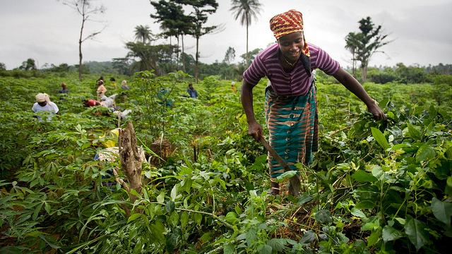
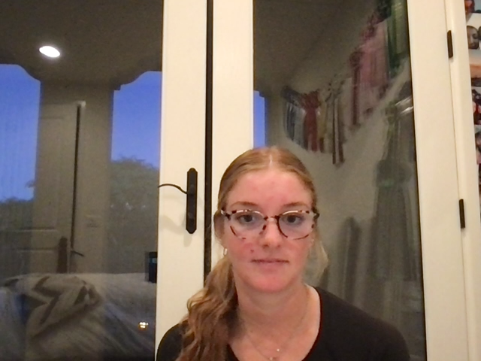
The Boy Who Harnessed the Wind: Chapter 7
William accepts that he must attend the secondary school in his village. He walks to school with Gilbert, who also attends. While his parents constantly work, they were informed school fees were due. William knew his parents were not able to pay. His father told him, “next year will be better”.
This Photo by Unknown Author is licensed under CC BY

Slide 2
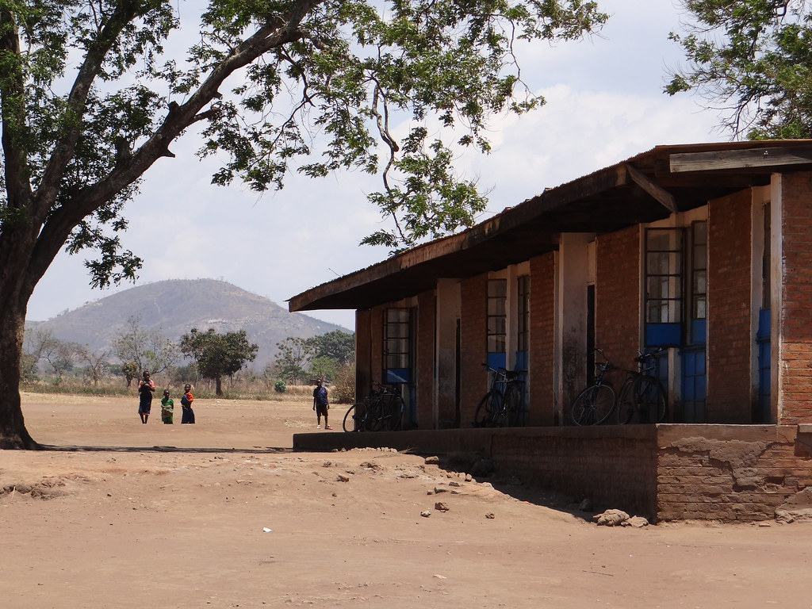
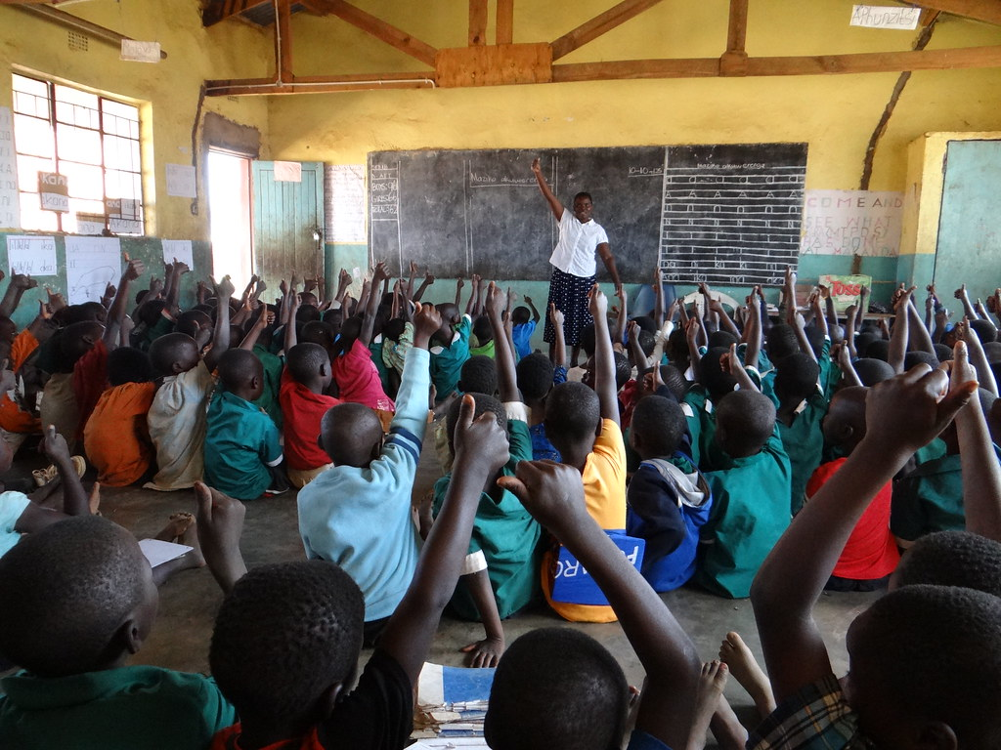
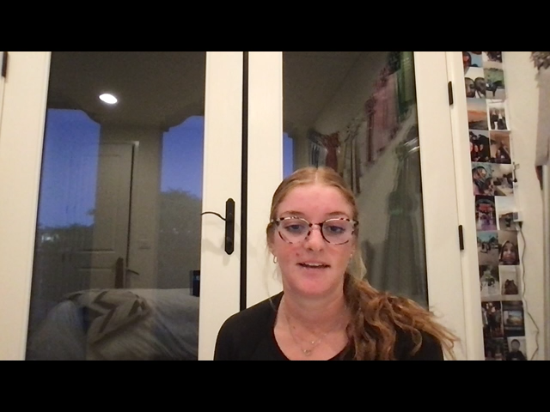
“That’s what I would do, I decided. I’d study and become the best student at this village school, then take my JCE exam and impress them all.” (56)
The disappointment William felt when he first saw his results was heart breaking. After he waited so long and didn’t get what he wanted, he instantly came up with a plan. Although Michael, bullied him for getting into a “bad school”, that gave him the motivation to get where he wanted to go. His resilience is shown clearly in this situation, he does not want to give up on his dreams and will do whatever it takes to get there one day.
This Photo by Unknown Author is licensed under CC BY-NC-ND
This Photo by Unknown Author is licensed under CC BY-NC-ND

Slide 3
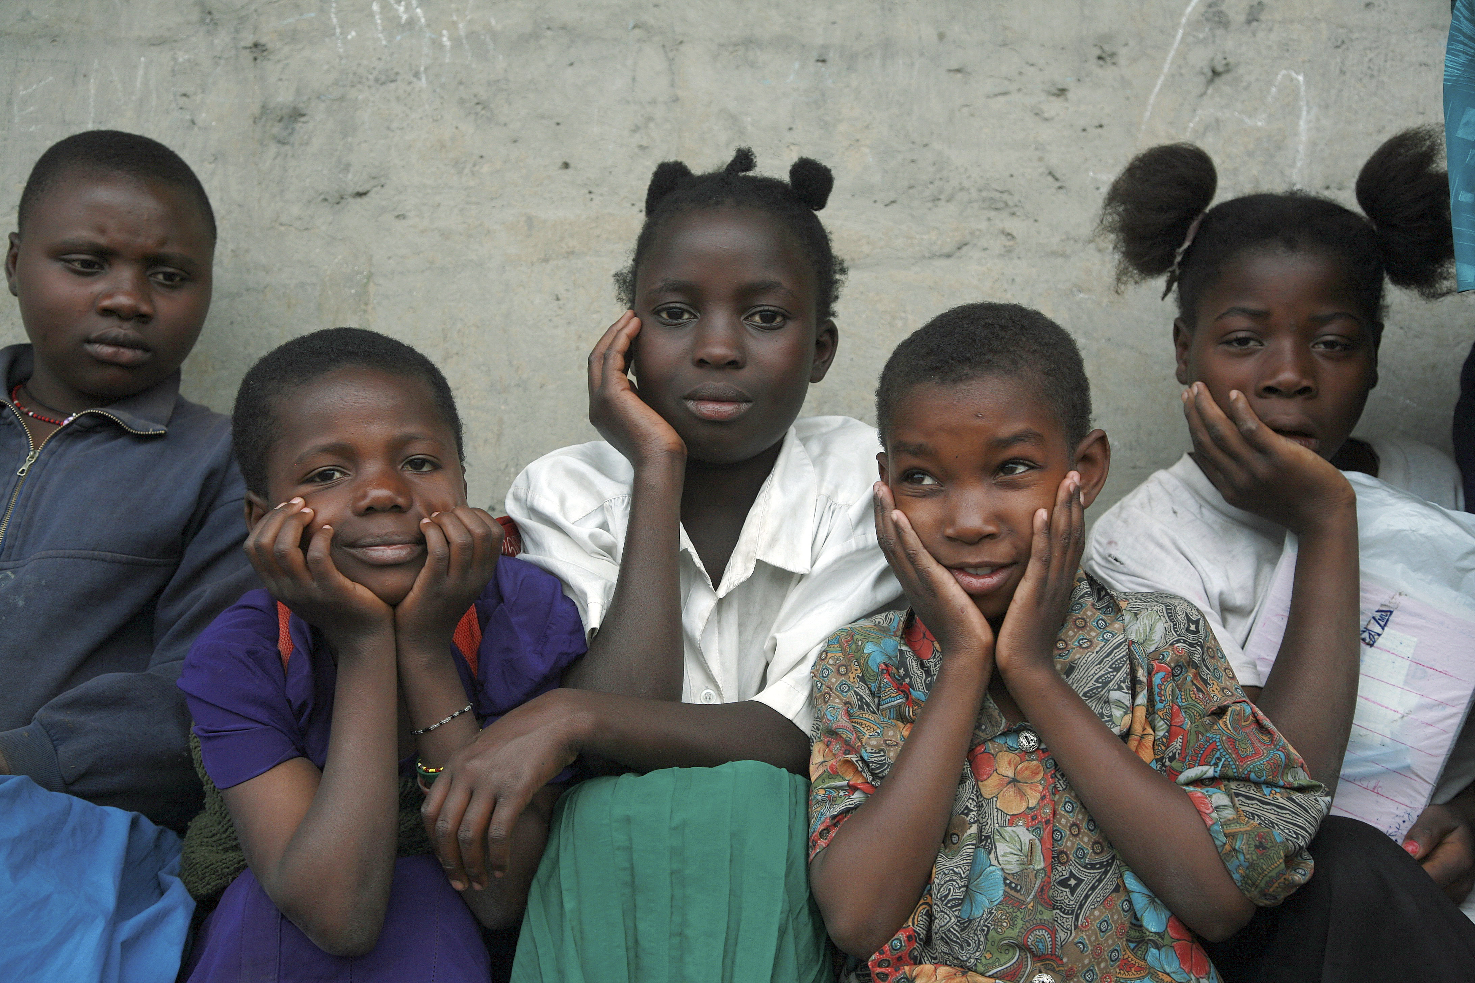
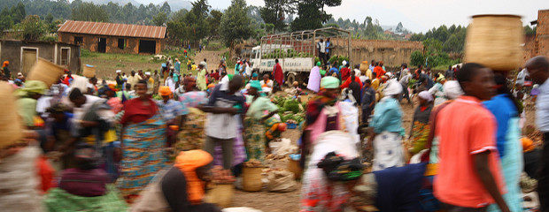
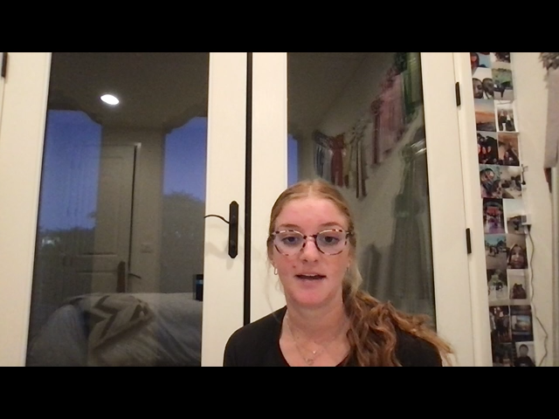
“My own problems didn’t seem so important; the hunger belonged to the entire country. I decided to put faith in my father’s word, that once we made it through the hunger, everything would be okay.” (58)
William came to realize that he was not go to be able to attend school. While listening to his father’s words, he also realized there were bigger problems within his community. People were starving. He accepted this and chose to work towards helping his community rather than being upset about his personal situation.
This Photo by Unknown Author is licensed under CC BY-SA-NC
This Photo by Unknown Author is licensed under CC BY-SA-NC

Slide 4
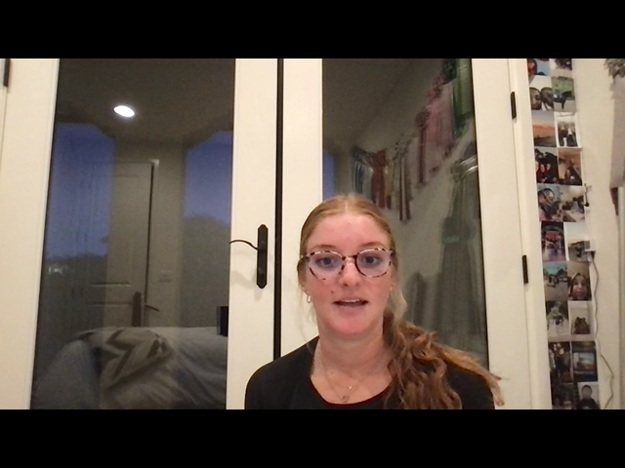
Class Discussion
Many of us jump to conclusions after hearing or receiving something we did not want to. Myself included, we tend to think of the negative in situations rather than thinking of the possible outcome or what we could do to better the situation. After receiving news you didn’t like, are you more likely to accept the negative outcome or move on, try and improve and better yourself from the situation? Why do you think you do what you do?
Thank you!!

